Slide 1
Evaluating FLASH and Conventional radiation response on brain-resident microglia
Vinoshene Pillai Rajan
Institute of Neuroscience, CNR Pisa

Slide 2
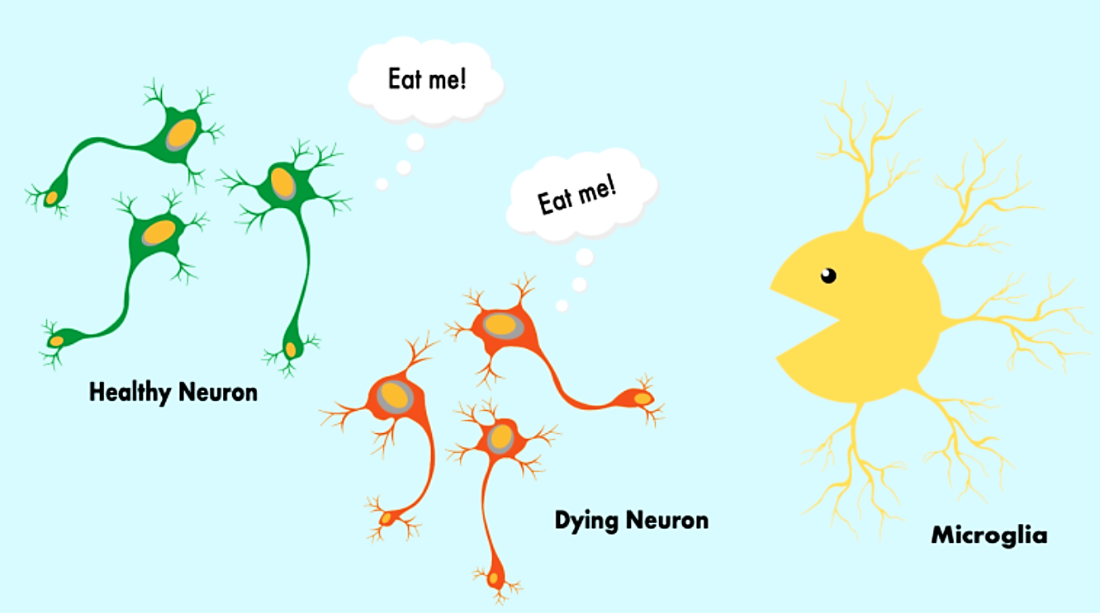
What do microglia do
in the brain?
Immune cells that makes up to 10% of all brain cells
Fighting off infections
Maintenance of neuronal functions
Phagocytosis
Cellular waste
Germs, like bacteria and viruses
Dead cells
https://sitn.hms.harvard.edu/flash/2023/are-microglia-the-hero-or-the-villain-in-alzheimers-disease/

Slide 3
What do microglia do
in the brain?
Foreign particles or threat can trigger microglial inflammation
Microglial release pro-inflammatory molecules to fight it off
If inflammation persists
Attacks healthy neurons
Affects neuroplasticity, memory impairment and cognitive decline
https://sitn.hms.harvard.edu/flash/2023/are-microglia-the-hero-or-the-villain-in-alzheimers-disease/

Slide 4
What do microglia do
in the brain?
Radiation perturbs homeostatic microglial function
https://sitn.hms.harvard.edu/flash/2023/are-microglia-the-hero-or-the-villain-in-alzheimers-disease/

Slide 5
Hypothesis
Effect of FLASH radiation therapy (FLASH-RT) on brain resident microglia is unknown
FLASH-RT demonstrates minimized microglial disruption compared to Conventional radiotherapy (CONV-RT)
Notes:
Tissue sparing is the ability to save healthy tissue

Slide 6
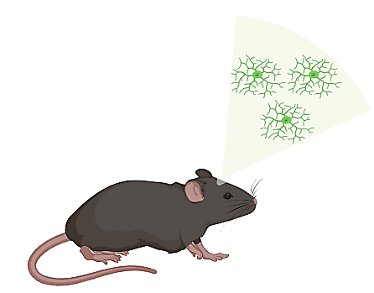
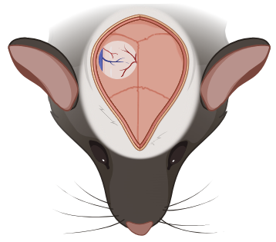
Experimental Pipeline
15 Gy
Longitudinal in vivo two photon
imaging of cortical microglia
Cx3CR1-eGFP
mice
Week -2
Day 0
Week 1
Week 2
Week 3
Week 4
Week 8
In collaboration with Simona Capsoni
Notes:
Mice was given by simona capsoni

Slide 7
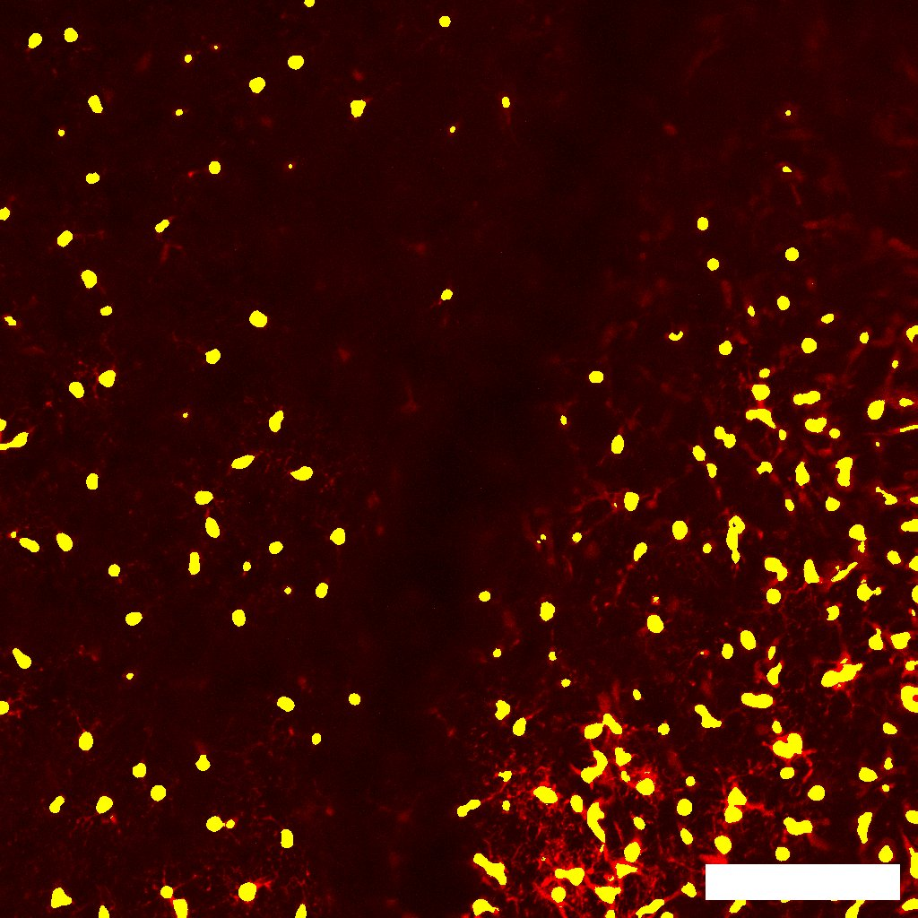
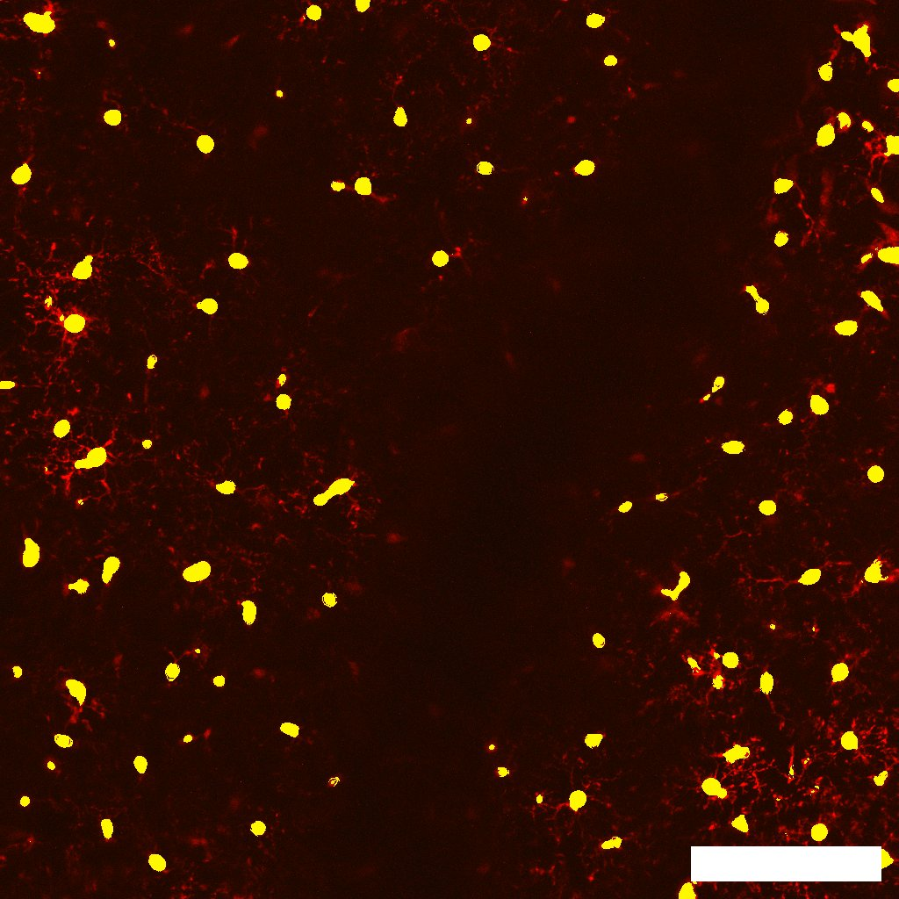
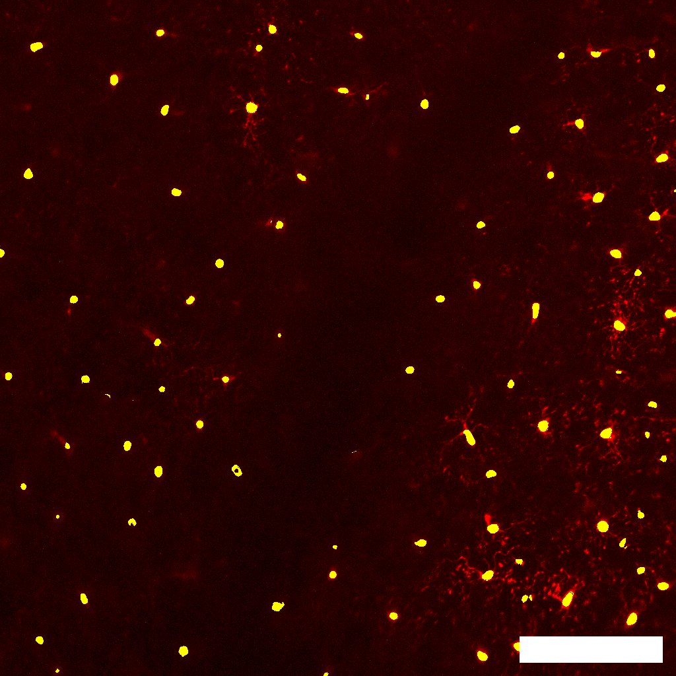
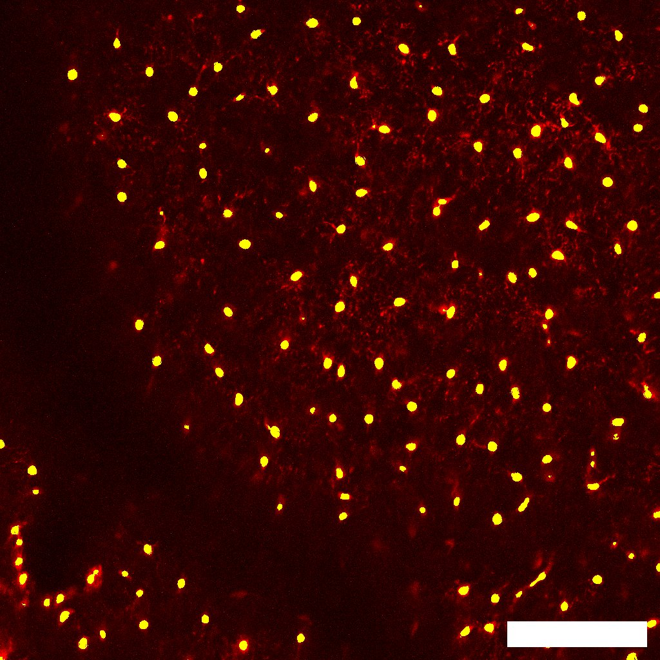
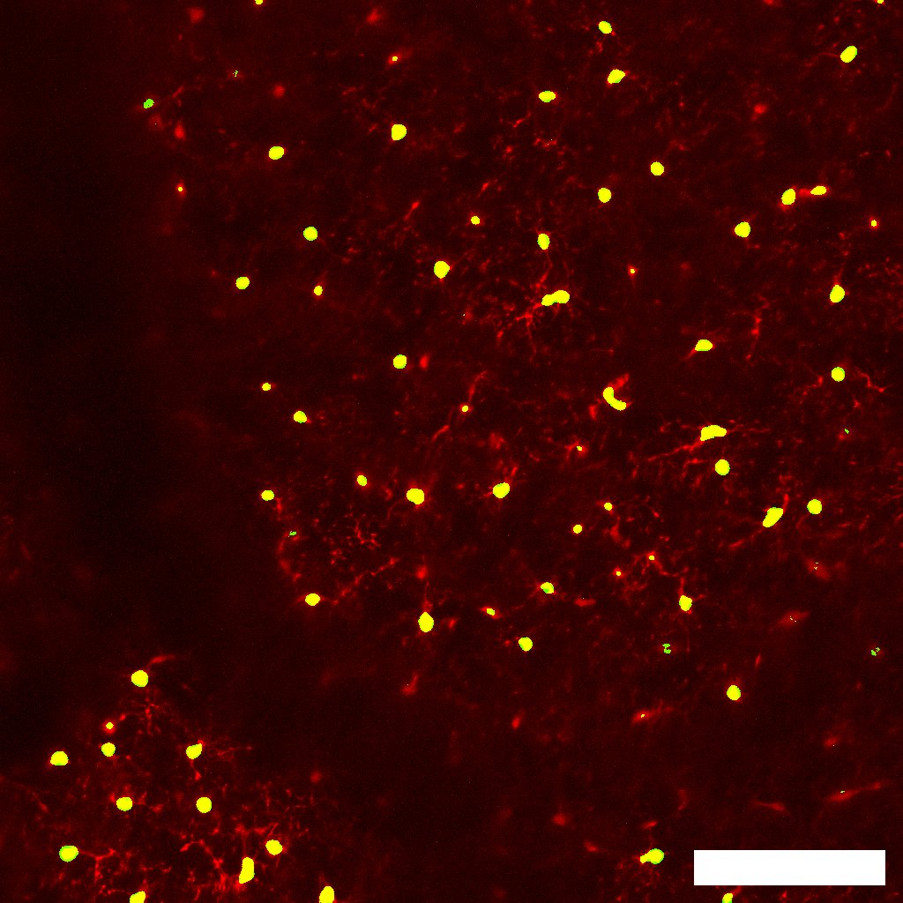
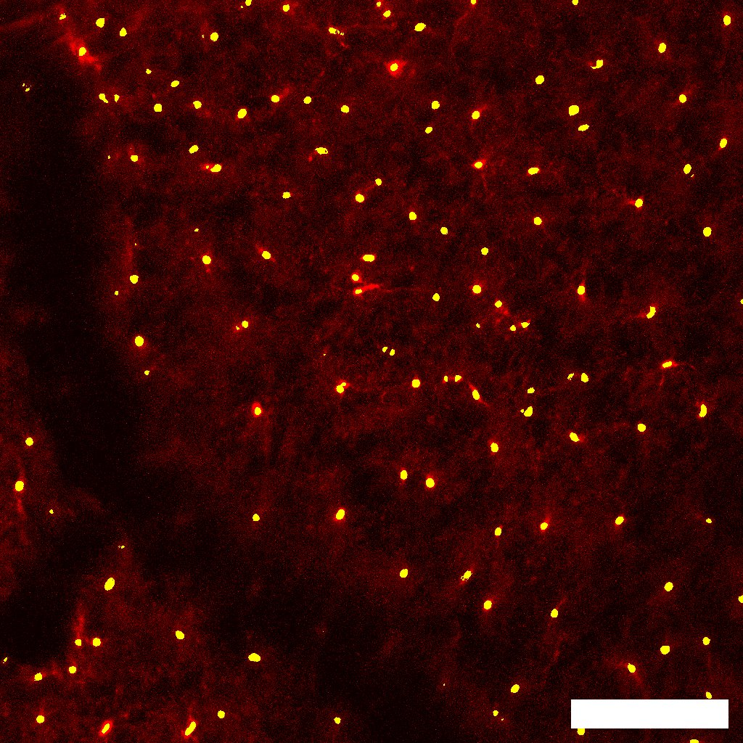
Preliminary results
Day 0: Pre-radiation
Week 2
Week 4
CONV-RT
FLASH-RT

Slide 8
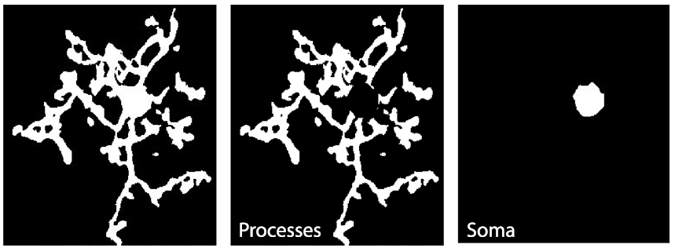
Preliminary results
Area (µm²)
Aspect ratio:
$$AR=\frac{major axis}{minor axis}$$

Slide 9
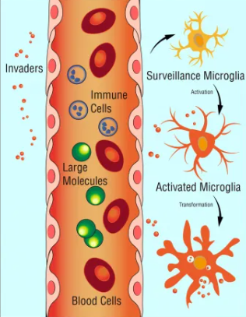
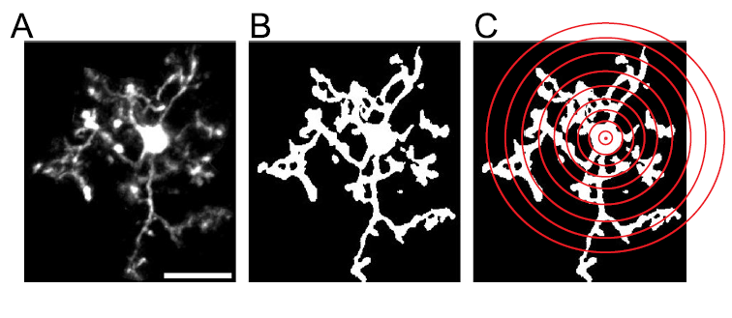
Future analysis
Sholl analysis
Number of processes/intersections
Microglia processes make dynamic, physical contacts with different components
of their environment to monitor the functional state of the brain

Slide 10
Summary
FLASH-RT induced lower % of cell loss and did not significantly affect microglia soma size compared to CONV-RT demonstrating its tissue sparing effect
Future perspective
Increase number of animals
Additional analysis of collected data
Possibility of performing immunohistochemistry on collected brains slices against marker for activated microglia (CD68..)

Slide 11
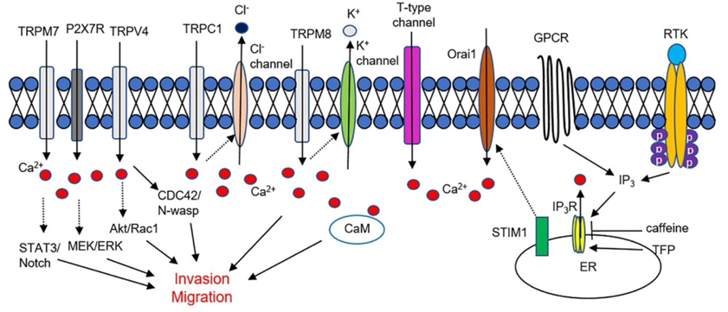
Parallel experiment:
In vivo Ca²⁺ imaging
of murine GBM (GL261)
Intracellular Ca²⁺ elevation from ER and extracellular region affects glioma cell migration and invasion. Ca²⁺ influx through TRP channels, P2X7Rs, and t-type Ca²⁺ channels are critically involved in glioma cell infiltration.

Slide 12
Experimental pipeline
Injection of murine GBM cells (GL261) expressing Ca²⁺ sensor (GCaMP6s) into the occipital cortex
Longitudinal in vivo two photon
calcium imaging
15 Gy
+
MRI
MRI
MRI
Week -2
Day -2
Day 0
Week 1
Week 2
Week 3
Week 4
In collaboration with Alessandra Flori & Gian Michele Ratto

Slide 13
Experimental pipeline
Injection of murine GBM cells (GL261) expressing Ca²⁺ sensor (GCaMP6s) into the occipital cortex
Longitudinal in vivo two photon
calcium imaging
15 Gy
+
MRI
MRI
MRI
Week -2
Day -2
Day 0
Week 1
Week 2
Week 3
Week 4

Slide 14
Preliminary MRI images
2 days before
irradiation
1 week post irradiation
1 month post irradiation
CONV-RT
FLASH-RT

Slide 15
Preliminary MRI images
2 days before
irradiation
1 week post irradiation
1 month post irradiation
Survival curve
CONV-RT
FLASH-RT
(n=6 mice)

Slide 16
What’s next
Establish a working protocol for the continuation of this experiment
Increase number of animals
Analysis of Ca²⁺ imaging data

Slide 17
Silvia Landi
Gabriele Sansevero
Alessandra Flori
Simona Capsoni
Gian Michele Ratto
Luigi Masturzo
Andrea Cavalieri
Fabio Di Martino
Fabiola Paiar
Simone Capaccioli
Mario Costa

Slide 20
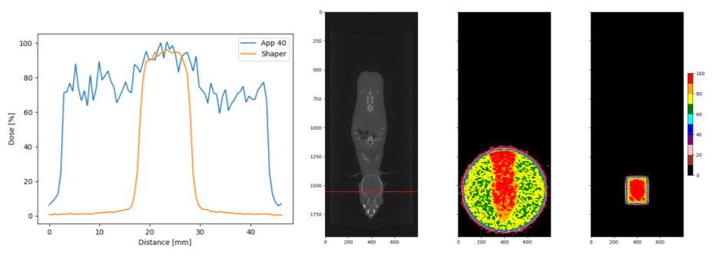
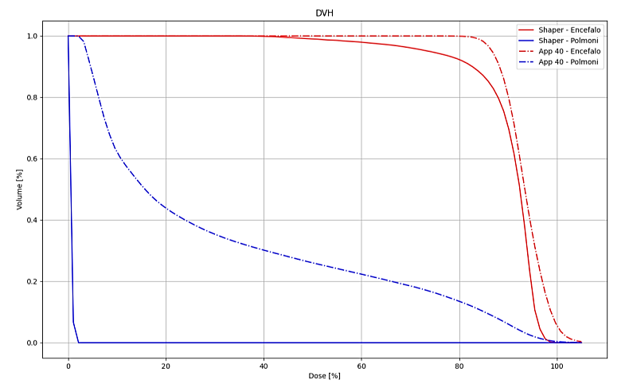
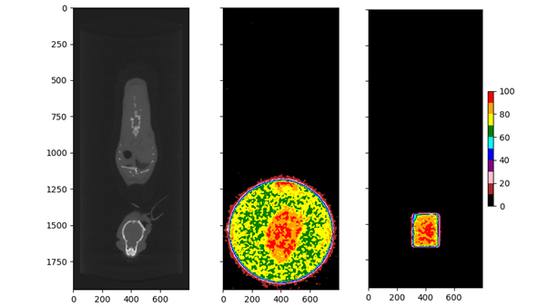
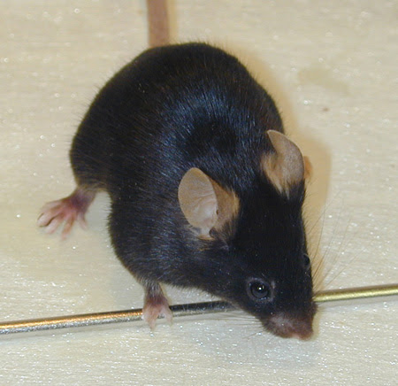
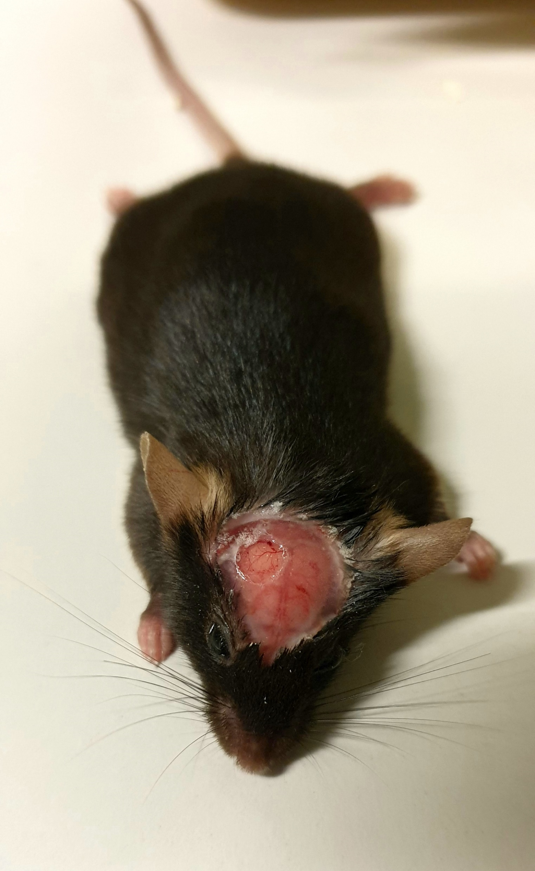
(a) Dose maps: 4cm applicator, 1.3x1cm2 shaper; (b) Dose profile (see red dashed line); (c) Dose-volume histogram
a
b
c
Without cranial window
With cranial window

Slide 21
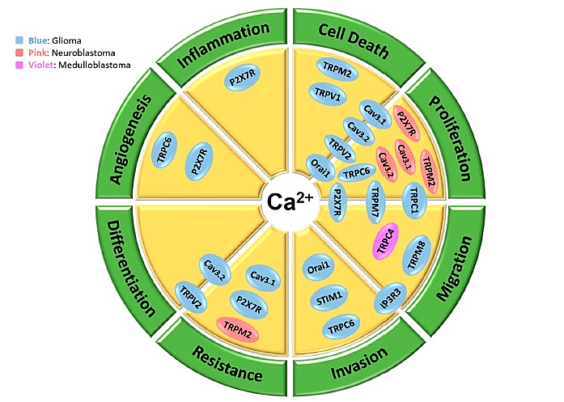
Calcium (Ca²⁺)
Secondary messenger involved in a variety of cellular processes
Calcium signalling in brain cancer:
Alterations in Ca²⁺ signalling can trigger tumorigenic behavior
Prolonged Ca²⁺ pulses are involved in uncontrolled cell divison, angiogenesis, differentiation and genomic instability in cancer cells
Maklad, A. et al. (2019). Cancers
Prevarskaya, N. et al. (2013). Expert Opin. Ther. Targets
Parkash, J. et al. (2010). Life Sci

Slide 22
Clinical trials
Interventions | Channel/ Pump Targeted | Type/ Stages of glioma | Clinical Trial Phase | Study end year | Outcomes | NCT#
CAI + Radiation | Non-voltage sensitive channels | Newly diagnosed GBM | II | 2010 | CAI can be safely administered with cranial irradiation but there were no significant efficacy on patients | 00004146
Mipsagargin | Serca pumps | Recurrent or progressive GBM | II | 2017 | Acceptable tolerability and favorable pharmacokinetic profile | 02067156
Mibefradil + Temozolomide | T-type channels | Recurrent Glioma | I | 2017 | Well tolerated and promising responses in patients | 01480050
Mibefradil + Hypofractionated radiation | T-type channels | Recurrent Glioma | I | 2017 | Safe co-administration with RT, effective brain penetration and promising response in a selection of patients | 02202993
CTO + Temozolomide or chemoradiation | Non.voltage sensitive channels | GBM and other anaplastic gliomas | I | Ongoing | Acceptable safety profile, favorable brain penetration and promising response in difficult-to-treat patients | 01107522
Levetiracetam + Temozolomide + Chemotherapy | Partial bloackade of N-type currents | Newly diagnosed GBM | II | Ongoing | Survival benefits in patients | 02815410
ST101 channels | T-type channels | Recurrent or progressive GBM and other solid tumor | I-II | Ongoing | No results available as the study started recently on July 2020 | 04478279

Slide 23
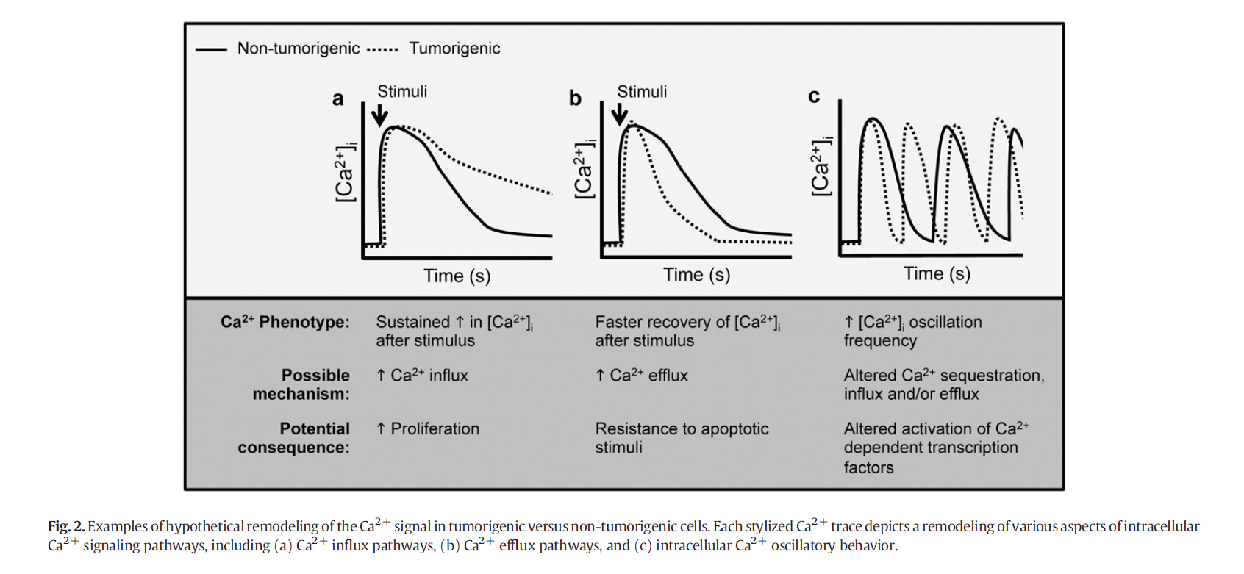
Altered calcium signaling in cancer cells
Cancer cell remodels Ca²⁺ signals in order to promote tumor progression and alter disease state
Elucidating such information would improve our understanding of the mechanisms underlying cancer progression, and may further help to identify molecular targets

