Slide 1
Towards the clinical applications of Flash Radiotherapy.
An overview of the 1.5.4/1.5.8 deliverables.
A. Cavalieri^{1,2,3}, M. Celentano^{1,2,4}, L. Masturzo^{1,2}, J.H. Pensavalle^{1,2}, F. Di Martino^{1,5}
1) Centro Pisano ricerca e implementazione clinica Flash Radiotherapy (CPFR@CISUP), Pisa Italy.
2) Department of Physics, University of Pisa, Largo B. Pontecorvo 3, Pisa, Italy
3) Center for Instrument Sharing of the University of Pisa (CISUP), University of Pisa, Pisa, Italy.
4) National Institute of Nuclear Physics (INFN), Section of Pisa, Pisa, Italy
5) Unit of Medical Physics, Pisa University Hospital “Azienda Ospedaliero-Universitaria Pisana” Pisa, Italy

Slide 2
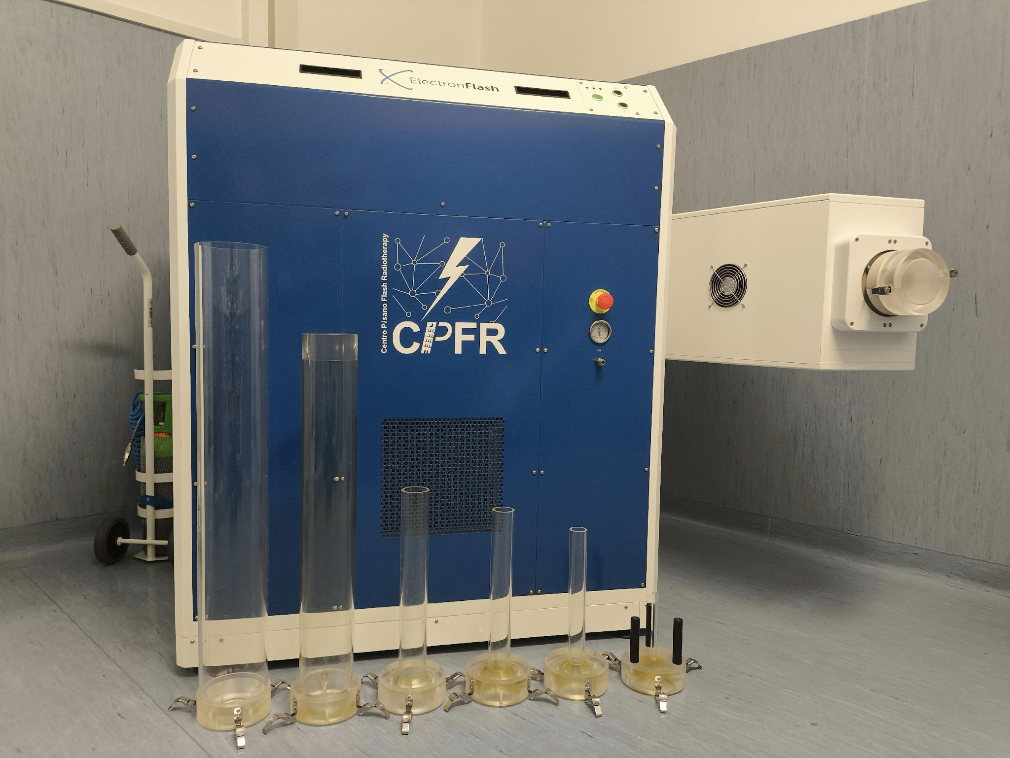

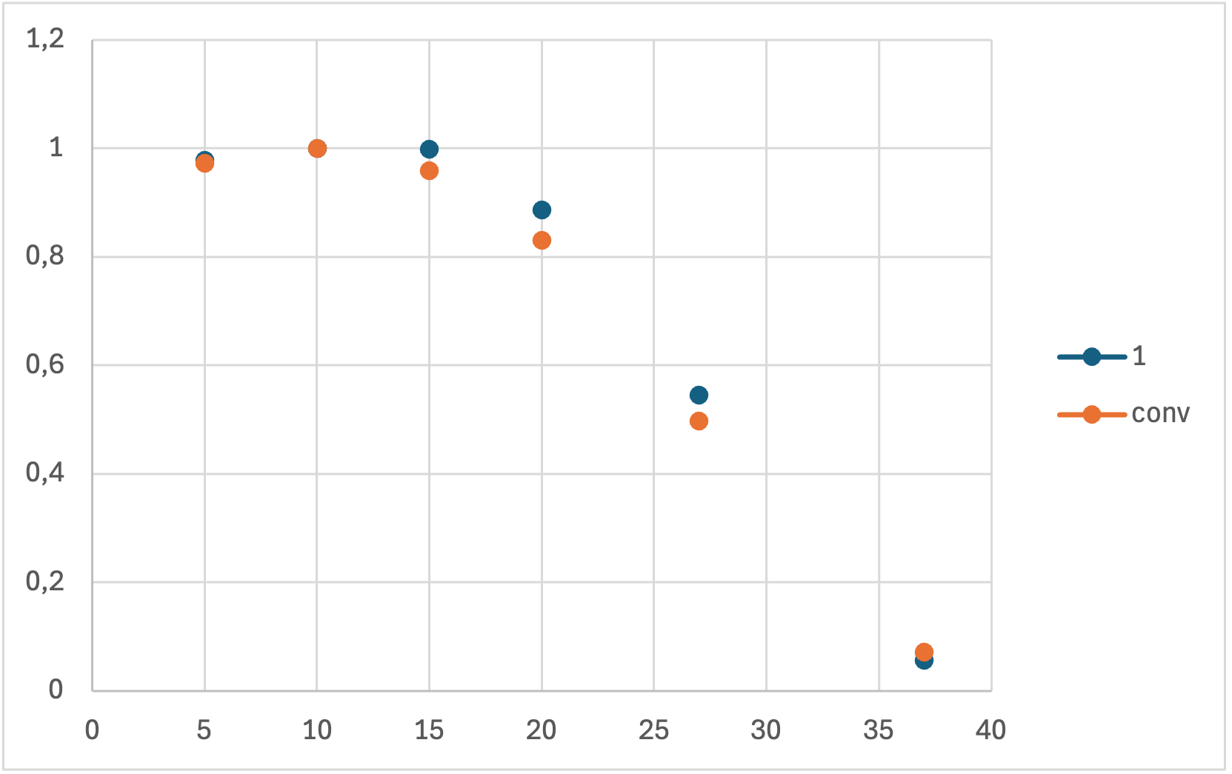
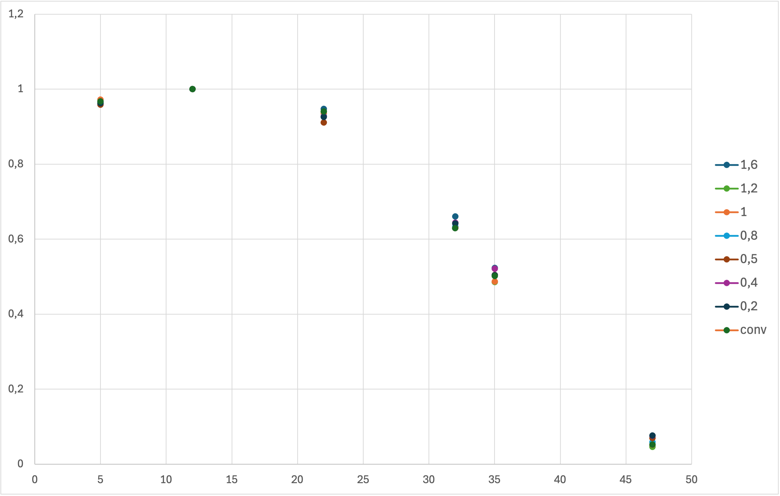
Towards the clinical applications of Flash Radiotherapy : technological challenges
Beam profile for each applicator
PDD 7 MeV
PDD 9 MeV
ElectronFlash [1]
Triode-gun-based linac
Electron beam energy 7, 9 MeV
Passive collimation
Same energy spectrum for Conv and FLASH regime.
Independent parameters: D_{p,} ADr, Idr , PRF, 𝛕.
Each work point has the same energy spectrum

Slide 3
Towards the clinical applications of Flash Radiotherapy : technological challenges
ElectronFlash is not a clinical linac!
For clinic:
-Additional beam collimation system
-Dosimetric characterization
-TPS
PDD 7 MeV
PDD 9 MeV
ElectronFlash [1]
Triode-gun-based linac
Electron beam energy 7, 9 MeV
Passive collimation
Same energy spectrum for Conv and FLASH regime.
Independent parameters: D_{p,} ADr, Idr , PRF, 𝛕.

Slide 4
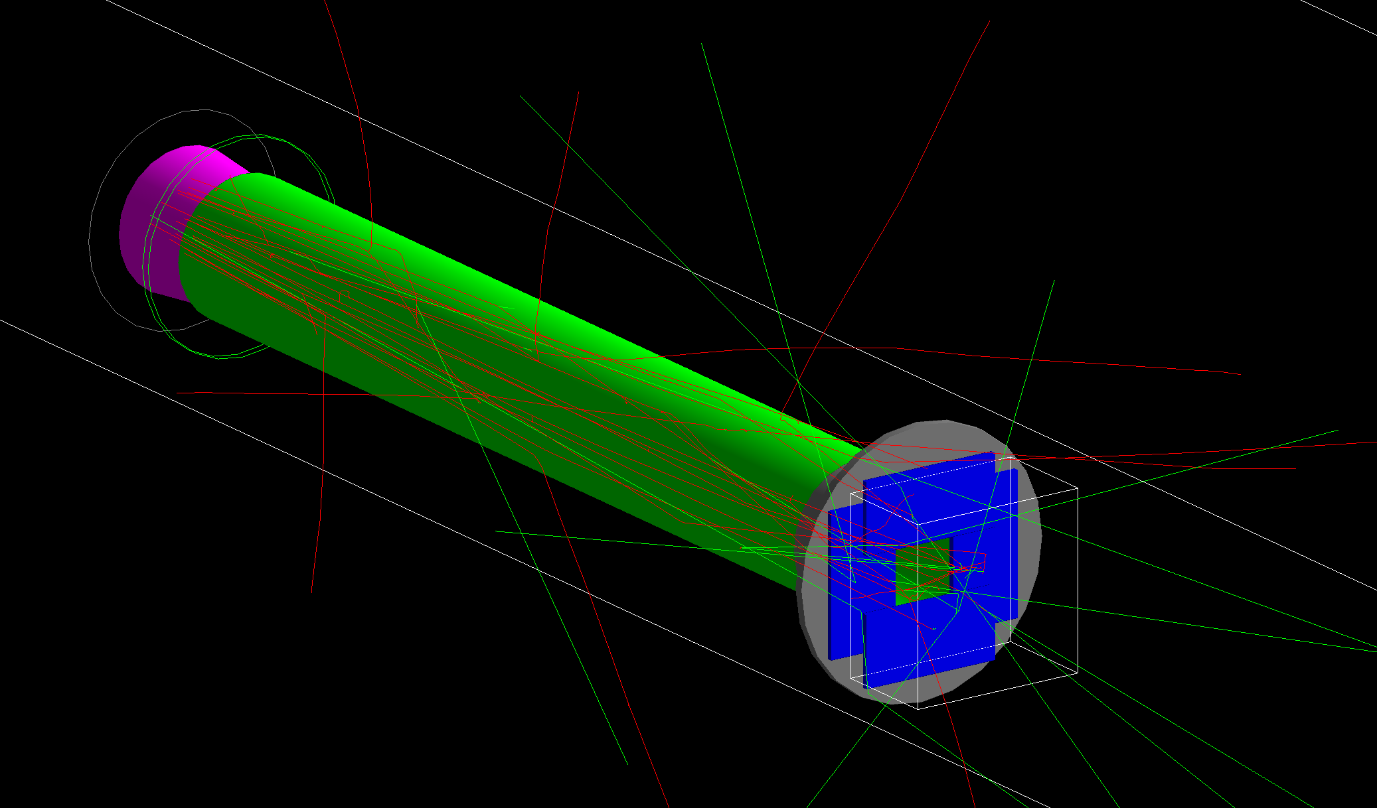
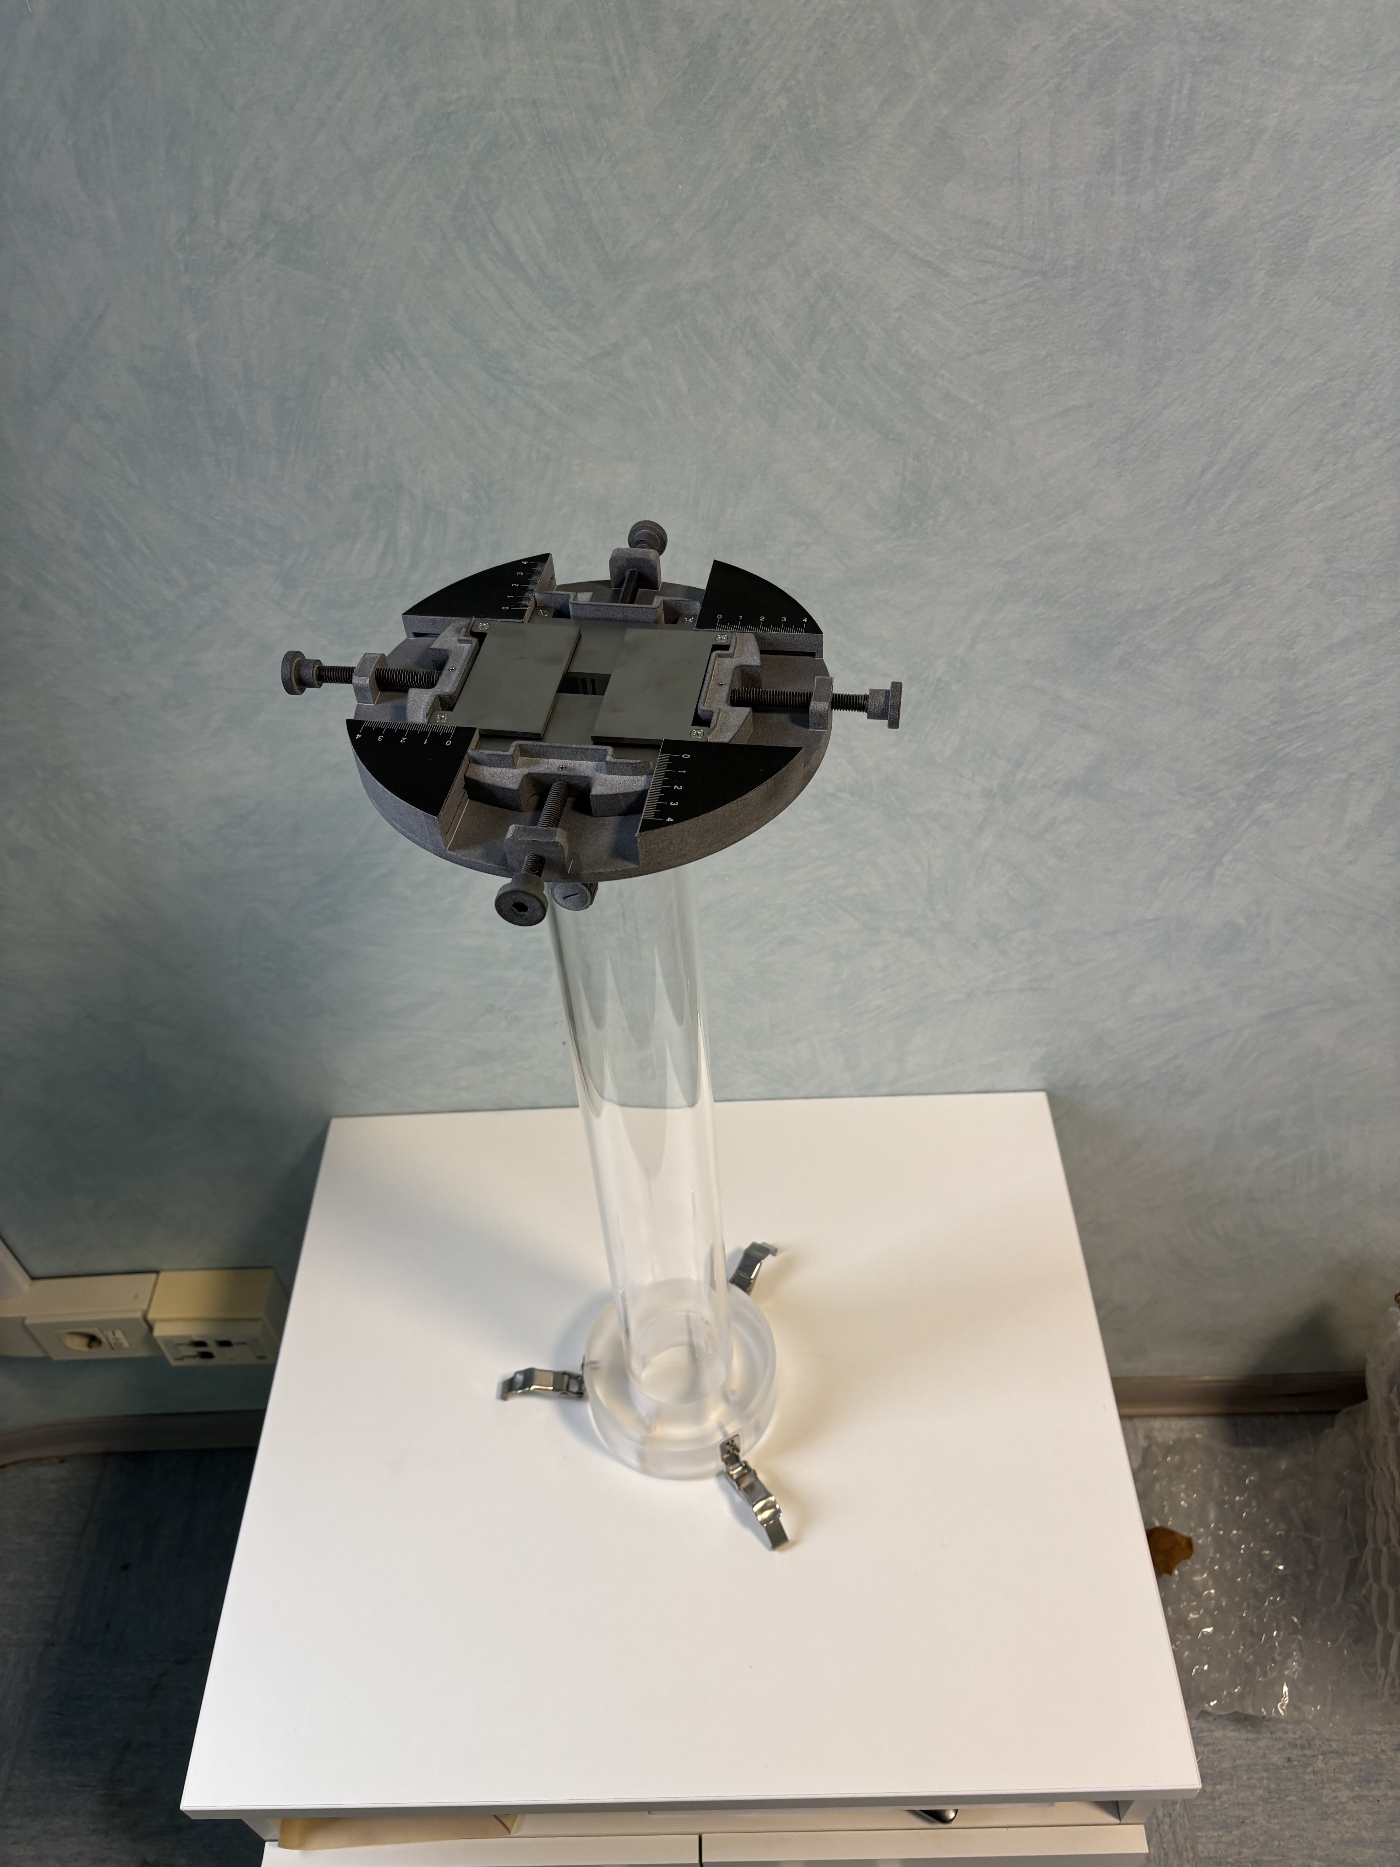
Technological challenges: beam shaping devices
Simulation of the beam shaper device mounted on the 70 mm ø applicator
This shaper device does not alter the main beam parameters.
The characterization of the 70 mm ø applicator and the beam shaper device are still in progress…

Slide 5

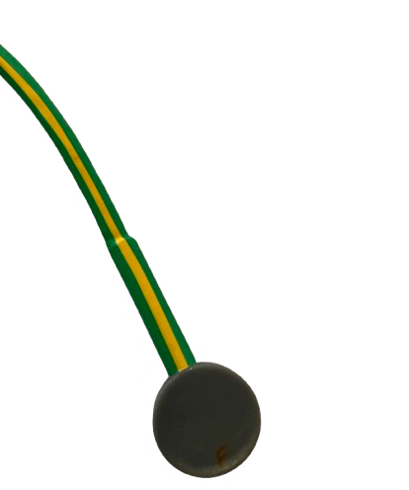

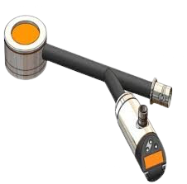
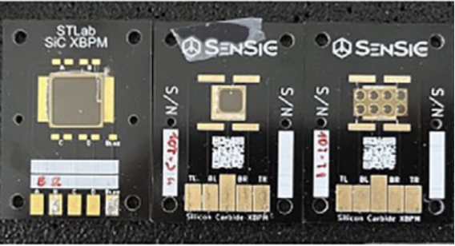
Dosimetric challenges
Active dosimeters
ALLS chamber [2]
Advanced Markus chamber
Calorimeter
FlashDiamond [3]
SiC [4]
Passive dosimeters
Alanine
Gafchromic films [5]

Slide 6
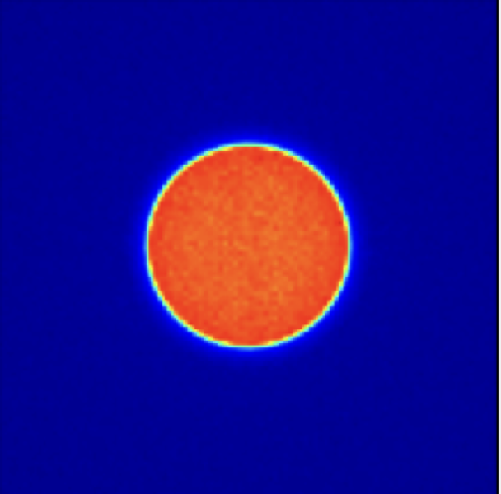
Monte Carlo simulation of the dose distribution in water of EF (ElectronFlash) beams: simulation validation
Example of simulations of PDDs and beam profiles obtained using Gate (Geant4), compared with the experimental data.

Slide 7
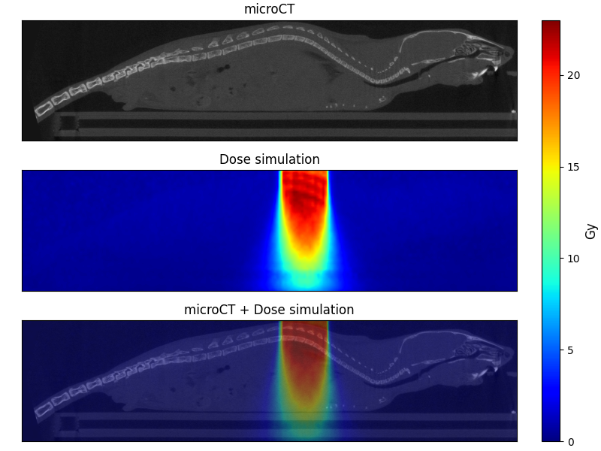
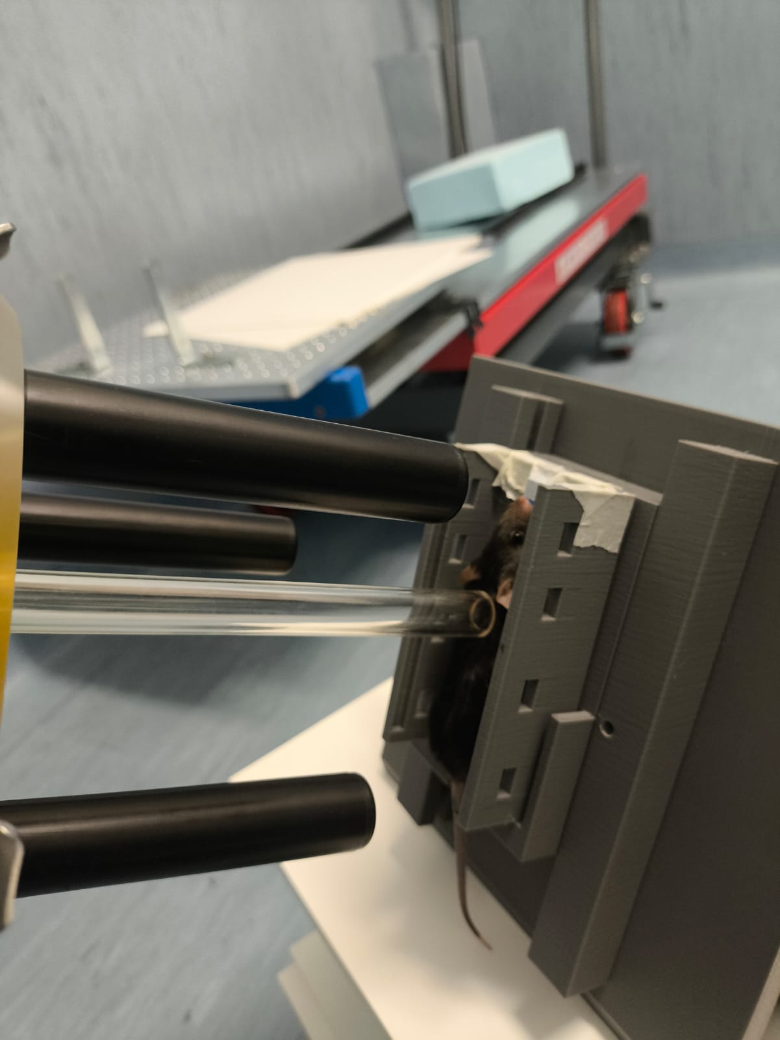
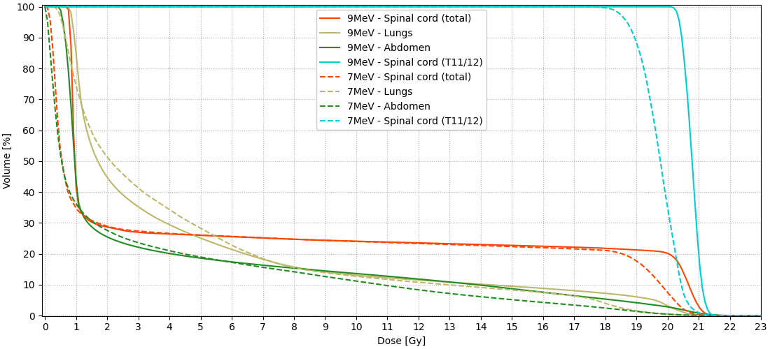
Monte Carlo simulation of the dose distribution in water of EF (ElectronFlash) beams: in-vivo experiments
Example of pre-clinical set-up for the spinal cord irradiation experiment.
Dose maps obtained through Monte Carlo simulation and corresponding DVHs based on microCT imaging

Slide 8
Patient dose distribution evaluation CT based: TPS
Optimization based on the leaves opening and the dose distribution
Simulated lesion
DVHs for different leaves configurations

Slide 9
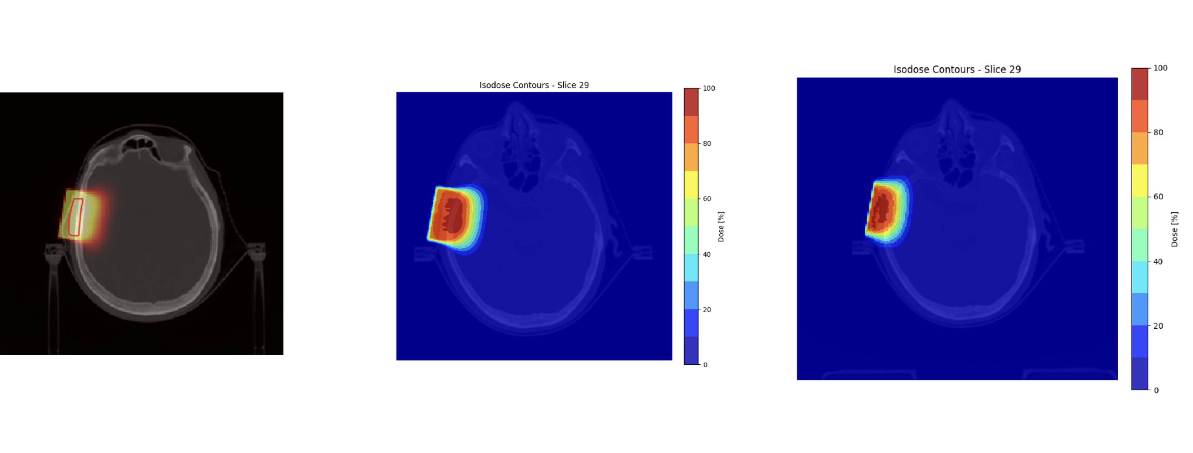
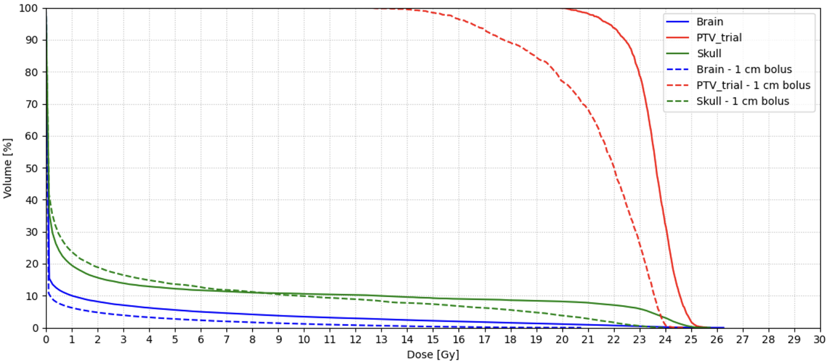
Patient dose distribution evaluation CT based: TPS
TPS obtained with in-house simulations.
In the optimization phase, we can also account for water-equivalent bolus.
In this tool will be implemented the experimental FLASH modifying functions that model the FLASH sparing.

Slide 10
Towards the clinical applications of Flash Radiotherapy: ULISSE clinical trial
ULISSE (ultra-high dose-rate fraction for squamous and basal skin cancer) is the first italian clinical trial on FLASH-RT. The main features of the study are:
T1 type tumors (dermatologic treatement)
Maximum lesion dimension: ~4 cm
Total dose in a single fraction of 22.5 Gy with a prescription to the 90% isodose in both FLASH and conv modalities.
Electron beam energy: 7/9 MeV for both FLASH and conv modalities.

Slide 11
Conclusions
We identified the reference applicator (∅ 100 mm) and the reference conditions using both passive and active dosimeters
Our planning system is based on Monte Carlo simulations validated using a water phantom and it is based on PTV coverage optimization. Additionally, we developed a beam shaper device to further optimize the PTV coverage without affecting the beam dosimetric parameters
Our planning system is used to calculate the key beam parameters to use in FLASH irradiations. Once obtained the experimental thresholds (functions) that describe the FLASH sparing effect, we can incorporate them into the evaluation of DVHs to obtained the RBE-weighted DVHs.

Slide 12
Thanks for your attention
We thank Fondazione Pisa for funding CPFR with the grant “prog. n. 134/2021”
This work was funded by Piano Nazionale di Ripresa e Resilienza (PNRR), Missione 4, Componente 2, Ecosistemi dell’Innovazione–Tuscany Health Ecosystem (THE), Spoke 1 “Advanced Radiotherapies and Diagnostics in Oncology”—CUP I53C22000780001

Slide 13
Bibliography
[1] F. Di Martino et al. Architecture, flexibility and performance of a special electron linac dedicated to Flash radiotherapy research: electronFlash with a triode gun of the centro pisano flash radiotherapy (CPFR). Frontiers in Physics, 11, 1268310.
[2] F. Di Martino et al. A new solution for uhdp and uhdr (flash) measurements: Theory and conceptual design of alls chamber. Physica Medica, 102:9–18, 2022.
[3] M. Marinelli et al. Design, realization, and characterization of a novel diamond detector prototype for flash radiotherapy dosimetry. Medical Physics, 49(3):1902–1910, 2022.
[4] F. Romano et al.l. First characterization of novel silicon carbide detectors with ultra-high dose rate electron beams for flash radiotherapy. Applied Sciences, 13(5):2986, 2023.
[5] D. Del Sarto et al. A systematic investigation on the response of EBT-XD gafchromic films to varying dose-per-pulse, average dose-rate and instantaneous dose-rate in electron flash beams. Frontiers in Physics 2024

