Slide 1
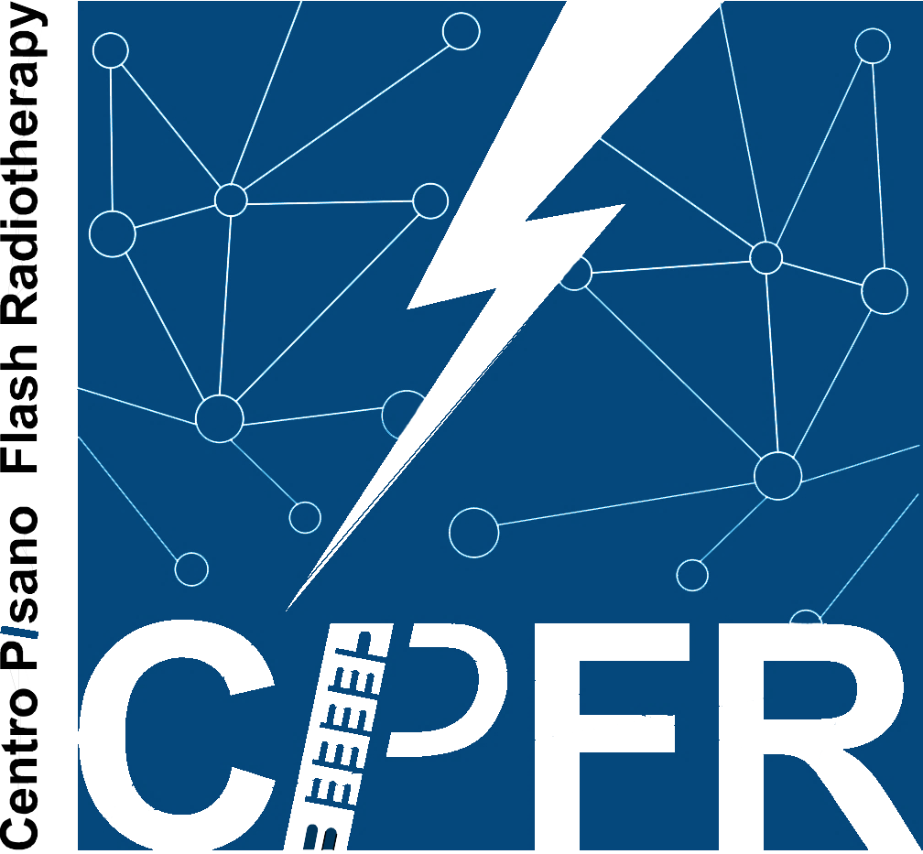
Preliminary evaluation of FLASH electron radiotherapy in the treatment of uveal melanoma
M. Celentano^{1,2,4,6}, T. Fuentes³, J. H. Pensavalle^{1,4,6}, A. Giuliano⁶, C. Scapicchio^{1,2}, A. Retico^{1,2}, L. Masturzo^{1,4,6}, A. Cavalieri^{1,4,5}, F. Paiar^{3,4}, F. Di Martino^{4,6}
University of Pisa, Physics Department “E. Fermi”, Pisa, Italy;
INFN, Pisa Section, Pisa, Italy;
Department of Translational Research and New Technologies in Medicine and Surgery, University of Pisa, Pisa, Italy;
Centro Pisano Multidisciplinare Sulla Ricerca e Implementazione Clinica Della Flash Radiotherapy (CPFR), University of Pisa, Pisa, Italy;
Center for Instrument Sharing of the University of Pisa (CISUP), University of Pisa, Pisa, Italy;
Azienda Ospedaliero-Universitaria Pisana, U.O. Fisica Sanitaria, Pisa, Italy.

Slide 2
Introduction
FLASH radiotherapy (FLASH-RT) is a novel treatment modality based on Flash effect [1]:
Ultra-high dose rate (≥ 40 Gy/s)
Total irradiation time < 200 ms
Protective effect on normal tissues compared with conventional irradiation
Isoefficacy on tumoral lesions
Adapted from [2]
AIM of this study:
$→$ verify the possibility of using low energy electron FLASH-RT as an alternative treatment modality for localized uveal melanoma
highly radioresistant
most common primary intraocular malignancy in adults [2]
Treatment options include [2]:
enucleation
plaque brachytherapy
stereotactic radiotherapy (SRS-RT)
particle therapy
1
Notes:
Flash radiotherapy is a novel treatment modality which uses the benefits of flash effect to cure the tumor while sparing the normal tissue around it.
The aim of this study is to verify the possibility of using Flash Radiotherapy as an alternative treatment method for localized uveal melanoma, a highly radioresistant tumor that constitutes the most common primary eye malignancy among adults.
Today, the most common treatment options include enucleation, plaque brachytherapy (which are highly invasive for the patient), stereotactic radiotherapy with photons and particle beam radiotherapy.

Slide 3
Introduction
FLASH radiotherapy (FLASH-RT) is a novel treatment modality based on Flash effect [1]:
Ultra-high dose rate (≥ 40 Gy/s)
Total irradiation time < 200 ms
Protective effect on normal tissues compared with conventional irradiation
Isoefficacy on tumoral lesions
Main steps of the project:
Dose distribution evaluation and optimization (Monte Carlo tool)
RBE voxel by voxel implementation + FLASH sparing effect
in vivo and in vitro experiments and/or literature data
Evaluation of the therapeutic potential of FLASH-RT compared to SRS-RT + development of a quantitative comparison tool based on dosiomics and advanced statistics
Adapted from [2]
AIM of this study:
$→$ verify the possibility of using low energy electron FLASH-RT as an alternative treatment modality for localized uveal melanoma
highly radioresistant
most common primary intraocular malignancy in adults [2]
Treatment options include [2]:
enucleation
plaque brachytherapy
stereotactic radiotherapy (SRS-RT)
particle therapy
1
Notes:
The main steps of this project are:
MonteCarlo validation and optimization of geometry
Implementation of RBE dose maps and flash sparing effect, using the results from in vivo and in vitro experiments
Evaluation of the therapeutic potential of Flash radiotherapy compared with stereotactic treatment al ready erogated on the patient. For that matter, a quantitative comparison using dosiomics and advanced statistics will be implemented

Slide 4
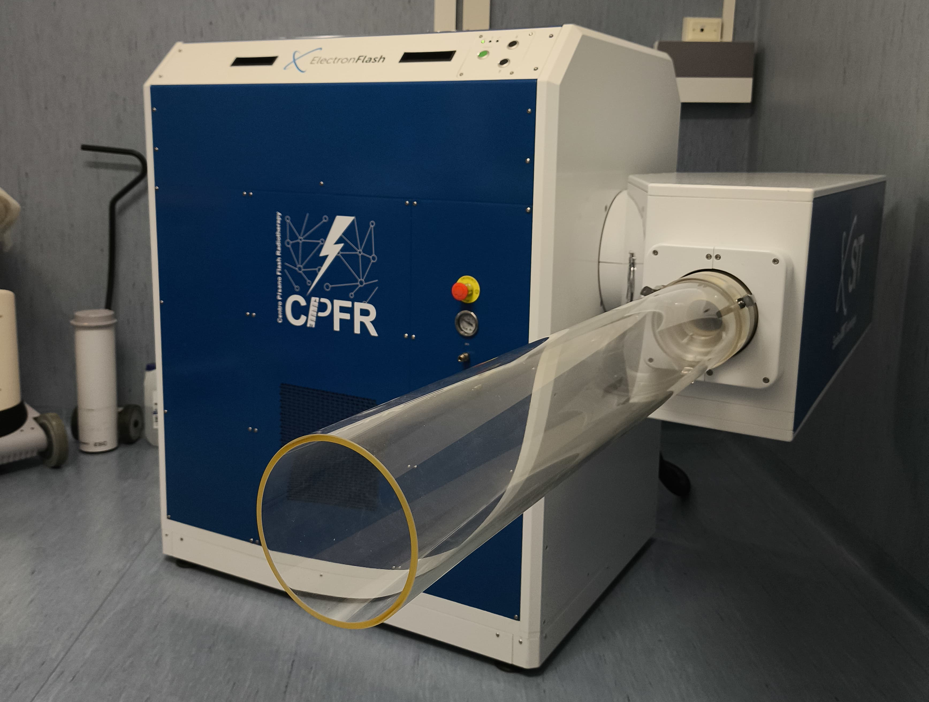
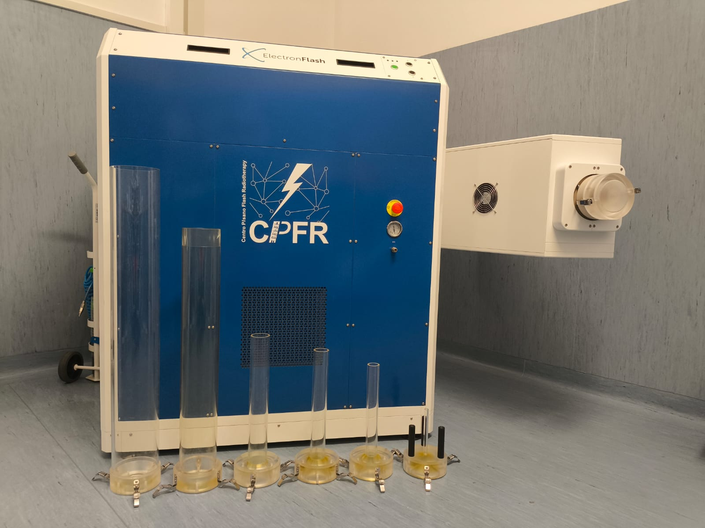
ElectronFlash
ElectronFlash (EF) research LINAC installed in Pisa A.O.U.P. - S. Chiara Hospital [3]
The system operates in electron mode only, with energies of 7 and 9 MeV [3]
The e-beam is collimated by means of a passive beam optics + tungsten shaper [3]
Independent parameters
e-beam current (mA)
Pulse time width (µs)
Dose-per-pulse (Gy)
Average dose-rate (Gy/s)
2
Notes:
All simulated treatments are planned using ElectronFlash, an electron LINAC based in Santa Chiara Hospital, in Pisa.
This system operated in electron mode only, with two possible energies of 7 and 9 MeV and a passive electron collimation through PMMA collimators, as shown in this photo.
This machine is really unique, as it enable the user to vary independently all beam parameters, such as the beam current, the pulse time width, the dose for each pulse and the dose rate.

Slide 5
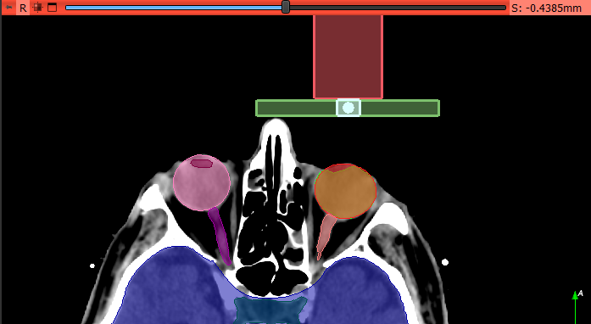
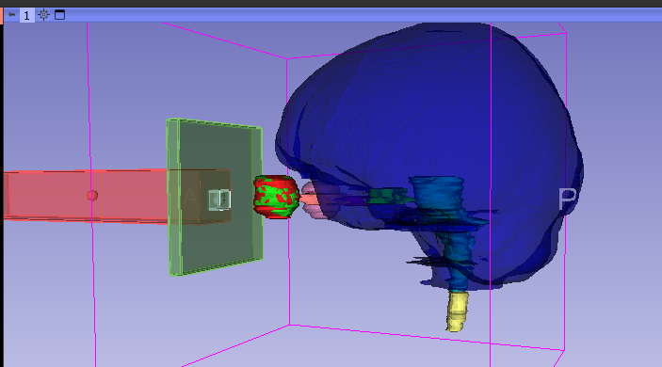
Simulations
EGSnrc Monte Carlo software
9MeV electron beam
∅30mm primary collimator (PMMA)
Tungsten shaper for further beam collimation
∅30mm applicator
Tungsten shaper with 10mm² central opening
Beam optics modelled in EGSnrc
Part of the setup has been already dosimetrically validated!
\\
\\
3
Notes:
The MonteCarlo software used for this study is EGSnrc, developed specifically for electron beams’ simulations.
Some of the fixed parametrs were:
9MeV beam energy, which covers deeper targets than 7MeV
PMMA collimator with 30mm diameter, because these targets are not wider than 3cm
Tungsten shaper in to further collimate the beam

Slide 6
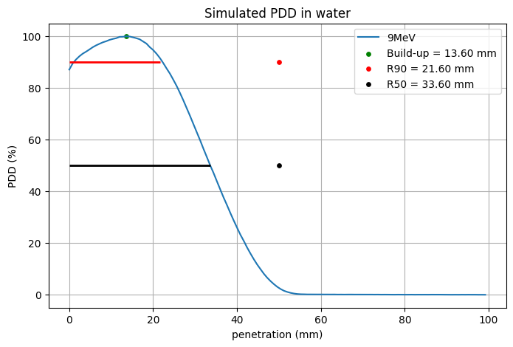
Simulations
EGSnrc Monte Carlo software
9MeV electron beam
∅30mm primary collimator (PMMA)
Tungsten shaper for further beam collimation
Target coverage with beam R90
limiting factor
∅30mm applicator
Tungsten shaper with 10mm² central opening
max target depth
Beam optics modelled in EGSnrc
Part of the setup has been already dosimetrically validated!
\\
\\
3
Notes:
Also, in the optimization phase we requested that the target was covered with at least the R90 (from the PDD curve). This represents the main limiting factor of this study, as the R90 for our 9MeV beam, without any further collimation, is 21mm.

Slide 7
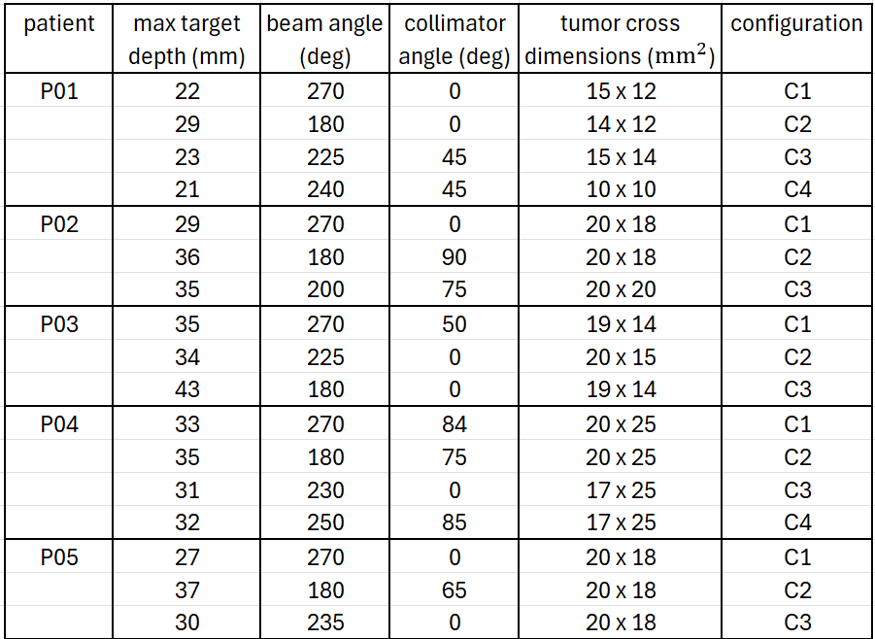
Patient’s CTs
Feasibility study
patient
tungsten shaper
clinical target
e-beam axis
4
Notes:
The patients for which we tired the optimization are listed in this table, with all the different configurations I tried. As you can see in this scheme, the beam is erogated in the air outside the patient and inclined with a certain beam angle towards the target.
Both tumor cross dimensions and maximum target depth are calculated along the beam axis and, as you can see, target depth range between 20 and 45 mm, well beyond the R90 of our 9MeV beam.

Slide 8
Patient’s CTs
Feasibility study
patient
tungsten shaper
clinical target
e-beam axis
4
Notes:
The patients for which we tired the optimization are listed in this table, with all the different configurations I tried. As you can see in this scheme, the beam is erogated in the air outside the patient and inclined with a certain beam angle towards the target.
Both tumor cross dimensions and maximum target depth are calculated along the beam axis and, as you can see, target depth range between 20 and 45 mm, well beyond the R90 of our 9MeV beam.

Slide 9
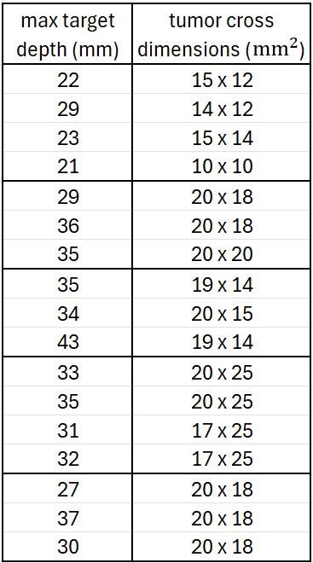
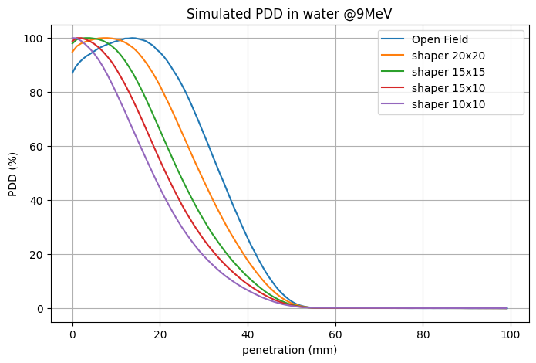
Critical issues
$$mm^{2}$$
$$mm^{2}$$
$$mm^{2}$$
$$mm^{2}$$
$$mm^{2}$$
$$mm^{2}$$
$$mm^{2}$$
$$mm^{2}$$
5
Notes:
Also, using the tungsten collimation to improve beam conformity to the target, the R90 is further shrinked, as you can see in this PDD plot vaying the tungsten collimation.
This happens because the lateral particles which contribute to the central dose are lost.

Slide 10
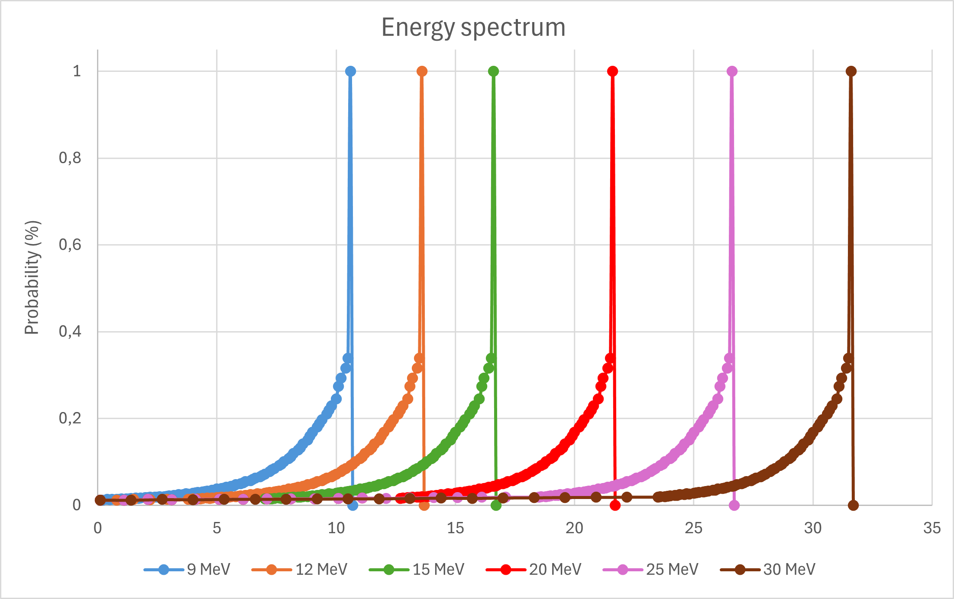
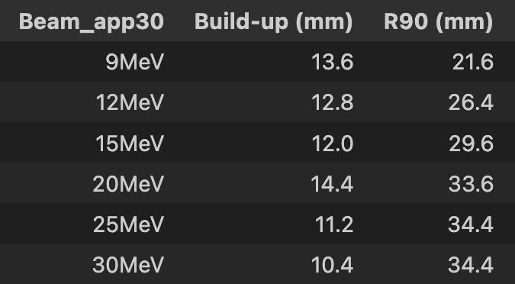
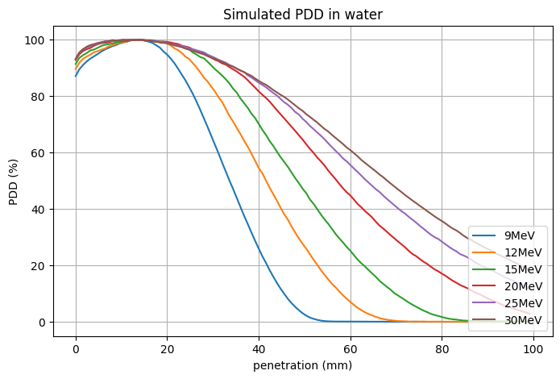
New possibilities
R90 @ E > 20MeV
Open Field
Magnetron powered electron LINACs can produce up to 30 MeV beams [4]
Can be mechanically collimated
6
Notes:
Magnetron powered LINACS, however, can produce up to 30MeV beams which can be mechanically collimated.
That’s why I produced virtual energy spectra starting from the real 9MeV one, in order to cover deeper targets.
Nominal energy degli spettri (non è energia massima)

Slide 11
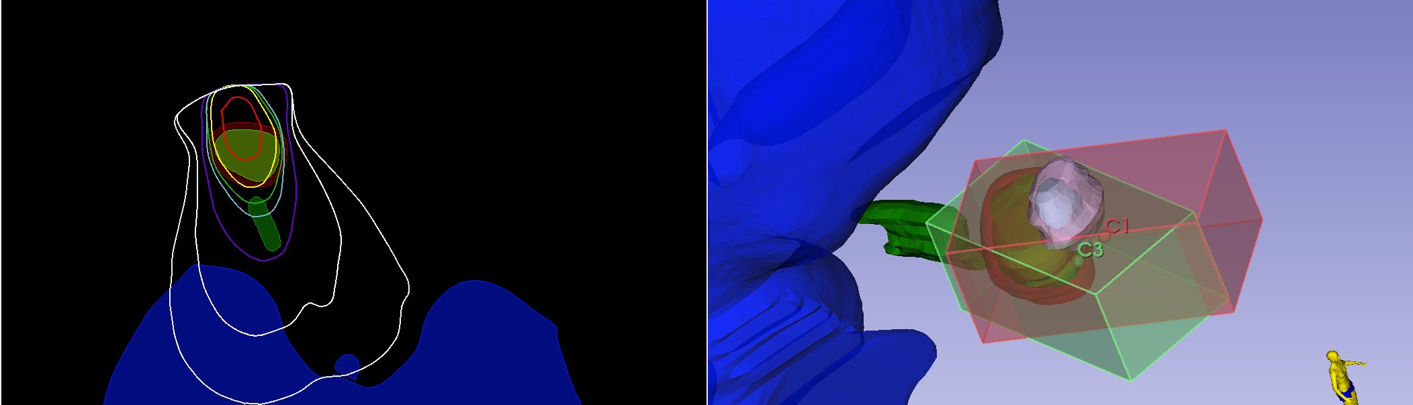
Example 1
Patient 05
best configuration
C1
C3
65% + 35%
Best Configuration
7
Notes:
Now I present to you some examples. This is patient 3, in the table are listed all the different configurations that I used, in particular you can see that the energies are always greater that 20MeV.
They have different angles and you can see the isodose curves in this picture.
The best configuration is achieved adding C1 and C3 beam, weighted 65 and 35%. This was chosen on the basis of the DVH

Slide 12
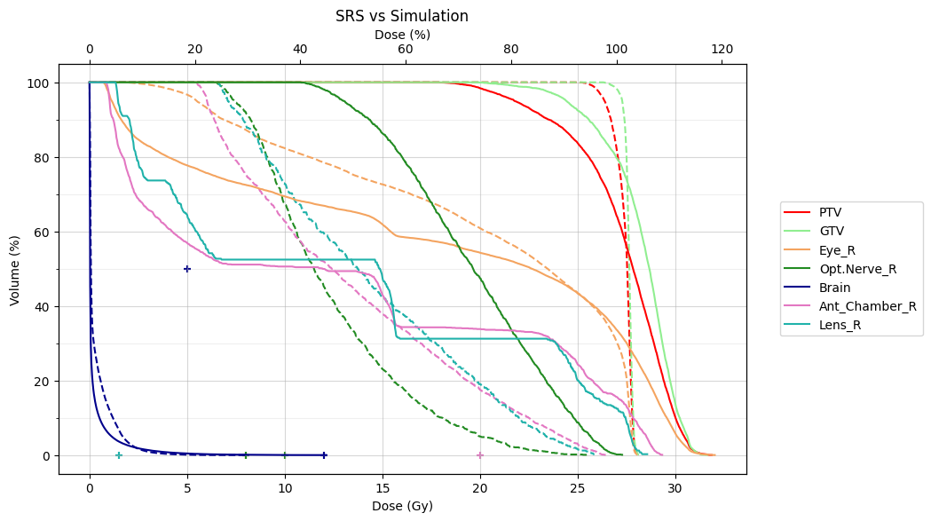
Example 1
Optic Nerve
$$D_{max}=10 Gy$$
Prescription dose
$→$ 27Gy@PTV
Normalization point
$→$ 27Gy@GTV _{80%}
SRS
Simulation
Anterior Chamber $D_{max}=20 Gy$
7
Notes:
We can see on the right the simulated one, while on the left there is the stereotactic treatment and you can see all the differences between them.
For example the Optic Nerve has a radiobiological constraint on the maximum dose, which is 10Gy and both of these plans go above it. However, SRS plan seems to better spare the structure than my simulation.
Also, for the Anterior Chamber, which should reach at maximum 20Gy, the SRS plan seems better, even if the constraint is not respected.
I want to point out that the red dot in the DVH represents my normalization point, which I used for my planning but is not the same for the TPS.
In fact the prescription dose is 27Gy to the PTV, while I used 27Gy to the 80% of the GTV, which is totally arbitrary.

Slide 13
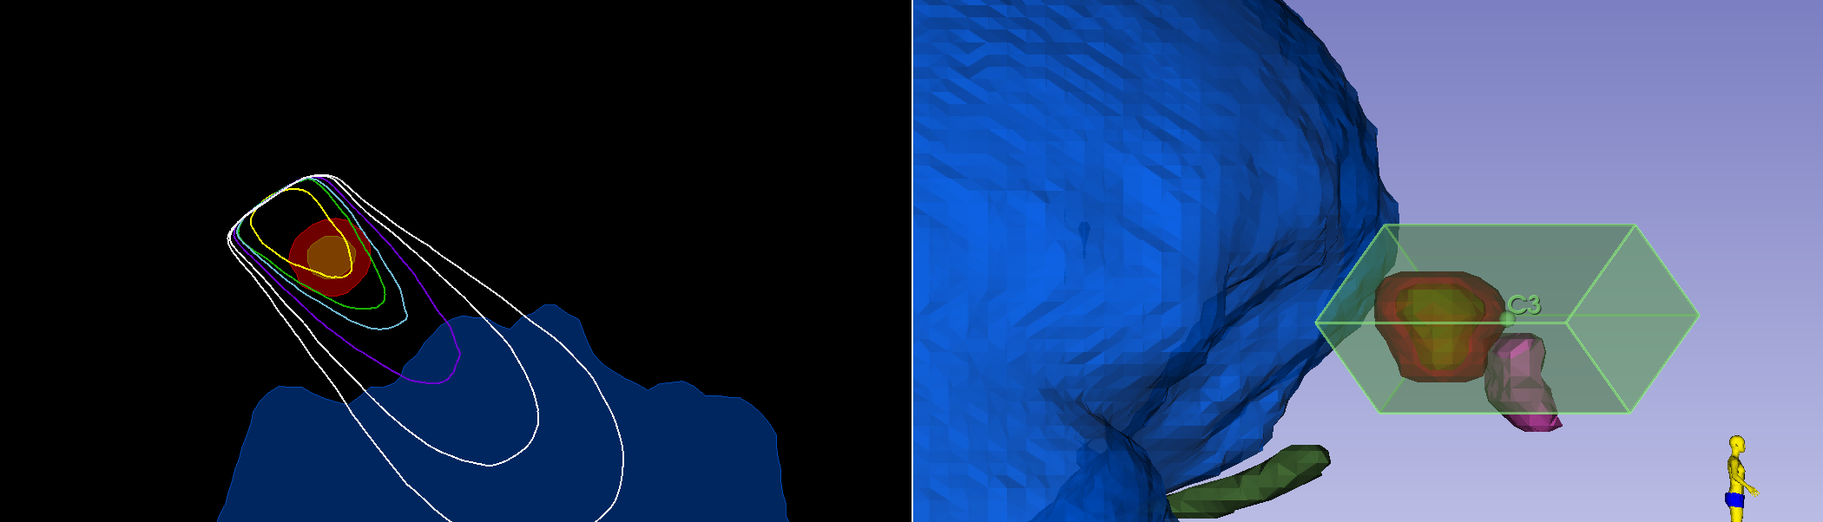
Example 2
Patient 01
best configuration
Best Configuration
8
Notes:
Then there is patient 1, for whom the best configuration was the single C3, shown in the picture above.

Slide 14
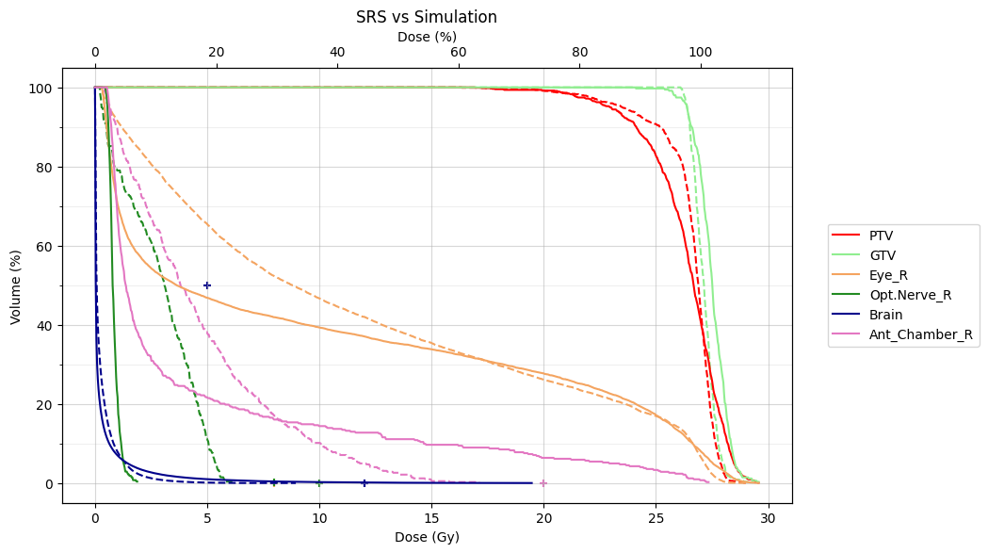
Example 2
Optic Nerve
$$D_{max}=10 Gy$$
SRS
Simulation
Anterior Chamber $D_{max}=20 Gy$
8
Notes:
In this case, you can see that my simulation still doesn’t respect the constraint on the anterior chamber, while it seems to better spare the optic nerve than the SRS plan.
None of my simulations are taking into account the flash sparing effect, which will certainly improve the results. For now my optimization is only based on the geometry and the beam energy and in some cases like this one, it already is comparable with the real treatment.

Slide 15
Conclusions
Final aim of this study: evaluation of the EF virtual treatment eﬀectiveness and direct quantitative comparison with SRS-RT
9 MeV electron beam is not enough to cover deep targets $→$ virtual beam simulations
Future perspectives:
Quantification of flash sparing effect (radiobiological studies)
Combination with minibeam effect
Bibliography:
Friedl, Anna A., et al. "Radiobiology of the FLASH effect." Medical Physics 49.3 (2022): 1993-2013. (https://doi.org/10.1002/mp.15184)
Lamas, Nuno Jorge, et al. "Prognostic biomarkers in uveal melanoma: The status quo, recent advances and future directions." Cancers 14.1 (2021): 96. (https://doi.org/10.3390/cancers14010096)
Di Martino, F., et al. "Architecture, flexibility and performance of a special electron linac dedicated to Flash radiotherapy research: electronFlash with a triode gun of the centro pisano flash radiotherapy (CPFR)." Frontiers in Physics 11 (2023): 1268310. (https://doi.org/10.3389/fphy.2023.1268310)
Shvedunov, V. I., et al. "Electron accelerators design and construction at Lomonosov Moscow State University." Radiation Physics and Chemistry 159 (2019): 95-100. (https://doi.org/10.1016/j.radphyschem.2019.02.044)
9
Notes:
To finally conclude, the aim of this study is evaluate the effectiveness of a flash treatment on this specific tumoral lesions, comparing it with stereotactic treatment already erogated on these patients.
9MeV electron beam is clearly not enough to cover these targets so it’s necessary an upgrade on the beam energies, at least above 20MeV.
In the meantime, radiobiological studies are being performed to quantify the sparing effect of flash radiotherapy and these are necessary to better compare my results with other treatments.
We also would like to add the minibeam effect, to lower the entrance dose.

Slide 16
Thanks for your attention!
This work was funded by Piano Nazionale di Ripresa e Resilienza (PNRR), Missione 4, Componente 2, Ecosistemi dell’Innovazione–Tuscany Health Ecosystem (THE), Spoke 1 “Advanced Radiotherapies and Diagnostics in Oncology”—CUP I53C22000780001.
We also thank Fondazione Pisa for funding CPFR with the grant “prog. n. 134/2021”.

