Slide 1
Development of multimeric radiotracers for the design of tumor microenvironment-selective theragnostic agents for cancer diagnosis and therapy
COSTANZA FABBRI​
PhD student (SSSUP)​
costanza.fabbri@santannapisa.it​

Slide 2
Introduction
Theragnostic Radiotracers
Monomeric Radiotracers
short retention time
excellent for
imaging
Multimeric Radiotracers
retention time
specificity
sensitivity
tumor uptake
Radionuclide
Diagnosis (¹⁸F, ⁶⁸Ga)
Therapy (¹⁷⁷Lu)
THE TUSCANY HEALTH ECOSYSTEM
4° Meeting SPOKE 1 – December 12th 2024, Pisa
2

Slide 3
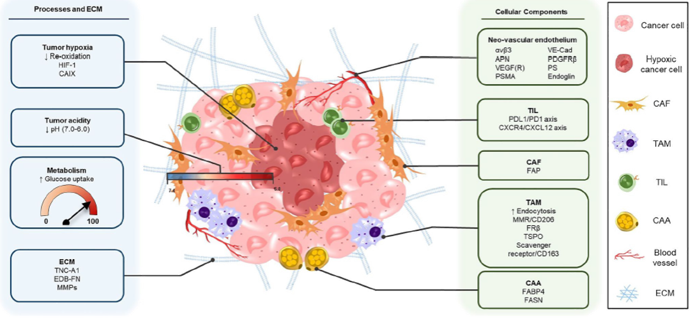
Introduction
Tumor Microenvironment (TME) targets
that can be used for nuclear imaging or/and therapy
RGD PET Radiotracers
CA IX/XII PET Radiotracers
FAPI PET
Radiotracers
C. D. van der Heide and S. U. Dalm, Eur. J. Nucl. Med. Mol. Imaging,, Nov. 2022, doi: 10.1007/s00259-022-05870-1
THE TUSCANY HEALTH ECOSYSTEM
4° Meeting SPOKE 1 – December 12th 2024, Pisa
3

Slide 4
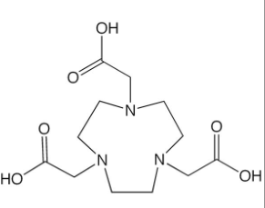
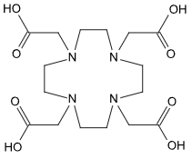
Aim
Development of novel multimeric radiotracers for the design of tumor microenvironment-selective theragnostic agents for cancer diagnosis and therapy
Chelator =
Or
Radioisotope = [¹⁸F]AlF²⁺ or ¹⁷⁷Lu
NOTA DOTA
From 11/2024
CANCER DIAGNOSIS
CANCER THERAPY
-Radiolabeling with [¹⁸F]AlF²⁺
- In vivo PET imaging studies for the evaluation of biodistribution and uptake in Melanoma models
-Radiolabeling with ¹⁷⁷Lu
-Evaluation of cellular uptake, affinity, specificity and antitumor activity
in vitro
University Medical Center Groningen
THE TUSCANY HEALTH ECOSYSTEM
4° Meeting SPOKE 1 – December 12th 2024, Pisa
4

Slide 5
Aim
Development of novel multimeric radiotracers for the design of tumor microenvironment-selective theragnostic agents for cancer diagnosis and therapy
Chelator =
Or
Radioisotope = [¹⁸F]AlF²⁺ or ¹⁷⁷Lu
NOTA DOTA
From 11/2024
CANCER DIAGNOSIS
CANCER THERAPY
-Radiolabeling with [¹⁸F]AlF²⁺
- In vivo PET imaging studies for the evaluation of biodistribution and uptake in Melanoma models
-Radiolabeling with ¹⁷⁷Lu
-Evaluation of cellular uptake, affinity, specificity and antitumor activity
in vitro
University Medical Center Groningen
THE TUSCANY HEALTH ECOSYSTEM
4° Meeting SPOKE 1 – December 12th 2024, Pisa
5

Slide 6
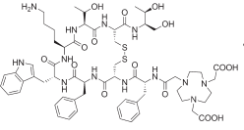
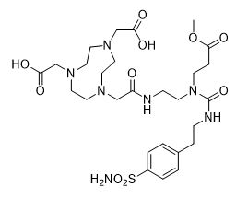
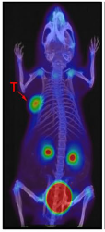
Workflow
Radiolabeling with [¹⁸F]AlF²⁺ of radiotracers:
Chemical synthesis of multimeric Precursors
Mutimeric
Monomeric
[¹⁸F]AlF-NOTA-RGDfK
[¹⁸F]AlF-NOTA-FAPI-04
[¹⁸F]AlF-NOTA-CAX
in vivo PET imaging studies
To evaluate the uptake and biodistribution of novel multimeric versus monomeric radiotracers in
B16-F10 Melanoma syngeneic
murine model
The protocol for animal use has been approved by the Ministry of Health
THE TUSCANY HEALTH ECOSYSTEM
https://doi.org/10.1007/s00259-023-06587-5
4° Meeting SPOKE 1 – December 12th 2024, Pisa
6

Slide 7
Workflow
Radiolabeling with [¹⁸F]AlF²⁺ of radiotracers:
Chemical synthesis of multimeric Precursors
Mutimeric
Monomeric
[¹⁸F]AlF-NOTA-RGDfK
[¹⁸F]AlF-NOTA-FAPI-04
[¹⁸F]AlF-NOTA-CAX
in vivo PET imaging studies
To evaluate the uptake and biodistribution of novel multimeric versus monomeric radiotracers in
B16-F10 Melanoma syngeneic
murine model
The protocol for animal use has been approved by the Ministry of Health
THE TUSCANY HEALTH ECOSYSTEM
https://doi.org/10.1007/s00259-023-06587-5
4° Meeting SPOKE 1 – December 12th 2024, Pisa
7

Slide 8
Methods
Optimization of a radiolabeling
conditions with [¹⁸F]AlF²⁺
1
Formation of the [¹⁸F]AlF²⁺ labeling agent
Optimization of chelation reaction
Amount of precursor
Effect of % cosolvent (v/v)
concentration of AlCl₃
RCY
Radiochemical Yield (%)
2
¹⁸F
¹⁸F-Radiotracers
Standard radiolabeling conditions with [¹⁸F]AlF²⁺
Quality Control
Radio-TLC
Radio-HPLC
THE TUSCANY HEALTH ECOSYSTEM
4° Meeting SPOKE 1 – December 12th 2024, Pisa
8

Slide 9
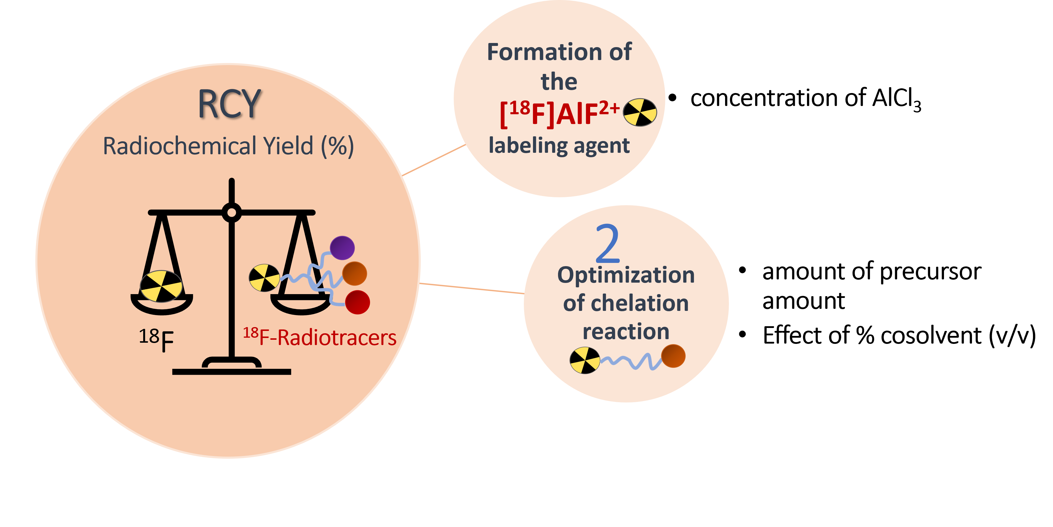
Results
Concentration of AlCl₃
Reaction conditions
Complexation yields of [¹⁸F]AlF²⁺ as a function of AlCl₃ concentration
2mM
Quality Control
Cation exchanger (Maxi-CleanTM SPE 0,5ml IC-H, Alltech)
THE TUSCANY HEALTH ECOSYSTEM
4° Meeting SPOKE 1 – December 12th 2024, Pisa
9

Slide 10
Results
Radiolabeling conditions with [¹⁸F]AlF²⁺
Effect of precursor amount
[¹⁸F]AlF-NOTA-FAPI-04
[¹⁸F]AlF-NOTA-CAX
Quality Control
Radio-TLC
THE TUSCANY HEALTH ECOSYSTEM
4° Meeting SPOKE 1 – December 12th 2024, Pisa
10

Slide 11
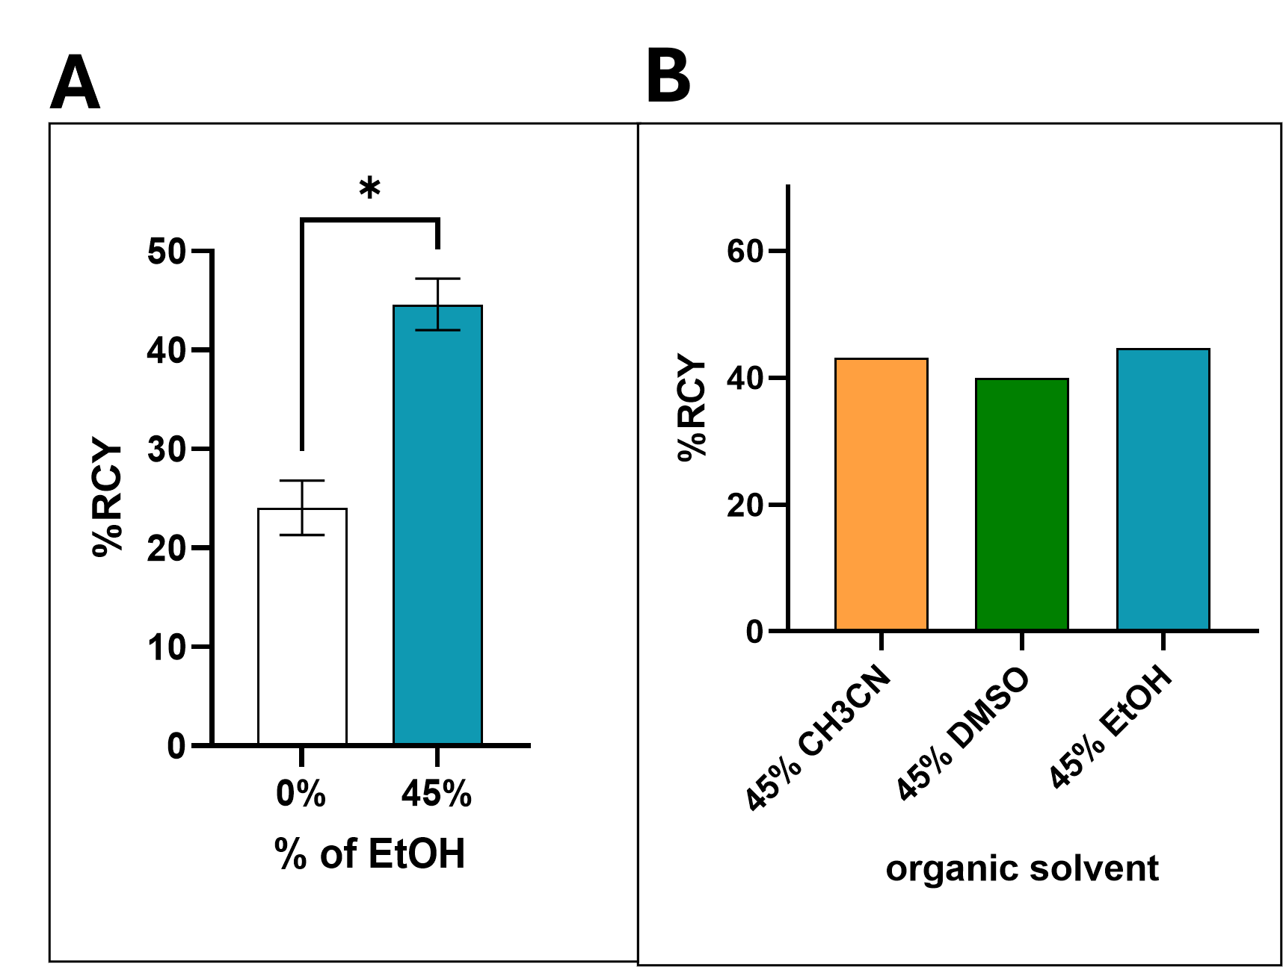
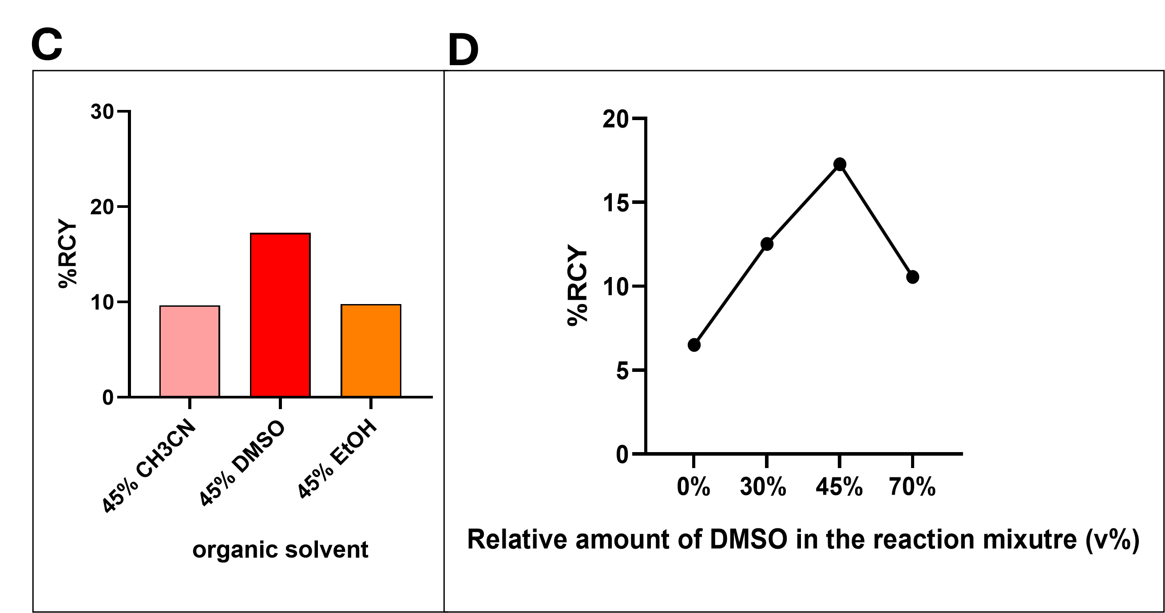
Results
Radiolabeling conditions with [¹⁸F]AlF²⁺
Effect of % cosolvent (v/v)
[¹⁸F]AlF-NOTA-FAPI-04
[¹⁸F]AlF-NOTA-CAX
Quality Control
Radio-TLC
Radio-HPLC
THE TUSCANY HEALTH ECOSYSTEM
4° Meeting SPOKE 1 – December 12th 2024, Pisa
11

Slide 12
Results
Radiosynthesis for in vivo experiment
and stability test
Optimization of radiolabeling reactions following the purification step lead to:
[¹⁸F]AlF-NOTA-FAPI-04
v
[¹⁸F]AlF-NOTA-RGDfK
RCY= 30.9 ± 2.8%
Additional information
(N=3) Molar Activity = 3,0 ± 0,2 GBq/μmol
RCY= 28.3 ± 3.0 %
Additional information
(N=2) Molar Activity = 1.9 ± 0.7 GBq/μmol
Same radiolabeling conditions of:
THE TUSCANY HEALTH ECOSYSTEM
4° Meeting SPOKE 1 – December 12th 2024, Pisa
12

Slide 13
[¹⁸F]AlF-NOTA-FAPI-04
v
[¹⁸F]AlF-NOTA-RGDfK
FOR ANIMAL USE:
RCY= 30.9 ± 2.8%
Additional information
(N=3) Molar Activity = 3,0 ± 0,2 GBq/μmol
RCY= 28.3 ± 3.0 %
Additional information
(N=2) Molar Activity = 1.9 ± 0.7 GBq/μmol
RCP ≥ 95%
(Radiochemical Purity)
2. STABILITY TEST
(Pure Radiotracers incubated at 37°C for 2 hours
in PBS and FBS )
Purification with
solid phase extraction
(SPE) cartridge
(to remove free ¹⁸F)
Same radiolabeling conditions of:
THE TUSCANY HEALTH ECOSYSTEM
4° Meeting SPOKE 1 – December 12th 2024, Pisa
13

Slide 14
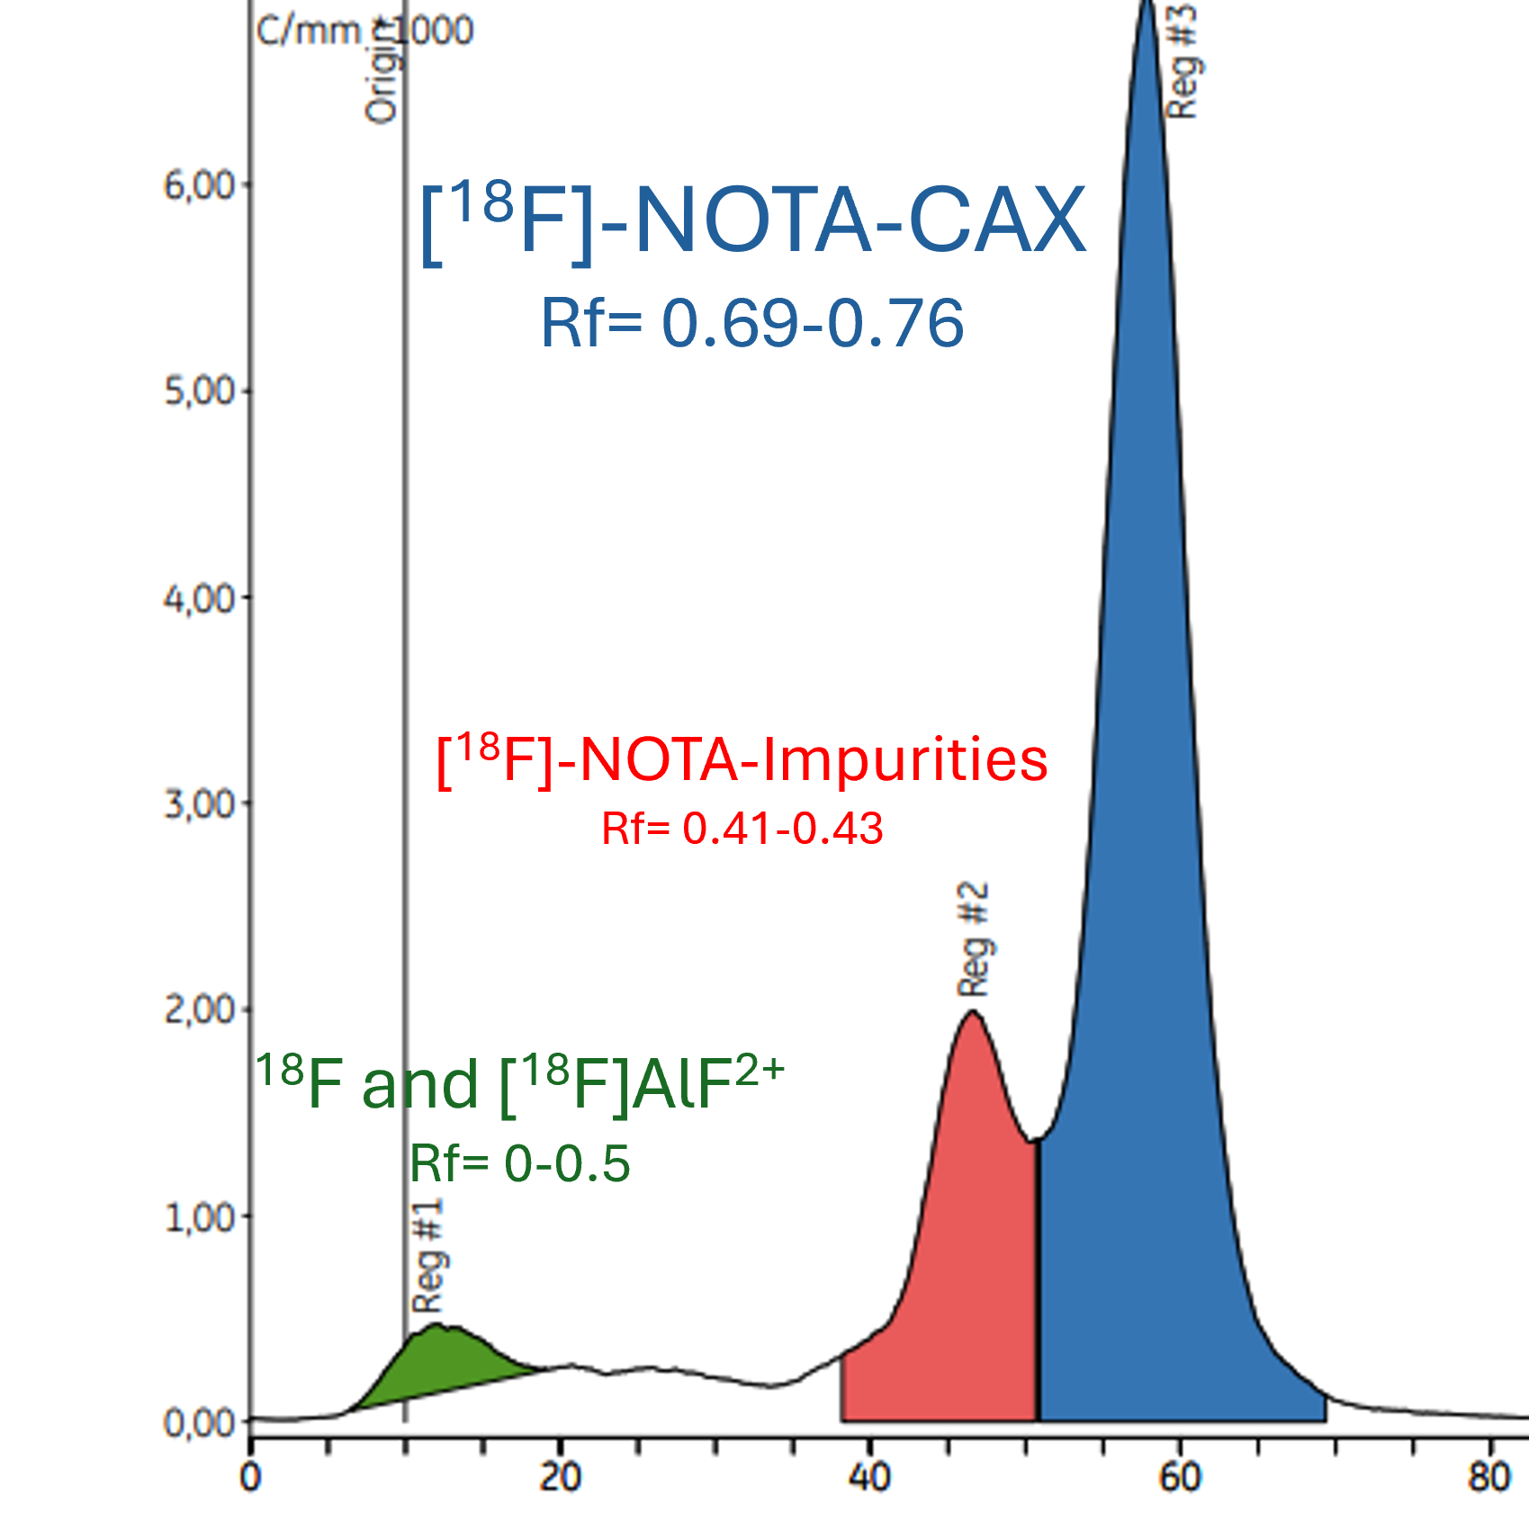
Results
Radiosynthesis for in vivo experiment
and stability test
Radiochemical purity and stability test:
[¹⁸F]AlF-NOTA-FAPI-04
v
[¹⁸F]AlF-NOTA-CAX
[¹⁸F]AlF-NOTA-RGDfK
RCP=
≥ 98.51 ±0.19 %
Stability after 2h
RCP = ≥ 98.51%
RCP=
≥ 97.41 ±0.8 %
Stability after 2h
RCP = ≥ 96.61%
RCP=
≤95%
Radio-TLC chromatogram
the NOTA-CAX precursor
will be purified by
THE TUSCANY HEALTH ECOSYSTEM
4° Meeting SPOKE 1 – December 12th 2024, Pisa
14

Slide 15
Future prospects
Radiolabeling with [¹⁸F]AlF²⁺ of radiotracers:
Chemical synthesis of multimeric Precursors
Mutimeric
Monomeric
[¹⁸F]AlF-NOTA-RGDfK
[¹⁸F]AlF-NOTA-FAPI-04
[¹⁸F]AlF-NOTA-CAX
in vivo PET imaging studies
To evaluate the uptake and biodistribution of novel multimeric versus monomeric radiotracers in
B16-F10 Melanoma syngeneic
murine model
The protocol for animal use has been approved by the Ministry of Health
THE TUSCANY HEALTH ECOSYSTEM
https://doi.org/10.1007/s00259-023-06587-5
4° Meeting SPOKE 1 – December 12th 2024, Pisa
15

Slide 16
Future prospects
Radiolabeling with [¹⁸F]AlF²⁺ of radiotracers:
Chemical synthesis of multimeric Precursors
Mutimeric
Monomeric
Fine-tuning of:
1. The syngeneic mouse model of B16-F10 Melanoma
2. Imaging PET studies with Monomeric radiotracers
[¹⁸F]AlF-NOTA-RGDfK
[¹⁸F]AlF-NOTA-FAPI-04
[¹⁸F]AlF-NOTA-CAX
in vivo PET imaging studies
To evaluate the uptake and biodistribution of novel multimeric versus monomeric radiotracers in
B16-F10 Melanoma syngeneic
murine model
[¹⁸F]AlF-NOTA-FAPI-04
[¹⁸F]AlF-NOTA-RGDfK
The protocol for animal use has been approved by the Ministry of Health
THE TUSCANY HEALTH ECOSYSTEM
https://doi.org/10.1007/s00259-023-06587-5
4° Meeting SPOKE 1 – December 12th 2024, Pisa
16

Slide 17
THANKS YOU FOR YOUR ATTENTION
People involved(WP7) @CNR IFC
Luca Menichetti
Debora Petroni
Daniele Panetta
Patricia Iozzo
PhD (SSSUP)
Costanza Fabbri
THE TUSCANY HEALTH ECOSYSTEM
4° Meeting SPOKE 1 – December 12th 2024, Pisa
17
17

Slide 18
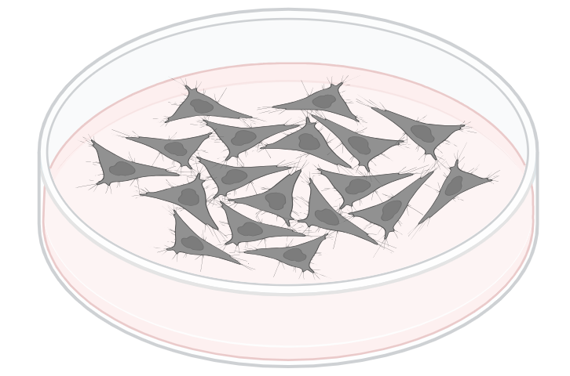
B16-F10 Melanoma syngeneic murine model
B16-F10 melanoma syngeneic
murine model
C57/BL6 strain
Intradermal
injection of B16-F10 cells
into the hind leg
Tumor tissue is obtained from a mouse with the same genetic background as the immunocompetent recipient mouse.
Because the tumor microenvironment and the transplanted cells belong to the same strain, syngeneic models are potential immuno-oncology models for studying the response to cancer therapies
The B16-F10 cell line was generated as the 10th serial passage subclone of the B16 parent tumor line in C57BL/6 mice.
In vitro, these cells grow as an adherent population taking on an epithelial morphology.
In collaboration with: IFC-CNR: Margherita Maffei, Alice Usai, Claudia Kusmic, Gaia Scabia, Eduarda Silva IN-CNR: Mario Costa, Gabriele Sansevero

Slide 19
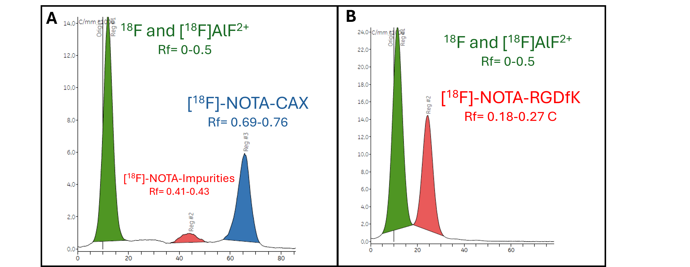
Radio-TLC chromatogram
Formulas
Molar activity:
MBq/nmol x RCY
Radiochemical Yield (%) of a Pure Radiotracer:
(MBq of Pure Radiotracer/ Starting activity of ¹⁸F (MBq))
x 100
Radiochemical Yield (%) of the crude product:
was calculated by radio-TLC analysis of the crude product
%Area below peak in Radio-TLC chromatogram

Slide 20
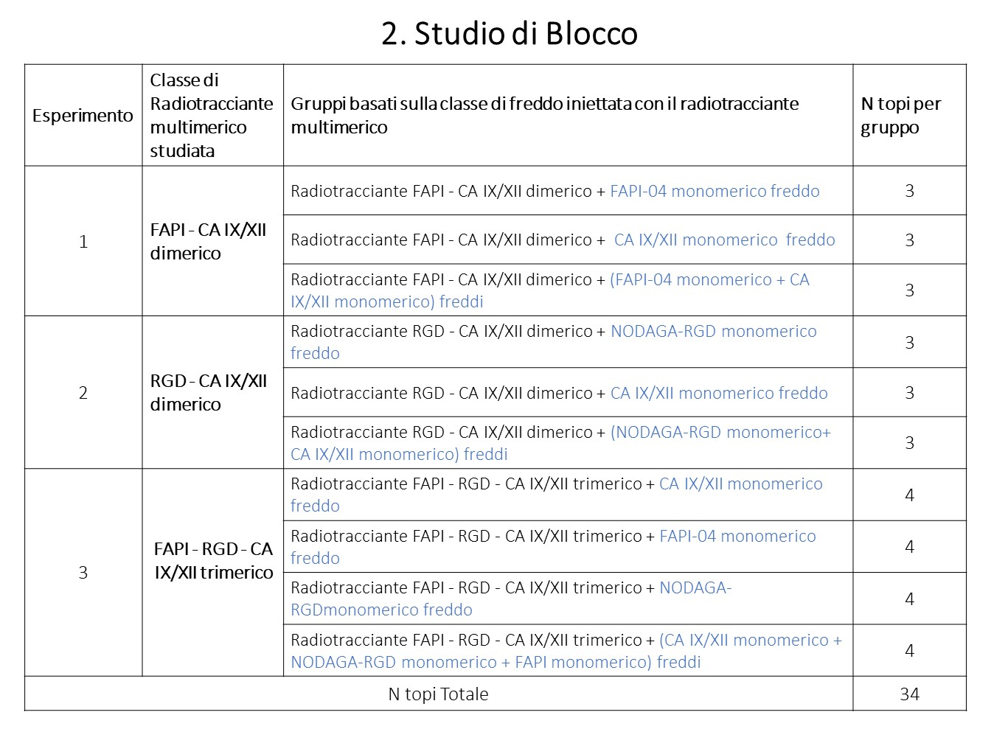
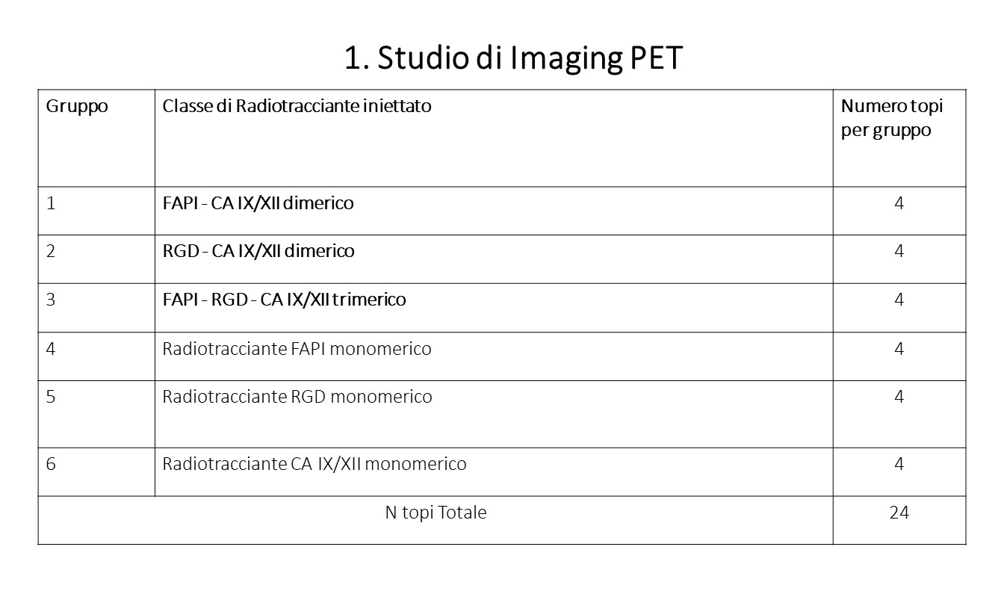
Protocol for in VIVO studies

Slide 21
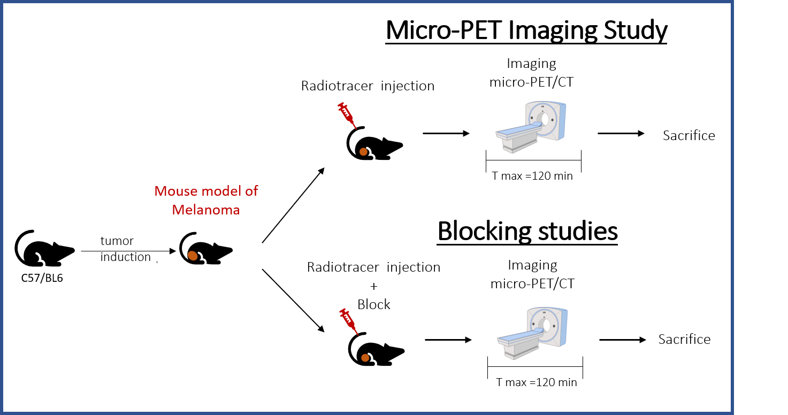
Protocol for in VIVO studies
In vivo Imaging studies in a Mouse models of Melanoma

