Slide 1
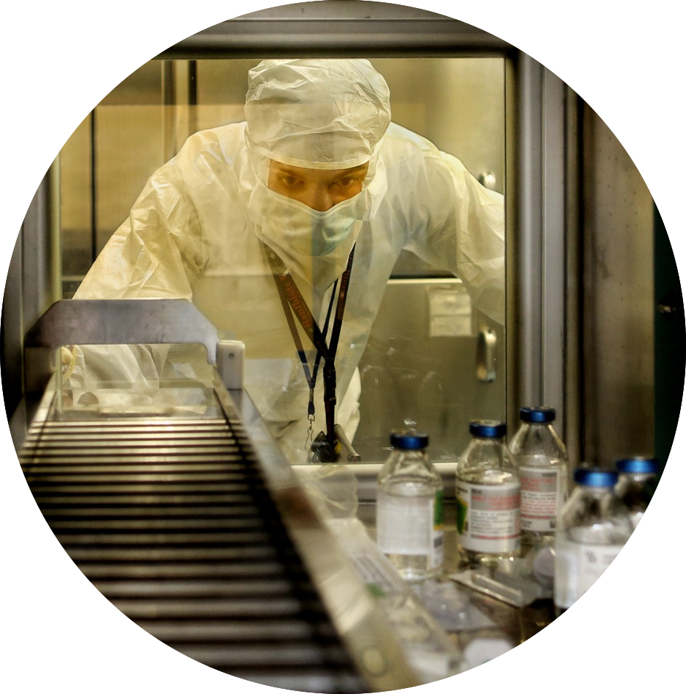
THE - Tuscany Health Ecosystem-Spoke 1-WP 8
From applied research to patients,
«one more chance»
Michela Poli
Letizia Guiducci
Duccio Volterrani
Pisa 12 Dicembre 2024

Slide 2
THE - Tuscany Health Ecosystem-Spoke 1-WP 8: activities
Synthesis and production of tumor-targeted radionuclides, radiotracers and radiopharmaceuticals for clinical use
Production of radiopharmaceuticals to be used in diagnosis and follow -up of patients affected by glioblastoma in clinical trials carried-out in collaboration with the UNIPI Nuclear Medicine Department according to Good Manufacturing Practice (GMP) within the IFC-CNR Officina Farmaceutica
18F-FDG and 18F-Choline
18F-FET, 18F-FDOPA
18F-FAPI74.

Slide 3
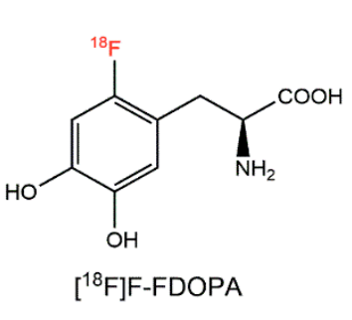
FLUORODOPA 90 MBq/mL solution for injection (Curium Italy MAH)
PET with Fluorodopa (18F) is indicated in neurology for the diagnosis parkinsonian syndromes.
PET with fluorodopa (18F), is also indicated in oncology for brain tumors and for the diagnosis and localization of various forms of neuroendocrine tumors.
Fluorodopa technology transfer was completed in September 2024 and AIFA application is in progress.
To date, 18F-DOPA is not available in Tuscany and it supplied by other italian regions

Slide 4
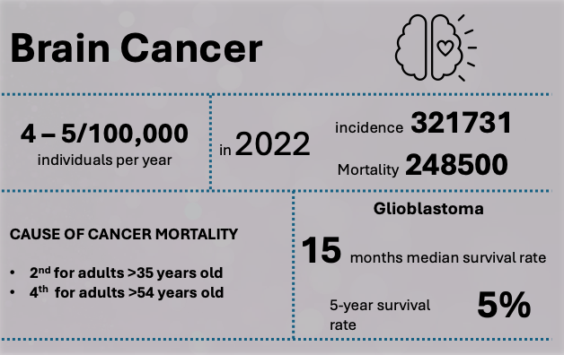
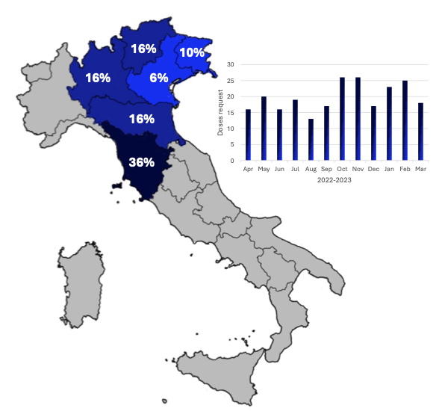
IASOGLIO® 2000 MBq/mL solution for injection (Curium MAH)
Brain tumors have a devastating impact, clinical use of 18F-FET is supported by specialized medical associations in a personalized medicine perspective. To date, 18F-FET is not available in Italy for large-scale distribution and it is imported from abroad.
IASOGLIO® technology transfer was completed in February 2024 and AIFA issued manufacturing authorization in April 2024.
Officina 2.0 was the first Italian site authorised by AIFA to produce IASOGLIO ®, the mutual recognition procedure to start large-scale distribution is underway at EMA.
The PROFETI project promoted by Curium Pharma in the context of the THE cascade calls has been awarded allowing for the extension of the TT of IASOGLIO® to the production sites of Roma Tor Vergata, Milano Istituto Europeo di Oncologia e Udine.
Technology transfer of IASOglio® drug product on Pisa PET production site
Notaro A., Poli M., Guiducci L., Bodenant V., Colombo P. 2024

Slide 5

THE Spoke 1 WP8 Milestone 1
Preliminary activities for the purchase of the synthesis module and QC instrumentations.
AIFA authorization for experimental radiopharmaceuticals
D 1.8.1 (M6): Acquisition of the Synthesizer and of the QC instrumentations for radiopharmaceuticals synthesis
D 1.8.2 (M6): AIFA authorization for experimental radiopharmaceuticals
Order form!!

Slide 6
THE Spoke 1 WP8 Milestone 2
Supply of radiopharmaceuticals with Marketing authorization or produced according to European Pharmacopoeia under GMPs rules for preclinical and clinical study
D 1.8.3 (M9): Acquisition of the instrumentations for radiopharmaceuticals preparations
D 1.8.4 (M9): Release of radiopharmaceuticals with MA for preclinical and clinical study
D 1.8.5 (M12): Report on feasibility study for synthesis of 18F-DOPA and 18F-FET

Slide 7



THE Spoke 1 WP8 Milestone 2
Supply of radiopharmaceuticals with Marketing authorization or produced according to European Pharmacopoeia under GMPs rules for preclinical and clinical study
D 1.8.6 (M18): 18F-FET Process validation, and final release for clinical use
D 1.8.7 (M18): Patient enrollment and clinical study
Cascade Call: Studi per l’avvio del trasferimento tecnologico di nuovi radiofarmaci attualmente non disponibili sul territorio regionale/nazionale.

Slide 8
THE Spoke 1 WP8 Milestone 2
Supply of radiopharmaceuticals with Marketing authorization or produced according to European Pharmacopoeia under GMPs rules for preclinical and clinical study
D 1.8.6 (M18): 18F-FDOPA Process validation, and final release for clinical use
Technology Transfer of F-DOPA
D 1.8.7 (M18): Patient enrollment and clinical study

Slide 9

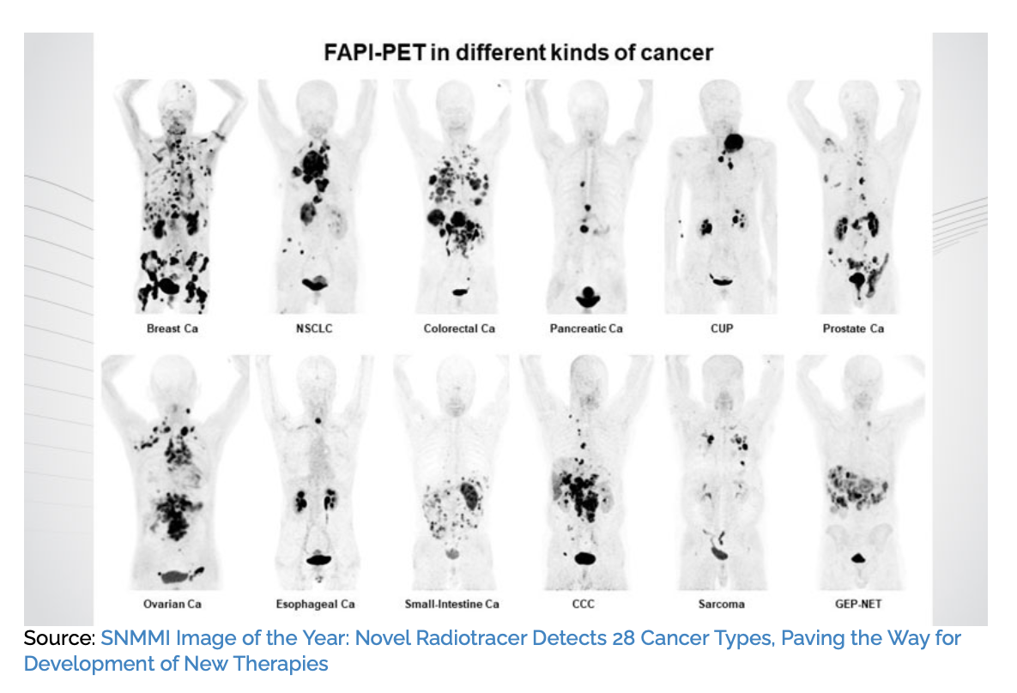
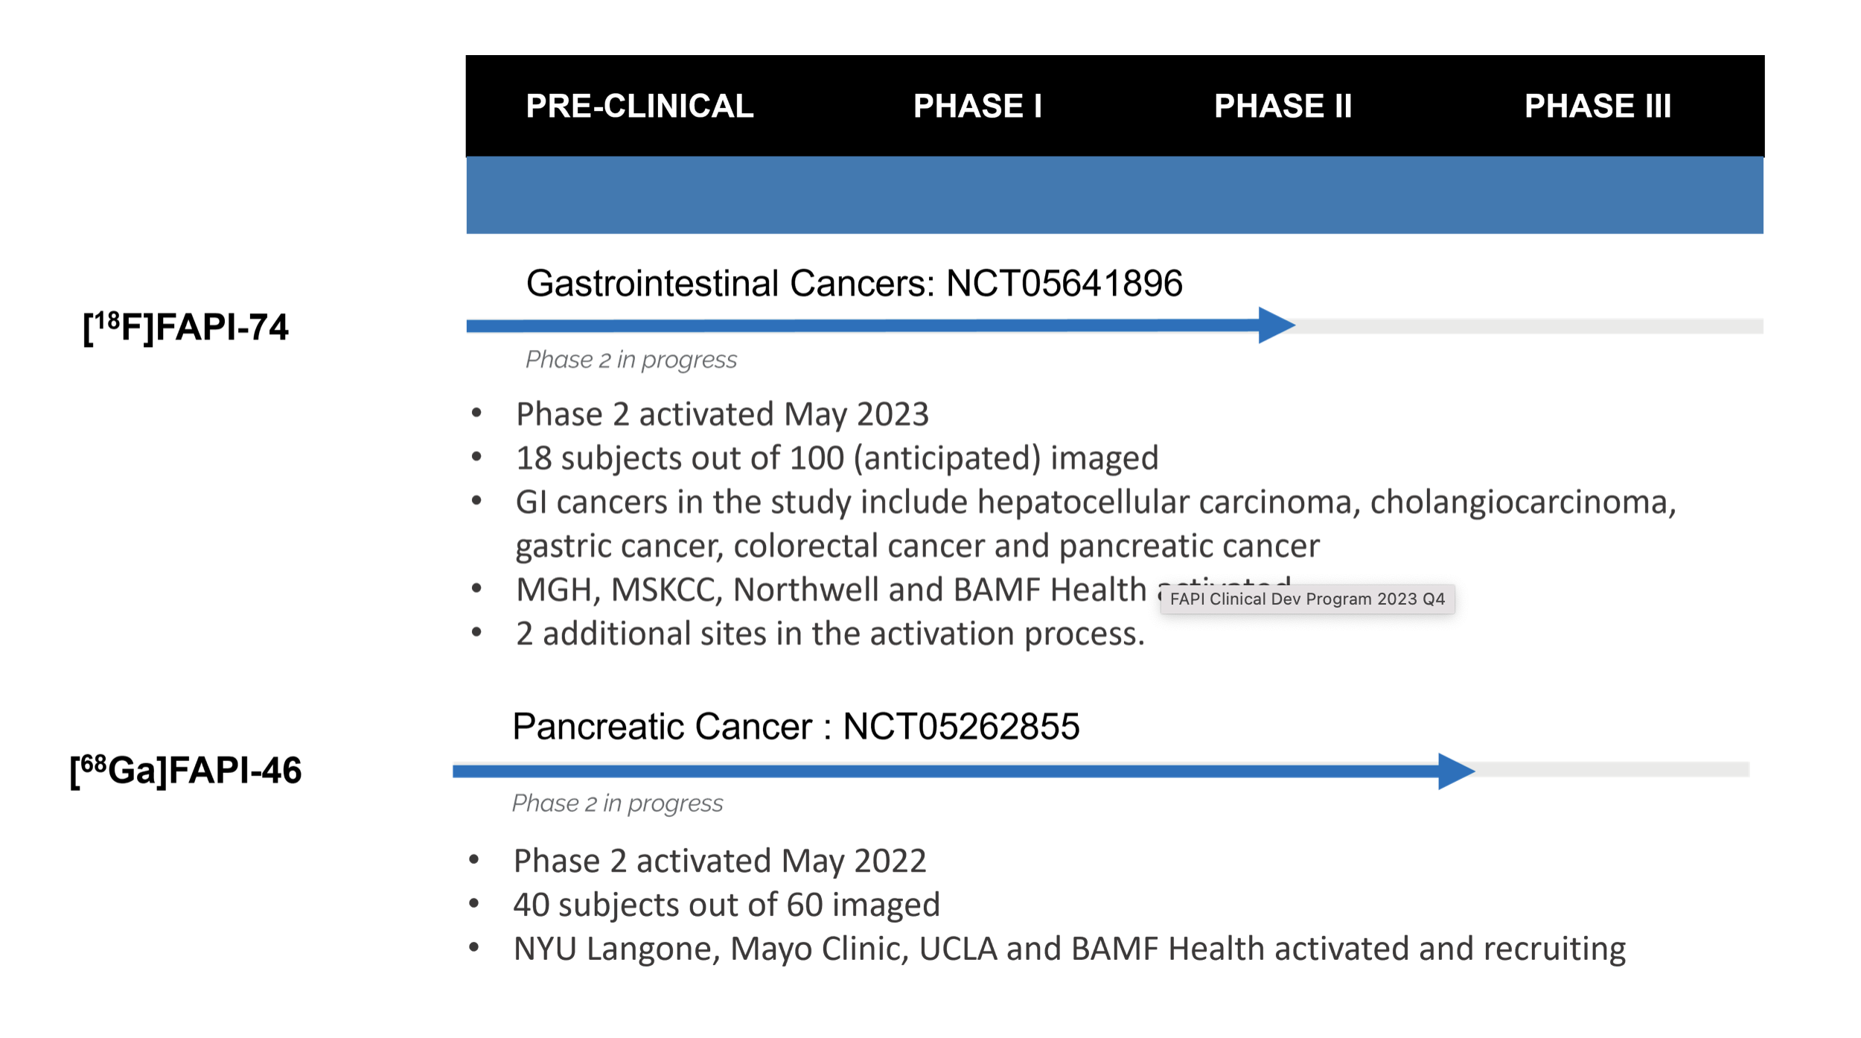
THE Spoke 1 WP8 Milestone 3
[18F]FAPI-74 PET showed higher uptake and detection rates in primary and metastatic lesions than did [18F]FDG PET. [18F]FAPI-74 PET is a promising novel diagnostic modality for various tumors, especially for precise staging before treatment, including characterization of tumor lesions before surgery. Moreover, 18F-labeled FAPI ligand might serve a higher demand in clinical care in the future (Initial Evaluation of [18F]FAPI-74 PET for Various Histopathologically Confirmed Cancers and Benign Lesions, Watabe et all Journal of Nuclear Medicine, published on June 2, 2023)

Slide 10
THE Spoke 1 WP8 Milestone 3
Supply of novel radiopharmaceuticals produced according GMPs rules, to be used for preclinical and clinical studies. Preparation of 18F-labeled FAP (Fibroblast Activation Protein) derivative
D 1.8.8 (M20): Report on feasibility study for synthesis of 18F-labeled FAP
Completed
D 1.8.9 (M24): 18F-labeled FAP Process validation and final release
D 1.8.10 (M36): Patient enrollment and clinical study
Prospective Evaluation of [18F]FAPI PET in Intermediate Hepatocellular Carcinoma (HCC): DETECT Study.
Targeting the Tumour Microenvironment in Gliomas: A Novel FAPI-PET Approach for Predictive Imaging Biomarkers TARG Study.

Slide 11
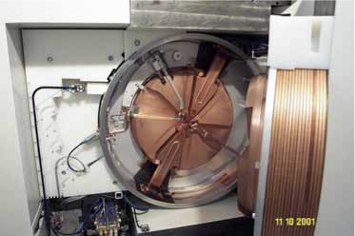
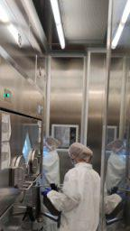
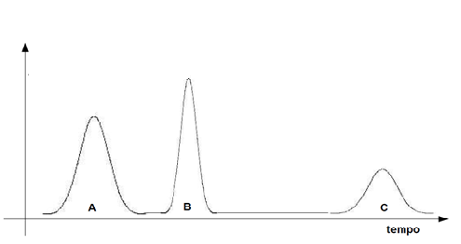


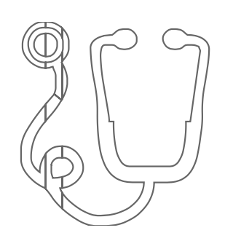
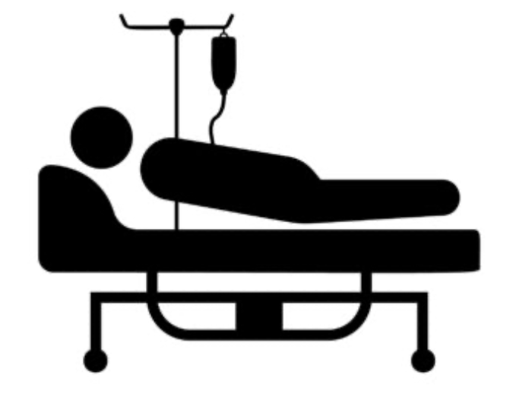
Cyclotron
Production
QC
QA
QP
Clinicals
Industry
Daniele Panetta
Mauro Telleschi
Alessandro Zega
Francesco Martelli
Salvatore Limpido
Mauro Telleschi
Alessia Danti
Marco Dicanio
Silvia Pardini
Mauro Quaglierini
Michela Poli
Letizia Guiducci
Michela Poli
Antonio Fiore
Duccio Volterrani
Gayane
Aghakhanyan
Paolo Colombo
Anna Notaro
Florian Hamon
Andrea Marianelli
Etc…

Slide 12
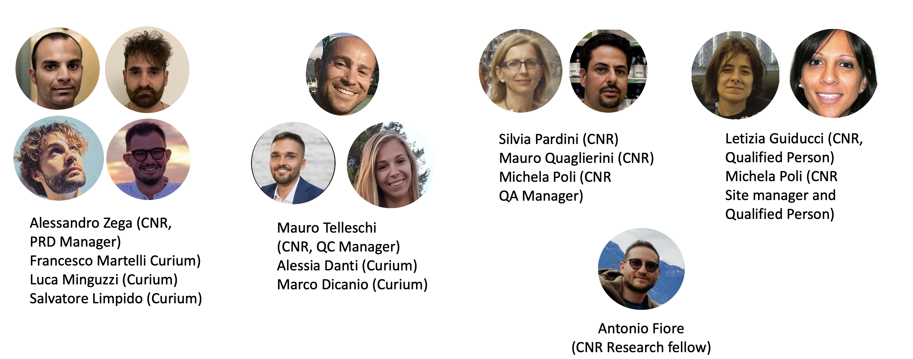
Grazie per l’attenzione e Buone Feste!!!
Our team
Our team is made up of people who are part of both CNR and Curium Pharma company

