Slide 1


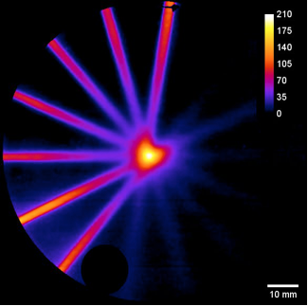



Tuscany Health Ecosystem
“THE”
4° INCONTRO SULL’ECOSISTEMA TOSCANO PER L’INNOVAZIONE - SPOKE 1
Leonida A. Gizzi
CNR-INO
12 Dicembre 2024

Slide 2
CONTENTS
Recap of project domains and SPOKE 1 activities
Status of SPOKE 1
Summary of Cascade Calls
Next steps
THE Beyond PNRR
Outreach activity
Acknowledgements
Within single fraction CONV
Average dose
CONV 0.001 Gy/p
Dose rate [Gy/s]
Average dose rate CONV 100 Gy/s
time [s]

Slide 3
“THE - Tuscany Health Ecosystem”
supports growth and consolidation of Tuscany's life sciences ecosystem
1. University of Florence (UNIFI)
2. University of Pisa (UNIPI)
3. University of Siena (UNISI)
4. School of Advanced Studies – Pisa (SSSA)
5. Scuola Normale Superiore (SNS)
6. IMT School for Advanced Studies Lucca (IMT)
7. University for Foreigners of Siena (UNISTRASI)
8. Istituto Italiano di Tecnologia (IIT)
9. National Research Council (CNR)
10. National Institute for Nuclear Physics (INFN)
11. Toscana Life Sciences (TLS)
12. Museo Galileo - Istituto e Museo di Storia della Scienza(MGS)
13. Esaote S.p.A. (ESA)
14. Medea S.r.l (MED)
15. Orthokey Italia S.r.l. (ORT)
16. Dedalus (DED)
17. Fondazione Pisana per la Scienza (FPS)
18. Digital Innovation Hub Toscana (DIH)
19. WEARABLE ROBOTICS SRL
20. IUVO S.r.l.
21. QBROBOTICS SRL
22. WEART S.r.l.
● CENTRAL HUB AS COORDINATING UNIT
● SPOKE 1: ADVANCED RADIOTHERAPIES AND DIAGNOSTICS IN ONCOLOGY
● SPOKE 2: PREVENTIVE AND PREDICTIVE MEDICINE;
● SPOKE 3: ADVANCED TECHNOLOGIES, [] FOR HUMAN HEALTH AND WELL-BEING;
● SPOKE 4: NANOTECHNOLOGIES FOR DIAGNOSIS AND THERAPY;
● SPOKE 5: IMPLEMENTING INNOVATION FOR HEALTHCARE AND WELL-BEING;
● SPOKE 6: PRECISION MEDICINE & PERSONALIZED HEALTHCARE;
● SPOKE 7: INNOVATING TRANSLATIONAL MEDICINE;
● SPOKE 8: BIOTECHNOLOGIES AND IMAGING IN NEUROSCIENCE;
● SPOKE 9: ROBOTICS AND AUTOMATION FOR HEALTH;
● SPOKE 10: POPULATION HEALTH.
Total funding 110 M€
Personnel participating: 1400

Slide 4
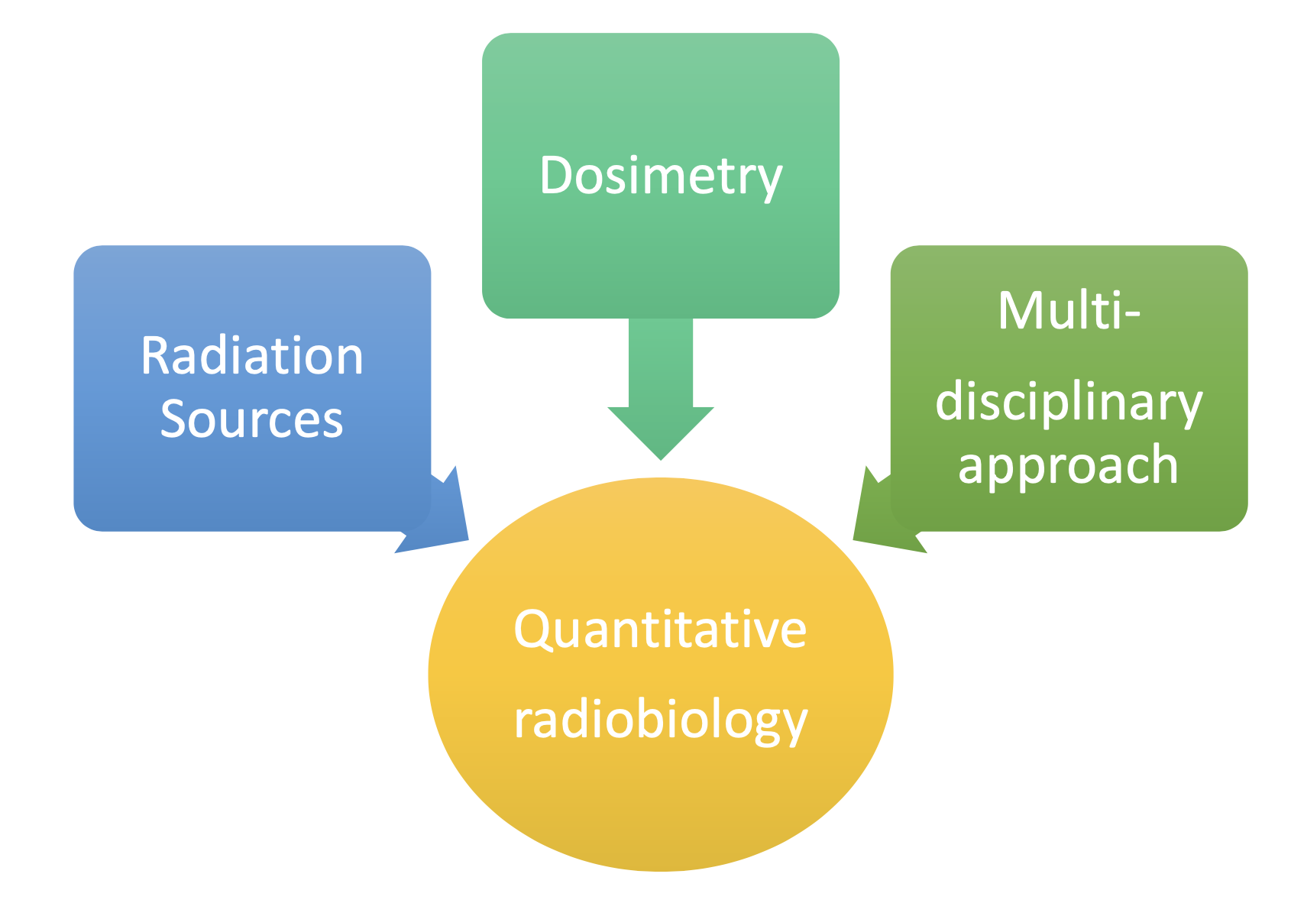
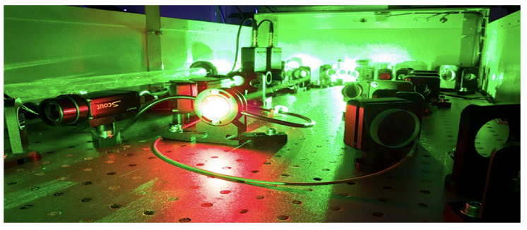
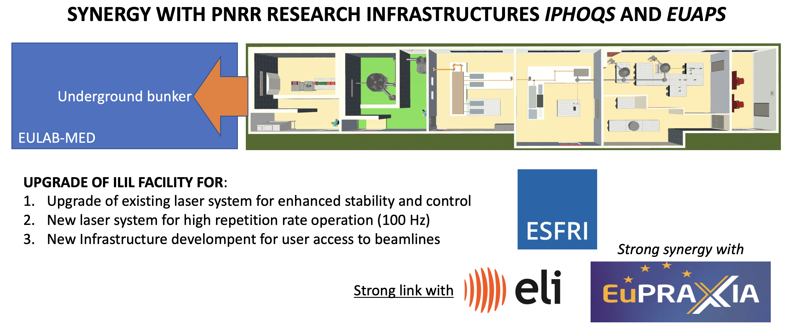



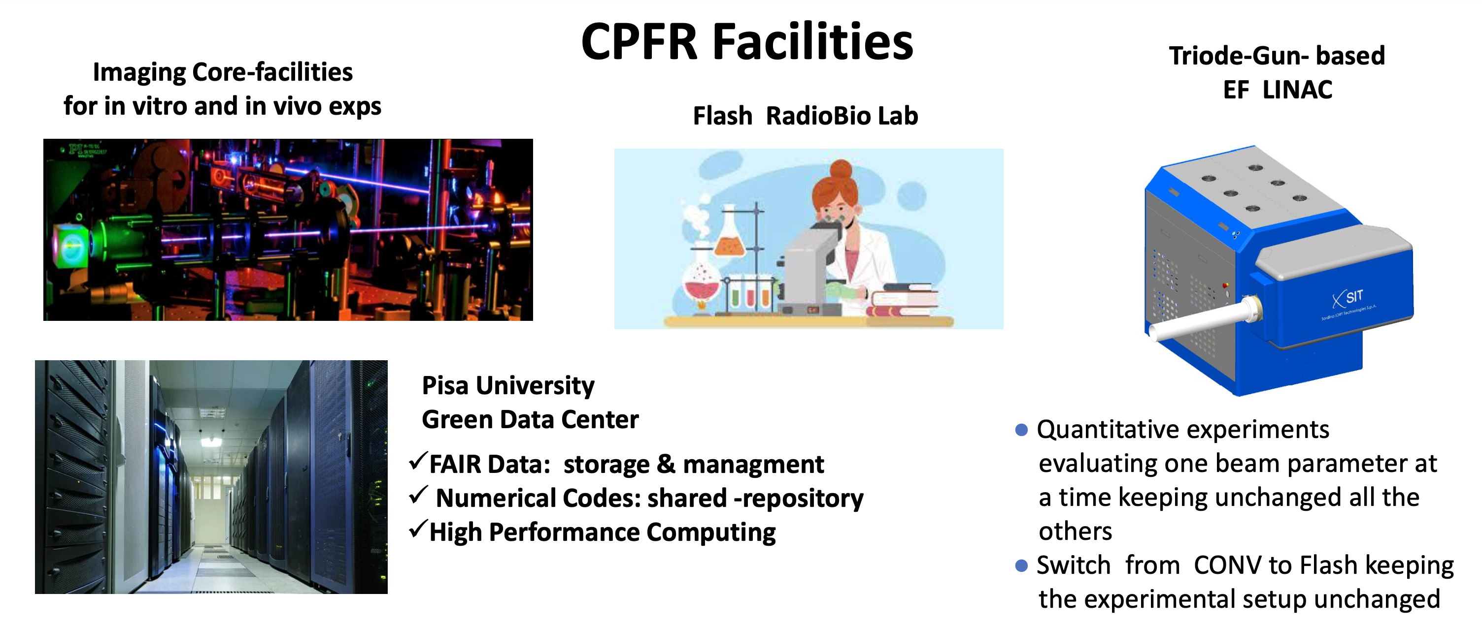
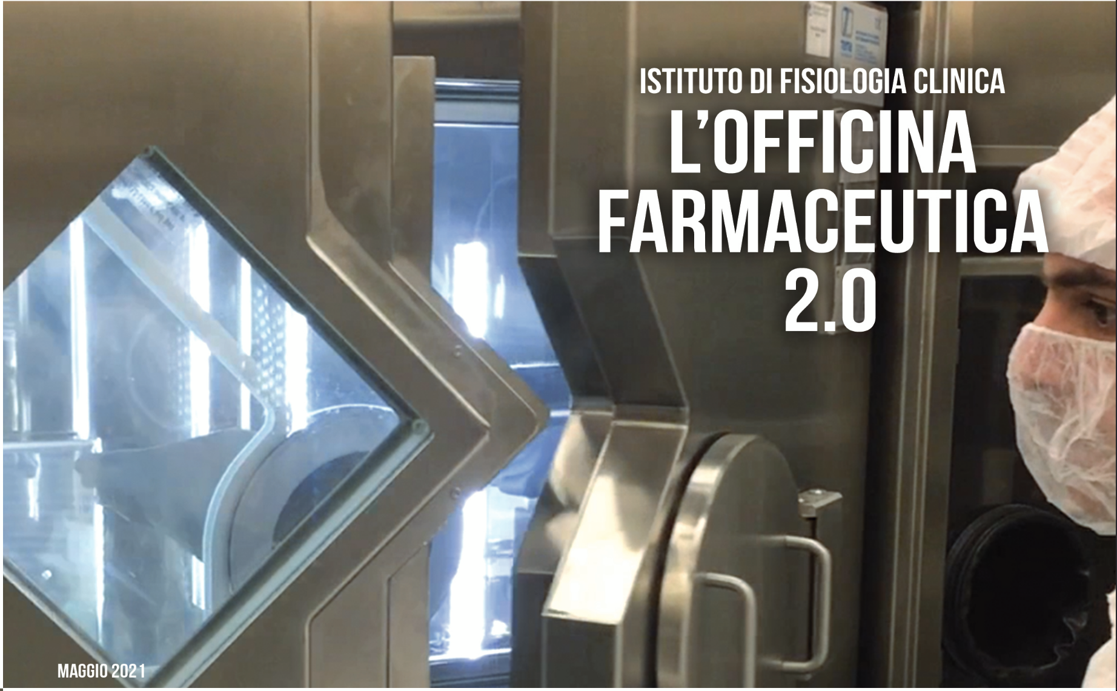



SPOKE 1: ADVANCED RADIOTHERAPIES AND DIAGNOSTICS IN ONCOLOGY
Xtreme Photonics
New accelerator technology
New radiobiological effects
New technology for high dose-rate dosimetry
New radiotracers development
Advanced diagnostic approaches
Novel dose deposition control techniques
Syntesis of new radiopharmaceuticals
From radiobiology to clinical application
INTENSE LASER LAB @ CNR-INO
CPFR center @ UNIPI/AOUP
Preclinical to clinical translation
OFFICINA FARMACEUTICA CNR-IFC
WITH

Slide 5
SPOKE 1 MAIN PATHWAYS
Develop technologies
  Very high energy electron sources for deep tumors
  UHDR Dosimetry
  In situ dose deposition and TP
Understand radiobiology
  Use existing advanced technology for preclinical studies, in vitro, ex-vivo and in vivo
  Establish knowledge base and data collection platform
Prepare clinical translation
  Use achievements to plan the first human trials (FLASH)
  Tecnology transfer and authorization of new radiofarmaceuticals
Non-thematic tasks (link to Spoke 5 and HUB)
  Establish regulatory paths
  Deliver innovation through patents and startups
  Disseminate and raise interest

Slide 6
SPOKE 1: SUBPROJECTS AND THEIR LEADERS
SUBPROJECT (WP) | PARTNERS INVOLVED | LEAD
1.0 OPEN CALLS FOR RECRUITMENT AND SPOKE MANAGEMENT SETUP | All | All
1.1 INNOVATIVE APPROACHES TO ONCOLOGIC RADIOTHERAPY: RADIATION SOURCES | CNR-INO, INFN, UNIPI | Gizzi (CNR-INO) Bisogni (UNIPI)
1.2 SIMULATIONS, MOLECULAR MECHANISMS VALIDATION AND RADIOBIOLOGICAL EFFECT MODELLING | CNR-IFC, CNR-INO, CNR-ITB, CNR-NANO, INFN, UNIPI | Tozzini (CNR-NANO) Gizzi (CNR-INO) Andreassi (CNR-IFC)
1.3 RADIOBIOLOGICAL EFFECTS OF IONIZING RADIATION: IN VITRO (CELL CULTURE) AND IN VIVO | CNR-IFC, CNR-IN, CNR-INO,UNIPI | Costa (CNR-IN) Kusmic (CNR-IFC)
1.4 FLASH RADIOTHERAPY: PRECLINICAL | CNR-IFC, CNR-IN,CNR-INO, UNIPI | Maffei (CNR-IFC) UNIPI
1.5 FLASH RADIOTHERAPY – FROM PRECLINICAL TO CLINICAL | CNR-IFC, CNR-IN,UNIPI | Paiar (UNIPI) Vannini (CNR-IN)
1.6 IN SITU ADVANCED DIAGNOSTICS OF RADIATION DEPOSITION AND CONFORMALITY | CNR-IFC, CNR-IN, CNR-INO, INFN, UNIPI | Retico (INFN) Labate (CNR-INO)
1.7 SYNTHESIS AND PRODUCTION OF TUMOR-TARGETED RADIONUCLIDES, RADIOTRACERS AND RADIOPHARMACEUTICALS FOR EXPERIMENTAL STUDIES | CNR-IFC, CNR-IN, UNIFI | Menichetti (CNR-IFC) Carta (UNIFI)
1.8 SYNTHESIS AND PRODUCTION OF TUMOR-TARGETED RADIONUCLIDES, RADIOTRACERS AND RADIOPHARMACEUTICALS FOR CLINICAL USE | CNR-IFC, CNR-IN, UNIFI, UNIPI | Poli (CNR-IFC) Volterrani (UNIPI)
1.9 CASCADE CALLS | CNR-INO | Gizzi (CNR-INO) Fornaciari (CNR-INO)

Slide 7
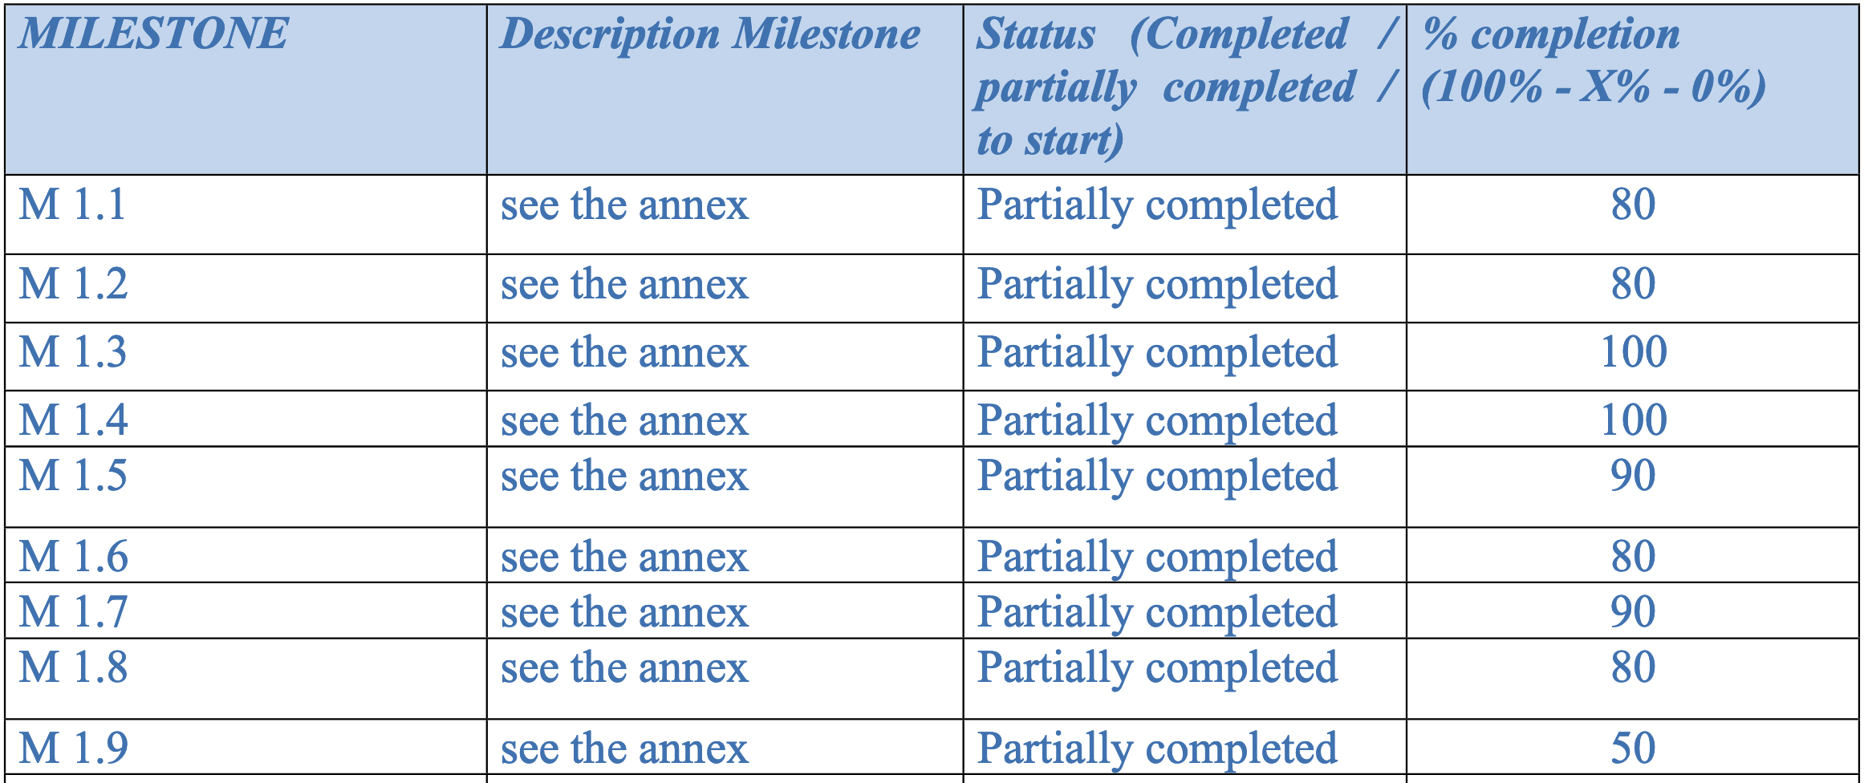
REPORT @NOV 2024
OVERALL PROJECT’S PROGRESS SUMMARY
- Tuscany Health Ecosystem (health)
- Approved funding € 110.000.000
- Disbursement received € 33.000.000
- Costs reported: € 46.906.381,25
Cost reported: 47%

Slide 8
CASCADE CALL – SPOKE 1
BANDO A CASCATA PER ORGANISMI DI RICERCA E IMPRESE
Progetto “THE - Tuscany Health Ecosystem”
Codice progetto ECS00000017
CUP B83C22003930001
BANDO PUBBLICO PER LA SELEZIONE DI PROPOSTE PROGETTUALI DA FINANZIARE NELL’AMBITO DEL
PROGRAMMA DI RICERCA DELL’ECOSISTEMA DELL’INNOVAZIONE “THE - TUSCANY HEALTH
ECOSYSTEM”, A VALERE SULLE RISORSE DEL PIANO NAZIONALE PER LA RIPRESA E RESILIENZA
(PNRR), MISSIONE 4 “ISTRUZIONE E RICERCA” – COMPONENTE 2 “DALLA RICERCA ALL’IMPRESA” –
INVESTIMENTO 1.5 – CREAZIONE E RAFFORZAMENTO DI “ECOSISTEMI DELL’INNOVAZIONE PER LA
SOSTENIBILITÀ”, CREAZIONE DI “LEADER TERRITORIALI DI R&S”, FINANZIATO DALL’UNIONE
EUROPEA – NEXTGENERATIONEU.
Obiettivi specifici del Bando
Il Bando ha lo scopo di finanziare progetti di ricerca e innovazione, sviluppo sperimentale e studi di fattibilità su tematiche indicate nell’Allegato C al presente Bando e relative allo Spoke 1_Advanced radiotherapies and diagnostics in oncology.

Slide 9
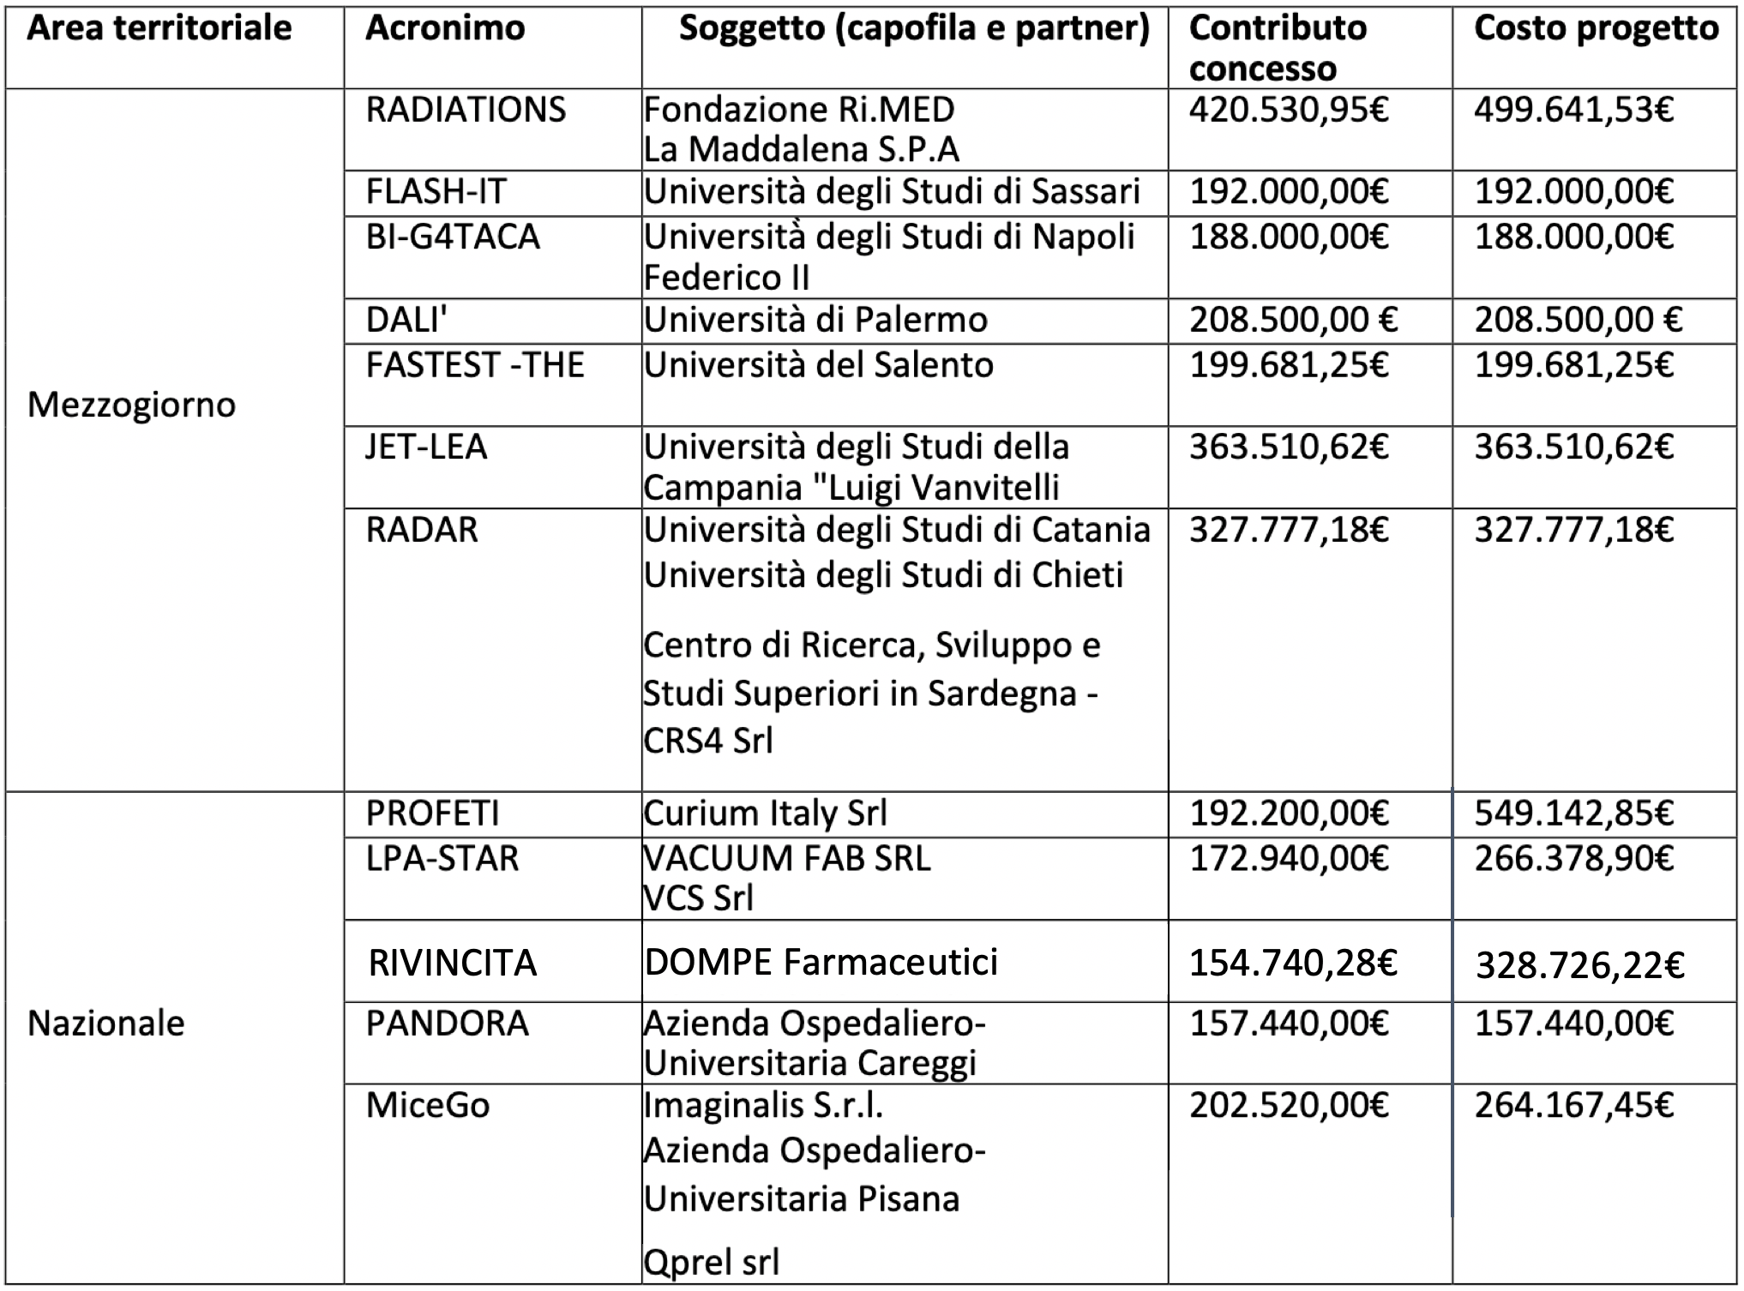
FUNDED CC PROJECTS WITH COORDINATORS AND PARTNERS

Slide 10
FUNDED CC PROJECTS AND LINK TO SUBPROJECTS
Coordinator | Acronym | Title/Topic | Link to Subproject
Università degli Studi di Palermo | DALI' | Development of Advanced dosimetric techniques for uLtra-hIgh dose rate beams | 1.5 Flash: dal preclinico al clinico
Curium Italy Srl | PROFETI | Trasferimento Tecnologico e Prima Rete per l’uso Oncologico della FET in Italia | 1.8 Sintesi e produzione di radionuclidi - Uso clinico
Azienda Ospedaliero-Universitaria Careggi | PANDORA | Caratterizzazione dosimetrica di rivelatori e fasci di PArticelle coN altissimo DOse rate in Radioterapia | 1.4 Flash: Preclinica
Università degli Studi della Campania "Luigi Vanvitelli" - Dipartimento di Matematica e Fisica | JET-LEA | JEt Target for Laser Electron Acceleration | 1.1 Approcci innovativi: sorgenti di radiazione
Università degli Studi di Sassari | FLASH-IT | IT Platform for Heterogeneous Data Analysis and Collection in FLASH Radiotherapy | 1.2 Simulazioni, validazione e Modelling
Dompé farmaceutici SPA | RIVINCITA | Radiofarmaci InnovatiVI per approcci teraNostiCI verso Tumori Aggressivi del Pancreas | 1.7 Sintesi e produzione di radionuclidi - Uso preclinico
Dipartimento di Farmacia Università degli Studi di Napoli Federico II | BI-G4TACA | Agenti Teranostici Leganti G-quadruplex e Anidrasi Carbonica in Batteri Intratumorali | 1.7 Sintesi e produzione di radionuclidi - Uso preclinico
Fondazione Ri.MED | RADIATIONS | Studio e valutazione dell’effetto RADiobiologico di nanopartIcelle polimeriche innovative di origine nATurale radiomarcate con radioIsotopO Lu-177 in linee cellulari di caNcro della proStata | 1.7 Sintesi e produzione di radionuclidi - Uso preclinico
Università degli Studi di Catania - Dipartimento di Scienze mediche, chirurgiche e tecnologie avanzate "G.F. Ingrassia" - DGFI | RADAR | Database per addestrare l'IA a riconoscere danni da radiazione nei tessuti solidi | 1.4 Flash: Preclinica (?)
Imaginalis S.r.l. | MiceGo | Medical Imaging and Calculations for Exposure in Goal-oriented Oncology | 1.4 Flash: Preclinica
Università del Salento - Dipartimento di matematica e fisica "Ennio De Giorgi | FASTEST -THE | FAST ElectronS for radioTherapy aT very High Energy | 1.6 Diagnostica in situ e conformalità
VACUUM FAB SRL | LPA-STAR | Stable Targeting and Alignment for Radiotherapy in Laser-Plasma Acceleration | 1.1 Approcci innovativi: sorgenti di radiazione

Slide 11
PROGETTO PNRR THE_TUSCANY HEALTH ECOSYSTEM
https://tuscanyhealthecosystem.it ECS00000017 – CUP B83C22003930001
Missione 4 Istruzione e Ricerca, Componente 2 Dalla ricerca all’impresa, Investimento 1.5 Creazione e rafforzamento di “Ecosistemi dell’innovazione”, costruzione di “Leader Territoriali di R&S”
Bando a Cascata Spoke 1: RADIOTERAPIE E DIAGNOSTICHE AVANZATE IN ONCOLOGIA
Kick-off meeting dei progetti vincitori
10 ottobre 2024 ore 11:00 – 17:00 c/o Area della Ricerca CNR di Pisa, Aula 27 - via G. Moruzzi, 1
AGENDA
Cascade Calls Projects kicked off
Ore 11.00 - 11.30 Saluti e Introduzione ai lavori - Il progetto “THE” - Tuscany Health Ecosystem: Panoramica e obiettivi del bando a cascata, Dott. Leonida Gizzi, CNR-INO, Responsabile Scientifico CNR del progetto THE
Ore 11.30 – 12.45 Alcuni highlight scientifici dello Spoke 1
• Sistemi dosimetrici per FLASH-RT: misurazione della dose con rivelatori basati su scintillatori plastici – Eleonora Ravera (UNIPI)
• Tecnologie abilitanti per la sperimentazione preclinica con acceleratori laser-plasma – Simona Piccinini (CNR-INO)
• Sviluppo di un sistema di posizionamento per modelli animali – Alessandra Gonnelli (UNIPI)
• Piattaforma 3D in vitro per studiare gli effetti della radioterapia in cellule sane e tumorali – Alice Usai (UNIPI)
• Strumenti di imaging per valutare l’efficacia di FLASH e CONV RT su un modello murino – Edoarda Mota da Silva (CNR/SSSA)
• Piattaforma per la gestione e analisi dei dati per la sperimentazione FLASH – Camilla Scapicchio (INFN)
Ore 12.45 - 13.15 Step attuativi e adempimenti contrattuali - Aspetti gestionali, amministrativi e finanziari, Dr.ssa Donata Fornaciari, CNR-INO, Project manager CNR del progetto THE
Ore 13.15 - 14.45 Light Lunch
Ore 14.45 - 15.30 Aspetti gestionali, amministrativi e finanziari, Dr.ssa Donata Fornaciari, CNR-INO, Project manager CNR del progetto THE
Ore 15.30 - 16.30 Il gestionale AtWork per la rendicontazione, Dott. Paolo Prosperini, consulente per il Bando a Cascata THE – Spoke 1
Ore 16.30 - 17.00 Q&A
Ore 17.00 Conclusione dei lavori

Slide 12
NEXT STEPS
Next Scientific Report update – Deadline 15 gennaio.
Update previous file of Scientific Report (Nov 2024) with blue text
Update on deliverables e target, to be included in «Detailed description of activities’ progress»
Figures to be placed in a separate file - attachment
Update on dissemination and publications to be placed in separate file – attachment
Do not add names of staff – reports concern teamwork – represents 1400 people

Slide 13
THE DEADLINE EXTENSION
MUR will allow a deadline extension of one month, from Nov. 30, to Dec 31st 2025
HUB decision is to keep deadline for consolidation of expenditure on Nov. 30, 2025
All order should be placed by 20 June 2025
Extra month only for cost of personnel (massa critica)
Deadline for final financial reporting: 31 Jan, 2025
Deadline for final scientific reporting: 7 Jan. 2026

Slide 14
THE BEYOND PNRR: THE HUB VIEW
The future of THE - Preparation of a feasibility and sustainability plan for the future of the Ecosystem
The HUB is preparing a feasibility and sustainability plan based on public-private funding;
An appropriate light legal form (foundation, scarl, consortium) similar to the existing SCARL;
Coordination of research support services (mainly coordinated at the moment by spoke 5).
Construction of a model that can act as an intermediate body between Regional and National/European levels.
Support the development of products and services useful for responding to "unmet medical needs".
Strengthen network research expertise, infrastructures, towards innovative solutions and products
An internal task force will be established within the project to draft the ecosystem sustainability plan.

Slide 15
THE BEYOND PNRR: THE CNR APPROACH
Sinergia tra le iniziative PNRR in ambito CNR (49) - Infrastrutture e Hub&Spoke.
Individuazione di 10-15 iniziative sulle quali poter investire come CNR ma anche attrarre investimenti. Da definire:
              Un business plan avanzato, basato di partnership pubblico-privata
      I costi di gestione e i contributi da richiedere ai soci, i proventi attesi etc …
      Il personale coinvolto e quello che si richiede, tenendo presente il Turn Over CNR
      L’impatto ambientale
      L’impatto scientifico, tecnologico e socio-economico

Slide 16
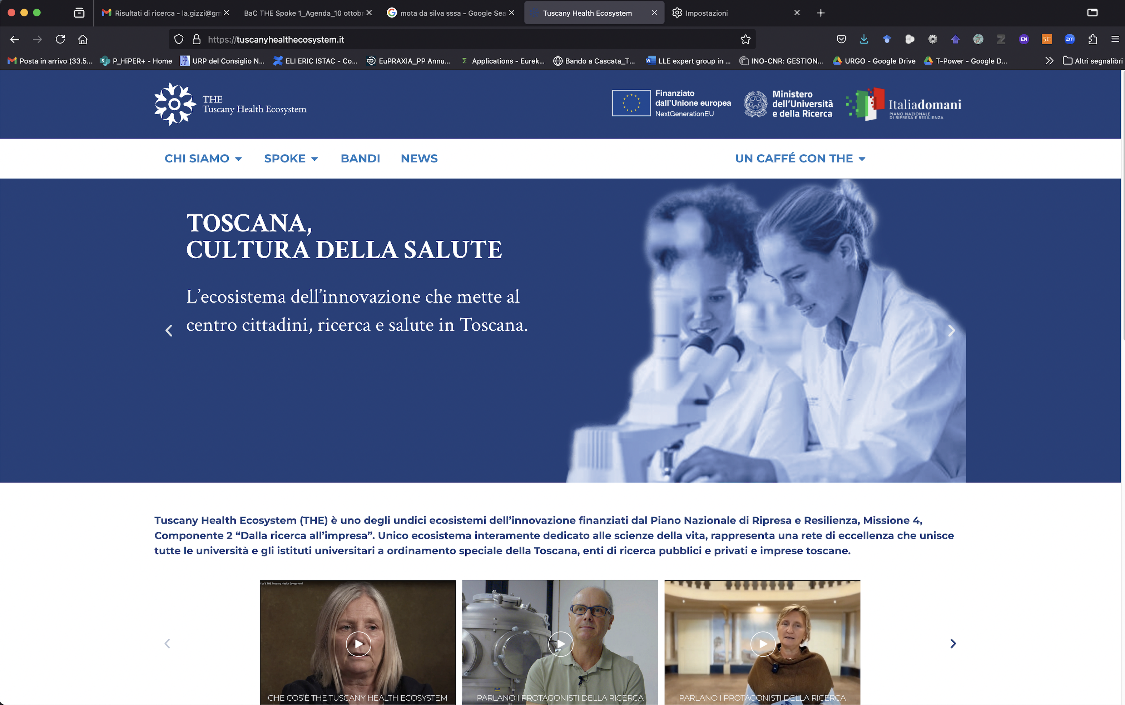
“THE - Tuscany Health Ecosystem”: Web Site
https://www.tuscanyhealthecosystem.it/
Vetrina accessibile al pubblico e aggiornata quitidianamente grazie collegamento con gli SPOKE (Ambassadors)
CONTRIBUTI
Video
Interviste
Caffè con THE
Approfondimenti

Slide 17
SUMMARY
Scientific milestones on track;
    Focus on high quality and high impact;
Financial reporting is fine, but behind schedule;
  1 month extension for personnel cost only
Detailed plan of 3rd and last year of project needed;
All orders to be placed by end of June 2025
Strategies for the future of Tuscany Health Ecosystem under evaluation;
Focus on innovation(IP), TT and clinical perspective;
Cooperation needed to define action plan to attract funding;
  Highlight synergies with othe PNRR initiatives.

Slide 18




Acknowledgements
Organizing committee
Federico Avella
Martina Salvadori
Costanza Panaino
Simona Piccinini
Nunzia Aprile
Michela Balderi
Donata Fornaciari
Paolo Prosperini
Susanna Ughi
PNRR Research Infrastructures

