Slide 1
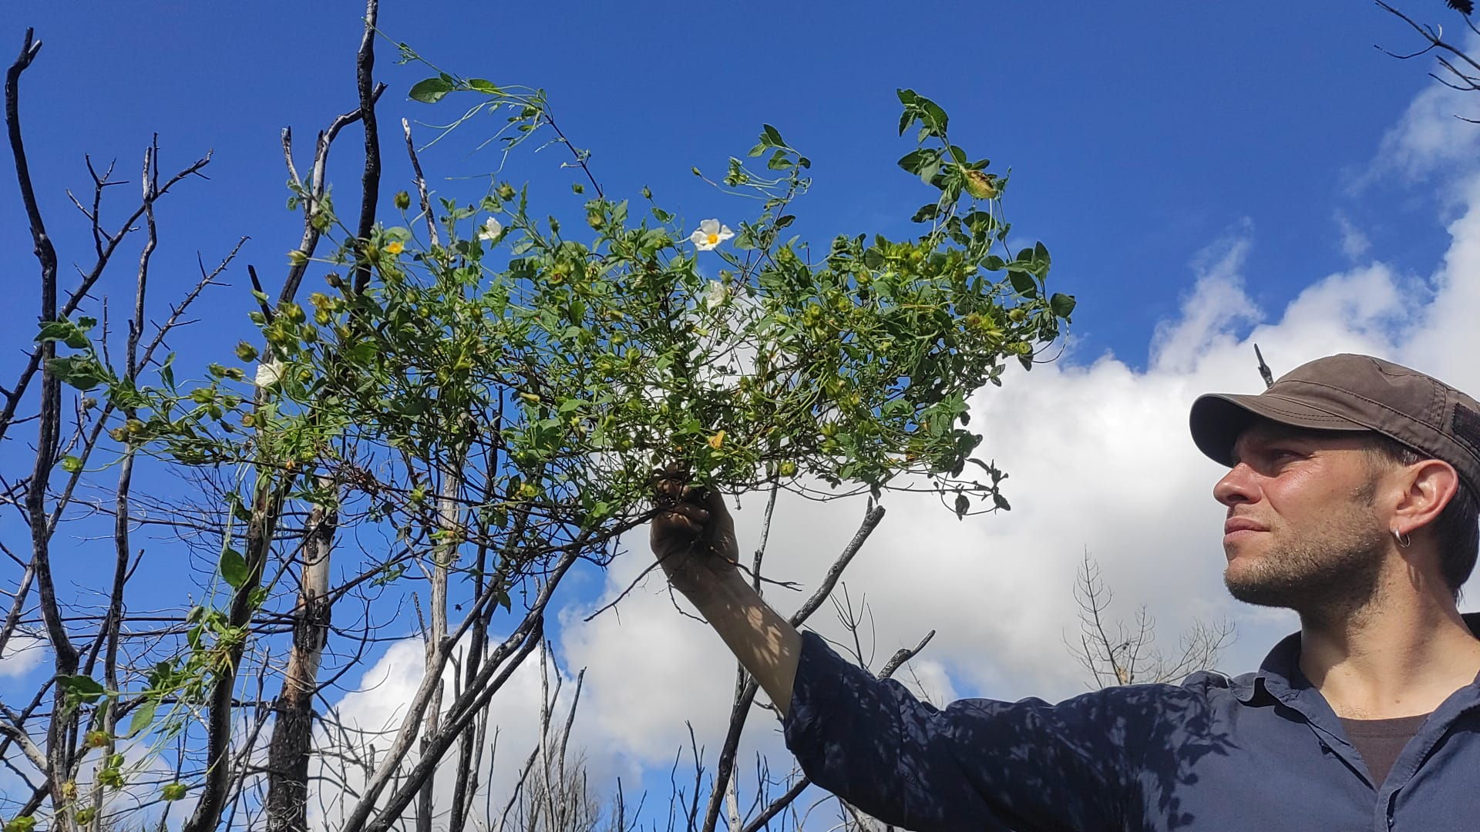
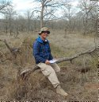
Trait syndromes and intraspecific responses to fire regimes of Mediterranean reseeder and resprouter woody plants
Gianluigi Ottaviani^{1,2}, Mathieu Millan³, NBFC Wildfire-Biodiversity WG
¹Research Institute on Terrestrial Ecosystems (IRET), National Research Council (CNR), Porano, Italy
²National Biodiversity Future Center (NBFC), Palermo, Italy
³32153 Route de Mende, Montpellier, France

Slide 2
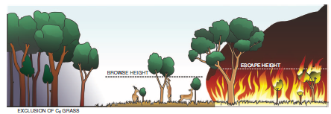

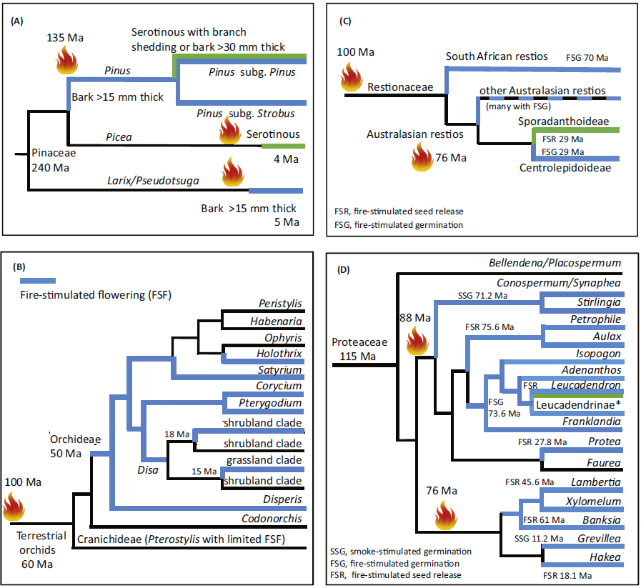

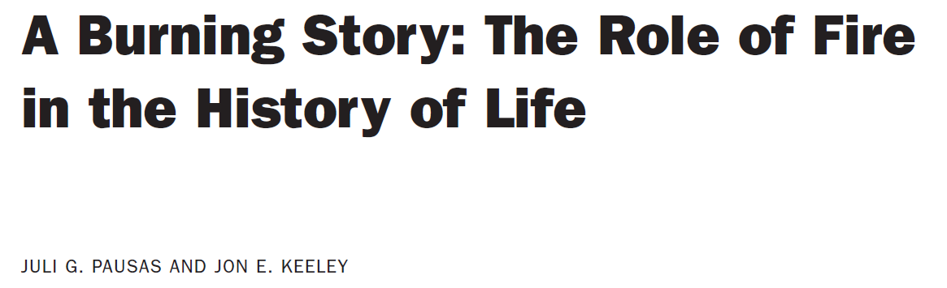
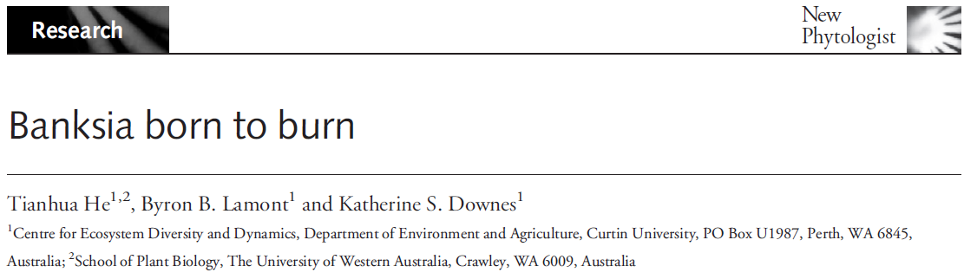
Wigley et al. 2020 Aust J Bot
Fire = an eco-evolutionary force
Plant forms & functions
Lamont & He 2017 Trends Plant Sci

Slide 3
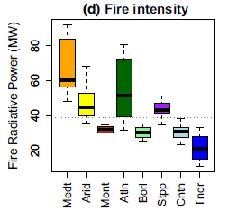
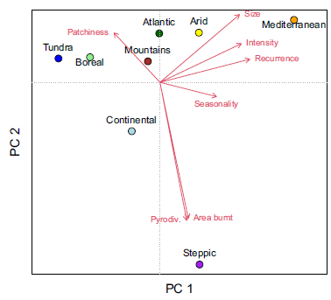
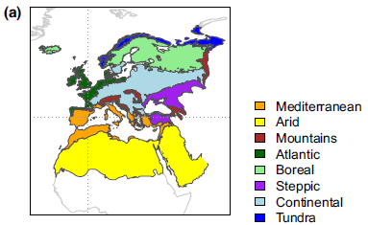
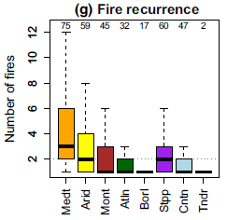
Fire = an eco-evolutionary force
Biome distribution & dynamics
Pausas 2022 Glob Ecol Biogeogr

Slide 4
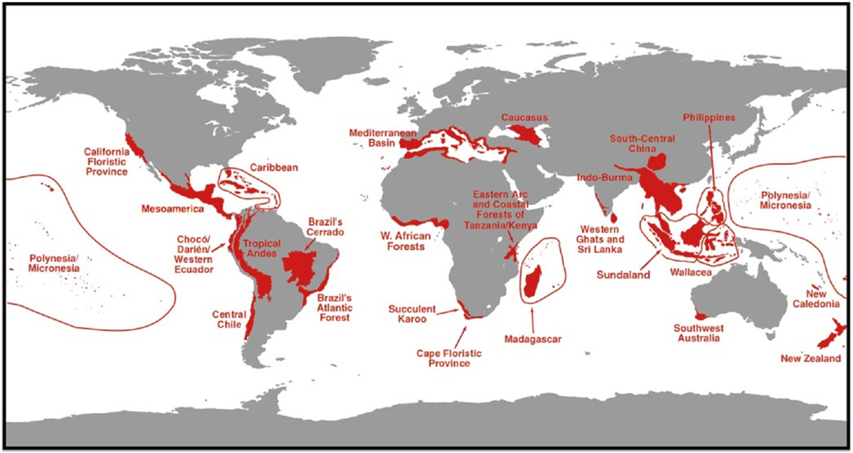
Mediterranean-type ecosystems = hotspots of biodiversity & exacerbating threats
Myers et al. 2000 Nature

Slide 5
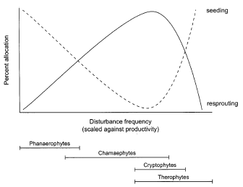
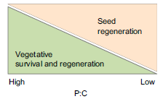
Post-fire plant strategies = resprouters & reseeders
Carta et al. 2024 Funct Ecol
Bellingham & Sparrow 2000 Oikos
Pausas & Keeley 2014 New Phytol
A continuum occurs between obligate resprouters & reseeders, i.e. facultative strategies

Slide 6
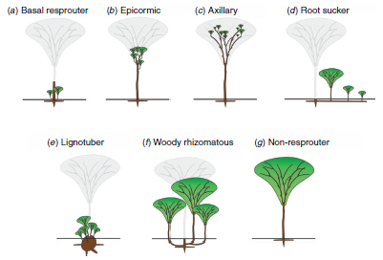
Post-fire plant strategies = resprouters & reseeders
Wigley et al. 2020 Aust J Bot
(modified from Clarke et al. 2013 New Phytol)

Slide 7
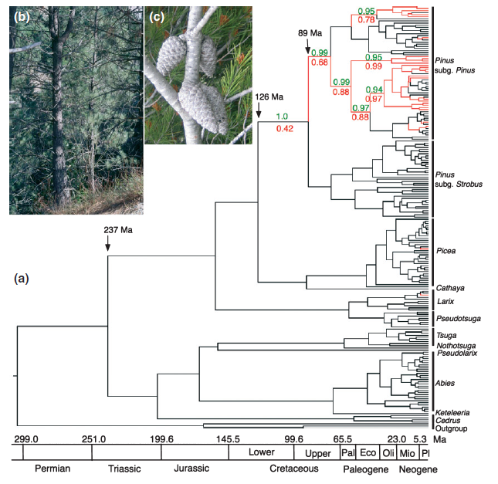
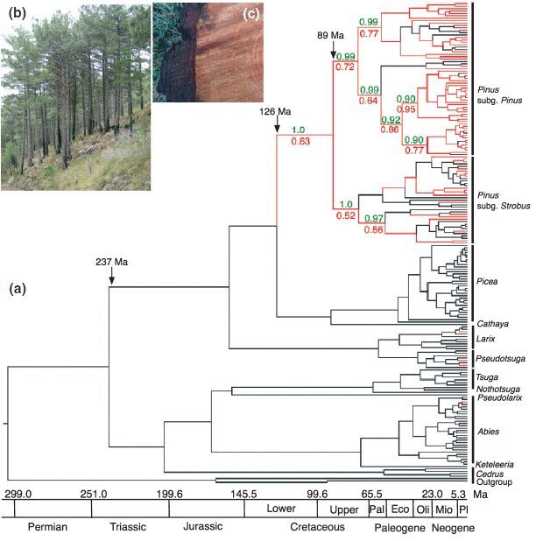
Post-fire plant strategies = resprouters & reseeders
Fire-driven evolution of serotiny in Pinus
Fire-driven evolution of thick bark in Pinus
Schwilk & Ackerly 2001 Oikos
He et al. 2011 New Phytol

Slide 8
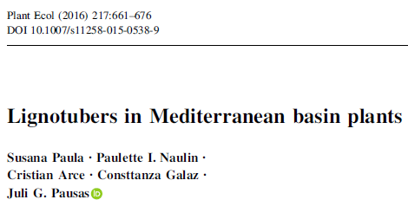
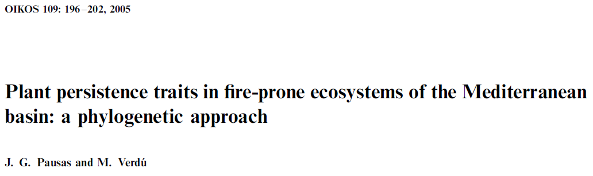
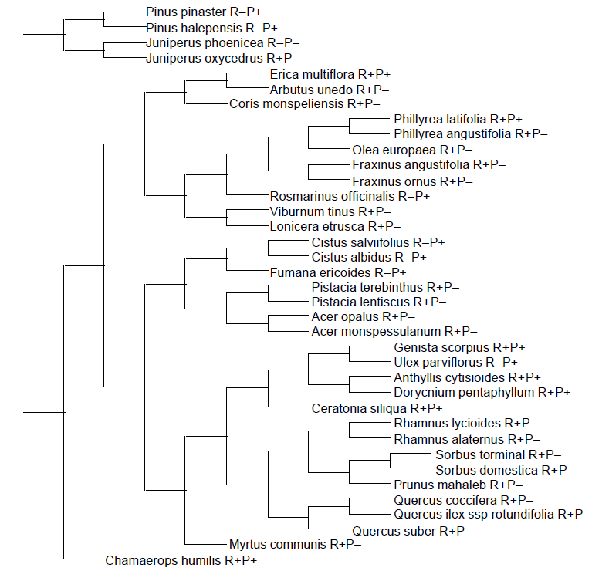
Mediterranean Basin = an aridity- and fire-driven hotspot of biodiversity & exacerbating threats

Slide 9
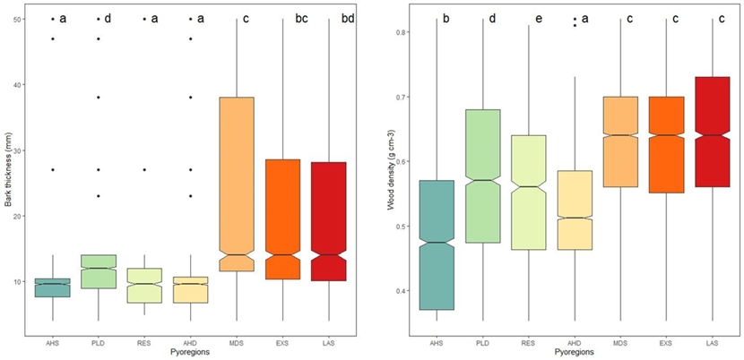
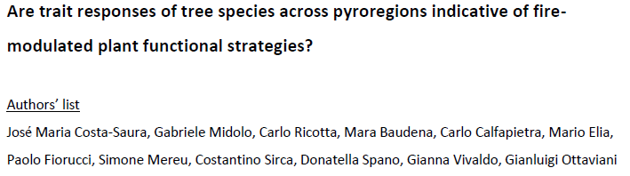
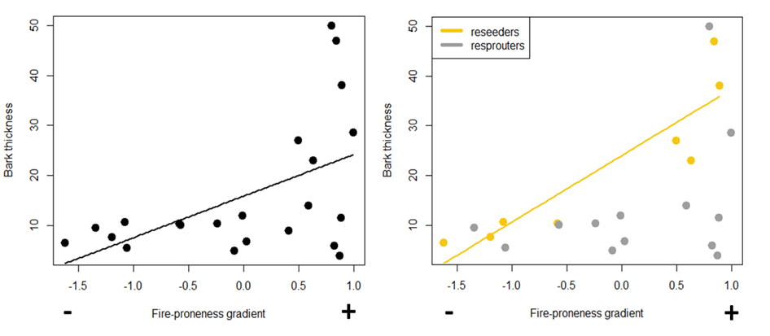
Mediterranean Basin = an aridity- and fire-driven hotspot of biodiversity & exacerbating threats

Slide 10
Study goal: Examining trait syndromes & post-fire intraspecific responses of Mediterranean reseeder and resprouter woody plants
Q1. Do resprouter and reseeder species differ in their trait coordination?
Q2. Do trait patterns indicate fire-modulated plant responses to changes in fire regime?
Q3. Does fire regime affect trait coordination relationships?

Slide 11
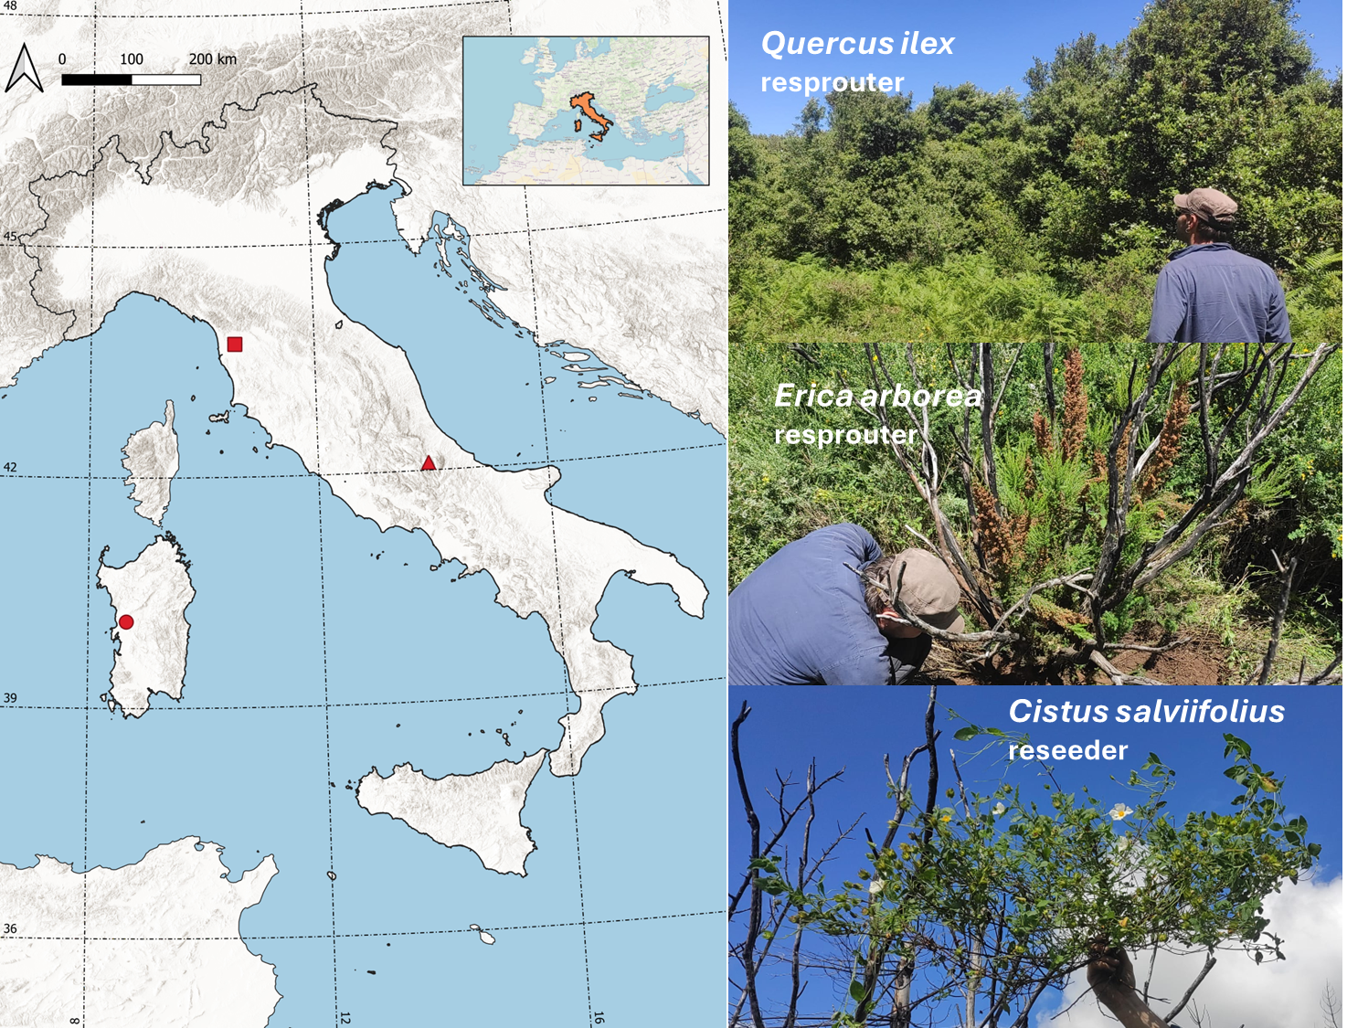
Study system
Sites
Species
Post-fire strategies
Mt Pisano
Mt Morrone
Montiferru

Slide 12
Study system
Plant functional traits (some): informing on fire-related strategies & fitness
TRAIT | MAIN PLANT & ECOSYSTEM FUNCTION(S) | ORGAN
Bark thickness (mm) | Protection from disturbance (mainly fire); Resource storage | Stem base
Belowground coarse organ dry matter content [BDMC] (mg g⁻¹) | Resource (water) conservation; Plant lifespan | Thick root, lignotuber
Leaf dry matter content [LDMC] (mg g⁻¹) | Resource (water) conservation; Leaf and plant lifespan; Resistance to herbivory; Flammability; Litter decomposability | Leaf
Plant height (cm) | Aboveground biomass allocation & vertical space occupancy; Light capture; Escape from disturbance trap(s) | Stem
Ratio between generative and vegetative stems (%) | Main reproduction type; Generative vs vegetative reproduction effort | Stem bearing flowers and/or fruits
Ratio between dead and alive stems (%) | Disturbance damage; Mortality/vitality | Stem
Stem dry matter content [SDMC] (mg g⁻¹) | Resource (water) conservation; Plant lifespan; Flammability; Structural support | Stem
Stem diameter (cm) | Response to aridity, Aboveground biomass allocation | Stem base

Slide 13
Study system & sampling design
Fire regimes
Site | Plot type | Year Burnt | Time since last fire (yrs) | Number of fires | Fire return interval (=yrs/(#fires+1)) | Species
 |  |  |  |  |  | Resprouter |  | Reseeder
 |  |  |  |  |  | Q. ilex (n=50) | E. arborea (n=40) | C. salviifolius (n=30)
Montiferru | Control – Holm oak | <1970 | 54 | 0 | 54 | 10 |  | 5
 | Control – Mix | <1970 | 54 | 0 | 54 | 10
 | 2 Fires | 1994, 2021 | 3 | 2 | 18 | 5 | 10 | 10
 | 3 Fires | 1983, 1994, 2021 | 3 | 3 | 13.5 | 10 | 5
Mt Morrone | 1 fire | 2017 | 7 | 1 | 27 | 10
 | 2 Fires | 2017, 2023 | 1 | 2 | 18 | 5
Mt Pisano | Control – Pine | <1970 | 54 | 0 | 54 |  | 10
 | 1 fire | 1998 | 26 | 1 | 27 |  | 10 | 5
 | 2 Fires | 1998, 2023 | 1 | 2 | 18 |  | 5 | 10

Slide 14
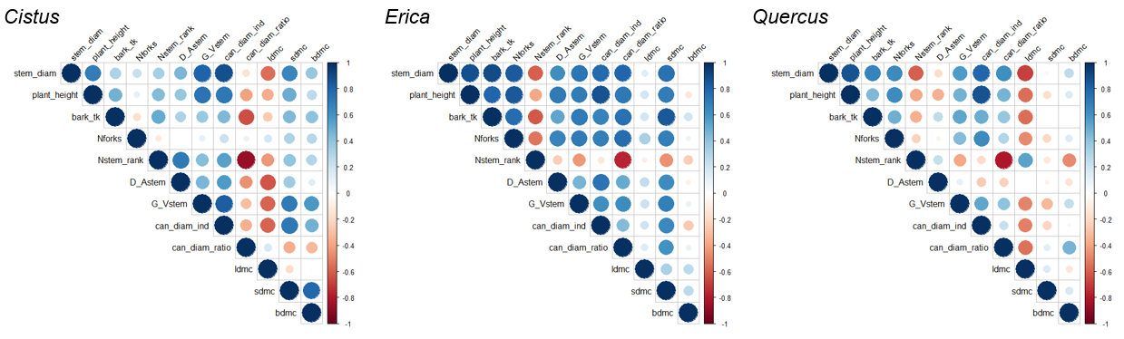
Q1. Do resprouter and reseeder species differ in their trait coordination?
A1. Yes they do differ, as there are differences between resprouters

Slide 15
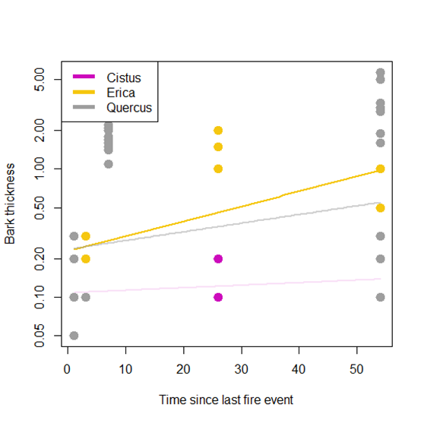
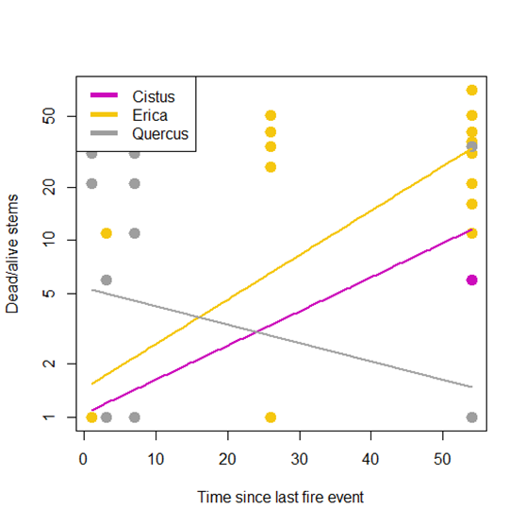
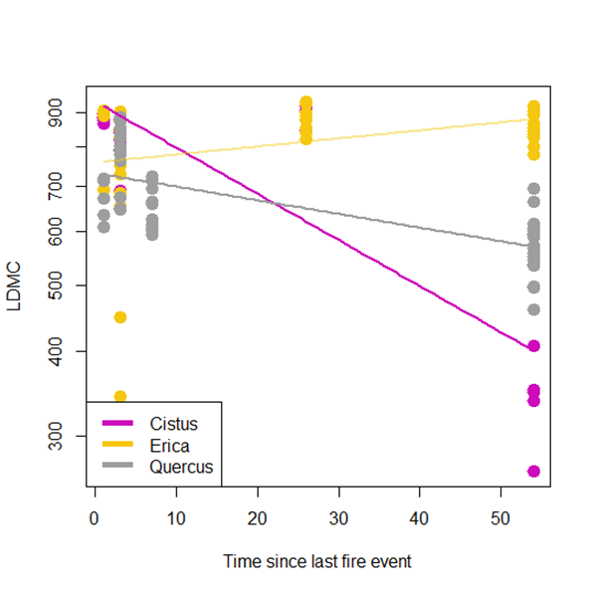
Q2. Do trait patterns indicate fire-modulated plant responses to changes in fire regime?
A2. Yes they do, and responses are species-specific & not necessarily aligning with post-fire strategy (life history classification)

Slide 16
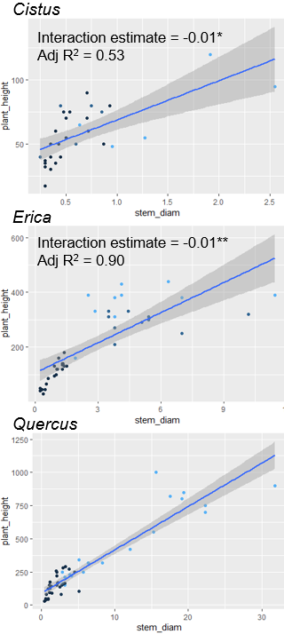

Q3. Does fire regime affect trait coordination relationships?
A3. Yes for C. salviifolius (reseeder) and E. arborea (resprouter) – e.g. weakening the size-related allometric link – but not for Q. ilex (resprouter)
Time since last fire

Slide 17
Takeaways
1. Plant species are not homogeneous entities, even less so are life histories; the dichotomy between reseeder and resprouter plant strategies is more nuanced – when including intraspecific variability (being trait- and context-dependent)
2. A priori classifications of life histories, including post-fire strategies (e.g. reseeders vs resprouters, life forms), can constitute powerful tools to examine species and functional patterns at coarser scales. At finer scales considering species-specific patterns and intraspecific variability can refine our understanding of how plants may cope with changes in the environment (e.g. fire disturbance) – useful information to estimate cascading effects on ecosystem functioning & for restoration purposes

Slide 18

This research is supported by NBFC (National Biodiversity Future Center) funded by the Italian Ministry of University and Research, P.N.R.R., Missione 4 Componente 2, “Dalla ricerca all'impresa”, Investimento 1.4, Project CN00000033 (financed by the European Union – NextGenerationEU).
A special thank goes to Mara Baudena (CNR-ISAC), Heath Beckett (Stellenbosch Uni, SA), José Maria Costa-Saura, Costantino Sirca, Mauro Lo Cascio (UniSS), Marta Magnani (CNR-IGG), Silvia Portarena, Ettore D’Andrea (CNR-IRET) for conceptually contributing to the study or helping with field- & lab-work.
Extensions of this trait-based research are undergoing with 2 students (1 Master @ UniTO, 1 PhD @ UniGE & CIMA).
Thanks for your attention!

Slide 20
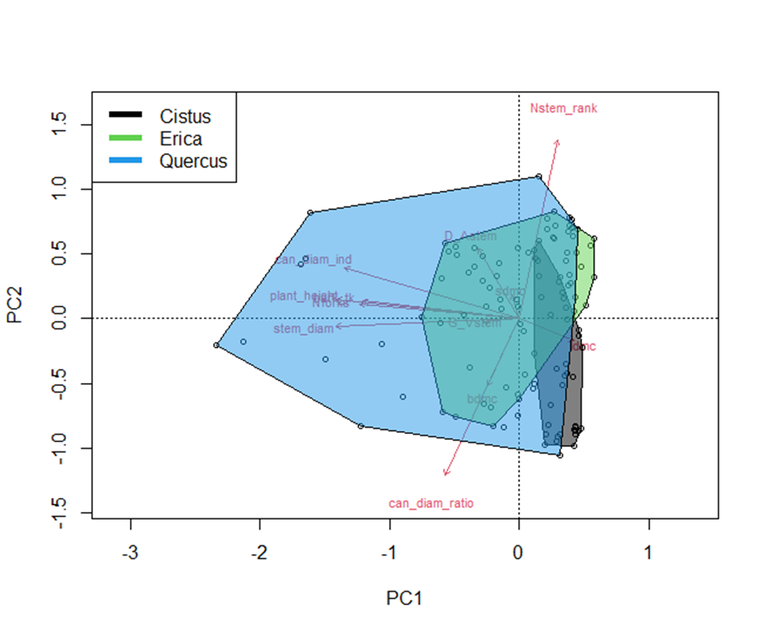
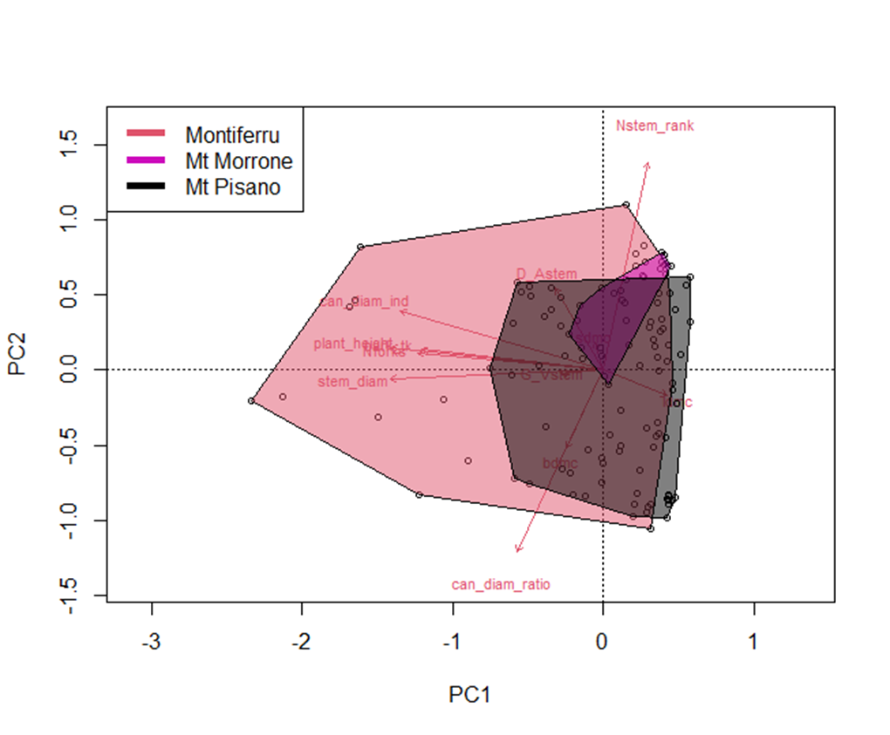
Species
Site

