Slide 1
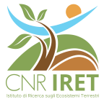
One method to rule them all:
a FAIR and Open approach
for the study and integrated management
of Invasive Alien Species
Cristina Di Muri
CNR IRET
Di Muri C., Azzurro E., Chiappi M., Ciolfi M., Flore S., Giacalone V.M., Lauteri M., Loru L., Mancinelli G., Pipitone C., Pollegioni P., Scarcella G., Strafella P., Rosati I.

Slide 2
Background Principles
Variety of
monitoring approaches
Multi-disciplinary experts
F
A
I
R
Variety of
research
products
Diverse
data collection
protocols
Notes:
The implementation of FAIR (Findable, Accessible, Interoperable, Reusable) principles and Open Science practices can greatly enhance the capacity to integrate and reuse multi-disciplinary research products obtained by various monitoring approaches and data collection methods. Such ability allows a better transfer of knowledge-based scientific information to different stakeholders, especially those involved in policymaking, and to the society

Slide 3
Alien Invasive Species Network
Notes:
The opportunity to test the adoption of FAIR and Open Science practices at the national Italian level in a multi-disciplinary, multi-ecosystem, and multi-taxonomic context was provided by USEit, a project focusing on Invasive Alien Species (IAS), funded by the National Research Council (CNR), and involving scientists from three different CNR Institutes.
The scope of USEit was to combine expertise from scientists studying IAS in different ecosystems (aquatic and terrestrial) and find synergies across different data collection and data management methods, ultimately, outlining operational and technical guidelines suitable for adoption within and beyond the project.

Slide 4
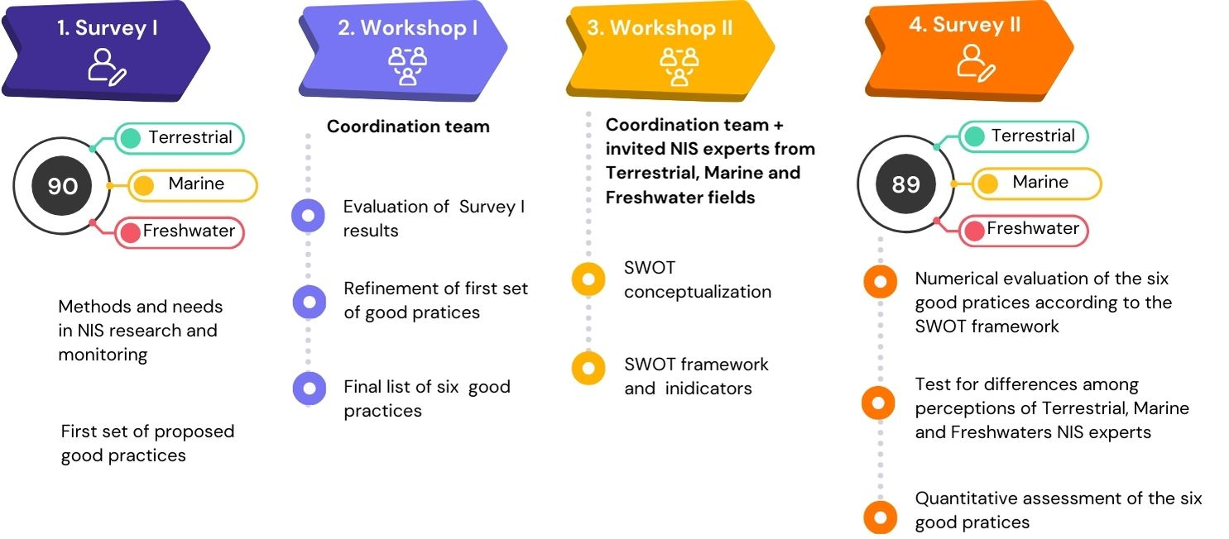
Methods
Azzurro et al., Insights for collecting, sharing and communicating Non-Indigenous Species data in Italy: A SWOT analysis. In prep.
Notes:
The operational guidelines for IAS data collection were drafted based on an analysis of the responses to a national survey. They were subsequently reviewed by national experts of biological invasions and, finally, validated through SWOT analysis.

Slide 5
Final set of Good Practices
GP1: Identify and report
by-catch NIS information
GP2: Use reference protocols
for NIS data collection
GP3. Integrate citizen science
and local ecological knowledge
GP4: Share and promote NIS data
using Open and FAIR practices
GP5: Archive NIS (meta)data
into open-access repository
GP6: Enhance public communication of NIS data
Azzurro et al., In prep.

Slide 6
Final set of Good Practices
GP1: Identify and report
by-catch NIS information
GP2: Use reference protocols
for NIS data collection
GP3. Integrate citizen science
and local ecological knowledge
GP4: Share and promote NIS data
using Open and FAIR practices
GP5: Archive NIS (meta)data
into open-access repository
GP6: Enhance public communication of NIS data
Azzurro et al., In prep.

Slide 7
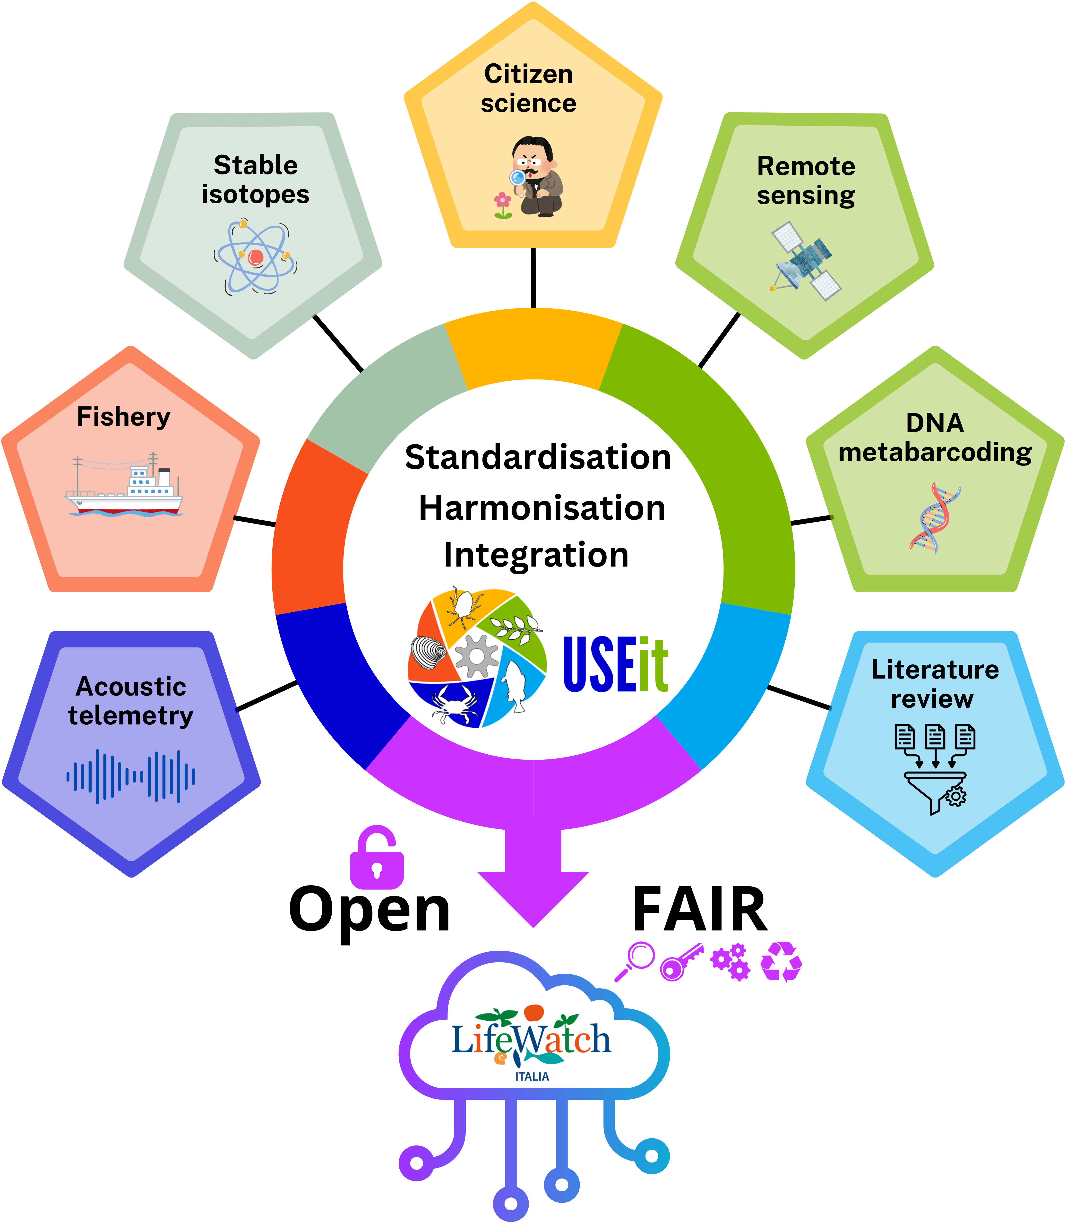
Data sharing: GP 4
Dataset
STANDARDS
DATA
METADATA
CONTROLLED VOCABULARIES

Slide 8
Data publication: GP 5
Ensure access to Invasive Alien Species data within a unique open-access repository

Slide 9
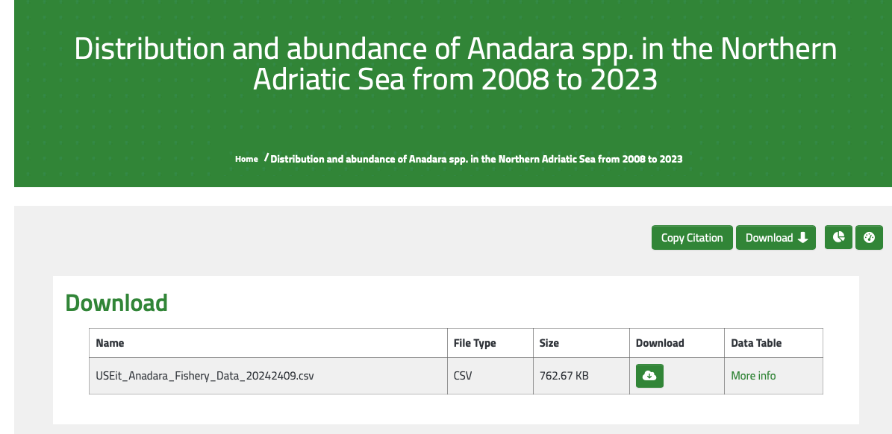
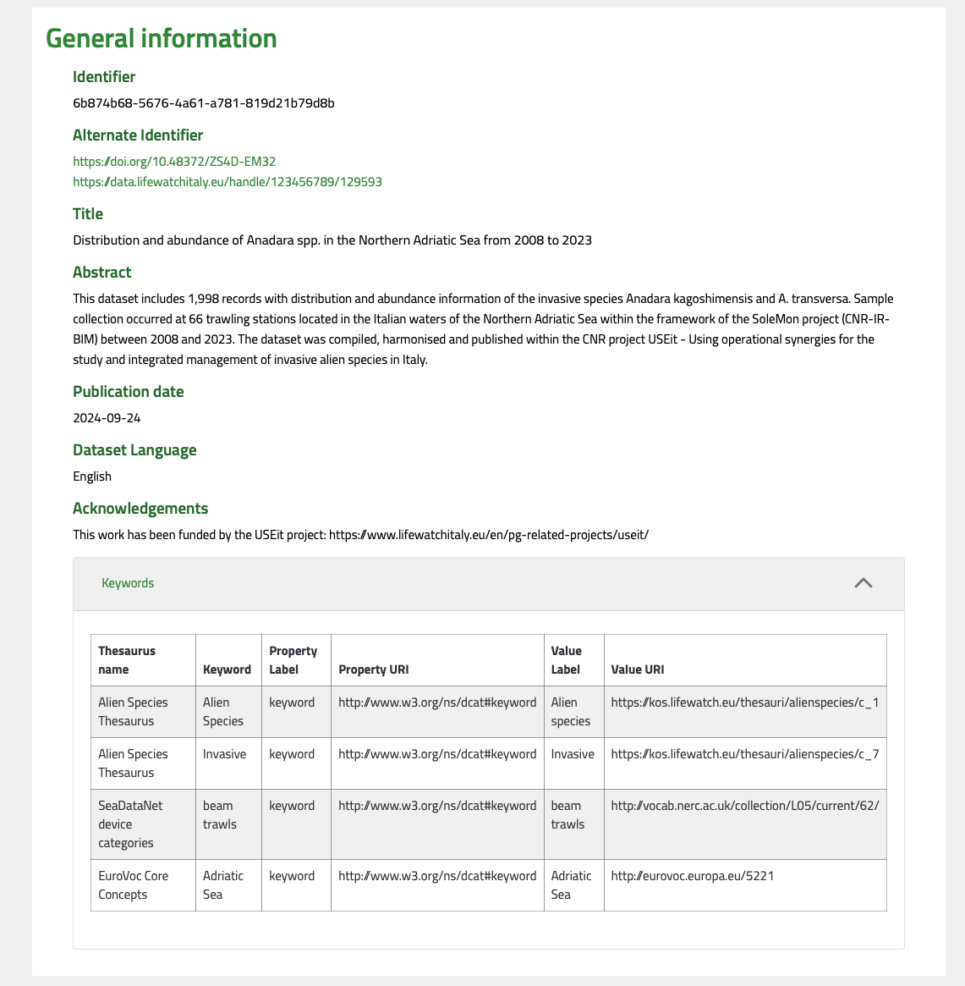
Provide credits to authors by assigning DOI to datasets and other research products
Ensure rich metadata descriptions to enhance data reusability

Slide 10
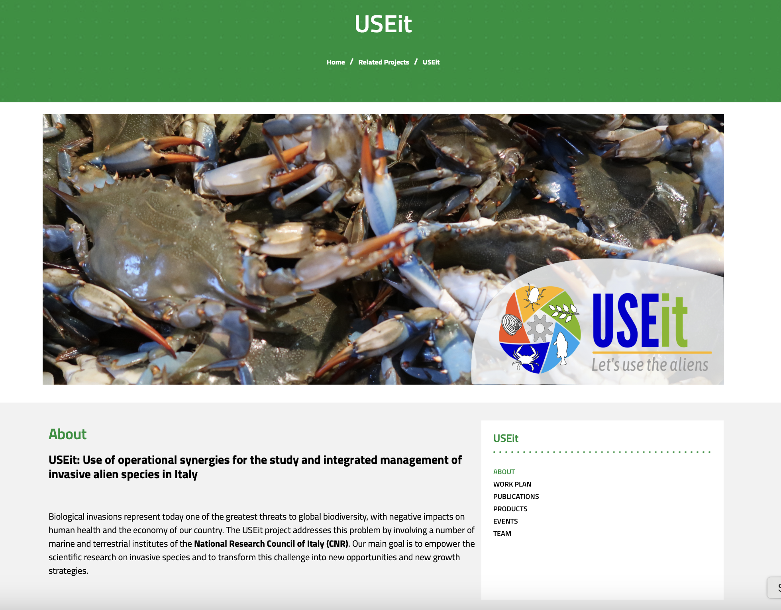
Public communication: GP 6
Data Management Plan
Research products
Publications
Reports
Team
Project Information
WP activities
Photos / Videos / Press release
Communication Material
Events

Slide 11
Data collection, curation & archiviation
Data analysis
Publication
Research Management Plan
Research communication
Free icons taken from Flaticon.com

Slide 12
Data collection, curation & archiviation
Data analyses
Publication
Research Management Plan
Research communication
Free icons taken from Flaticon.com

Slide 13
This shared and integrated approach provides technical and operational solutions for bioinvasion research and COULD develop new capabilities for IAS management.
Thank you!
We are grateful to all members and collaborators of the USEit team.

