Slide 1


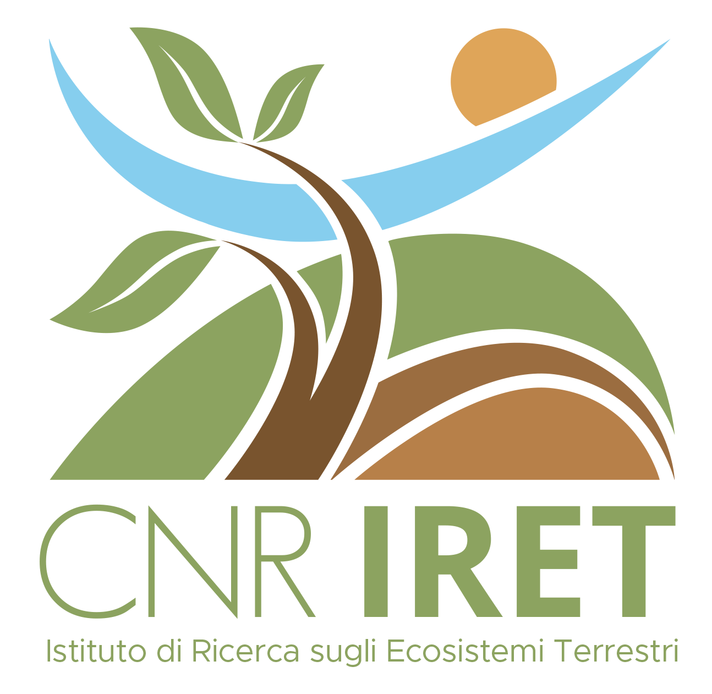




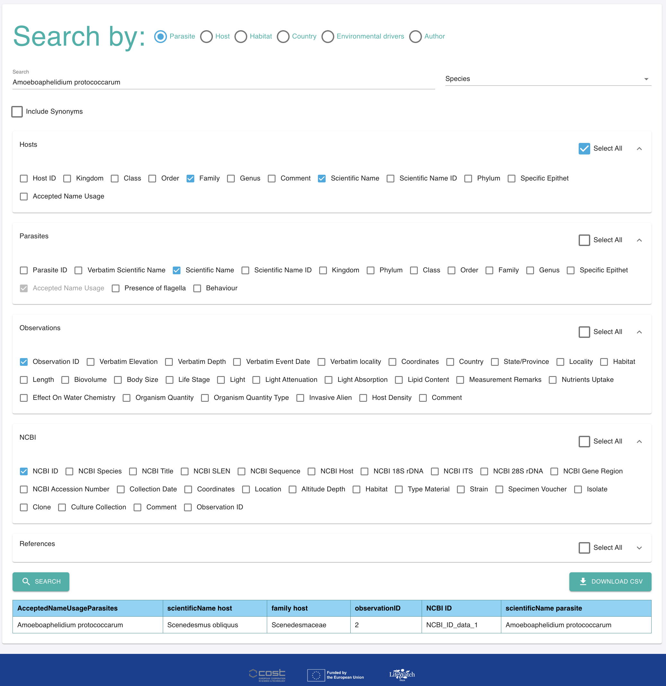
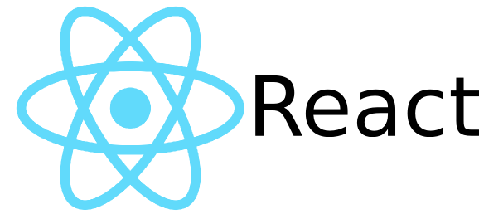


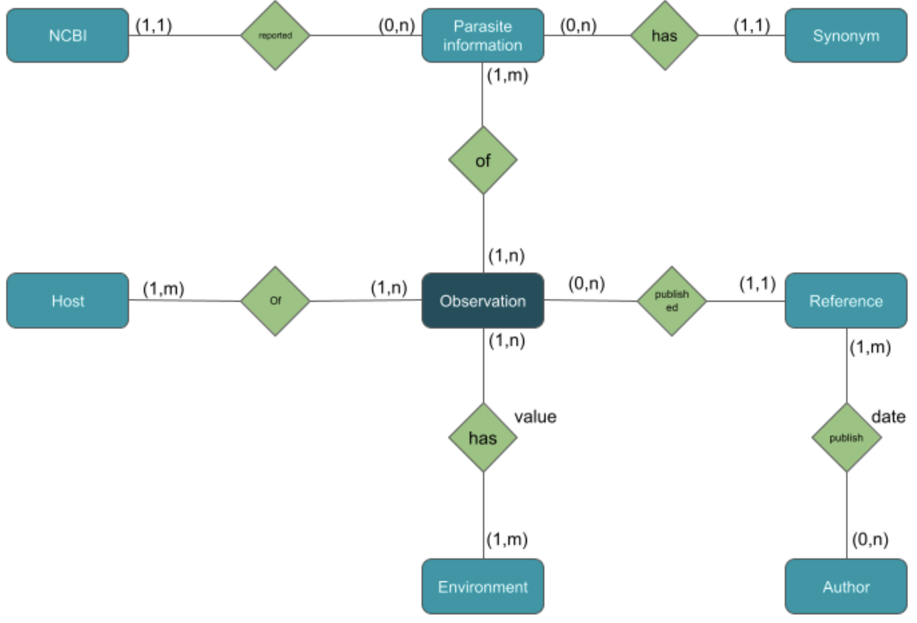


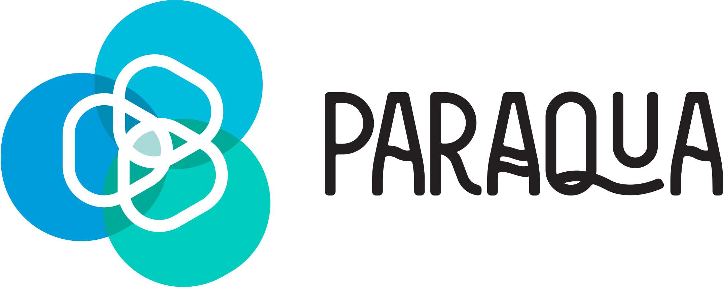

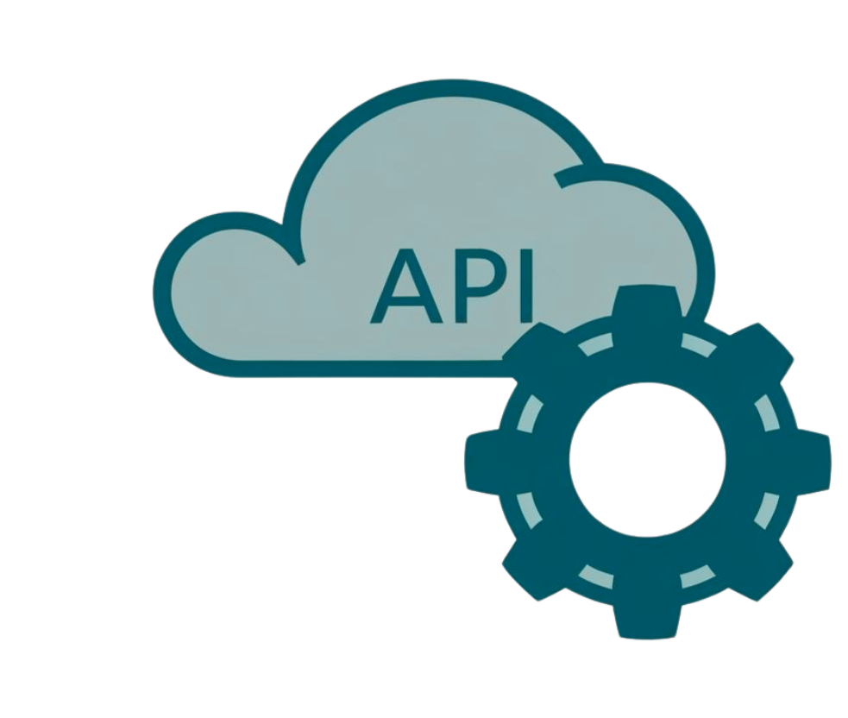





CNR IRET Conference
Rome, February 18th-19th 2025
A FAIR and User-Friendly Web Application for Democratizing Research on Zoosporic Parasites in Aquatic Systems
Raho D.¹*, Tarallo A.¹, Rosati I.¹
¹Research Institute on Terrestrial Ecosystems, National Research Council, URT Lecce, Italy
* Corresponding author
Analyzing Research Needs
Democratizing
The taxonomy of the parasite and its fixed traits.
The taxonomy of the host algae and its fixed traits.
Observation variables collected on the sampling event.
Genetic data collected from the NCBI database.
Synonymous parasites names.
Literature sources for the data gathered in the other categories.
Information about the authors of the referenced literature.
Developing a web-application for data access. User-friendly UI for structured queries to get a navigable data-table output and downloading files in CSV. Stateless Restful API for JSON files.
Zoosporic parasites play a crucial, yet often overlooked, role as invisible regulators of ecosystems, posing significant challenges to microalgae production. A comprehensive understanding of parasite-host interactions is not merely an ecological concern but a fundamental requirement for ensuring the sustainability of algae-based resources and industrial-scale production.
Designing Conceptual Model
The ParAqua database represents the first structured effort to centralize knowledge on zoosporic parasites, integrating in situ observations, genetic data (from NCBI), and literature data, to provide a comprehensive understanding of algae-parasite interactions.
Harmonizing Data
Use of Controlled Vocabularies: Darwin Core, LifeWatch Traits Thesaurus, Dublin Core, NCBI
Davide RAHO

