Slide 1






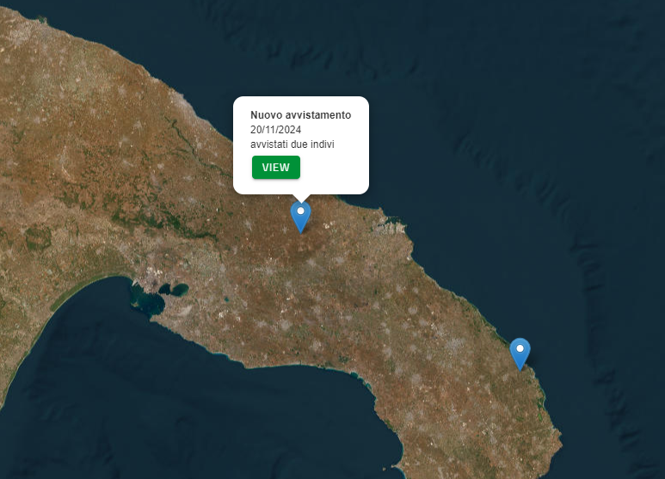
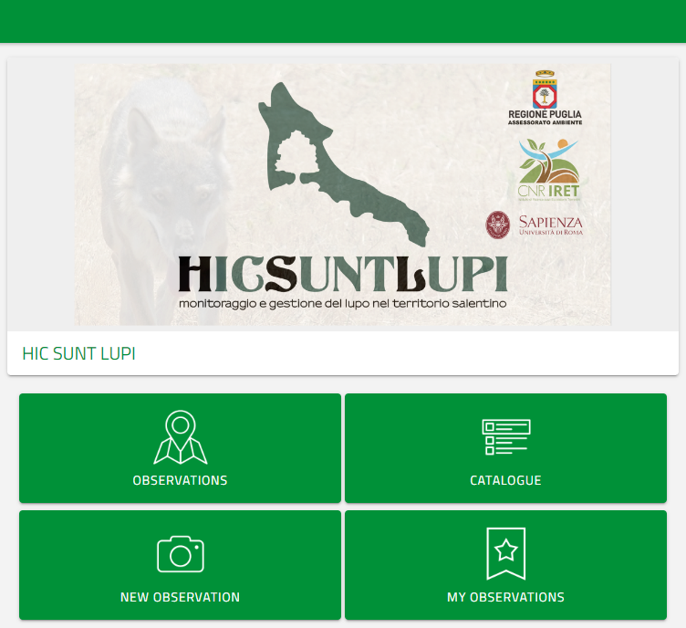
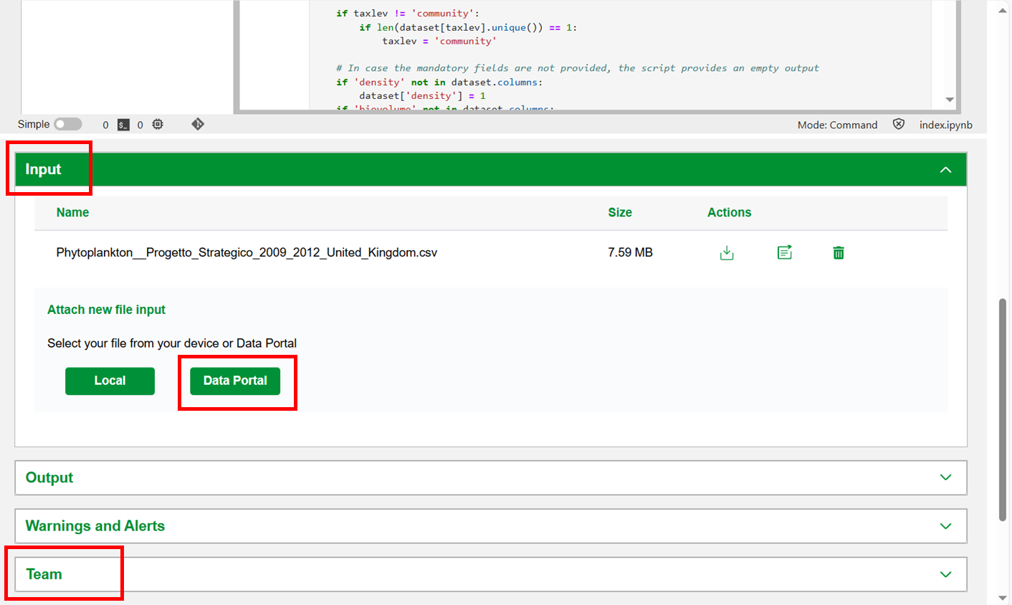


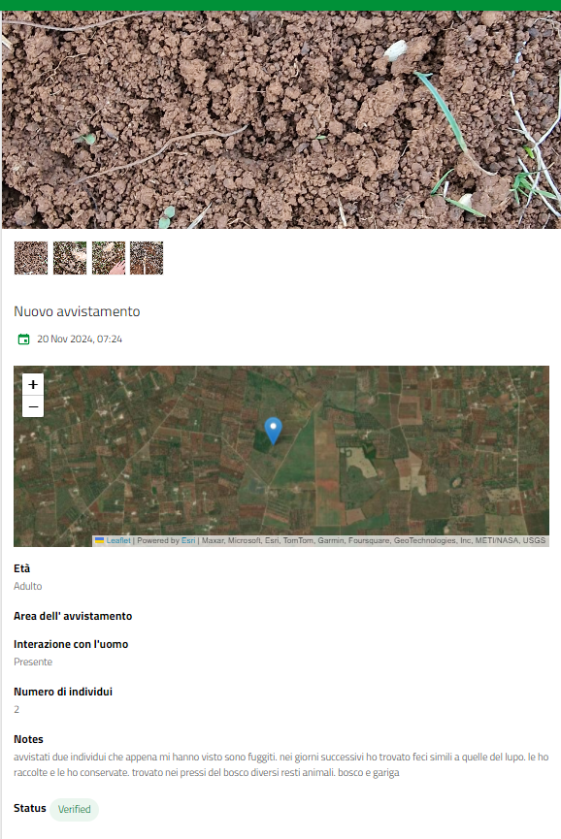

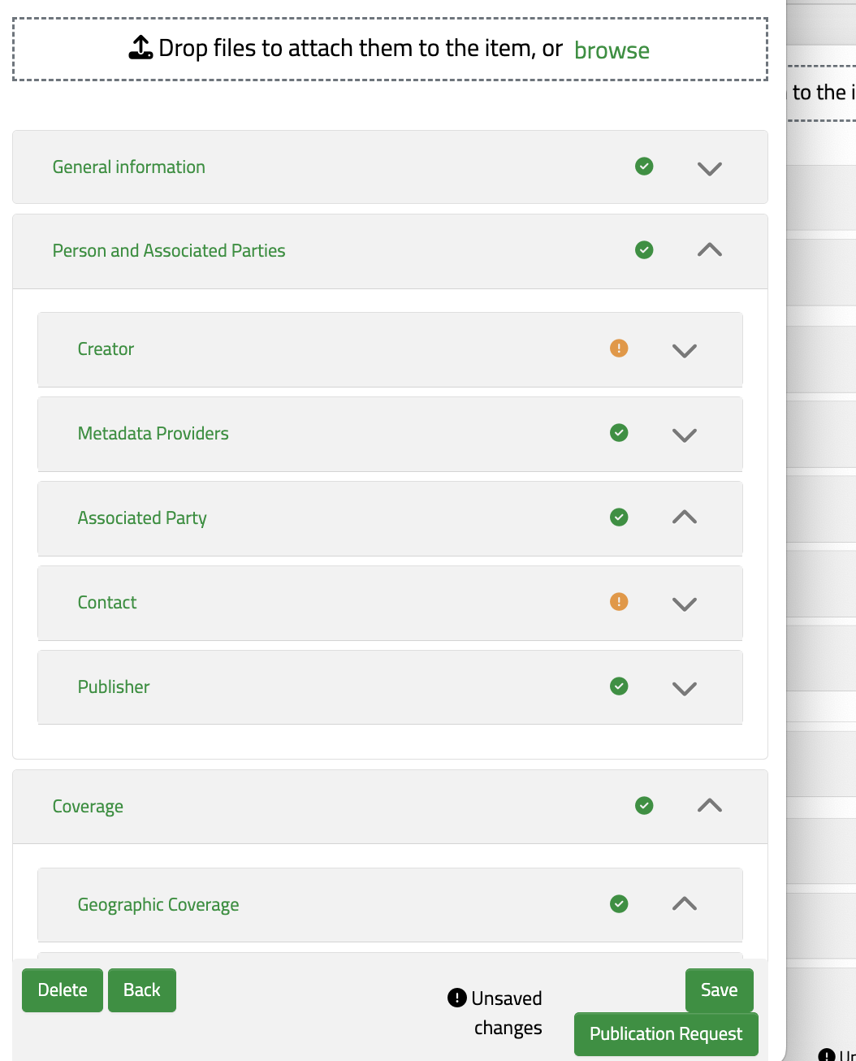

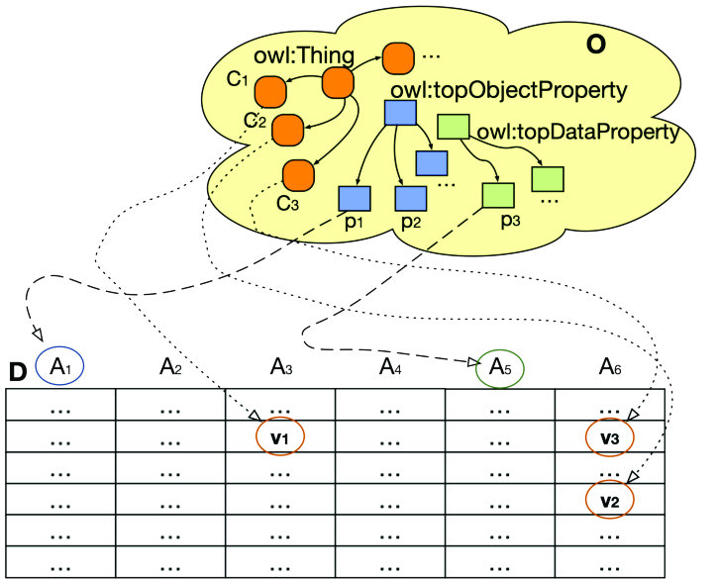

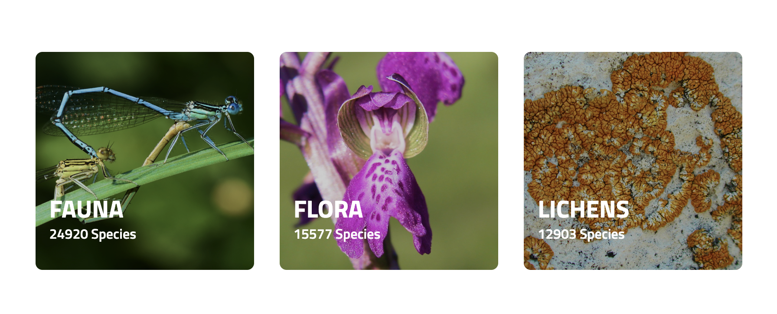

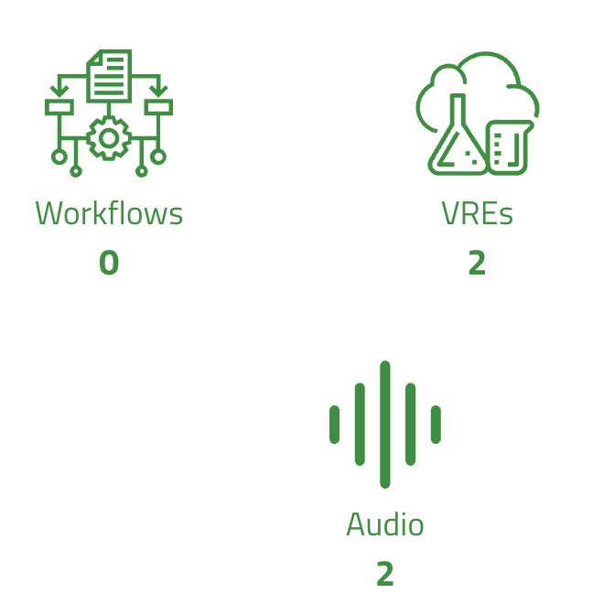


CNR IRET Conference
Rome, February 18th-19th 2025
Training Platform
Citizen Science Platform
DataLabs
Data Portal
Semantic Platform
Taxonomic backbone
locality | scientificName | feces
Grotta delle Grazie | Chiroptera | N
Grotte di Castellana | Myotis blithyii | N
Grotte di Castellana | Myotis capaccinii | N
Grotte di Castellana | Myotis blithyii | N
Grotte di Castellana | Rhinolophus euryale | N
Metadata Catalogue
B
B
Andrea Tarallo¹, Alberto Basset², Ilaria Rosati¹
1. CNR-IRET, 2. UniSalento
Modified from Chang et al., 2020

