Slide 1
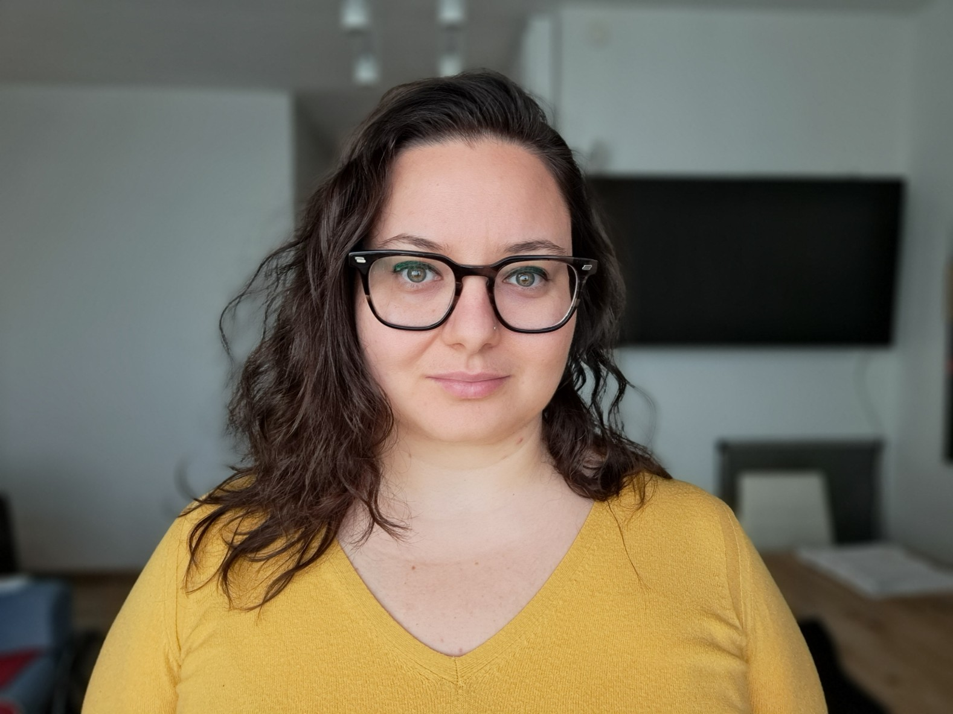
Making Digital Objects FAIR and Interoperable Across Environmental Research Infrastructures: Insights from the ITINERIS Project
Alexandra Nicoleta Muresan, Cristina Di Muri, Gianmarco Ingrosso, Enrica Nestola, Davide Raho, Gregorio Sgrigna, Andrea Tarallo, Ilaria Rosati
CNR IRET Lecce

Slide 2

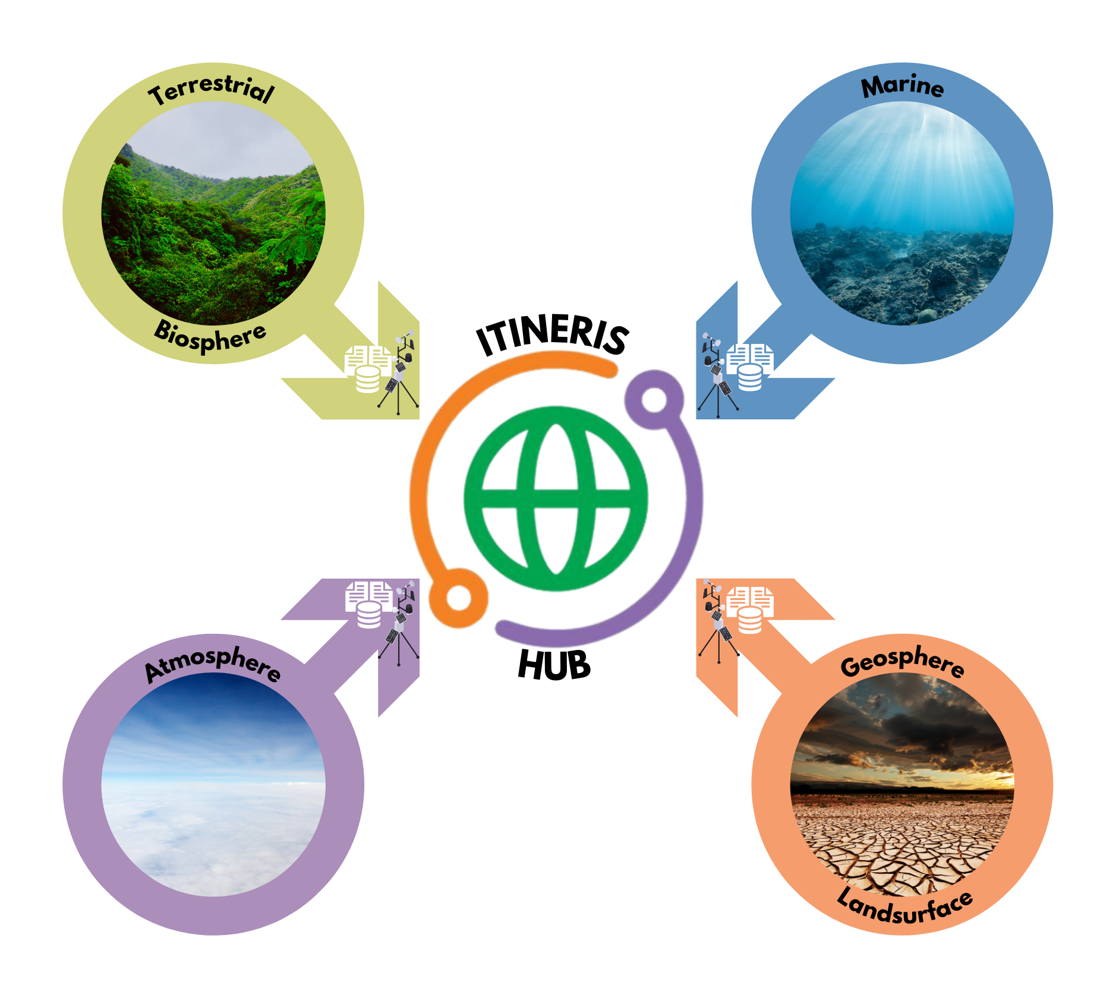

ITalian INtegrated Environmental Research Infrastructures System (ITINERIS)
7 partners
22 Research Infrastructure
8 Working Packages (89 activities)
39 Operating Units
AIM: provide the Italian Hub of Research Infrastructures in the environmental scientific domain (Atmosphere, Marine, Terrestrial Biosphere and Geosphere Landsurface) and connect it to the user community by providing access to the vast array of physical, remote and virtual services to produce new knowledge.

Slide 3


Innovation
Supports interdisciplinary research and data reuse
Facilitates access to environmental data and infrastructures
Strengthens Italy’s role in environmental research
Connects 22 national & European research infrastructures
Provides valuable insights for scientific & societal challenges
Aligned with the European Open Science Cloud (EOSC)
Follows FAIR principles

Slide 4


Work Package 2: Access to facilities, FAIR data and related services
Task 2.3 - Support the implementation and adoption of FAIR-enabling best practices
Task 2.4 - Interdisciplinary data interoperability
Help to integrate FAIR principles by:
developing a FAIR-compliant Data Management Plan
supporting the implementation of FAIR practices
promoting semantic interoperability

Slide 5
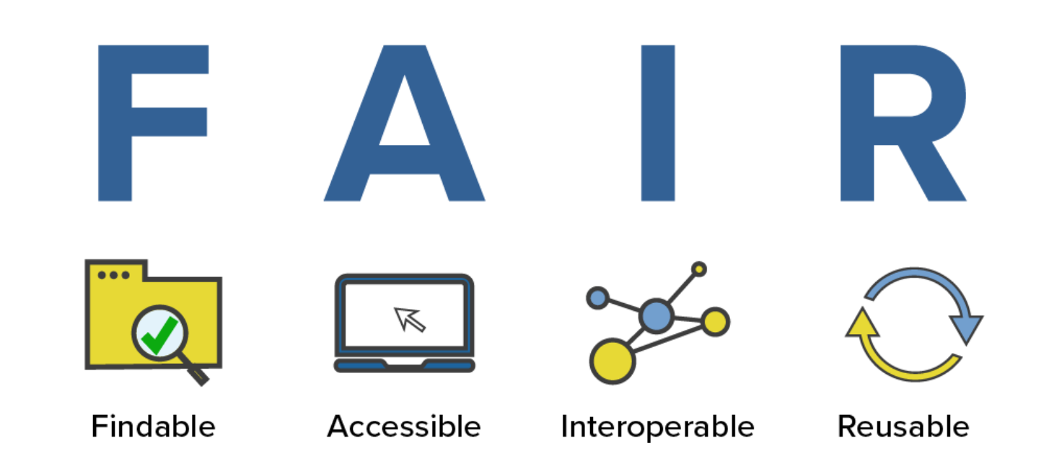

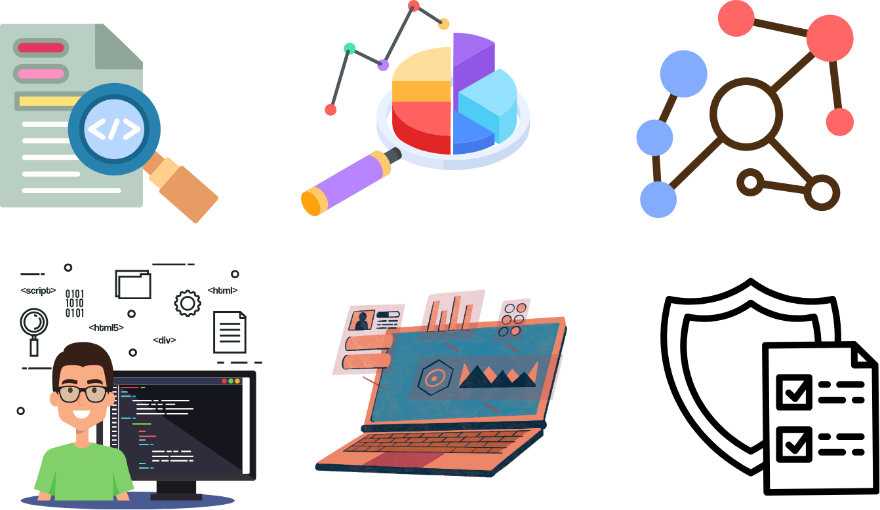

Principles for scientific data management and stewardship intended to provide guidelines to improve the Findability, Accessibility, Interoperability, and Reusability of digital objects.
Source: https://www.nlm.nih.gov/oet/ed/cde/tutorial/02-200.html
A Digital Object (DO) is a machine-independent data structure consisting of one or more elements in digital form that can be parsed by different information systems; the structure helps to enable interoperability among diverse information systems. A digital object is composed of a structured sequence of bits/bytes.
Metadata
Data
Protocols
Semantic artefacts
Software
Etc.

Slide 6
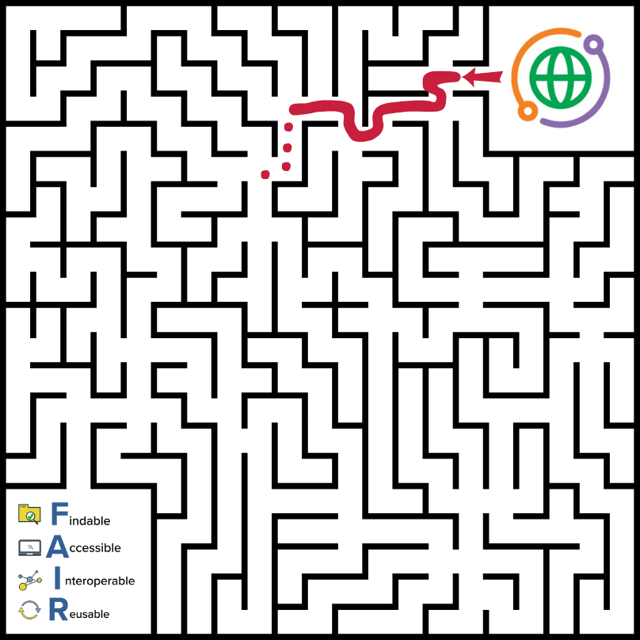

Main challenges in ITINERIS project
Heterogeneity: variety of digital objects and standards adopted
Interoperability & Reusability: achieving consensus on shared standards and solutions is particularly challenging
Redundancy: need to align with existing standards rather than creating new ones
Dispersion & Fragmentation: diverse community-specific technologies leads to fragmentation, hindering collaboration and data reuse
Schema Alignment: efforts required to map and align information across different standards within the same domain
Metadata Longevity Plans: inconsistent implementation of sustainable plans for metadata management and preservation

Slide 7
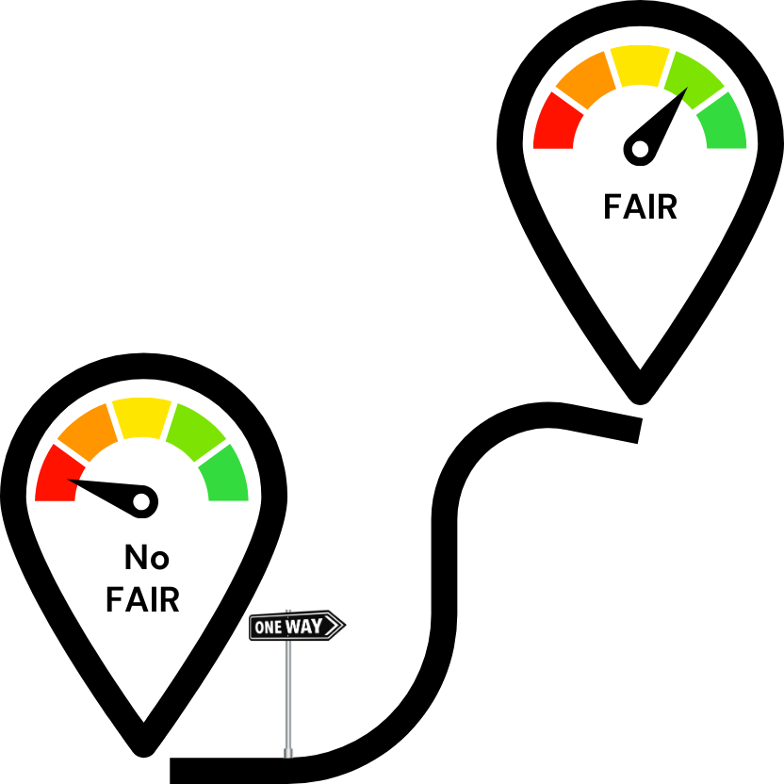

Benefits of FAIR implementation
Increased visibility and impact of research
Facilitated data reuse and integration
Optimised data management
Collaboration and networking
Increased trust in science
Support automation
Accelerated research and innovation
Improved quality of research products and analysis

Slide 8



FAIR principles adoption in Italian Environmental Research Infrastructures: an overview from the ITINERIS Project (Nestola et al., in preparation)
Analyse the adoption of FAIR principles
Methodology:
Online survey
Individual interviews
Analysis of available resources
This analysis serves as a foundation for monitoring future progress in the adoption of FAIR practices by RIs in the environmental domain and provides crucial insights for the near-future development of the national Hub of Italian environmental RIs.

Slide 9
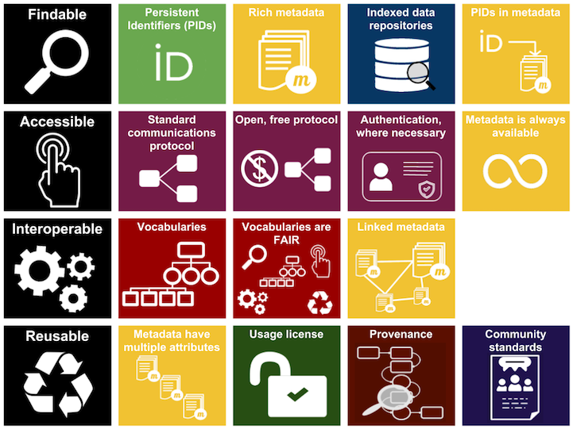
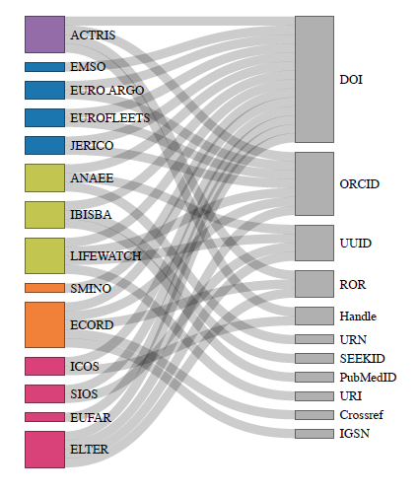
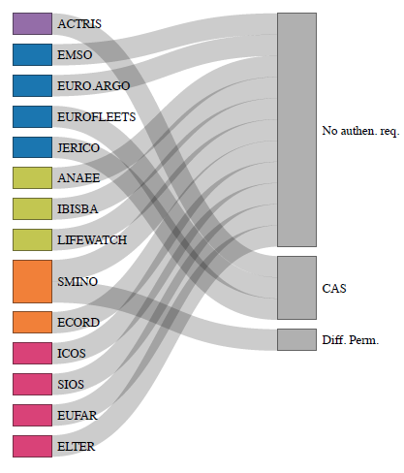
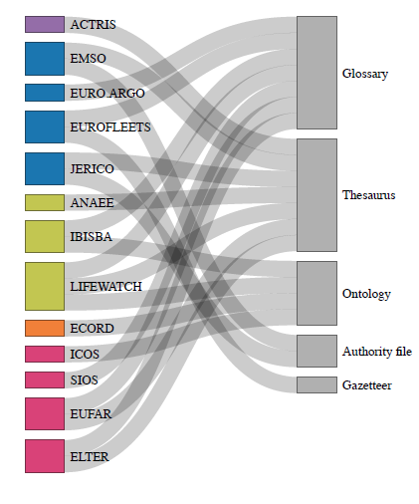
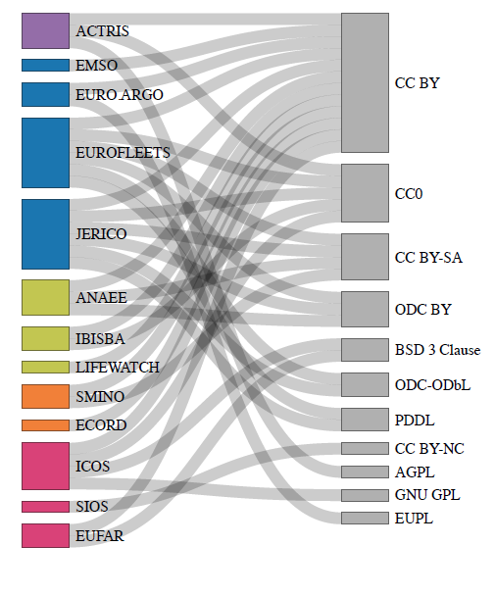
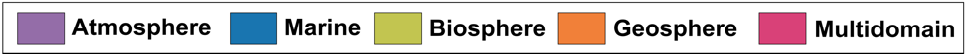

Slide 10
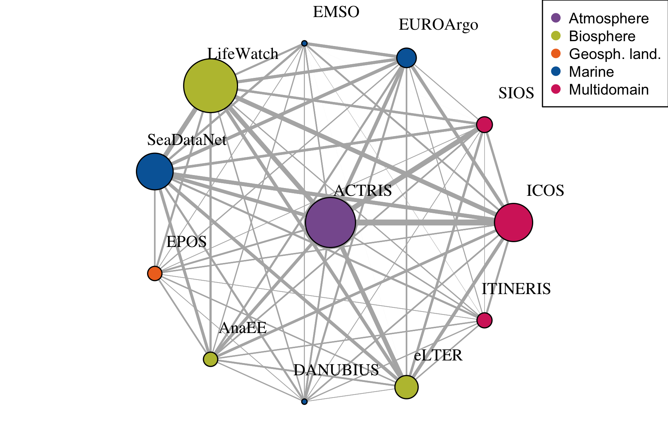
A FIP is a formal list of FAIR implementation choices declared by a specific community to fulfil one or more FAIR subprinciples.
FIPs help track the choices made by Research Infrastructures (RIs) to implement their FAIR strategy
The convergence of these choices can be assessed using matrices to evaluate how ITINERIS Hub and other RIs are making aligned decisions.

Slide 11
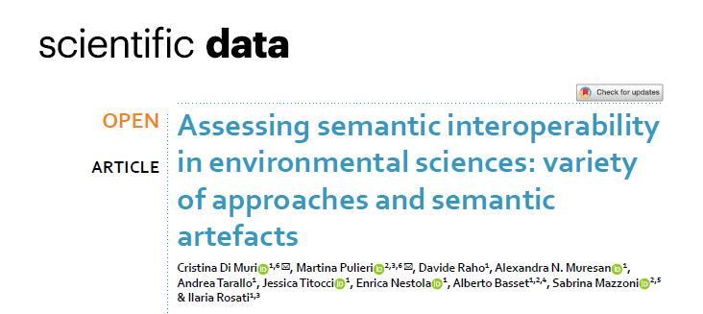
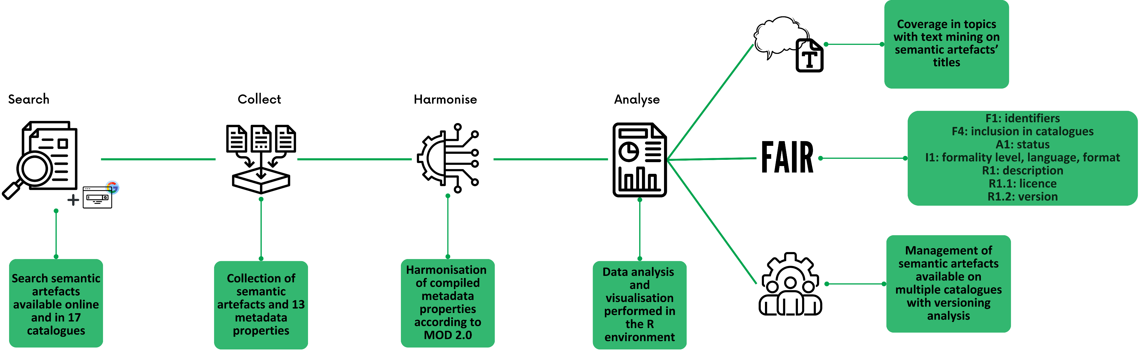
Semantic Interoperability

Slide 12
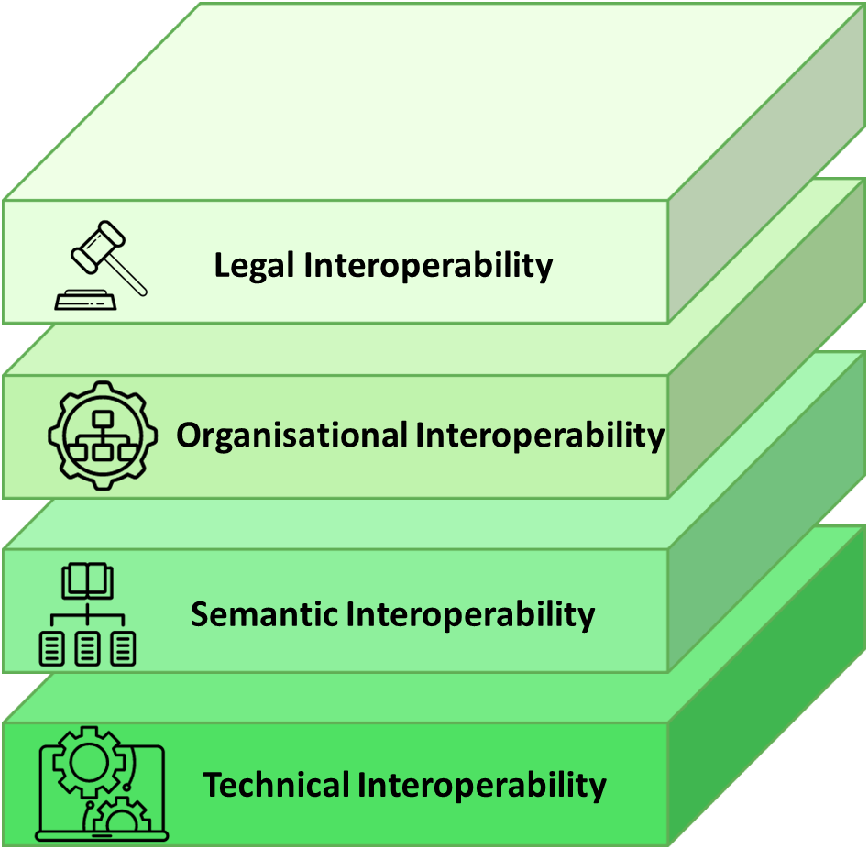
Interoperability layers
Technical Interoperability: ability of different information technology systems and software applications to communicate and exchange data and other digital objects (e.g. software, services, workflows, protocols, hardware designs, etc.).
Semantic Interoperability: the ability of computer systems to transmit data with unambiguous, shared meaning. Semantic interoperability is a requirement to enable machine computable logic, inferencing, knowledge discovery, and data federation between information systems.
Organisational Interoperability: the way in which organisations align their business processes, responsibilities and expectations to achieve commonly agreed and mutually beneficial goals.
Legal Interoperability: the ability to combine data and digital objects from multiple sources without conflict between the restrictions imposed by the various licences.

Slide 13
From this analysis, the FAIR semantic artefacts and catalogues were selected for integration into the Terminology Service.

Slide 14
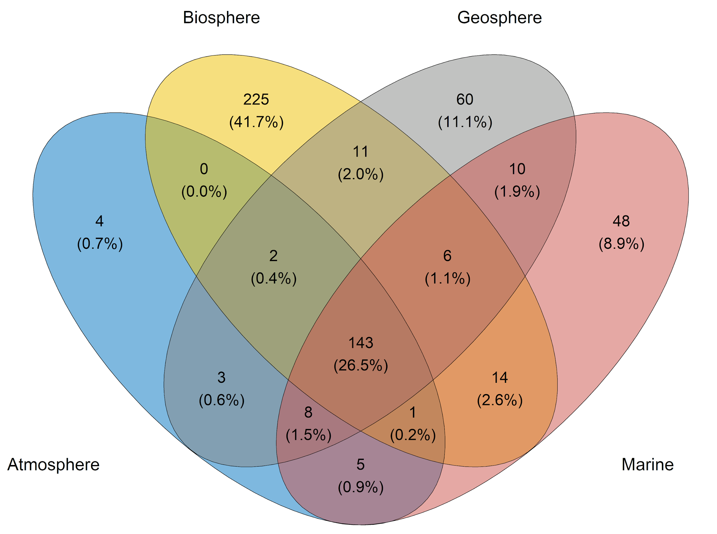
Distribution of the 540 semantic artefacts among ITINERIS domains
Evaluation of key metrics
FAIR sub-principles | Findings
F1: identifiers | 18.5% with DOIs
F4: catalogues | 5.5% not available in SA catalogues
A1: status | 64.6% without status info
I1: language and format | 8% without standard language and format
R1: description | 8.9% without description
R1.1: licence | 25% missing licence
R1.2: version | 22% missing version info

Slide 15

For FAIR implementation practices within ITINERIS:
Publish the Data Management Plan (DMP)
Support RIs to publish their FIPs
Re-do the convergence analyses with updated FIPs
To enhance the interoperability within ITINERIS:
FAIRification of existing semantic artefacts (used and/or managed by ITINERIS RIs) and publication into EcoPortal
Creation of the ITINERIS vocabulary
Design and development of a terminology service for data and metadata semantic annotation

Slide 16

Thank you!
The publication has been funded by EU - Next Generation EU Mission 4 “Education and Research” - Component 2: “From research to business” - Investment 3.1: “Fund for the realisation of an integrated system of research and innovation infrastructures” - Project IR0000032 – ITINERIS - Italian Integrated Environmental Research Infrastructures System - CUP B53C22002150006.
The authors acknowledge the Research Infrastructures participating in the ITINERIS project with their Italian nodes: ACTRIS, ANAEE, ATLaS, CeTRA, DANUBIUS, DISSCO, e-LTER, ECORD, EMPHASIS, EMSO, EUFAR, Euro-Argo, EuroFleets, Geoscience, IBISBA, ICOS, JERICO, LIFEWATCH, LNS, N/R Laura Bassi, SIOS, SMINO.

