Slide 1
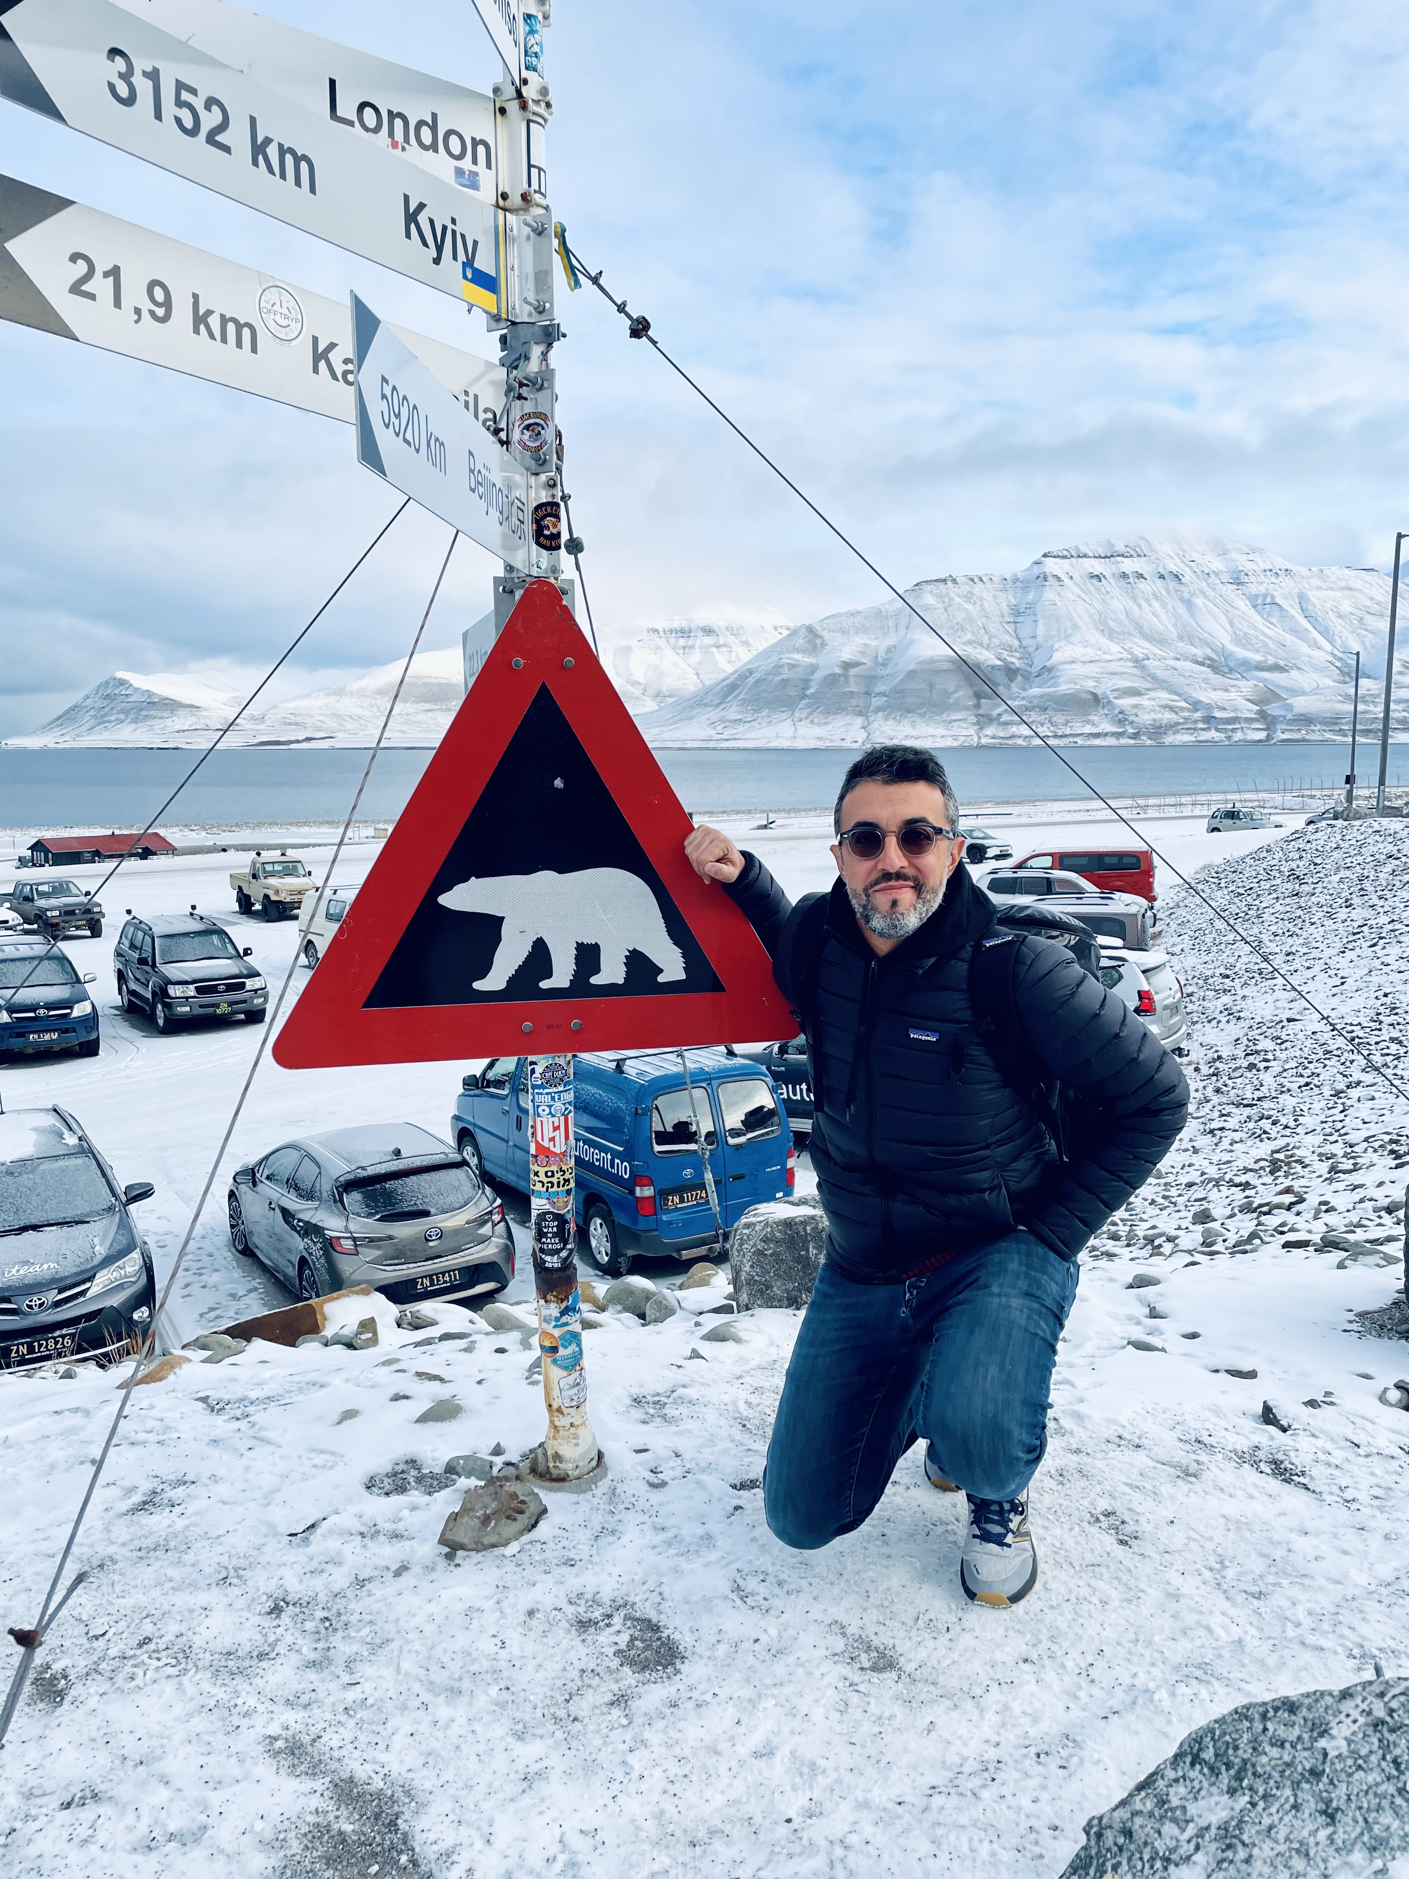





Greening of Svalbard in the twentieth century driven by sea ice loss and glaciers retreat
Gianmarco Ingrosso
CNR–IRET Lecce
C. Ceccarelli, F. Giglio, P. Giordano, J. Hefter, L. Langone,
S. Miserocchii, G. Mollenhauer, A. Nogarotto, M. Sabino, T. Tesi

Slide 2
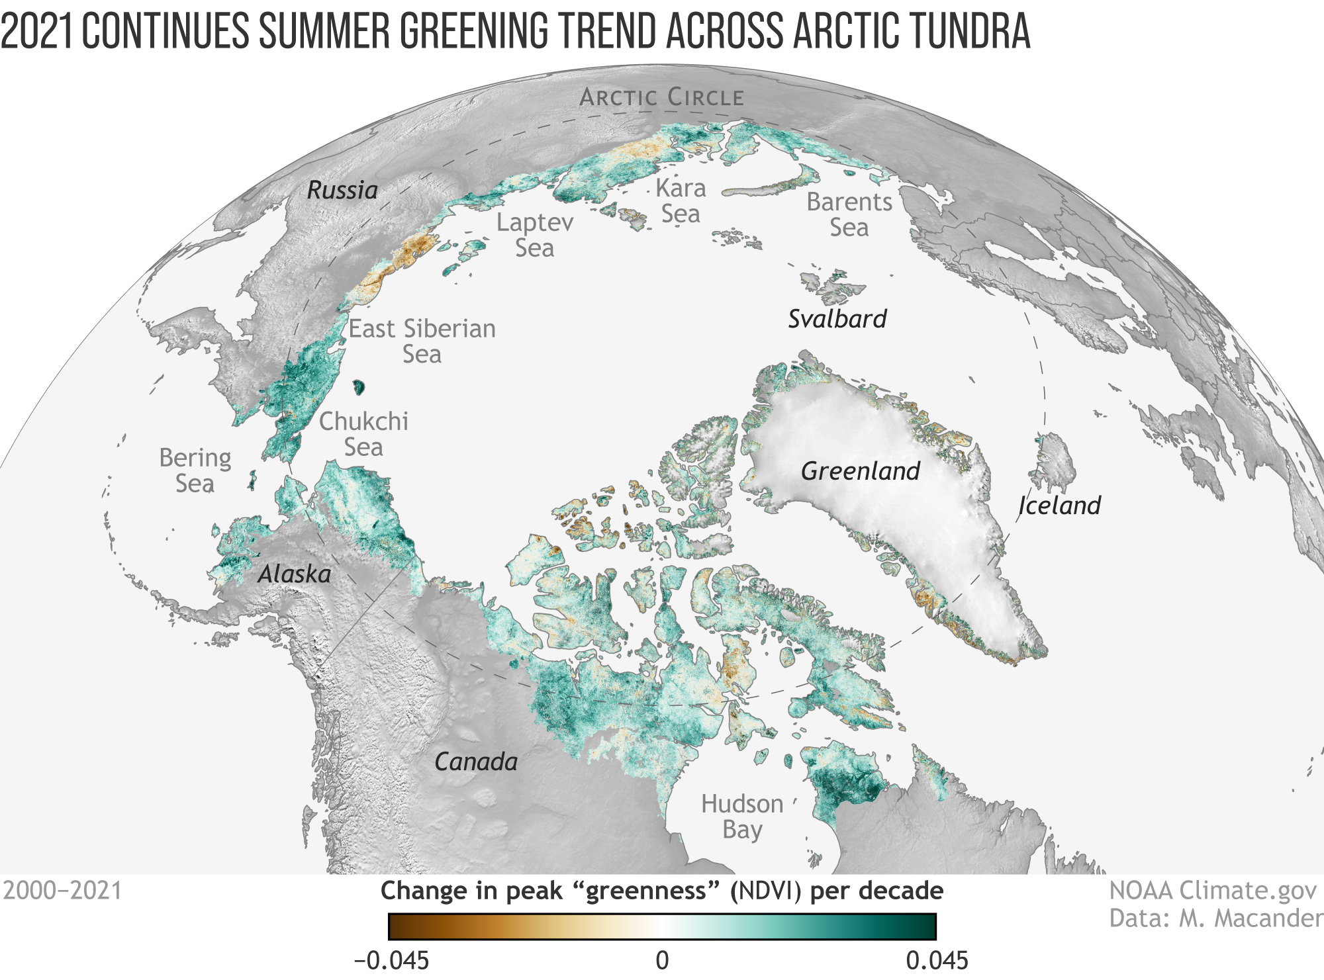

Slide 3
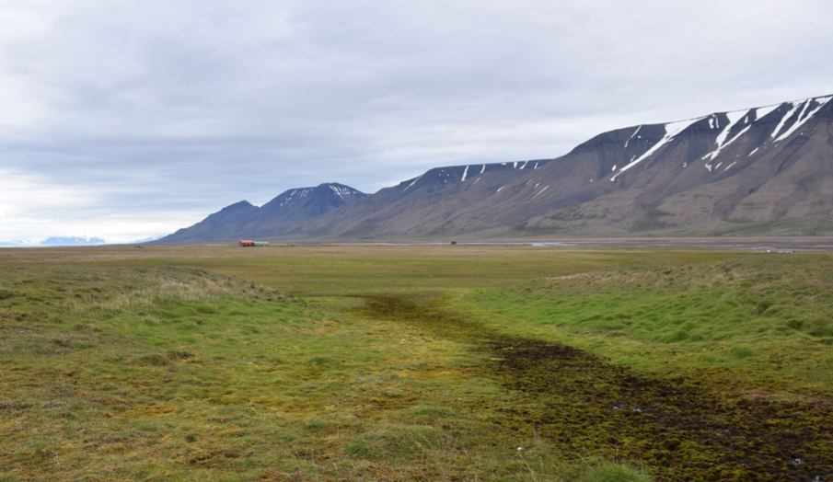
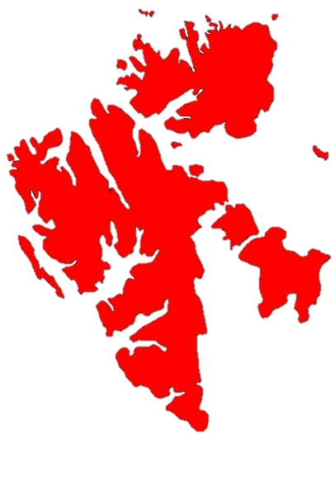
The Arctic Fjords of Svalbard are also showing important signals of greening due to the unprecedented collapse of the glacial environment.

Slide 4
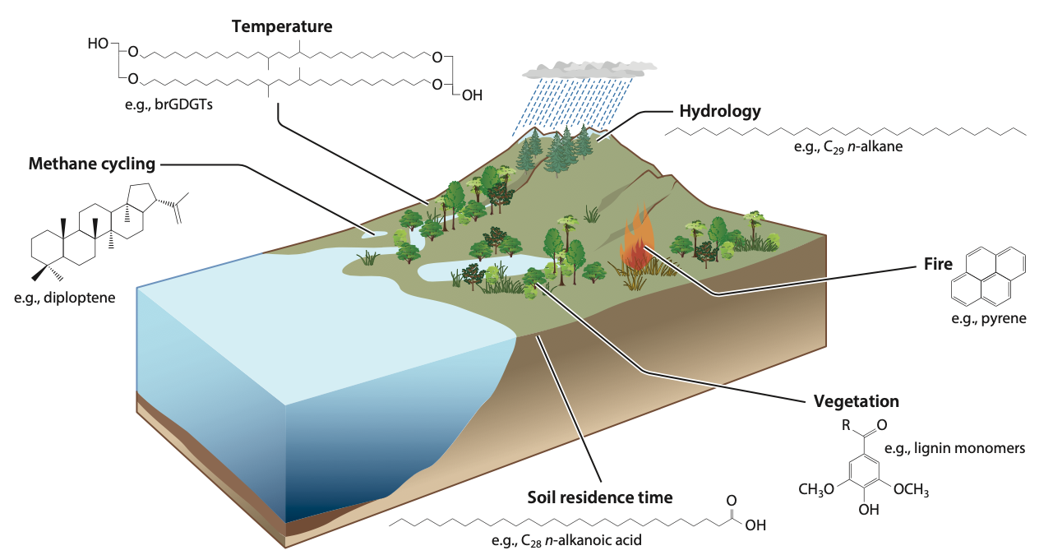

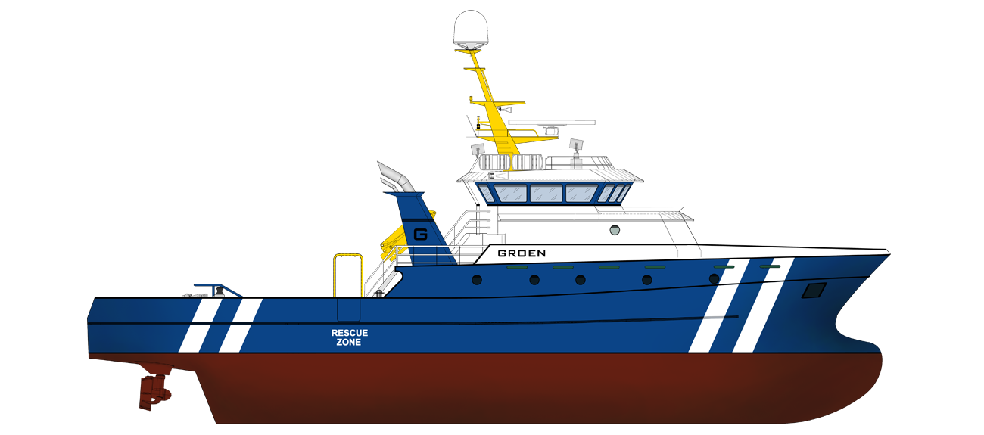
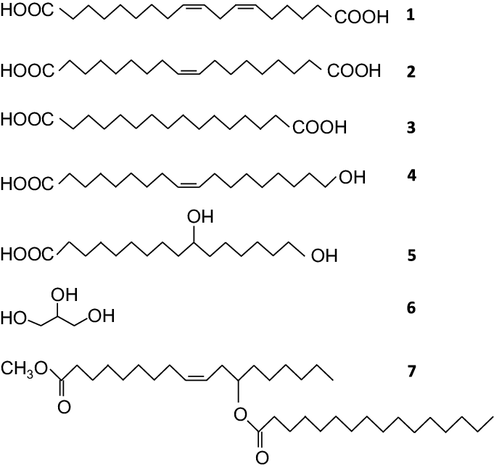
Biomarkers
into marine records
burial
cutin acids
Kusch et al., 2021
Inglis et al. (2022)

Slide 5
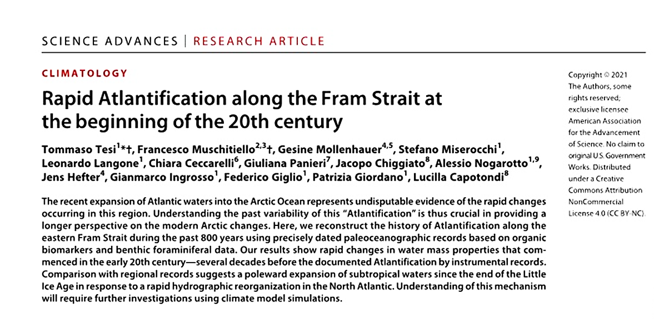
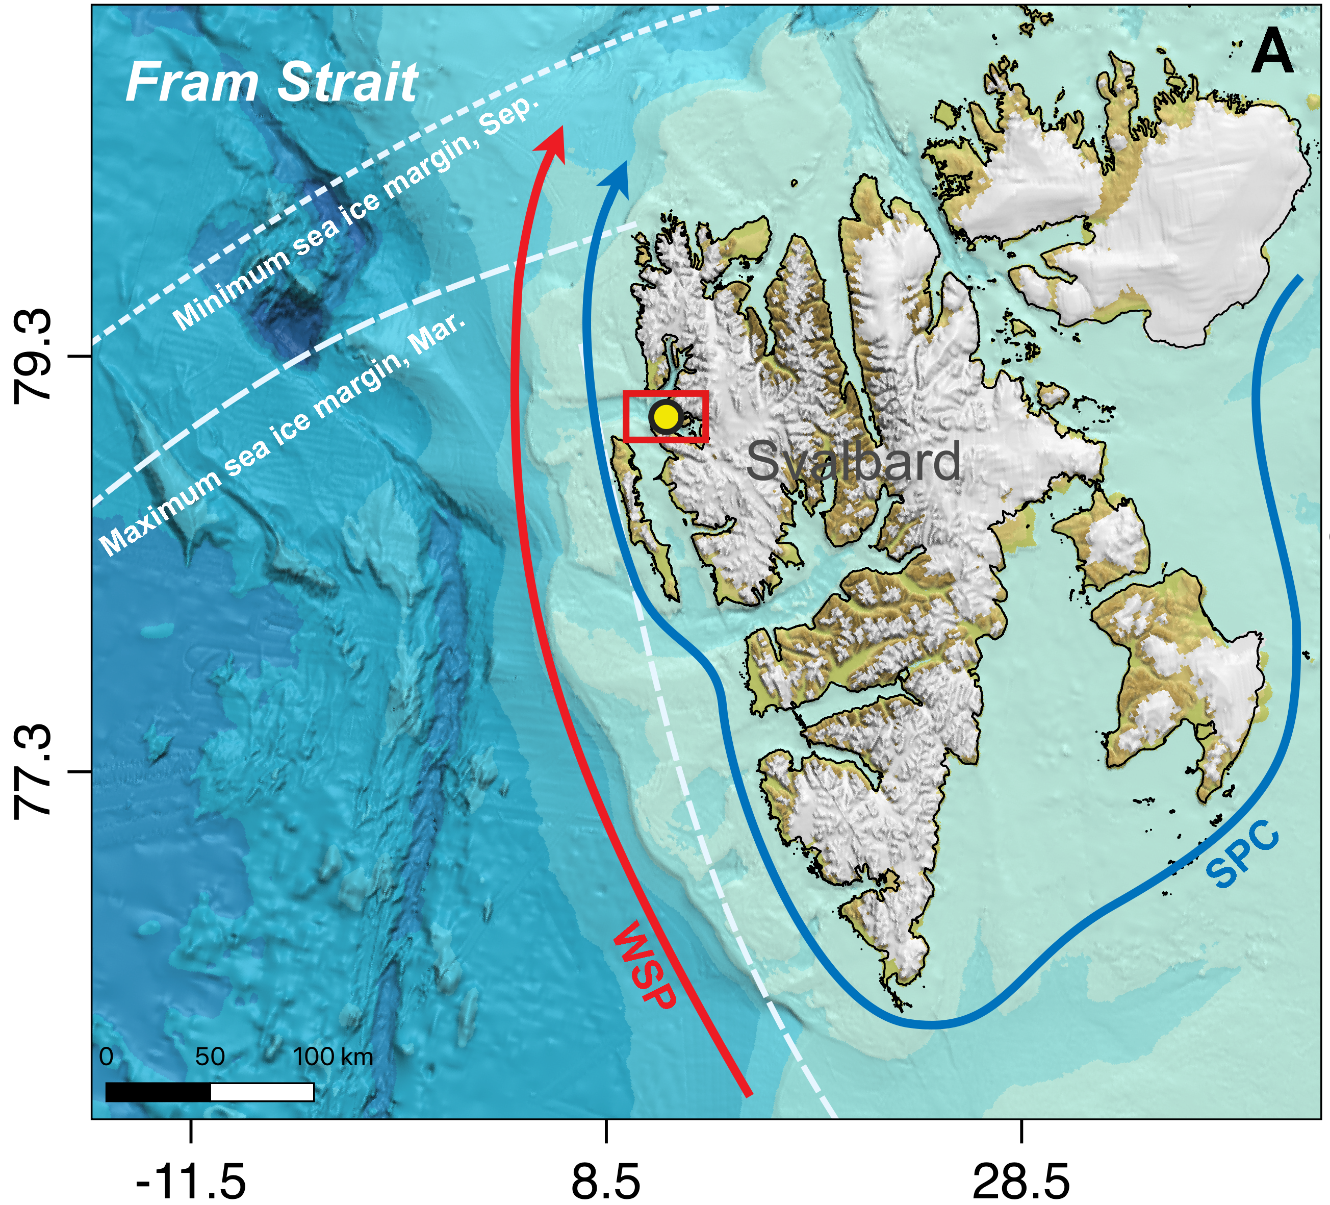
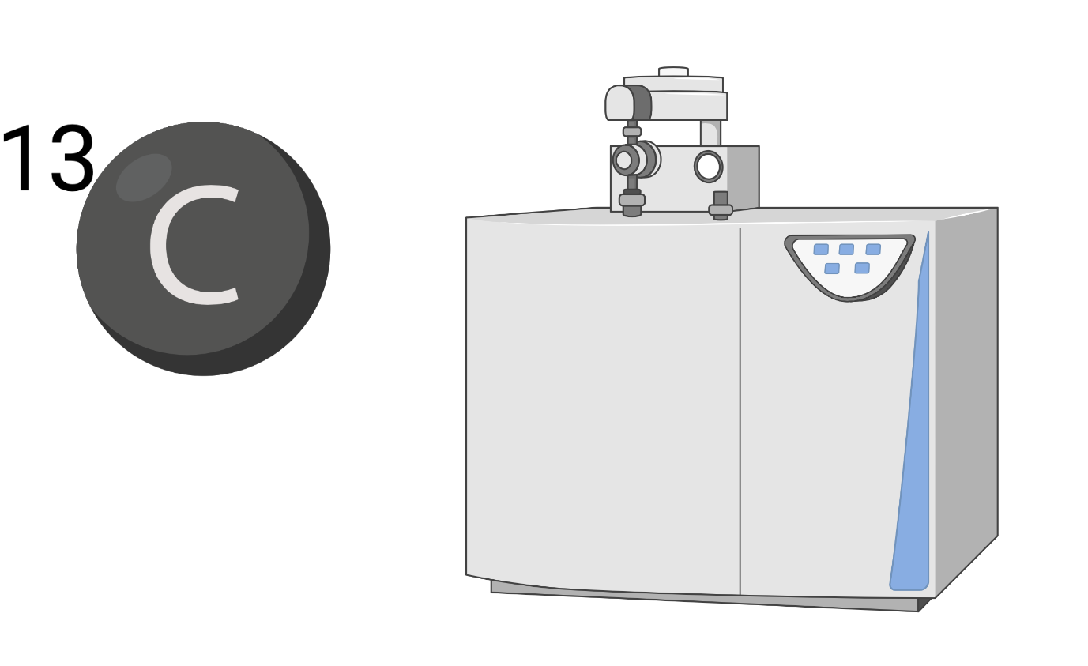

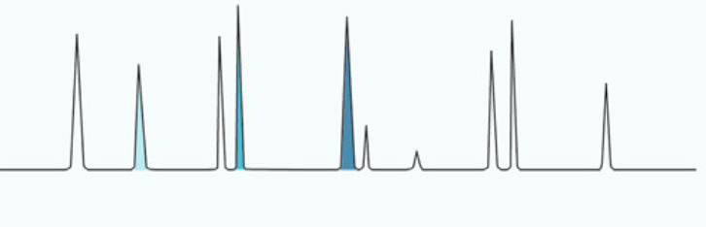
SCOPE: historical reconstruction of greening from marine archives
NYA17-154
BULK
Total organic carbon (TOC)
Radiocarbon (∆¹⁴C)
stable carbon isotope (δ¹³C)
TERRESTRIAL BIOMARKER
Long chain n-alkanes
Long chain fatty acids
Lignin phenols
Cutin acids

Slide 6
Generalised additive models (GAMs) analysis of trend
Biomarker
Simpson, 2018: Modelling Palaeoecological Time Series Using Generalised Additive Models
Year (AD)

Slide 7
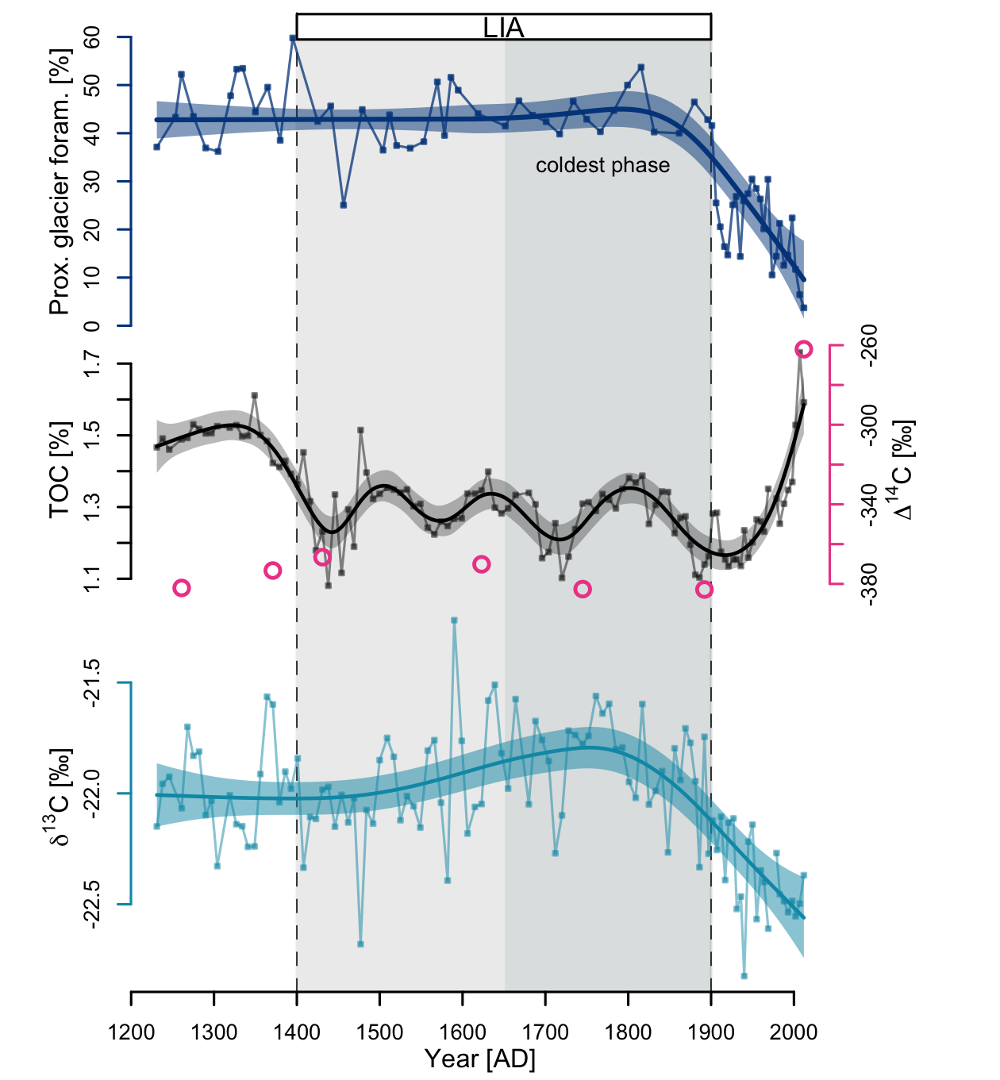
glacier retreat
(Tesi et al., 2021)
Bulk
The dynamic driving TOC trend was not easily to interpret
Depleted radiocarbon content indicated inputs of fossil material (ice-rafted detritus, permafrost, coal)
the δ¹³C signature suggested a mixture of terrestrial and marine OC

Slide 8
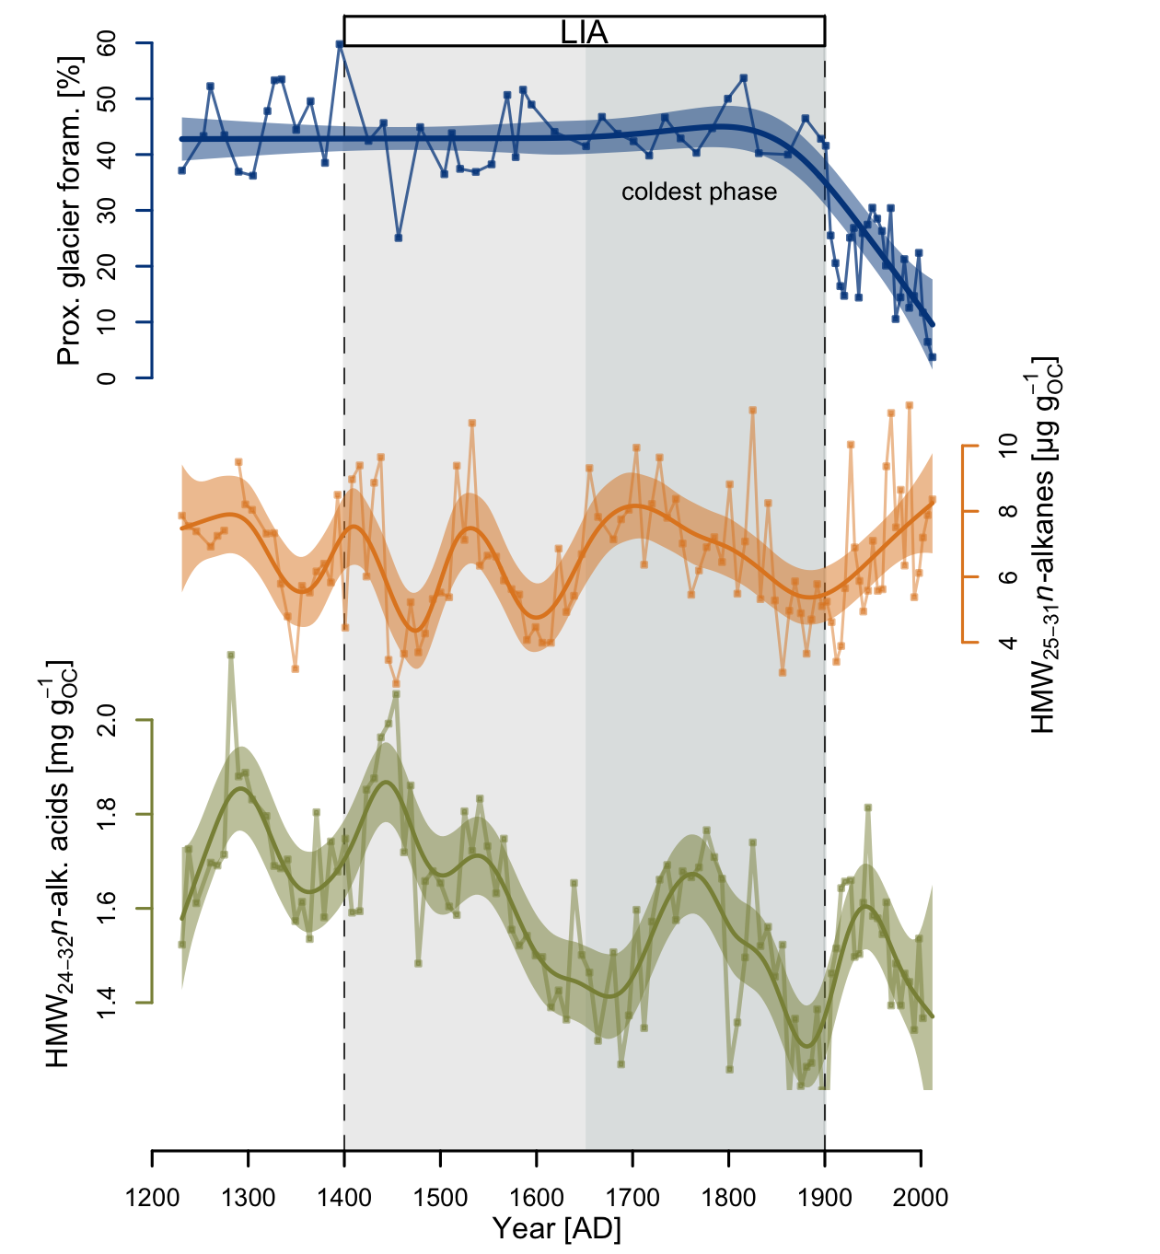
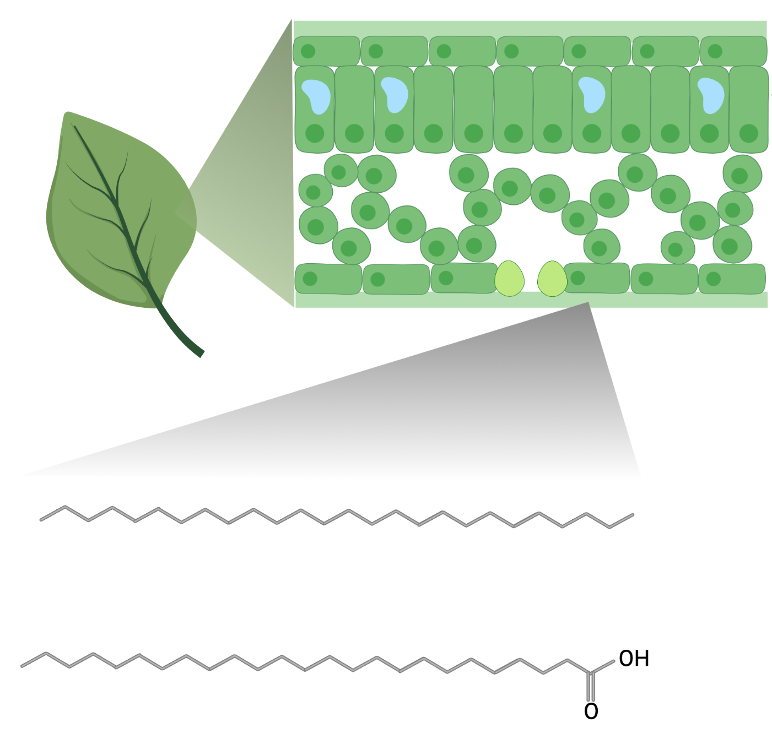
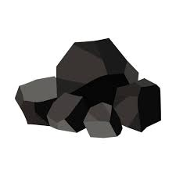

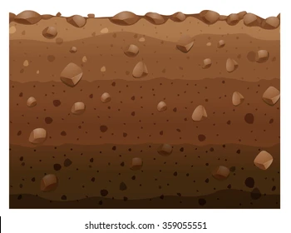
HMW n-alk & acids
glacier retreat
(Tesi et al., 2021)
Wax lipids are present in epidermal cells of most terrestrial plants
affected by fossil sources (permafrost, IRD, etc.)
the estimated trends are complex and do not provide useful information

Slide 9
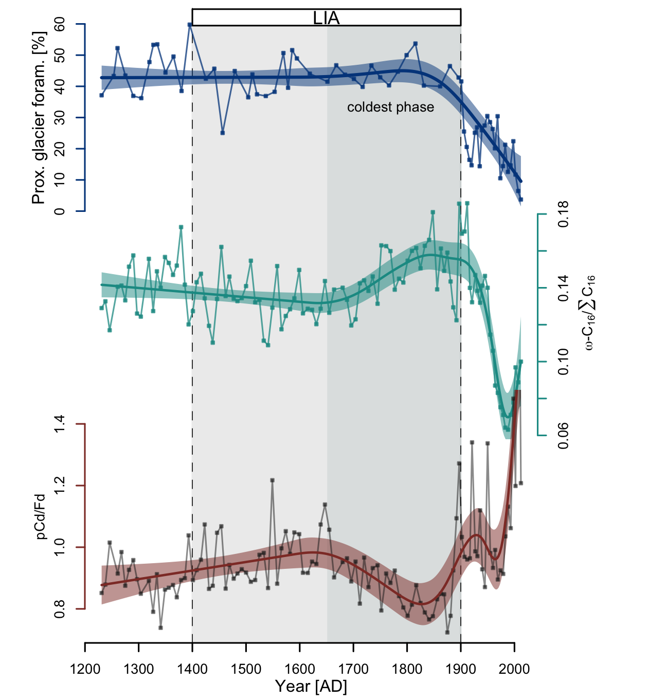
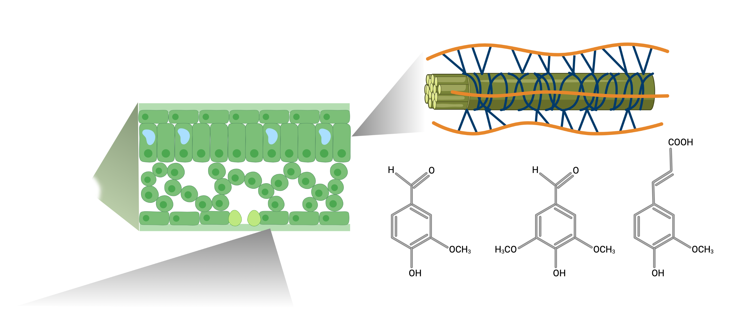
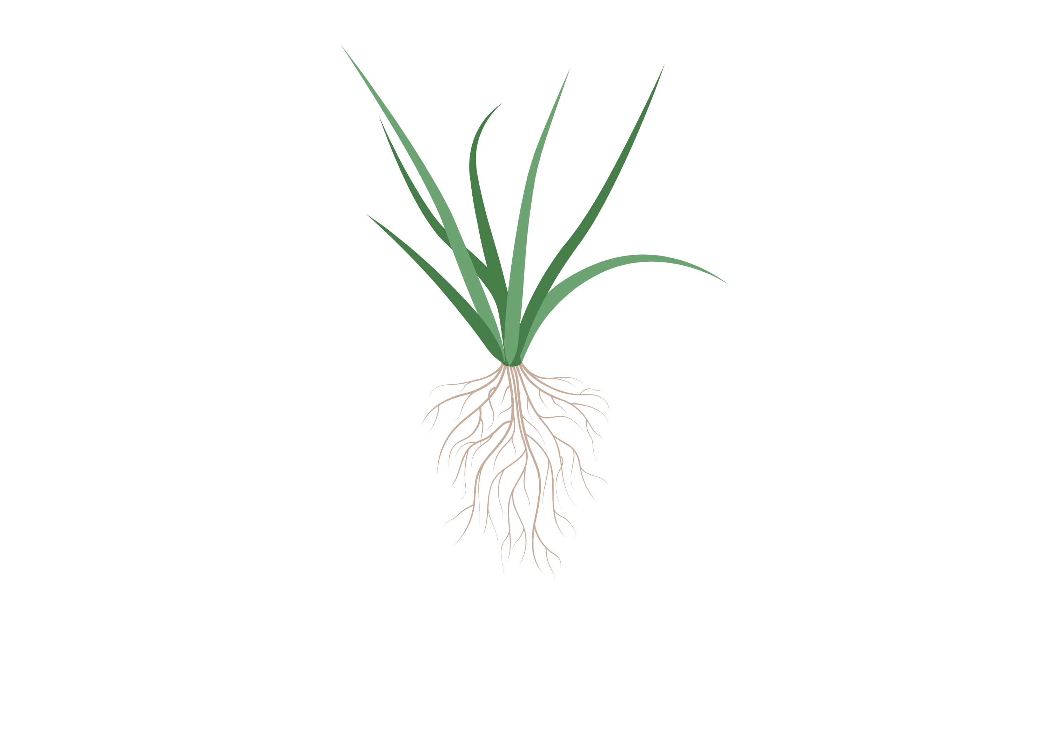
Plant specific biomarkers
glacier retreat
(Tesi et al., 2021)
lignin and cutin are biopolimers present both in leaves and roots the terrestrial vascular plants
cutin
lignin phenols
lignin
cutin acids

Slide 10
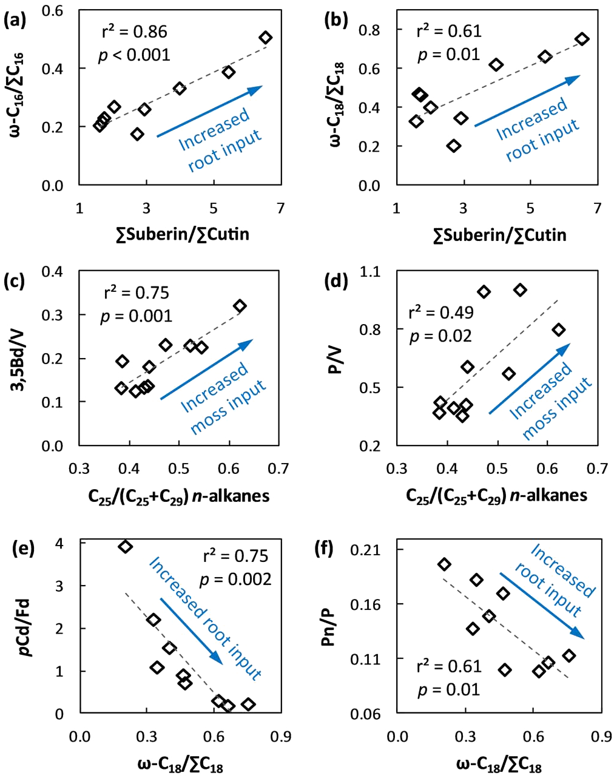
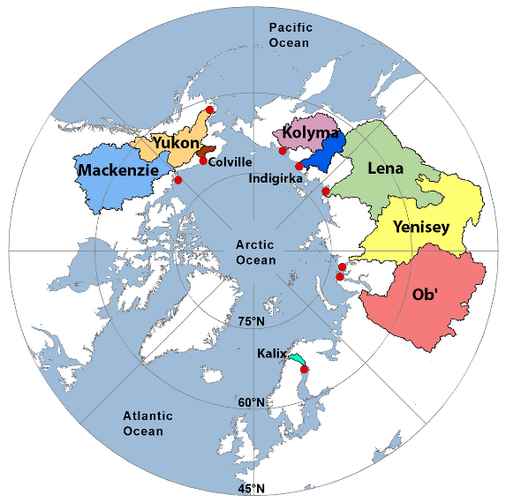
Plant specific biomarkers
glacier retreat
(Tesi et al., 2021)
surf. soil
input
cutin
roots
Feng et al., 2015
surface
surface
lignin
surf. soil
input
roots

Slide 11
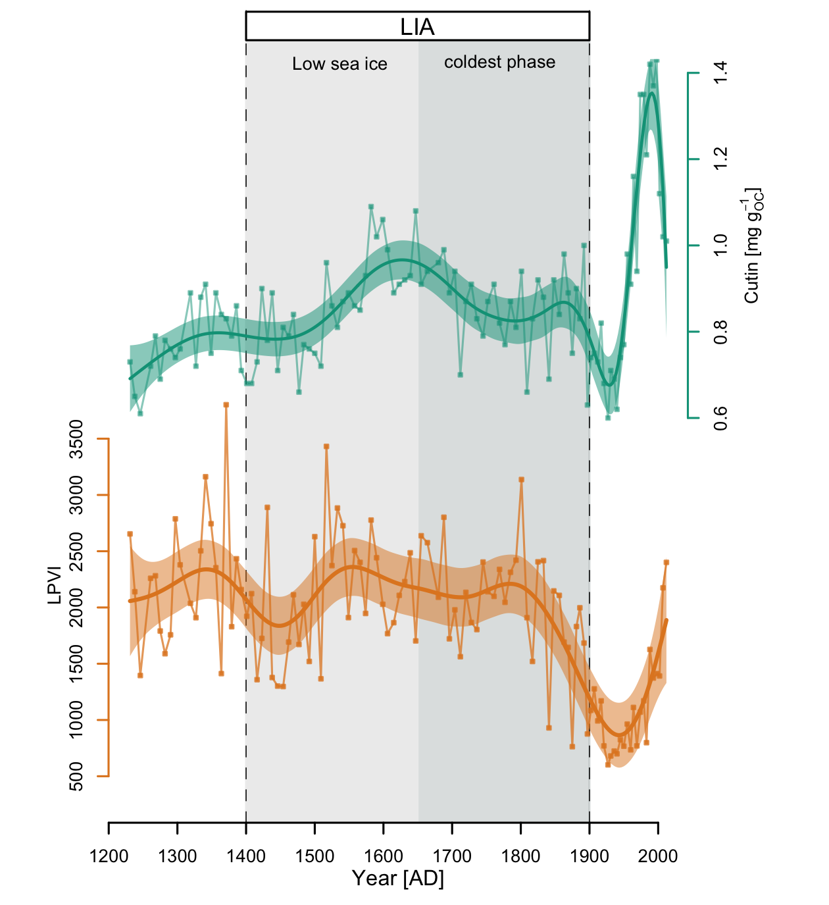
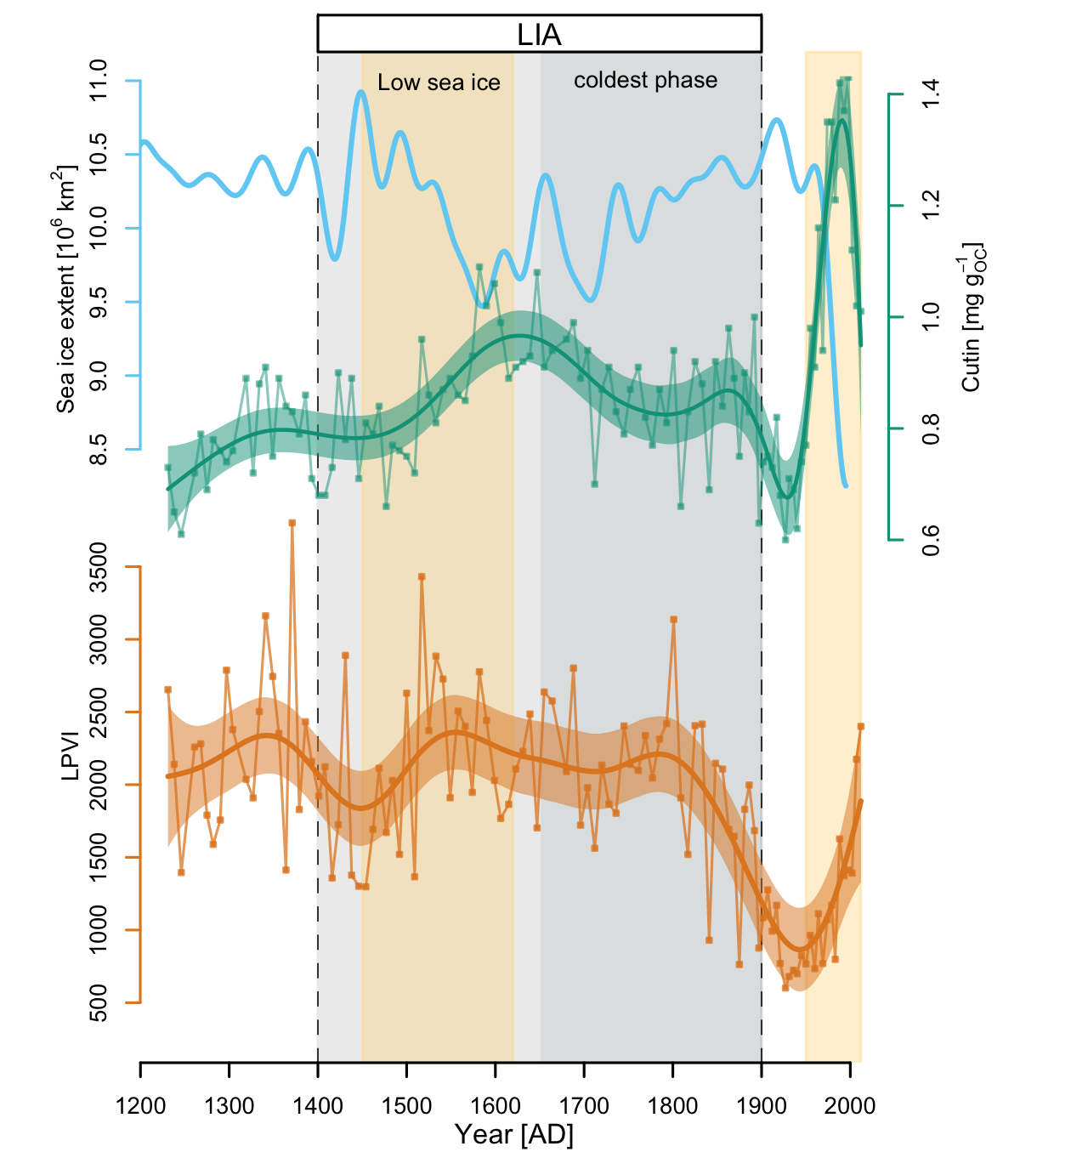
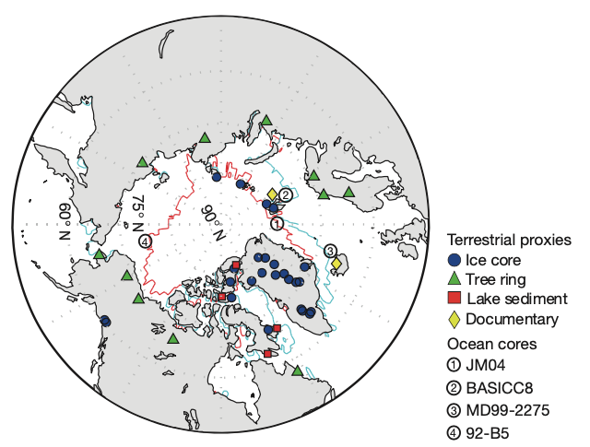
Plant specific biomarkers
Reconstruction of summer sea ice extent (Kinnard et al., 2011)
An early signal of greening of the western Svalbard that started at the beginning of the 20th century associated with the general sea ice collapse
non-woody angios.
(erbaceous species)

Slide 12
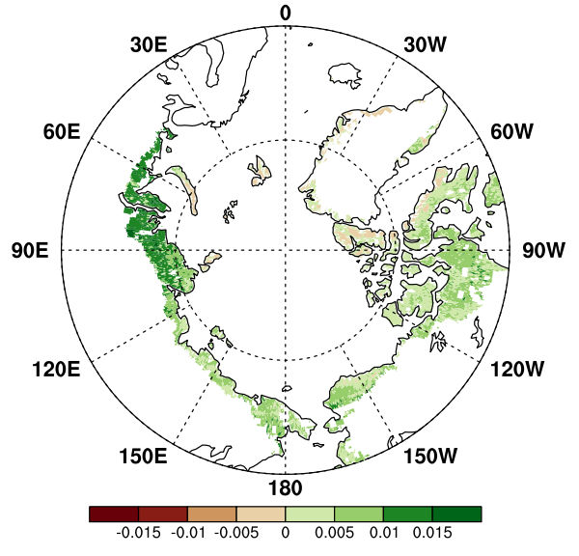
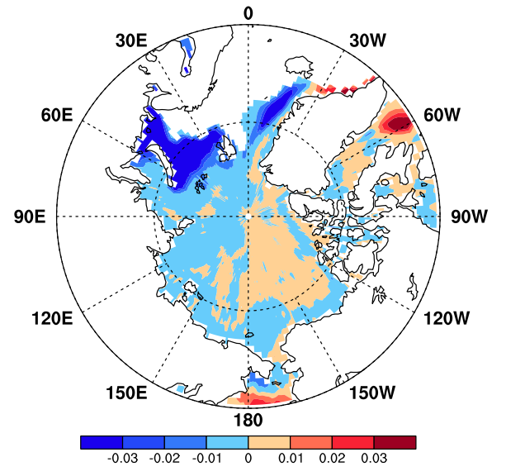
Arctic tundra growth associated with sea ice decline
Satellite records indicate a widespread interannual linkage between Arctic vegetation NDVI increase and sea ice retreat (Ji et al., 2024)
…especially in the Fram Strait
NDVI during 1982–2021
Sea ice concentration during 1982–2021

Slide 13
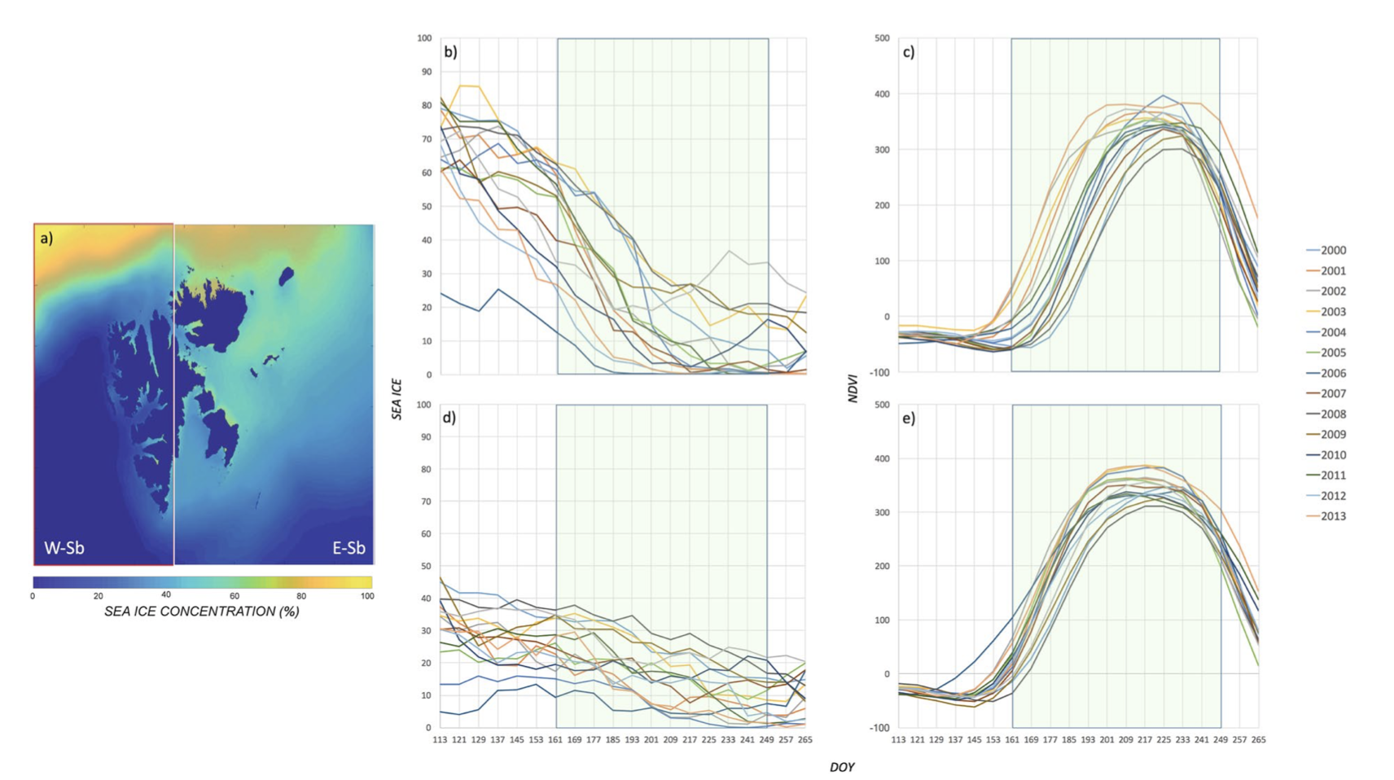
Arctic tundra growth associated with sea ice decline
Sea ice decline
Tundra productivity increase
For Svalbard an explicit relationship between sea ice decline and tundra productivity increase have been reported for the last decades (Macias-Fauria et al., 2017)
Data 2000 – 2013

Slide 14
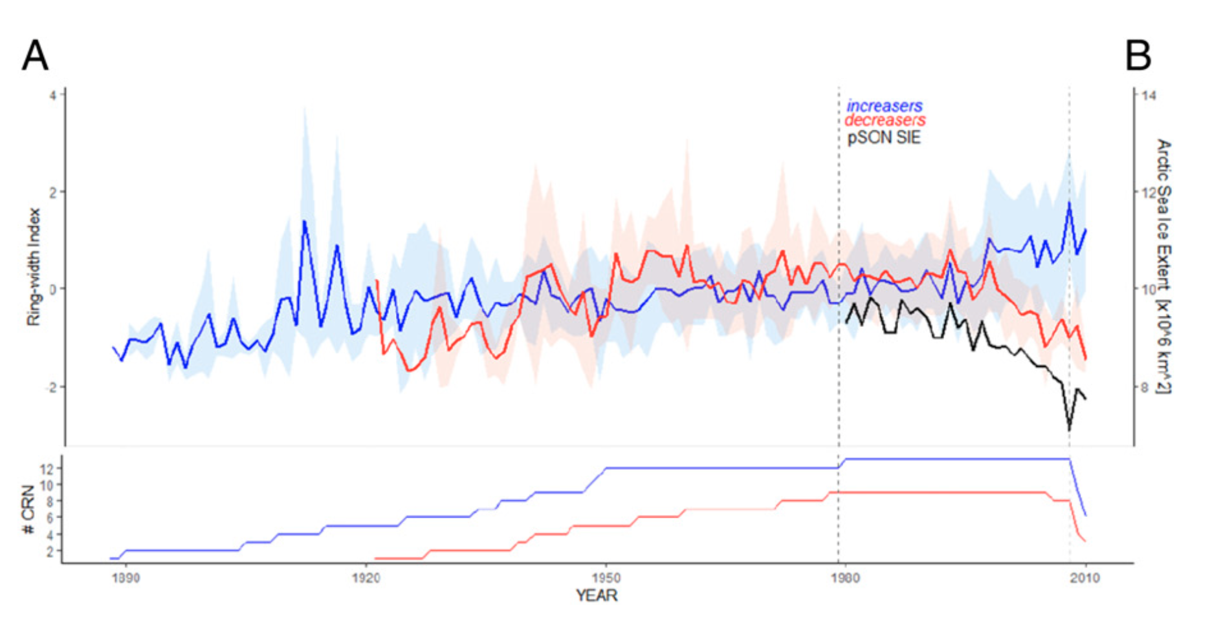
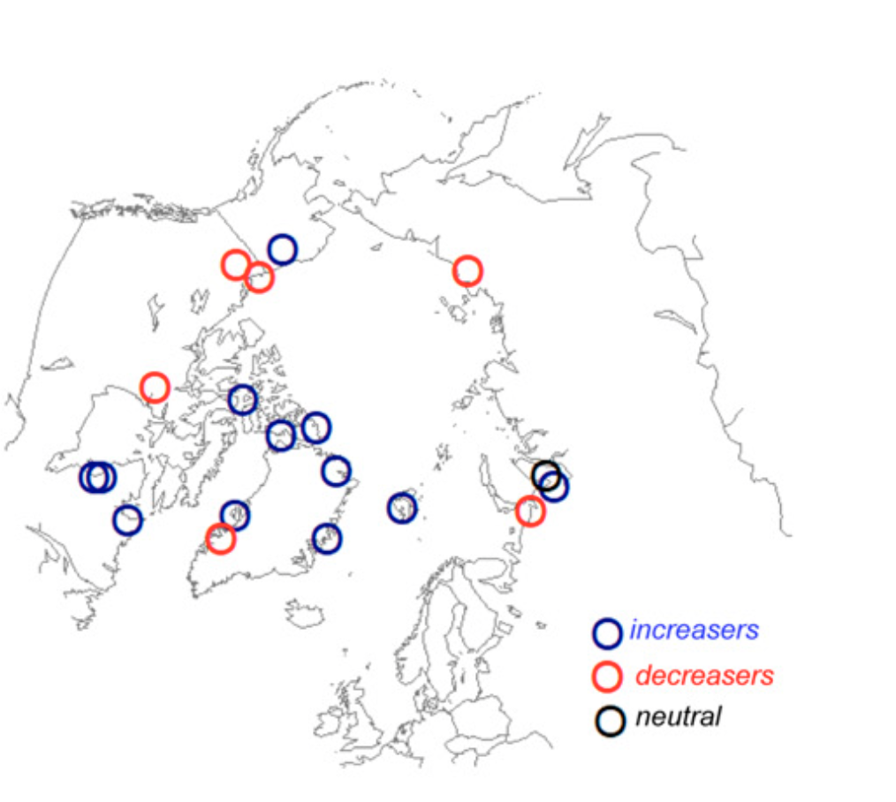
Arctic tundra growth associated with sea ice decline
Specific in-situ reconstructions (tundra shrub-ring chronologies) suggest that tundra productivity increase with summer sea ice decline in the Svalbard (Buchwal et al., 2020).

Slide 15
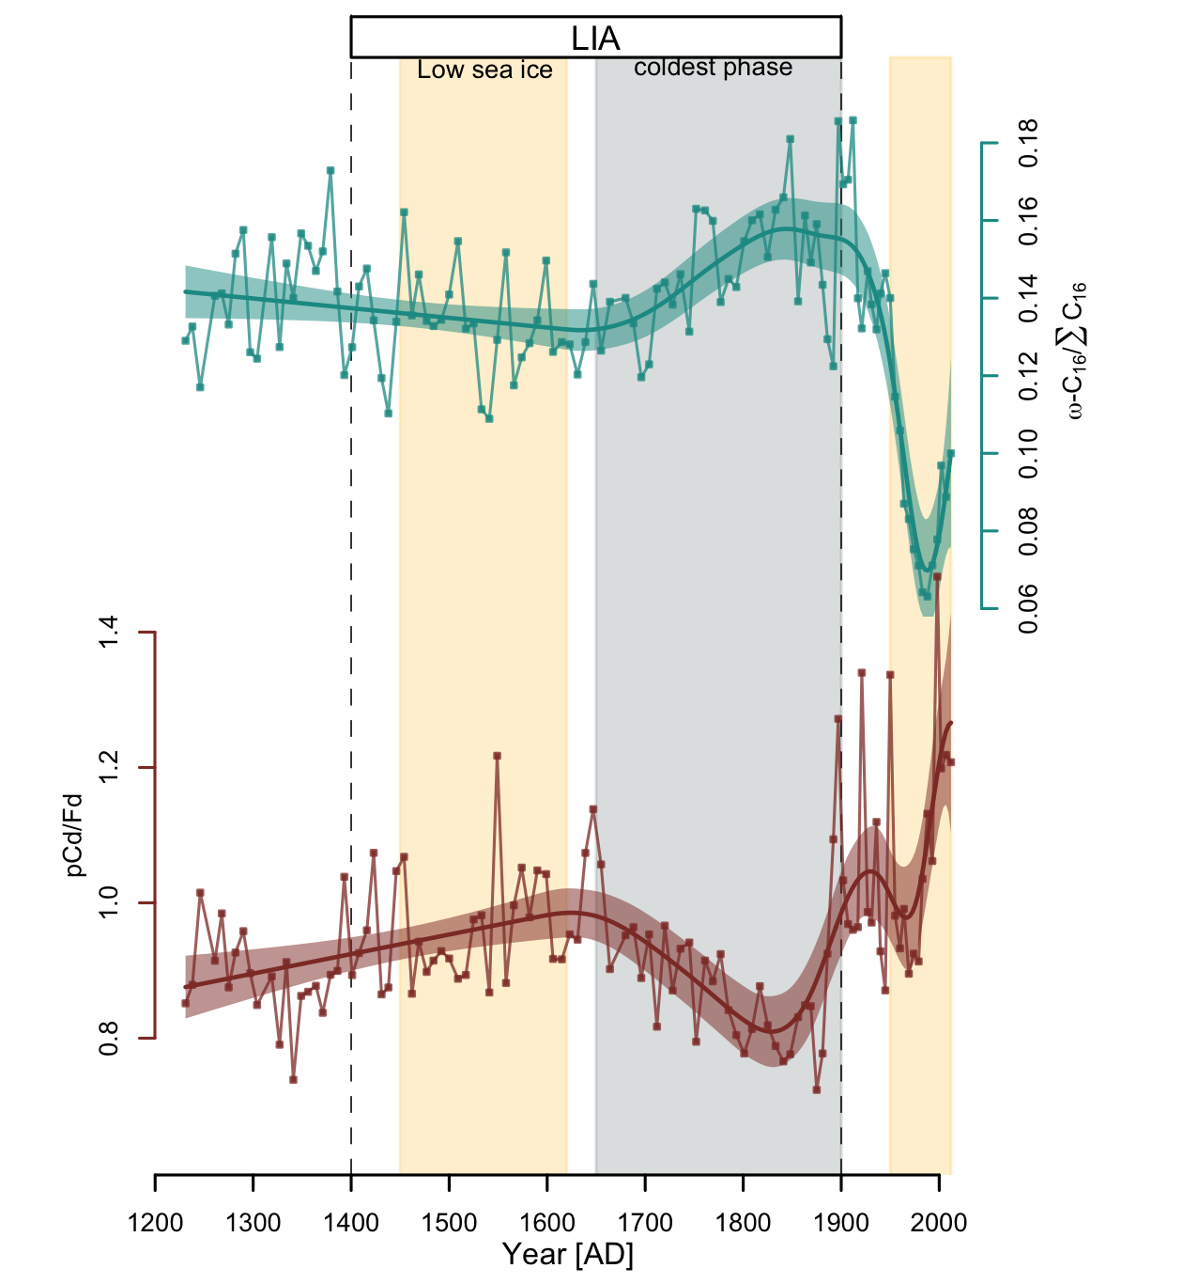
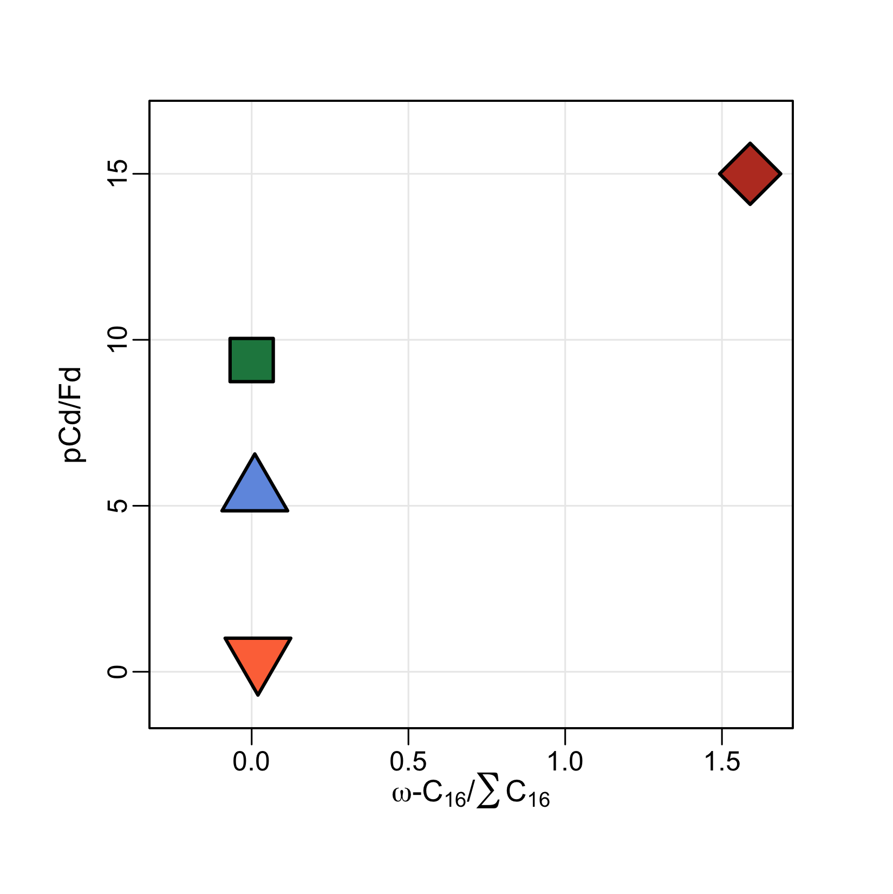
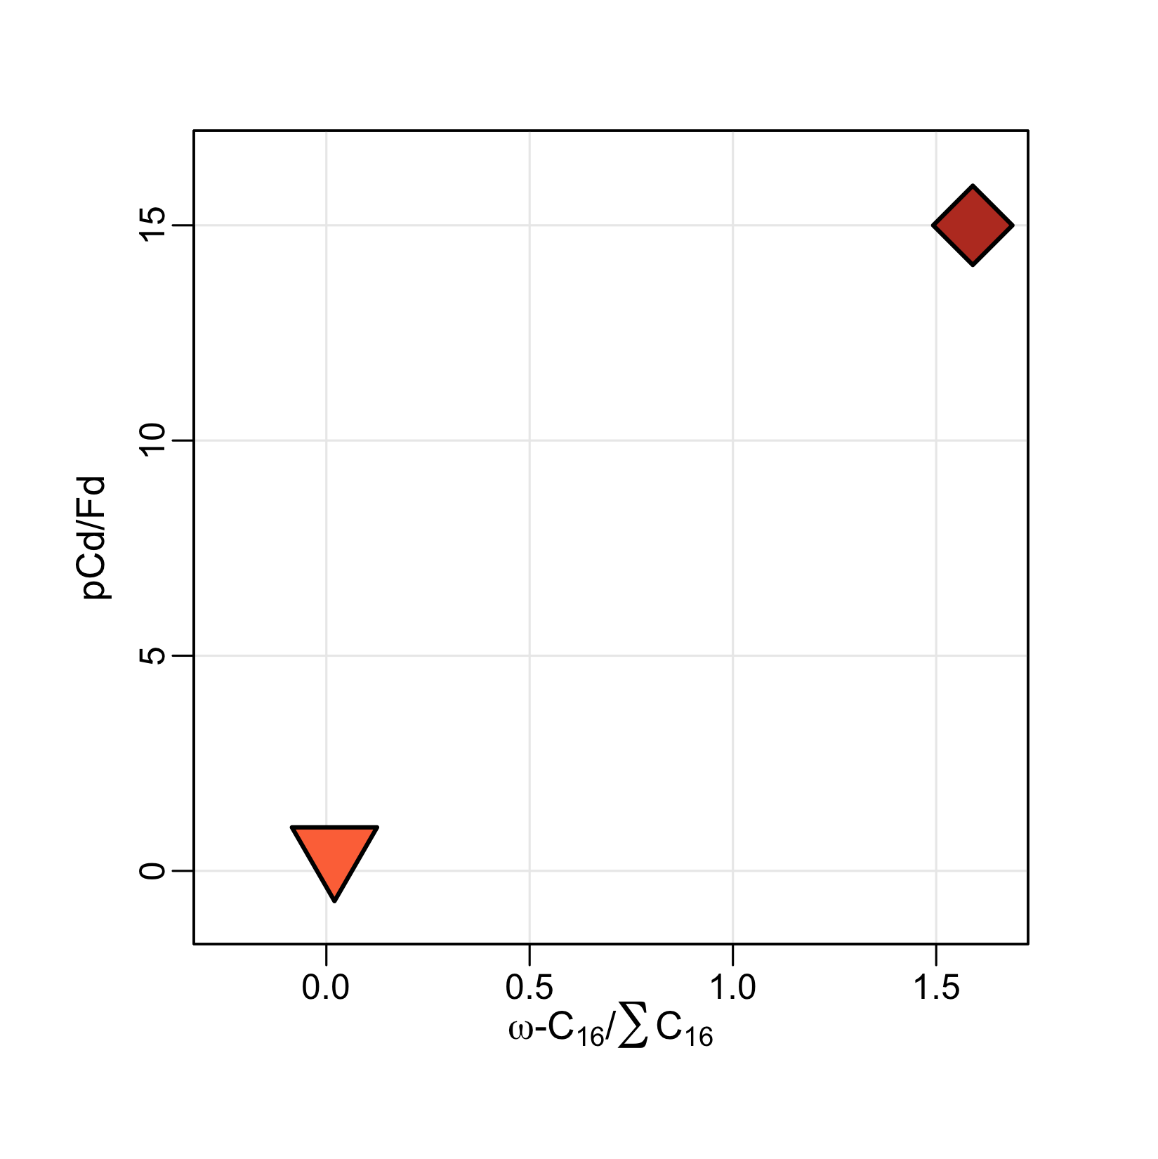
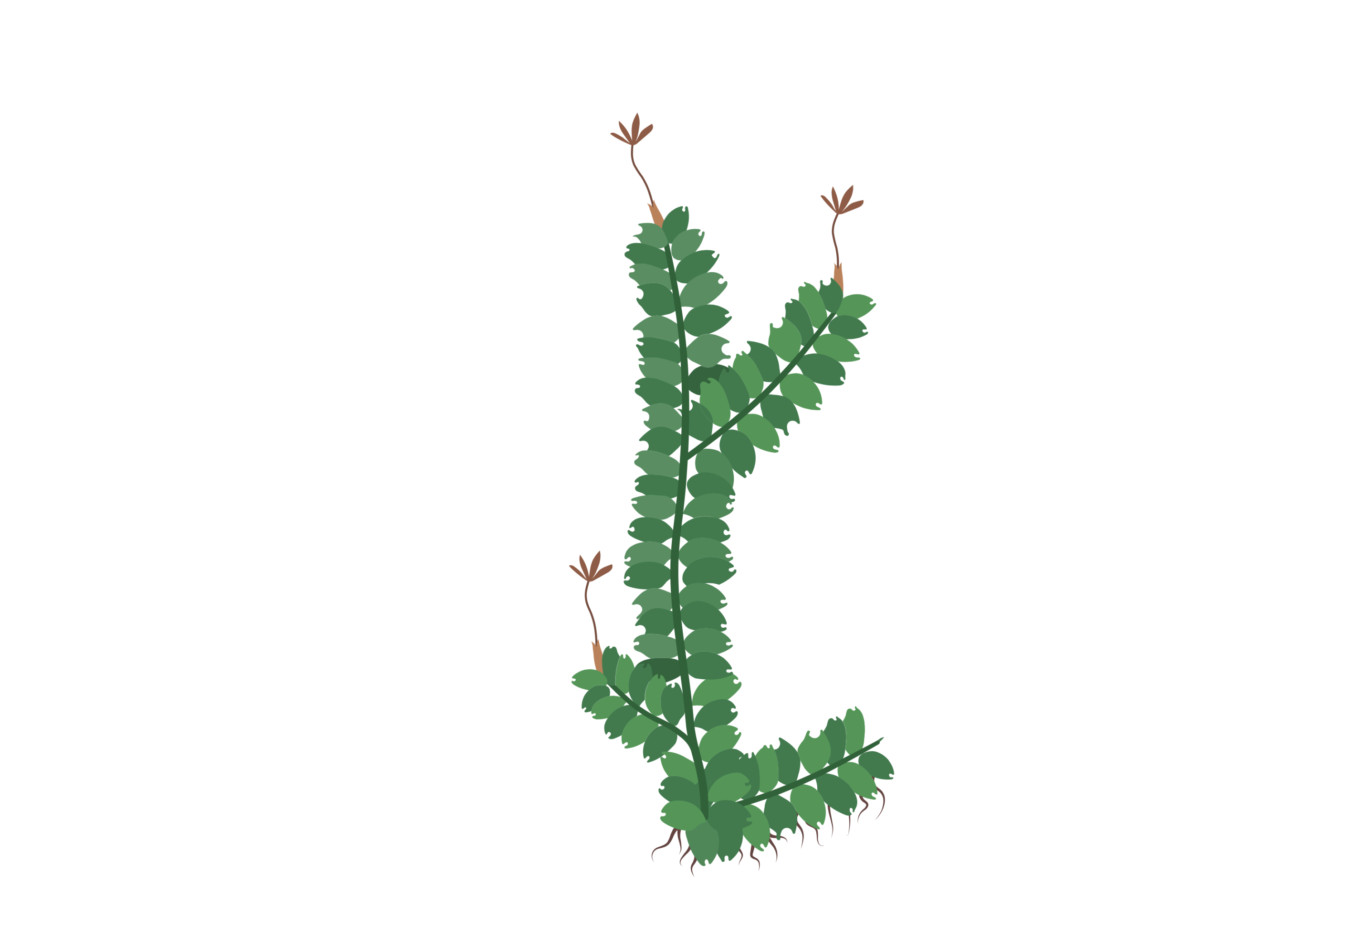
-
Change of the plant species composition
vascular
moss
moss
+
Salix polaris
+
Dryas ocopetala
moss
vascular
vascular
-

Slide 16
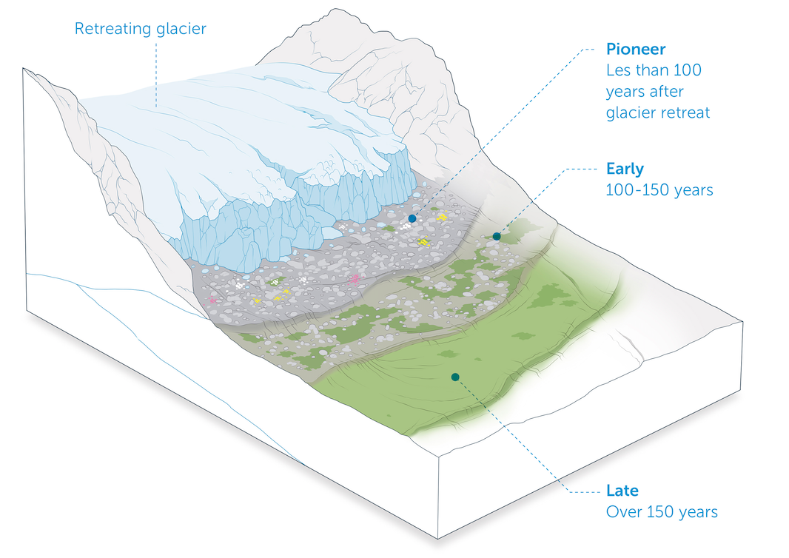
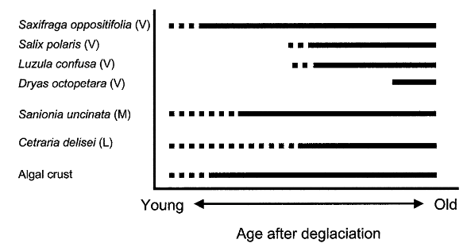
Plant successional series in the deglaciated area
Salix polaris and Dryas octopetala predominate in the later stages of succession (Nakatsubo et al., 2005).

Slide 17
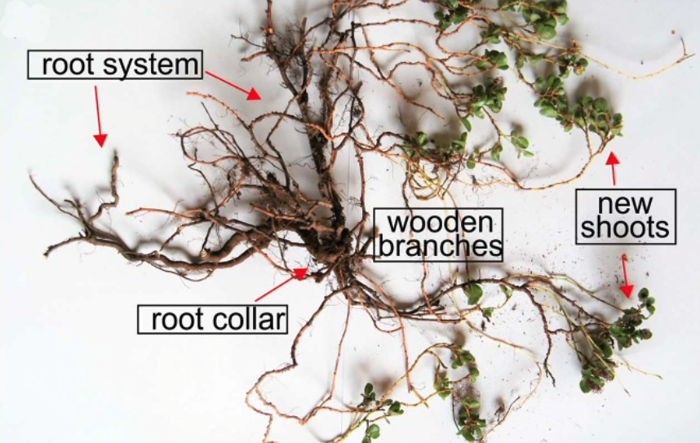
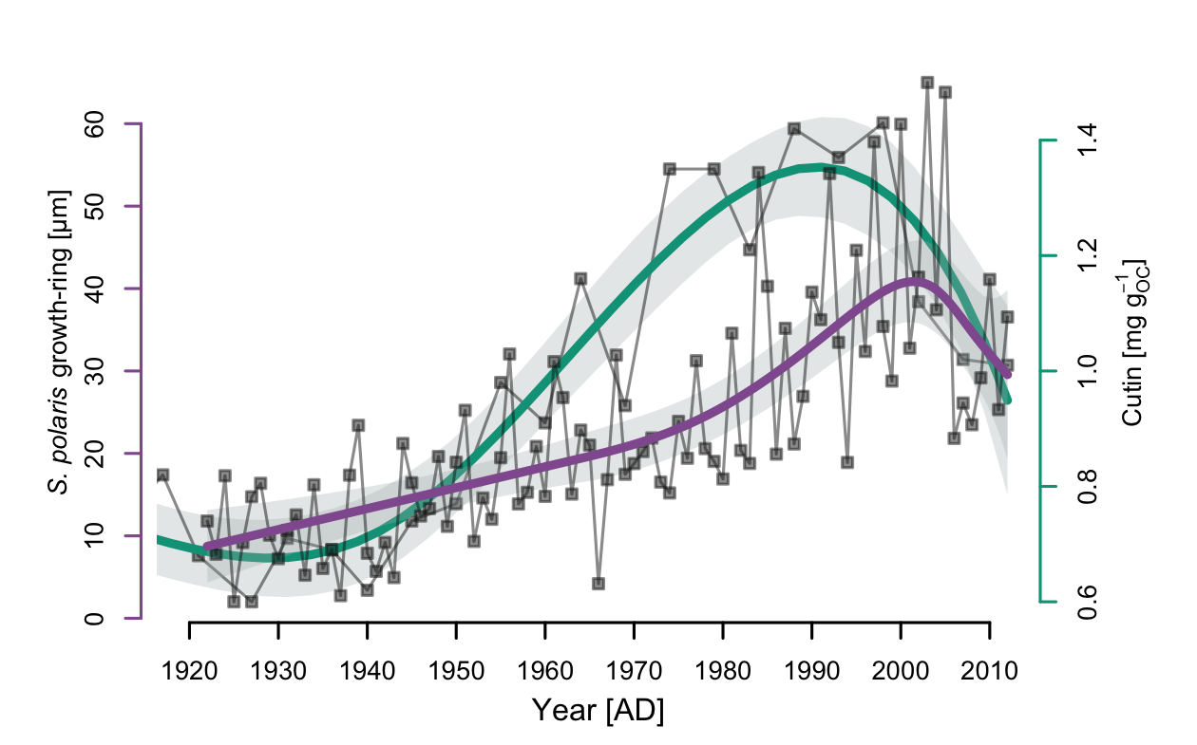
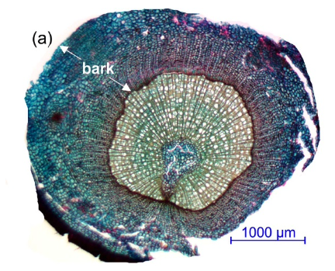
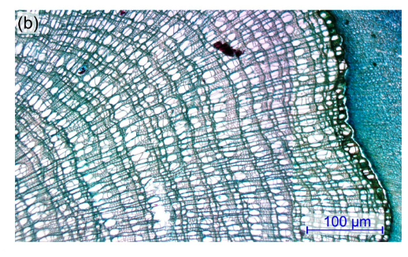
Greening signal VS. S. polaris growth-ring reconstruction
NYA 17-154
Owczarek et al., 2021

Slide 18
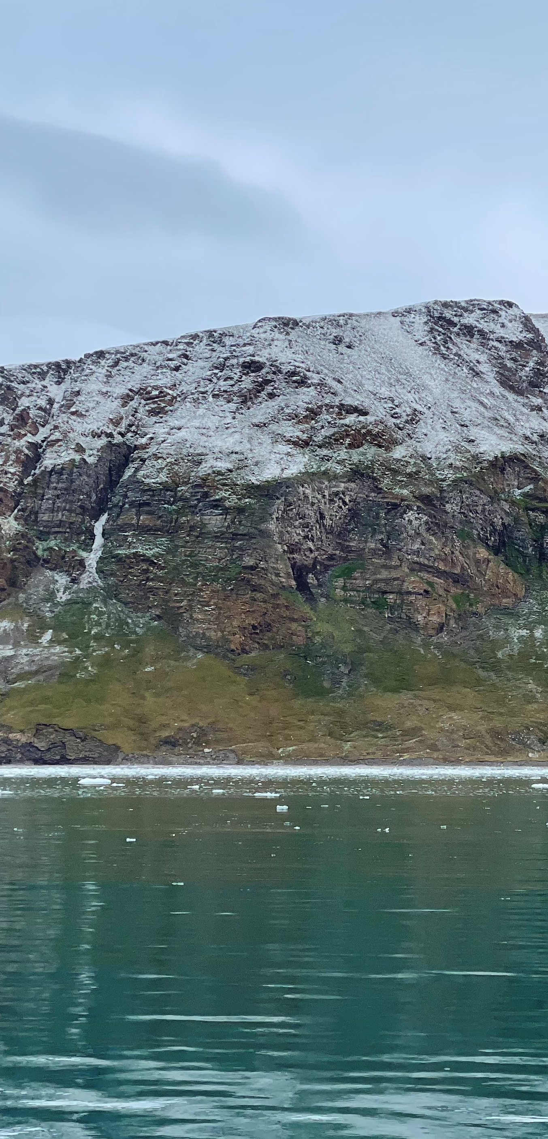
Conclusions
- Not all terrestrial organic proxies are suitable for describing the past greening events: n-alkanes and n-alkanoic acids
- Lignin phenols are cutin acids are more promising and consistent with the pan-Arctic reconstruction of sea ice
- In Northern Svalbard, greening began soon after the end of the LIA in the early 20th century
- Signals of tundra vegetation shift toward mature successional stages and vascular species adapted to milder climate (likely S. polaris and D. octopetala).
Greening around Kongfjorden, Svalbard

Slide 19
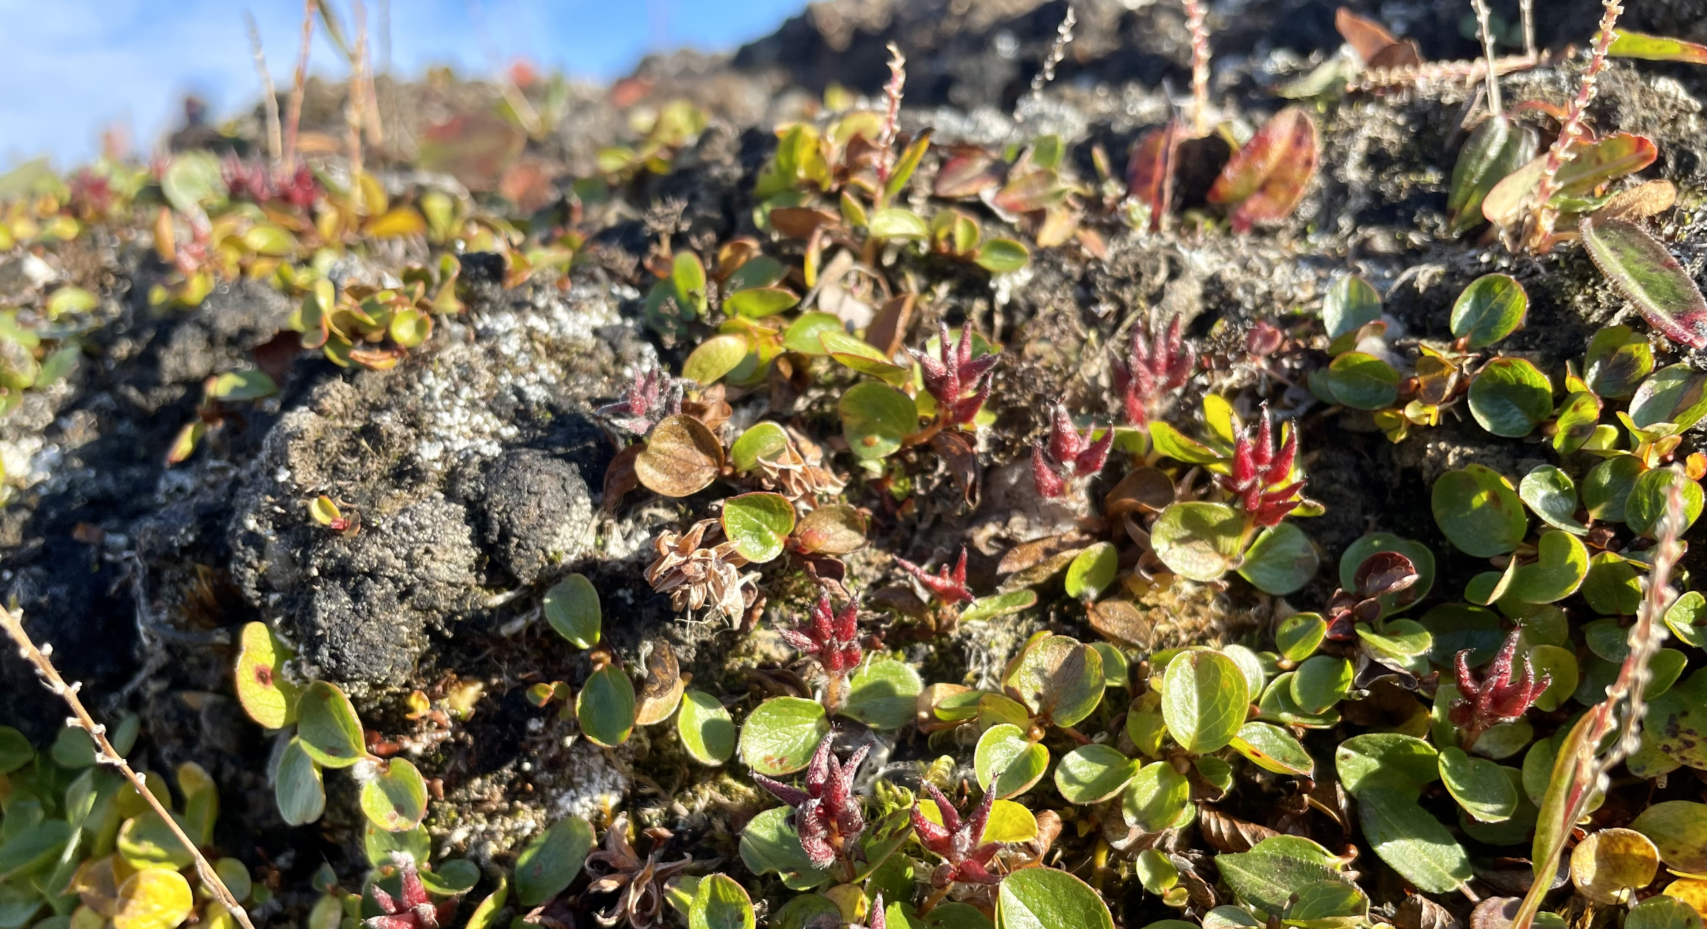
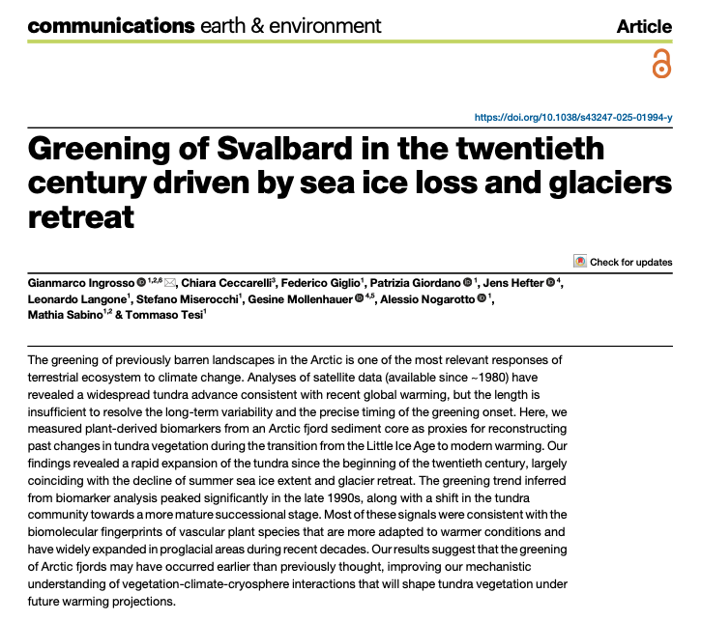
Thanks!

Slide 20
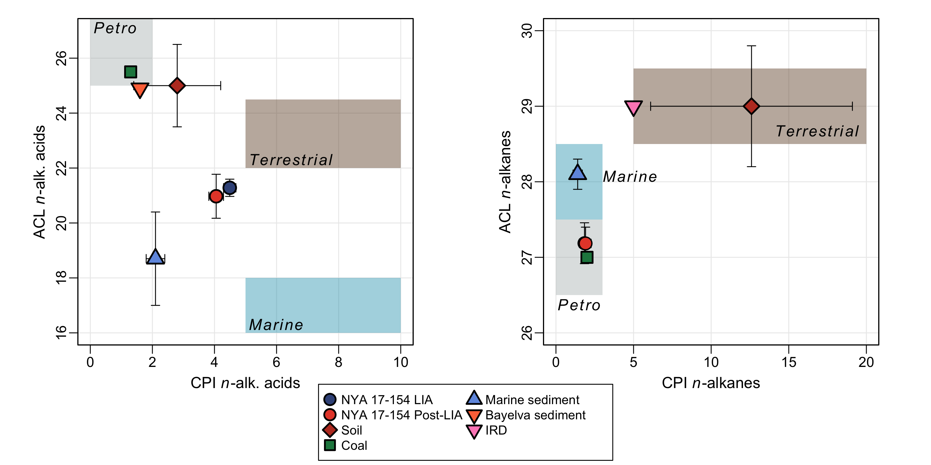
marine sediments(Kim et al., 2011; Kusch et al., 2021), soil(Kim et al., 2011; Kusch et al., 2021), coal(Kim et al., 2011; Kusch et al., 2021), ice-rafted detritus (IRD)(Kim et al., 2011), and sediments affected by proglacial river discharge (Bayelva sediment)(Kusch et al., 2021).

Slide 21
Correlation analysis
Specific Correlation analysis between Two Unevenly
Spaced Time Series (Cutin vs. Summer Sea Ice extent)
Mudelsee (2010)
Binned Pearson's correlation = -0.8751
p-value < 0.001
But…correlation dose not imply causation!
Notes:
12) The strong inverse relationships between cutin acids and sea ice is supported also by a specific correlation analysis between two unevenly spaced time series
But…correlation dose not imply causation

