Slide 1


An experimental infrastructure for realistic experiments in Mediterranean Europe –
FO₃X (Free air O₃ eXposure)
E. Marra¹, E. Paoletti ^{1,2}, B.B. Moura ^{1,2},
J. Manzini ^{1,3}, A. Viviano ^{1,3}, L. Lazzara ¹, Y. Hoshika ^{1,2}
¹IRET-CNR, (FI)
²NBFC, (PA)
³DAGRI-UNIFI, (FI)

Slide 2

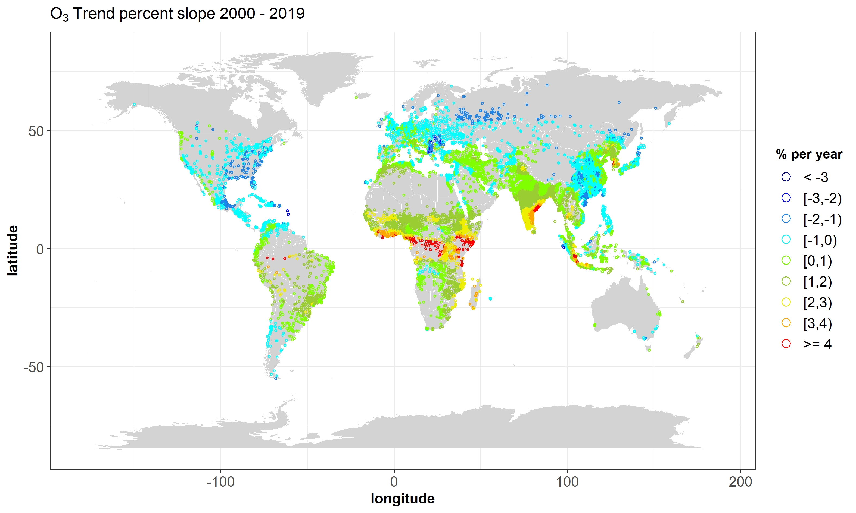
Tropospheric ozone (O₃)
Tropospheric ozone (O₃ - close to the Earth’s surface) is a secondary air pollutant that forms as a result of photochemical reactions.
Ozone concentrations over the last 20 Years
-1-2% year⁻¹ (air quality regulations)
North America
Central America
Northern Europe
Japan
Southeast China
+ 1-2% year⁻¹ (developing regions)
South America
Africa
Middle East
South Asia
+ 3% year⁻¹ (rapid industrialization/urbanization)
Equatorial Africa
India
Global trends (2000-2019) in urban areas ( > 50,000 inhabitants) show that ozone levels are still increasing - people and ecosystems are being exposed to dangerous levels of ozone.

Slide 3
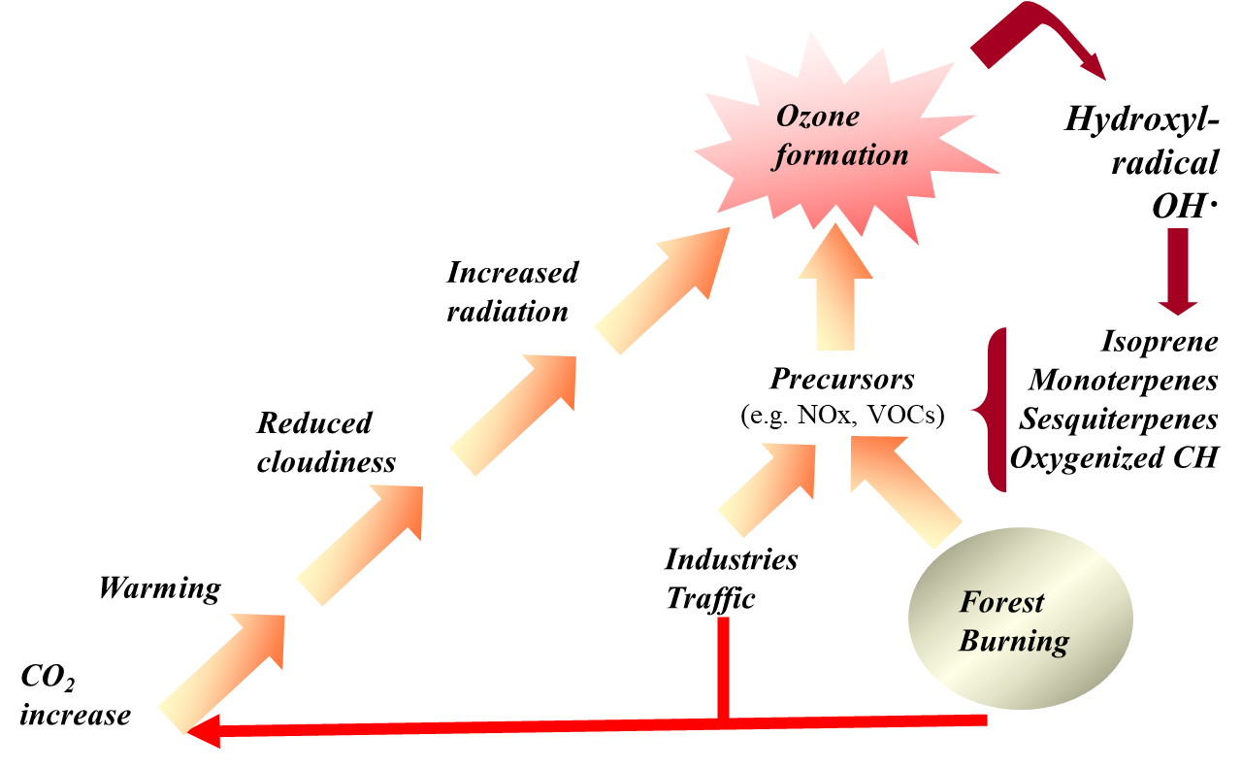
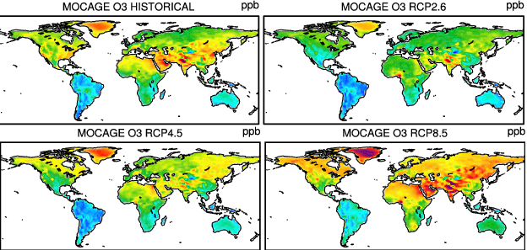
A component of Climate Change
& Global Change
Climate change, by raising temperatures and increasing sunlight/radiation, drives higher O₃ concentrations - Mediterranean Basin is particularly vulnerable (reduced biomass, photosynthetic capacity).
Emissions scenario for 2100
According to projected emission pathways (RCP), ozone concentrations by 2100 could decrease by 2-10 ppb under the optimistic RCP2.6 scenario or increase by 4-5 ppb under the high-emission RCP8.5 scenario.
2100: 40-55 ppb
Sicard et al., 2017

Slide 4
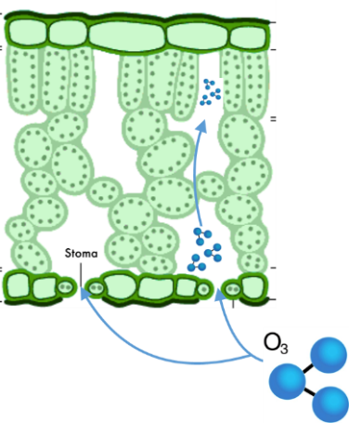
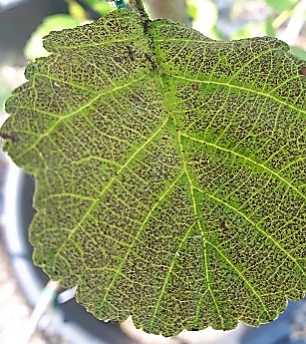
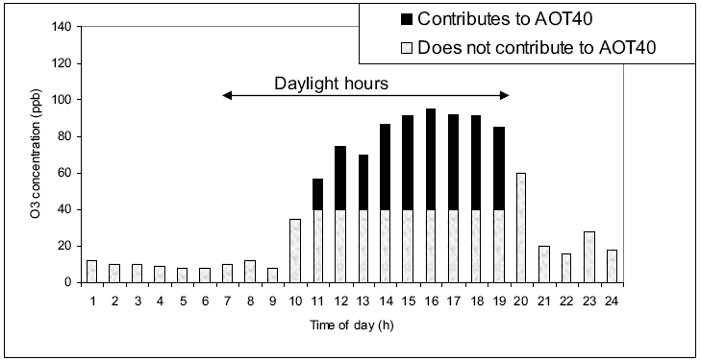
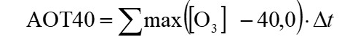
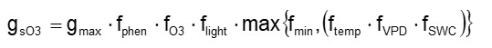
Introduction
O₃ is taken up through stomata (during photosynthesis) and damages the plant’s physiological and biochemical processes.
Physiology –
anatomical
Leaf level –
macroscopic
Ozone metrics for
plant protection
Exposure-based
(AOT40, Accumulated Ozone exposure over a Threshold of 40 ppb - EU)
Pros: easy to measure and calculate (entire growing season).
Cons: poorly
biologically relevant
(generic index)
Flux-based
(PODy, Phytotoxic Ozone Dose)
Pros: highly biologically relevant (specific species – i.e., Fagus, Quercus).
Cons: many variables
to be monitored.
Stomatal conductance
(setting critical levels CLs)

Slide 5
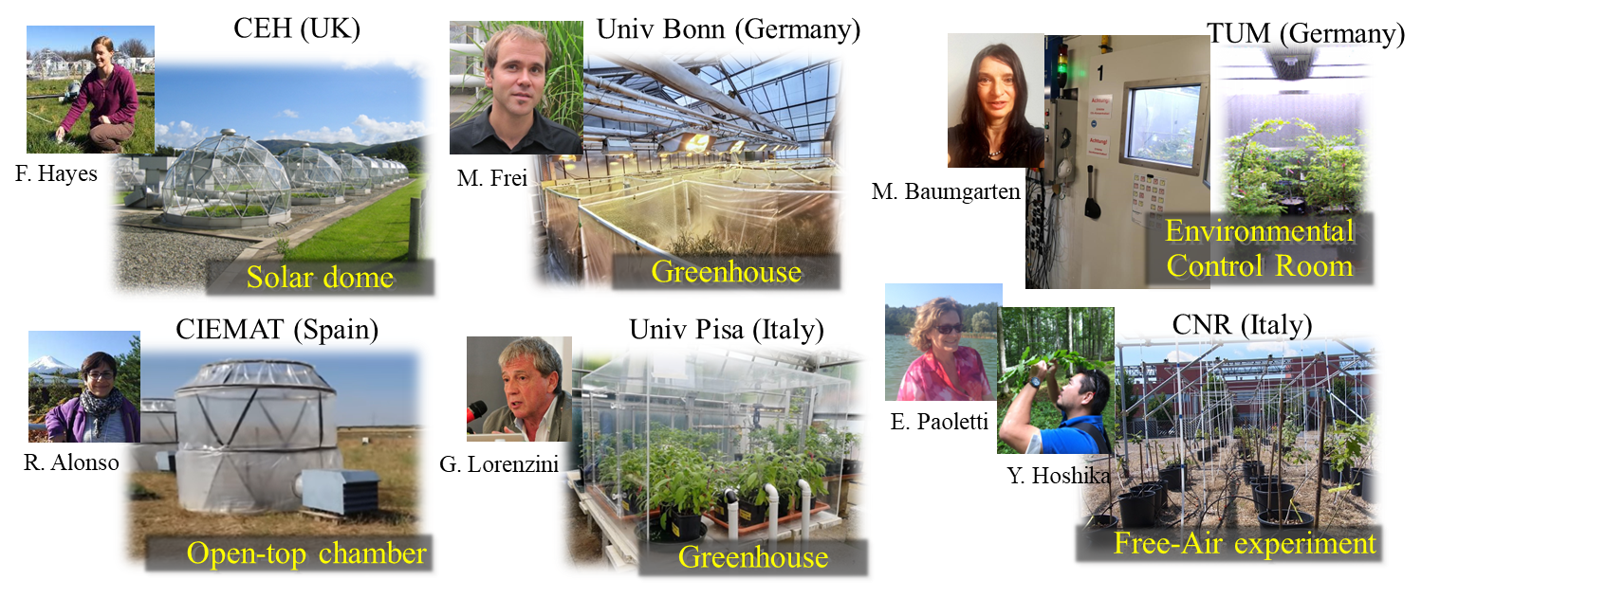
Current ozone exposure experiments in Europe
Since the 1970s, controlled and open-top chambers have been used to study the effects of O₃ on plant growth and crop yields – artificial/controlled conditions (which may influence how plants absorb O₃) and plant size.
FACE (field conditions) offering a more realistic open-air environments to better estimate plant responses to ozone.

Slide 6

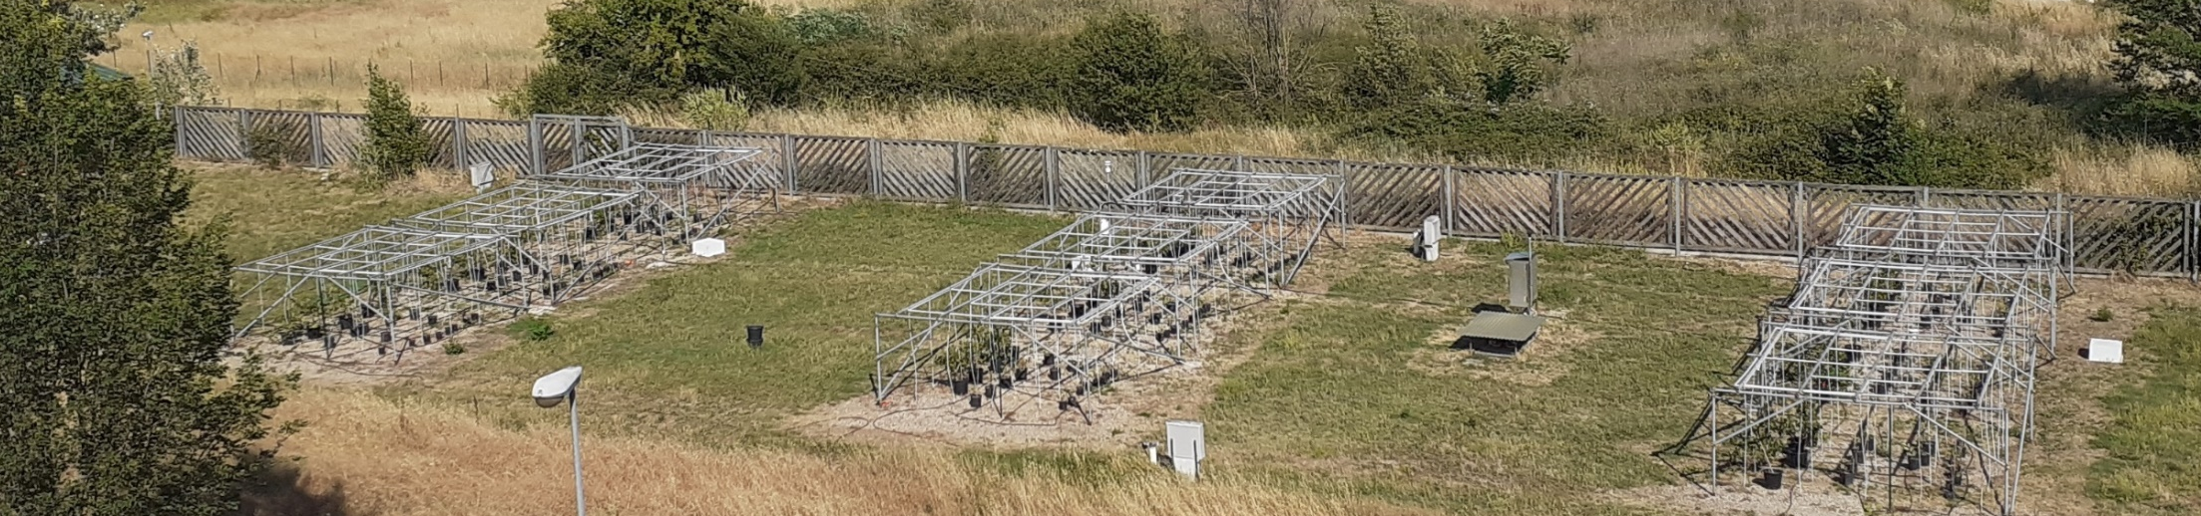

Free-air O₃ eXposure (FO₃X)
5 FACE systems worldwide - FO₃X the only one located in a Mediterranean climate
FO₃X
Set-up description:
The design is a split-plot experiment.
The facility permits to expose the plants to three levels of O₃ concentrations. Each O₃ treatment is replicated three times (total 9 plots 5 X 5 X 2 m).
A vertical network of vent pipes disperses the mixture of ambient air and O₃ (generated from pure oxygen) across the plots to simulate realistic exposure.
The air containing O₃ is injected through 25 teflon tubes hanging down from a fixed grid above the plants.
The O₃ concentration and all main environmental variables are continuously monitored.

Slide 7
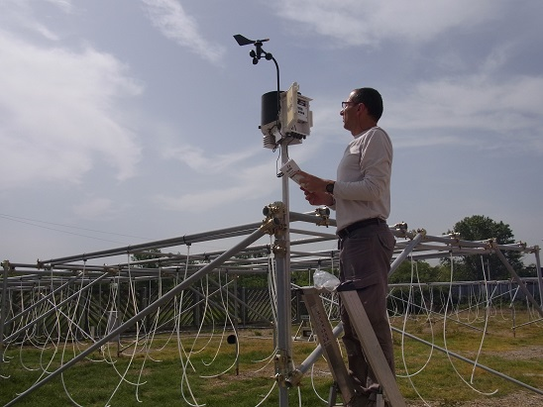
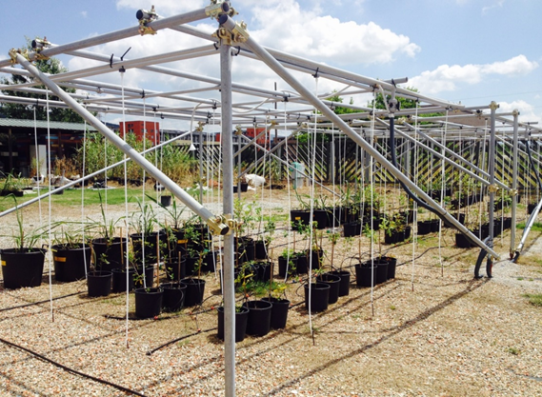
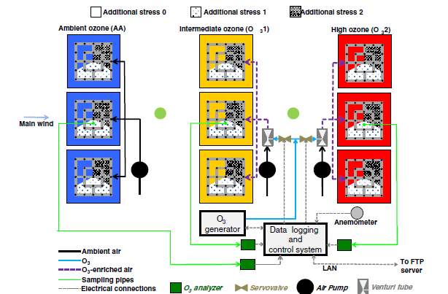
Free-air O₃ eXposure (FO₃X)
A. Materassi
A meteorological station monitors the climate conditions
(temperature, pressure, RH, PAR, GR, wind speed
and direction),
air vapor pressure deficit
O₃ concentration, NOx concentration
FO₃X

Slide 8
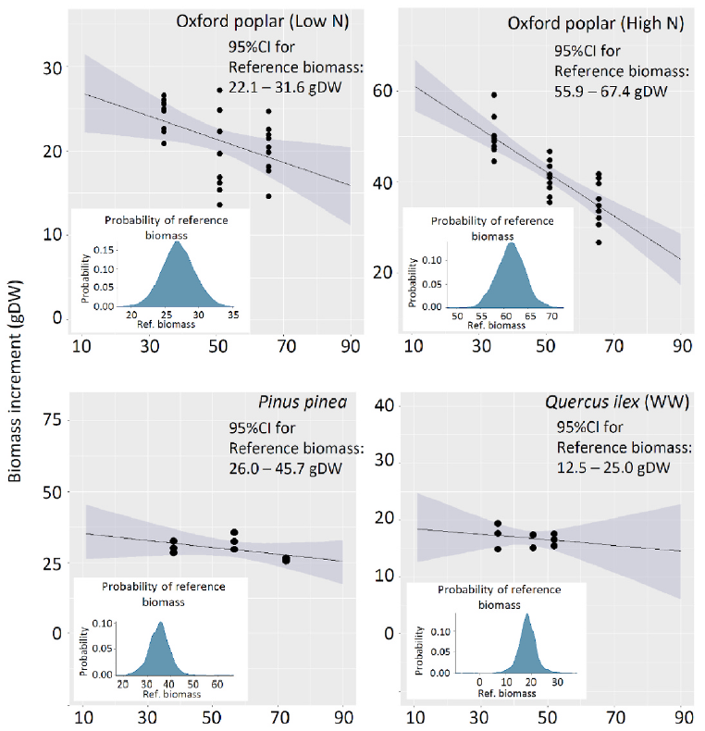
Ozone Risk Assessment
The application of various treatments (differing O₃) allows to analyze the relationship between O₃ and biomass variation. It is possible to parameterize species-specific gs and establish Critical levels (CLs - i.e. 4 or 5% decrease in biomass or yield), defined by the Phytotoxic Ozone Dose (POD).
Species | PODy (mmol m⁻²) | CL | Reference
Saccharum officinarium | POD₂ | 1.04 | Moura et al., 2018
Quercus ilex | POD₀ | 6.90 | Hoshika et al., 2018
Quercus pubescentis | POD₀ | 6.90 | Hoshika et al., 2018
Quercus robur | POD₀ | 3.60 | Hoshika et al., 2018
Populus oxford | POD₄ | 4.60 | Lu Zhang et al., 2018
Moringa oleifera | POD₄ | 1.10 | Moura et al., 2021
Eugenia unifolia | POD₀ | 3.60 | Engela et al., 2021
Vitis vinifera | POD₃ | 5.21 | Moura et al., 2024
M24 (ppb)
Setting the CLs allows to identify the threshold of susceptibility to O₃ to prevent detrimental effects

Slide 9
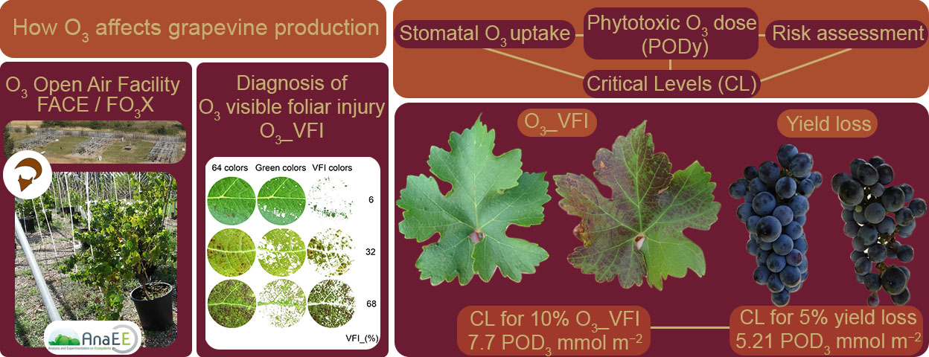
Risk assessment – How O₃ affects grapevine production
Stomatal conductance in different environmental conditions. Example of parameterization of the DO3SE model for POD₃
A three-year free-air experimental assessment of ozone risk on the perennial Vitis vinifera

Slide 10
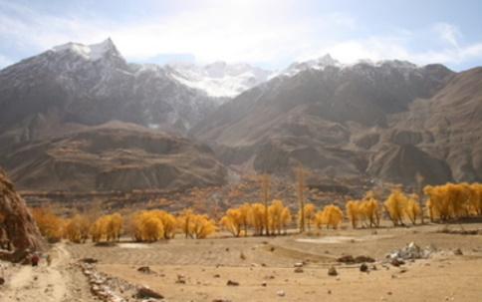
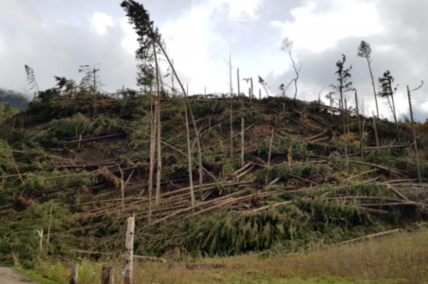
Ozone highly reduces root growth
Clean air
Ozone
Poplar Oxford clone
Above-ground
(stem + branch + leaf)
Below-ground (Roots)
-16%
-34%
FO₃X potted plants allow for the estimation of root system development.
The decrease in biomass is more pronounced in the roots compared to the above-ground parts.
→Resistance against drought
→Stability of trees

Slide 11
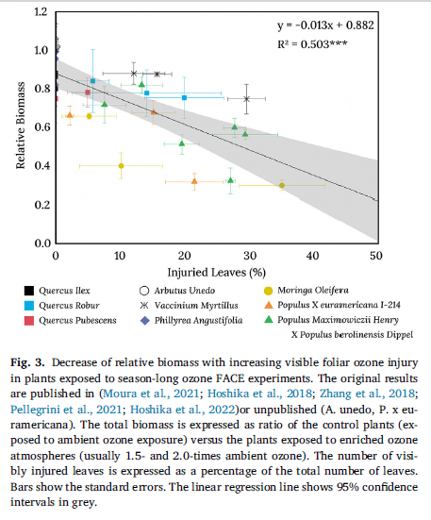
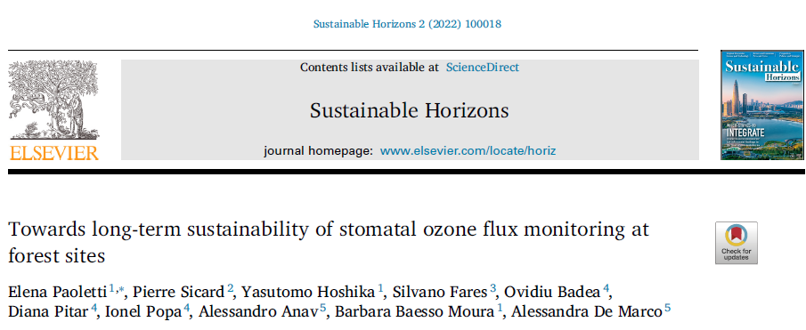
Biomass and VFI
Biomass losses increase with increasing visible foliar injury under O₃ exposure

Slide 12



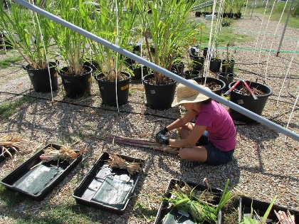
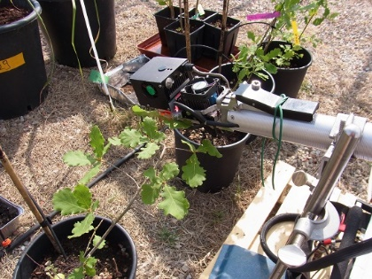
National and international collaborations (Since 2015)
10 countries - UNICAMP, IPA, Univ Sao Paulo (Brazil), CAS, NUIST, North East Agr Univ (China), CFI (Croatia), INRA, Univ Lorraine, ARGANS (France), Univ Freiburg, Univ Würzburg (Germany), UNIPI, UNIFI, UNITUS, CREA, Roma Sapienza Univ, ENEA (Italy), Univ Hokkaido, TUAT (Japan), INCDS (Romania), SFI (Slovenia), WSL (Switzerland), and 48 visiting researchers.
29 Plant species fumigated at FO₃X so far: Acer platanoides L. var. “Crimson king”, Alnus glutinosa (L.) Gaertn, Arbutus unedo L., Carpinus betulus L., Coffea arabica L., Cupressus sempervirens L., Moringa oleifera Lam., Ostrya carpinifolia Scop., Populus × canescens (Aiton) Sm., Populus deltoides W. Bartram ex Marshall x Populus nigra L. clone i21, Populus maximowiczii Henry x Populus berolinensis Dipper – Oxford clone, Passiflora edulis Sims., Phaseolus vulgaris L., Phillyrea angustifolia L., Phoenix dactylifera L., Pinus halepensis Mill., Pinus pinaster Aiton., Pinus pinea I., Punica granatum I., Quercus ilex I., Quercus pubescens Wild., Quercus robur I., Robinia pseudoacacia I., Rubus ulmifolius Schott., Saccharum officinarum L.
About 30 scientific research papers published.
Modeling analysis
Morphological
measurements
Physiological
measurements

Slide 13


Future FO₃X
«Open for collaborations»
Licor
Porometer
Leica
CosmO₃FACE
HeatFACE
How to implement face – instruments and tools to
assess and validate the
O₃-VFI:

Slide 14
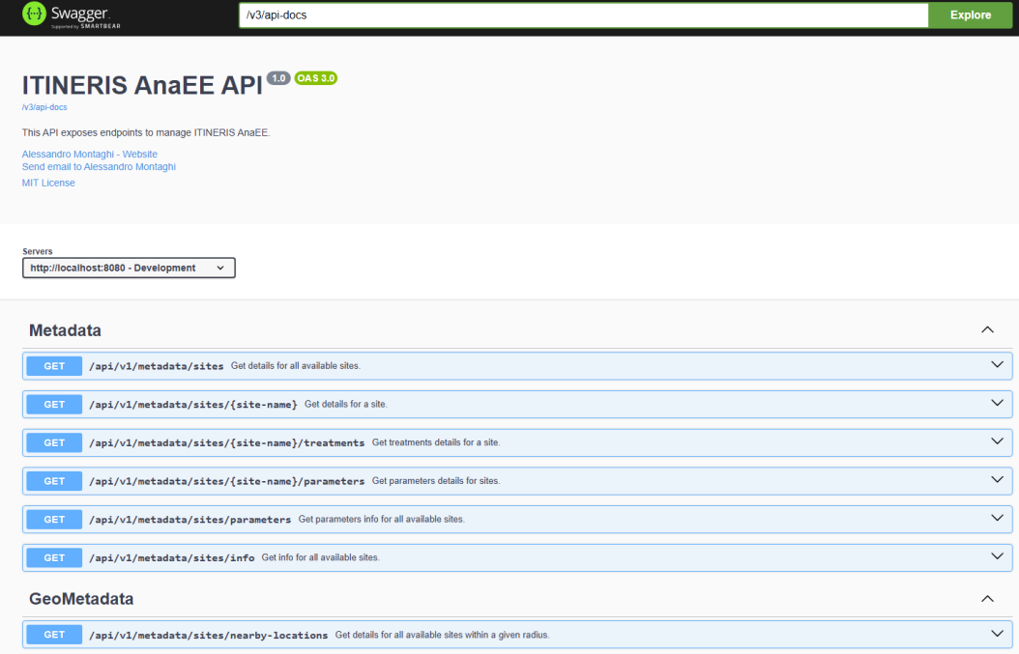

Enhancing Environmental Research with ITINERIS Metadata Base
Background:
- Environmental data are crucial for understanding global changes.
- Current practices often hinder data accessibility and sharing.
ITINERIS Goals:
- Establish ITINERIS Hub for unified access to environmental data.
- Focus on high-quality metadata for efficient data exploration.
Methods:
- Implemented metadata base using MVC architecture (Model-View-Controller).
- Model (Service Layer, Repository Layer) manages data and business logic.
- View (Swagger UI) facilitates user interface and data presentation.
- Controller manages data flow between Model and View, exposing RESTful APIs.
- MongoDB chosen for scalable data management without predefined schema.
Conclusion:
- Continuous improvement of metadata base through stakeholder collaboration.
- Promotes harmonization, standardization, and data sharing across ITINERIS infrastructures.
- Initial step towards establishing ITINERIS Hub for comprehensive environmental research.
#harmonization
#collaboration
#implementation

Slide 15

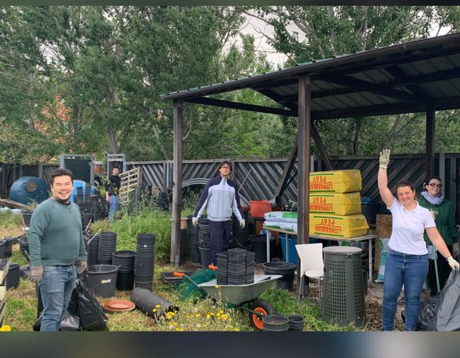
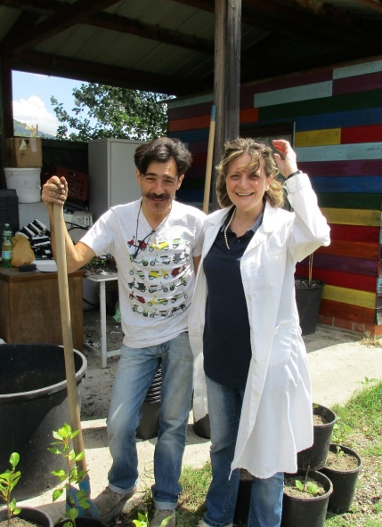
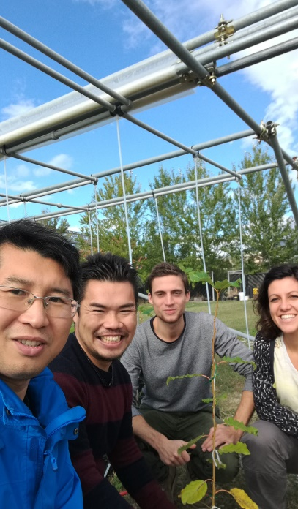
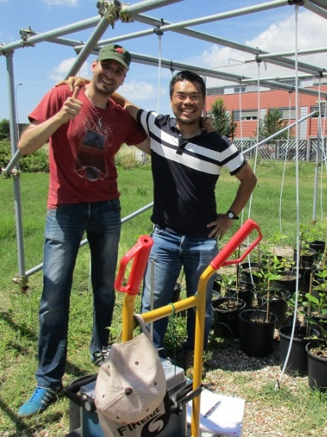
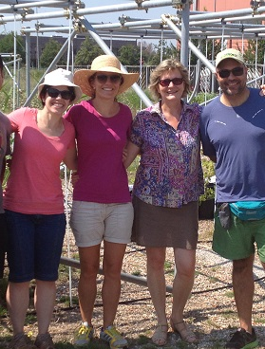
Thank you!

