Slide 1
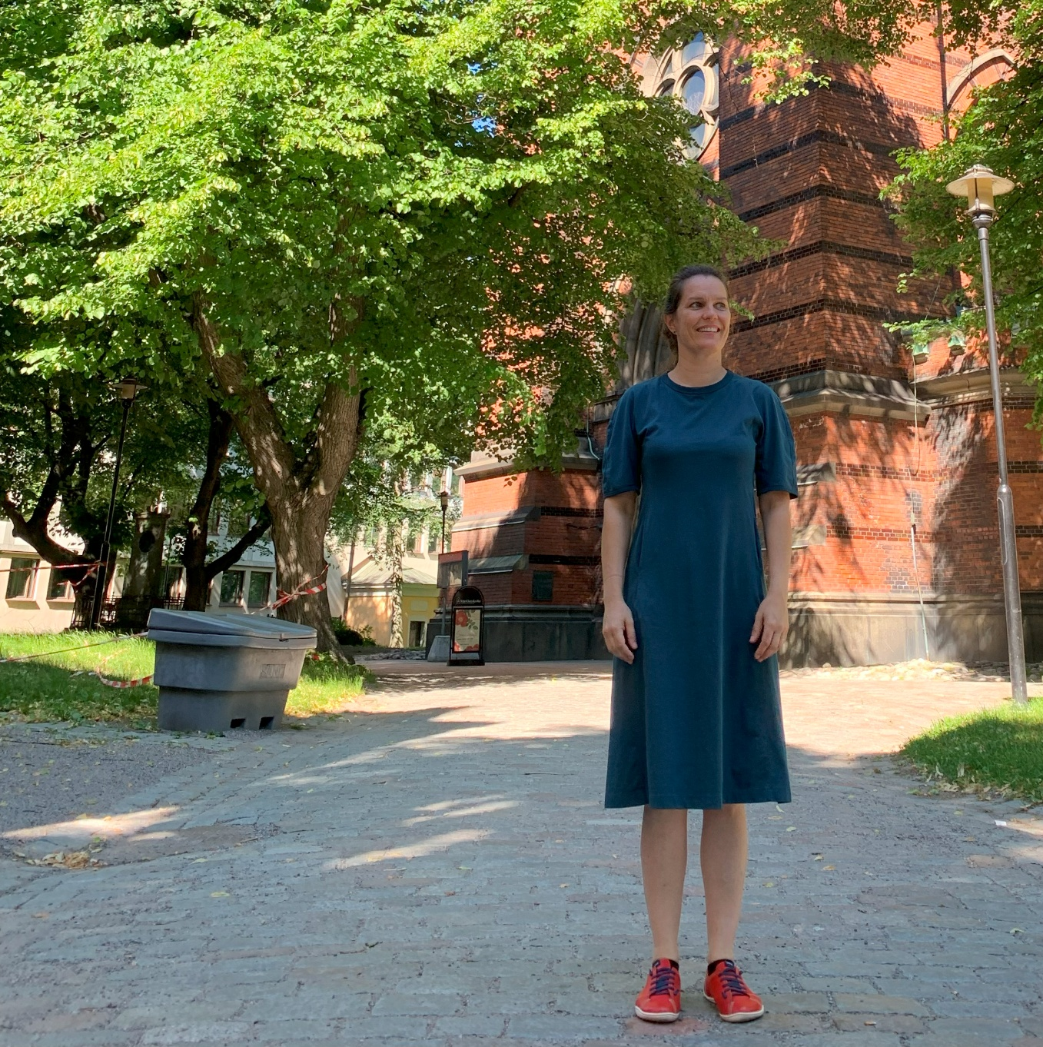
Spoke 5: URBAN BIODIVERSITY
Activity 4: Urban forestry and impacts on supporting and regulating ecosystem services
Task 4.1: Nature-Based Solutions (NBS) and plant biodiversity in air bioremediation
Enhancing Urban Air Quality:
Integrating Vegetation Strategies and Plant Stress Research
Barbara Baesso Moura
IRET/CNR Florence
NBFC

Slide 2
Content
  A brief introduction to the research theme
  Key topics:
    Methods to study plants’ responses to air pollutants
    Assessing plant capacity to cope with air pollution
Practical applications

Slide 3
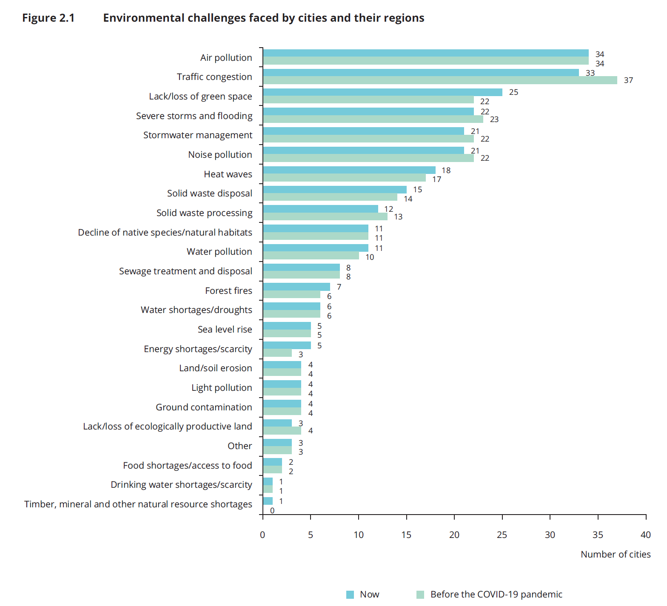
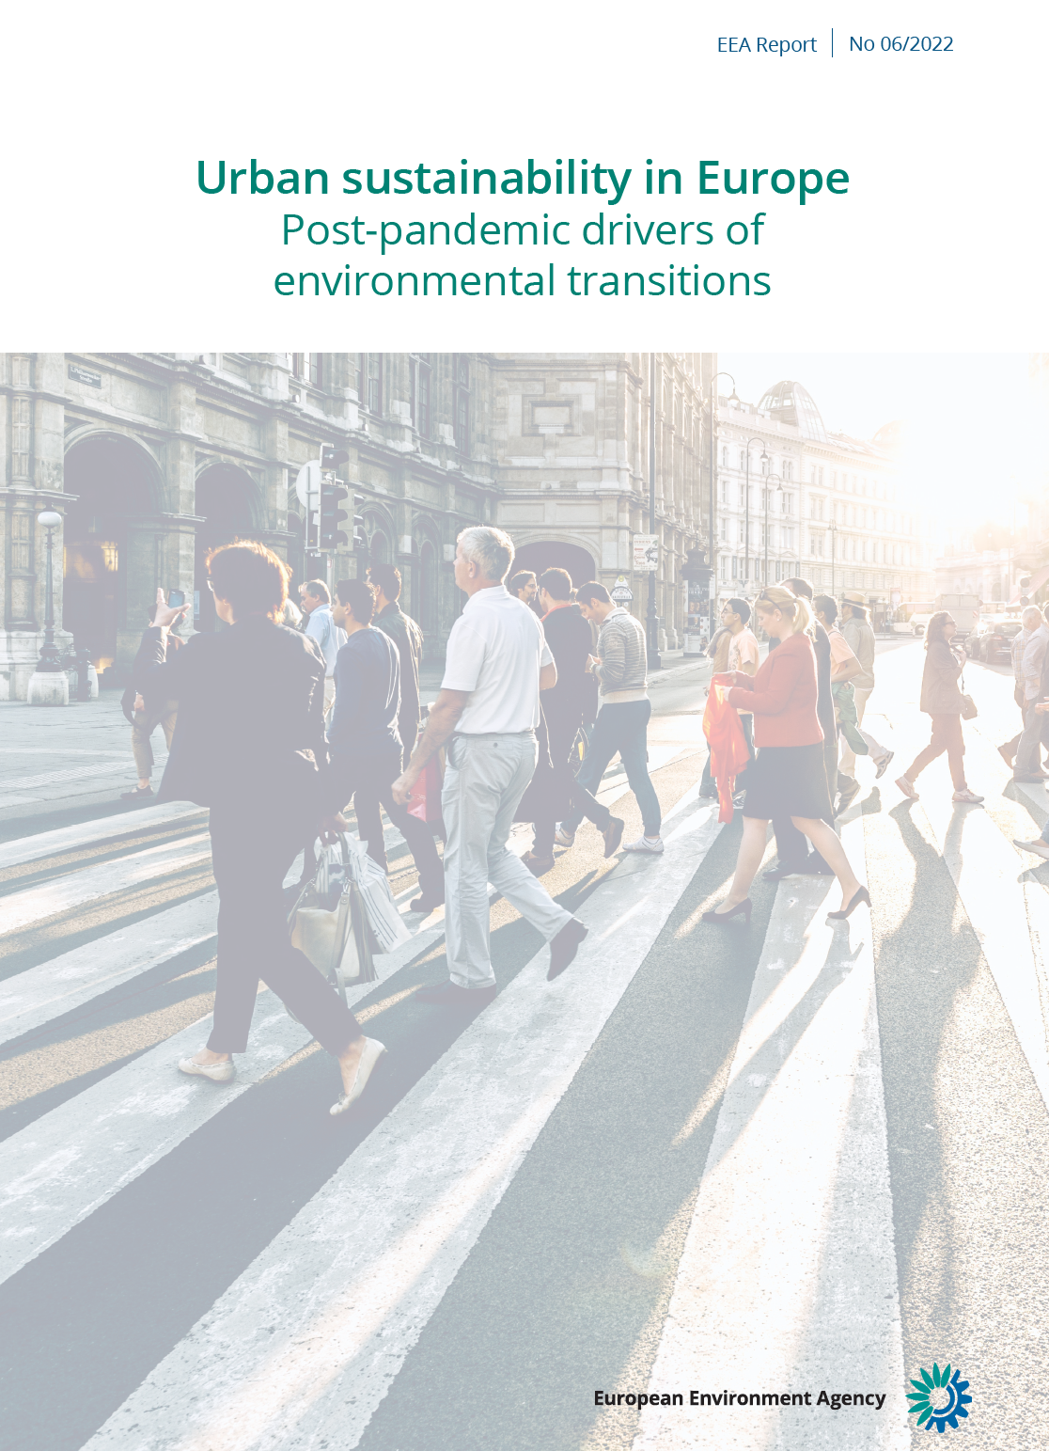
Urban Air Quality
Context & Challenges
Cities are facing a wide variety of environmental challenges
Understanding citizens’ priorities is a key to designing successful urban strategies

Slide 4
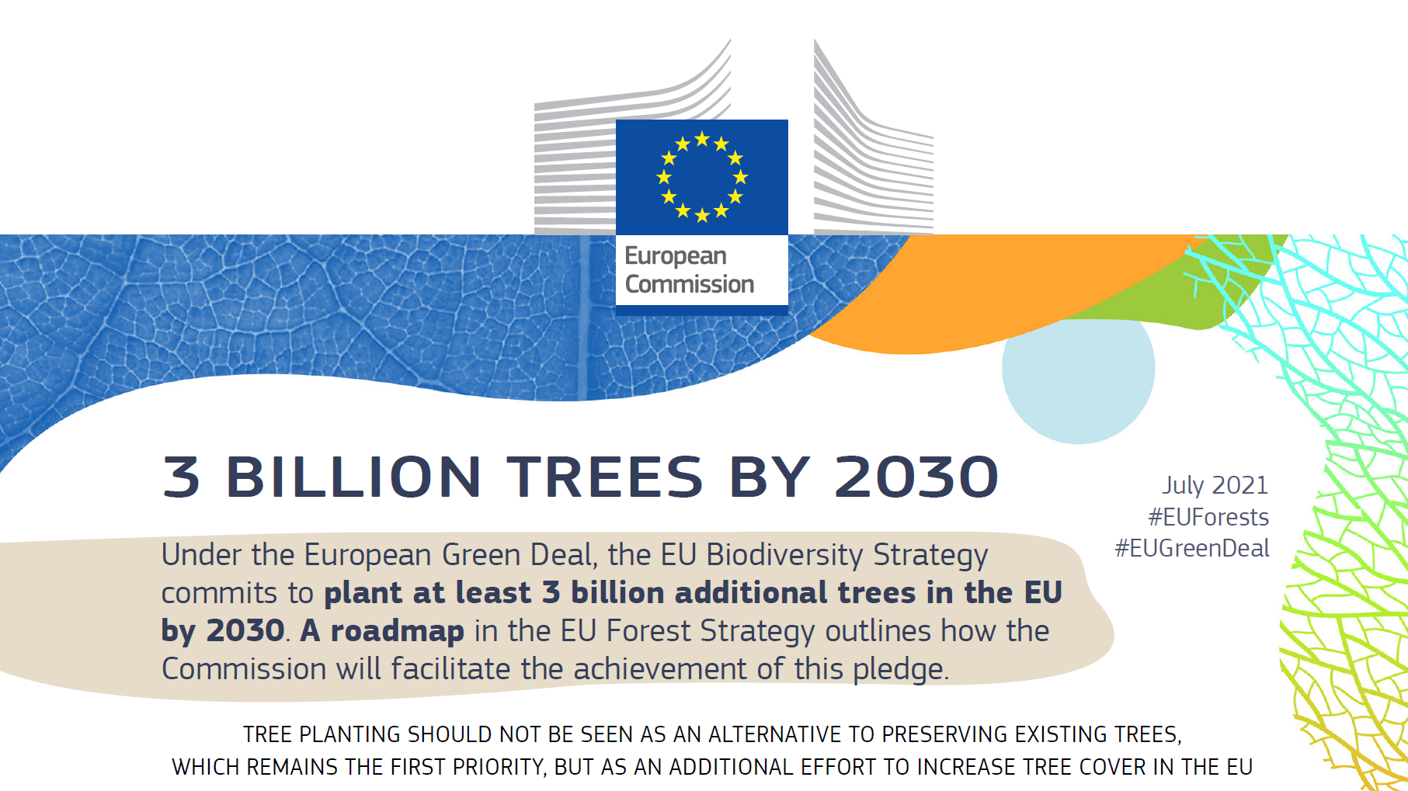

Slide 5
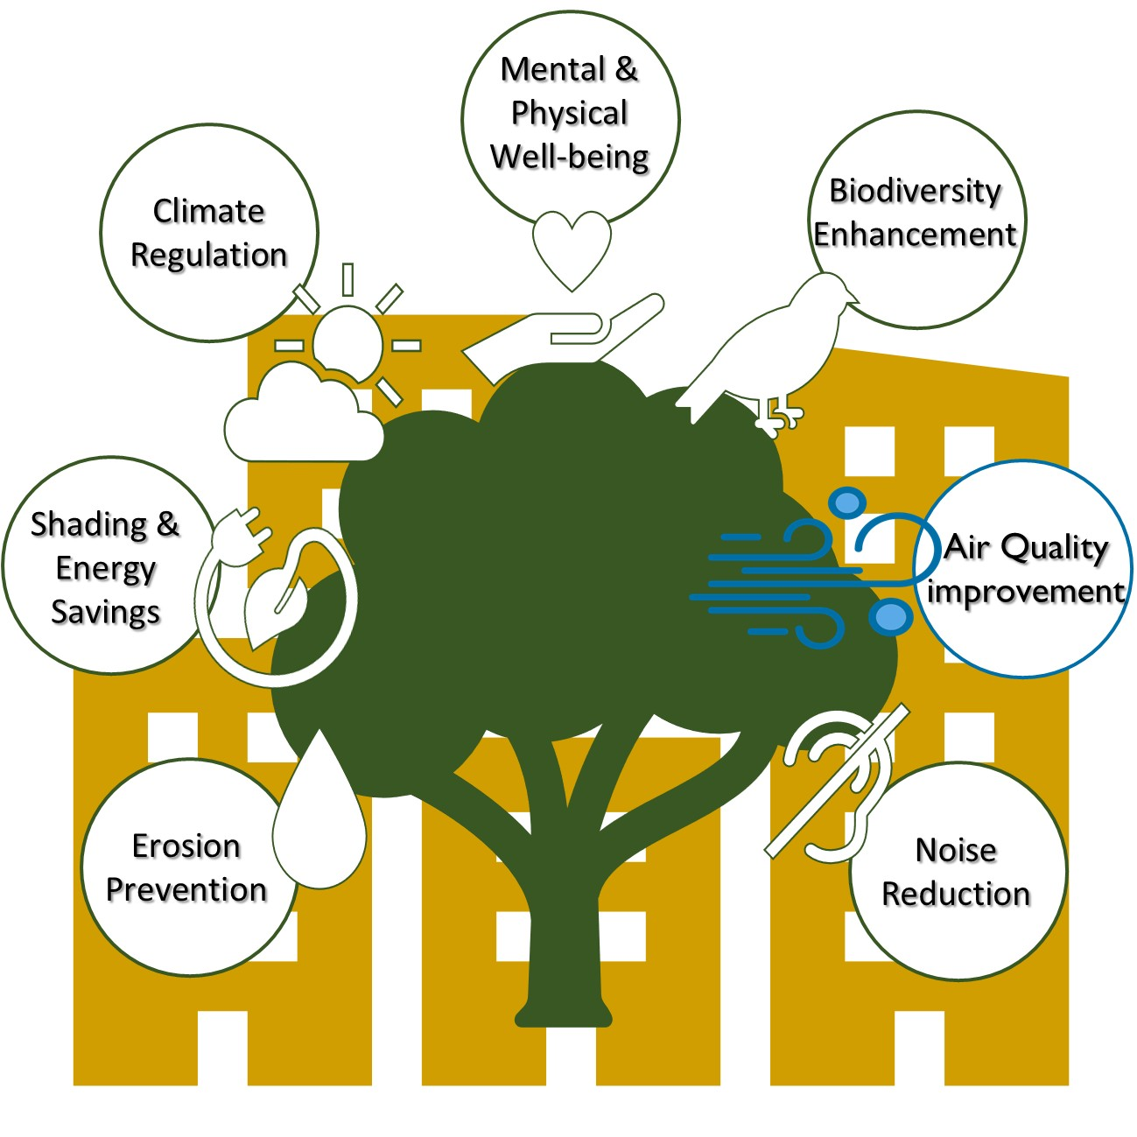
Urban Green Ecosystems Services

Slide 6
Vegetation as a Tool for Air Quality Enhancement
Particulate matter (PM₁₀)
Ozone (O₃)
Nitrogen dioxide (NO₂)
Studying Plants Responces to Air Pollutants
Urban trees frequently face elevated temperatures, irregular water availability, soil compaction, pathogen attacks and high pollution levels, requiring species with strong adaptive capabilities

Slide 7
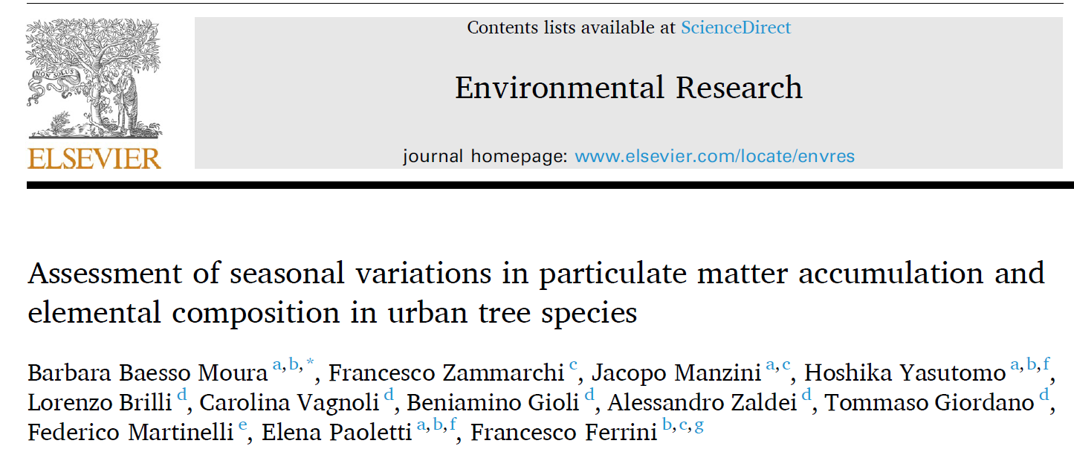

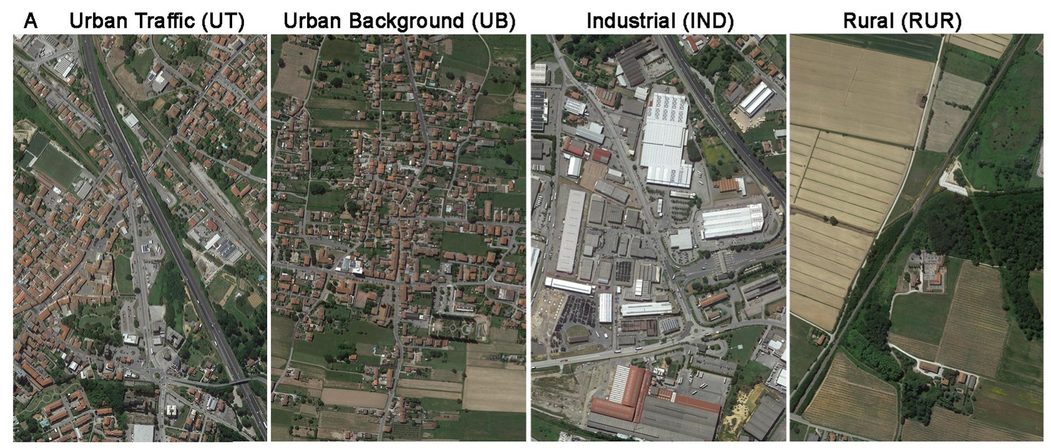
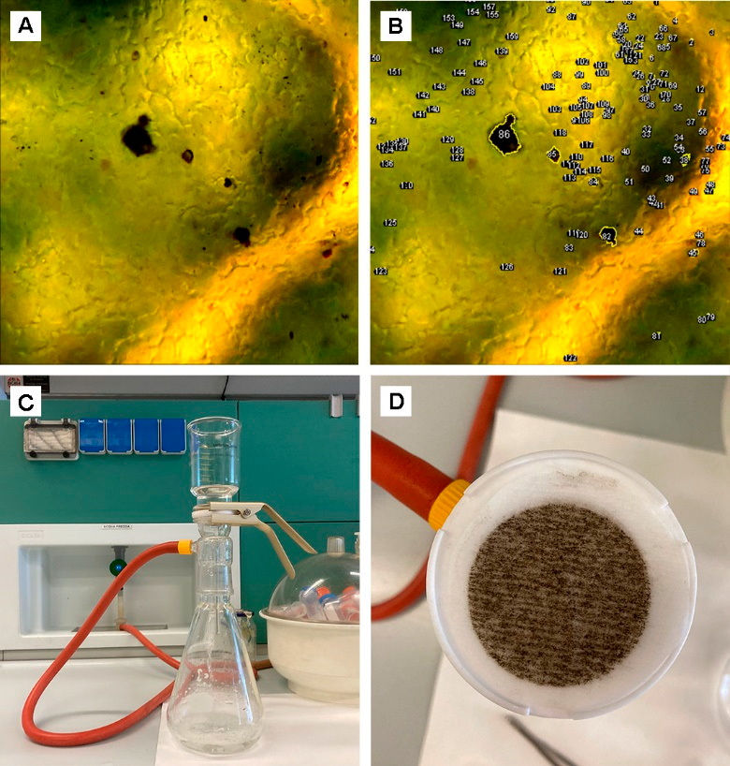
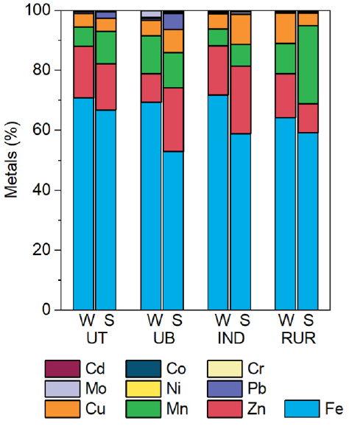
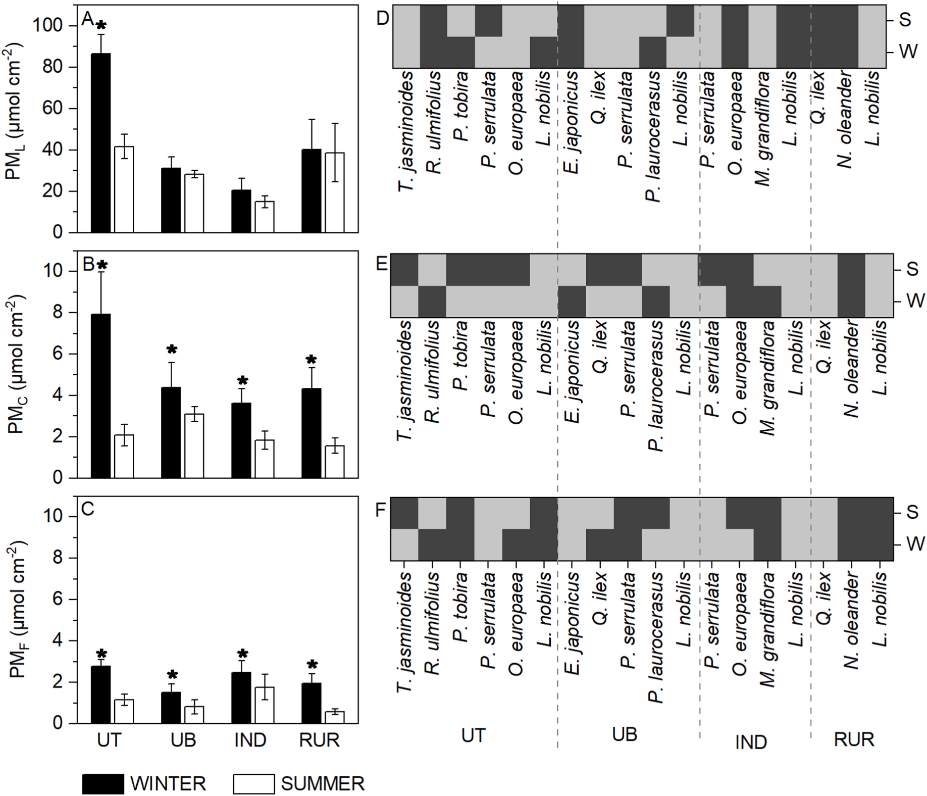
Particulate matter (PM₁₀)

Slide 8
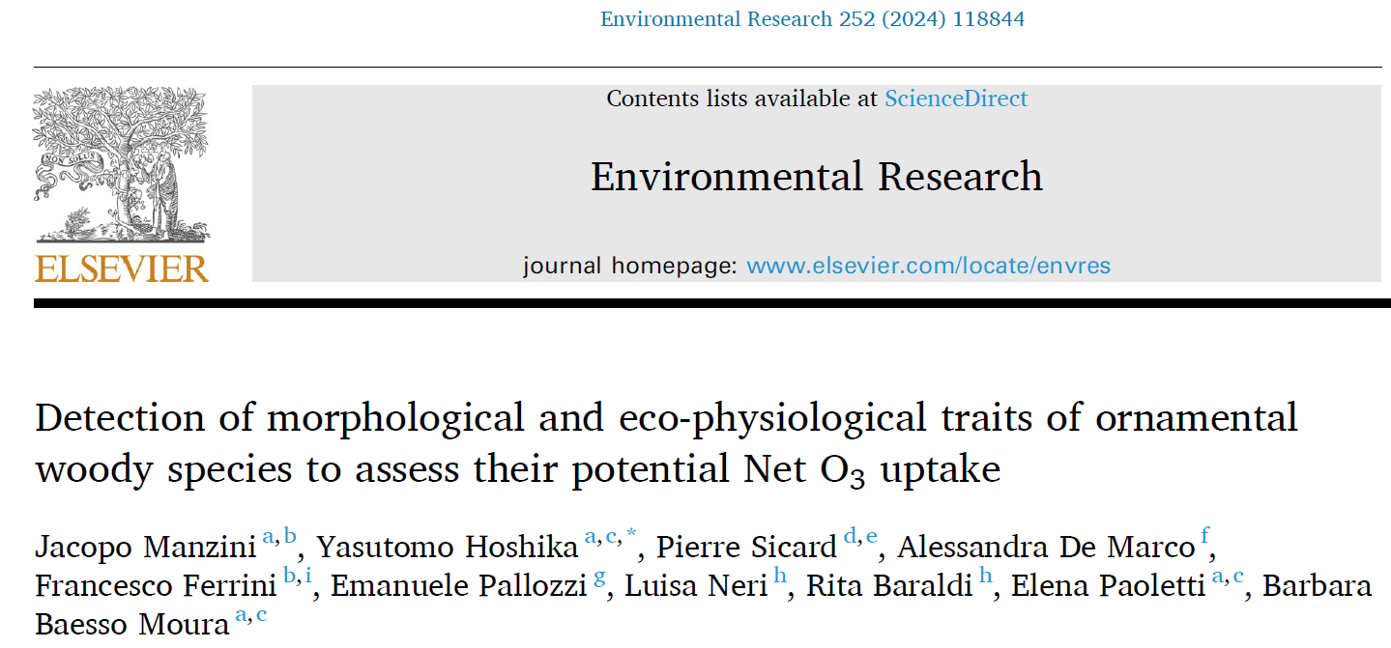
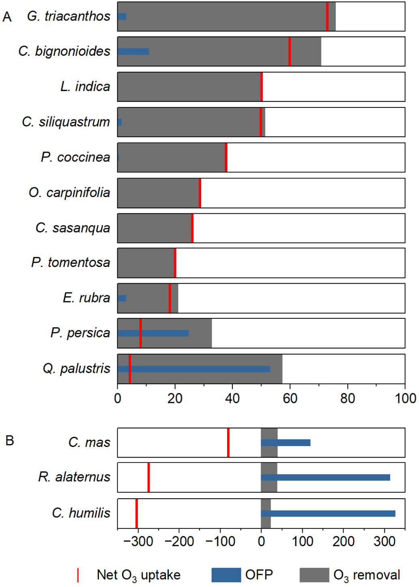
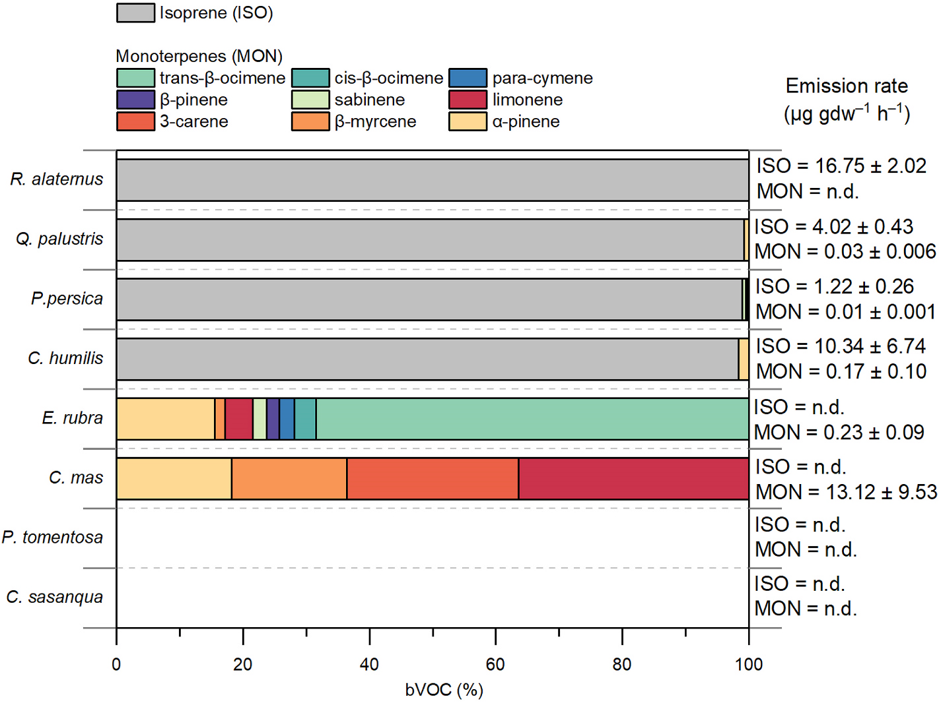
Ozone (O₃)
The research evaluated 14 woody species used in urban environments for their capacity to absorb ozone (O₃)
Negative O₃ balance
bVOCs profile
(isoprene and monoterpenes)
Positive Net O₃
Species not recommended:
Rhamnus alaternus
Cornus mas
Chamaerops humilis
Recommended species for O₃ uptake:
Catalpa bignonioides
Gleditsia triacanthos

Slide 9
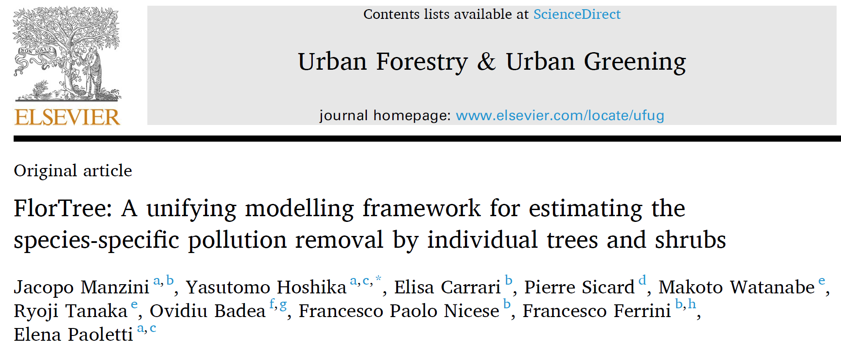
Assessing plant capacity to cope with air pollution
FlorTree - a practical tool to provide support public
institutions and citizens in the choice of species of
urban green spaces to reduce air pollution
Species ranking
High
3 points: > 75th percentile
2 points: 50 to 75th percentile
1 points: 25 to 50th percentile
0 points: < 25th percentile
Species receives a score according to their removal capacity for each pollutant
“The right tree in the right place”
Low

Slide 10
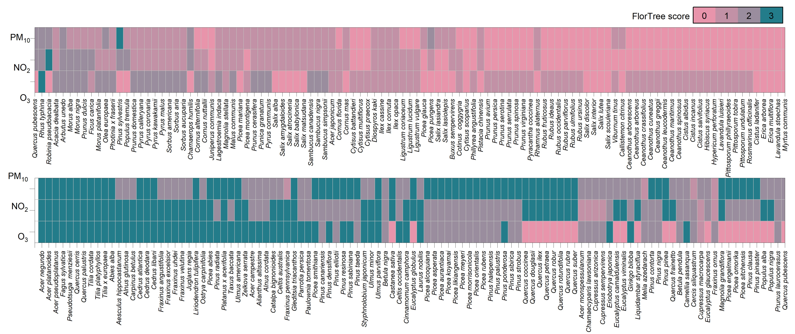
FlorTree ranking

Slide 11
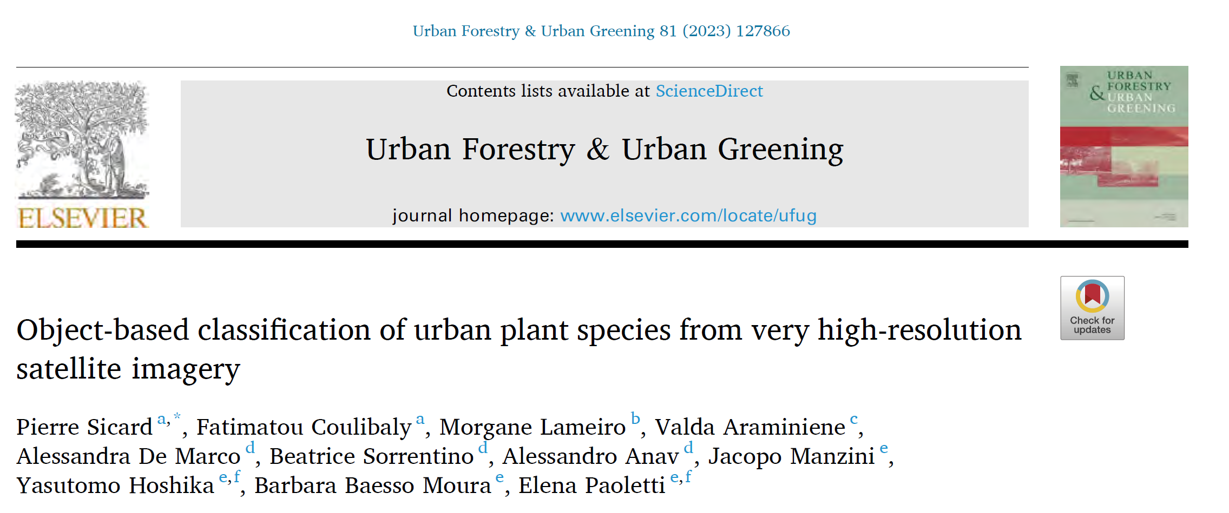
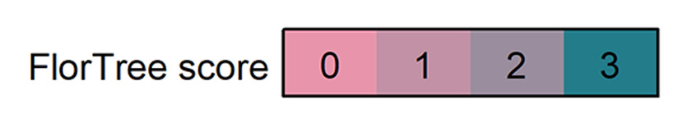
Practical applications

Slide 12
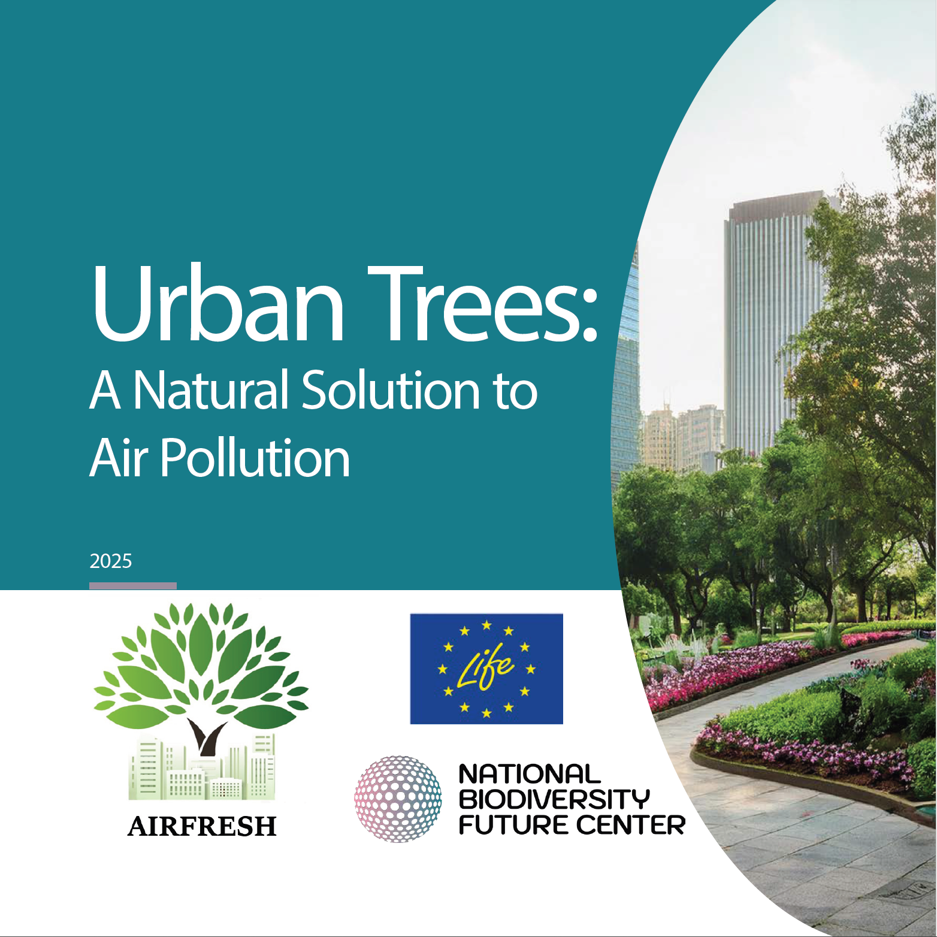

Slide 13
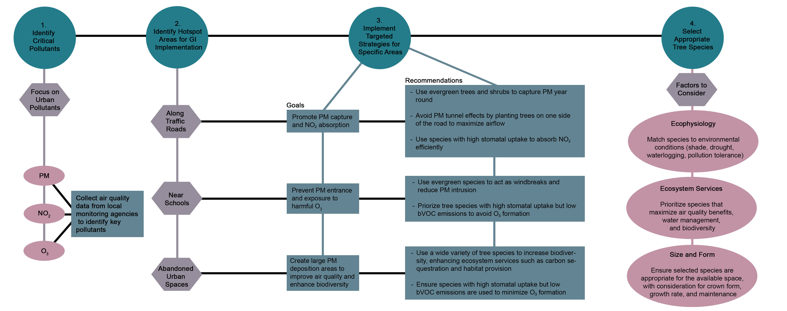
Good Practices for Designing Urban Green Infrastructure

Slide 14

WebApp

Slide 15
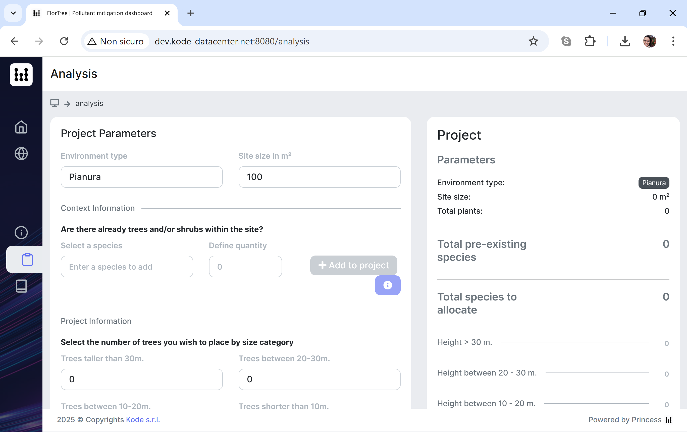
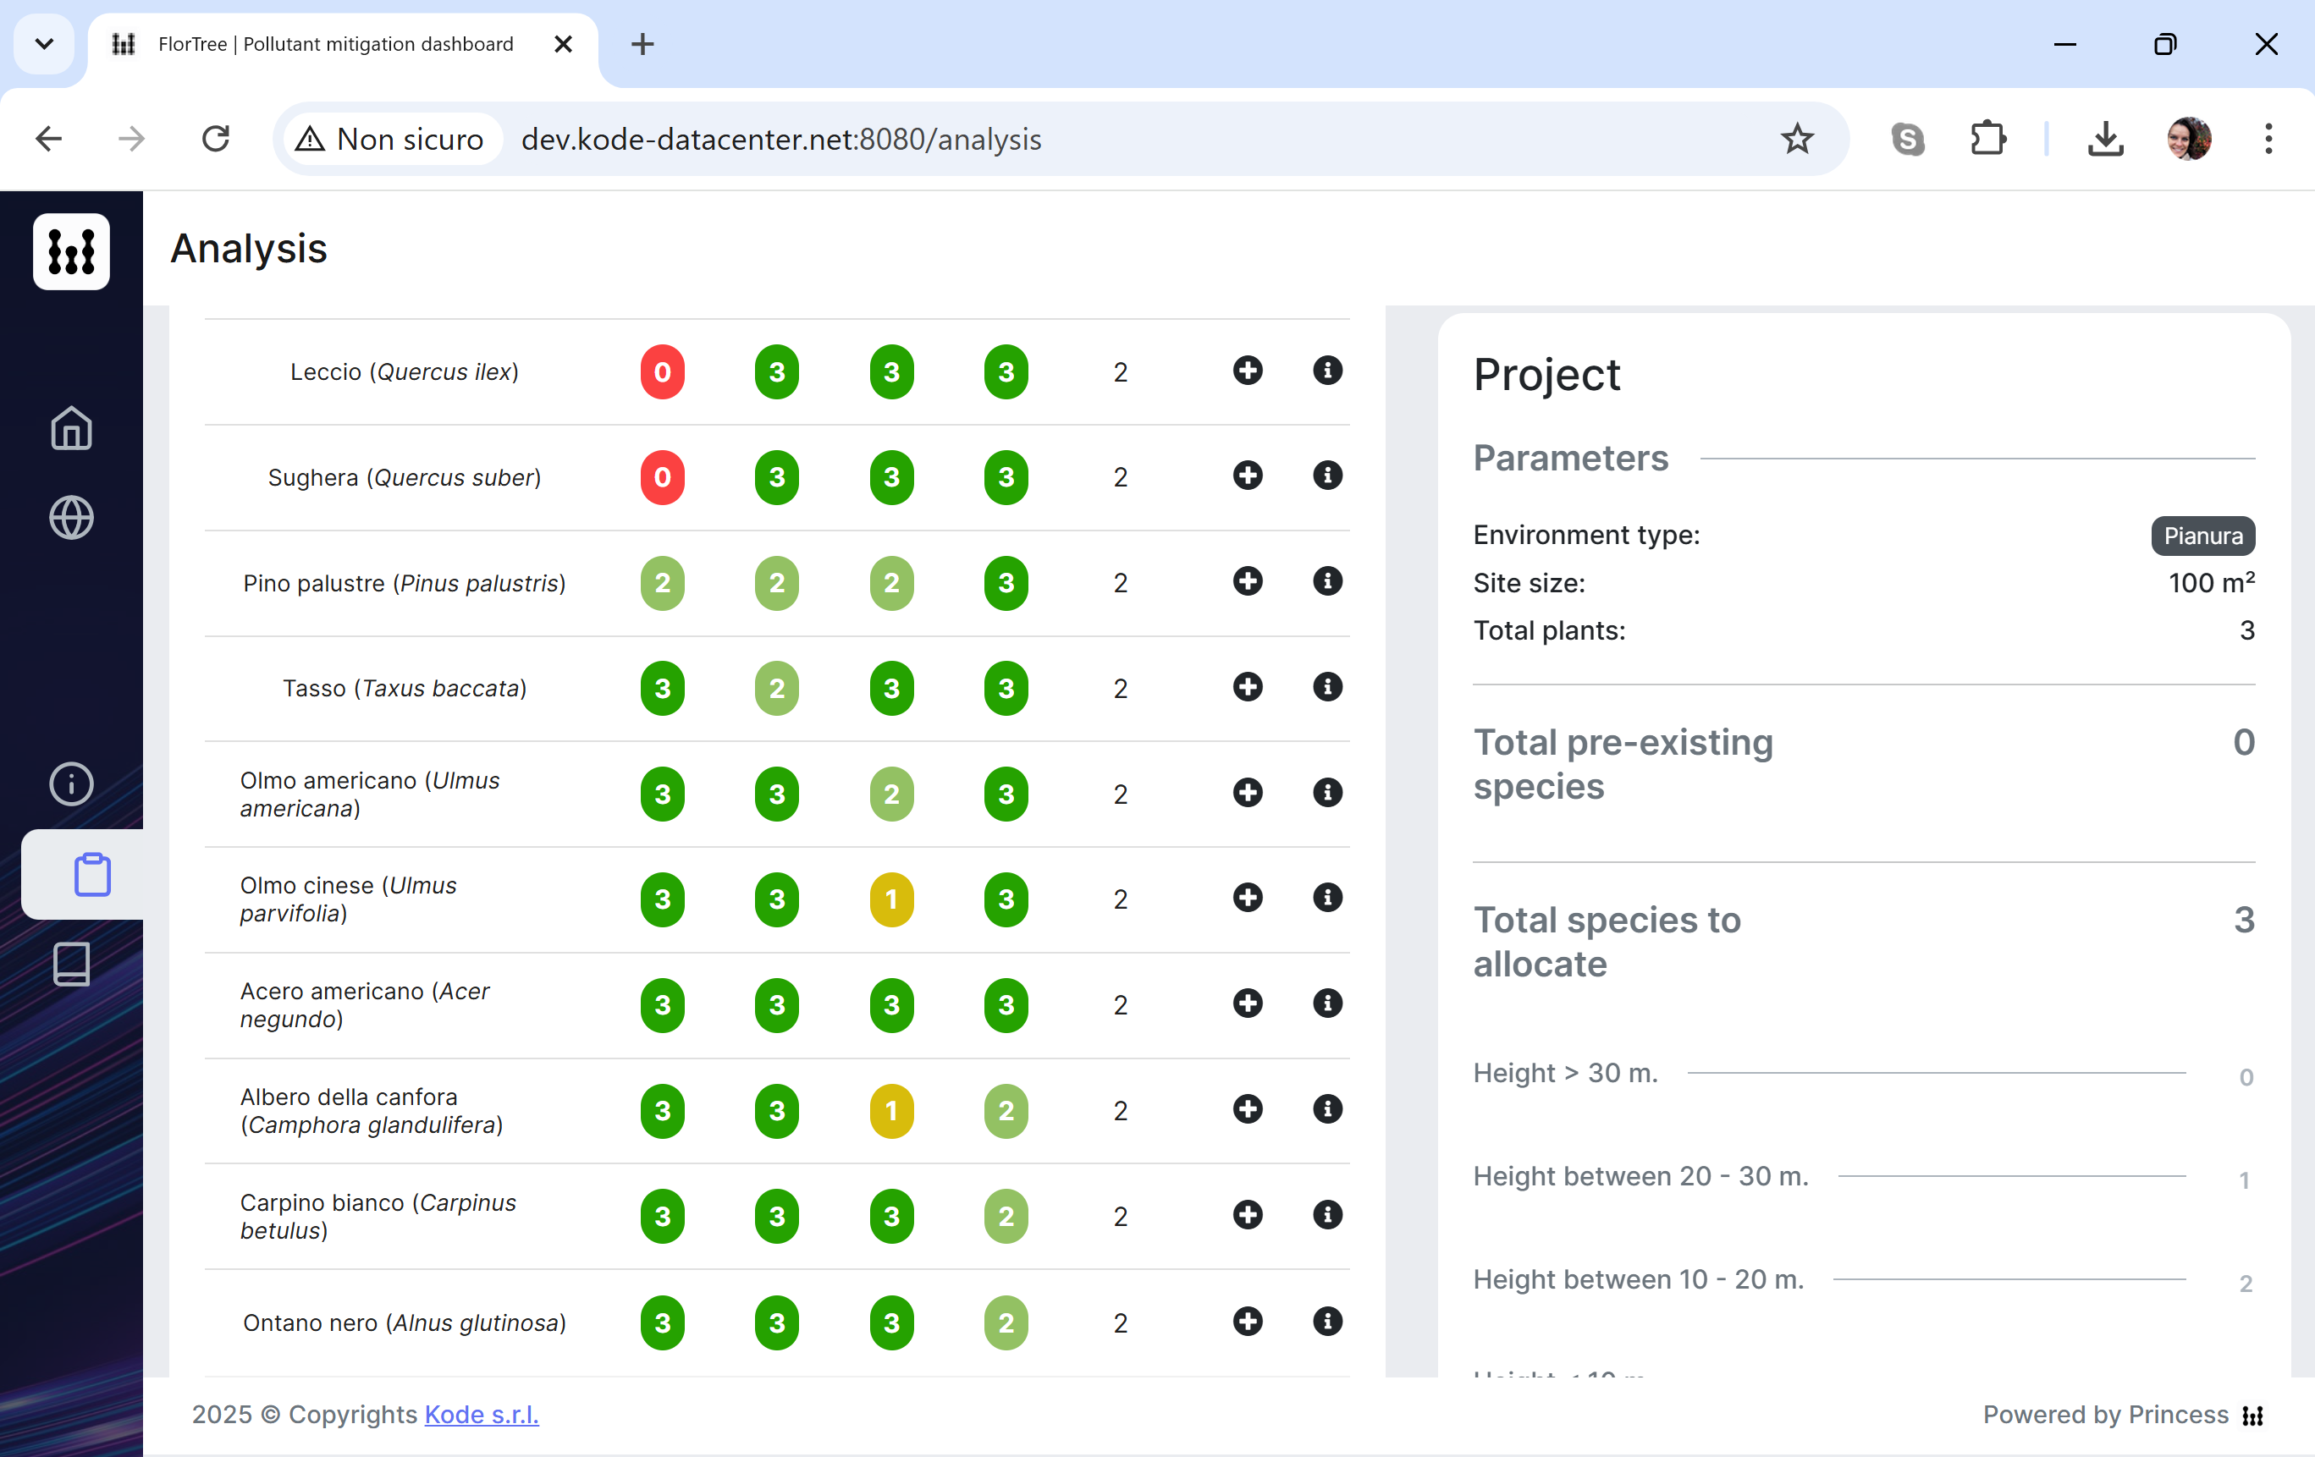
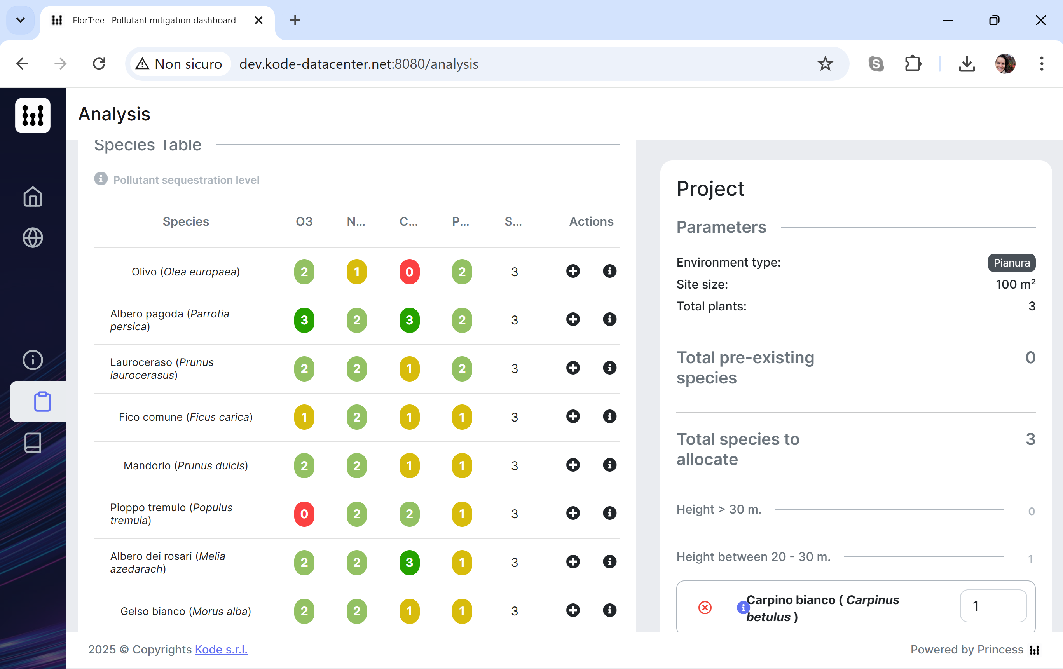
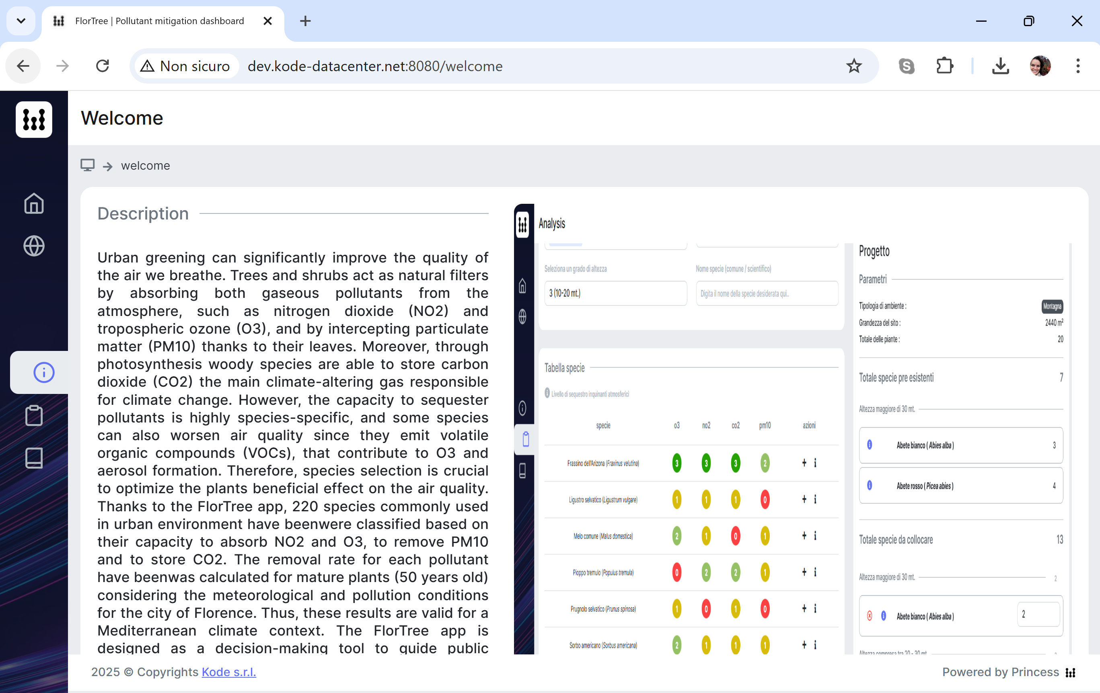
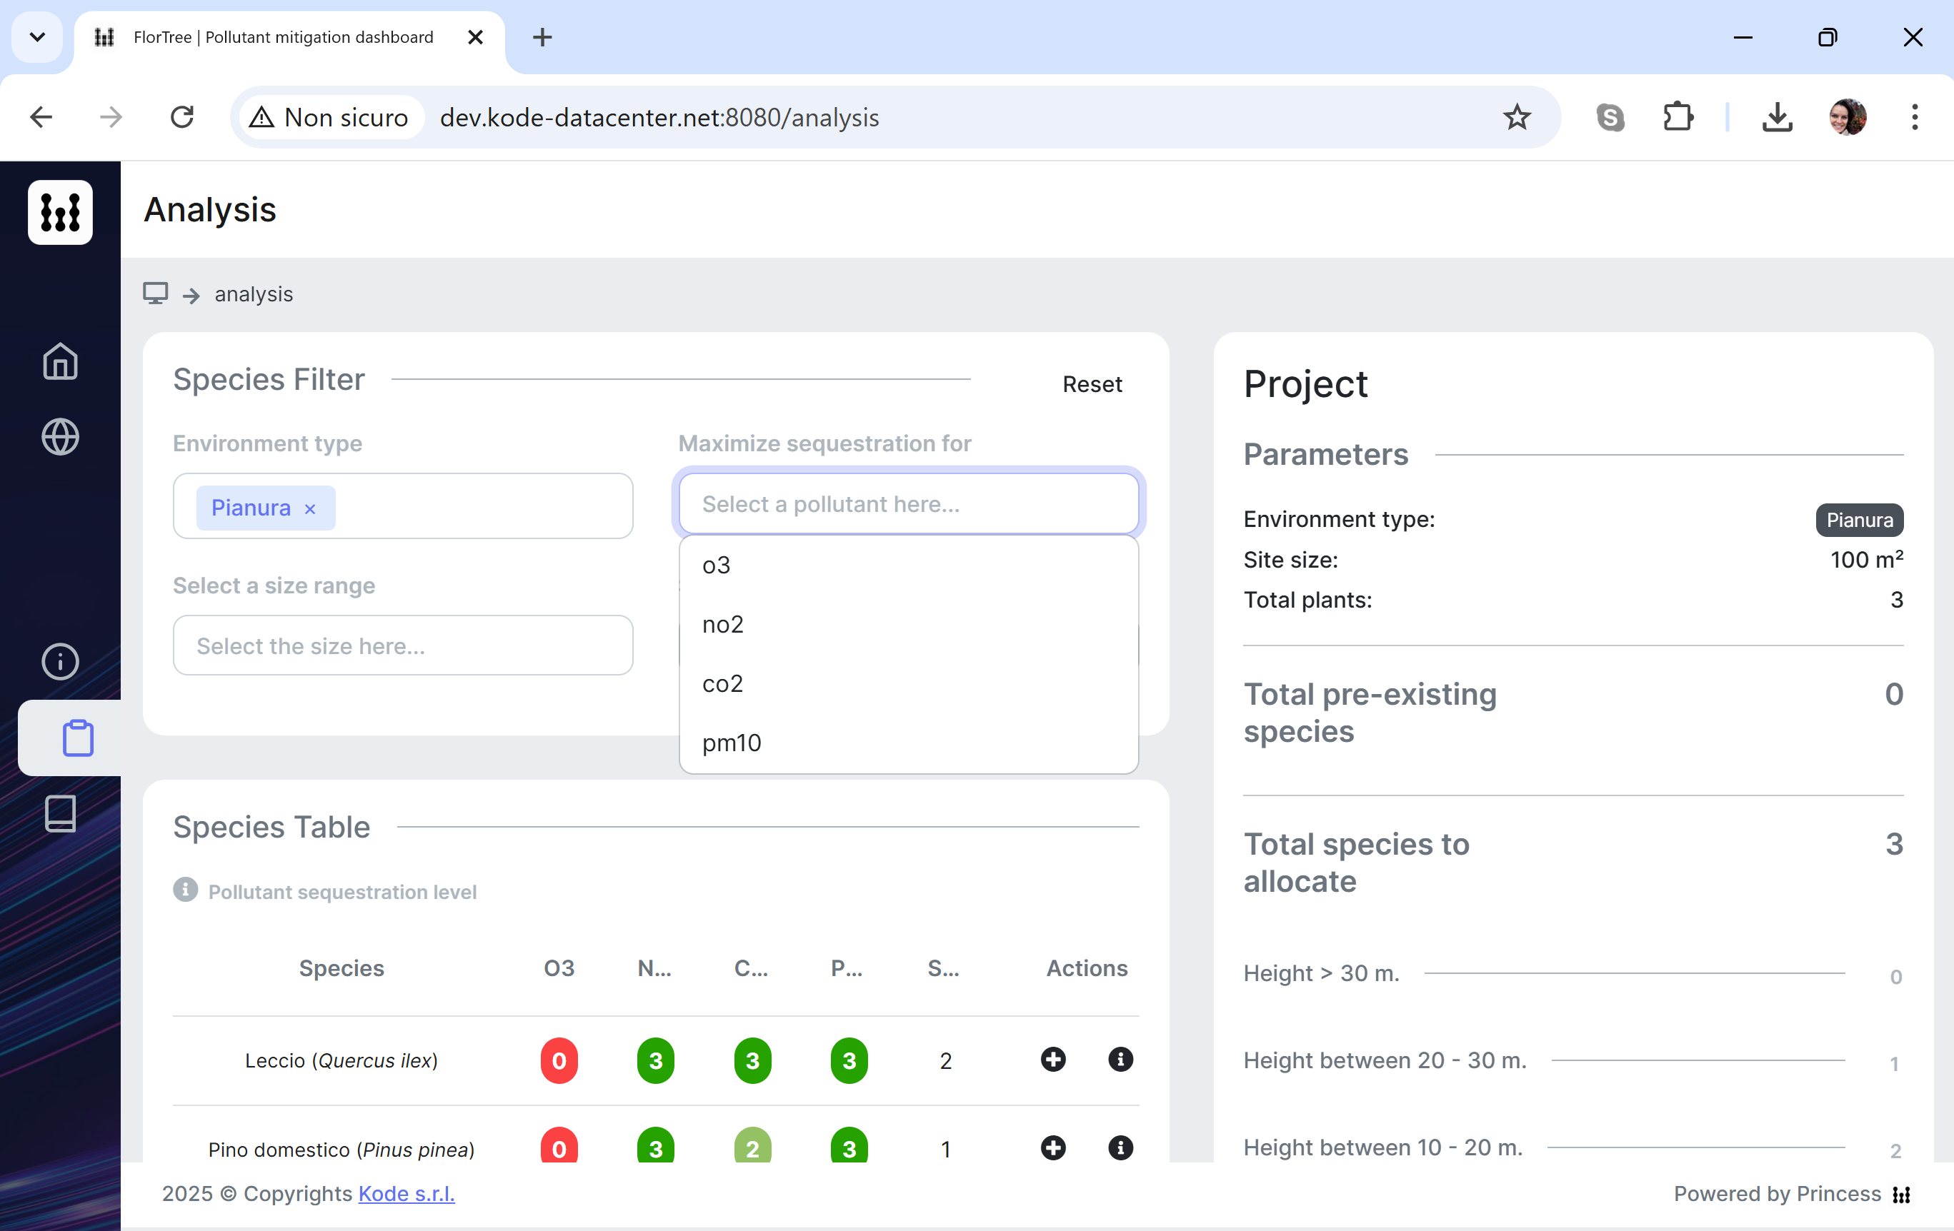
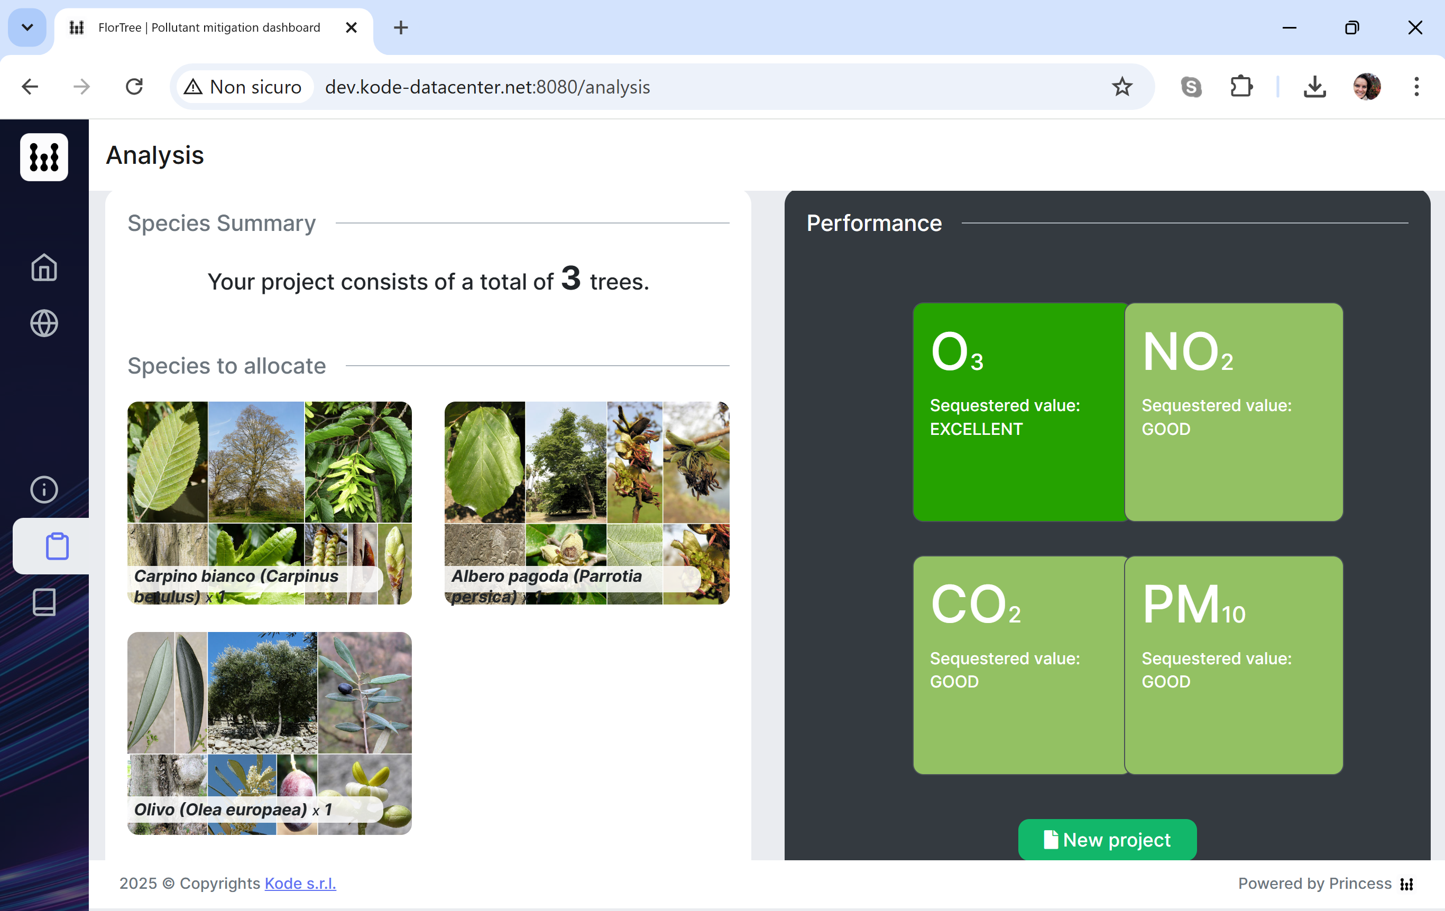
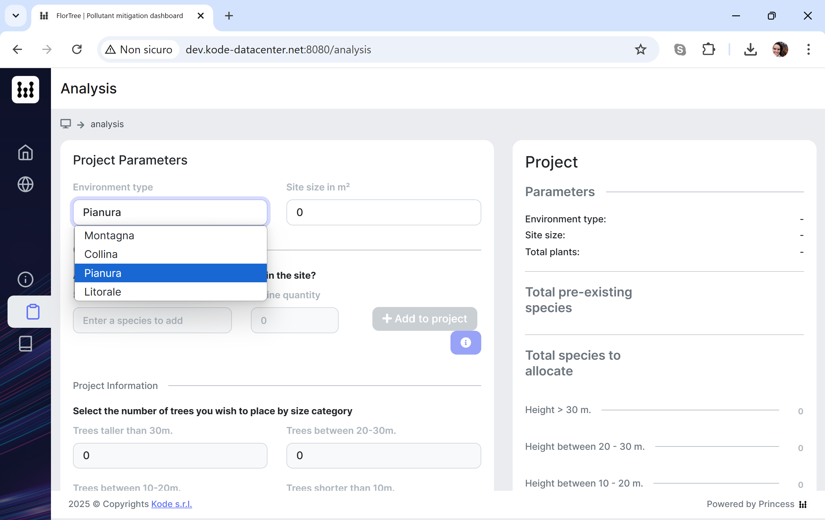
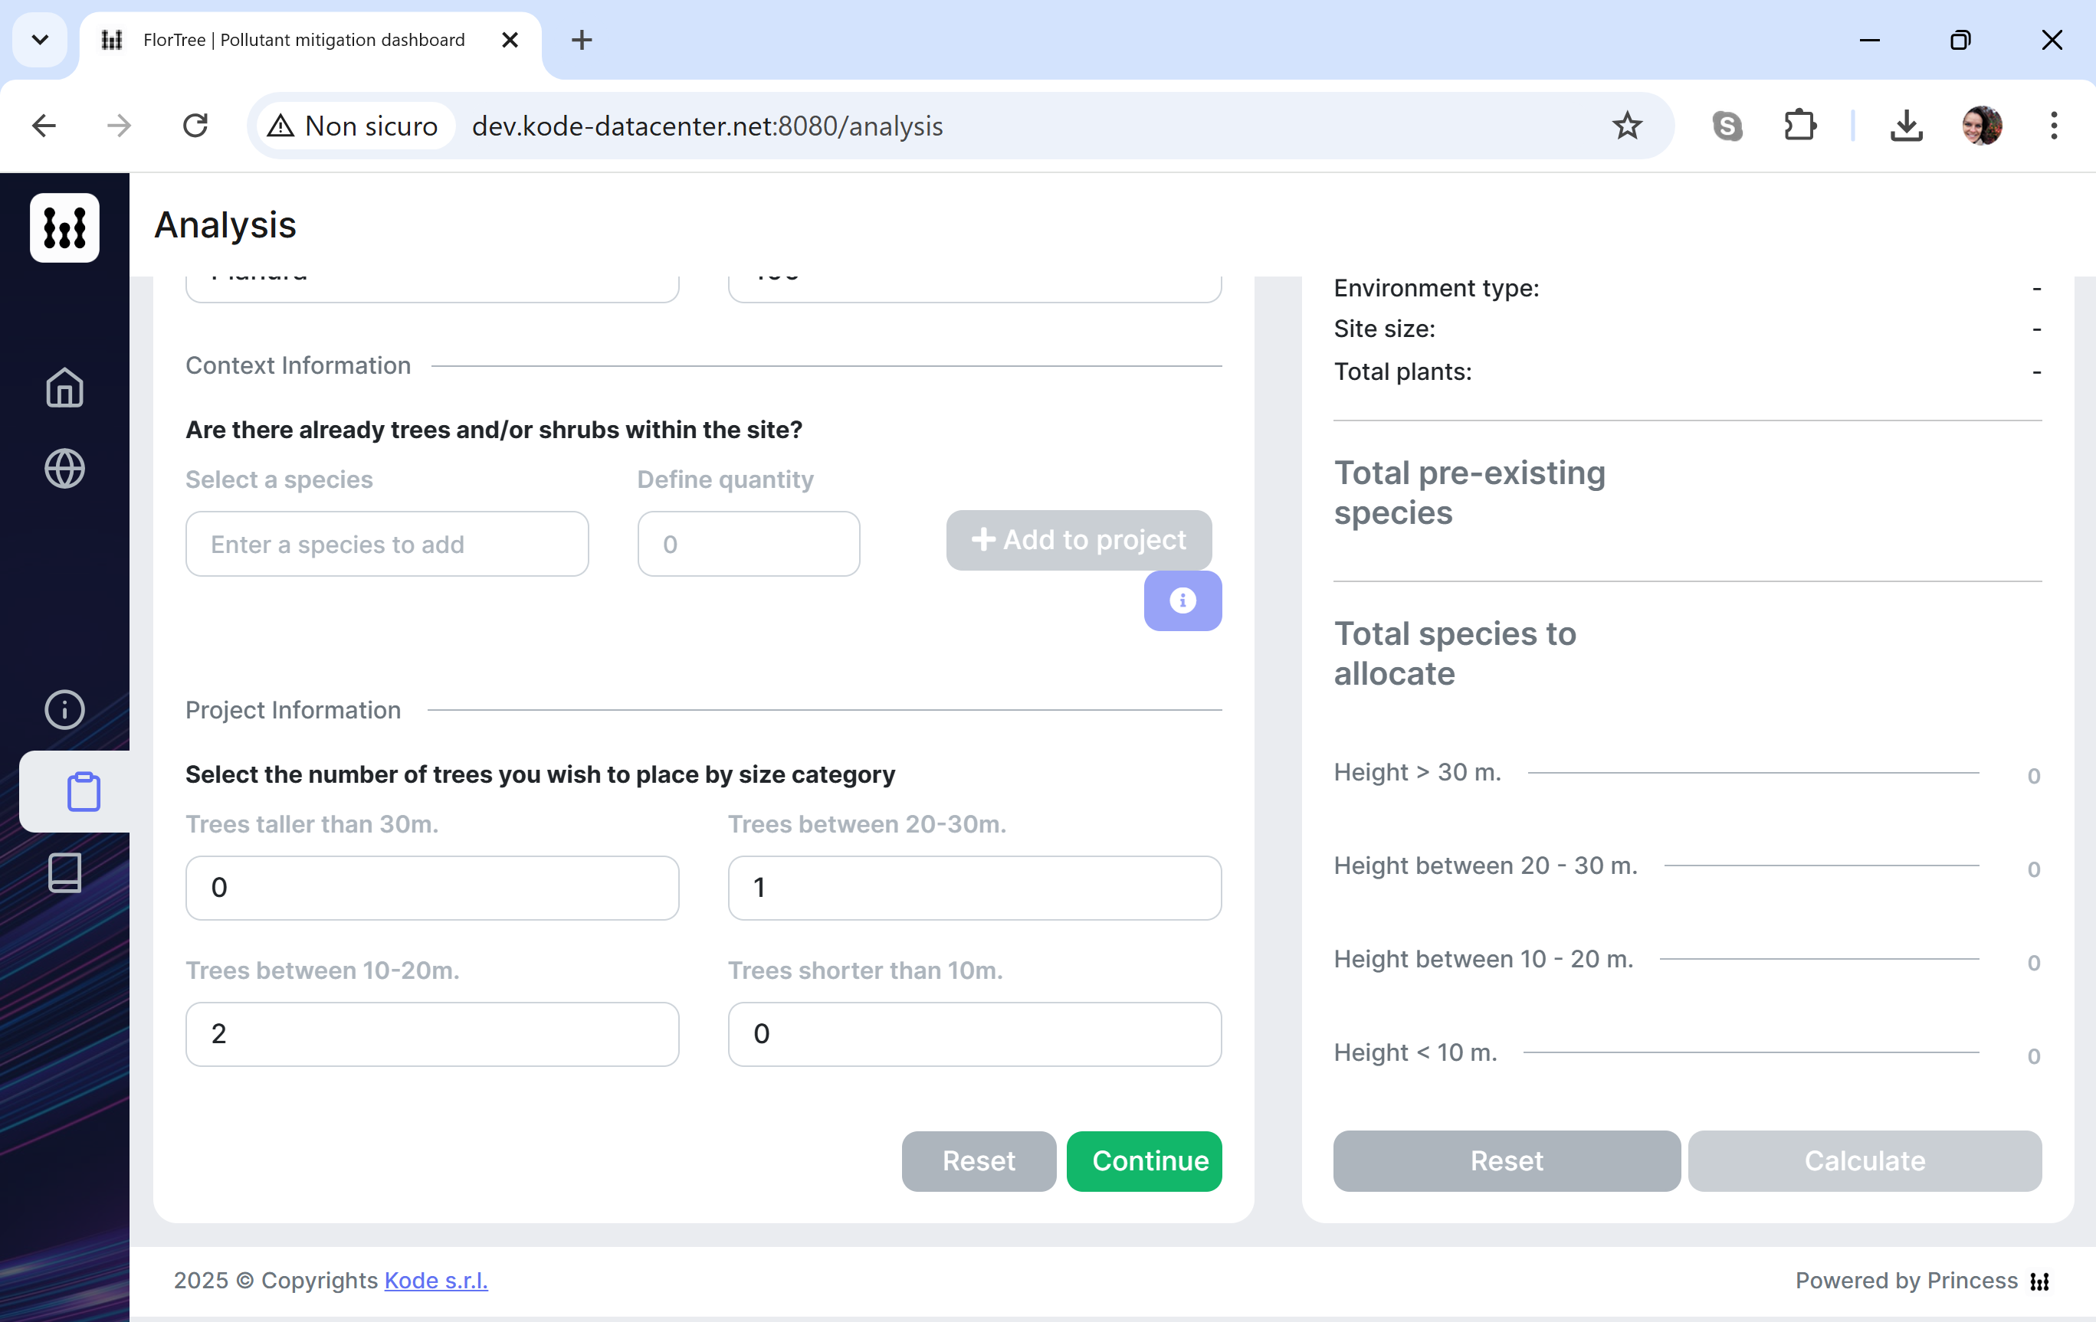

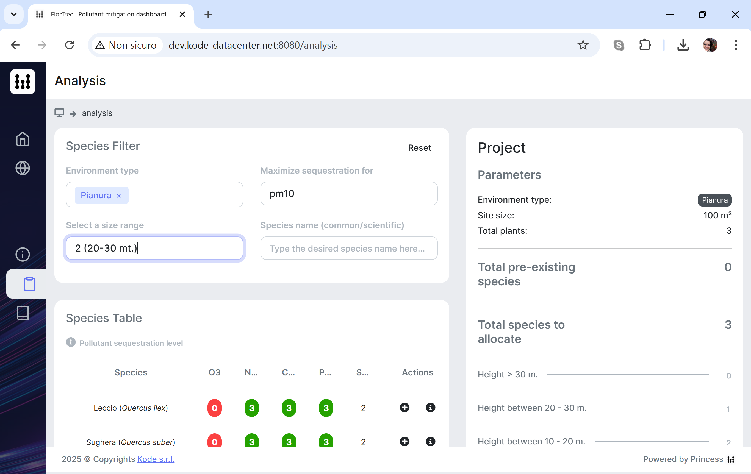
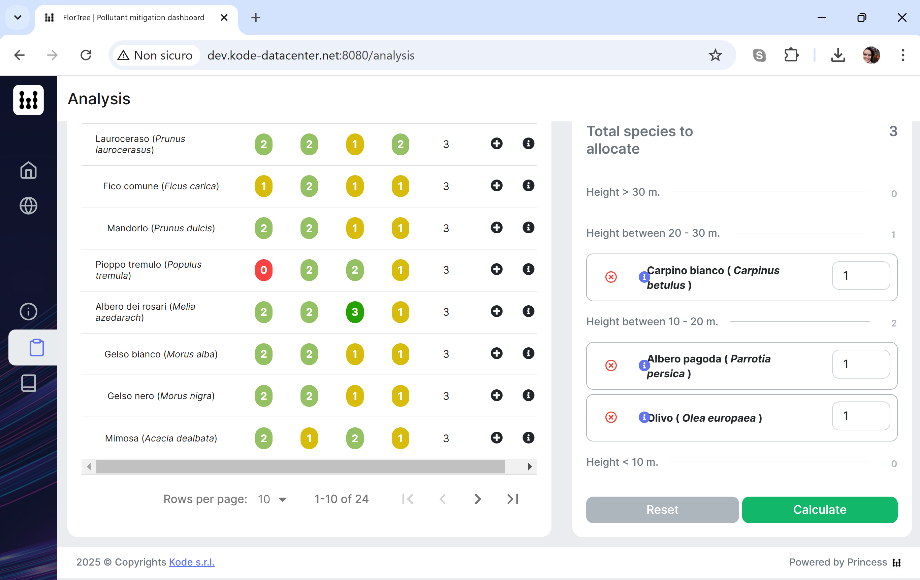
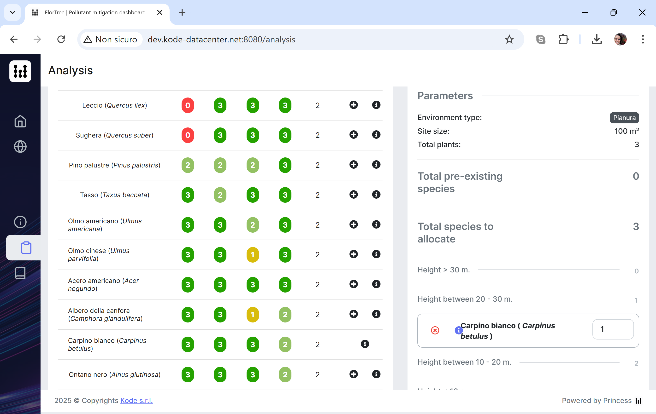

Slide 16

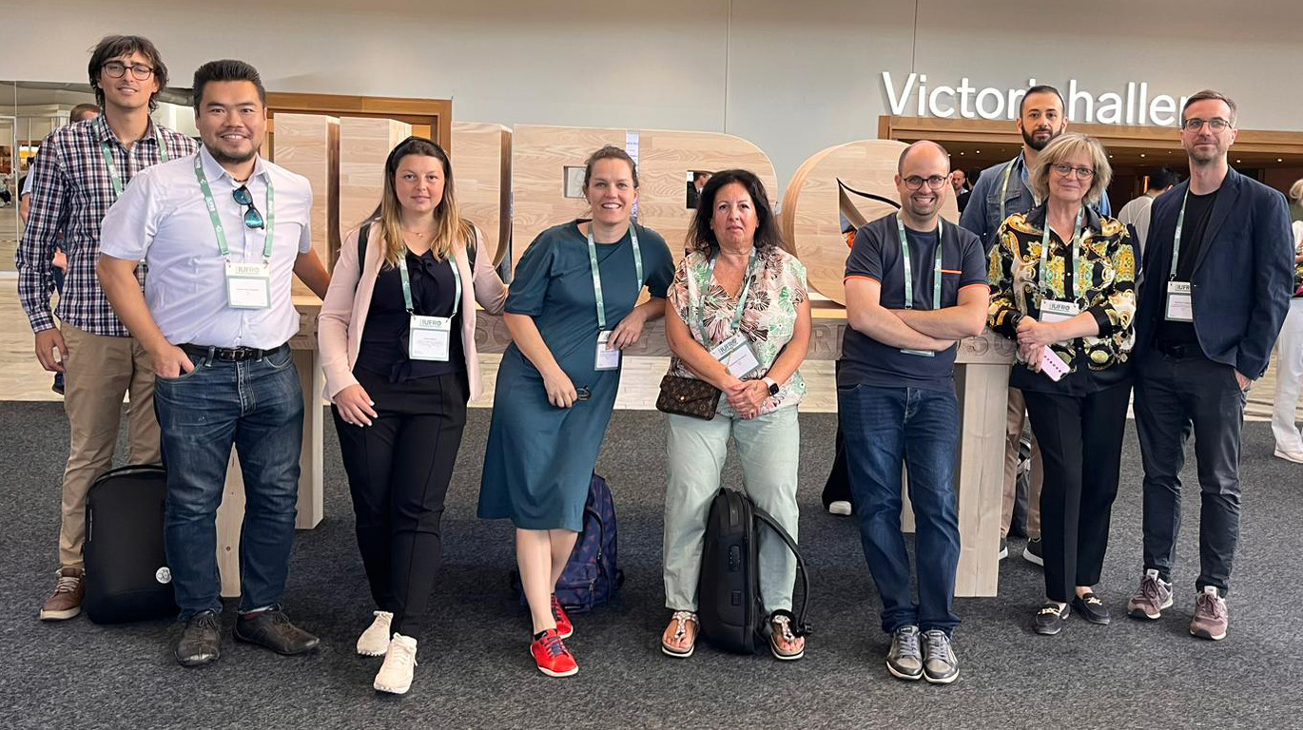
Thank you

