Slide 1



Genomics of
Mediterranean forest trees
Marchesini^{1,2}, P. Pollegioni^{1,2},
C. Mattioni^{1,2}
¹Research Institute on Terrestrial Ecosystems, National Research Council, Porano (TR), Italy
²National Biodiversity Future Center, Palermo, Italy

Slide 2
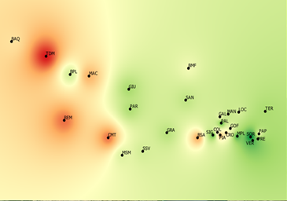
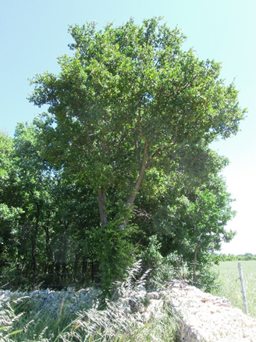
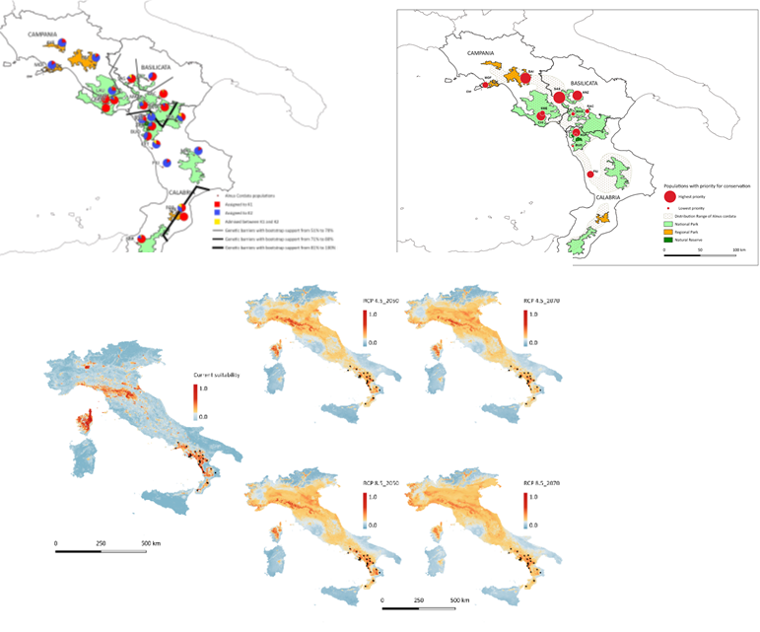
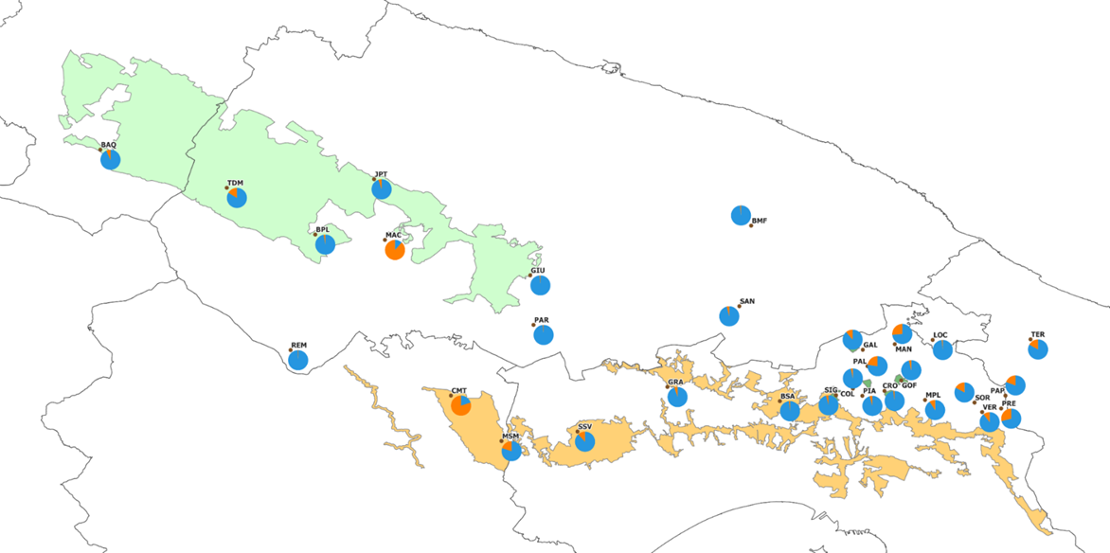
Genetic diversity and structure of Alnus cordata and Quercus trojana populations in the native range of southern Italy: an essential step towards the definition of management and conservation strategies
C. Mattioni, A. Marchesini, M. Gaudet, F. Chiocchini, L. Leonardi , M. Cherubini, P. Pollegioni P.
Microsatellite genotyping for:
-Understanding demography and genetic structure of natural populations
-Identify hot spots of neutral diversity and conservation units
-Reconstruct evolutionary history
- integrate the genetic/genomic data with climatic and topographic data
Priority conservation areas
Management strategies
Quercus trojana
STRUCTURE identified two genetic clusters weakly correlated with the elevation
Alnus cordata
30 populations,
552 samples,
12 SSRs markers
23 populations,
517 samples,
10 SSRs markers
Indication of priority conservation areas
STRUCTURE analysis revealed the presence of two main gene pools, genetic divergence between two populations in the core of distribution
Predicted current (A) and future potential geographic distribution of Alnus cordata by 2050 (range 2041-2060)

Slide 3
Genomics of
Mediterranean forest trees
at CNR-IRET:
Activities:
GENERATION OF REFERENCE GENOMES
FOREST GENOMIC AND PHYLOGENOMIC STUDIES
Target organisms:
Mediterranean oaks (Quercus spp.)
Italian alder (Alnus cordata)
European chestnut (Castanea sativa)

Slide 4
GENERATION OF REFERENCE GENOMES
Reference genomes are key scientific resources
allow to perform genomic studies based on methods which rely on the mapping of whole-genome sequence reads to a known reference sequence
provide the functional and genomic contexts for regions under selection, enabling the association of such loci with phenotypes important for adaptation and resilience
preserve genomics information for species at risk of extinction
contribute to new discoveries
Brandies et al. (2019). The value of reference genomes in the conservation of threatened species. Genes, 10(11), 846
Formenti et al. (2022). The era of reference genomes in conservation genomics. Trends in ecology & evolution, 37(3), 197-202.
Mc Cartney et al. (2024). The European Reference Genome Atlas: piloting a decentralised approach to equitable biodiversity genomics. npj Biodiversity, 3(1), 28.

Slide 5
Generation of reference genomes: Castanea sativa
Objective: generating the first reference genome for the sweet chestnut Castanea sativa Mill., the only native Castanea species in Europe, a tree of high economic value
Activity in collaboration with:
Fondazione Edmund Mach, Research and Innovation Center (San Michele all’Adige, TN)
CNR-IPSP (Sesto Fiorentino)
University of Bologna, Dept. of Agricultural and Food Science)
University of Turin, Dept. of Agricultural, Forest and Food Sci)
Marche Polytechnic University, Dep. of Agricultural, Food and Env.Sci
Methods: DNA of the ancient Italian variety ‘Marrone di Chiusa Pesio’; genome assembled using a combination of:
long reads sequencing (Oxford Nanopore)
short reads sequencing (Illumina PE150; 89 Gb)
Hi-C sequencing to capture chromatin conformation (Omni-C; Dovetail Genomics)
Results:
high-quality genome; 12 chromosomes, for a total genome size of about 715 Mb;
BUSCO assessment: 98.6% of the genome matched the embryophyte dataset, highlighting good completeness
Gene prediction and annotation: a total of 57,653 and 58,146 genes were predicted in the two haplotypes, and approximately 73% of the genes were functionally annotated

Slide 6
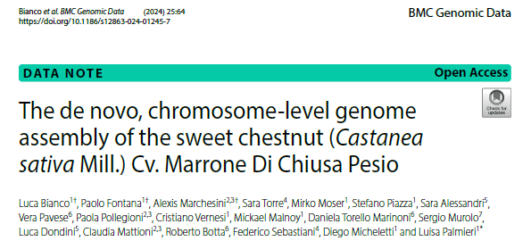
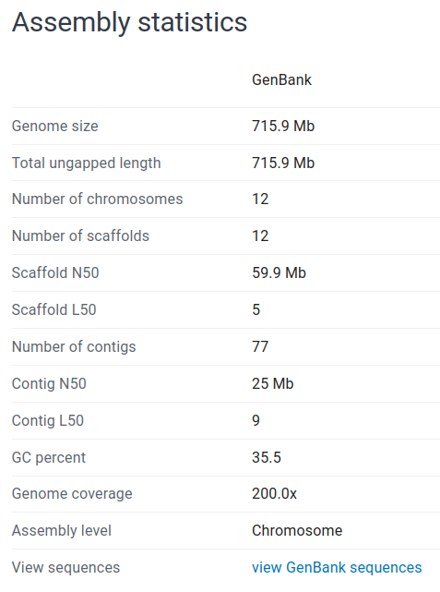
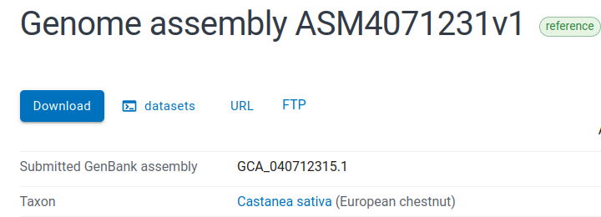
Generation of reference genomes: Castanea sativa
Our annotated de novo assembly was published and deposited in GenBank as reference genome for the species: GCA_040712315.1

Slide 7
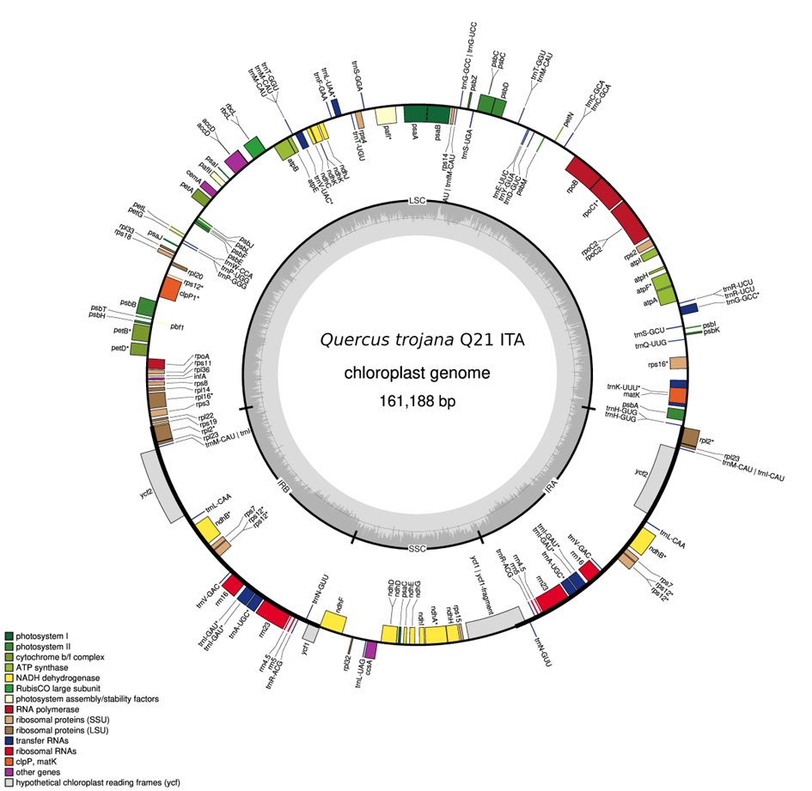
Generation of reference genomes:
Quercus trojana
Objective: generating the first chloroplast and nuclear reference genomes for the Macedonian oak (Quercus trojana), an eastern Mediterranean endemism
Chloroplast genome
Whole-genome sequencing (Illumina NovaSeq; PE150; coverage 5x)
genome assembly using GetOrganelle (Jin et al. 2020); genome annotation using Geseq (Tillich et al. 2017)
the whole chloroplast genome was assembled and annotated for the first time (sample: Q2; Italy, Murge)
Nuclear genome
planned for 2025; in collaboration with: University of Udine, Istituto di Genomica Applicata (IGA), Udine

Slide 8
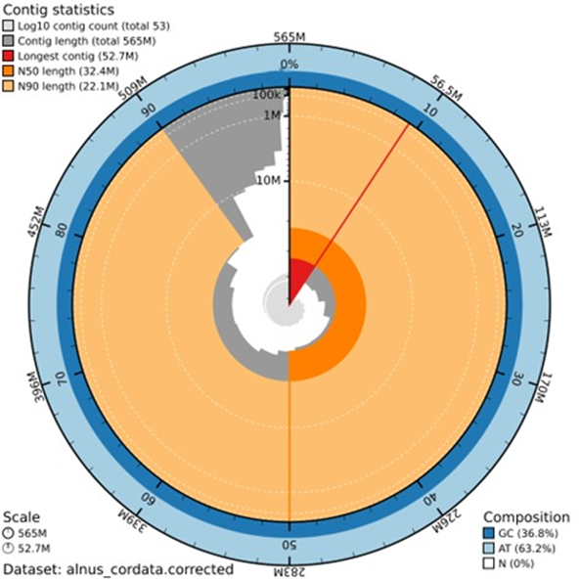
Generation of reference genomes: Alnus cordata
Objective: generating the first reference genome for the Italian alder
(Alnus cordata Loisel.), endemic to south-western Apennines and Corsica.
Note: due to its nitrogen-fixing ability, the species is ideal for reforestation,
improvement of degraded lands and reducing the risk of landslides (NBS)
Activity in collaboration with:
UNIUD, Dept. of Agricultural, Food,
Environmental and Animal Sciences;
Istituto di Genomica Applicata, IGA, Udine
Methods:
sequences generated with Oxford Nanopore
technology (ONT)
haplotype-resolved assembly with hifiasm
Coming up next:
reordering contigs; refining the assembly
gene prediction and annotation
(for high accuracy, we need RNA-seq data)
ONT long reads
10,16 M reads
73.68 Gb
ONT ultra-long reads
2,86 M reads
75.51 Gb
Draft genome
No. of contigs: 53
No. of T2T contigs: 15
(52,7 e 22,1 Mbp)
N50 (Mbp): 32
Total assembly
length (Mbp): 565
No. haplotype-resolved chromosomes: 14

Slide 9
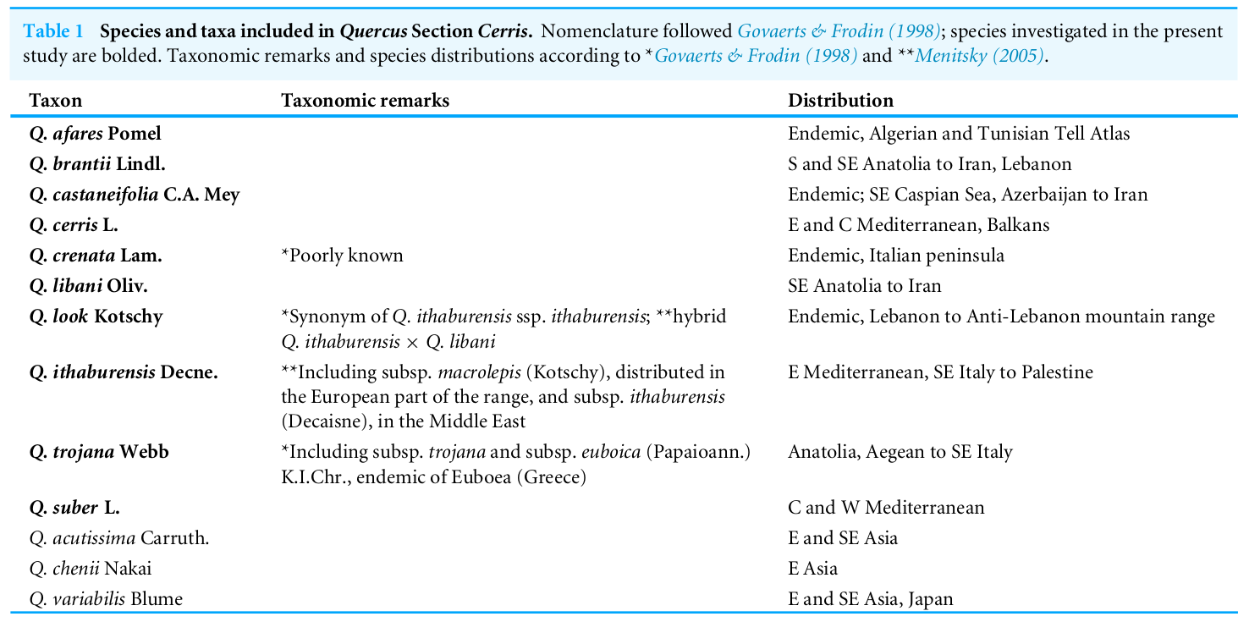
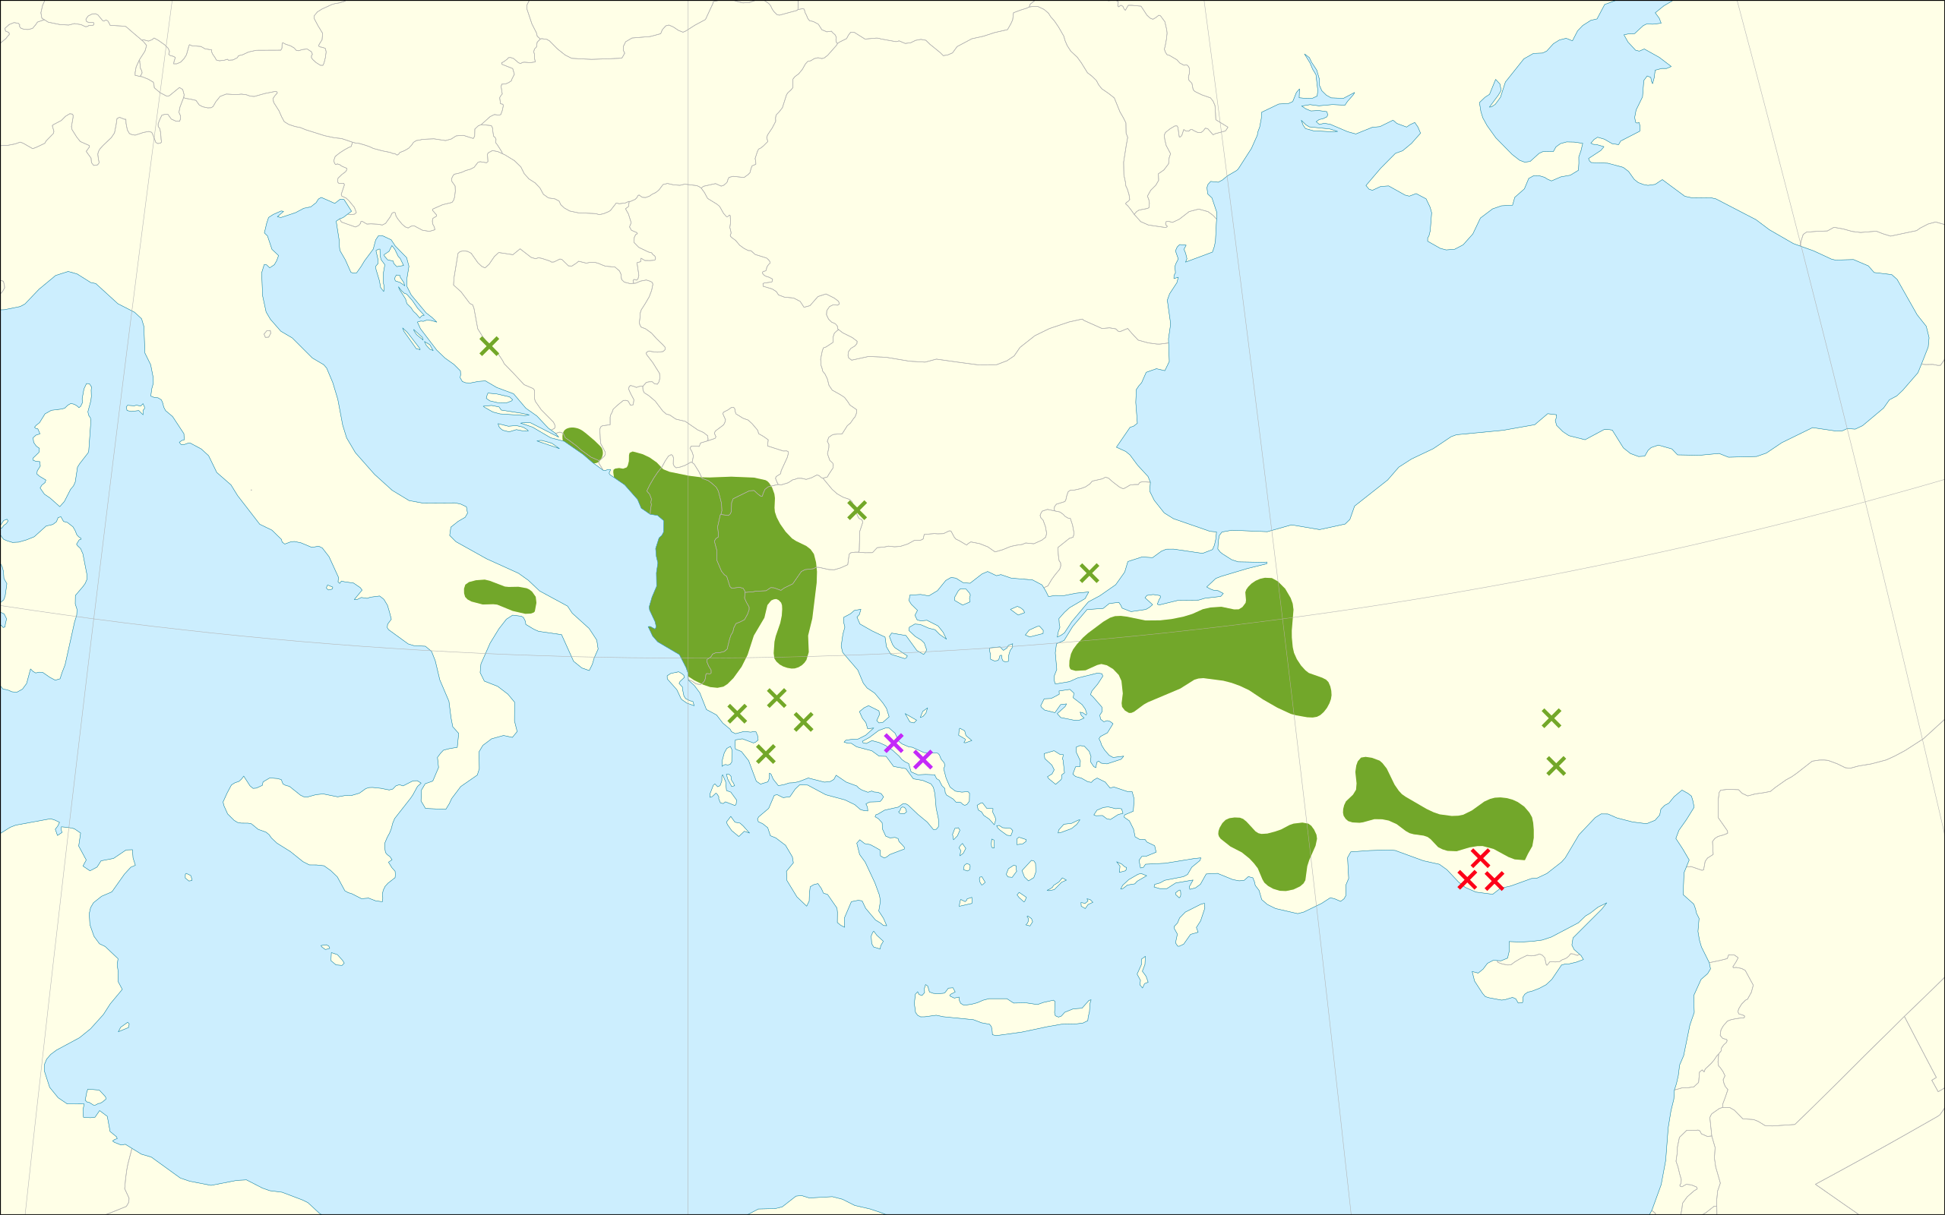
Genomic and phylogenomic studies: Quercus sect. Cerris
Study species: western Eurasian oaks of sect. Cerris; special focus on Q. trojana, an eastern Mediterranean endemism
Methods: phylogenomics and phylogeographic analysis based on whole chloroplast genomes, assembled starting from genome skimming data (i.e., WGS, about 5x coverage)
Activity in collaboration with: CNR-IPSP; Università degli Studi della Tuscia, Viterbo (DAFNE)
Oak species included
in this study (bold)
Table from:
Simeone et al. (2018).
PeerJ 6: e5793

Slide 10
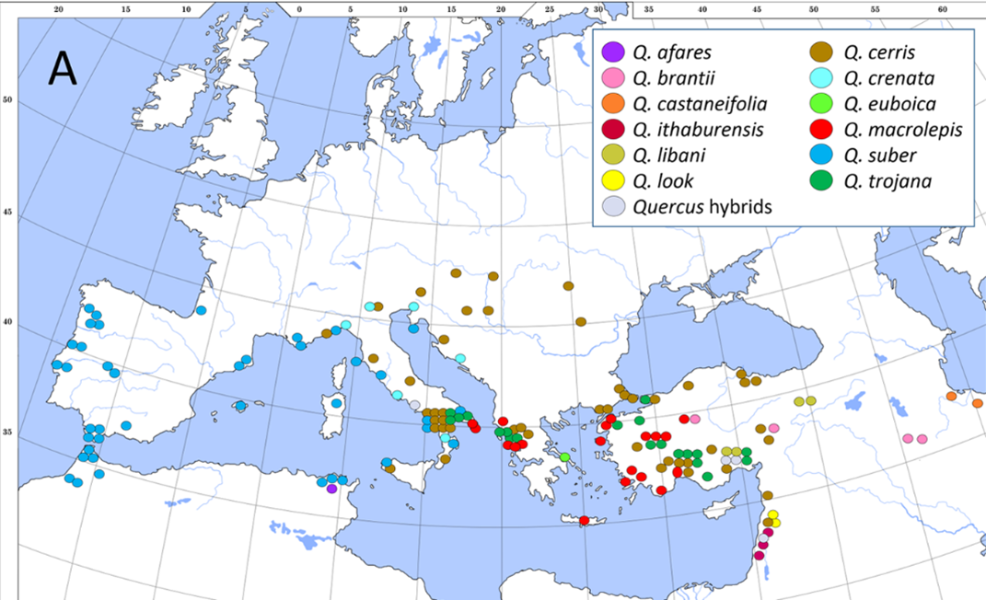
Genomic and phylogenomic studies: Quercus sect. Cerris
Dataset:
south-eastern Mediterranean species (most of them are endemics):
Q. trojana (20 provenances; 11 Italian samples, covering the whole Italian range - Murge region)
Q. trojana subsp. euboica (2 provenances)
Q. cerris (4 provenances)
Q. suber (2 provenances)
Q. macrolepis (3 provenances)
Q. ithaburensis (3 provenances)
Q. afares (1 provenance)
Q. brantii (1 provenance)
Q. castaneifolia (1 provenance)
Q. crenata (1 provenance)
Q. libani (1 provenance)
Q. look (1 provenance)
Results: 40/41 samples successfully assembled (whole chloroplast genomes)
Geographic distribution of oak samples included in this study
(red ellipse)
Figure from: Simeone et al. (2018). PeerJ 6: e5793

Slide 11
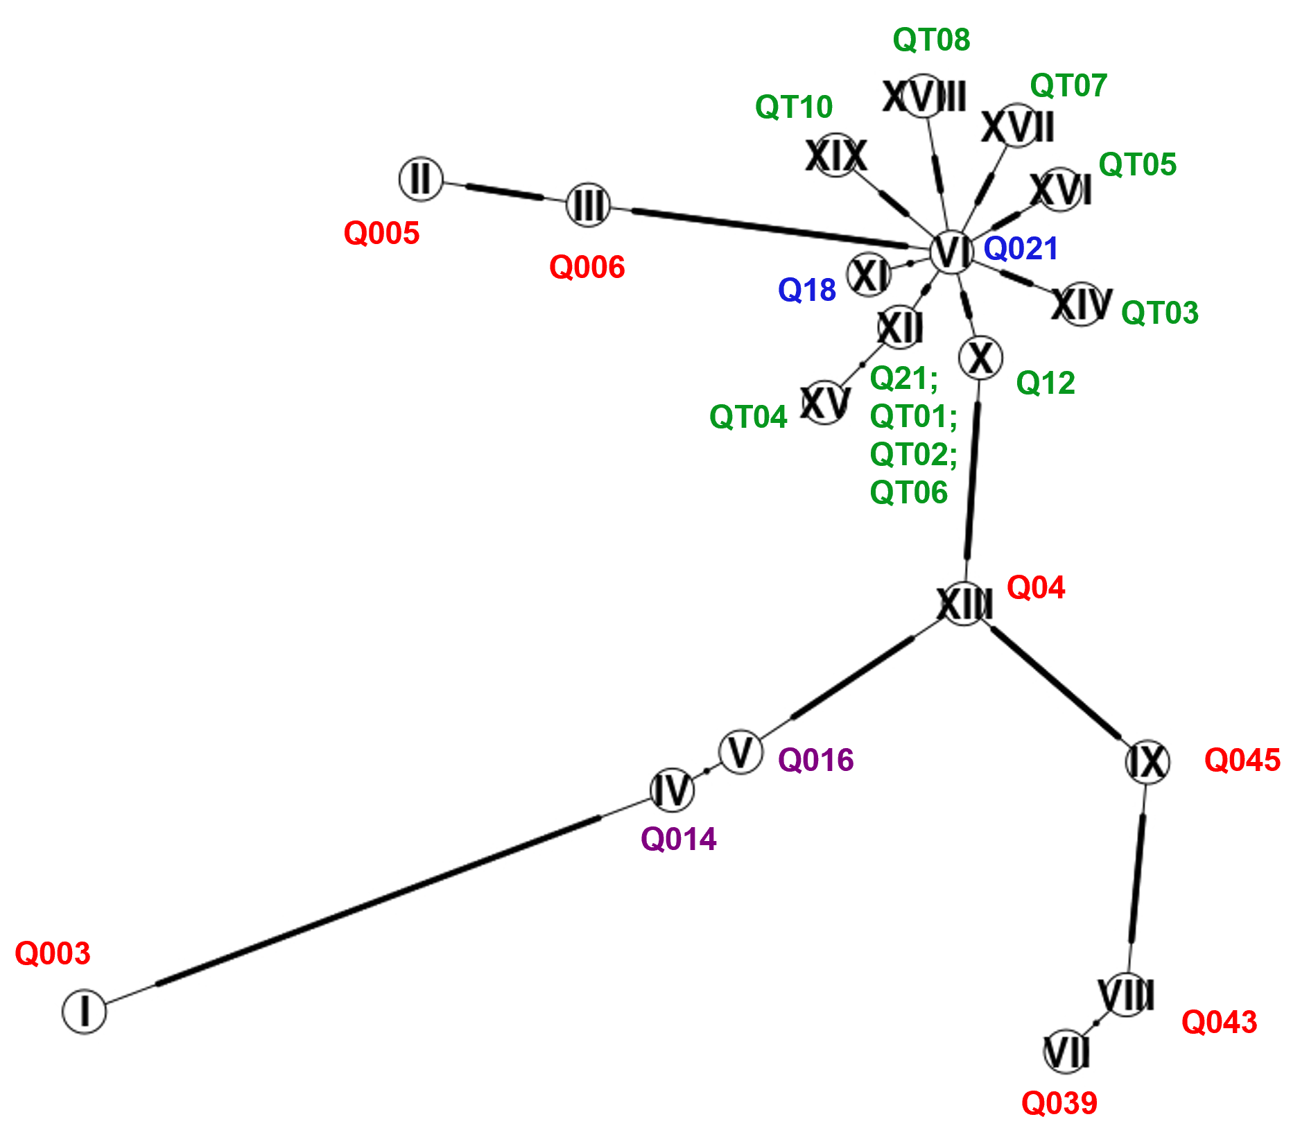
Parsimony network based on whole cp genomes
(focus on Q. trojana)
Genomic and phylogenomic studies: Quercus sect. Cerris
All Q. trojana Italian samples belong to the same haplogroup;
However, there is relatively high diversity (8 different haplotypes)
Italian samples seem to be closely related to samples from Northern Greece
Anatolian samples belong to different clades spread throughout the network; this is not surprising: they correspond to geographically distant and isolated areas
The phylogenetic relationships between the different Q. trojana haplogroups will be better investigated through Bayesian phylogenetic tree, including all the other Q. sect. cerris species (work in progress)
COLOR LEGEND
Green = Italy (Murge)
Blue = North Greece
Violet = Q. trojana subsp. euboica (Island of Evvia, Greece)
Red = Turkey

Slide 12
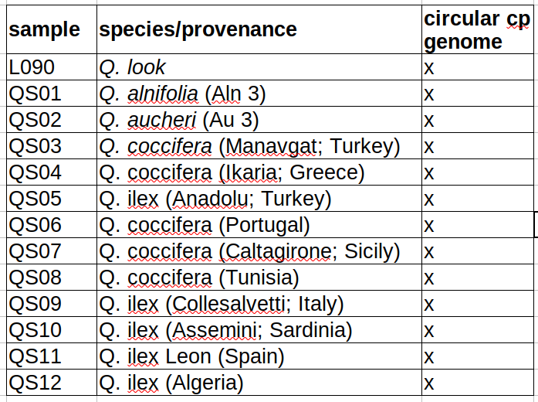
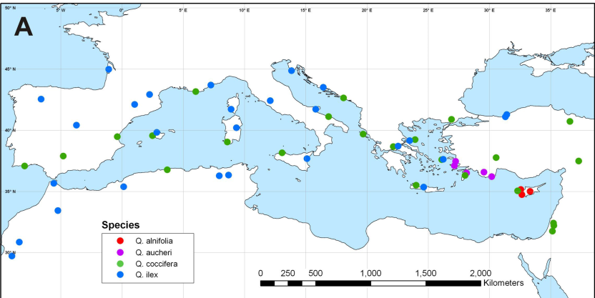
Genomic and phylogenomic studies: Quercus sect. Ilex
Study species: Mediterranean evergreen oaks of sect. Ilex
Methods: phylogenomic and phylogeographic analysis based on whole chloroplast genomes, assembled starting from genome skimming data (i.e., WGS, about 5x coverage)
Activity in collaboration with: Università degli Studi della Tuscia, Viterbo (DAFNE)
Preliminary results: all the 12 sequenced samples were successfully assembled (whole chloroplast genomes);
Coming up next: comparative genomics (with publicly available cp genomes of non-Mediterranean Quercus sect. Ilex) and phylogenomics
Figure from: Simeone et al. (2016). PeerJ, 4, e1897

Slide 13
Genomic and phylogenomic studies: Alnus cordata and Alnus glutinosa
Study species and sampling design:
89 Alnus cordata samples, collected from 19 locations covering the whole Italian distributional range;
26 Alnus glutinosa, from forest stands in close proximity to A. cordata, were included in the analysis to control for potential hybridization/introgression events
Methods:
whole-genome sequencing (WGS, about 20x coverage);
de novo plastome assembly + analysis of nuclear variants (SNPs), after mapping reads on ref. genome
Objectives:
investigating genome-wide genetic diversity and population structure in Alnus cordata populations
identifying Genetic Conservation Unit (GCU), diversity hotspots and conservation priorities
checking for potential hybridization/introgression events with the sympatric Alnus glutinosa, and evaluating their effects on A. cordata genome-wide diversity

Slide 14
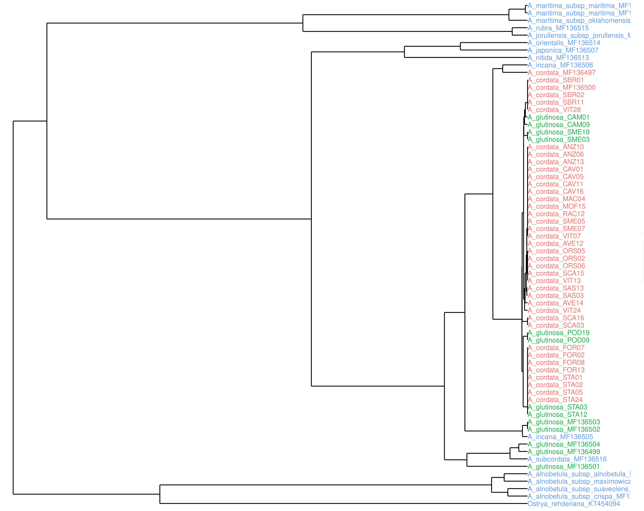
Genomic and phylogenomic studies: Alnus cordata and Alnus glutinosa
LEGEND
Green:
A. glutinosa ITA
Red:
A. cordata ITA
Blue:
other Alnus spp.
* A. cordata GenBank (C = Corsica; I = Italy)
** A. glutinosa GenBank: MF136499: Turkey; MF136501: Iran; MF136502: France; MF136503: UK; MF136504: Turkey
NJ tree
(whole cp genomes)
* C
* I
Preliminary results
Italian A. cordata and A. glutinosa samples do not form 2 distinct clades: they are all in the same branch, with substructure which is more related to the geographical provenance of samples than to taxonomic assignment
a similar scenario was already highlighted for other Alnus spp. by Gryta et al. (2017)
potential explanation: chloroplast capture via introgressive hybridization
Coming up next: hybridization/introgression could contribute to increase genetic diversity, especially if several species co-occurred in refugia: we will test this hypothesis with nuclear whole-genome data
**
**
**
**
**

Slide 15
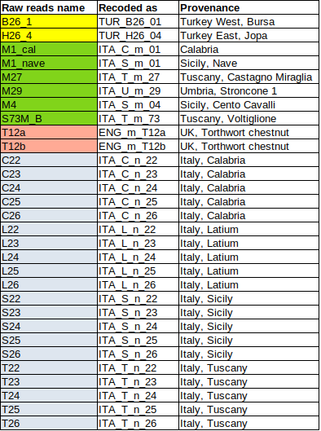

Genomic and phylogenomic studies: Castanea sativa
Sampling design:
4 Italian, natural chestnut stands (Calabria, Lazio, Sicilia, Toscana); 5 individuals per stand;
6 monumental trees in the surrounding areas
1 sample from West Turkey, 1 sample from East Turkey; 2 samples from England (same tree)
Methods:
whole-genome sequencing (WGS, about 10x coverage);
plastome assembly + analysis of nuclear variants (SNPs), after mapping reads on our assembled ref. genome
Activity in collaboration with:
CNR-IPSP; Fondazione Edmund Mach

Slide 16
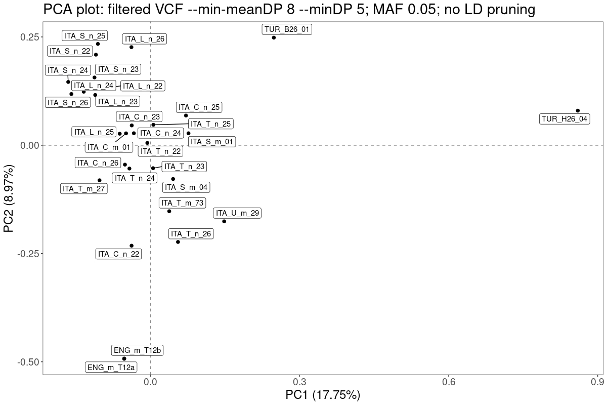
Genomic and phylogenomic studies: Castanea sativa
Nuclear genome: PCA based on whole-genome SNPs
W Turkey
E Turkey
Italy
East Turkey (TUR_H26_04): clearly separated from all the others on PC1 axis
West Turkey (TUR_B26_01): closer to Italian samples
England (ENG_m_T12): differentiated from Italian samples on PC2 axis
Italian samples: no clear correspondence between genetic and geographical structure; unique gene pool (pop structure need to be better investigated)
England

Slide 17
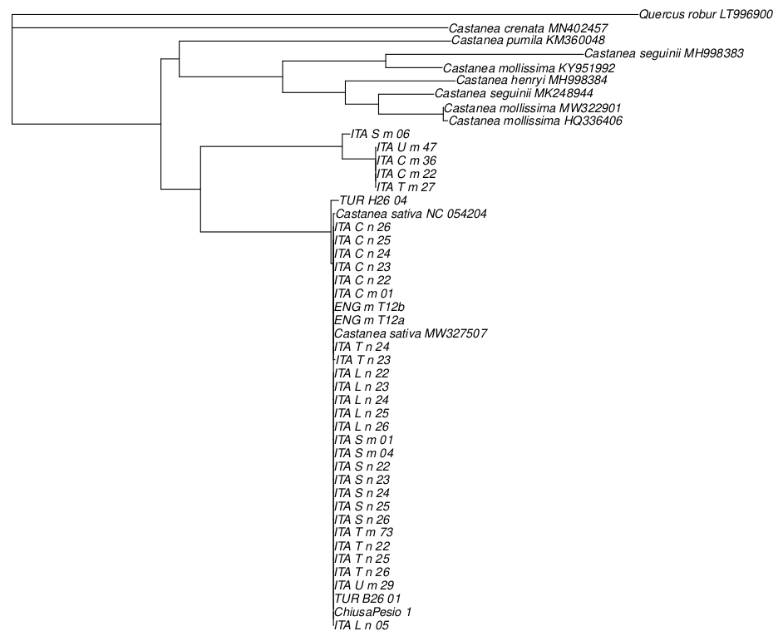
Genomic and phylogenomic: Castanea sativa
Chloroplast genome:
Neighbor joining (NJ) tree
Genomics and phylogenomics:
Castanea sativa
Chloroplast genome:
Neigh
bor joi
nintree
Japanese chestnut
American dwarf chestnut
Chinese chestnuts
* C. Ruossa (Sicilia)
Stroncone (Umbria)
Pollino (Calabria)
Sila (Calabria)
C. Miraglia (Toscana)
Castanea sativa:
Italian monumental trees*
The cp haplotypes of some Italian chestnut samples (5 monumental trees) form a separate clade, highly divergent from all the other Castanea sativa samples (including the 2 Turkish provenances)
The distance between this clade and all other C. sativa is remarkable: about 230 nucleotide differences
Coming up next: ML and/or Bayesian phylogeny to better investigate the evolutionary history of Italian monumental chestnuts and estimate divergence time
Castanea sativa:
all other samples

Slide 18

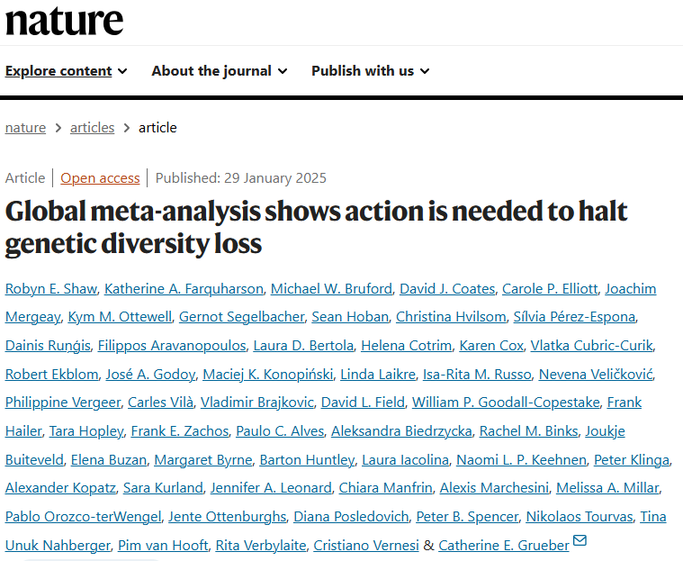
Why study and monitoring genetic diversity?

Slide 19
Thank you!
ACKNOWLEDGEMENTS
NBFC (National Biodiversity Future Center) - Project funded by the European Union - NextGenerationEU
Marcello Cherubini, Luca Leonardi, Michele Mattioni (CNR-IRET Porano): sampling, lab work and IT support
Muriel Gaudet, Francesca Chiocchini (CNR-IRET Porano); Paola Mairota (UNIBA): Alnus spp. and Quercus spp. sampling
Marco Cosimo Simeone (UNITUS, DAFNE); Mariangela Santorsola (UNIPV): Quercus spp. sampling and phylogenomics
Federico Sebastiani, Sara Villa (CNR-IPSP): phylogenomic analysis
Janik Fernando (MSc student), Tiziana Castrignanò (UNITUS): Alnus genomics analysis
Luca Bianco, Paolo Fontana, Stefano Piazza, Mirko Moser, Cristiano Vernesi, Mickael Malnoy, Diego Micheletti, Luisa Palmieri (Fondazione Edmund Mach, San Michele A./A., TN); Federico Sebastiani, Sara Torre (CNR-IPSP Sesto Fiorentino); Luca Dondini, Sara Alessandri (UNIBO, Dept. of Agricultural and Food Sciences); Roberto Botta, Vera Pavese, Daniela Torello Marinoni (UNITO, Dept. of Agricultural, Forest and Food Sci.); Sergio Murolo (UNIVPM, Dept. of Agricultural, Food and Env.Sci.): Castanea sativa reference genome assembly and genomic analysis
Alberto Biscontin¹, Michele Morgante^{1,2} (¹UNIUD, Dept. of Agricultural, Food, Environmental and Animal Sciences; ²Istituto di Genomica Applicata, IGA, Udine): Alnus cordata reference genome assembly
G-BikE (Genomic Biodiversity knowledge for Resilient Ecosystems) COST Action

