Slide 1
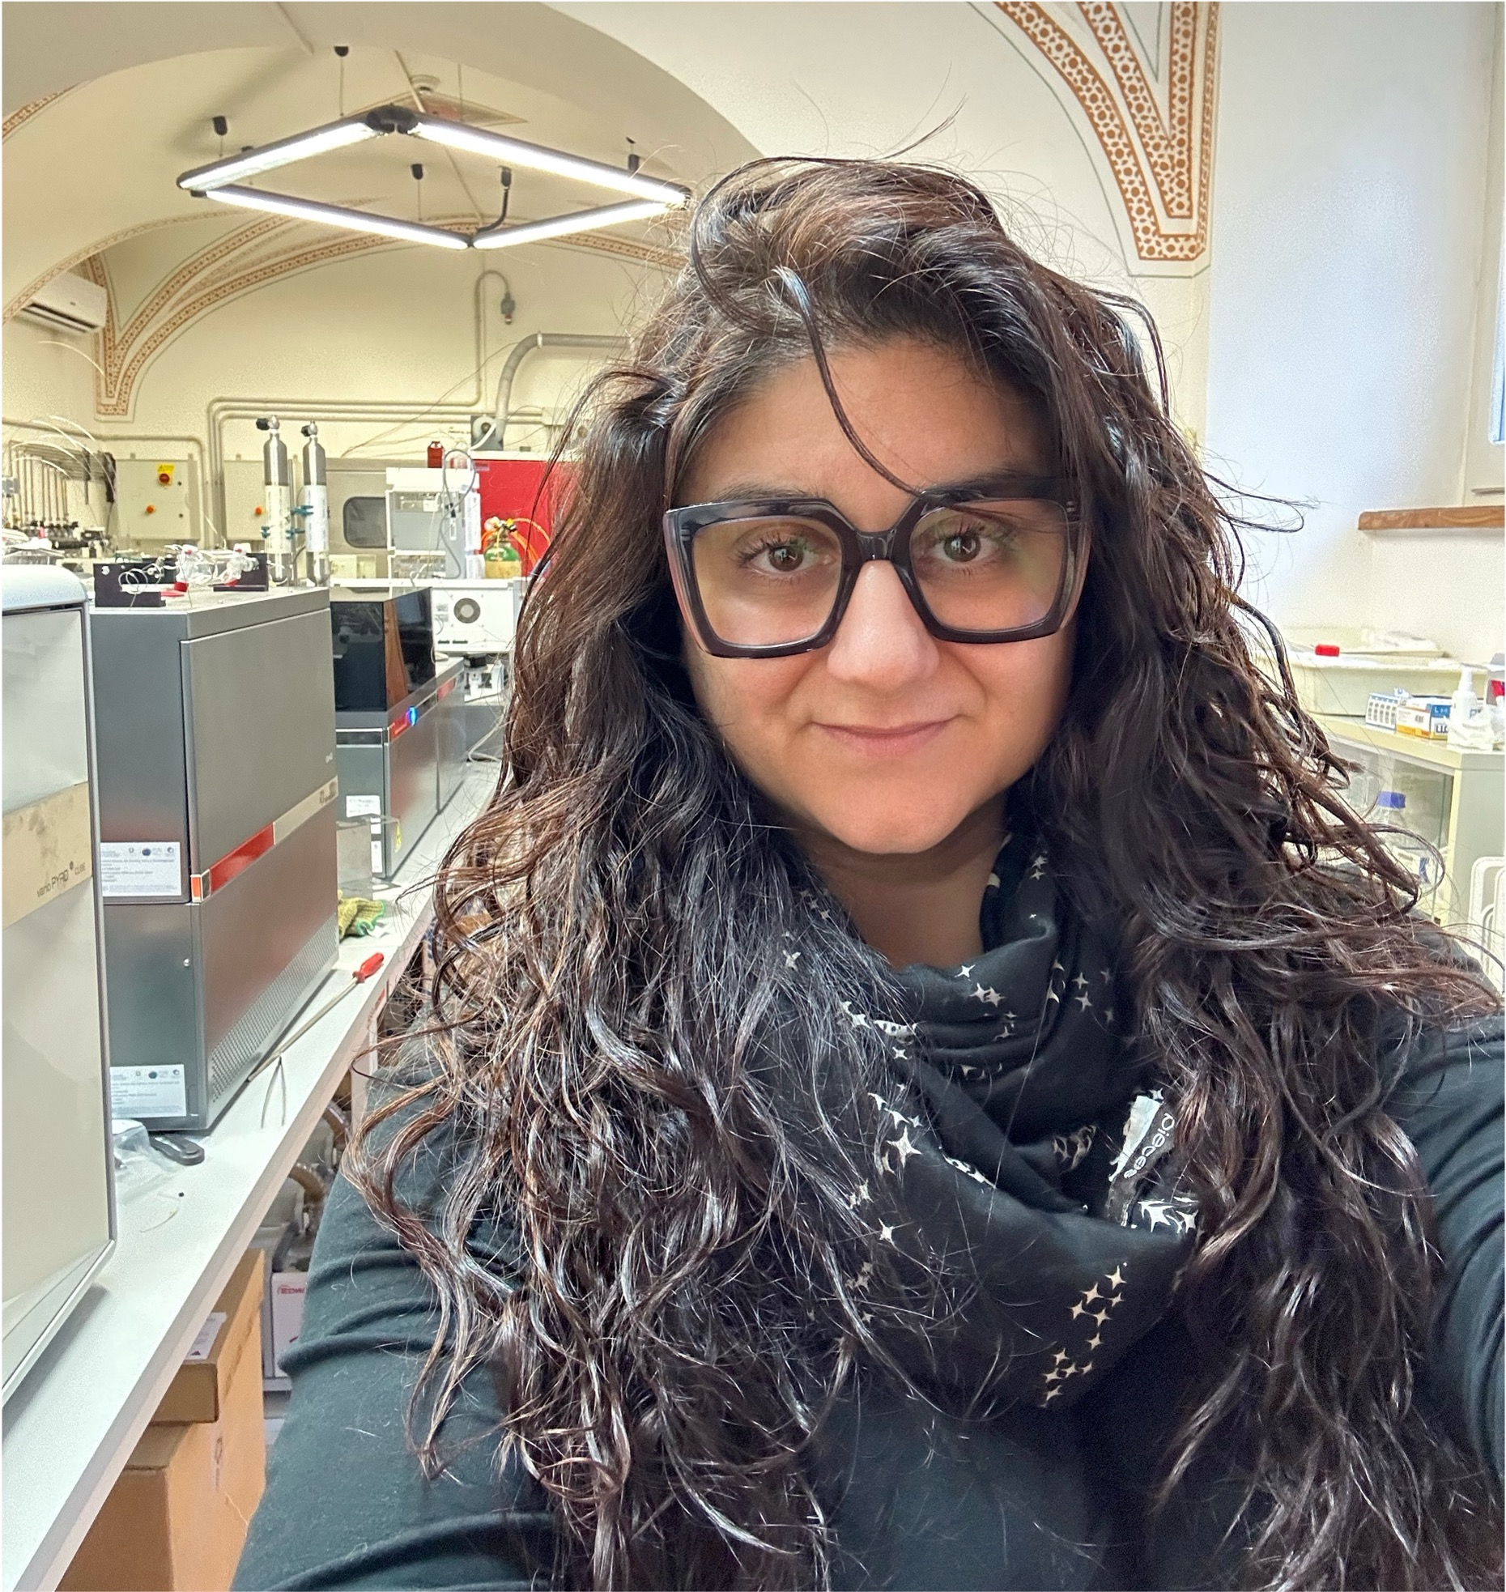
Comparing C and N stable isotopes analysis between urban and peri-urban Mediterranean parks along a latitudinal transect
I. Tunno¹, A. Scartazza², M. Micali¹, S. Portarena³, C. Calfapietra³, G. Guidolotti³, D. Papale¹
¹CNR – IRET Montelibretti (RM) Italy,
²CNR – IRET Pisa (PI) Italy,
³CNR – IRET Porano (TR) Italy

Slide 2

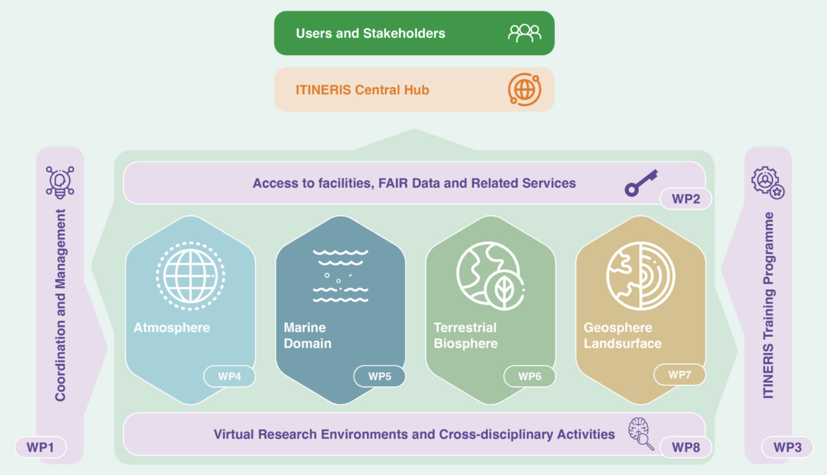
Italian integrated environmental research infrastructures system
https://itineris.cnr.it/about-itineris/the-project/

Slide 3
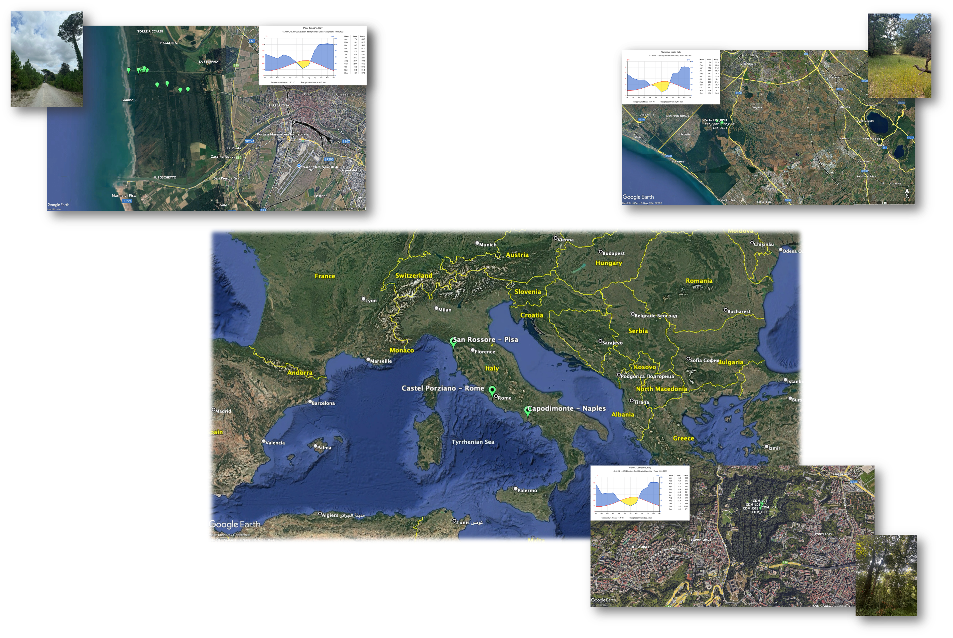
Study areas
Castel Porziano (CPZ) – Rome
25m asl, ~25 km SW of Rome, presidential estate and hunting reserve since 1949. Due to its proximity to Rome, it has been impacted by human activities since Roman time.
Capodimonte (CDM) – Naples
149m asl, is an urban park established in 1700’s as a hunting reserve and has been used for recreational activities since then. The vegetation is represented by mixed native and introduced species planted over the centuries.
Among the study areas this site is the most impacted by human activities.
San Rossore (SRS) – Pisa
4m asl, ~8 km from Pisa is a peri-urban park, natural reserve since 1979 and used for recreational purposes for centuries. The vegetation is represented by a mixed deciduous and evergreen species.
The three sites were selected among the ICOS (Integrated Carbon Observation System) network

Slide 4
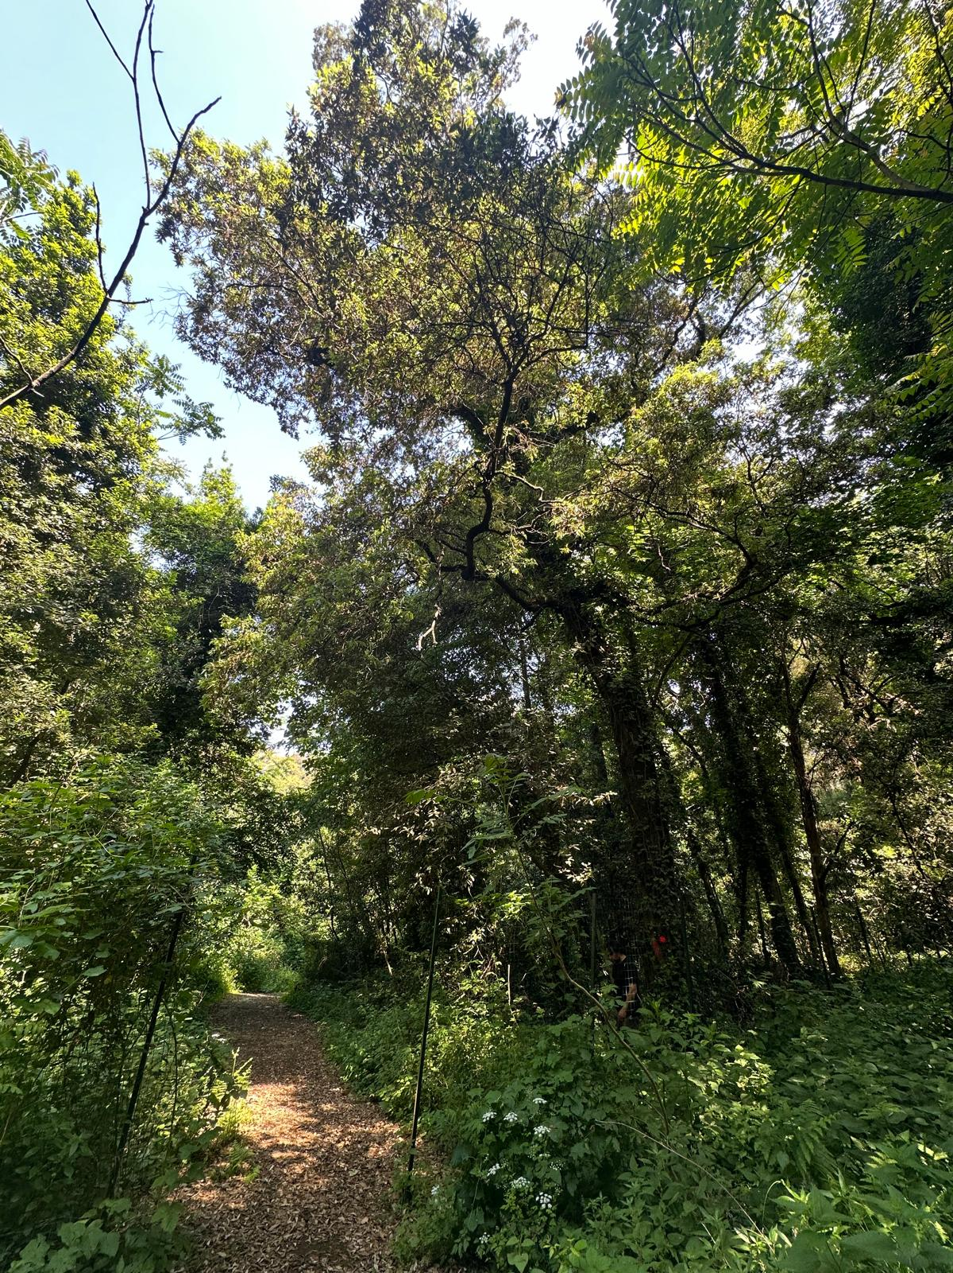
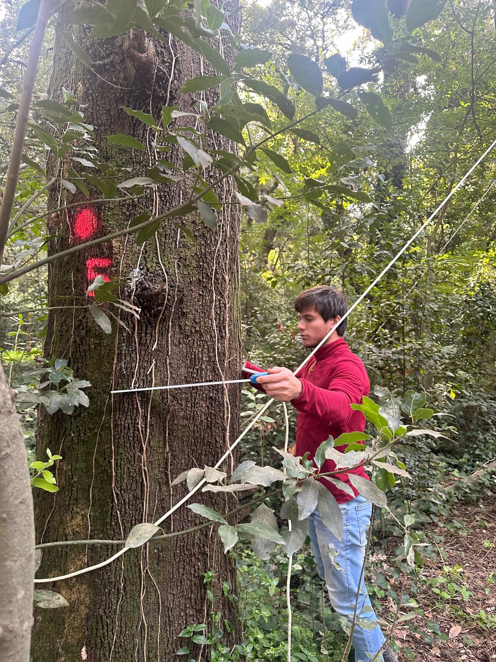
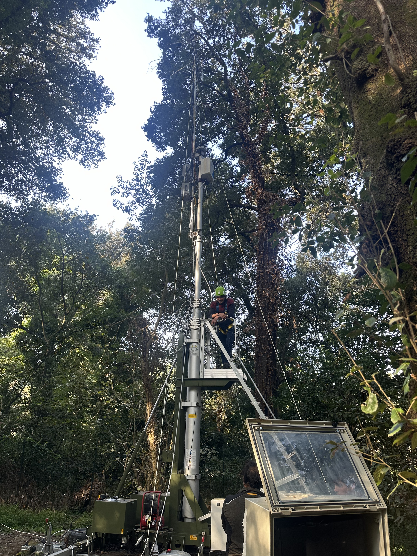
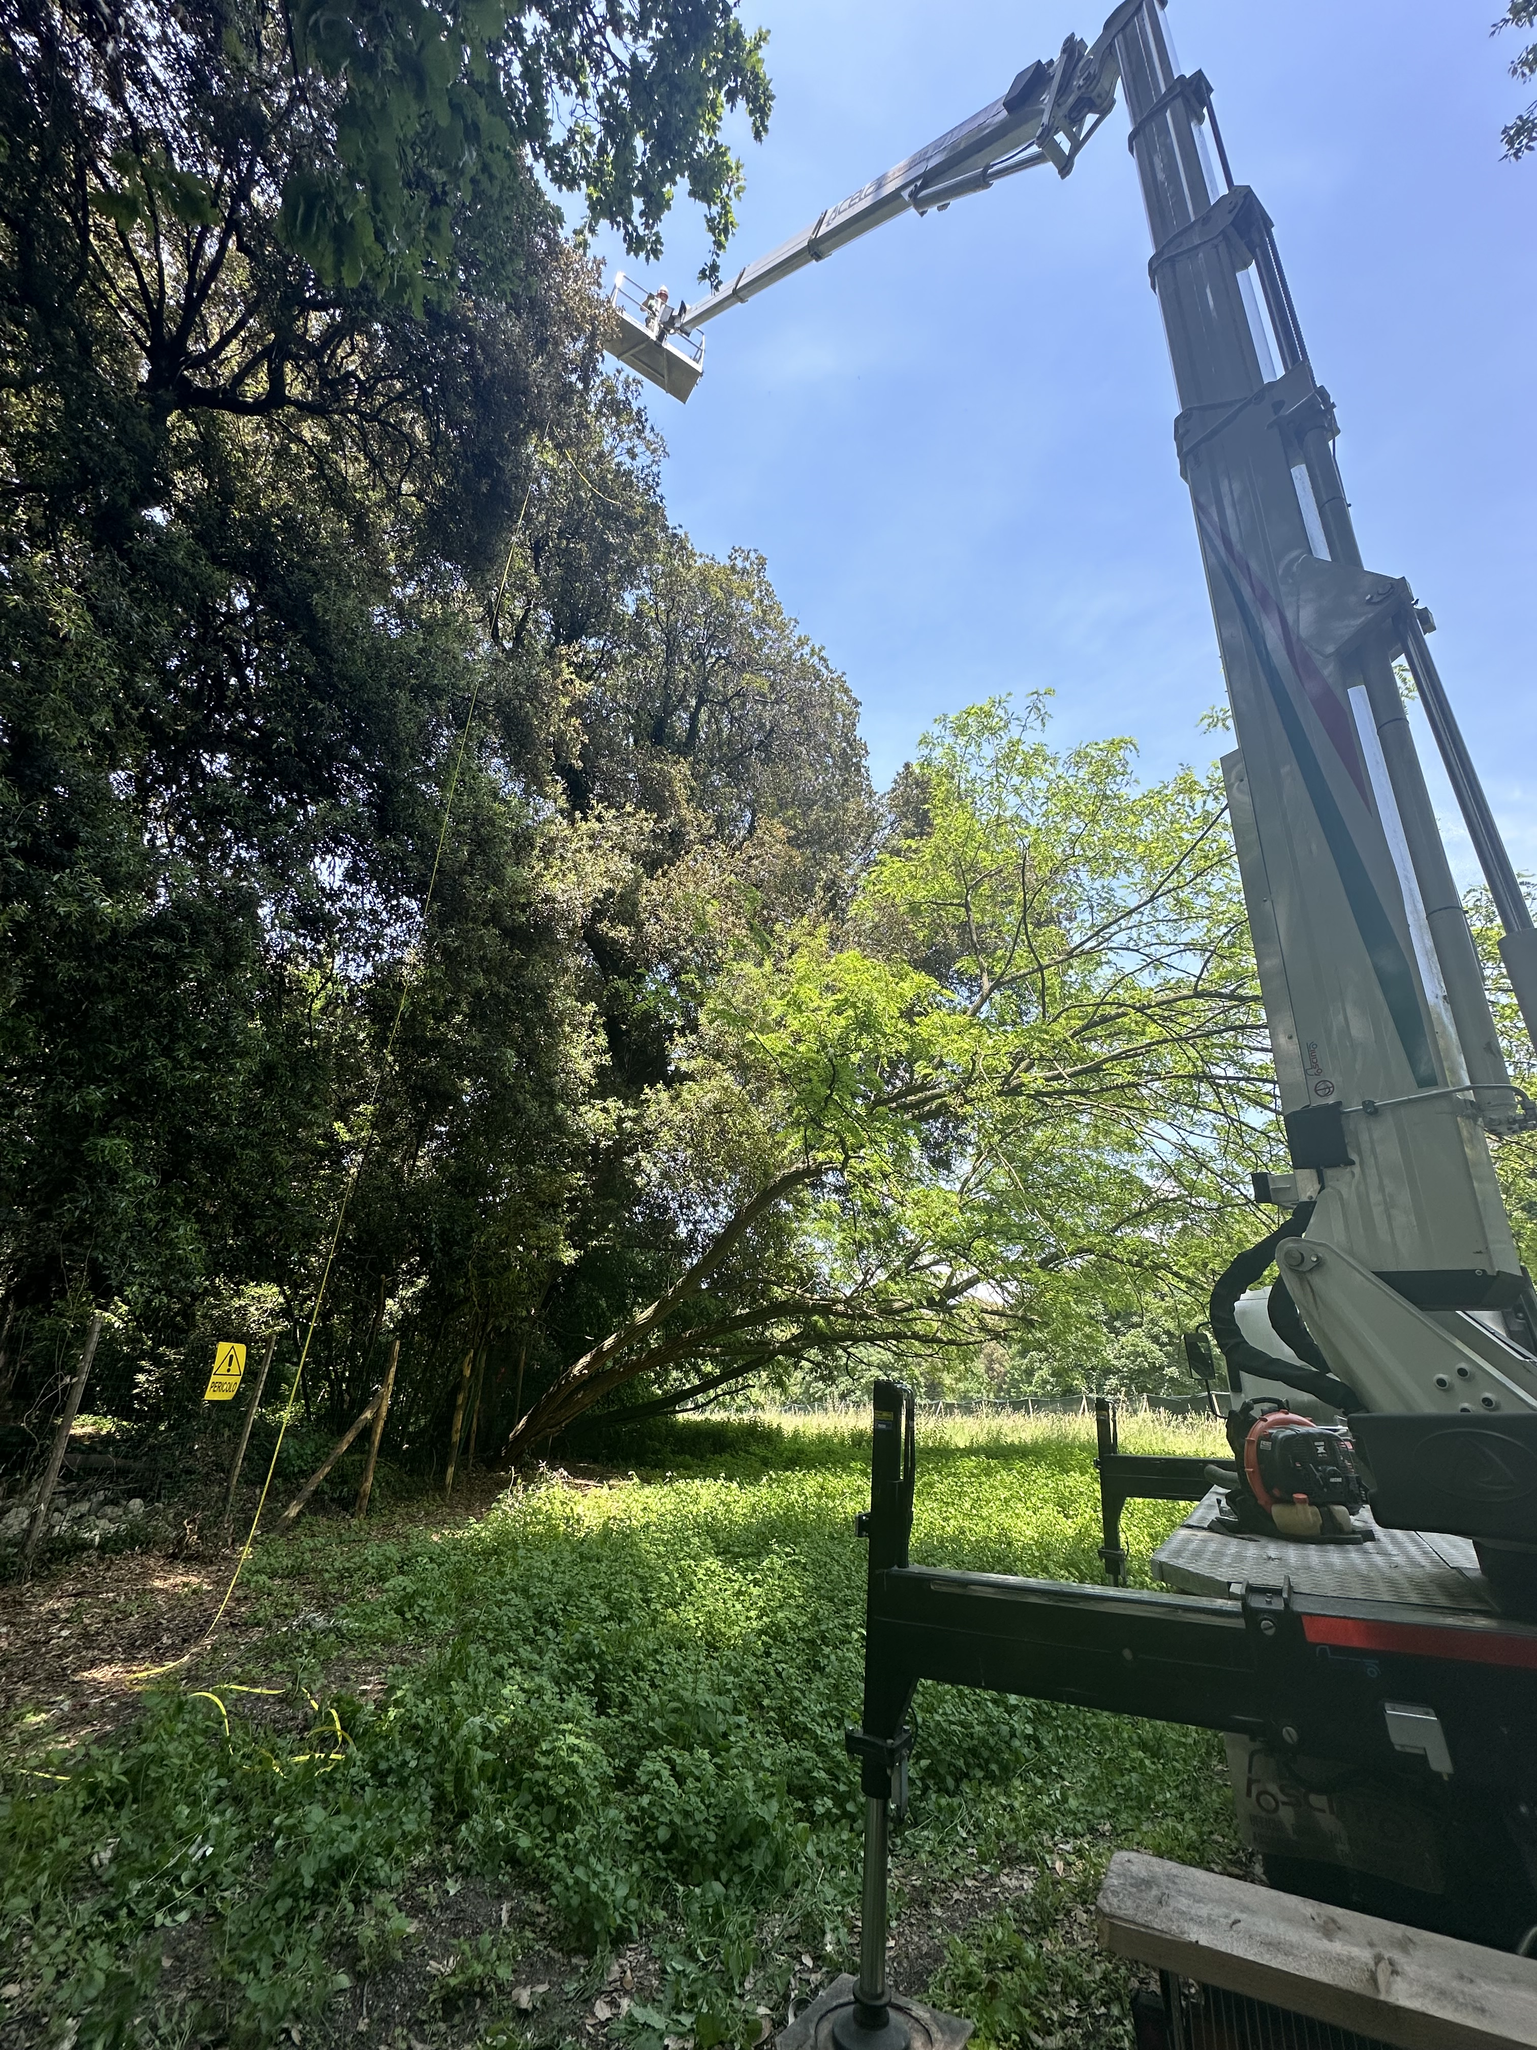
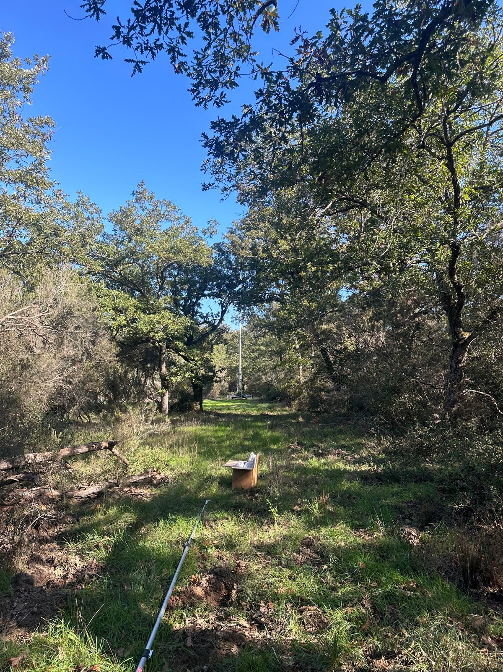
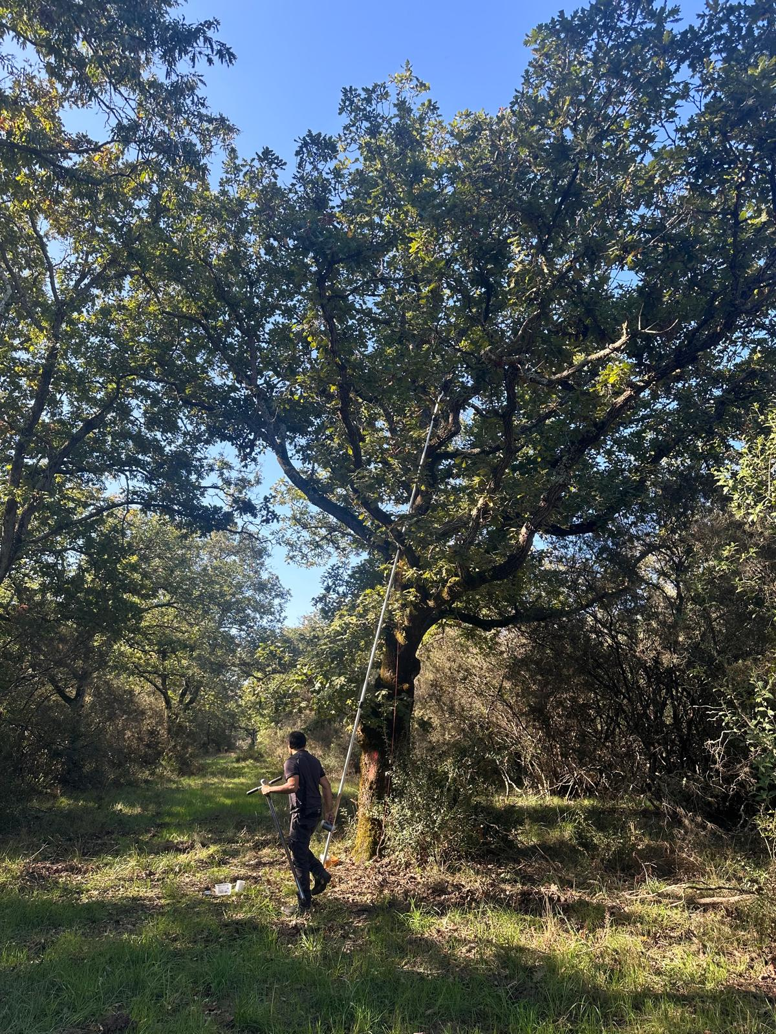
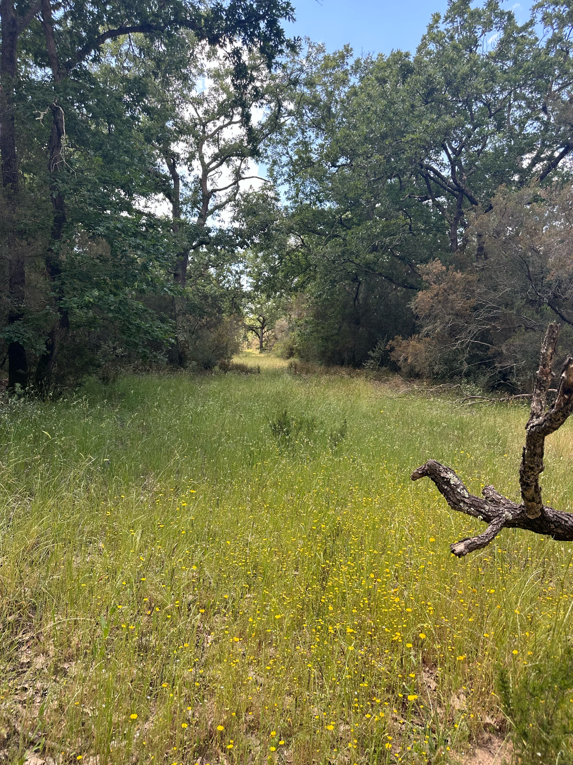
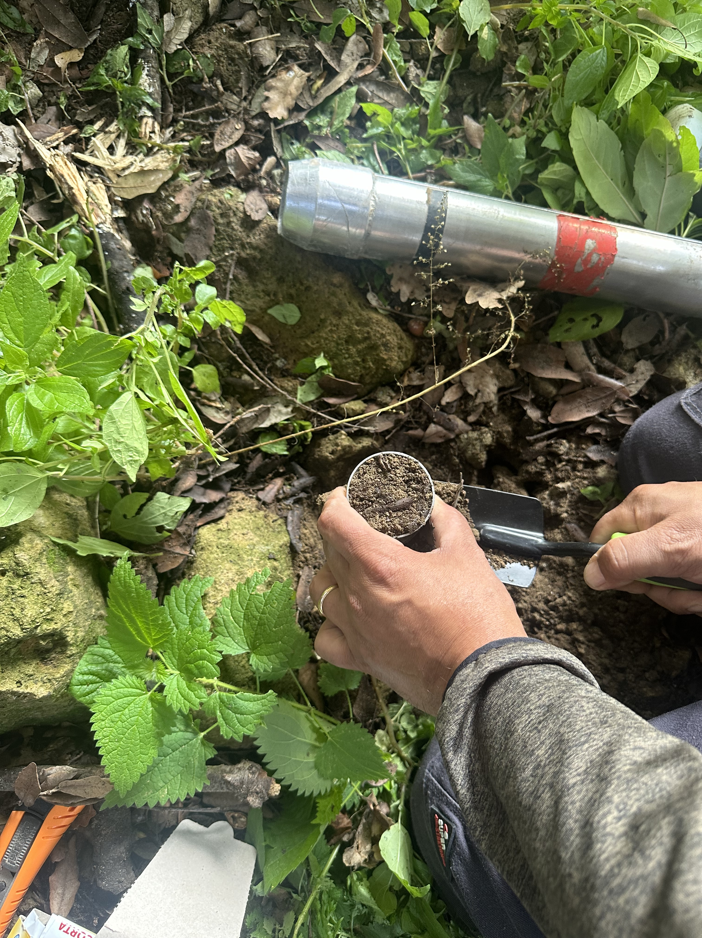
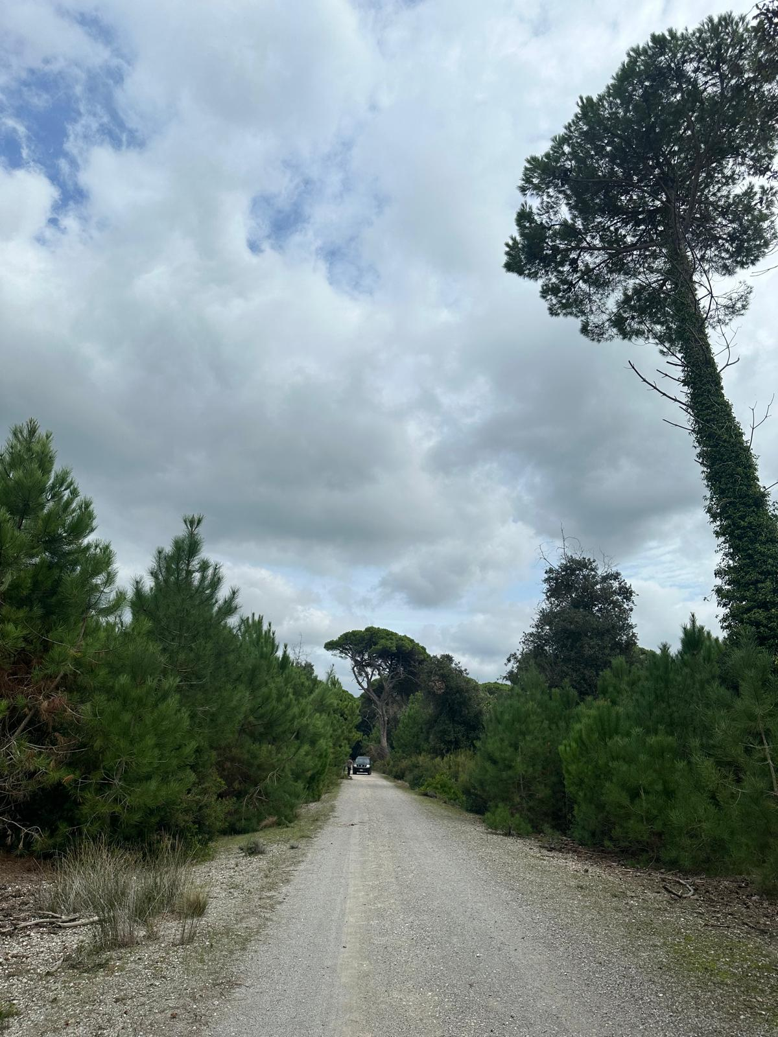
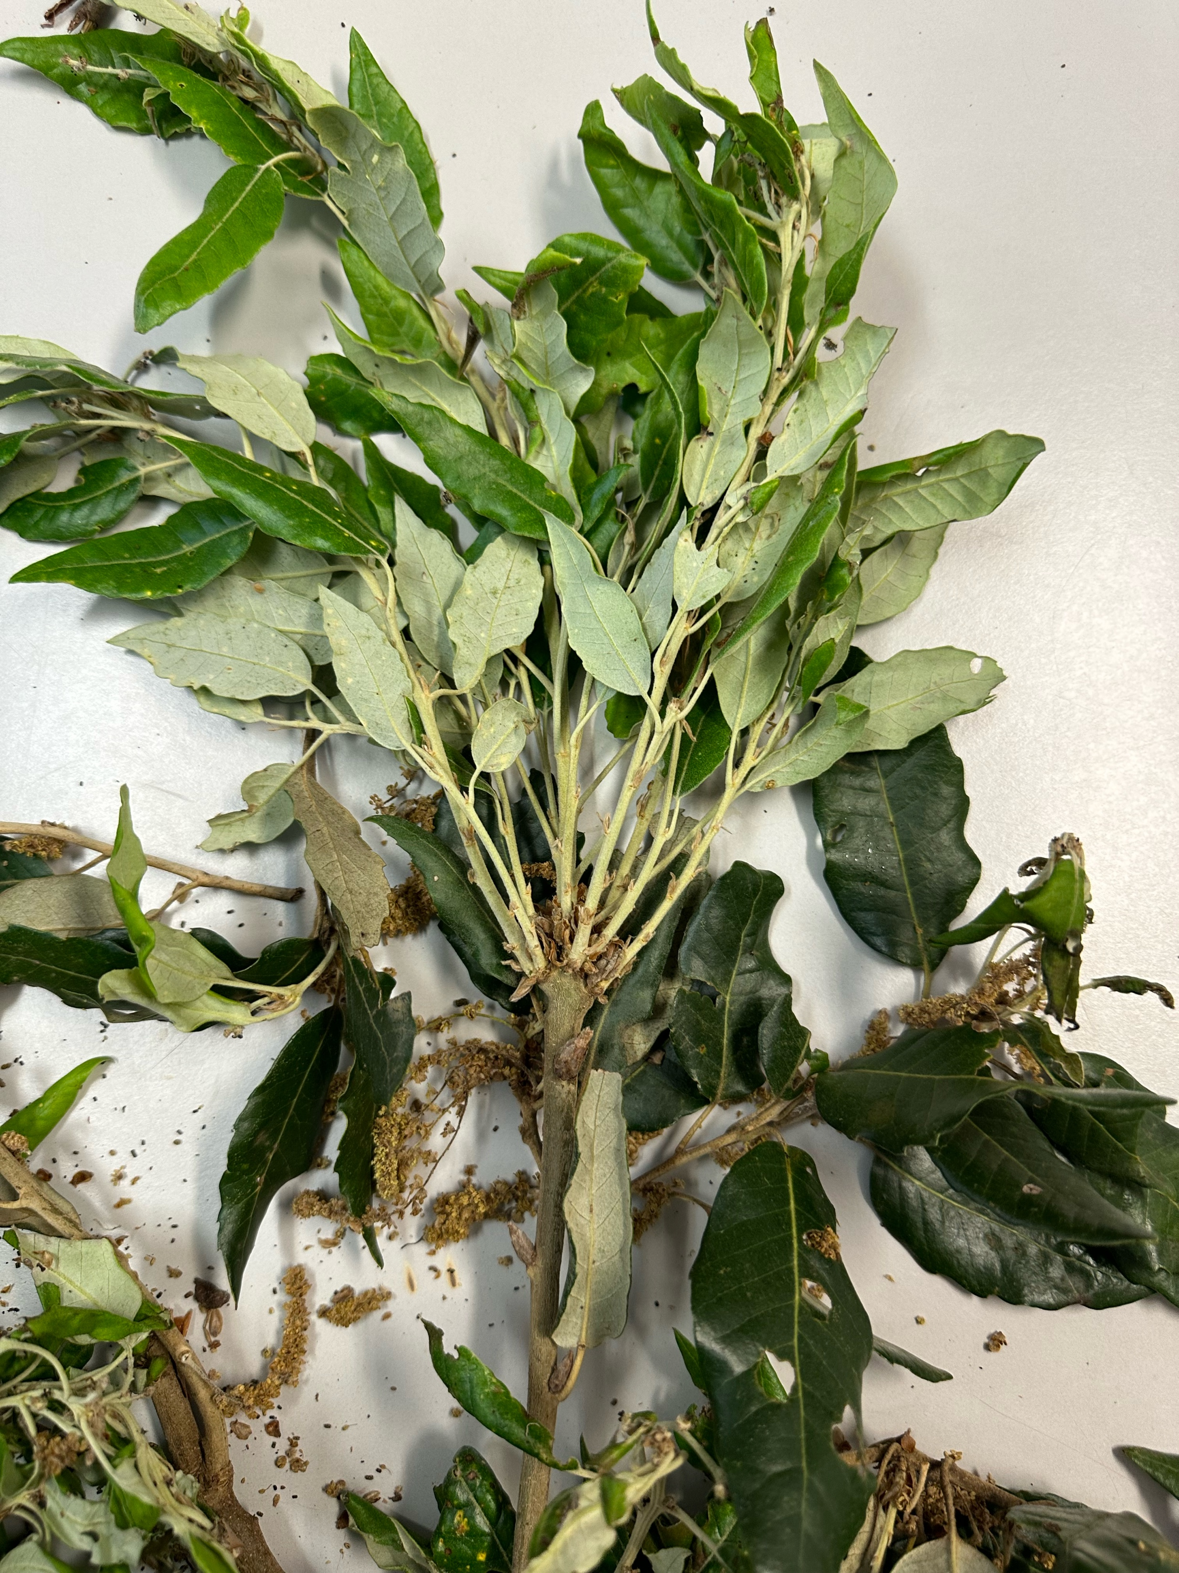
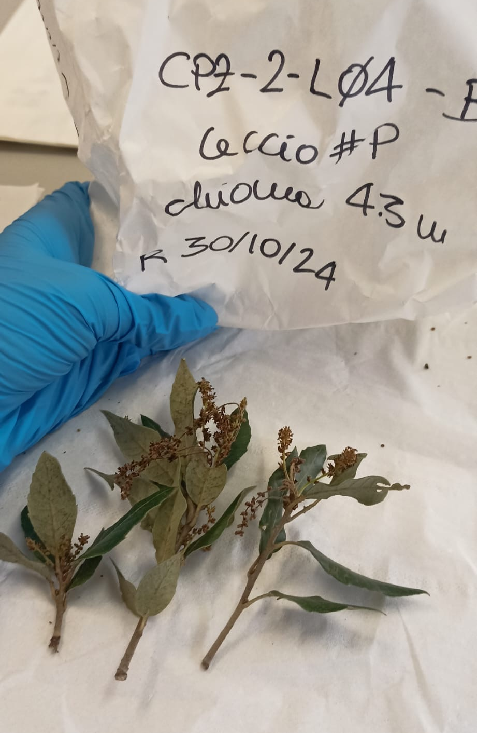
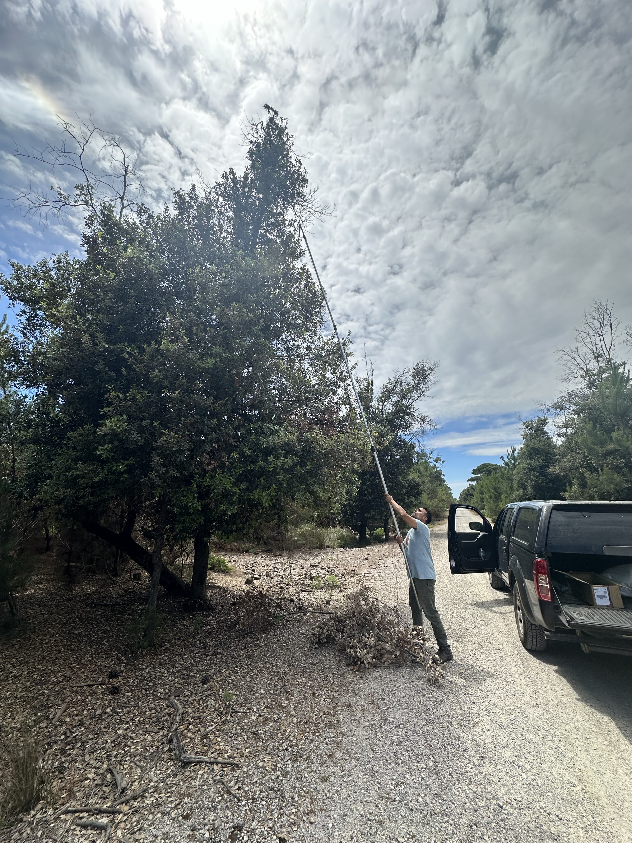
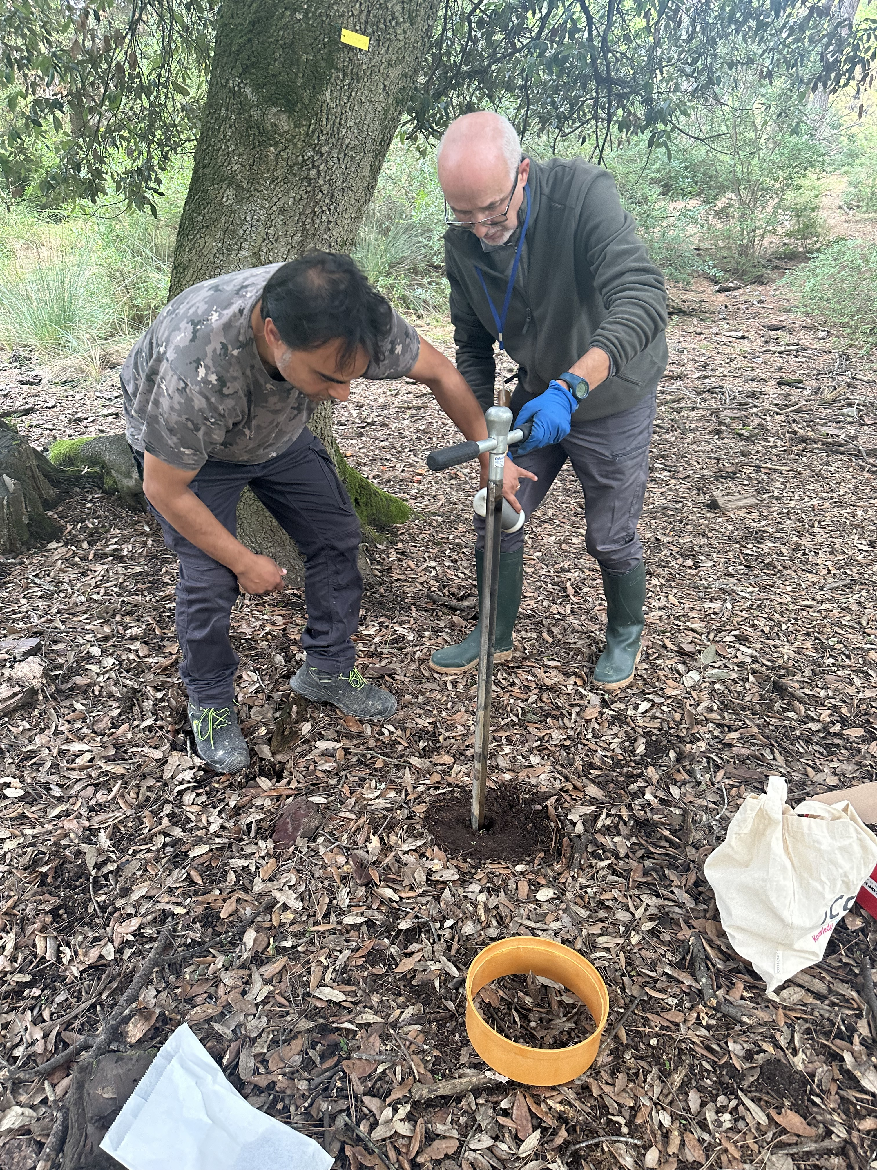
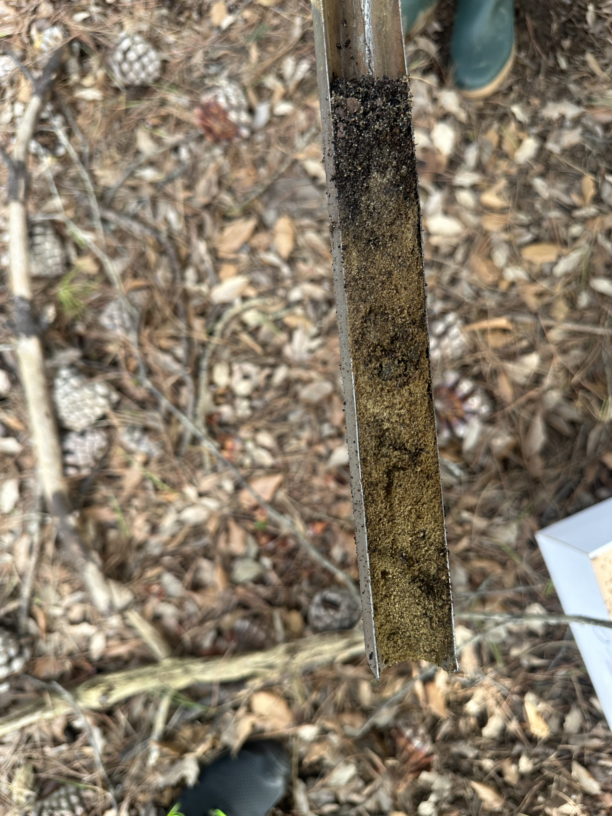
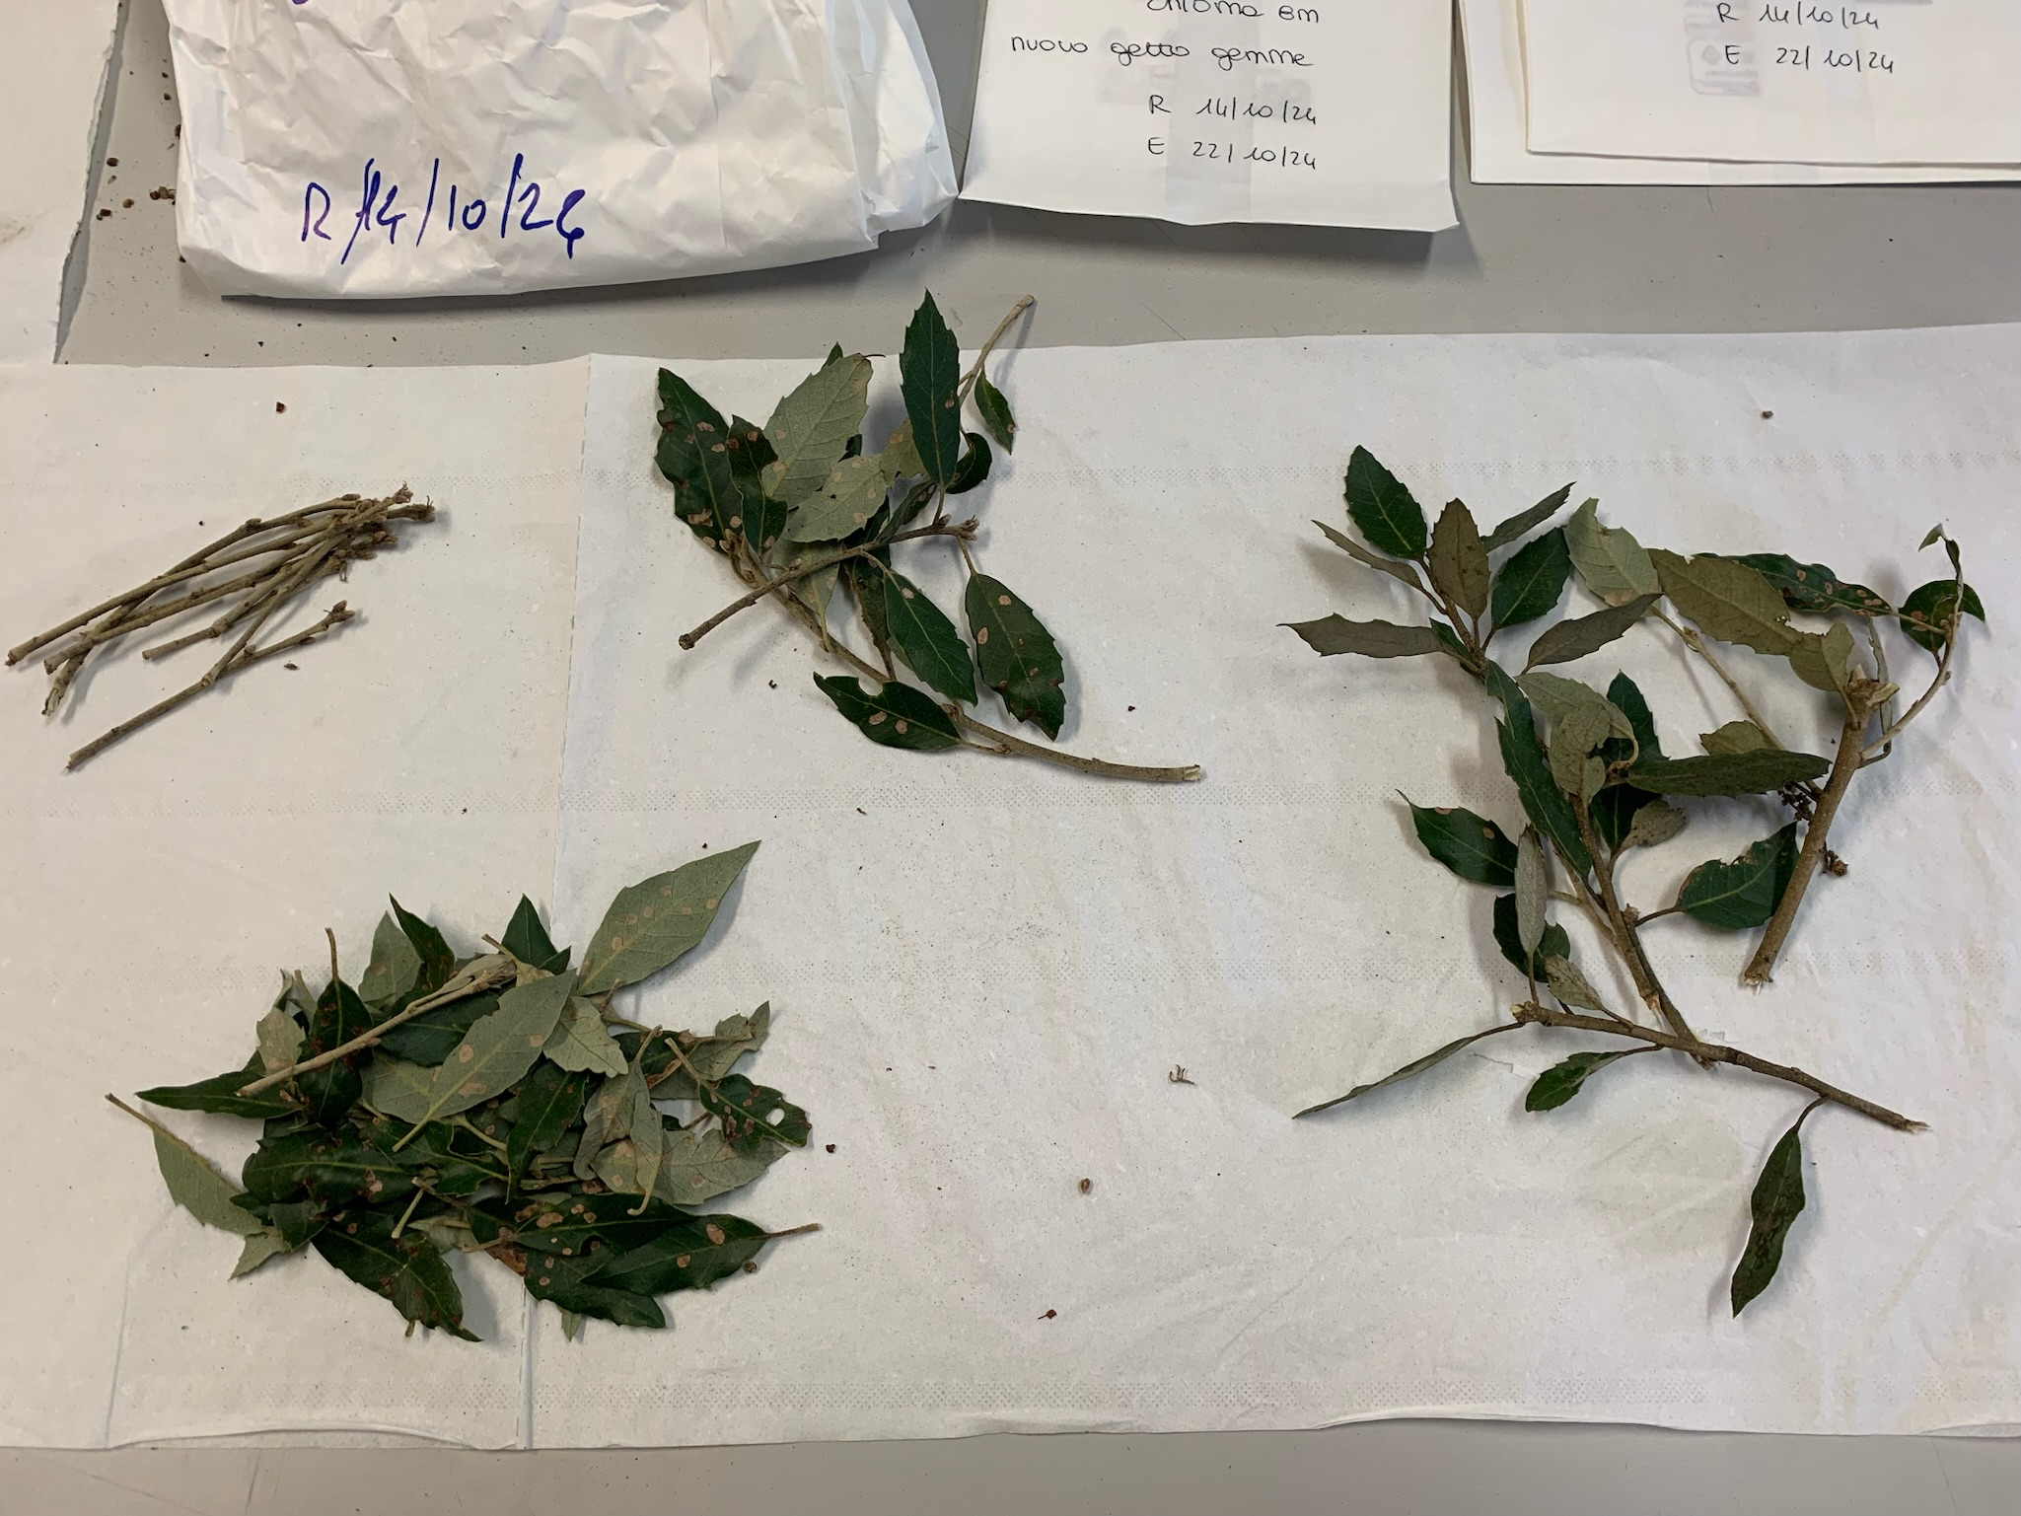
Sampling
2 sampling campaigns (May-Jun and Oct-Nov 2024)
3 sites (Capodimonte, Castel Porziano, San Rossore)
8 species
41 trees
~300 samples (vegetation + soil)
~1300 subsamples
~1000 C %, N%, δ¹³C and δ¹⁵N analysis

Slide 5
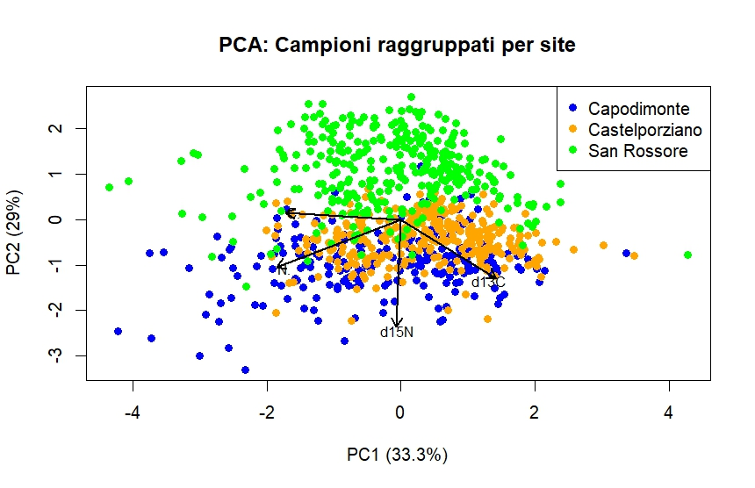
Sites separation along the latitudinal transect

Slide 6
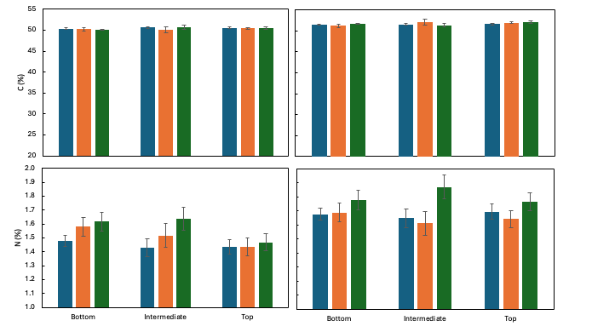
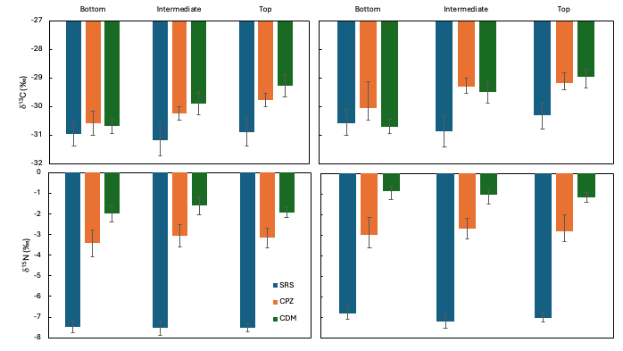
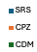
Holm oak (Quercus ilex) was chosen as potential bioindicator of environmental changes.
Differences in C and N concentrations and isotope compositions were observed along the latitudinal gradient and seasons
Capodimonte, the most southern site, reveals an enrichment in δ¹³C and δ¹⁵N in leaves compatible with a response to hot and dry climate, and a much higher degree of anthropization
Castel Porziano shows a similar trend but with lower δ¹⁵N and N concentration
Spring
Fall
Spring
Fall
San Rossore, the most northern site, appears to be less exposed to summer water stress and consequently shows more diluted δ¹³C and δ¹⁵N values
Leaves during the fall showed higher δ¹³C and N concentration compared to spring

Slide 7
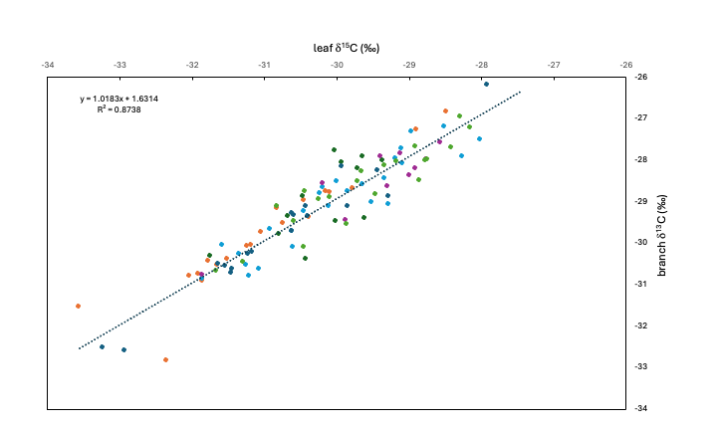
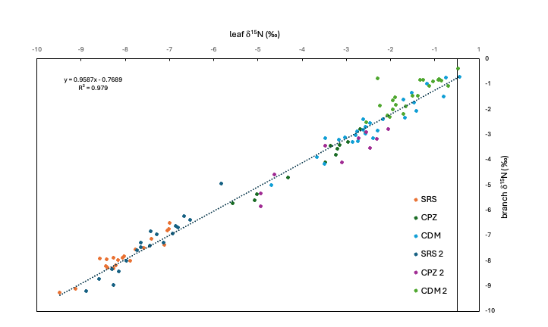
Linear relationships of C and N isotope compositions between leaves and branches show that branches were about 1 ‰ enriched in δ¹³C compared to leaves

Slide 8

Source vs sink comparison

Slide 9

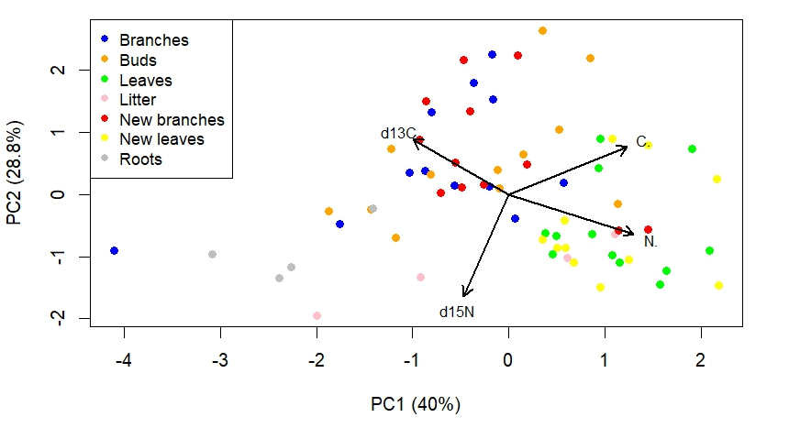
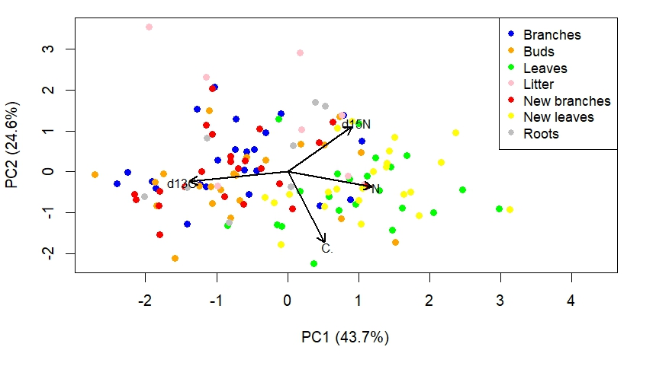
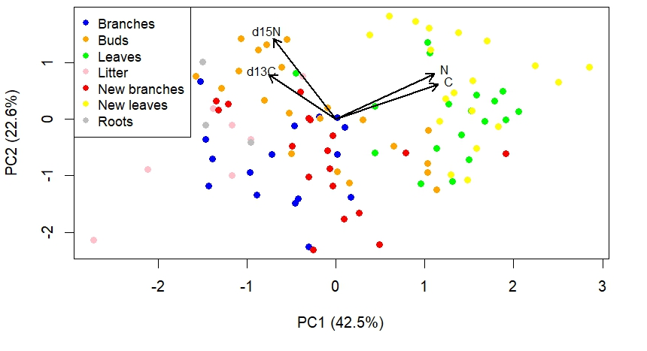
Castel Porziano
Capodimonte
San Rossore

Slide 10
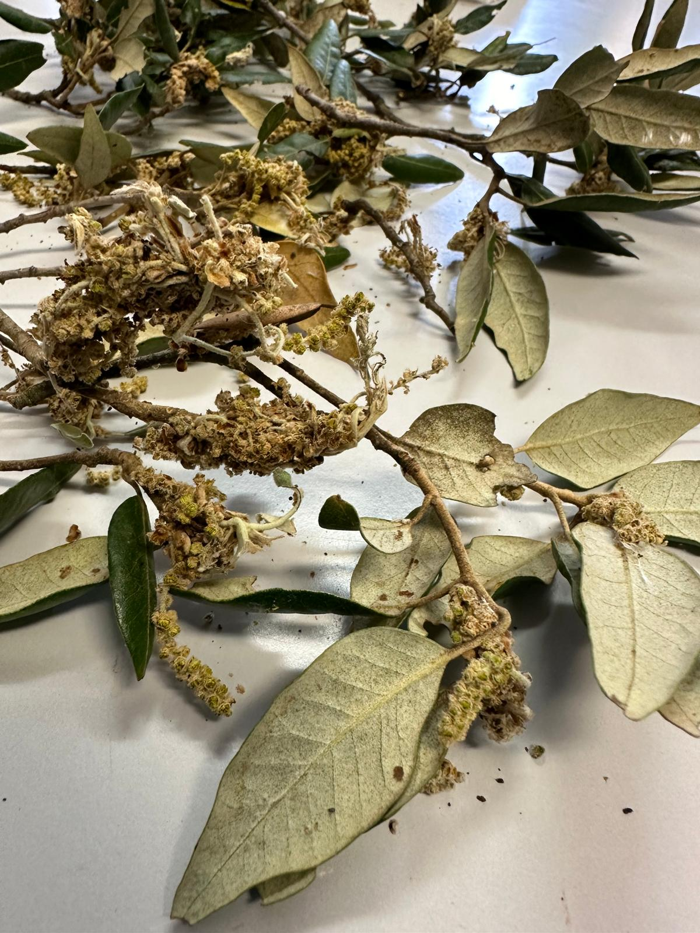
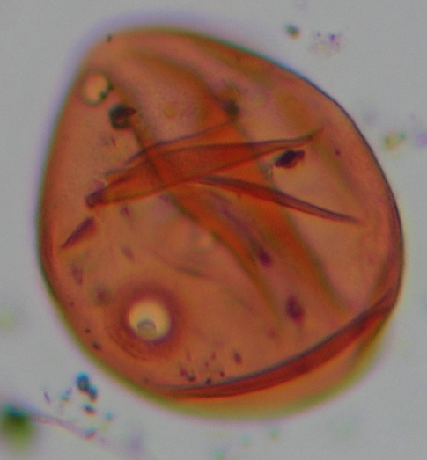
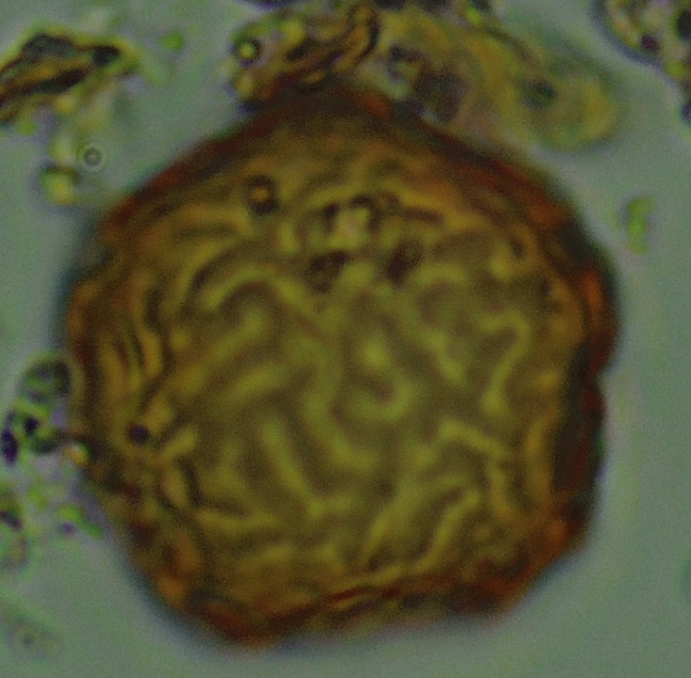
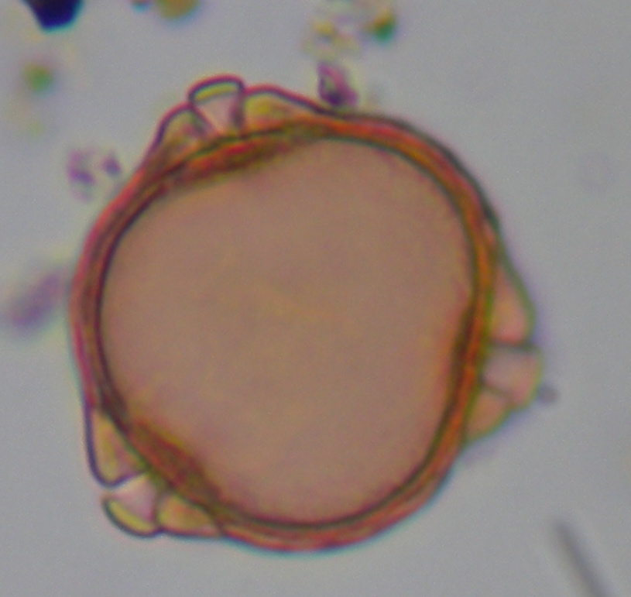
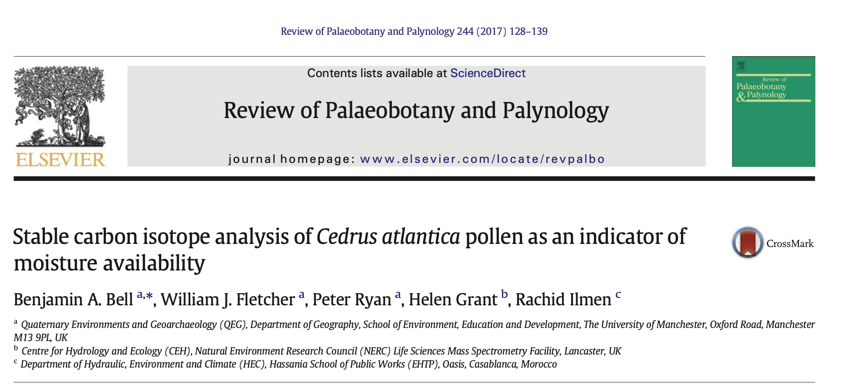
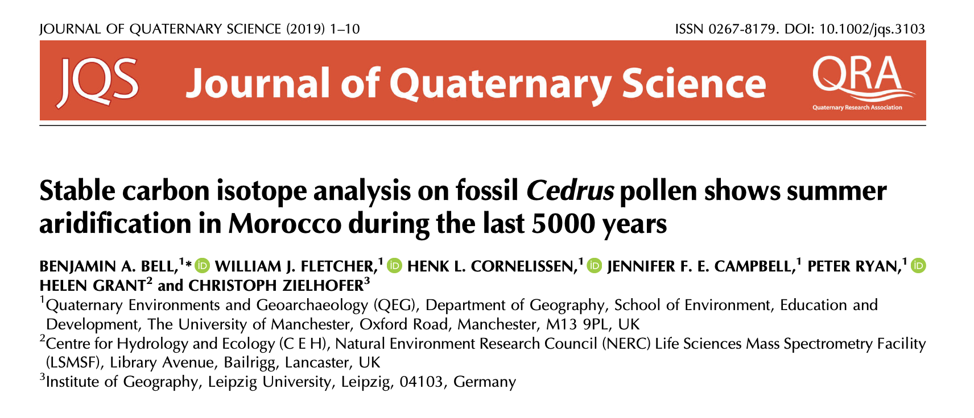
Further analysis are in progress on other plant compounds, including pollen extracts, and soil samples using new methodologies like LA system to better understand the response of Mediterranean species to climate change and human impact

Slide 11
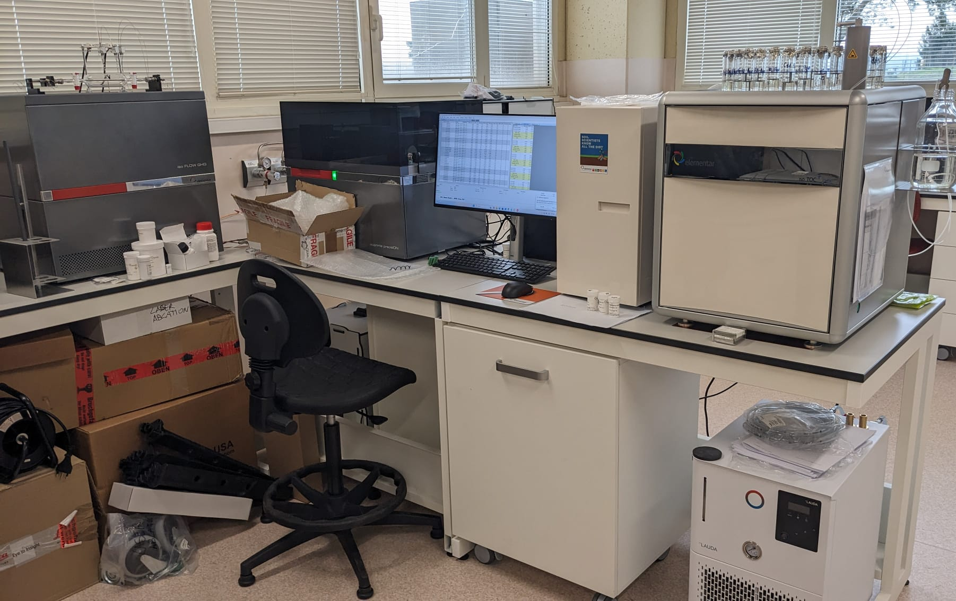
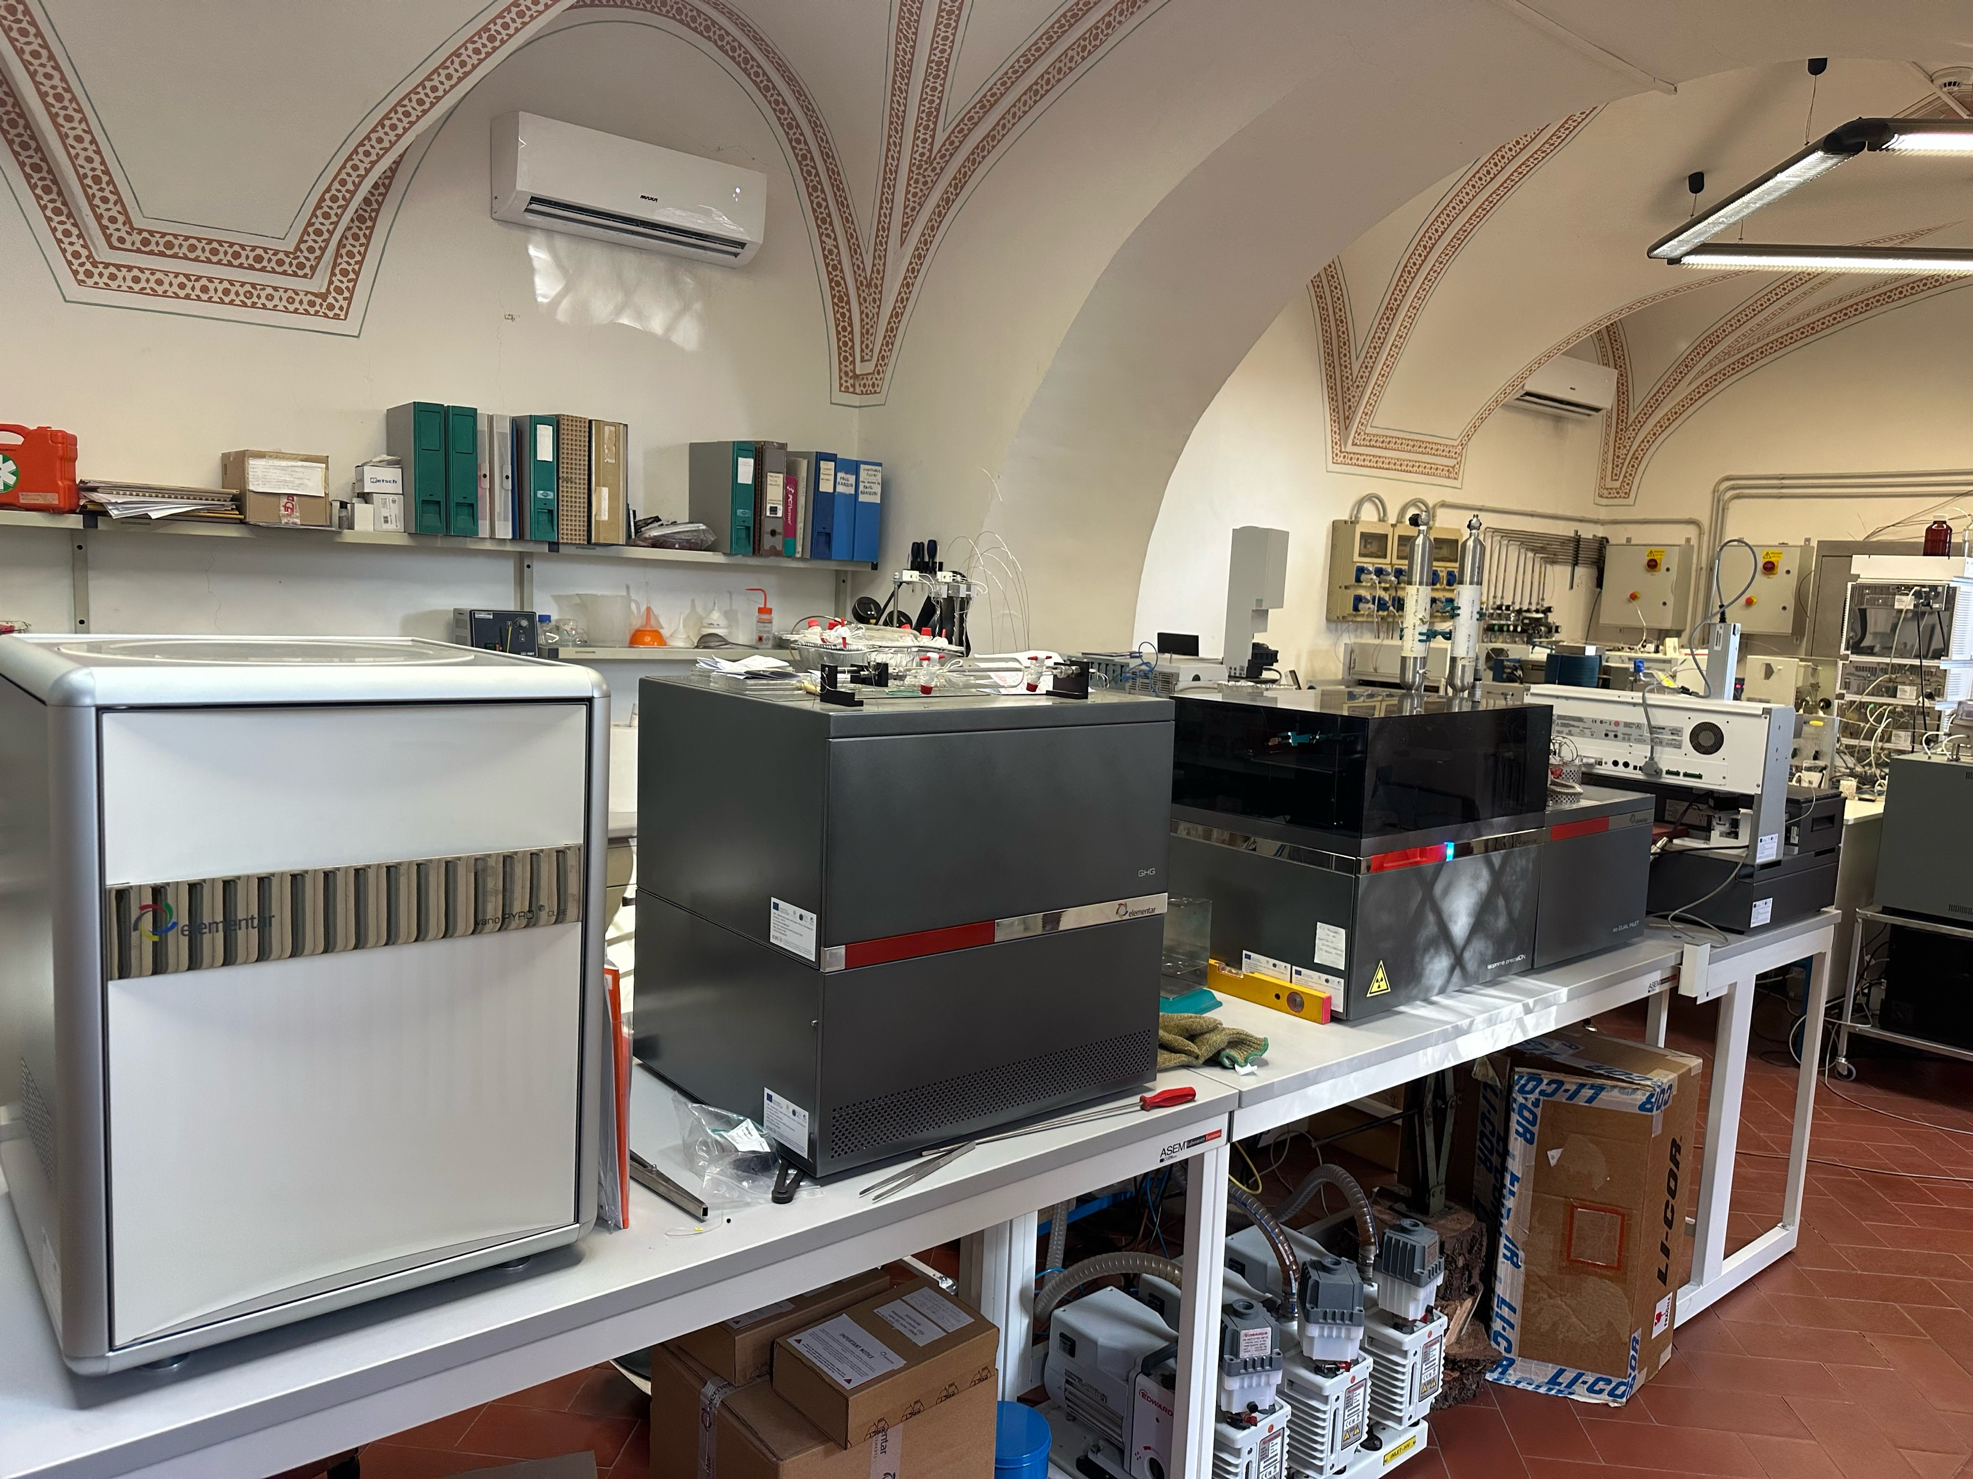
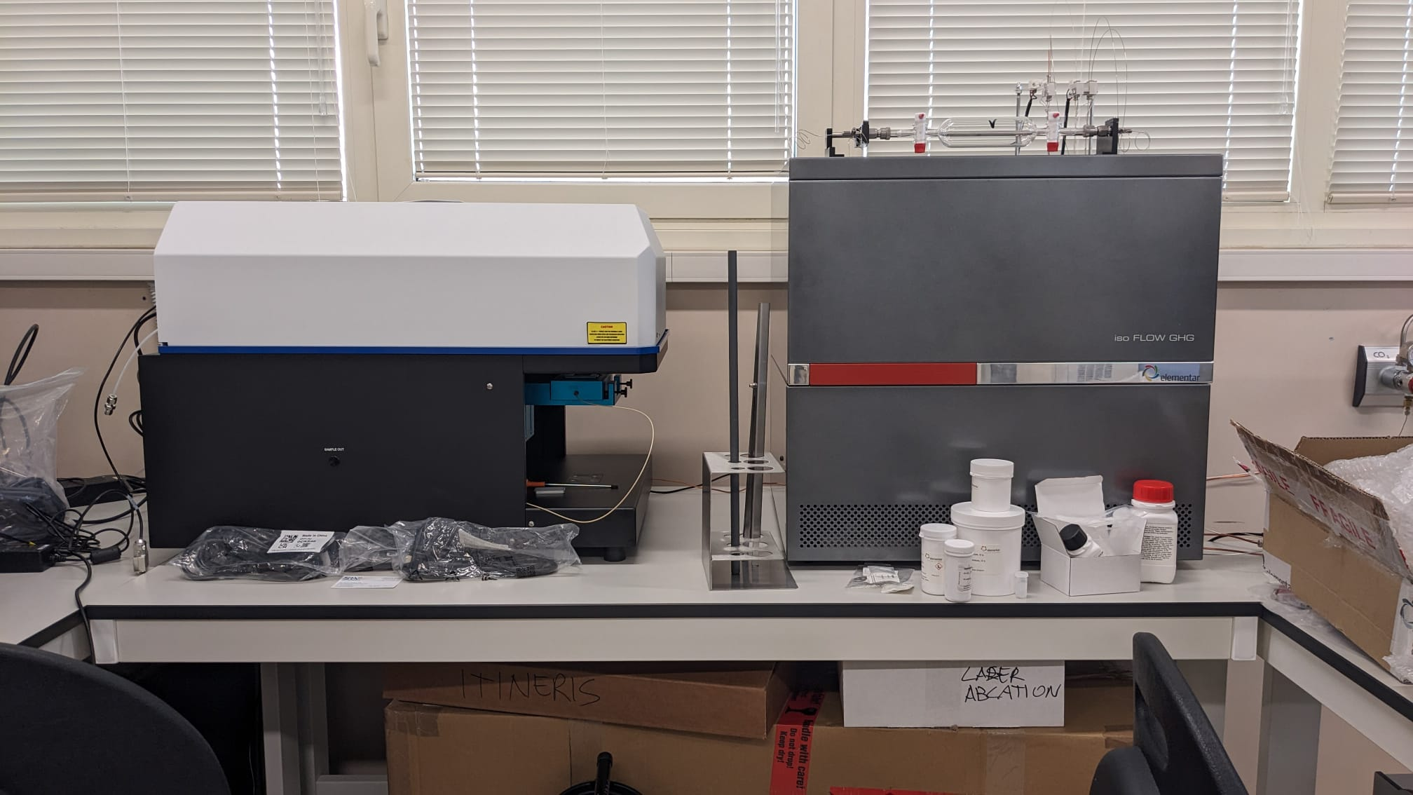
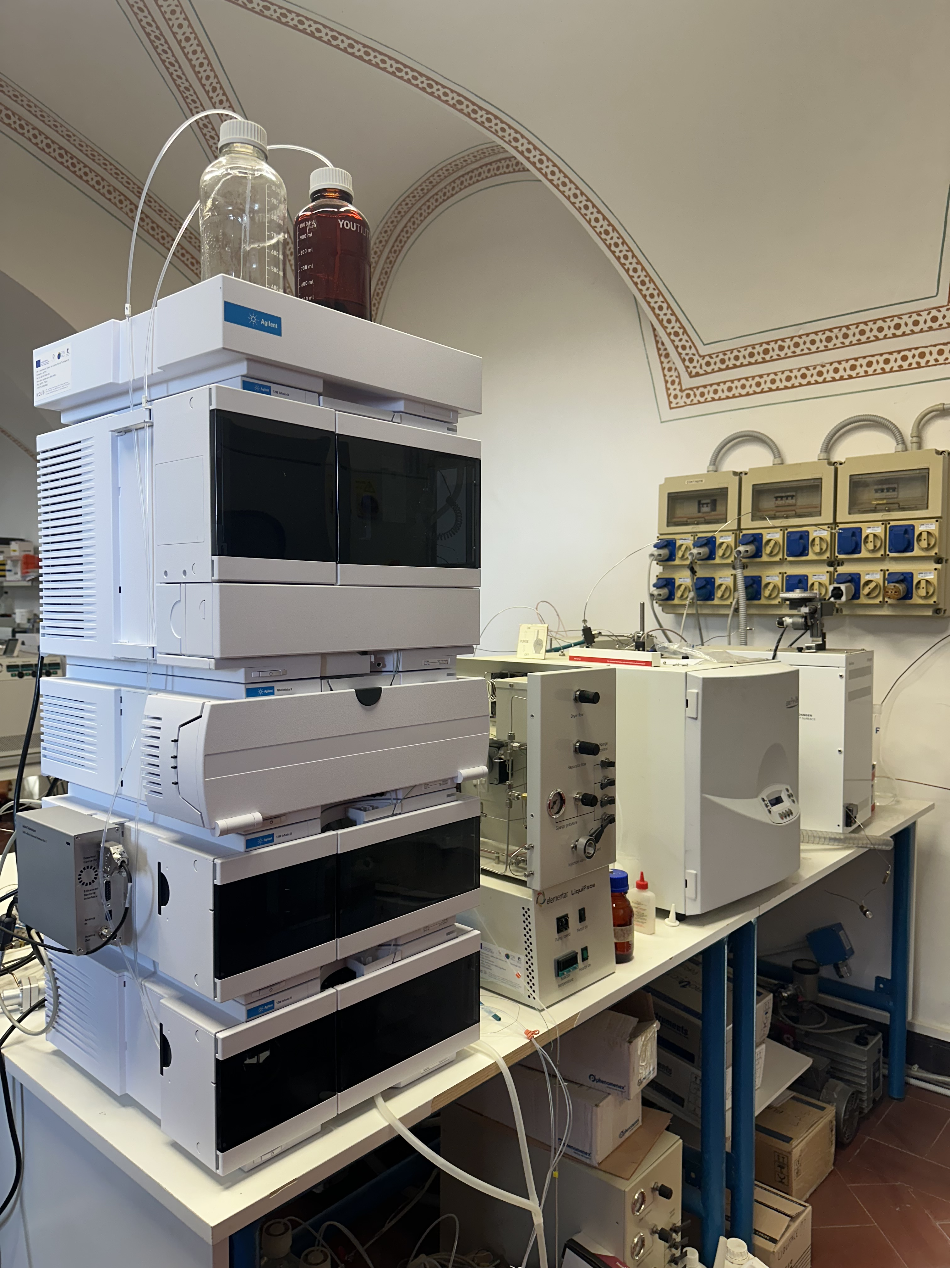
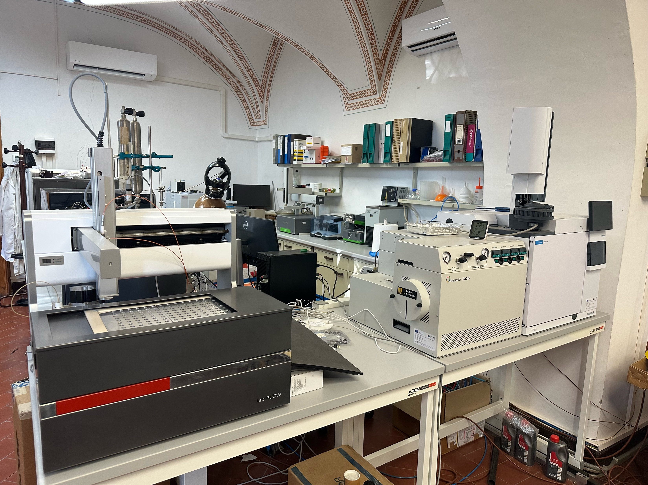
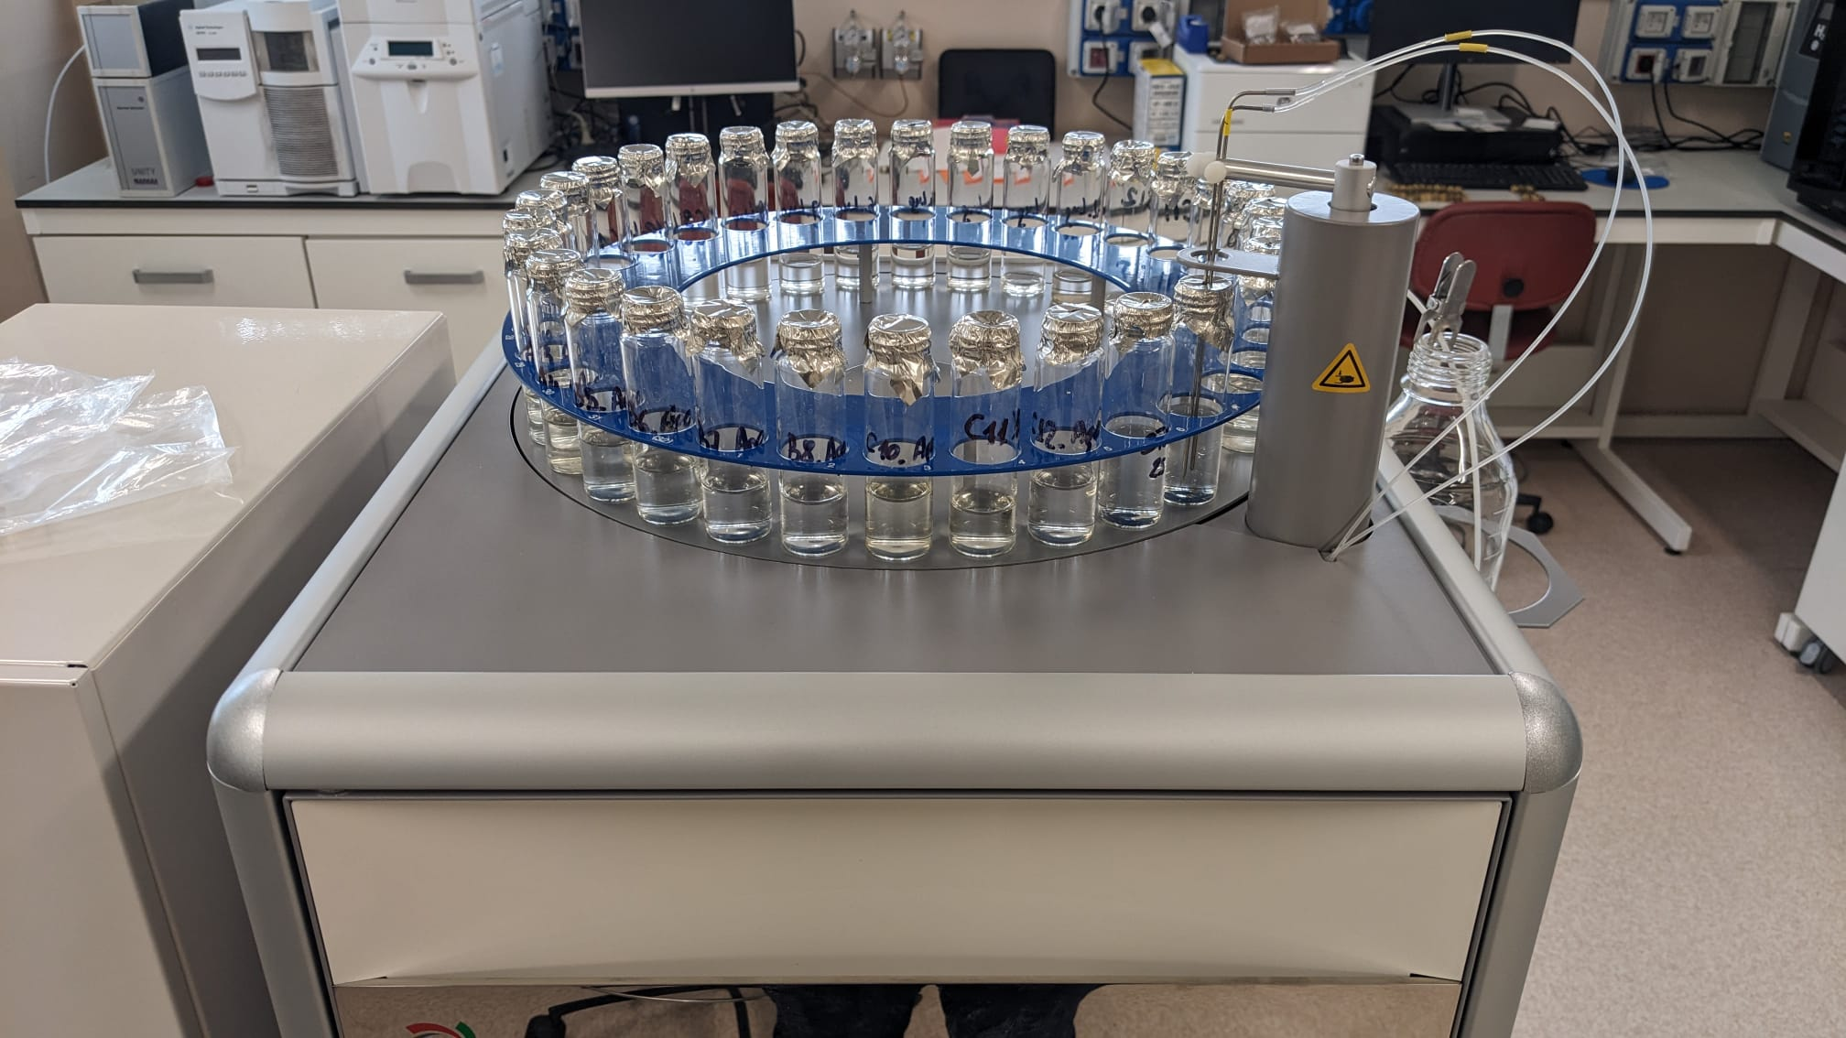
IRMS Labs
Montelibretti
Porano
IRMS
PyroCube
GHG
IsoFlow Liquiface
GC
HPLC
IRMS
GHG
Laser Ablation System
IsoToc

Slide 12

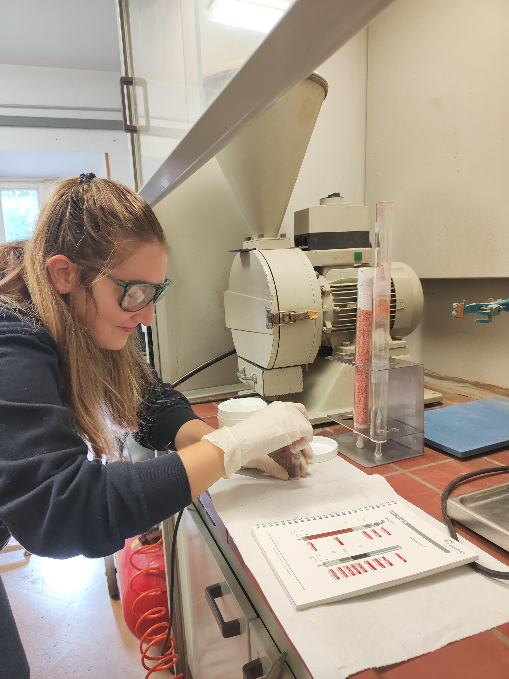
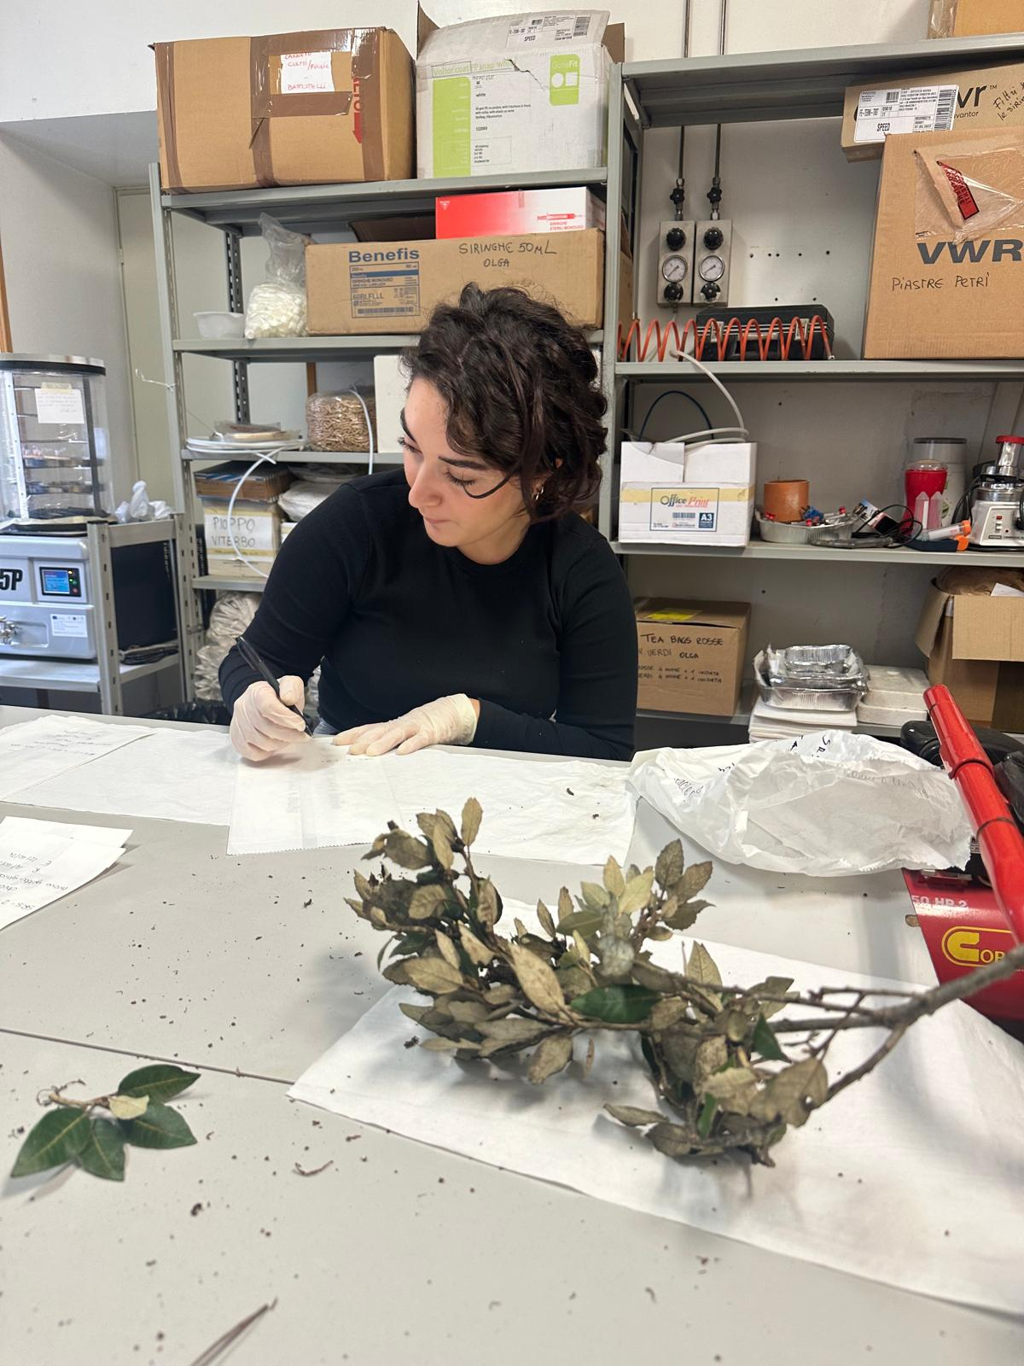
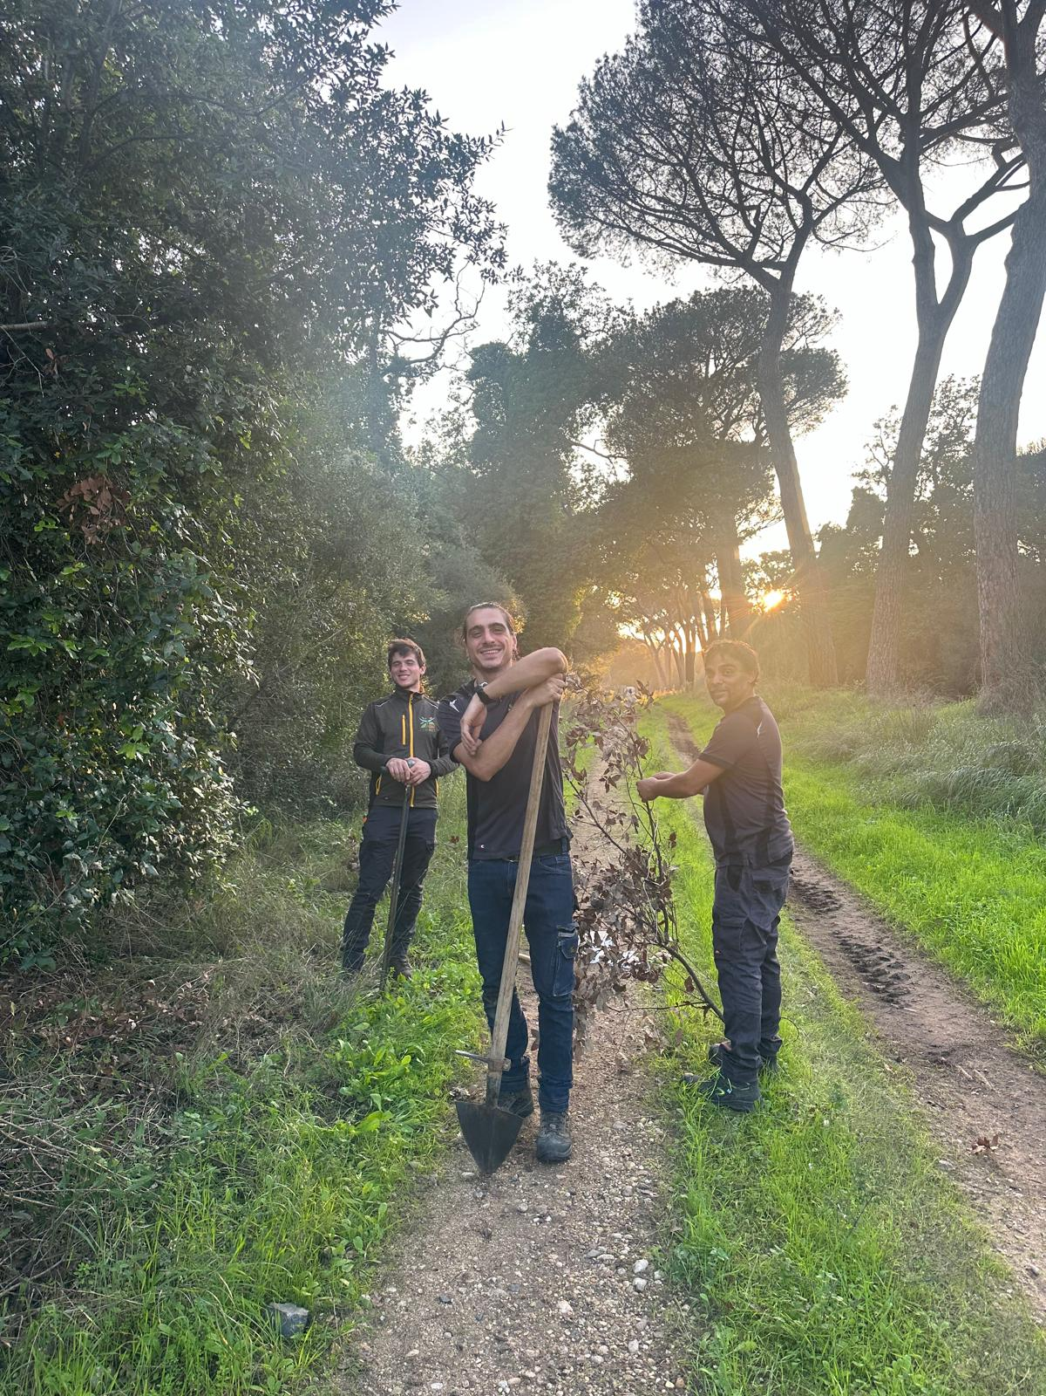
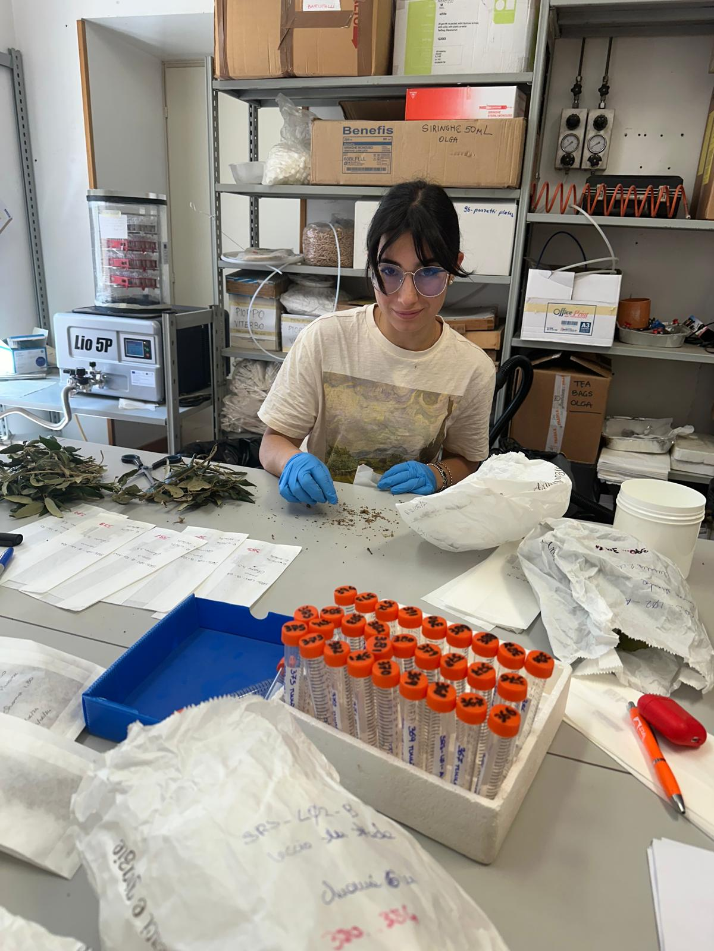
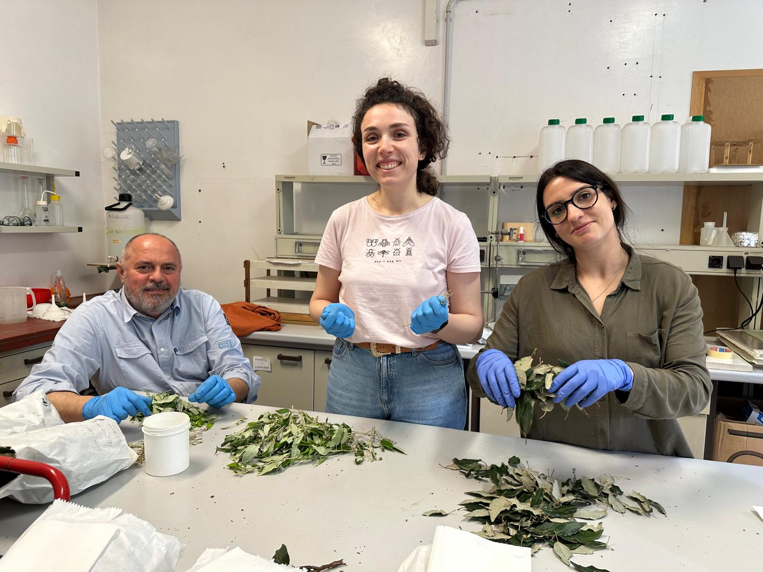
Thank you!

