Slide 1
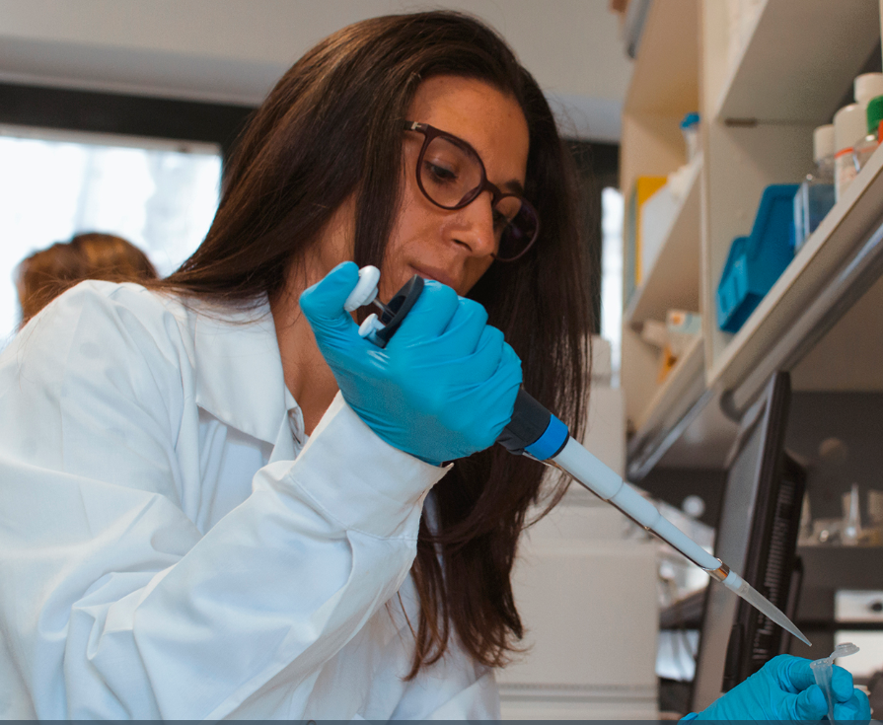
Extracellular Vesicles as Multi-Bioactive Complex and mediators of Inter-kingdom communication:
Their Versatile Ecosystem Effects
Anna Valentino
Research Institute on Terrestrial Ecosystems (IRET), CNR, Via Pietro Castellino 111, 80131 Naples, Italy

Slide 2
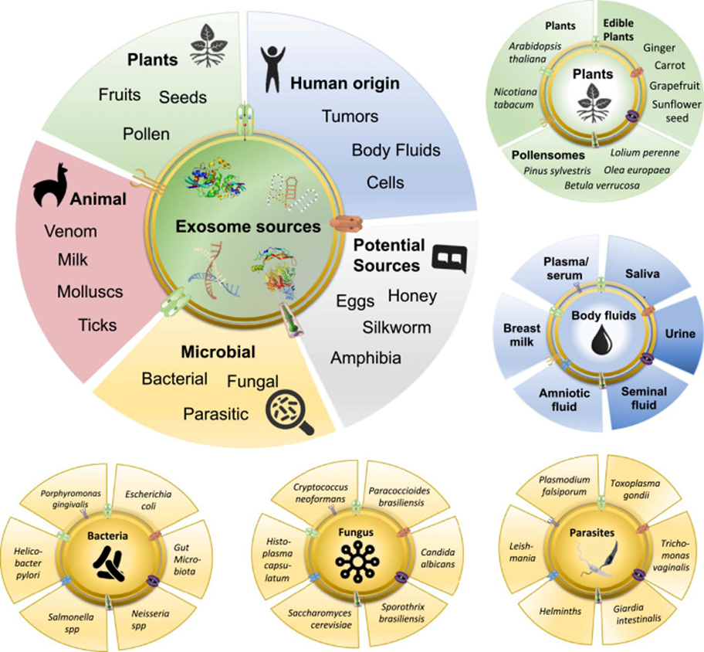
What are Extracellular Vesicles?
Christina M.A.P. Schuh, Jimena Cuenca, Francisca Alcayaga-Miranda, Maroun Khoury, Exosomes on the border of species and kingdom intercommunication, Translational Research,Volume 210, 2019, Pages 80-98, ISSN 1931-5244, https://doi.org/10.1016/j.trsl.2019.03.008.

Slide 3
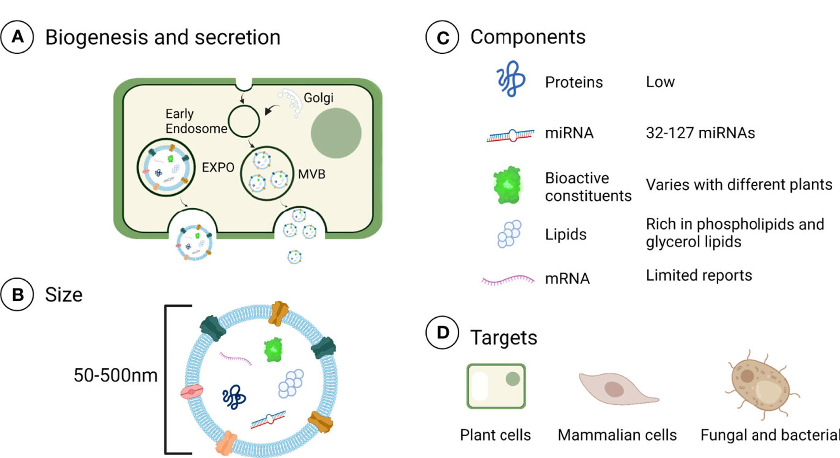
Extracellular Vesicles biogenesis
Zhang Z, Yu Y, Zhu G, et al. The Emerging Role of Plant-Derived Exosomes-Like Nanoparticles in Immune Regulation and Periodontitis Treatment. Frontiers in Immunology. 2022 ;13:896745. DOI: 10.3389/fimmu.2022.896745. PMID: 35757759; PMCID: PMC9231591

Slide 4
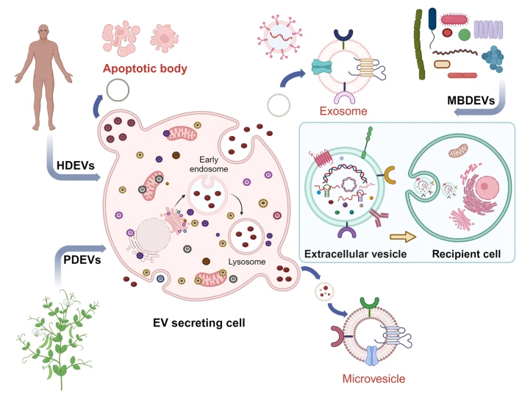
The Biology and Function of Extracellular Vesicles
EVs are emerging as essential mediators of intercellular communication involved in several physiological and pathological conditions. EVs function as a pivotal dialogue mechanism, coordinating cellular responses to environmental stimuli, maintaining homeostasis, and supporting tissue repair and regeneration. EVs also play a significant role in interspecies communication, influencing interactions between microbiota, plants, and animals, and helping ecosystems adapt to changing conditions.
Extracellular vesicles as tools and targets in therapy for diseases. Mudasir A. Kumar, Sadaf K. Baba, Hana Q. Sadida, Sara A. Marzooqi, Jayakumar Jerobin, Faisal H. Altemani, Naseh Algehainy, Mohammad A. Alanazi, Abdul-Badi Abou-Samra, Rakesh Kumar, Ammira S. Al-Shabeeb Akil, Muzafar A. et al.,.

Slide 5
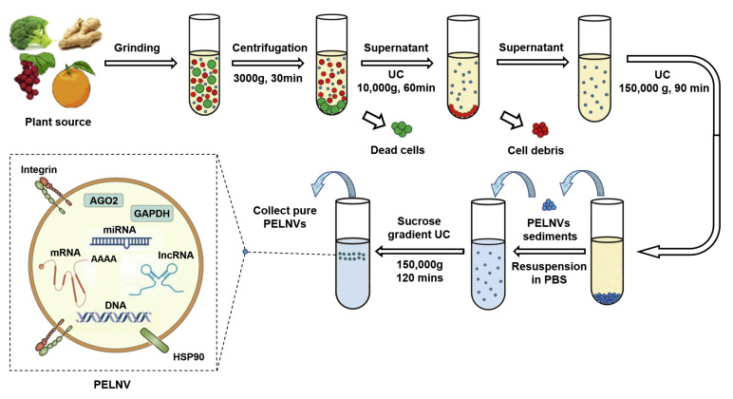
Extracellular Vesicles isolation
Dad, Haseeb Anwar et al. Plant Exosome-like Nanovesicles: Emerging Therapeutics and Drug Delivery Nanoplatforms Molecular Therapy, Volume 29, Issue 1, 13 – 31

Slide 6
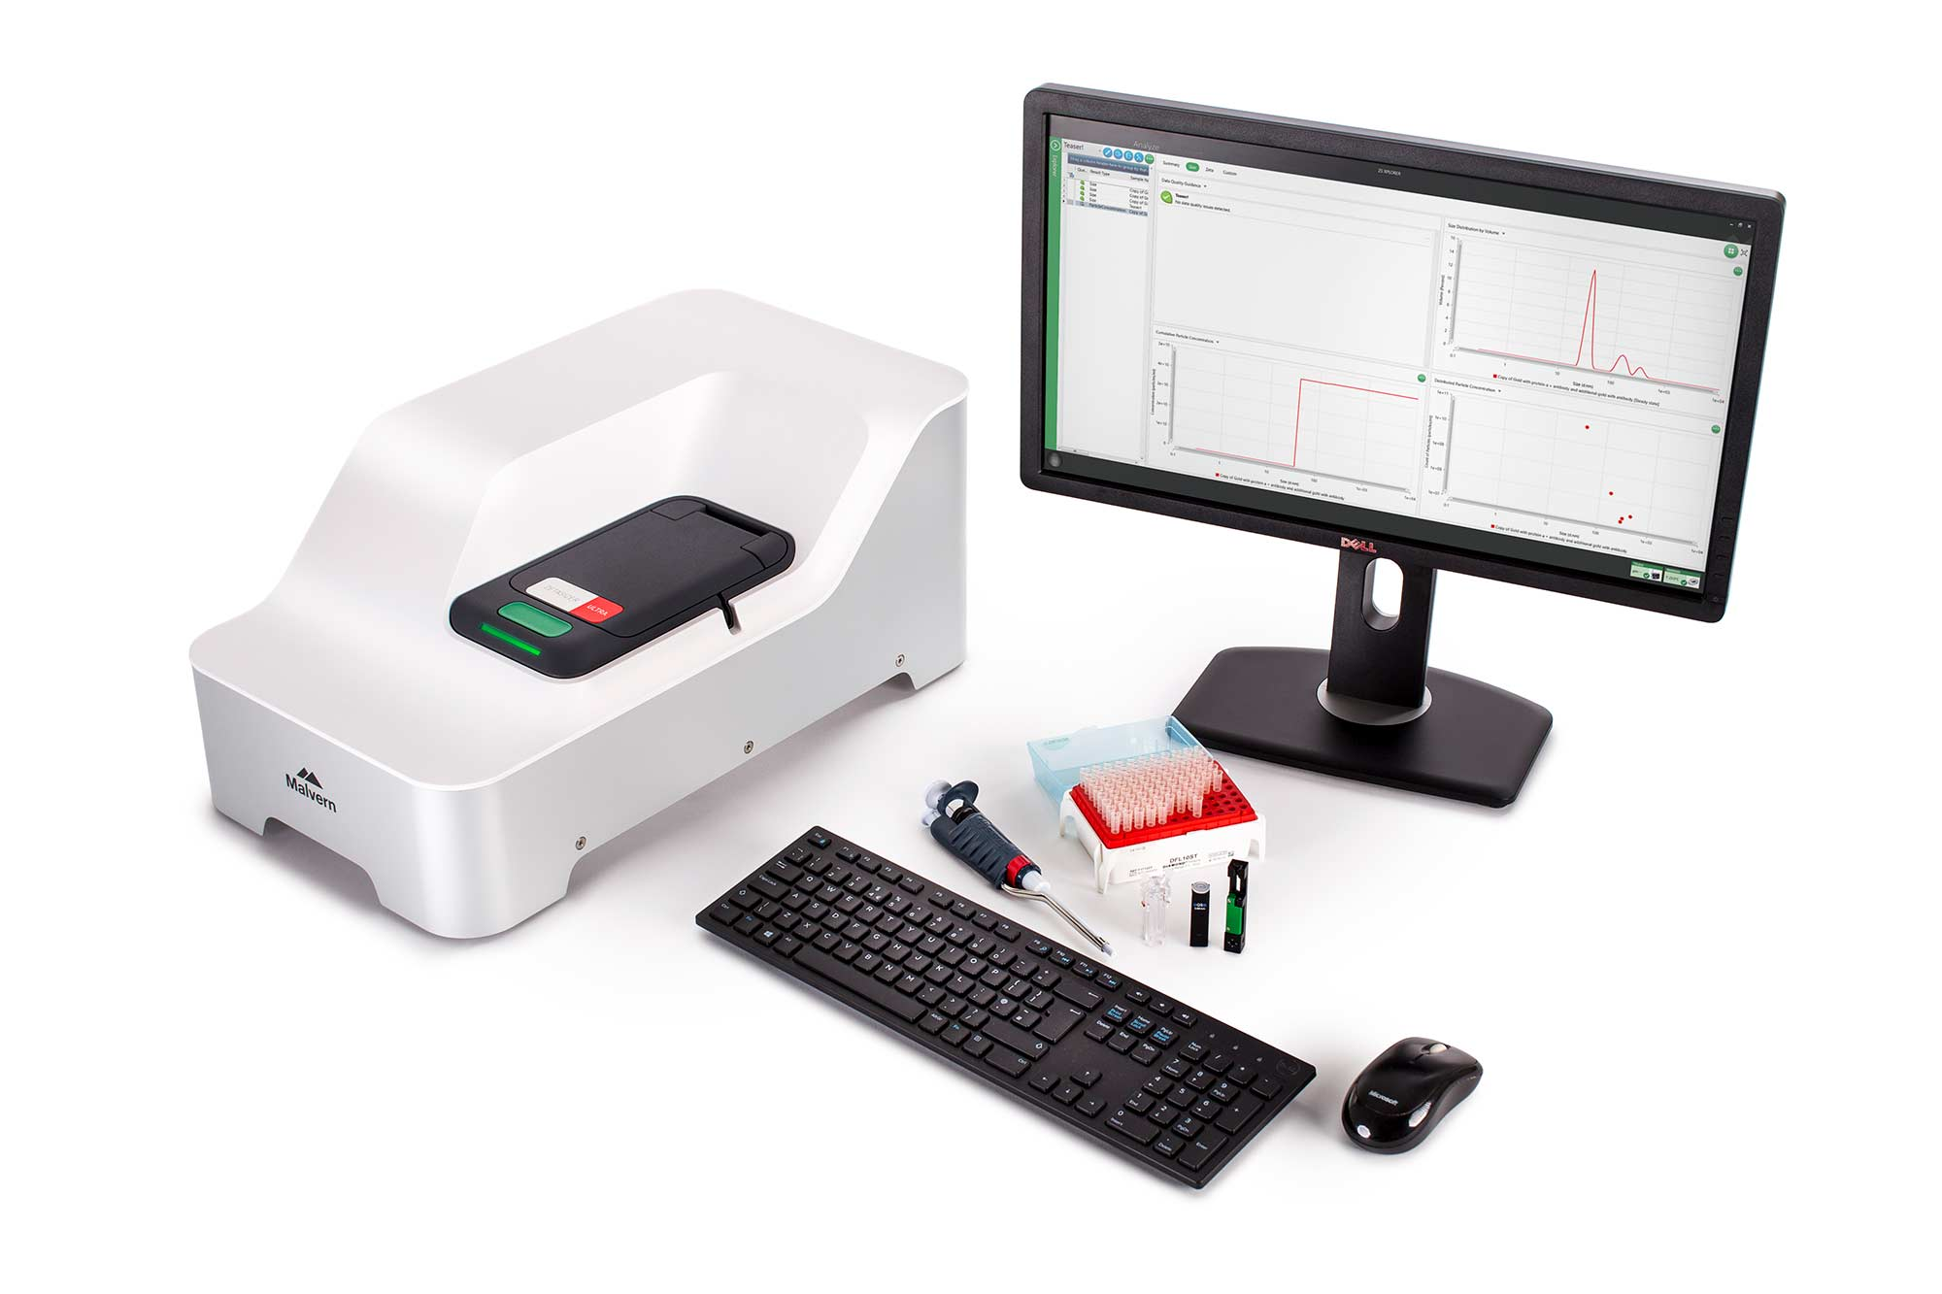
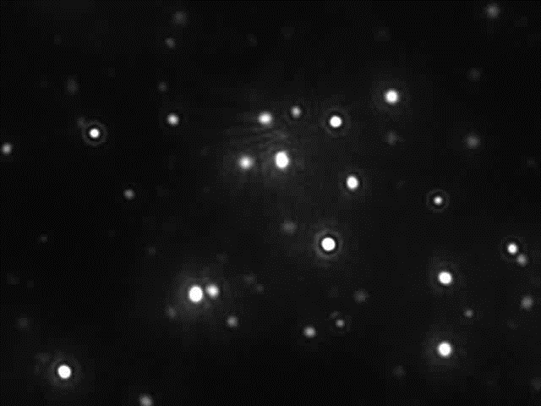
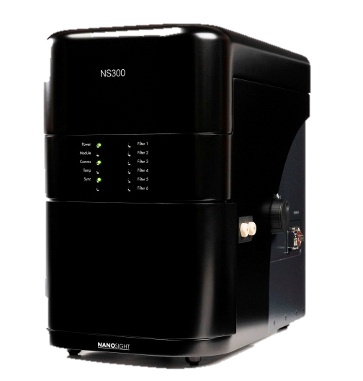
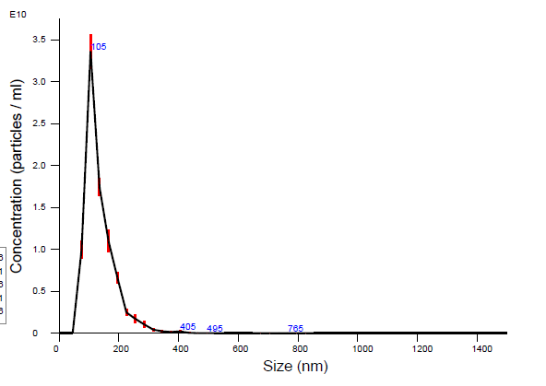
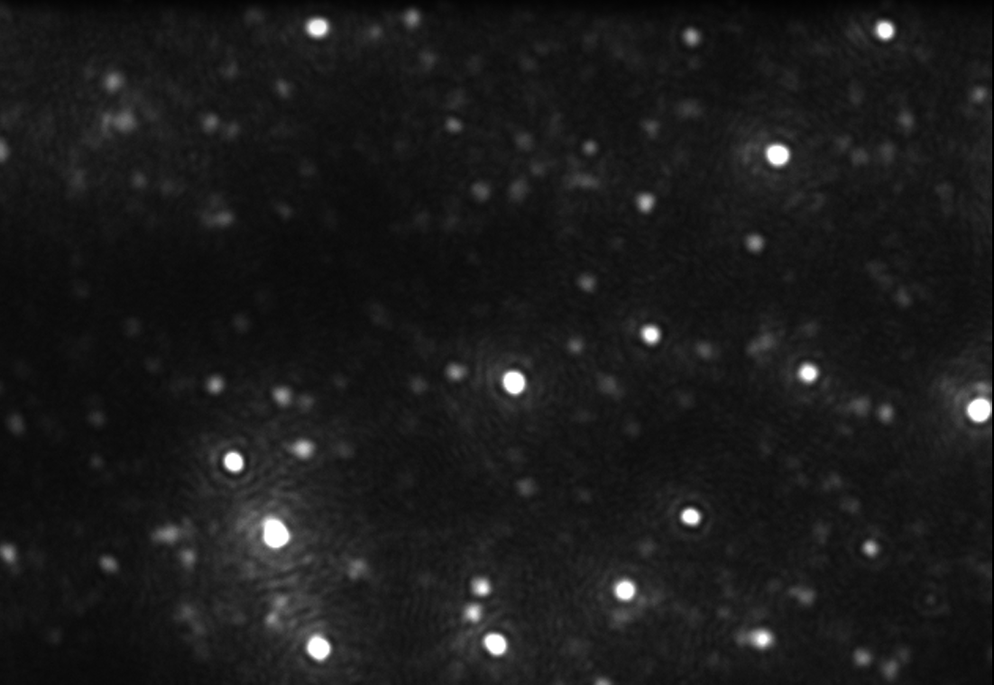
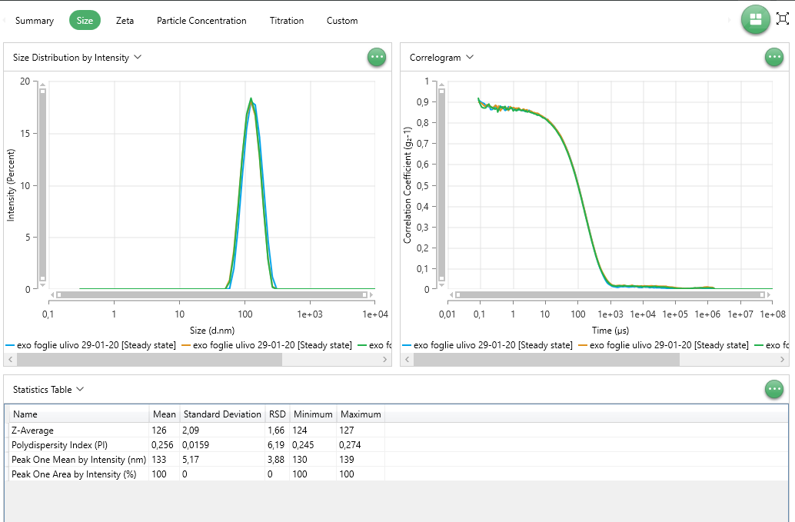
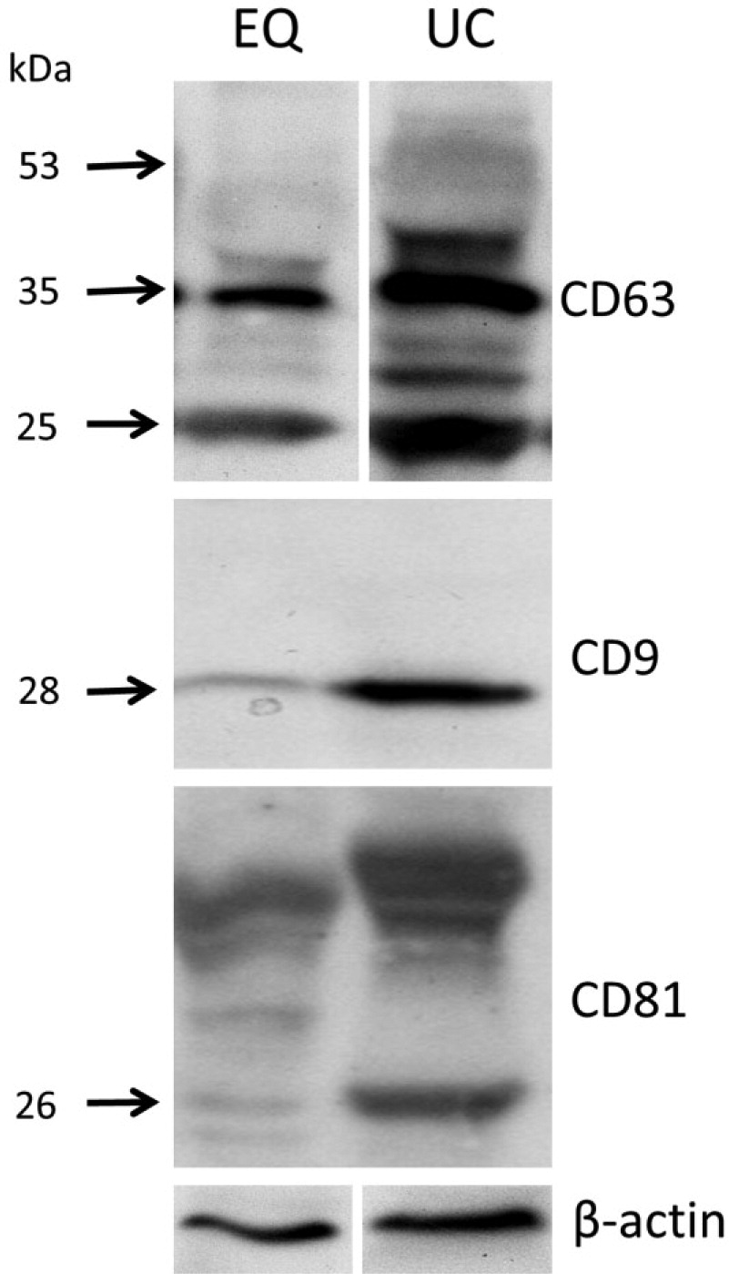
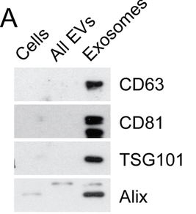
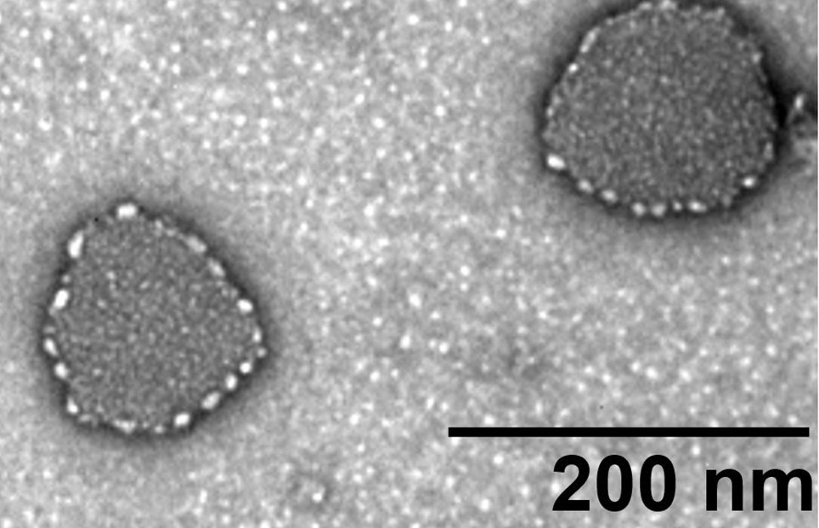
Chemical/physical characterization
Dynamic Light
Scattering
Nanoparticle Tracking Analysis
Trasmission Elettron Microscope

Slide 7
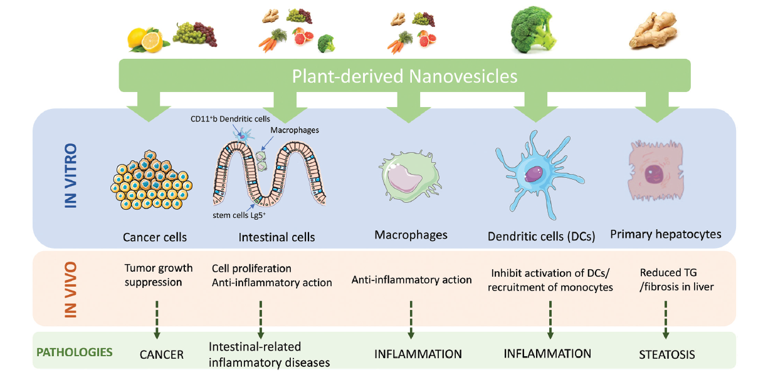
PDEVs demonstrated strong biological properties, such as anti-inflammatory, anticancer, antibacterial, antifungal, and antioxidative effects. They produce these effects through various mechanisms, such as gene regulation, influence on gut microbiota, macrophage activity, gene silencing, and the presence of specific active molecules. These innate therapeutic properties are a promising avenue, whether used alone or in combination with other therapeutic agents.
Rome S . Biological properties of plant-derived extracellular vesicles. Food Funct. 2019 Feb 20;10(2):529-538. doi: 10.1039/c8fo02295j.

Slide 8
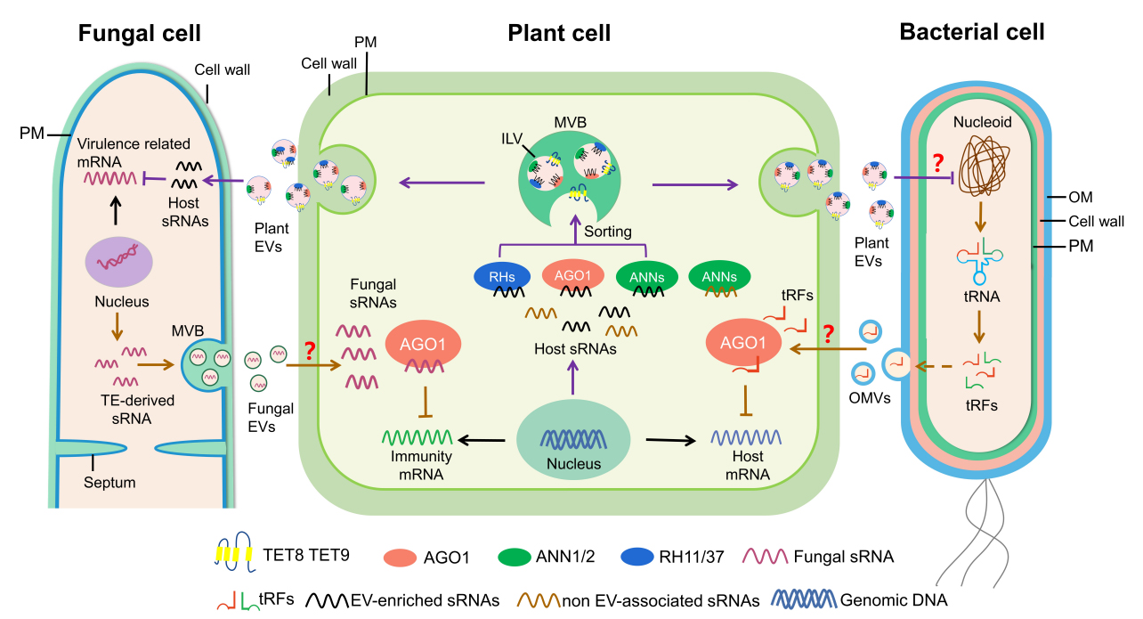
EVs as Biological Shuttles for Target cells
Qiang Cai, ... Hailing Jin. Extracellular vesicles: cross-organismal RNA trafficking in plants, microbes, and mammalian cells

Slide 9
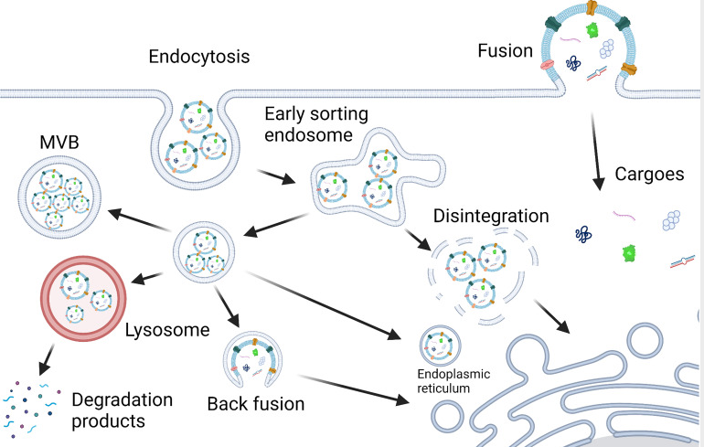
EVs as Biological Shuttles for Target cells
Messengers for
Target cells
Zhang Z, Yu Y, Zhu G, et al. The Emerging Role of Plant-Derived Exosomes-Like Nanoparticles in Immune Regulation and Periodontitis Treatment. Frontiers in Immunology. 2022 ;13:896745. DOI: 10.3389/fimmu.2022.896745. PMID: 35757759; PMCID: PMC9231591

Slide 10
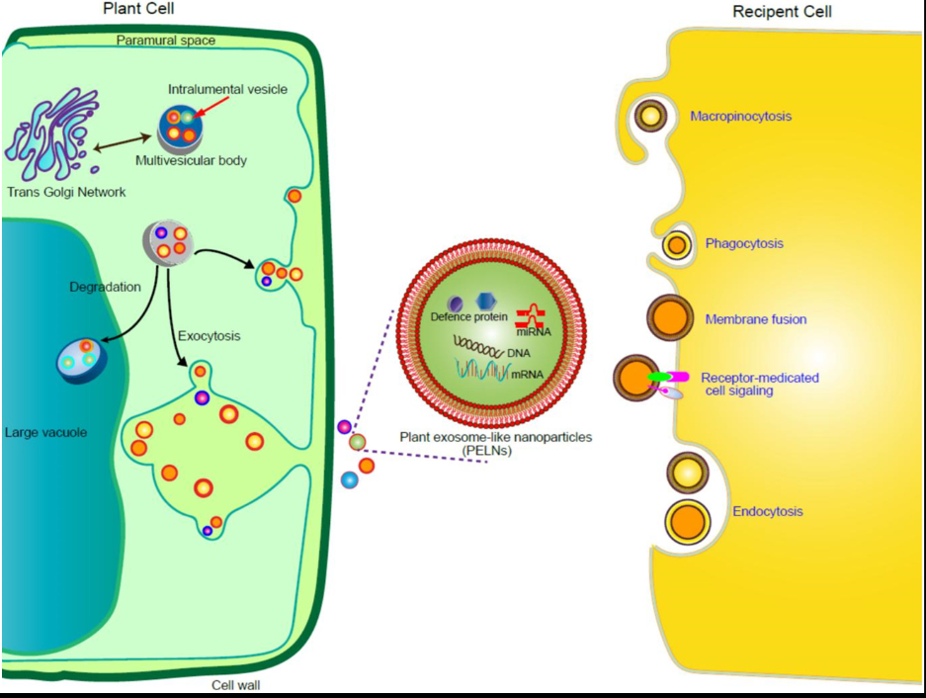
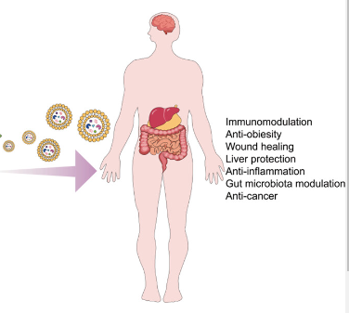
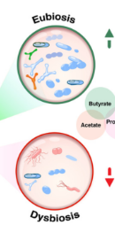
Extracellular Vesicles interaction mechanism
Shafiu A. Umar Shinge, Yin Xiao, Li Duan. New insights of engineering plant exosome-like nanovesicles as a nanoplatform for therapeutics and drug delivery
Notes:
Immunomodulation, anti-inflammatory, gut microbiota modulation,

Slide 11
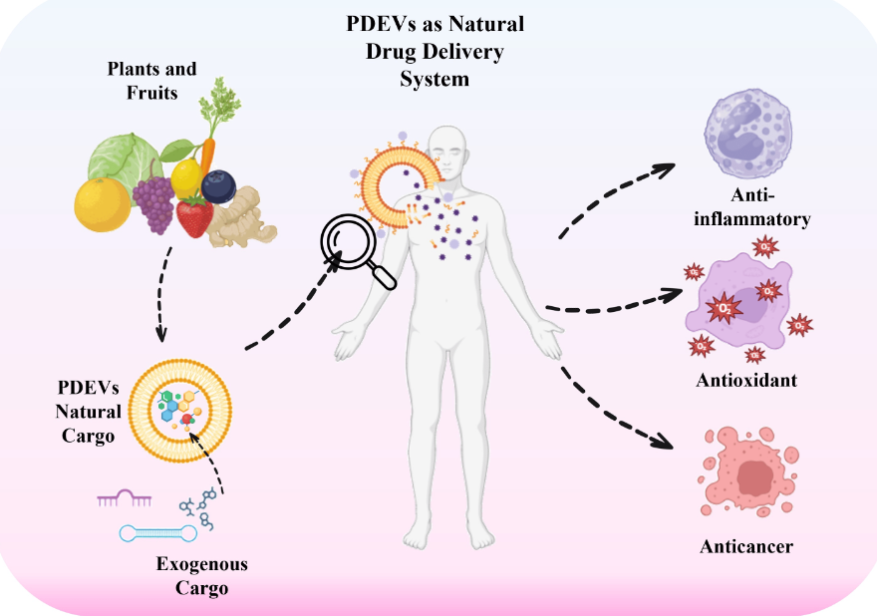
Calzoni, E.; Bertoldi, A.; Cusumano, G.; Buratta, S.; Urbanelli, L.; Emiliani, C. Plant-Derived Extracellular Vesicles: Natural Nanocarriers for Biotechnological Drugs. Processes 2024, 12, 2938.

Slide 12
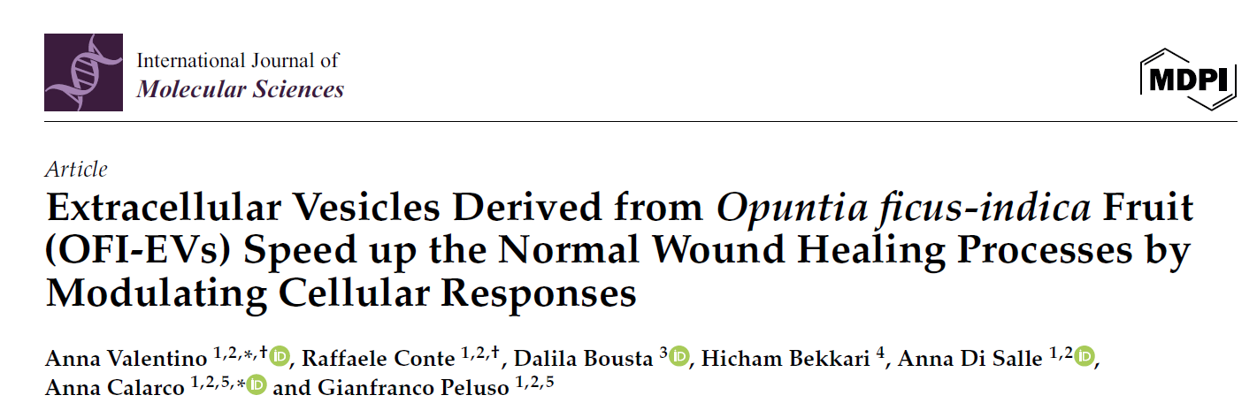
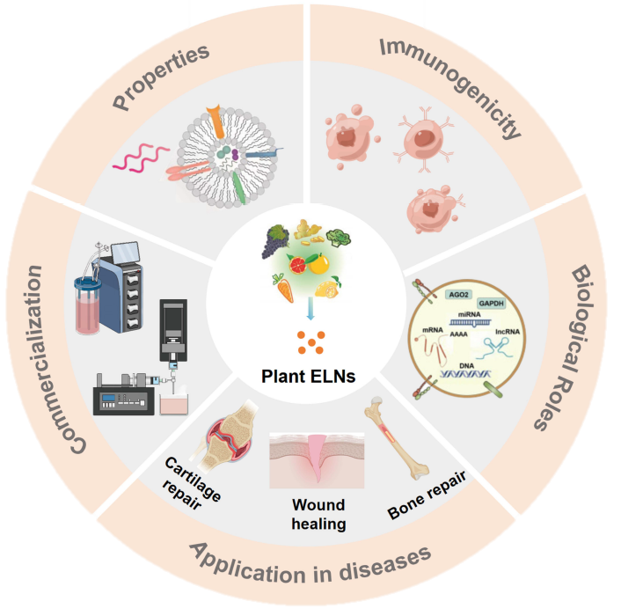
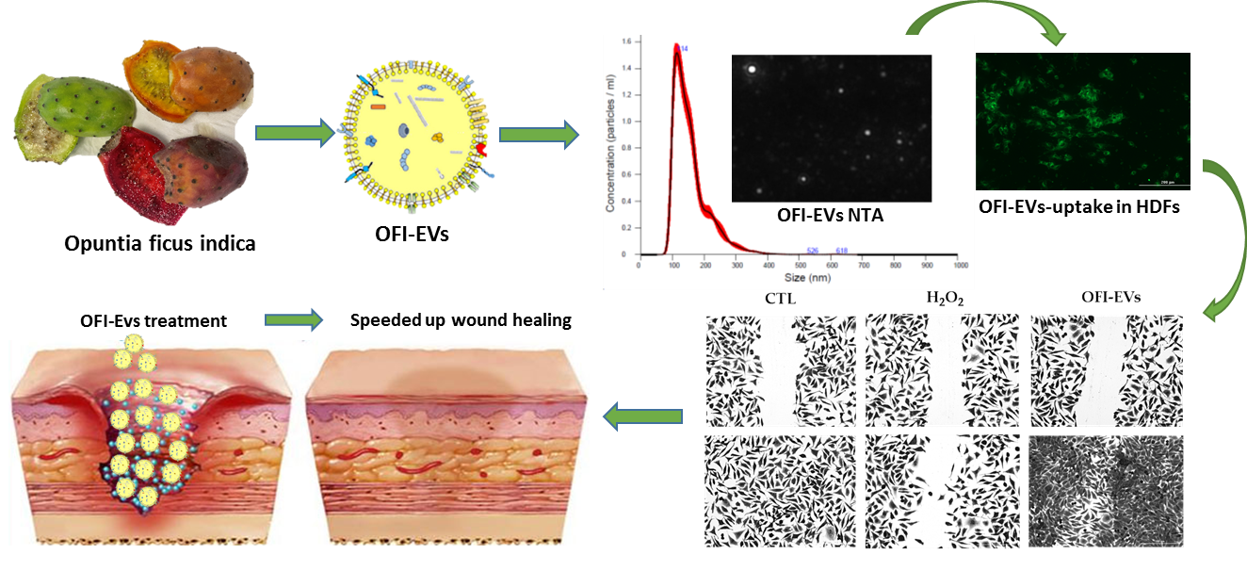
Valentino A, Conte R, Bousta D, Bekkari H, Di Salle A, Calarco A, Peluso G. Extracellular Vesicles Derived from Opuntia ficus-indica Fruit (OFI-EVs) Speed Up the Normal Wound Healing Processes by Modulating Cellular Responses. Int J Mol Sci. 2024 Jun 28;25(13):7103. doi: 10.3390/ijms25137103.

Slide 13
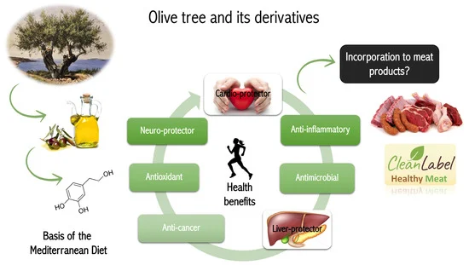
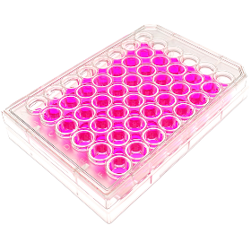

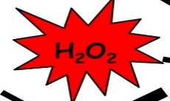
Biological assay
Cellular model: RAW 264.7
Plant-derived EVs
Results

Slide 14
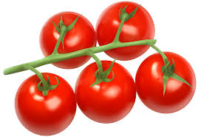
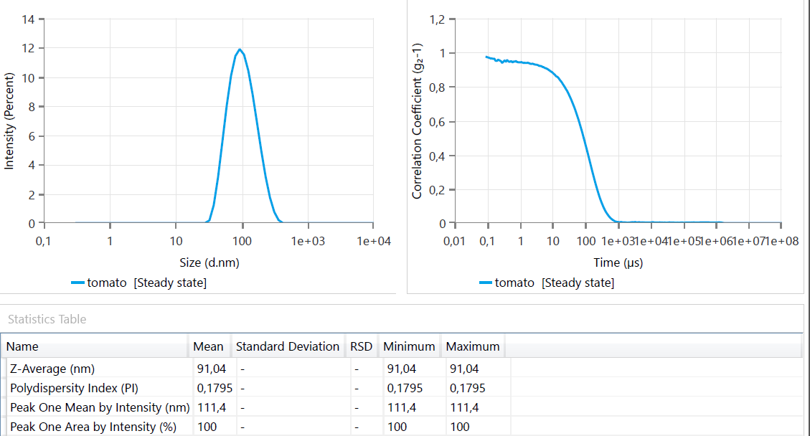
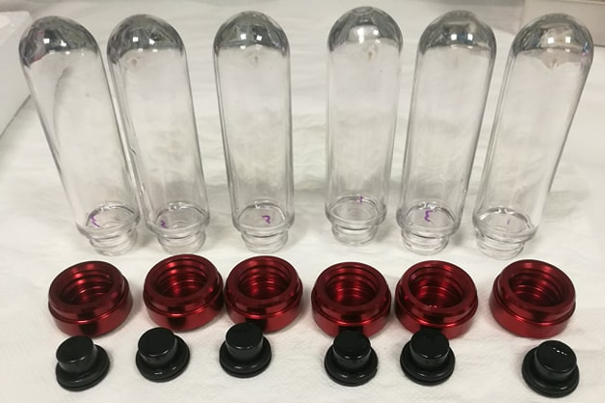
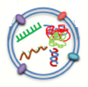
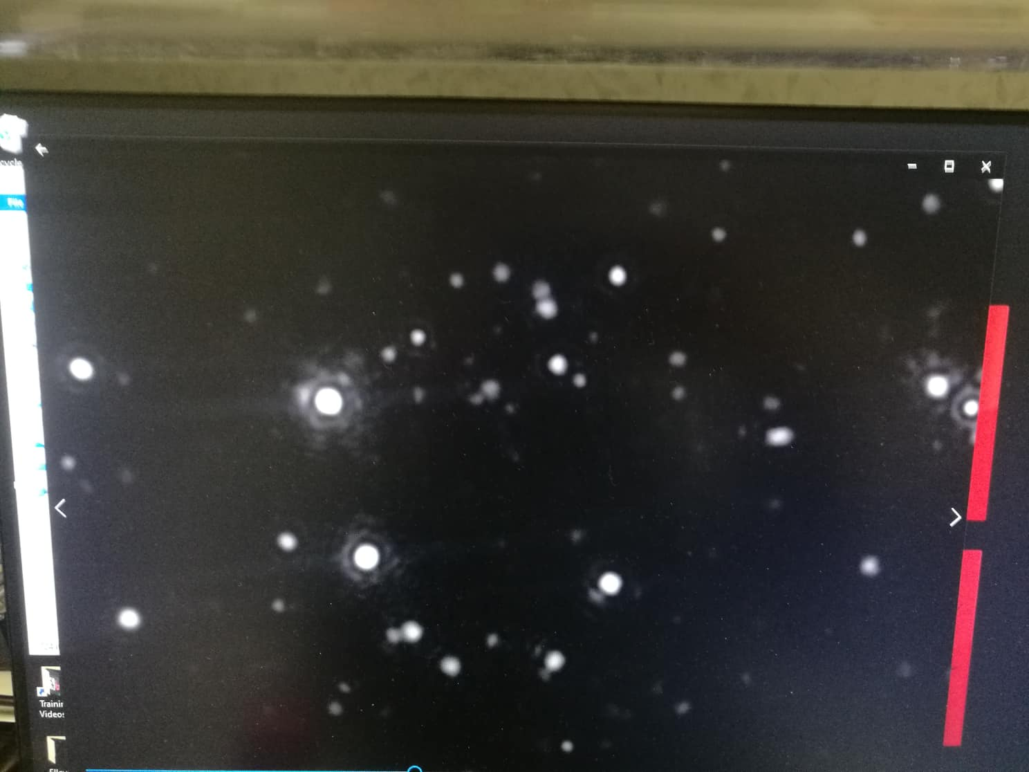
Tomato EVs
DLS
EVs derived from peel and pulp tomato
Differential centrifugation
Tomato-derived EVs

Slide 15
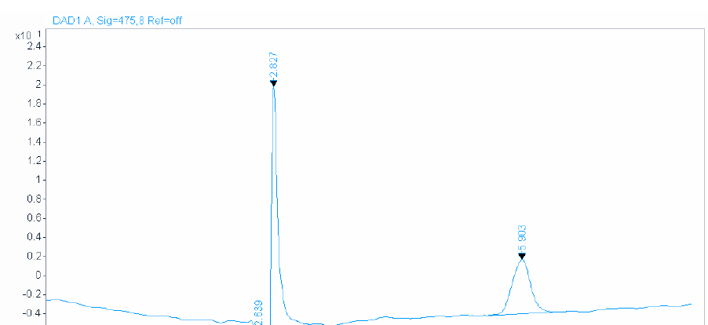
licopene
It is widely known that lycopene effectively suppresses the progression, proliferation, arrests the cell cycle and induces apoptosis of prostate cancer cells both in vivo and in vitro.
PNT2
PC3
DU145

Slide 16
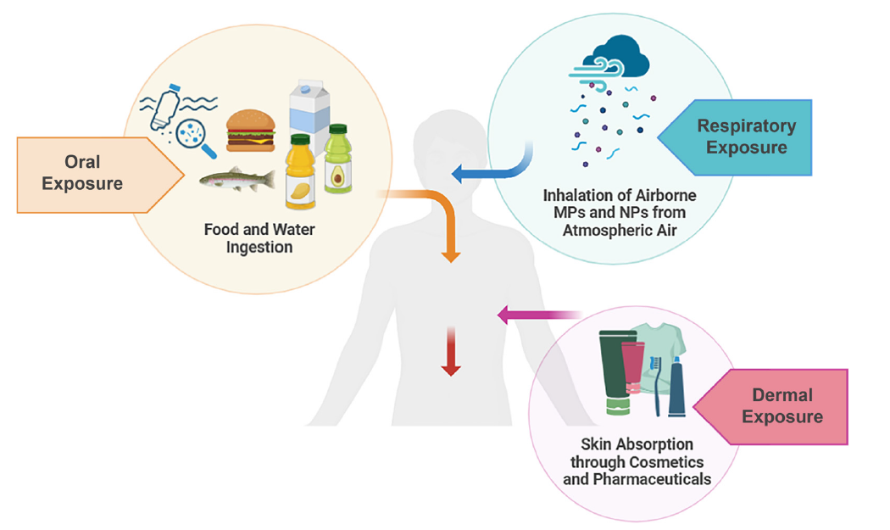
Extracellular Vesicles and Environmental Risks
Calzoni, E.; Montegiove, N.; Cesaretti, A.; Bertoldi, A.; Cusumano, G.; Gigliotti, G.; Emiliani, C. Microplastic and Extracellular Vesicle Interactions: Recent Studies on Human Health and Environment Risks. Biophysica 2024, 4, 724-746. https://doi.org/10.3390/biophysica4040047

Slide 17

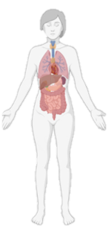
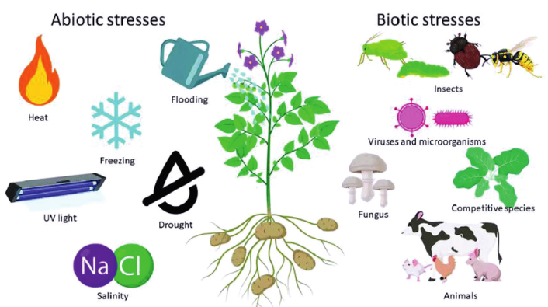

Environment and Health
Negative messengers
Environmental stress modify
the EVs molecular cargo
The role of EVs in these complex dialogues will open new avenues for therapeutic strategies aimed at restoring ecological balance and enhancing health resilience, since it is becoming increasingly evident that these nano-vesicles play important roles in the global ecosystem.
Human Health

Slide 18
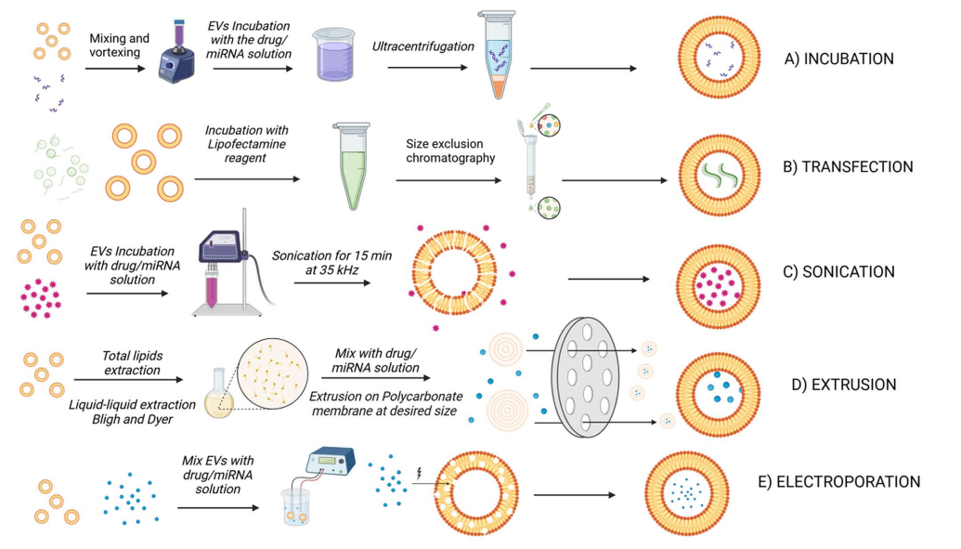
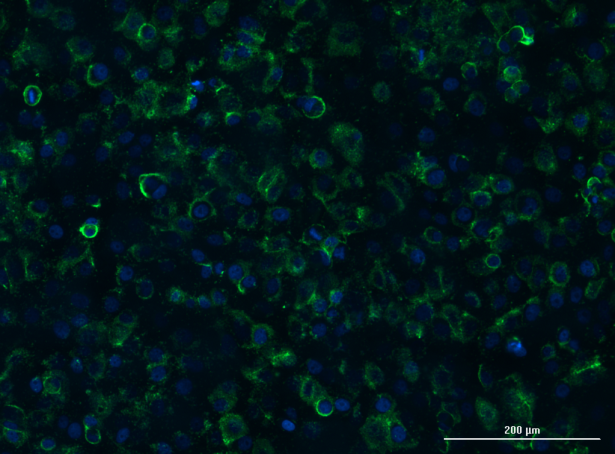
EVs as carrier of bioactive compounds
Fluorescent Probe : curcumin
Langellotto, M.D., Rassu, G., Serri, C. et al. Plant-derived extracellular vesicles: a synergetic combination of a drug delivery system and a source of natural bioactive compounds. Drug Deliv. and Transl. Res. 15, 831–845 (2025).

Slide 19
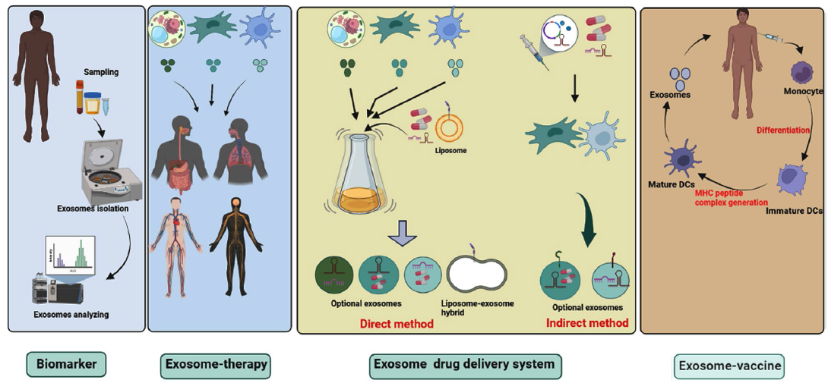
Clinical application of EVs. In clinical studies, exosomes are used as biomarkers, cell-free therapy (exosomal therapy). Exosomes of both animal and plant origin are promising vectors for drug delivery systems, proteins and bioactive molecules. In the direct method, exosomes are loaded with therapeutic agents, while through indirect methods, appropriate cells are genetically engineered or co-cultured with therapeutic agents to produce artificial exosomes.

Slide 20
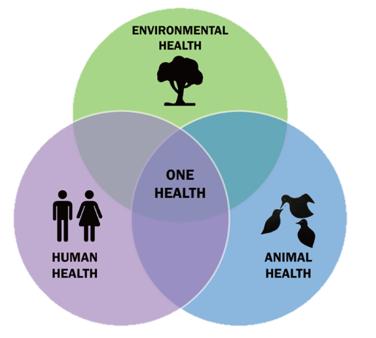

Source: Wikimedia Commons

Slide 21
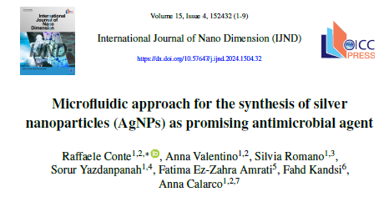
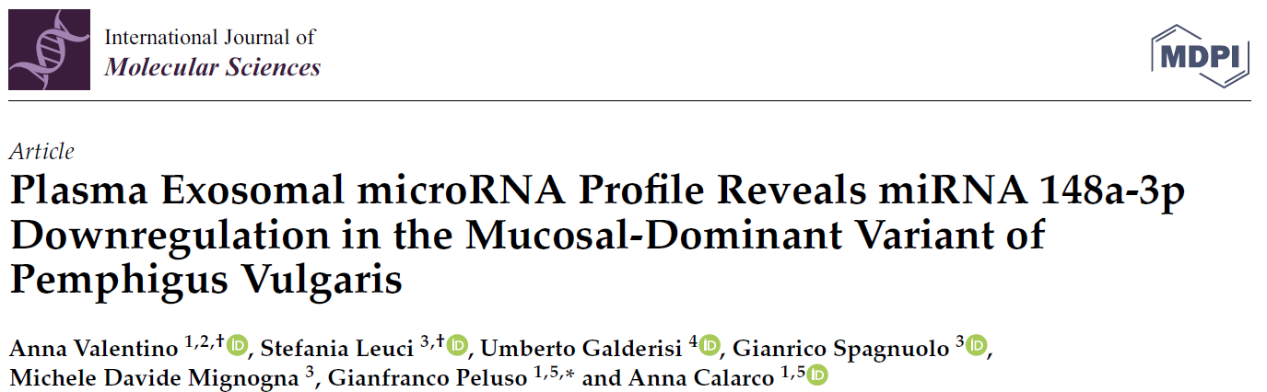
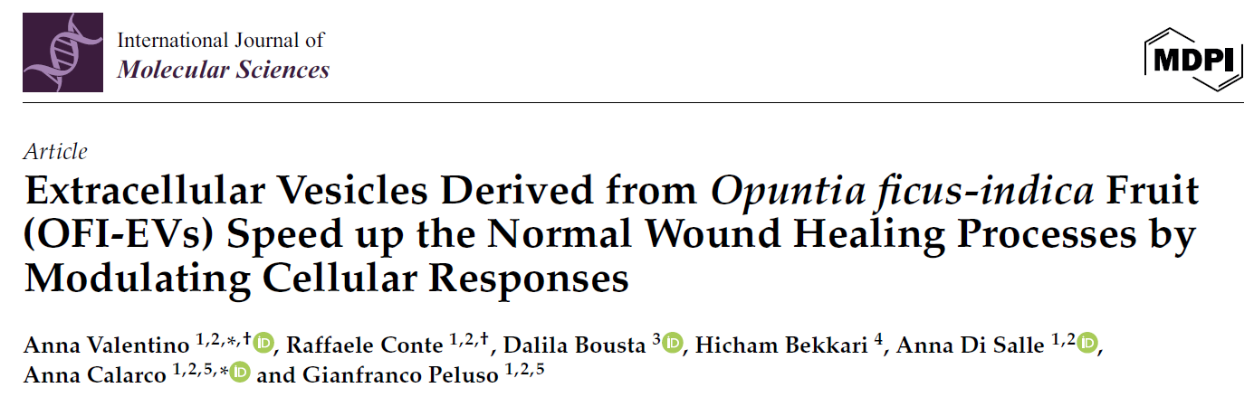
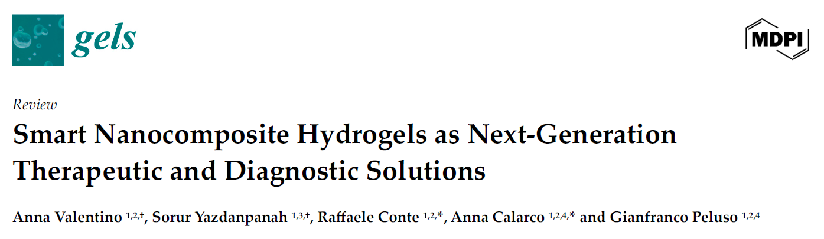
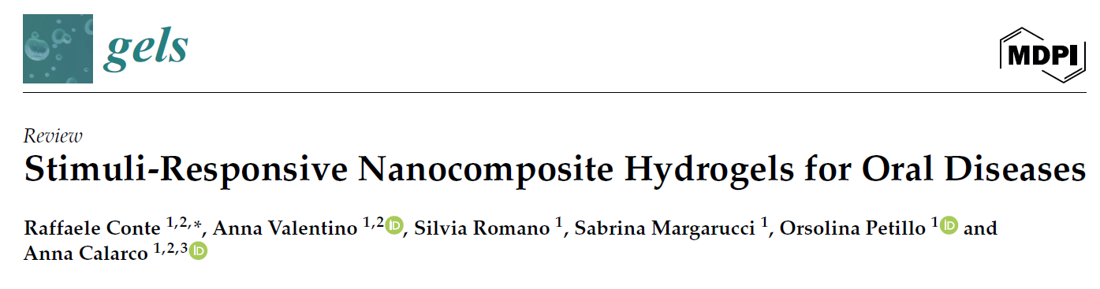
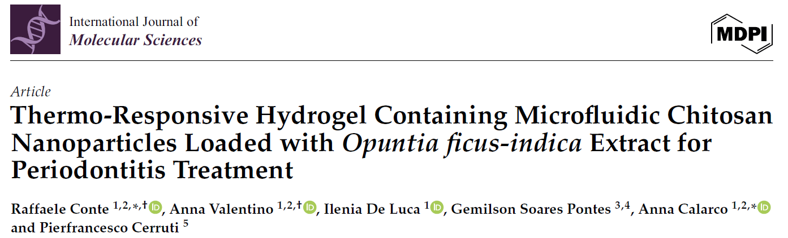
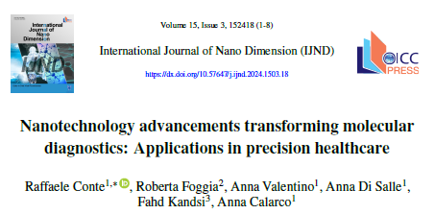
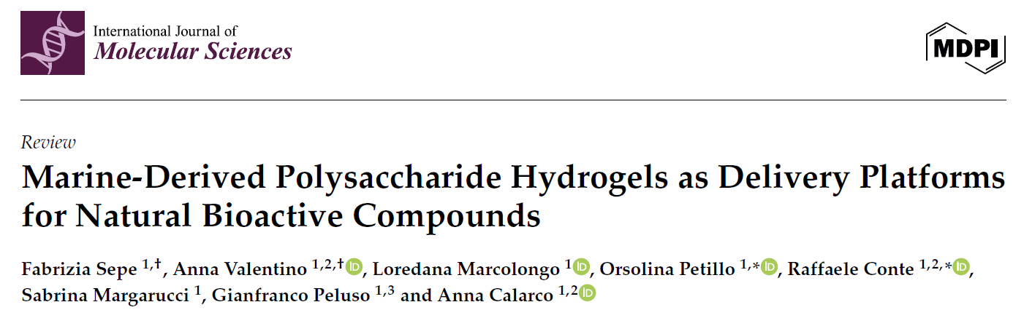

Slide 22

Thank you!

