Slide 1
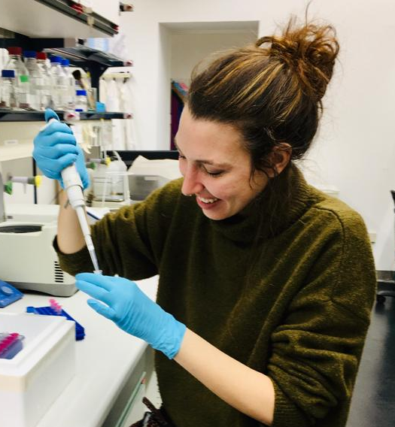
Intraspecific epigenomics divergence in brown bears (Ursus arctos): insights from genome-wide DNA methylation patterns
Laura Gramolini
IRET - Montelibretti

Slide 2
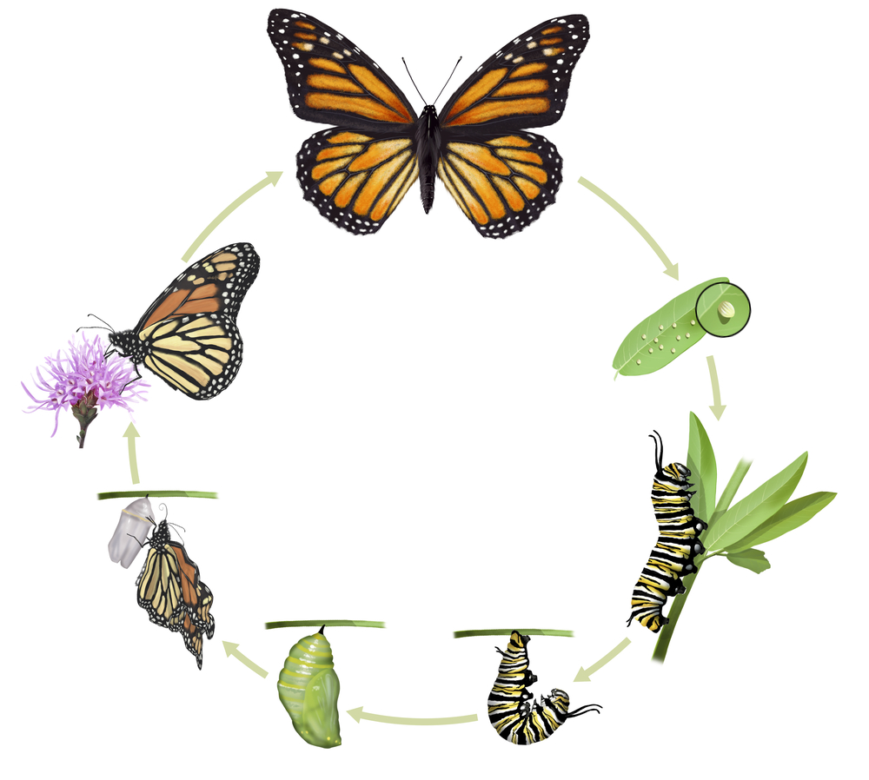

Phenotypic plasticity
Along life cycles
Between individuals from the same species, population or family

Slide 3

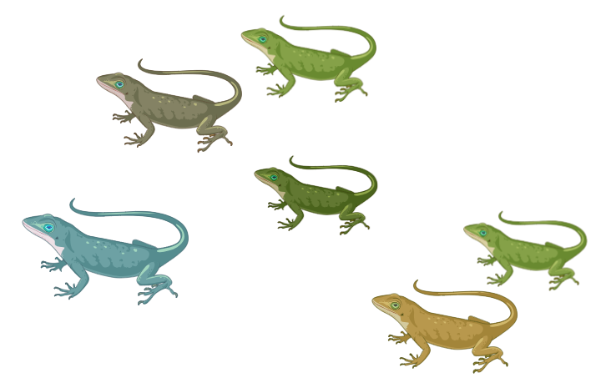
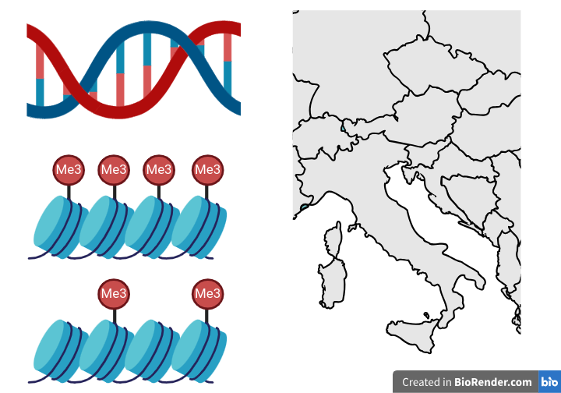

Genotype
Environment
Phenotype

Slide 4
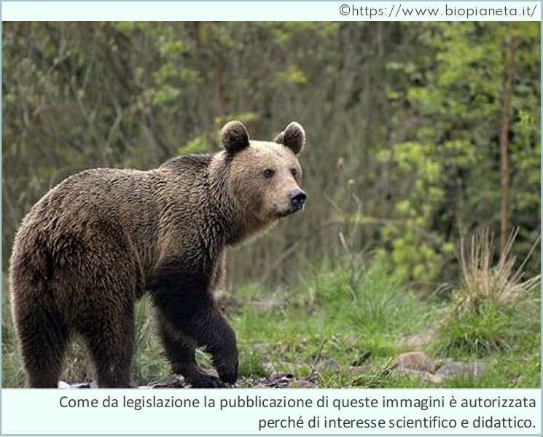
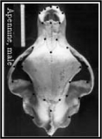
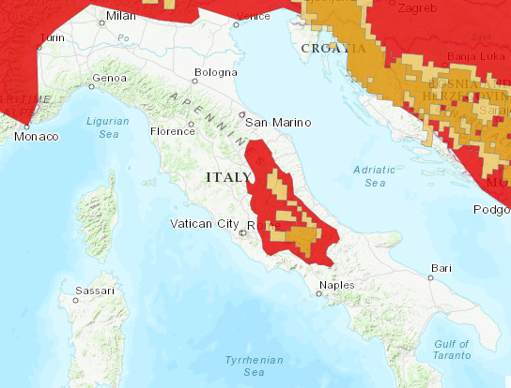
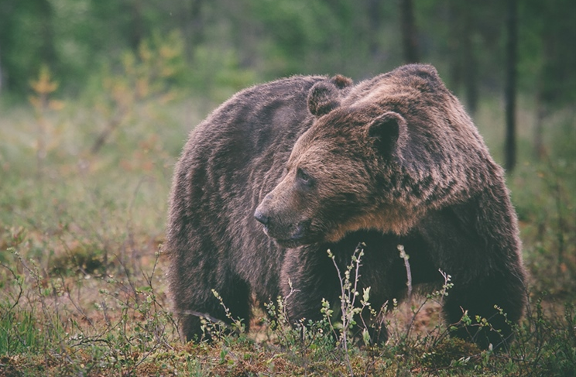
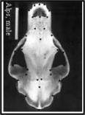
Marsican bear
European population

Slide 5
Differences in:
skull shape
diet
behaviour
sexual dimorphism
colour
Marsican bear
European population

Slide 6

Genotype
Environment
Phenotype

Slide 7
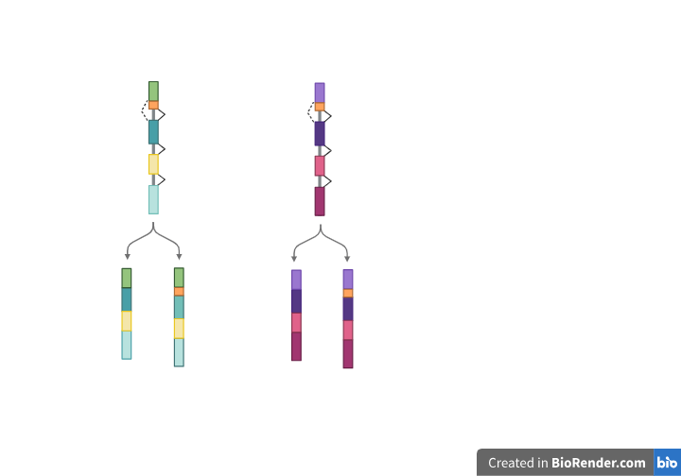
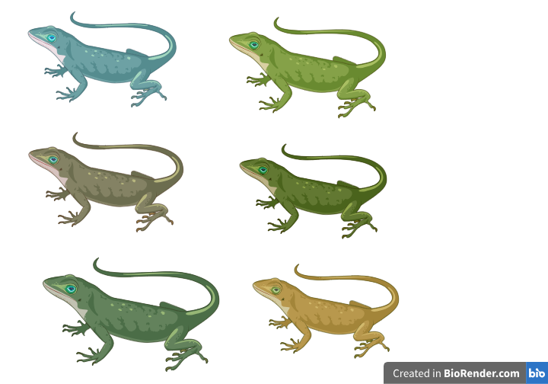
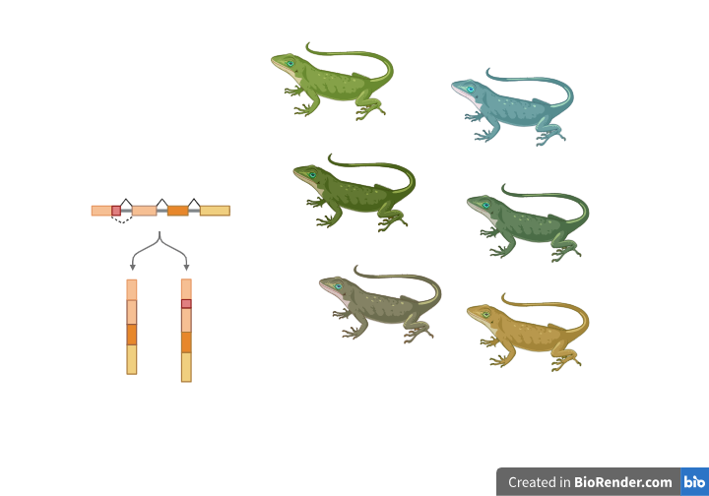
From Genotype
to Phenotype

Slide 8
From Genotype
to Phenotype
Non-genetic variability

Slide 9
From Genotype
to Phenotype
Methylation
Transcription
Alternative splicing

Slide 10
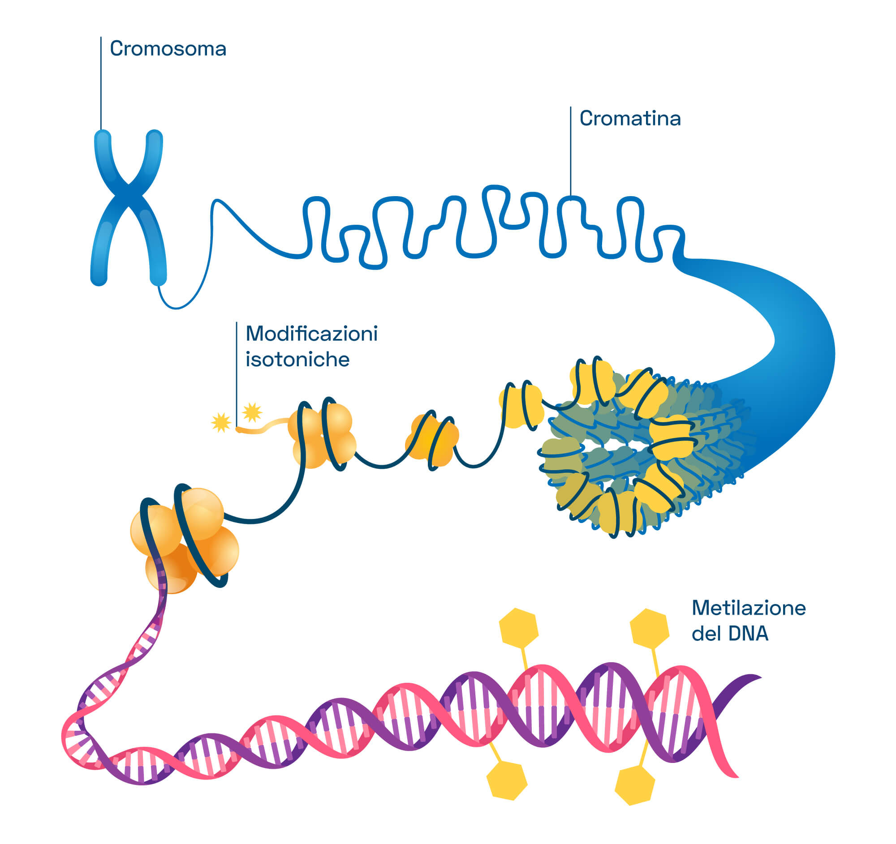
DNA Methylation
CH3
|
CH3
|
CH3
|
ACCGCTGGATAGCGAGCG

Slide 11
DNA Methylation
CpG Island
ACCGCTGGATAGCGAGCG

Slide 12
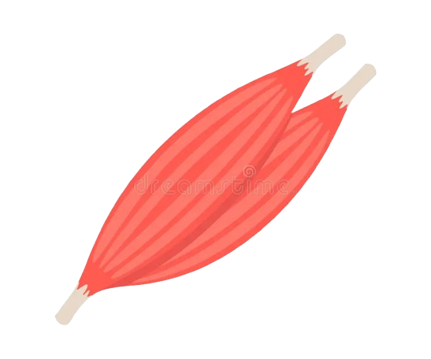
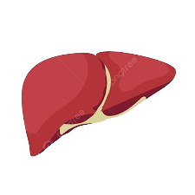

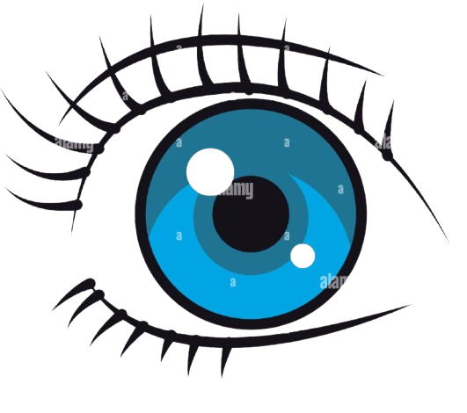

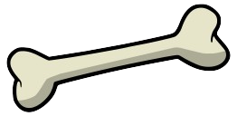
ACCCTGGATAGCAGC

Slide 13

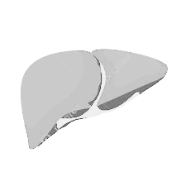

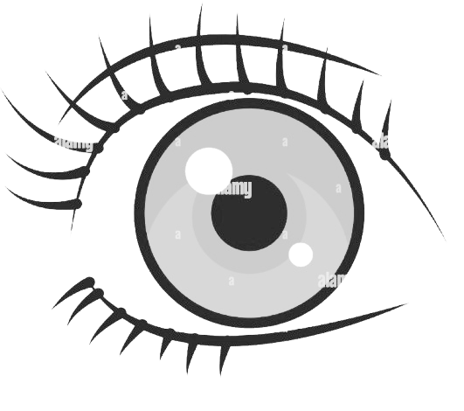
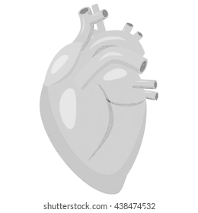

?
ACCCTGGATAGCAGC

Slide 14
AIM: Investigate the mechanisms driving phenotypic plasticity
Do the populations differ in terms of methylation patterns?

Slide 15
AIM: Investigate the mechanisms driving phenotypic plasticity
Do the populations differ in terms of methylation patterns?
Which is the suitable tissue for this kind of analysis in wild organisms?

Slide 16
AIM: Investigate the mechanisms driving phenotypic plasticity
Do the populations differ in terms of methylation patterns?
Which is the suitable tissue for this kind of analysis in wild organisms?
Where do these modifications occur? What are they related to?

Slide 17
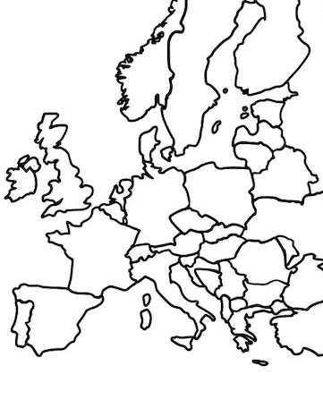
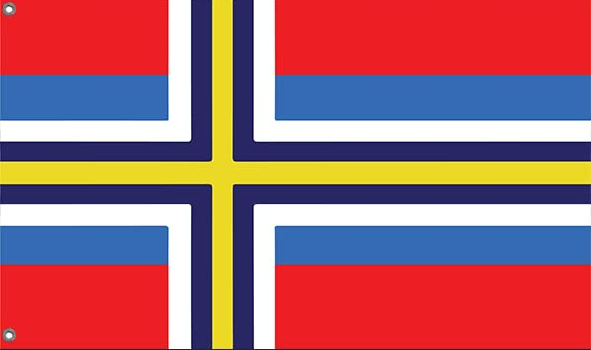

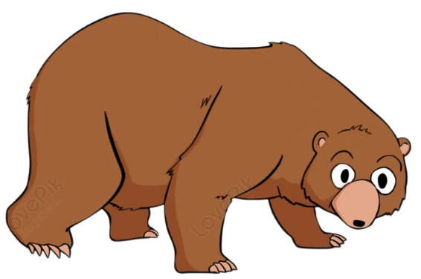
Sampling

Slide 18

Laboratory procedures
Data analysis
DNA extraction from two tissues:
Blood and Muscle
2 X
3 X
4 X
3 X
Reduced Representation Bisulfite Sequencing (RRBS)

Slide 19
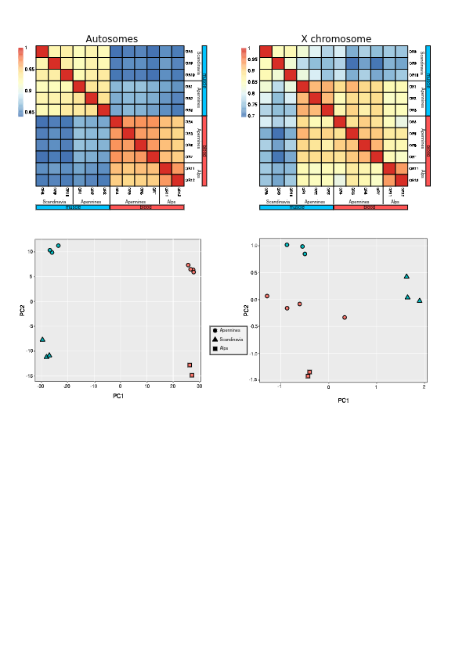
Results 1) Do the populations differ in terms of methylation patterns?
PC2
PC1

Slide 20
Results 1) Do the populations differ in terms of methylation patterns?
PC2
PC1

Slide 21
Results 1) Do the populations differ in terms of methylation patterns?
PC2
PC2
PC1
PC1

Slide 22
Discussion
1) Marsican brown bears can be distinguished by the methylation patterns

Slide 23
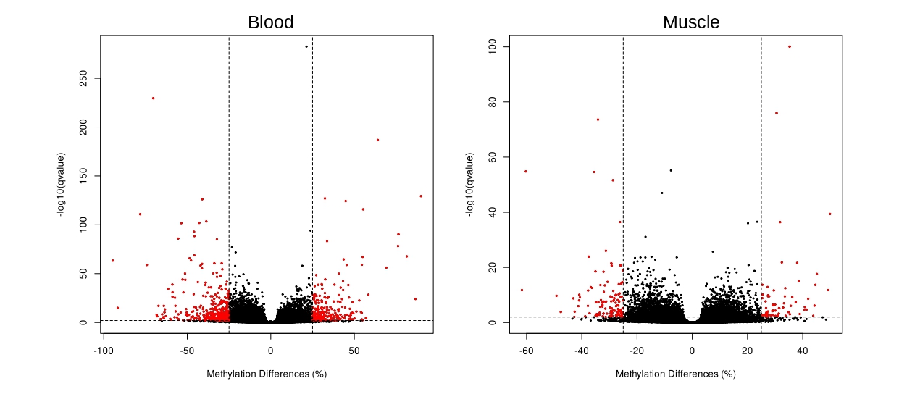
Results 2) Which is the suitable tissue for this kind of analysis?
Hypo
Hyper
Hypo
Hyper
Methylation

Slide 24
Discussion
1) Marsican brown bears can be distinguished by the methylation patterns
2) Blood is a suitable tissue for this
analysis and this organism
VS

Slide 25
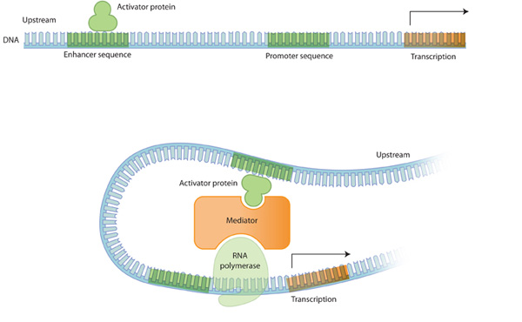
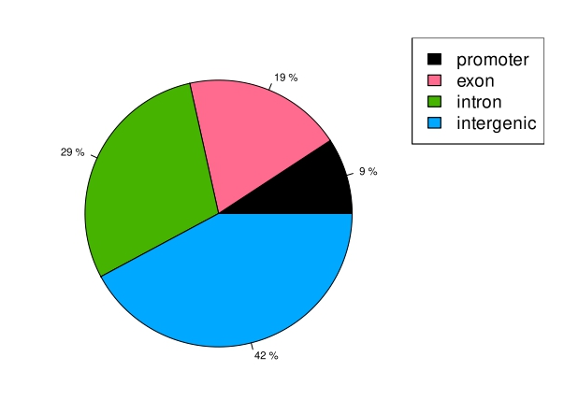
Results 3) Where do these modifications occur? What are they related to?
19%
29%
9%
42%

Slide 26
Results 3) Where do these modifications occur? What are they related to?
Developmental process: Bone Morphogenetic Protein 7 (BMP7) and Homeobox B3 (HOXB3)
Metabolic pathways: Galanin Receptor 3 (GALR3), Arachidonate 15-Lipoxygenase (ALOX15) and LDL receptor related protein 5
Immune Response: Colony Stimulating Factor 3 (CSF3), Class II Major Histocompatibility Complex Transactivator (CIITA), DLA class I histocompatibility antigen, and Interferon Regulatory Factor 7 (IRF7)

Slide 27
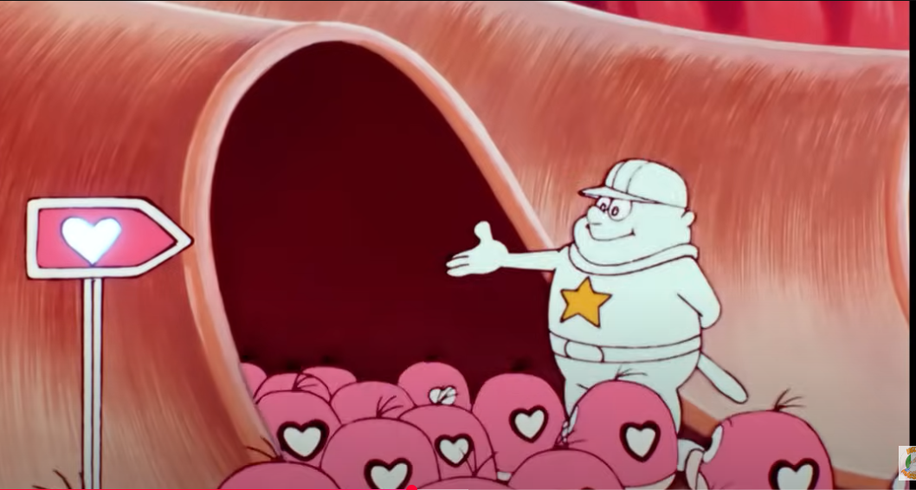
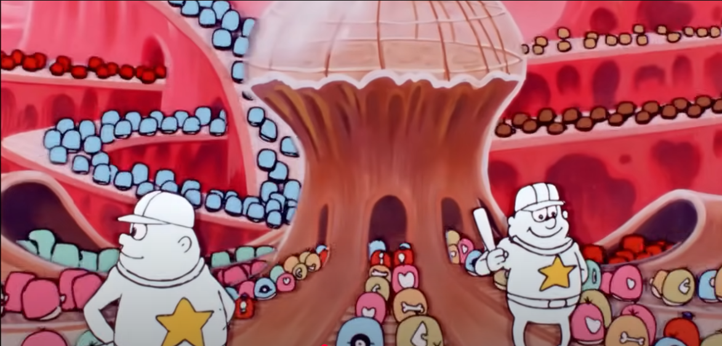
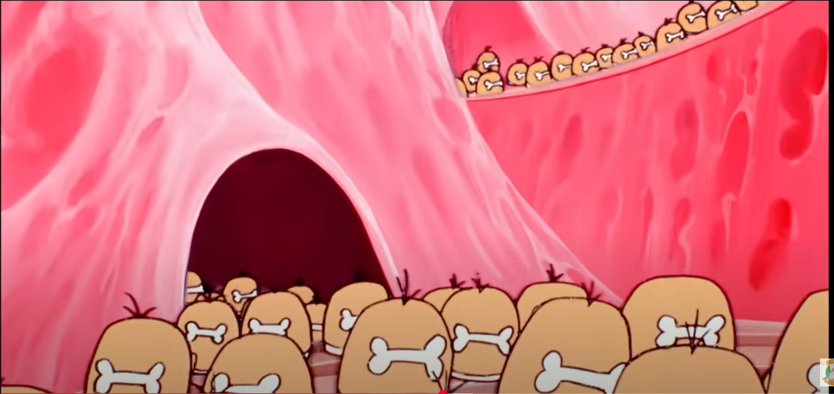
Discussion
1) Marsican brown bears can be distinguished by the methylation patterns
2) Blood is a suitable tissue for this
analysis and this organism
VS
3) Differences in the regulation of developmental processes are consistent with the emergence of novel phenotypes

Slide 28
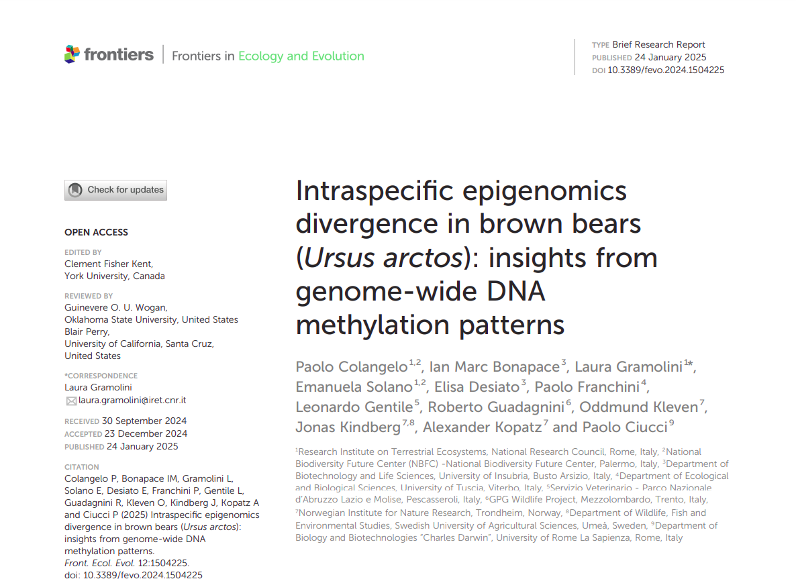

Slide 29
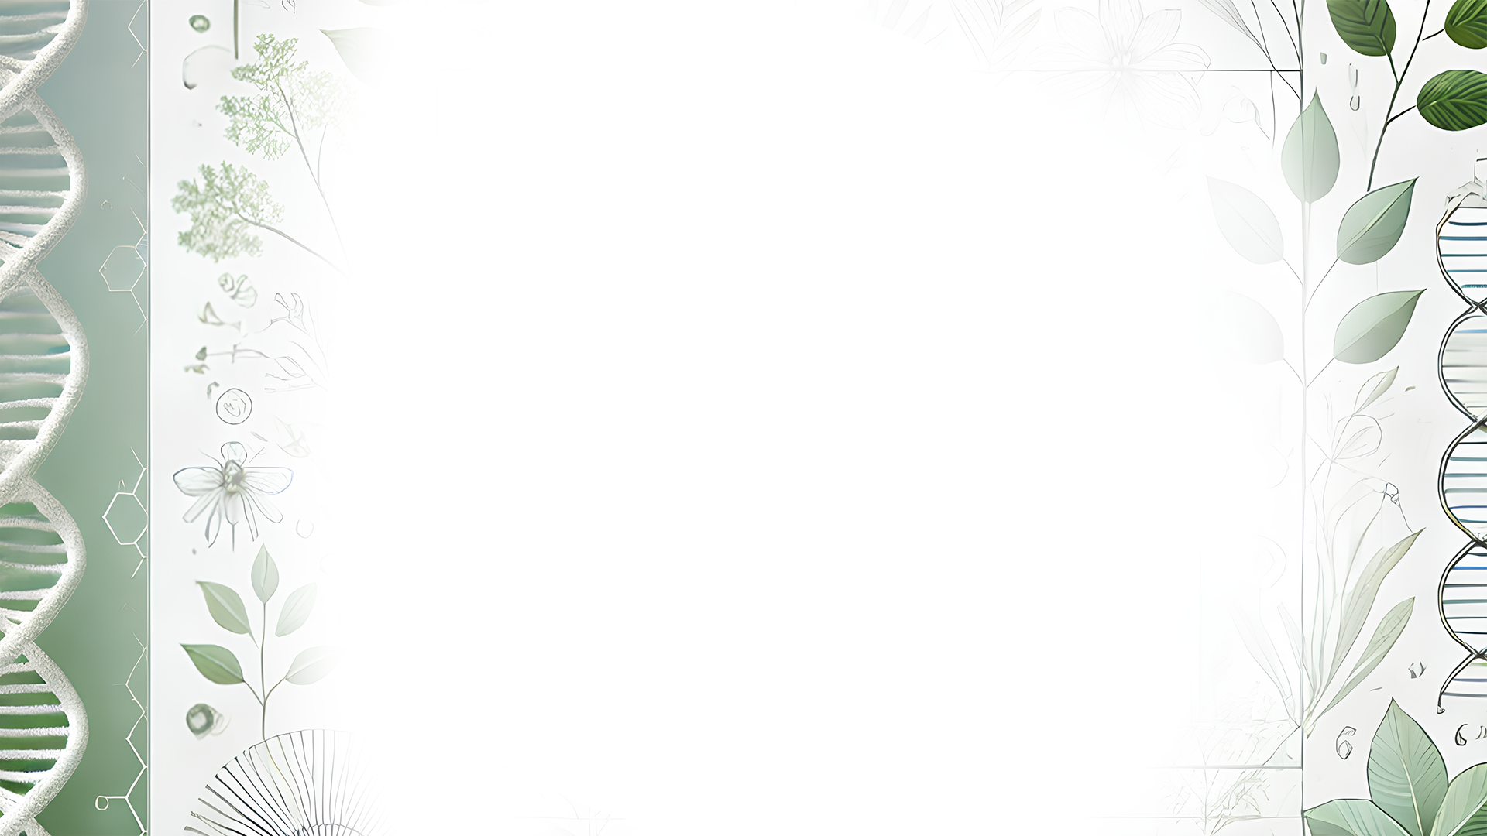
Thank you!

Slide 30
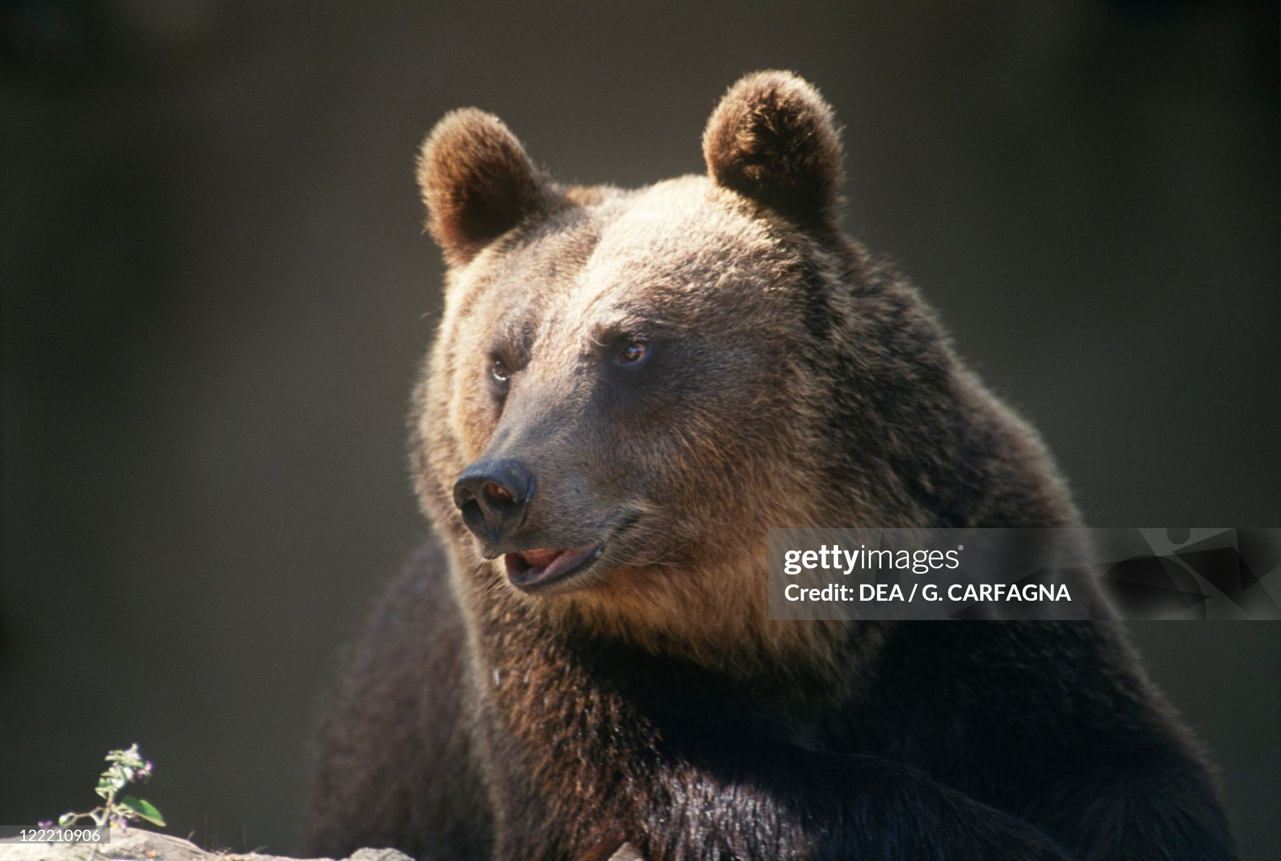
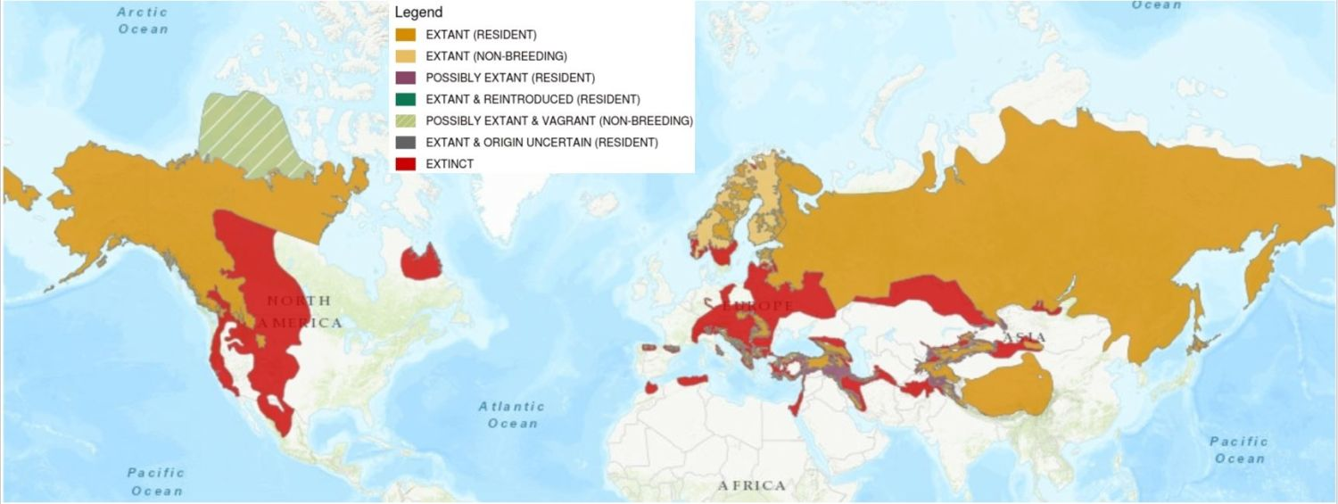
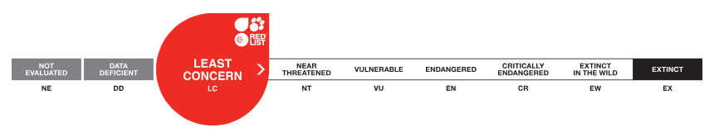

Slide 31
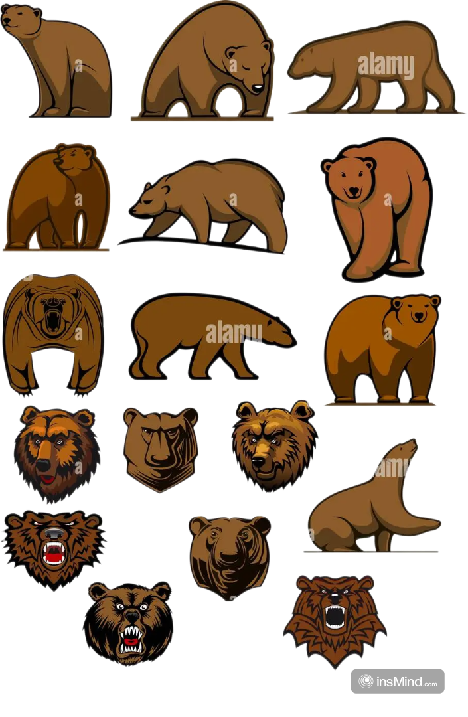

Slide 32
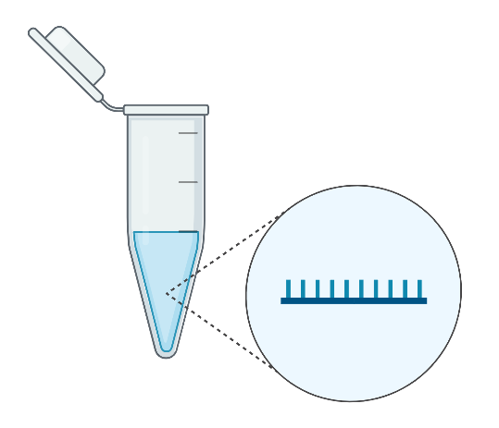
Laboratory analyses
DNA extraction from two tissues:
Blood and Muscle
Normal genome sequencing:
ACCCTGGATAGCAGC
Reduced Representation Bisulfite Sequencing (RRBS):
When a C is not methylated it is sequenced as Uracile (U).
ACUCTGGATAGUAGU

Slide 33
Results (1): Chromosome X

Slide 34

?
Genotype
Environment

Slide 35
Discussion
1) Populations can be distinguished
by looking at the methylations
patterns
2) Blood is a suitable tissue for this
analysis and this organism
VS
3) Developmental processes are the more diff methylated and the regulative regions

