Slide 1
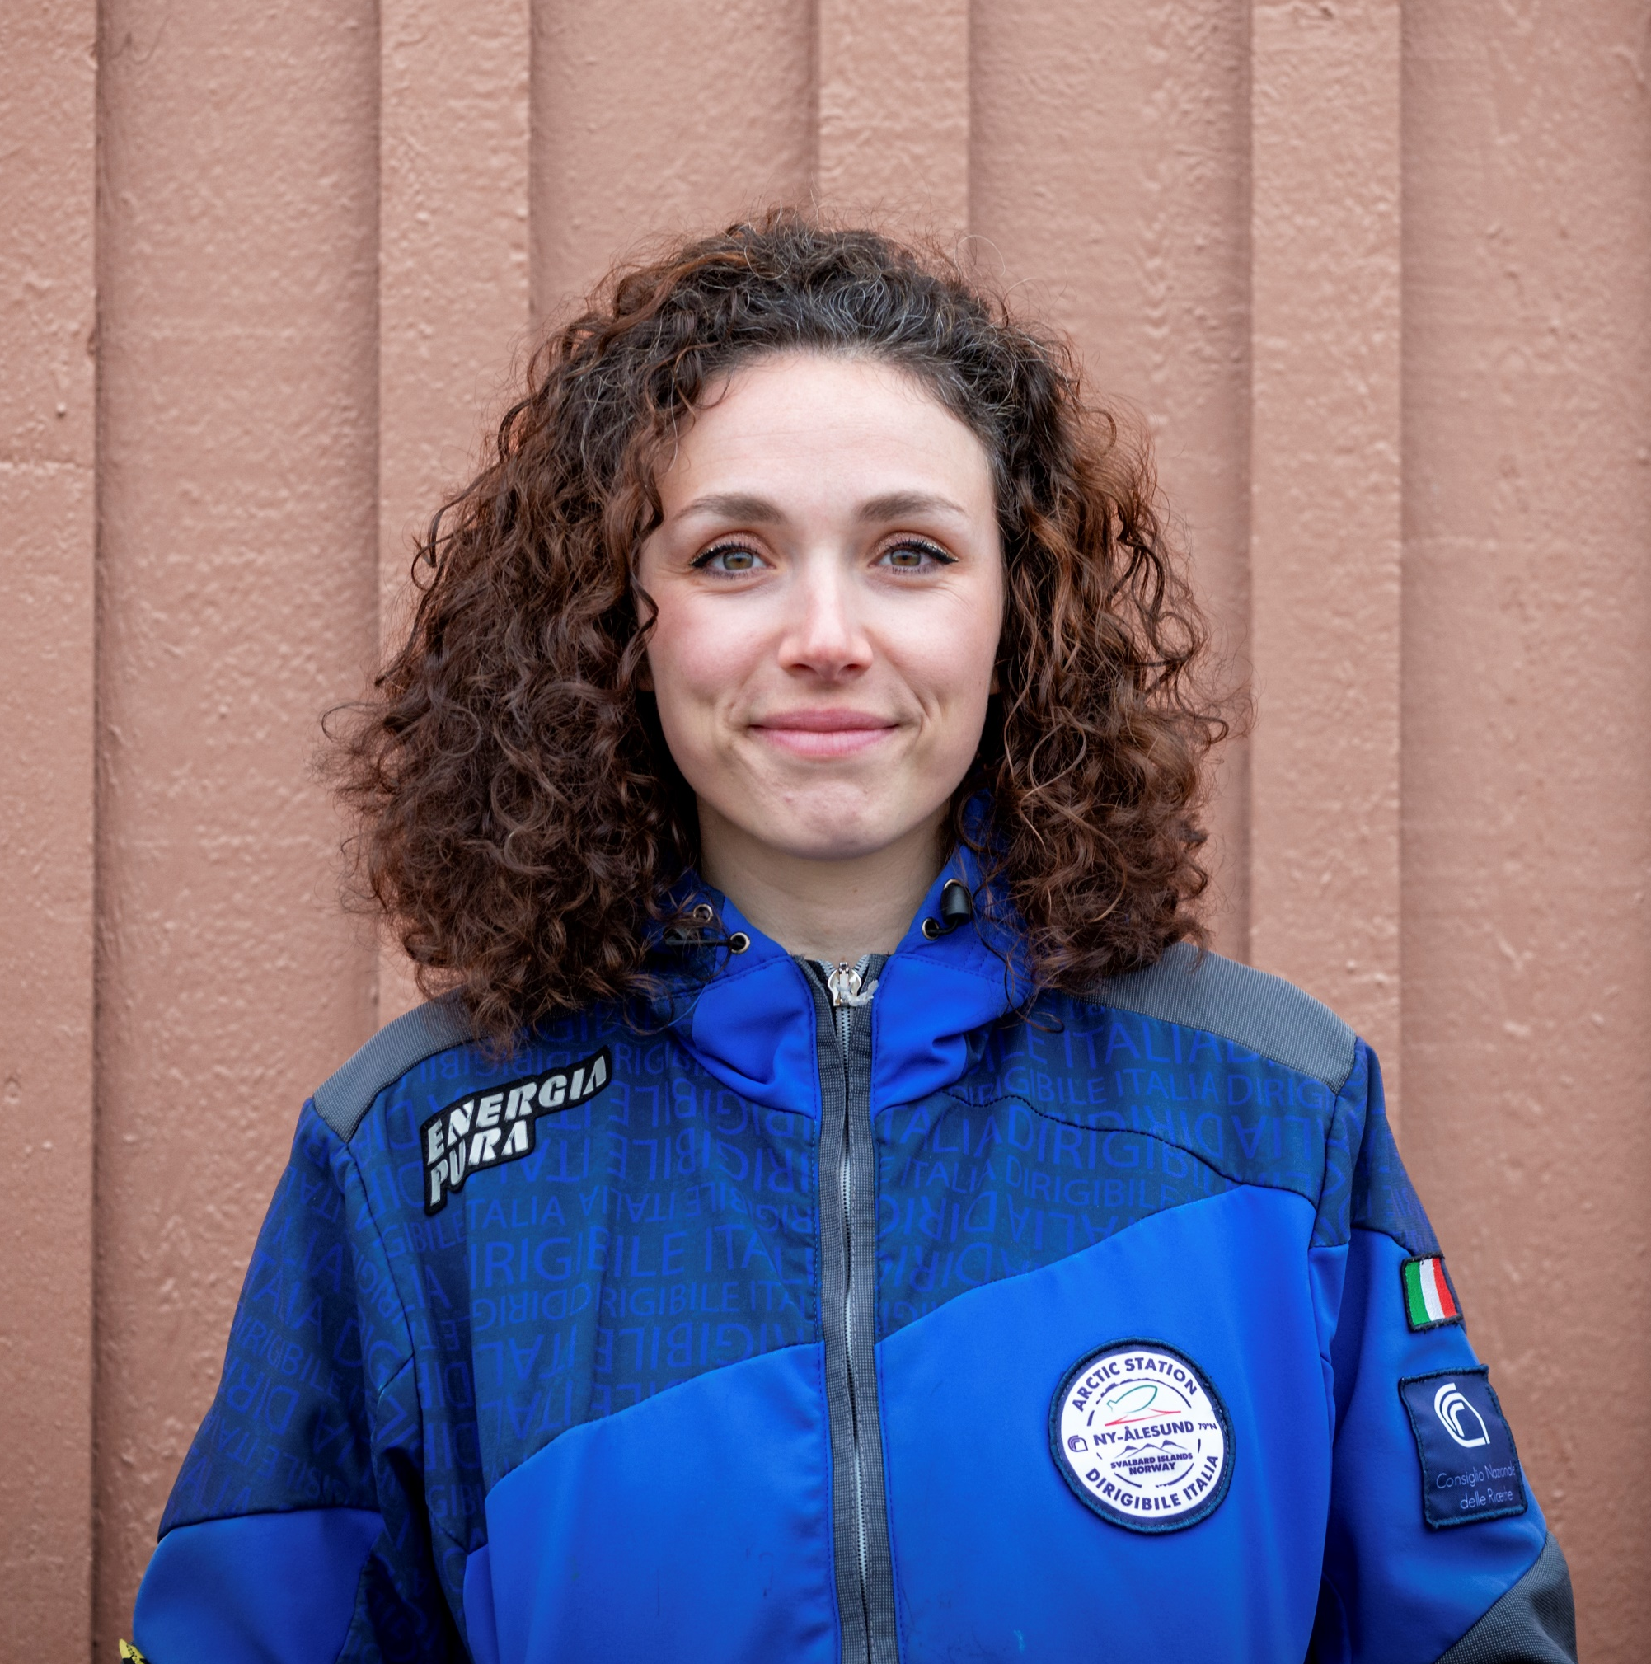
The Arctic tundra:
key drivers of the Carbon cycle under changing climate
Carlotta Volterrani^{1,3}
PhD student in Polar Sciences – Research fellow at CNR-IRET
A. Augusti¹, E. Pallozzi^{2,4}, F. D’Alò¹, E. Brugnoli¹, S. Moscatello¹, O. Gavrichkova^{1,4}
¹ Institute of Research on Terrestrial Ecosystems (IRET), National Research Council of Italy (CNR), 05010 Porano, Italy
² Institute of Research on Terrestrial Ecosystems (IRET), National Research Council of Italy (CNR), 00015 Monterotondo, Italy
³ Department of Environmental Sciences, Informatics and Statistics (DAIS), Cà Foscari University of Venice, 30172 Mestre (VE), Italy
⁴ National Biodiversity Future Center (NBFC), 90133 Palermo, Italy

Slide 2
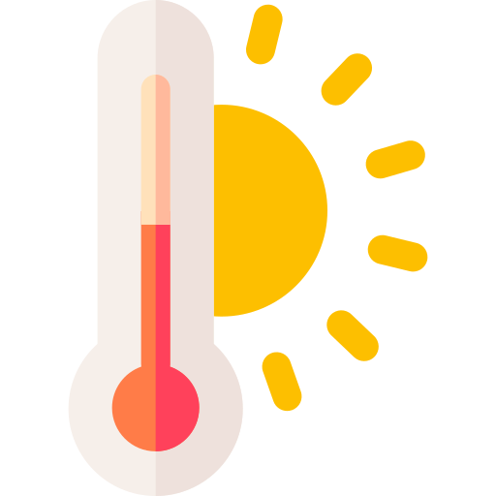

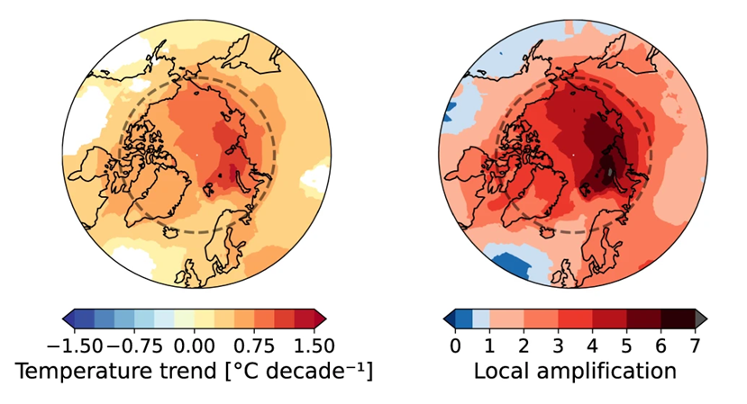
Global warming
Over the past 100 years, the global average temperature has increased by ~ 1.1°C, compared to pre-industrial level.
(NASA Earth Observatory, 2022)
Arctic amplification
Consolidate phenomenon caused by multiple potential factors.
Arctic warming is three times faster than global warming.
(Arctic Monitoring and Assessment Programme - AMAP, 2021)
Most significant warming was recorded in the region between Svalbard and Franz Joseph Land;
Winter T° increasing over 3.5°C
Spring T° by more than 2.5°C
(Przybylak & Wyszyński, 2020)
Rantanen et al. (2022)
The Arctic tundra: key drivers of the Carbon cycle under changing climate

Slide 3
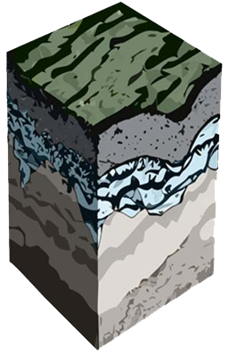
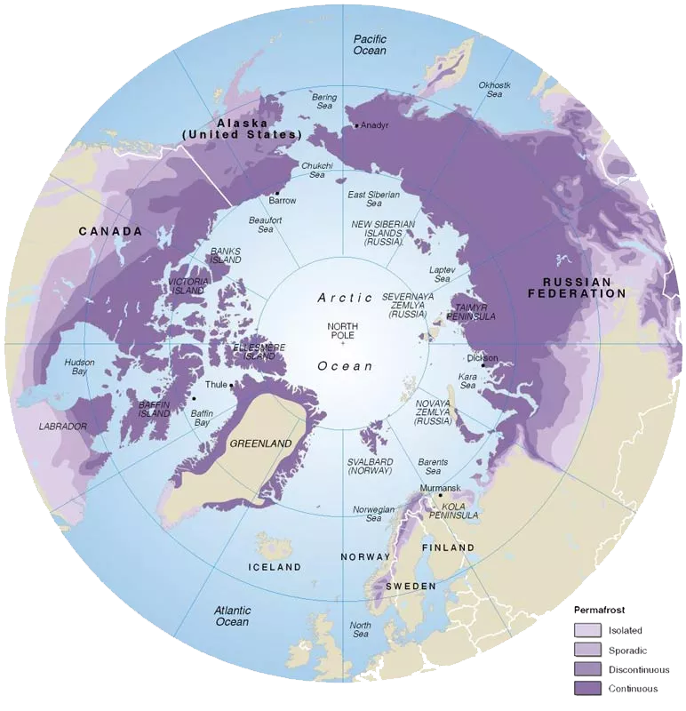
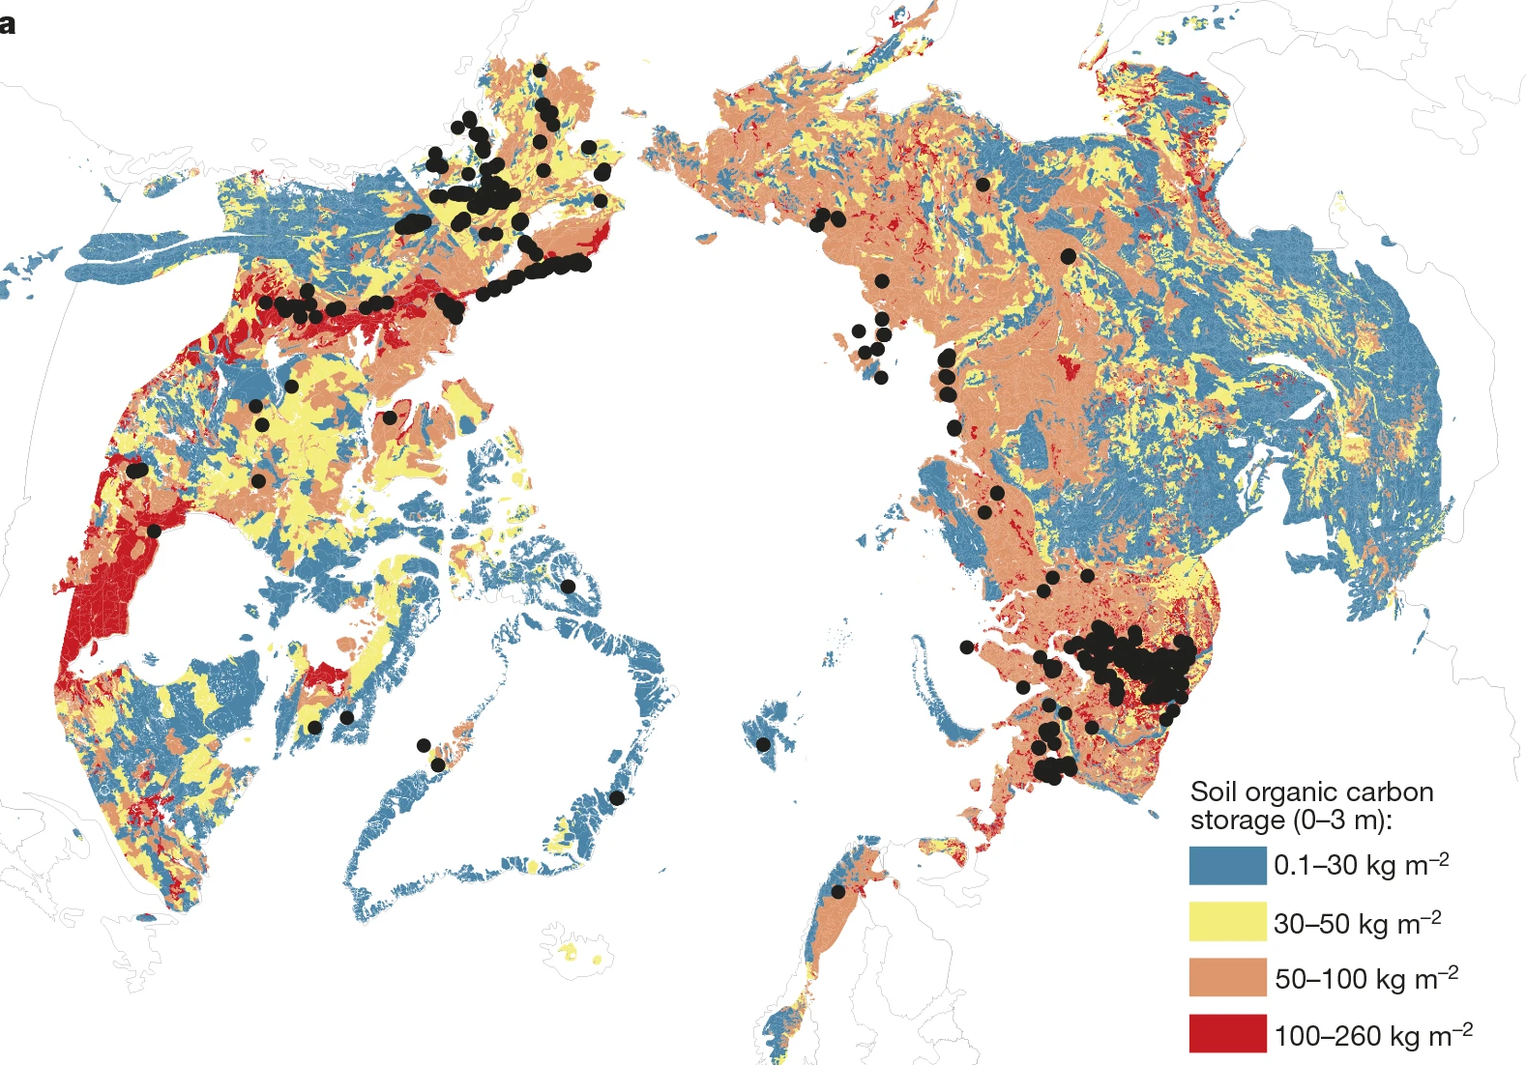

Permafrost
Perennially frozen ground
Account for approximately 50% of the estimated global belowground organic carbon (C) pool.
(Tarnocai et al., 2009)
Streletskiy et al. (2025)
Schuur et al. (2015)
International Permafrost Association (1998)
One quarter (25%) of the Northern Hemisphere and 17% of the Earth’s exposed land surface is underlain by permafrost.
(Biskaborn et al., 2019)
Permafrost
thawing
Acceleration of microbial breakdown of organic C
Release of GHG
(CO₂, CH₄)
Role of Arctic in C cycle?
What’s the climate feedback?
The Arctic tundra: key drivers of the Carbon cycle under changing climate

Slide 4
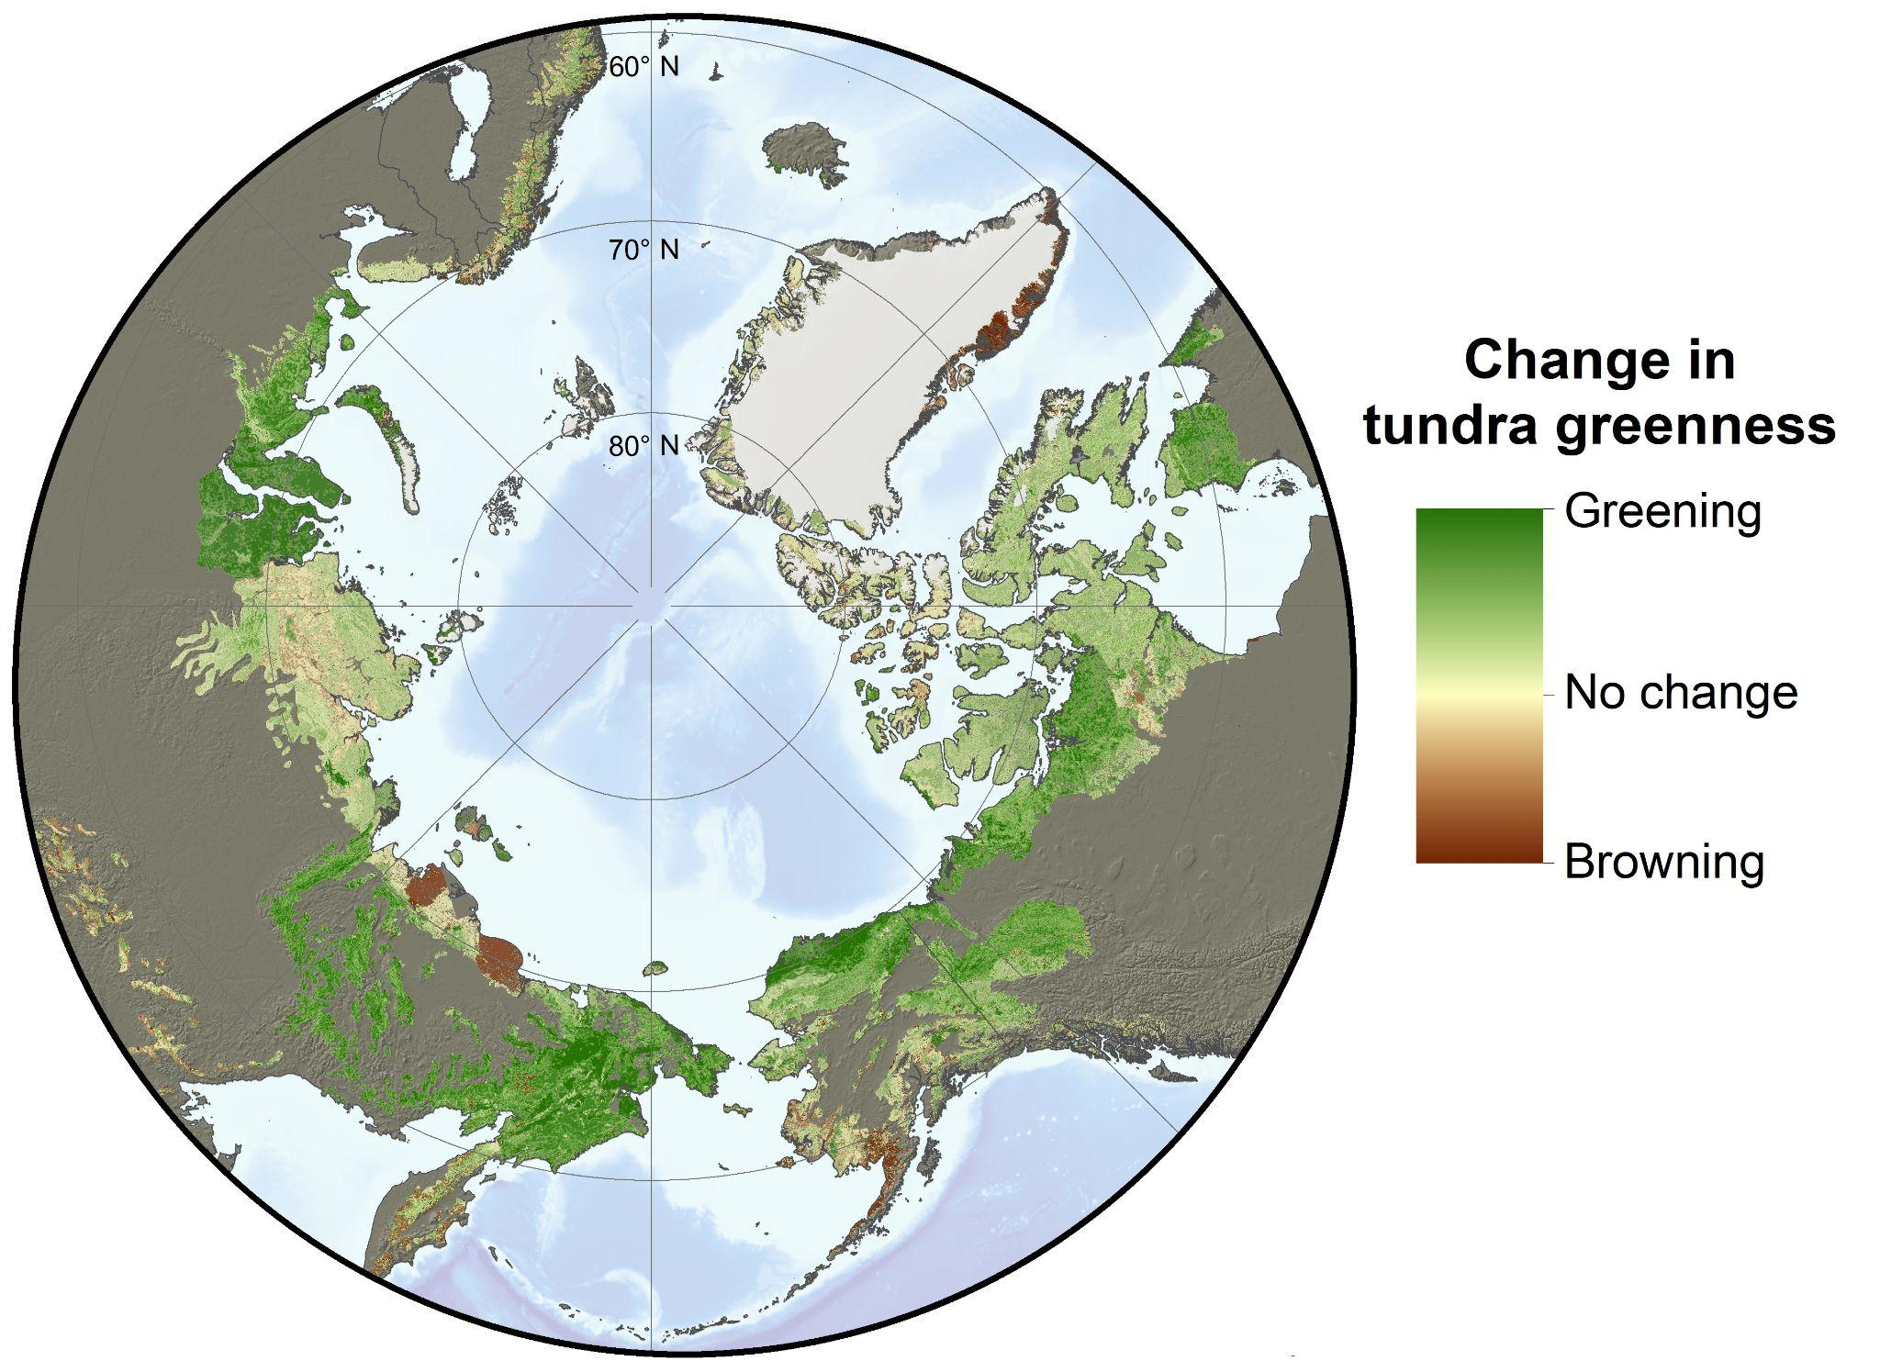
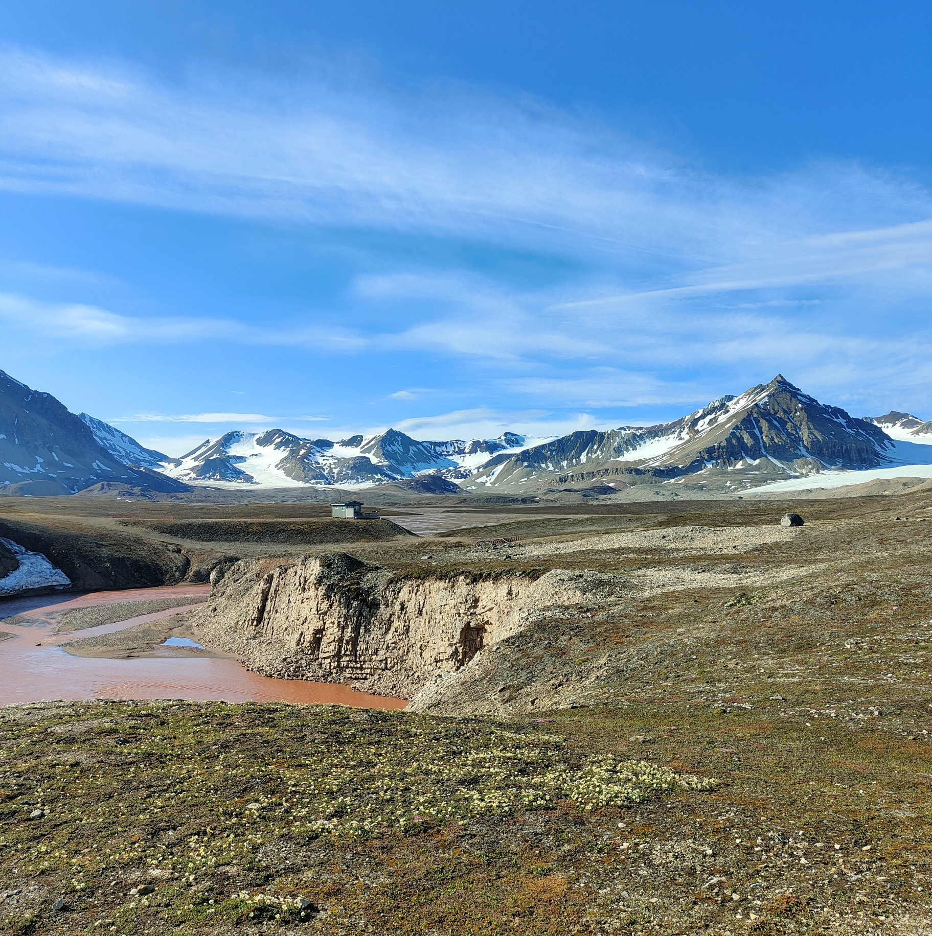
Arctic Greening
The increase in tundra greenness across the Arctic over the past four decades is partially attributed to enhanced vegetation growth, driven by warmer and longer summers (Elmendorf et al., 2012)
NASA Earth Observatory (2021)
Alteration in carbon and nitrogen (N) cycles across the atmosphere-biosphere continuum, leading to increased ecosystem complexity driven by fine-scale ecological interactions and climate change.
Complex interractions between vegetation and soil processes
Bayelva river, Ny-Ålesund - Svalbard Island
Photo by Carlotta Volterrani, 2024
The Arctic tundra: key drivers of the Carbon cycle under changing climate

Slide 5
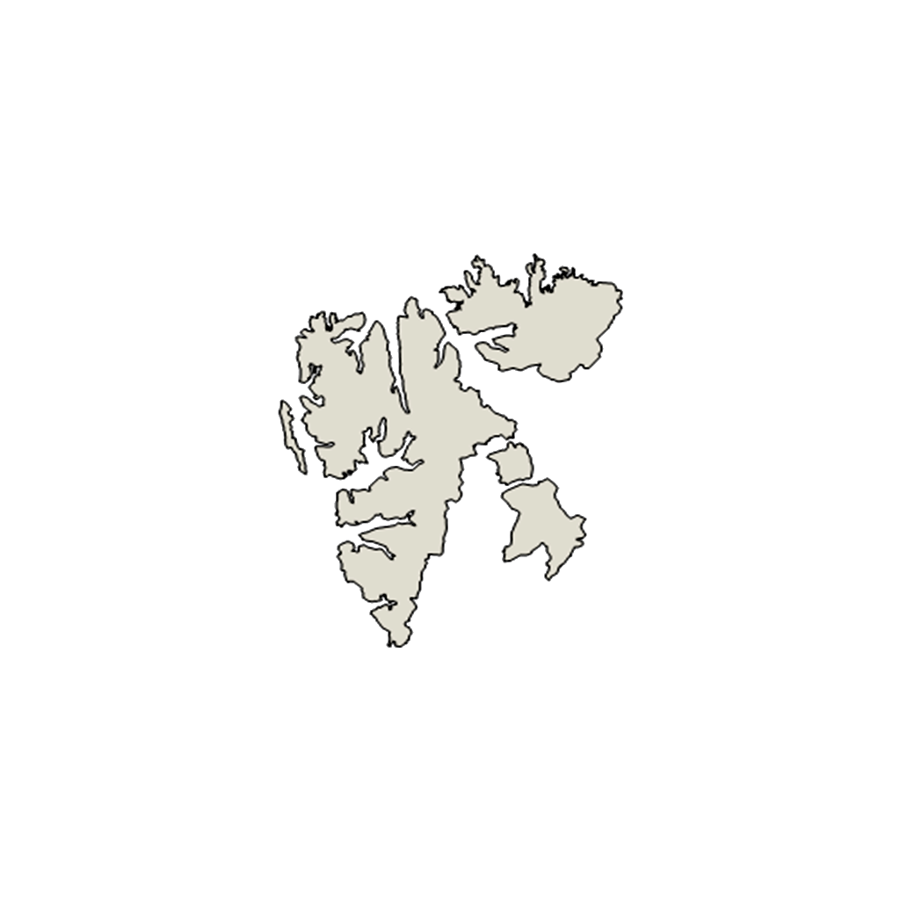

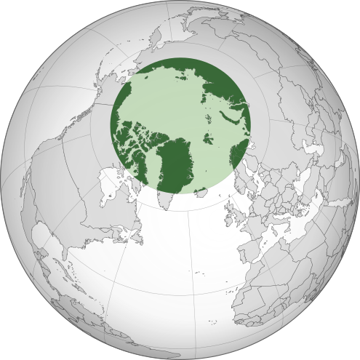



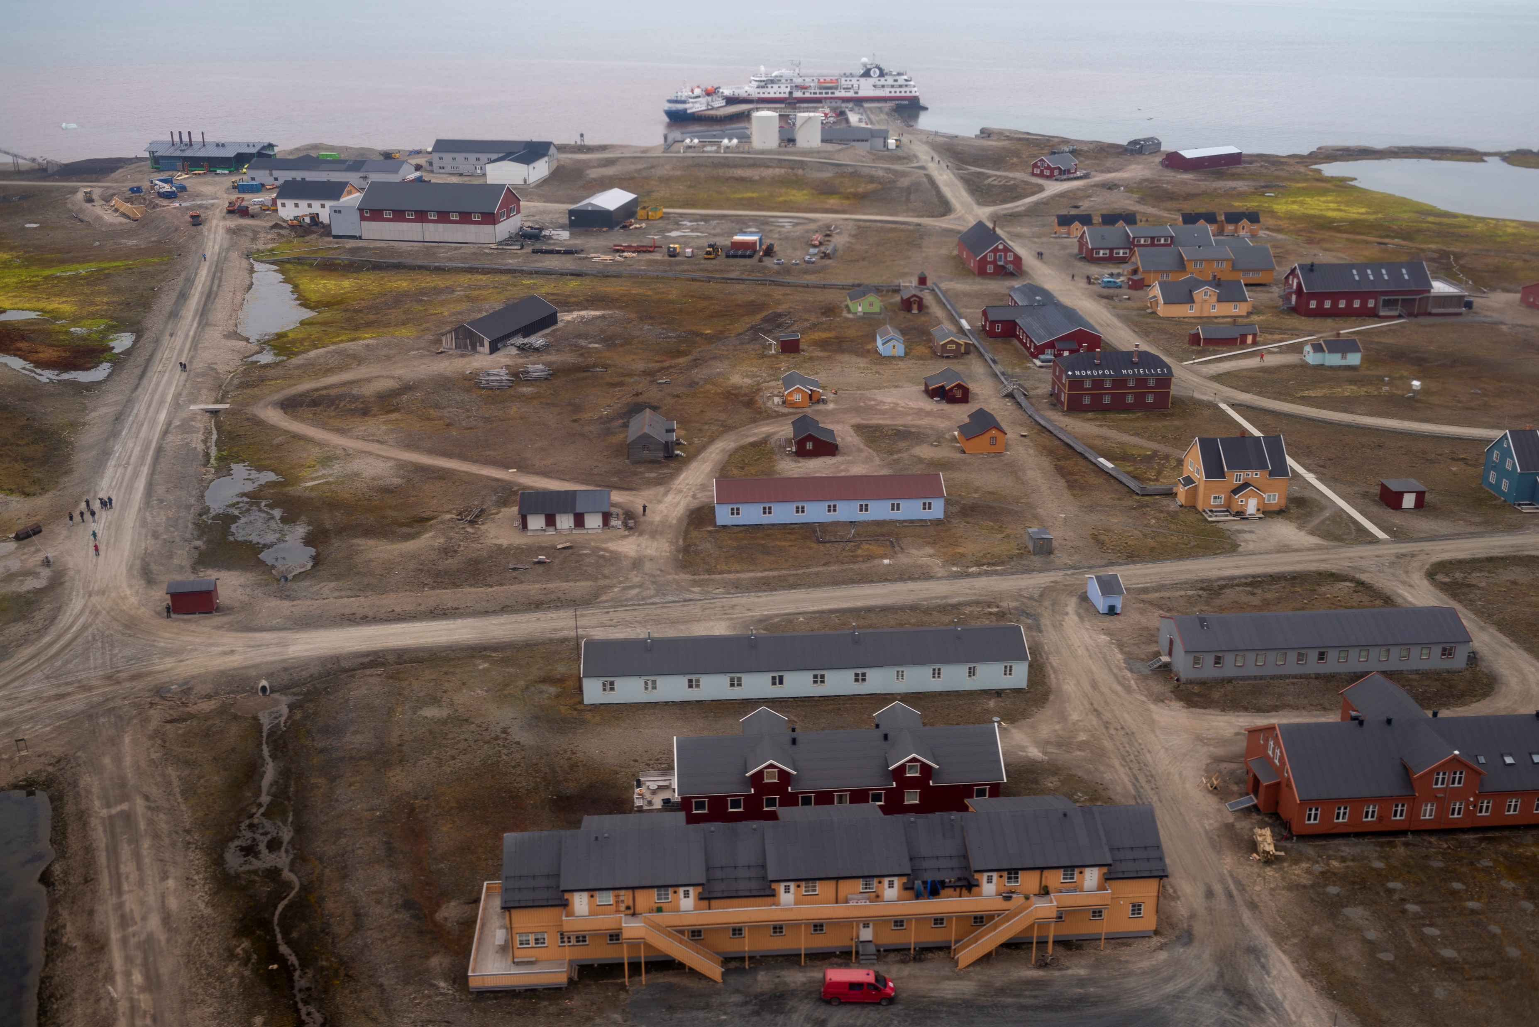
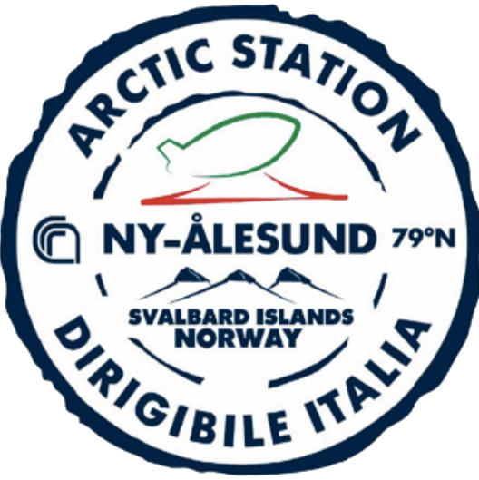
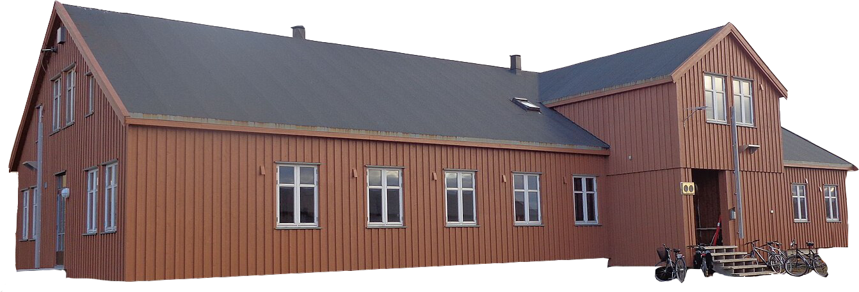

Objectives
Asses the sensitivity of dominant tundra species to variations in climatic drivers;
Examine the impact of biological drivers (e.g., herbivores) on ecosystem functioning and the interactions between soil microorganisms and vegetation communities;
Explore shifts in C and N allocation strategies between plants and soil in response to vegetation composition changes, including shrubs, sedges, mosses, and lichens;
The Arctic tundra: key drivers of the Carbon cycle under changing climate

Slide 6
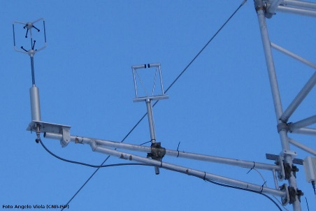
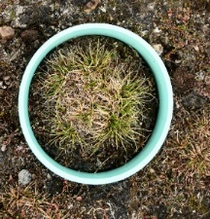
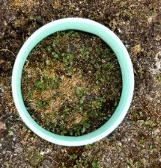
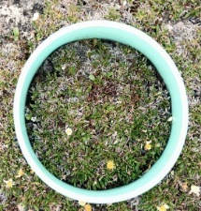
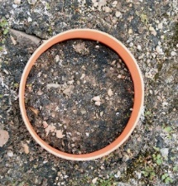
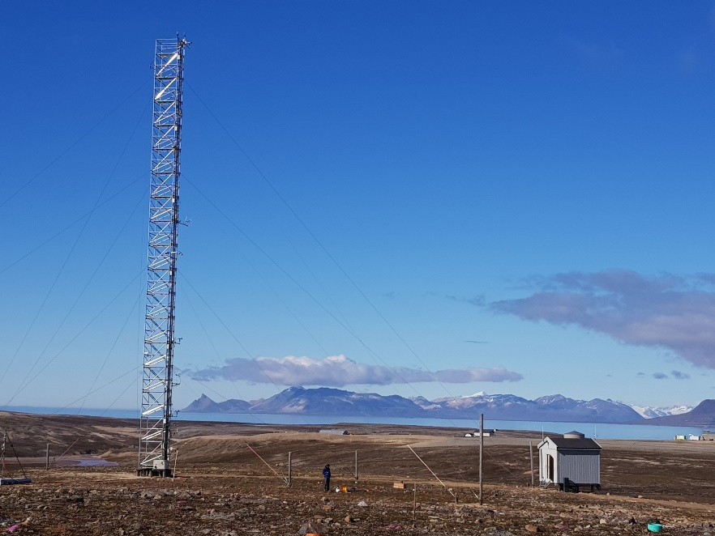
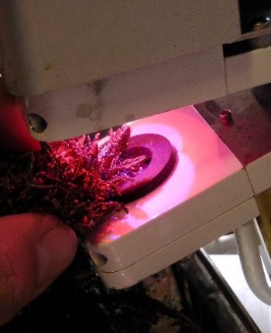
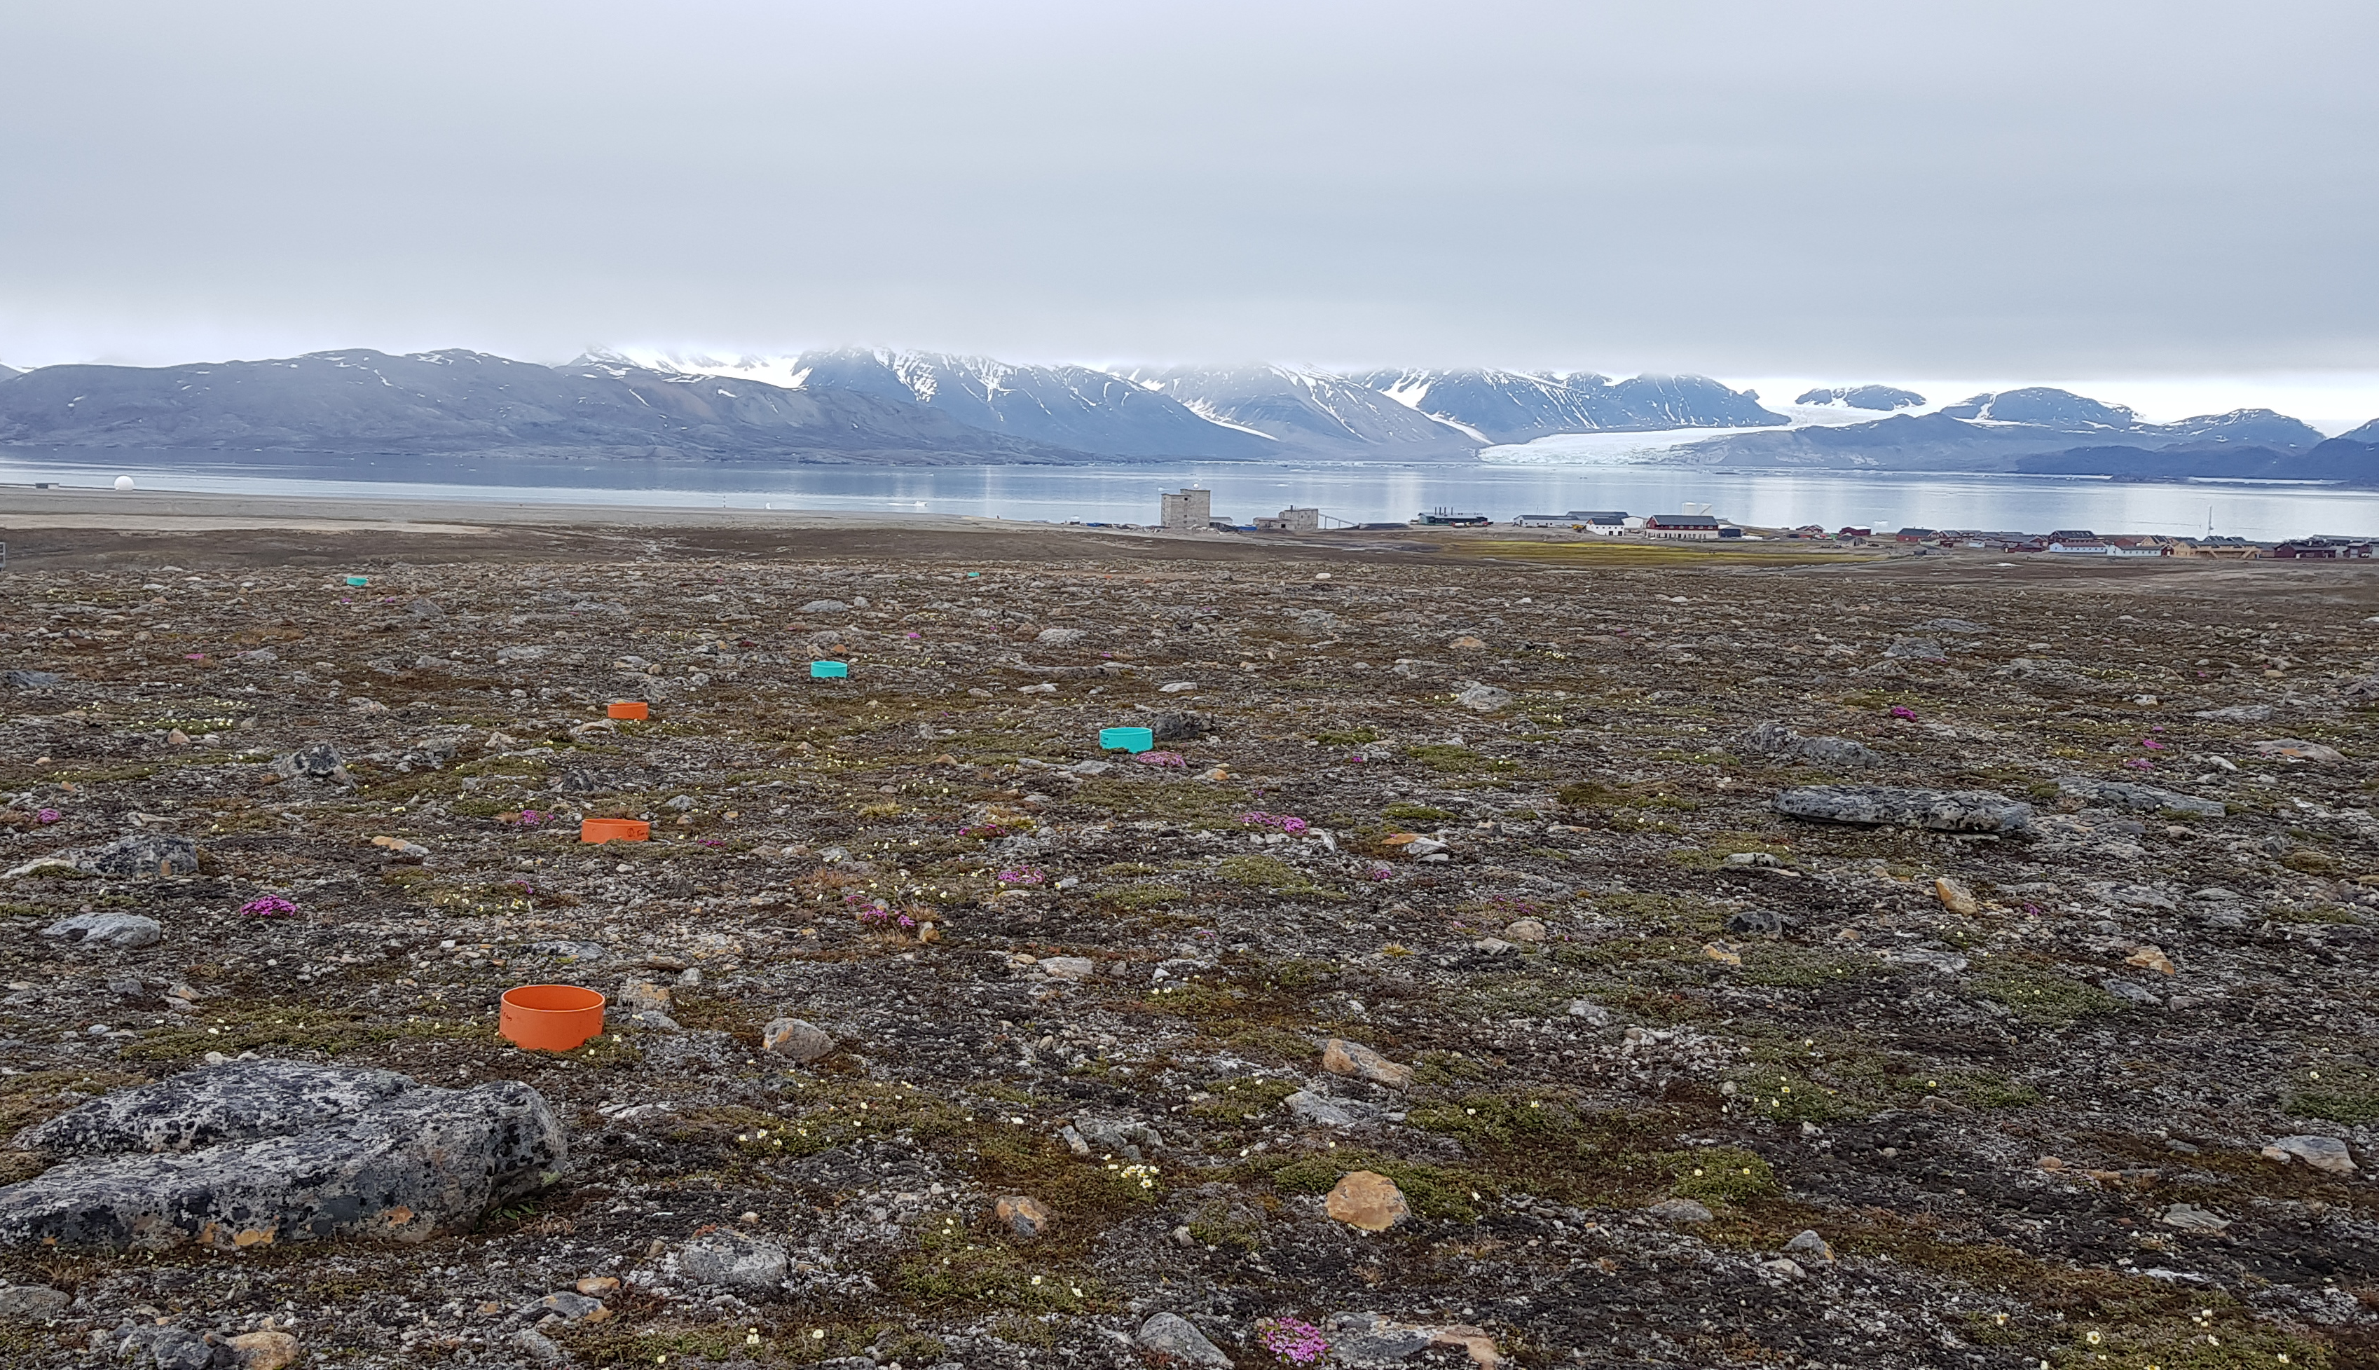
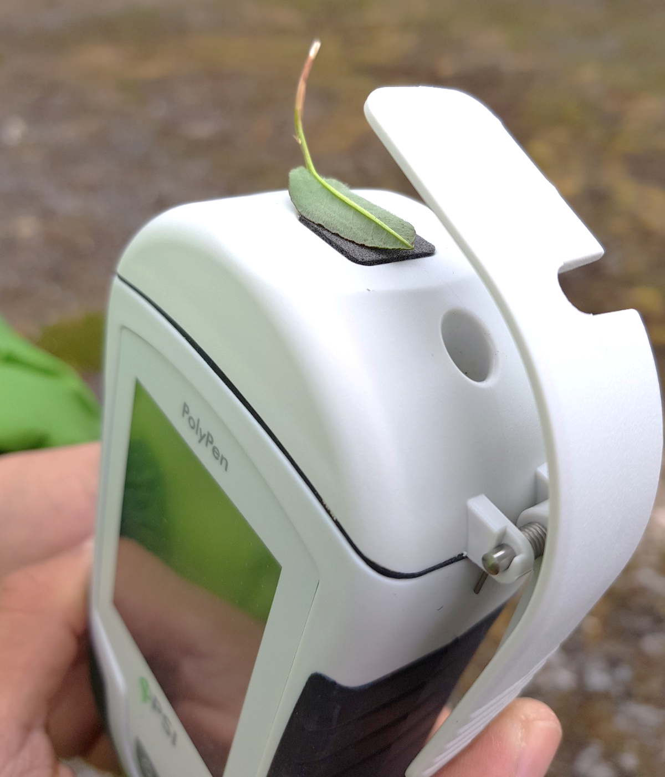
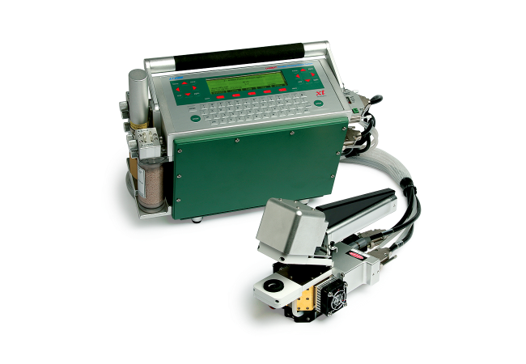
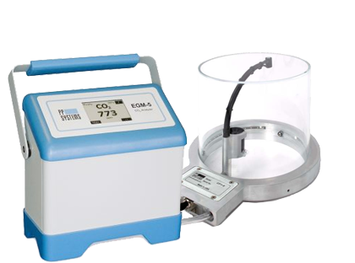
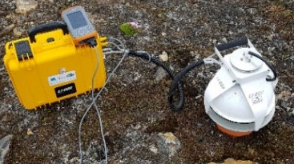
Methodologies
Species photosynthetic efficiency and spectral reflectance with change of:
Carbon and Nitrogen assimilation and allocation in relation to vegetation community and grazing pressure:
Carbon balance with eddy covariance
Continuous
High-time resolution
Non-specific
Interannual variability
Light
CO₂
Temperature
Nutrients
CO₂ flux measurements
¹³C pulse labelling
¹⁵N pulse labelling
Ecosystem
Vegetation community
Leaf
The Arctic tundra: key drivers of the Carbon cycle under changing climate

Slide 7

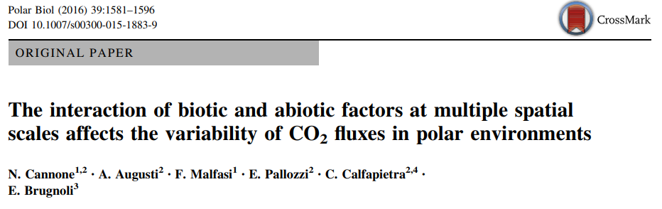
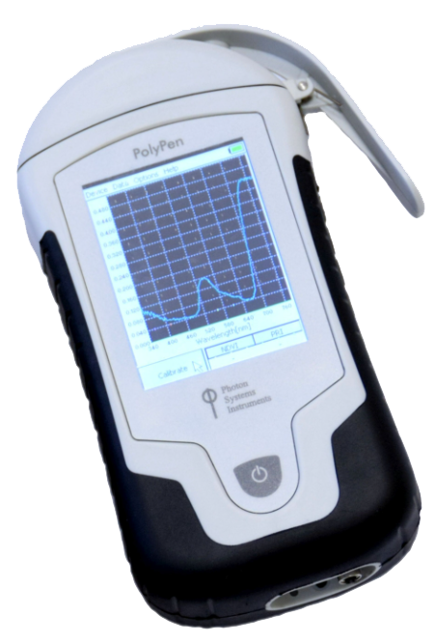
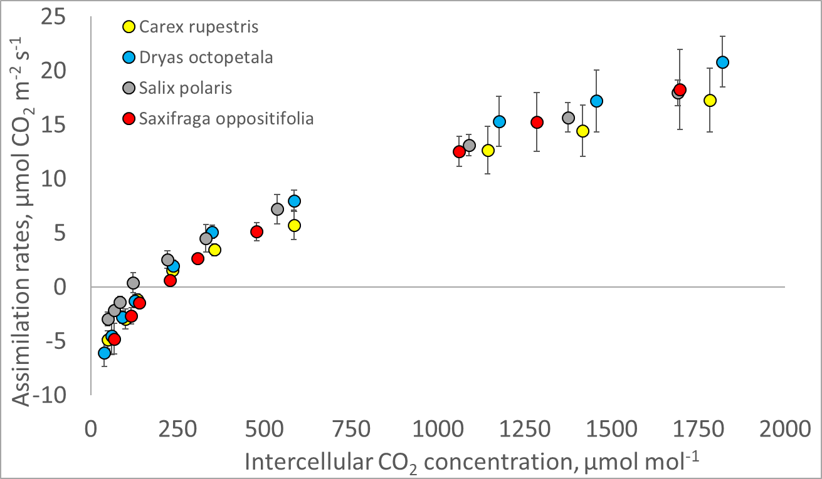
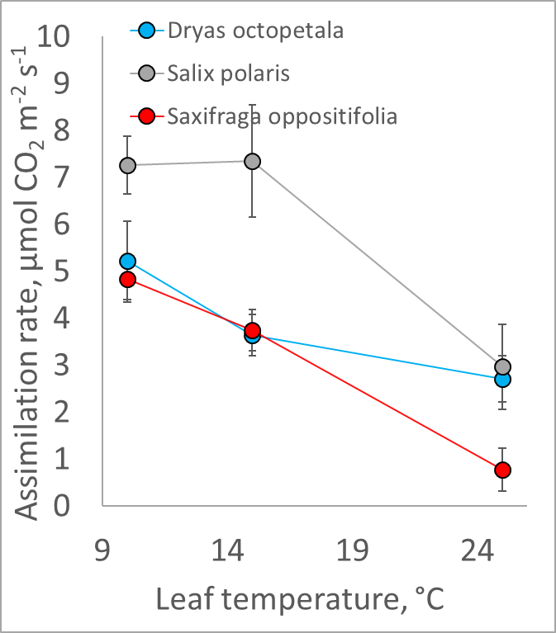

LEAF scale
Creation of reflectance database measurements
Based on:
Different species
Location
Treatment
PHOTOSYNTHES
I
S
380 - 790 nm
CO₂ Ambient Concentration
Temperature [°C]
Different responses among species to light intensity
Different species dominant in Brøgger peninsula are similarly sensitive to increase in CO₂ concentration. However, they demonstrate different sensitivity to short-term increase in ambient temperature.
640 - 1050 nm
Non-destructive measurements
The Arctic tundra: key drivers of the Carbon cycle under changing climate

Slide 8

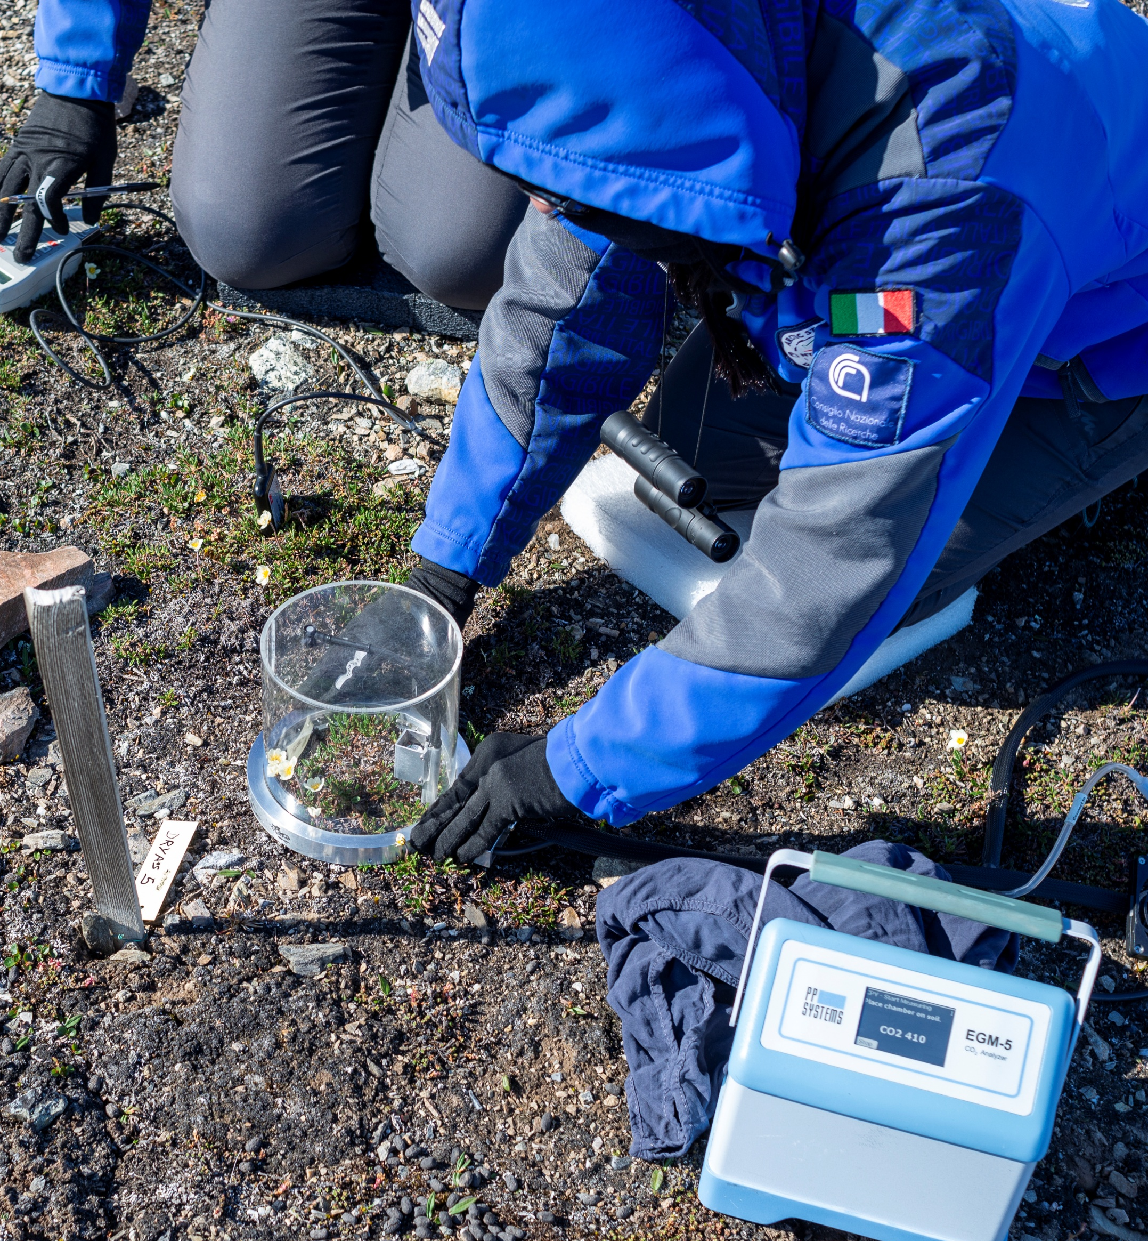
COMMUNITY scale
Carbon fluxes across dominant plant communities
Monitoring activity
Started in 2021;
Selection of two dominant species (Dryas octopetala L. and Salix polaris Wahlenb);
Measurements of Net Ecosystem Exchange (NEE) and Ecosystem Respiration (Reco) , coupled with enviroment parameters (T_{soil} °, EC and Soil Water Content)
D. octopetala acts as stronger sink for C in confront to S. polaris as suggested by more negative NEE, due to higher green area and biomass of Dryas compared with Salix
Higher sequestration of C
Despite higher R_{eco} values registered in Dryas plots, although the differences with Salix were not always significant.
The Arctic tundra: key drivers of the Carbon cycle under changing climate

Slide 9

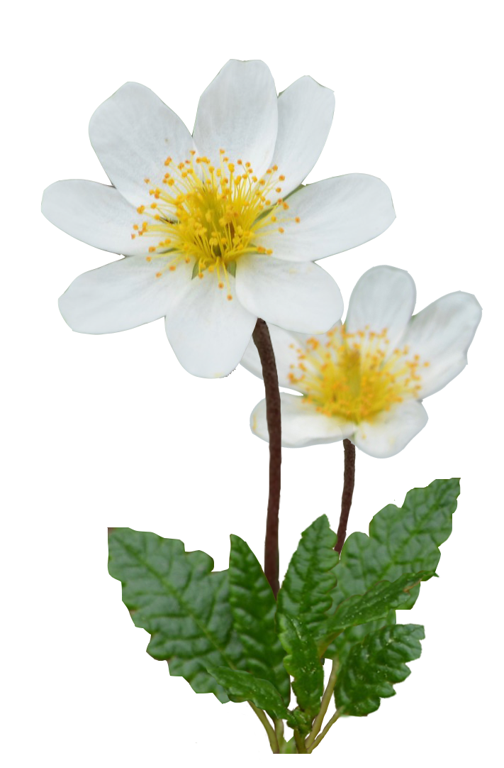
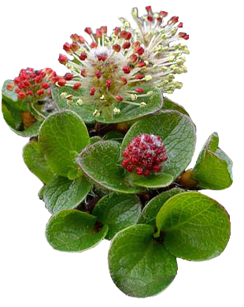
Preliminary results • Paper in preparation
Multi-year study on carbon fluxes
C balance variation in Dryas is best explained by SWC variation.
Drought-adapted Dryas assimilates more C at lower SWC. Future increase in precipitation and cloudiness will negatively impact this plant community
Direct relationship between Dryas and Soil Water content
Positive relationship of Ecosystem respiration with soil temperature suggest negative impact of warming on C balance on both communities;
Salix shows stronger correlation between Reco and soil temperature than Dryas.
The Arctic tundra: key drivers of the Carbon cycle under changing climate

Slide 10
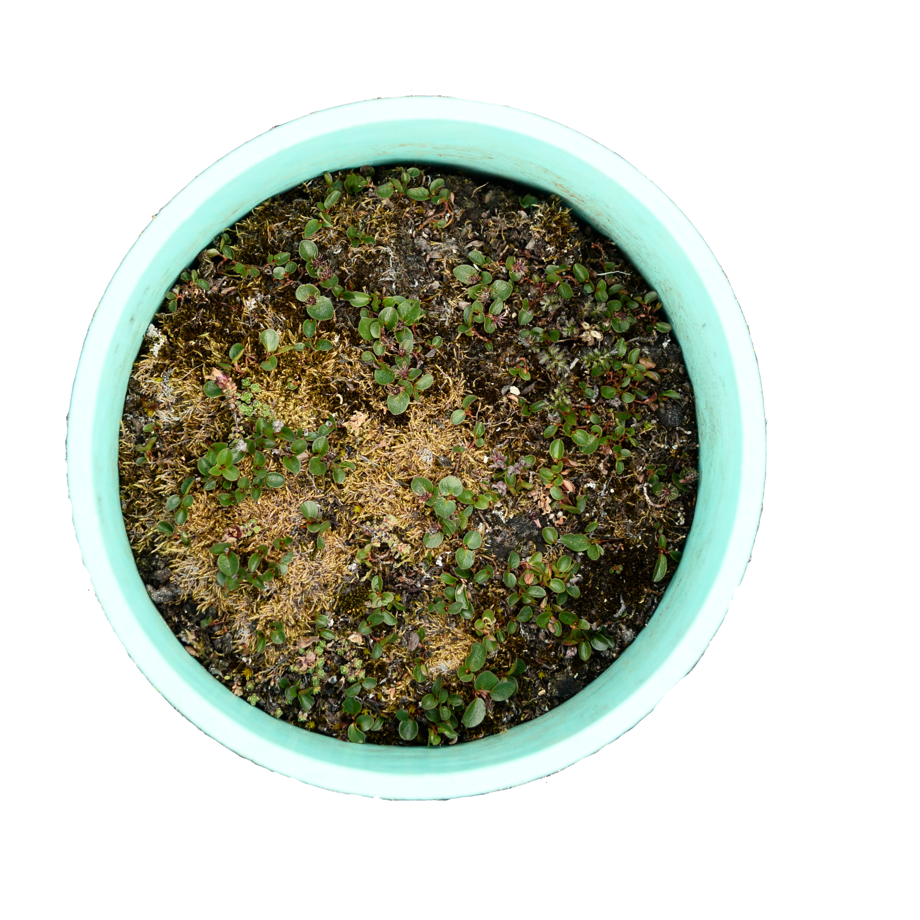
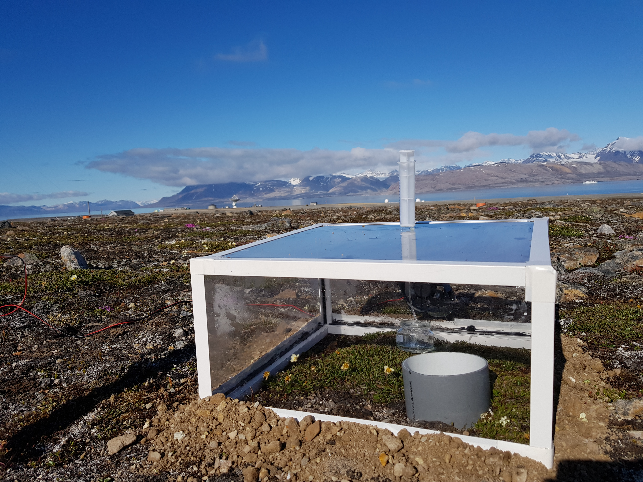
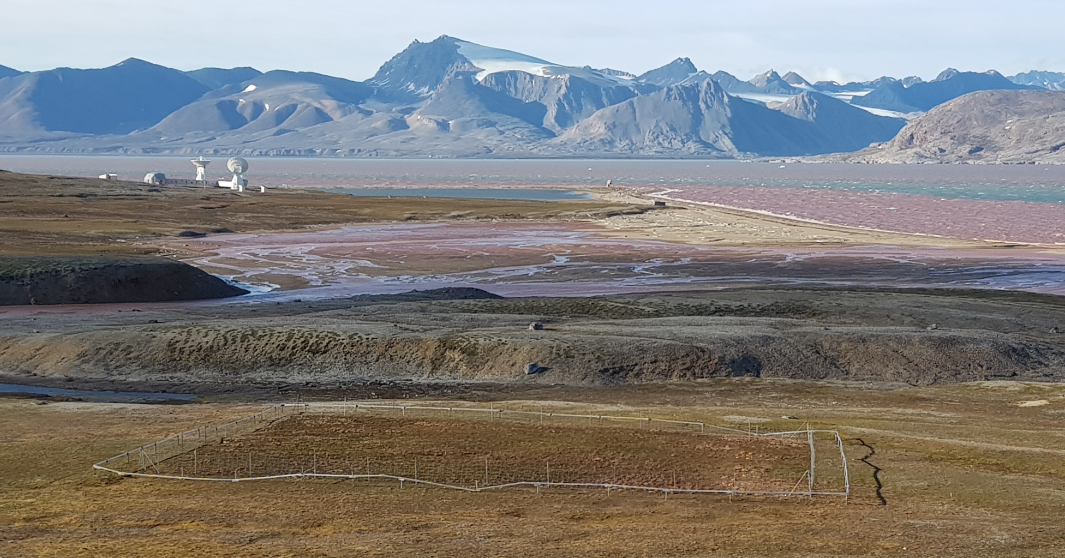


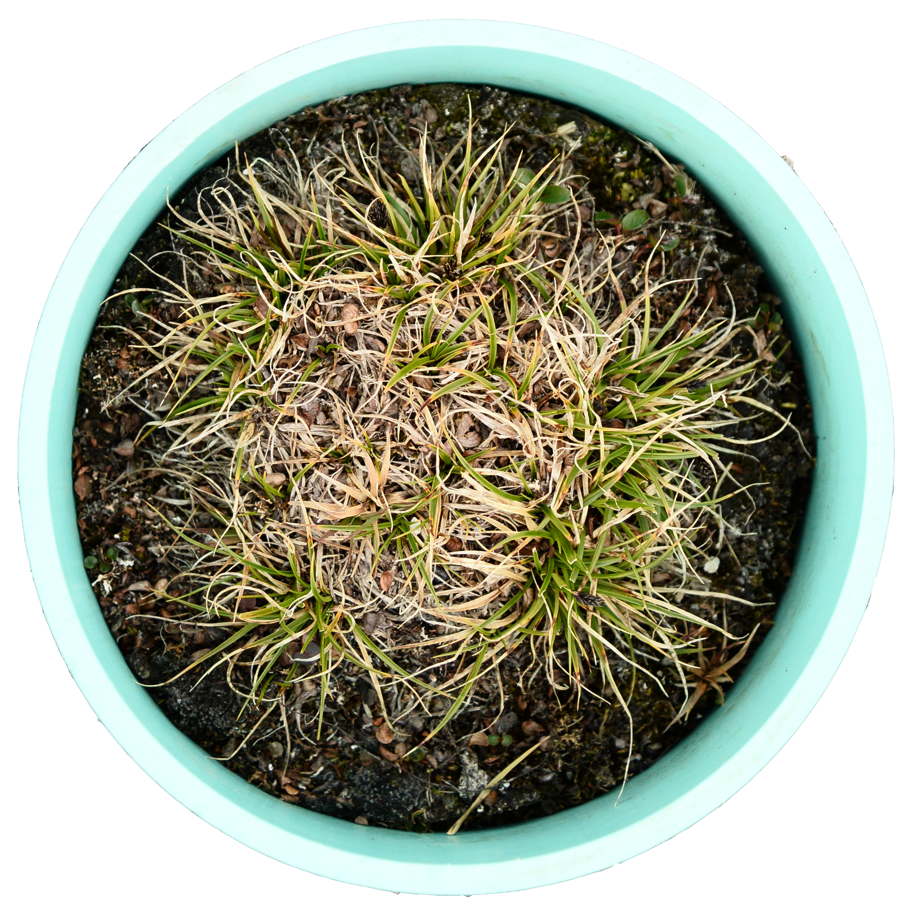



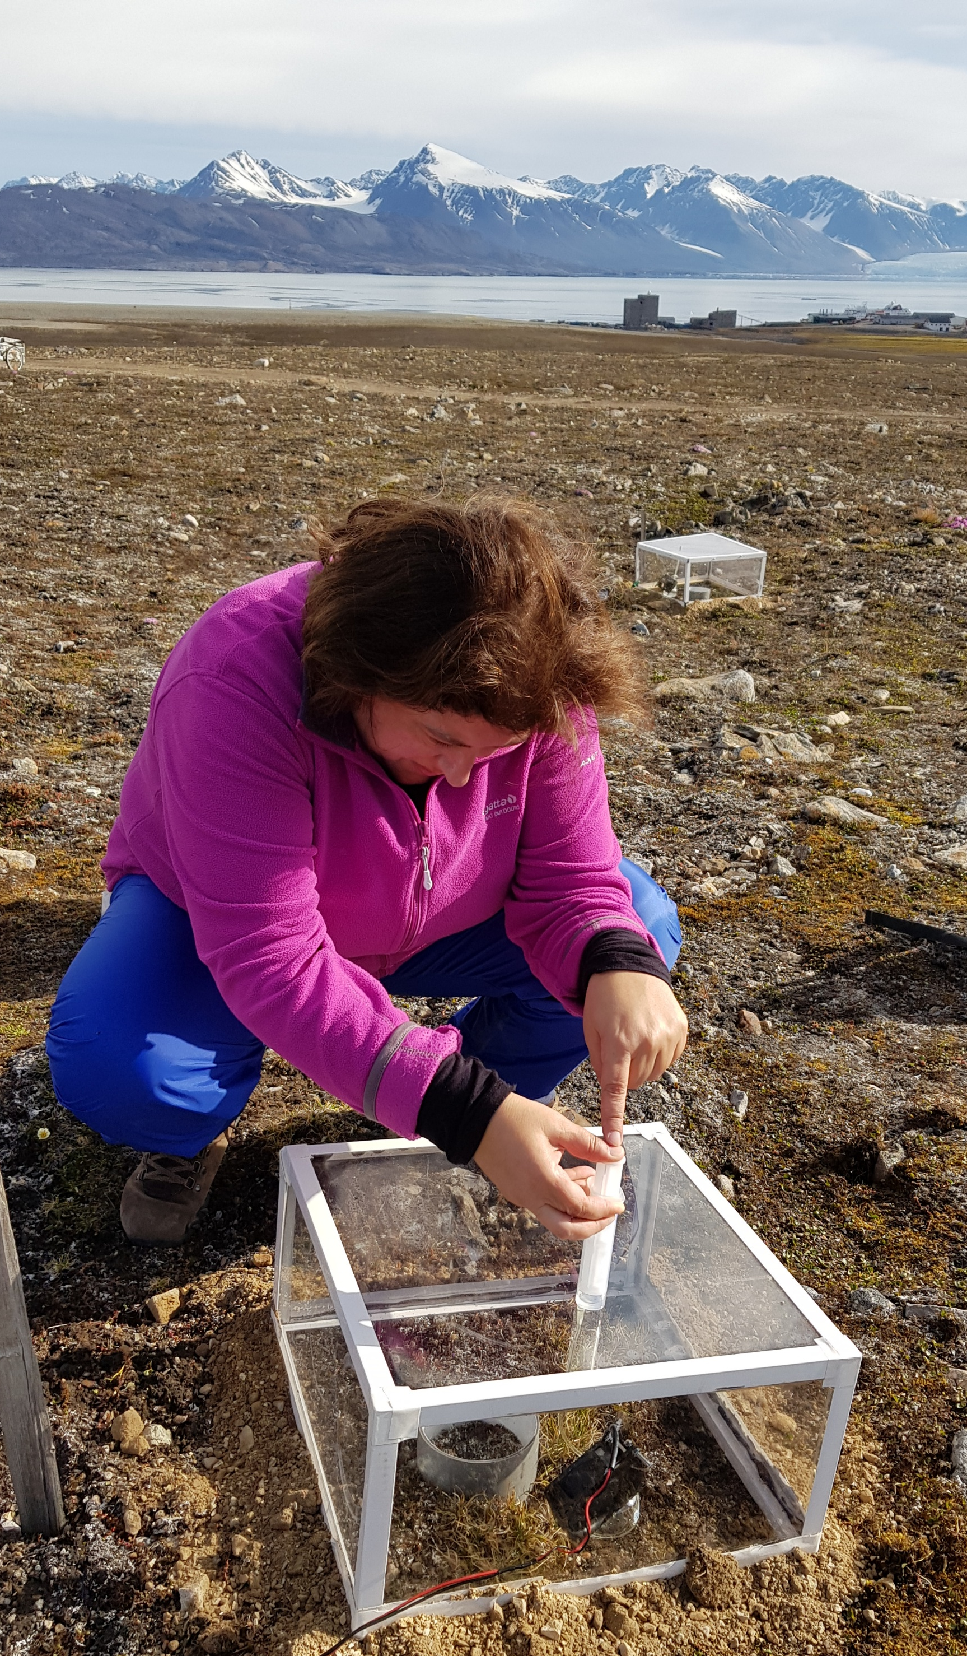
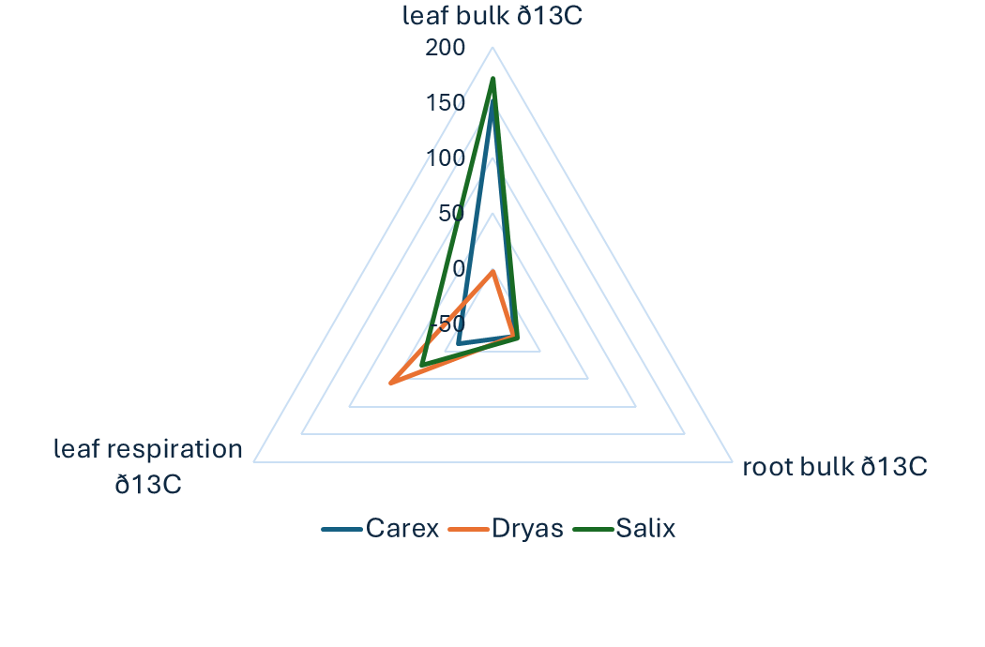


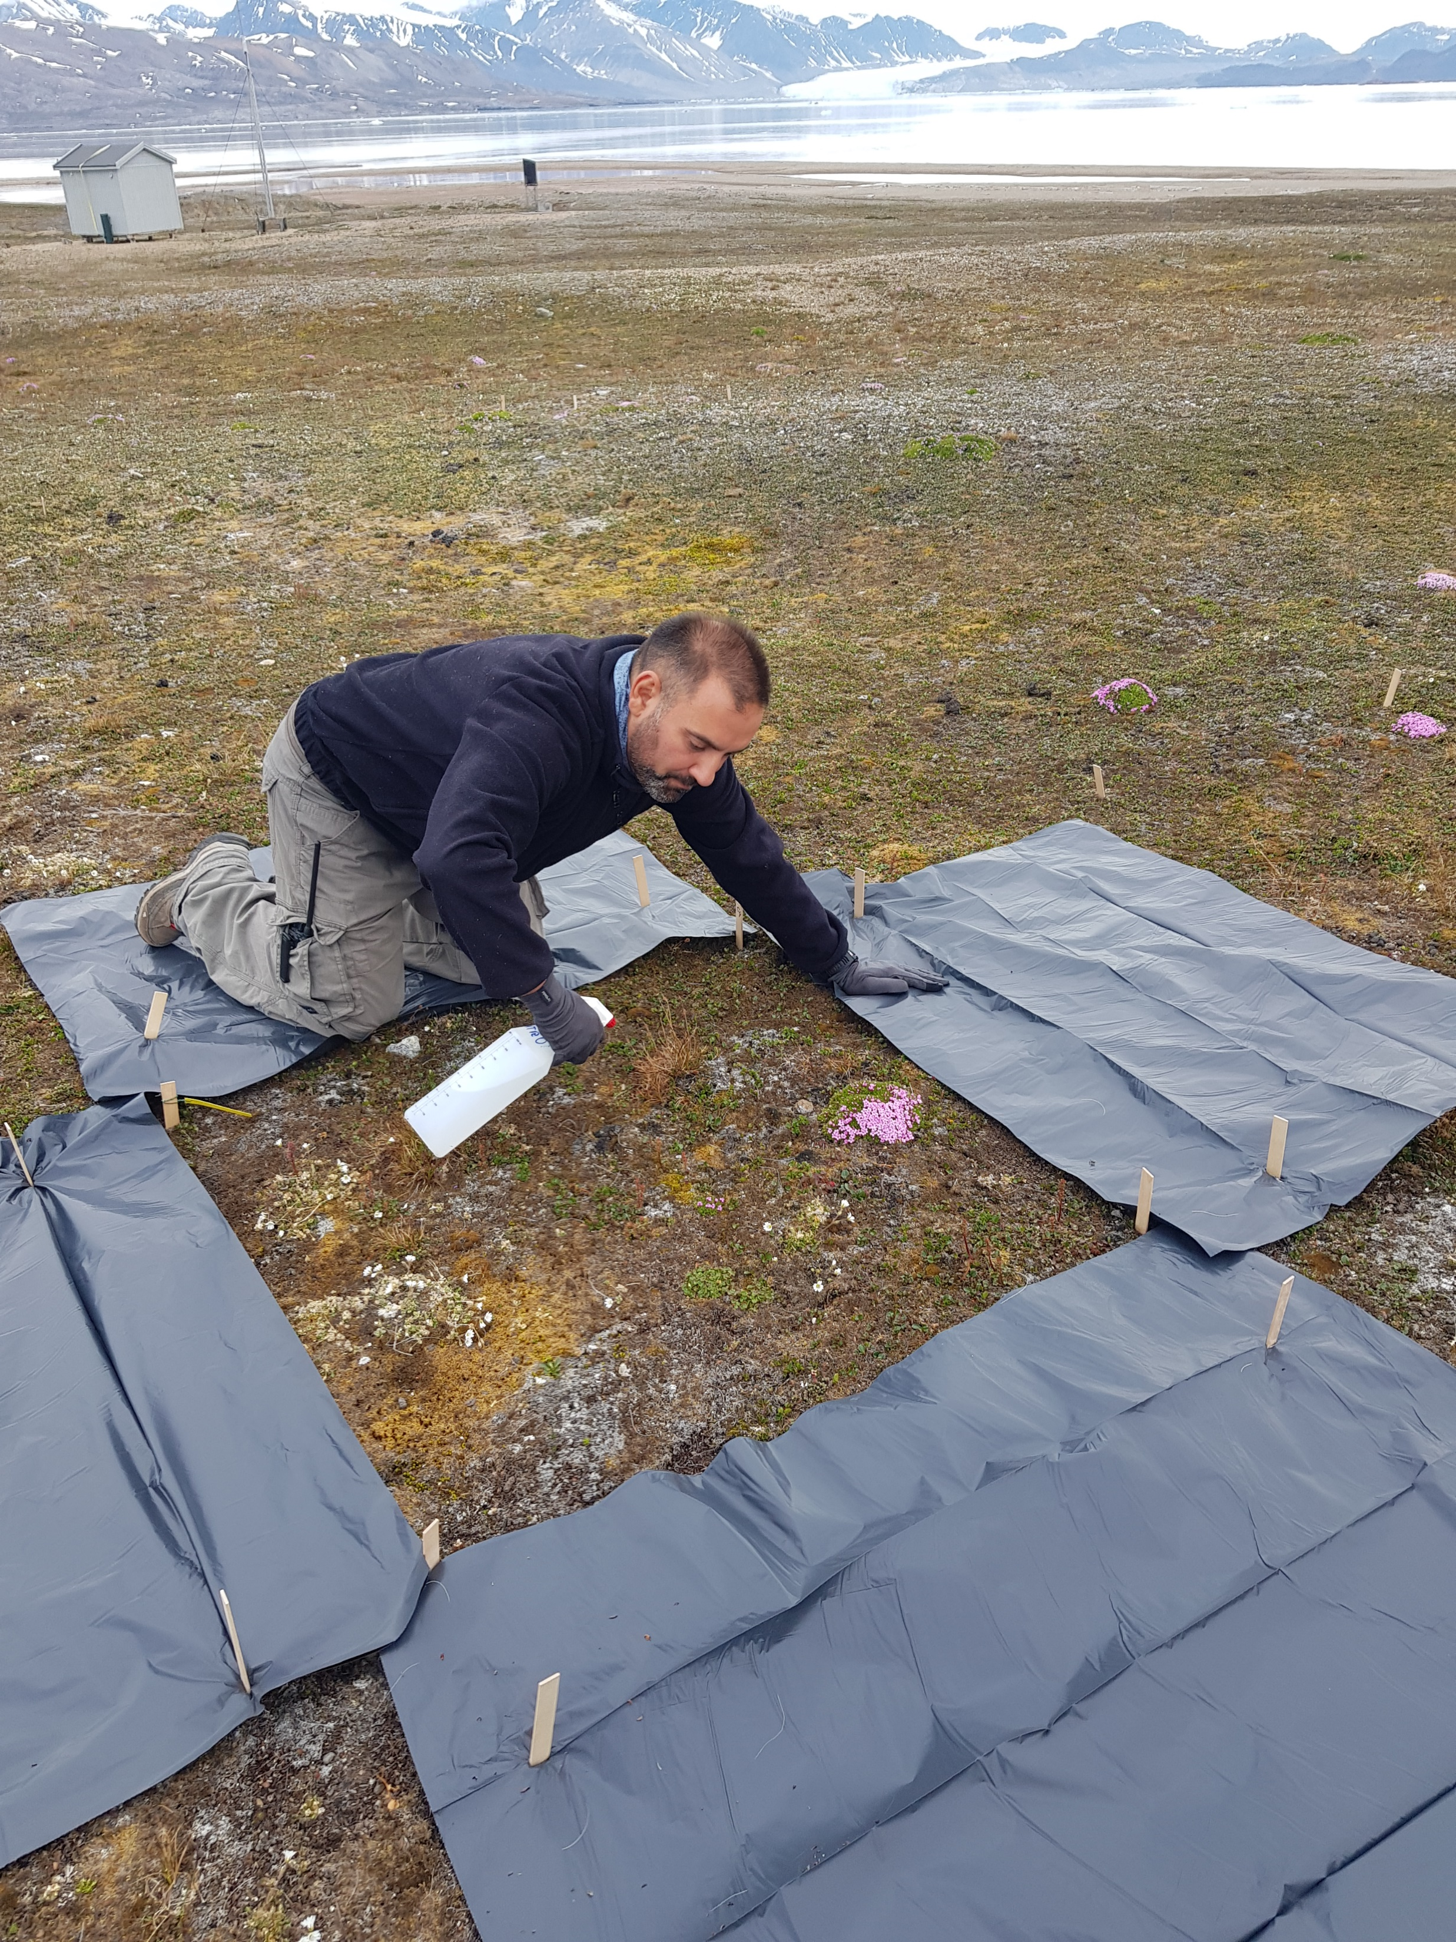
COMMUNITY scale
Soil-plant interactions through C and N allocation strategies
¹³C pulse-labelling experiment
¹⁵N pulse-labelling experiment
¹³CO₂
Assess the role of herbivores and hence to envisage the future contribution of them in tundra contribution to C cycle by studying:
nutrient interactions (C and N) associated to primary producer composition and physiology;
effects of reindeer grazing on the functioning of the primary players and on CO2 fluxes.
National Doctoral Degree Programme in Polar Sciences
Curriculum: Biology, Ecology & Biodiversity
PhD project: Herbivore impacts on Carbon and Nitrogen relationship in High Arctic tundra
The Arctic tundra: key drivers of the Carbon cycle under changing climate

Slide 11

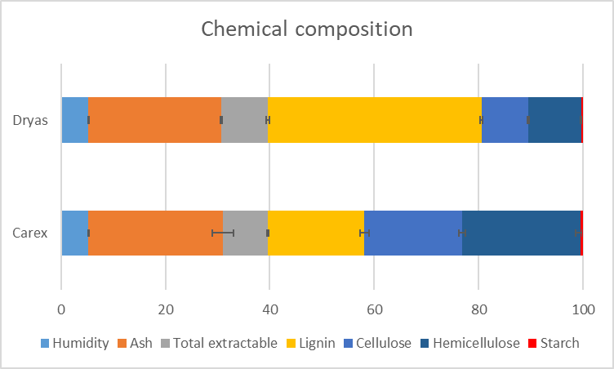
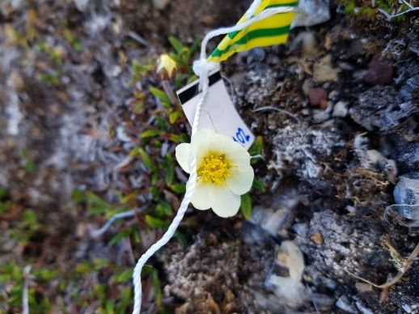
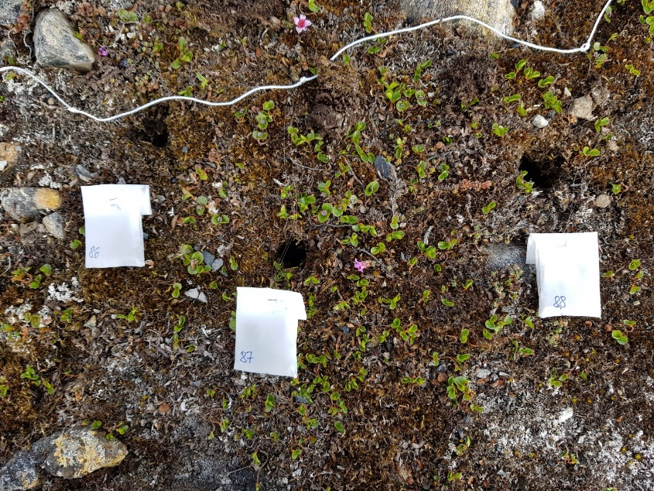
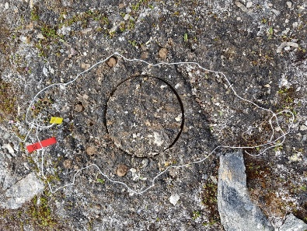
Microbial activity
Two different plants communities and bare soil
Salix polaris
Dryas octopetala
Bare soil
Microbial community of bare soil is not capable to decompose recalcitrant litter
The growth of vegetation (Arctic greening) will impact on soil microbial activity
Causes of change:
Shift in microbial community?
Expression of dormant genes?
The Arctic tundra: key drivers of the Carbon cycle under changing climate

Slide 12


This research was supported by the Research Council of Norway, projects:
2018 - Contribution of Vegetation and Soil components to Carbon cycle in Arctic environment in relationship to climate change (VegSoCA)
2021 - Effects of big herbivores on the functioning of decomposers and primary producers in High Arctic tundra (GrazeAct)
Svalbard Integrated Arctic Earth Observing System - Knowledge Centre (SIOS-KC)
For 2025 summer field campaign, we will receive funds from Arctic Field Grant (AFG) – Funding for Fieldwork in Svalbard from the Research Council of Norway, project:
Beyond Soil: exploring microbial dynamics and carbon cycling in Arctic Tundra soils
This grant will fund two Arctic expedition in late June – early July and in the end of August
The Arctic tundra: key drivers of the Carbon cycle under changing climate

Slide 13
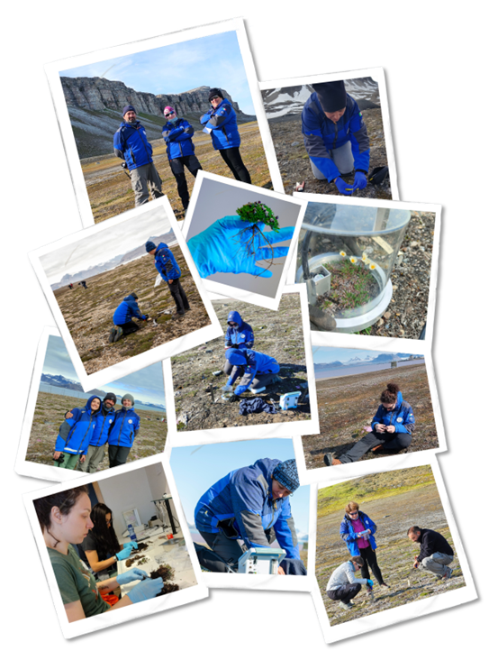
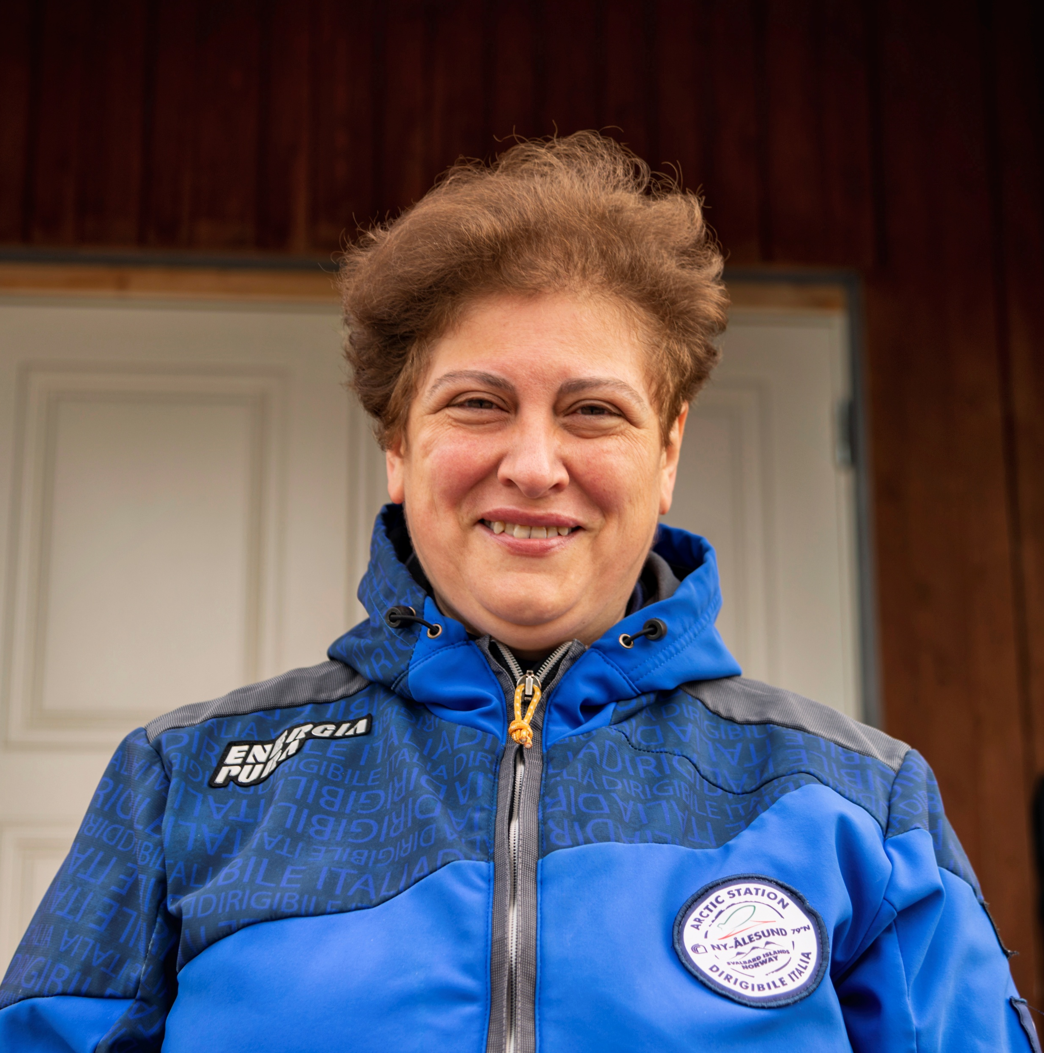
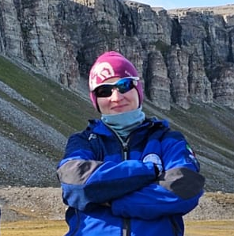
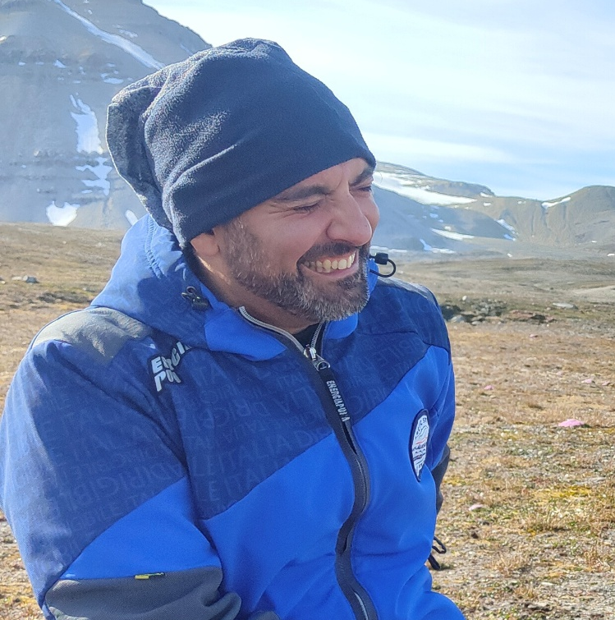
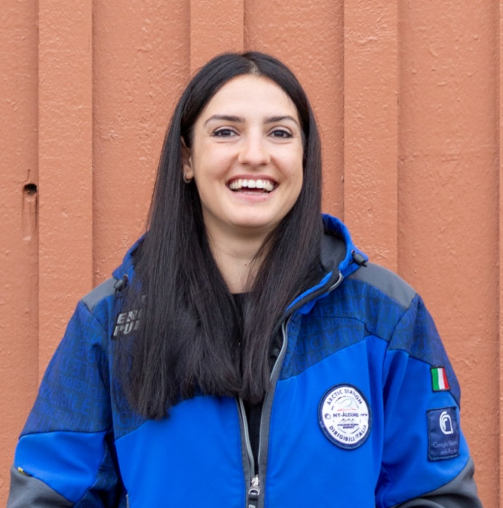
Research group
Dr. Angela Augusti
Senior researcher
Leader of Ny-Ålesund Terrestrial Flagship
Dr. Olga Gavrichkova
Senior researcher
Dr. Emanuele Pallozzi
Senior technologist
Dr. Federica D’Alò
Post-doc researcher
The Arctic tundra: key drivers of the Carbon cycle under changing climate

Slide 14

Thank you!

