Slide 1

Evaluating the Impact of Drought Events on Grassland and Forest Ecosystems in Northern Italian Mountains
Birhane G. Tesfamariam
Sarti M., Gavrichkova O.
CNR-IRET, Porano

Slide 2
1. Introduction
Prominent land-use change trends in Europe in recent decades include:
Abandonment of traditional pastoral activities
Conversion of grasslands to forests through rewilding
In the context of the ongoing climate change, investigating how these different ecosystems respond to climate variability has become a growing research priority

Slide 3
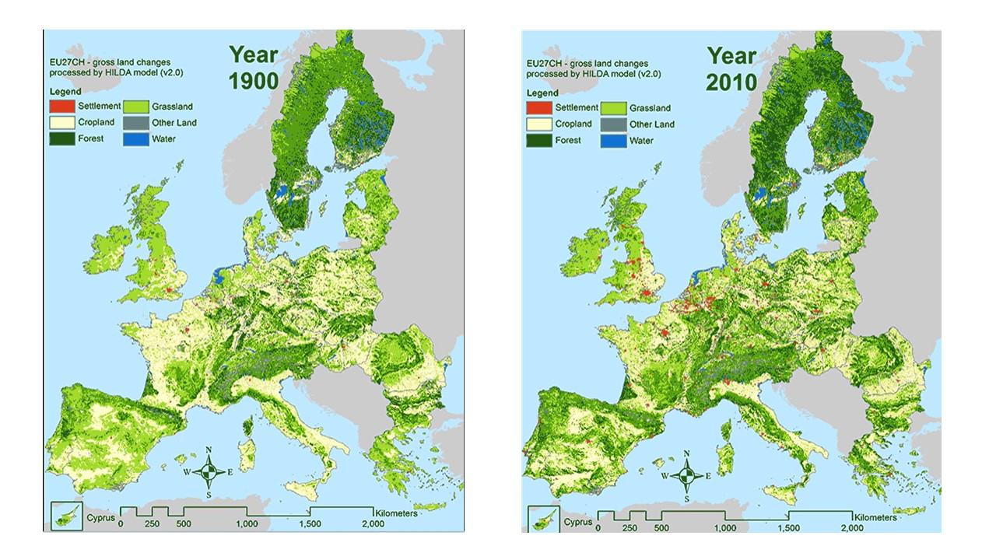
Greening trends in Europe

Slide 4
In Italy, this land use trend concerns primary mountains already experiencing accelerated climate change pressure with increase of extreme events like droughts
Thus, this study aims to examine how grassland and forest ecosystems along the climatic gradient in Italy respond to the impacts of drought events
The first evaluation concerned the Eastern Italian Alps and areas surrounding Passo Brocon (Trentino, Italy)

Slide 5
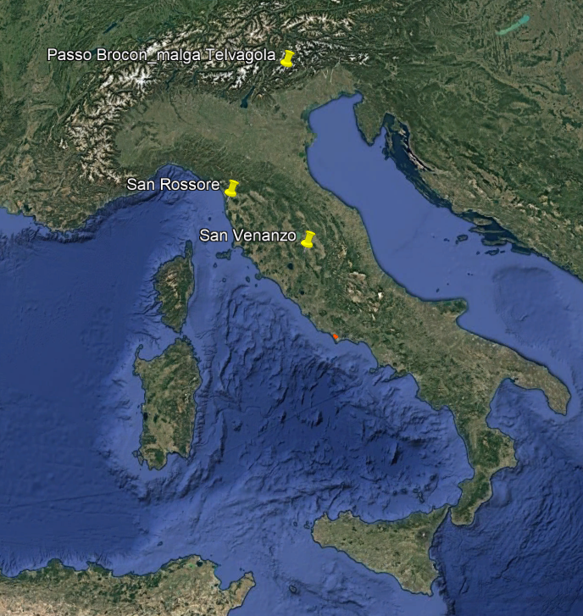
Current study area:
Passo Brocon

Slide 6
2. Materials and Methods
Input Data Sets
Data type | Variables (monthly) | Resolution | Time Range
Climate data (ECMW-Reanalysis ERA5) | Precipitation | 2.2 km | 1981 to 2023
 | Minimum Tº
 | Maximum Tº
Satellite image data | MODIS16-day NDVI | 250 m | 2001 to 2023

Slide 7
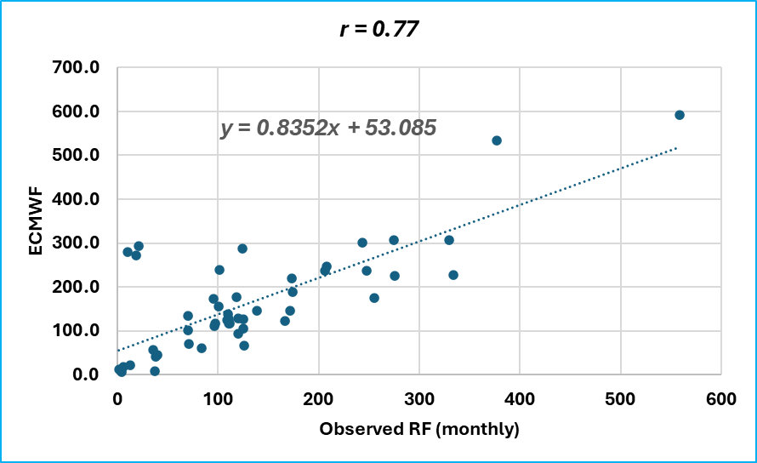
2.1 Validation of Climate Data
Correlation analysis
Accuracy of the ECMWF monthly precipitation was assessed against ground observations over 4 years (2019-2022)

Slide 8
2.2 Trend analysis
A trend analysis was performed
On three climate variables
Precipitation
Tmin
Tmax

Slide 9
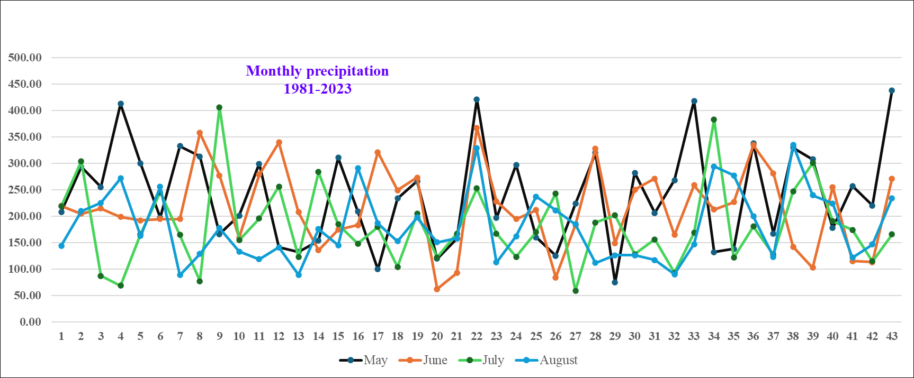

Slide 10
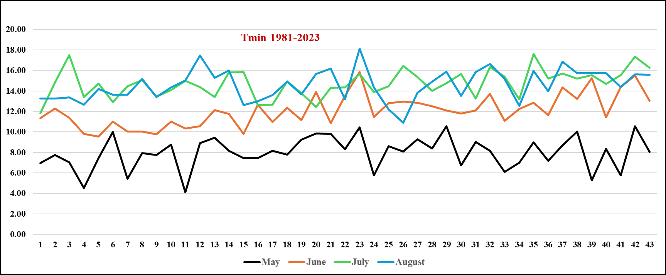

Slide 11
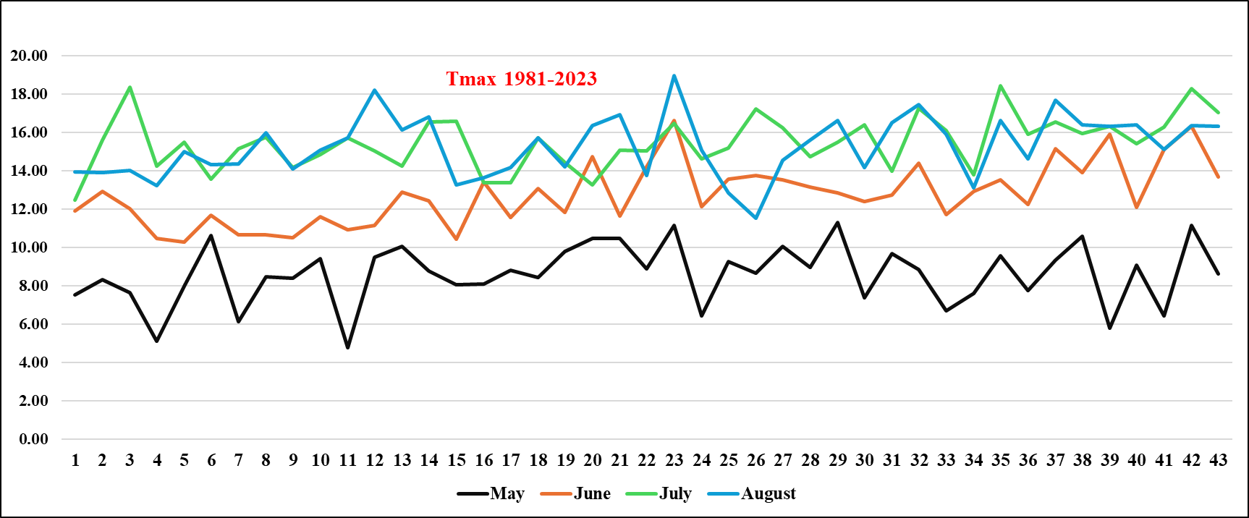

Slide 12
2.3 Methods of Meteorological Drought Assessment
Standardized Precipitation Evapotranspiration Index (SPEI)
Engage more climate variables than SPI
Monthly Precipitation, Tmin, and Tmax
Vegetation response was examined at various time-scales (1-, 3-, 4-, 6-, and 12-month)
The focus of the drought assessment was on:
the growing period from May to August:
to align with the stage of maximum phenological development

Slide 13
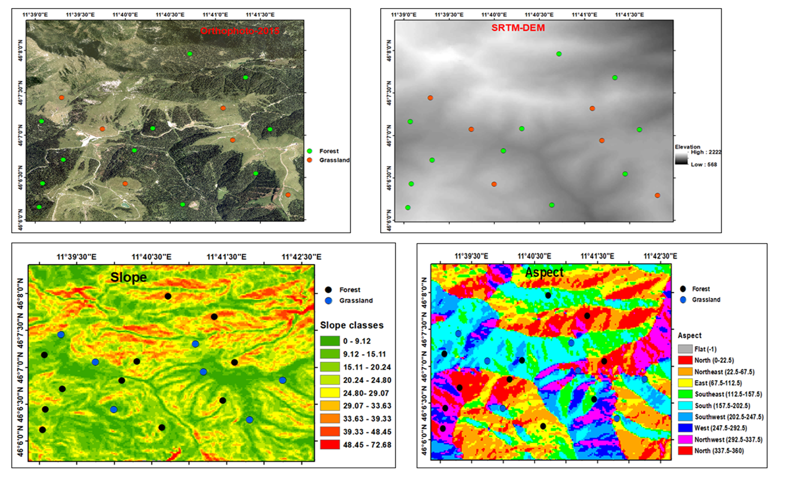
2.4 Selection of Vegetation Response Assessment Sites
11 forest and 7 grassland sites were selected
Elevation, slope, and aspect were considered
to understand the effect of topographic variations on vegetation responses to drought

Slide 14
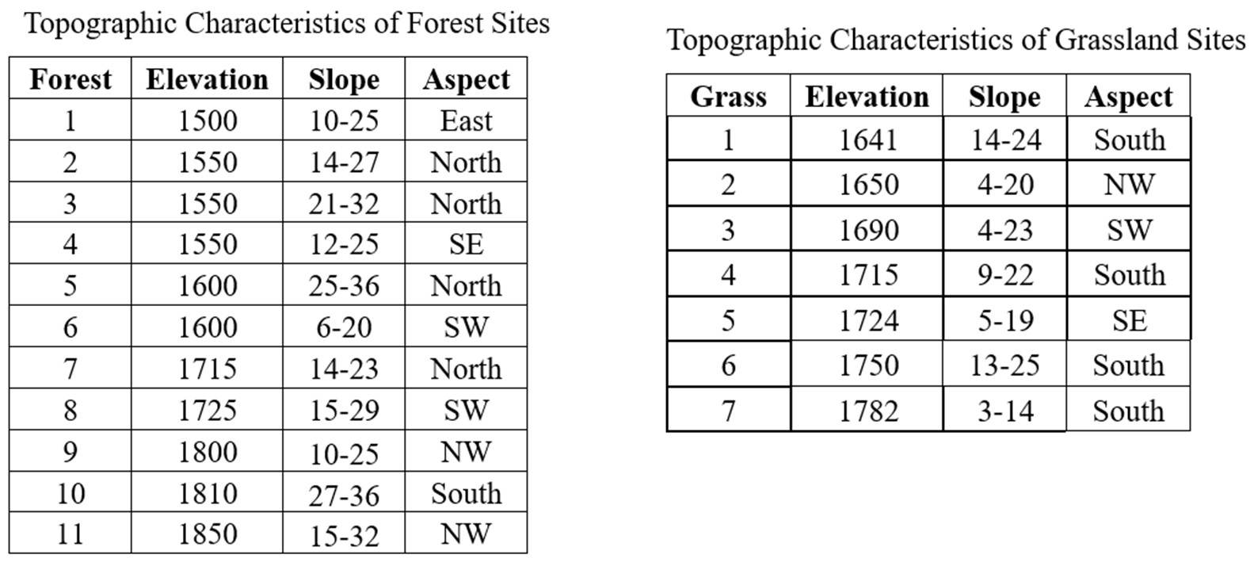

Slide 15
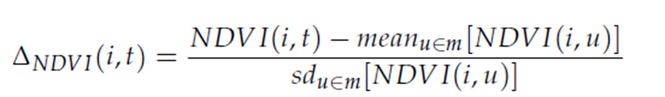
2.5 Characterizing Vegetation Response to Drought
Standardized NDVI anomaly
The monthly average NDVI in the time series is taken as the normal level (Ma et al, 2023)
NDVI anomaly value < -2 stdv is considered as vegetation response to drought (disturbance)

Slide 16
3. Results
3.1 Trend Test Results
The trend analysis result revealed
No significant trend in precipitation (MJJA)
Significant (α <0.05) increasing trends in Tmin and Tmax except for May
With rates of change > 0.04 ºc/ year
Month | Variables | Trend type | Z-value | P-value | Sen’s slope
June | Tmin | +ve | 2.2815 | 0.02 | 0.0494 ºc/year
 | Tmax | +ve | 2.2396 | 0.02 | 0.0487 ºc/year
July | Tmin | +ve | 2.6582 | 0.007 | 0.0497 ºc/year
 | Tmax | +ve | 2.7001 | 0.006 | 0.0495 ºc/year
August | Tmin | +ve | 2.4908 | 0.01 | 0.0440 ºc/year
 | Tmax | +ve | 2.4280 | 0.01 | 0.0438 ºc/year

Slide 17
3.2. Drought Assessment Results
SPEI drought categories (Li et al., 2015)
Drought category | SPEI values
Extremely wet | > 2.00
Very wet | 1.50 to 1.99
Moderately wet | 1.00 to 1.49
Near-normal | -0.99 to 0.99
Moderately dry | -1.49 to -1.00
Severely dry | -1.99 to -1.50
Extremely dry | < -2
Wetter
Drier
Finally, the drought assessment focused on two more important time-scales
SPEI-03 and SPEI-04
Relatively correlated with grassland and forest responses, respectively

Slide 18
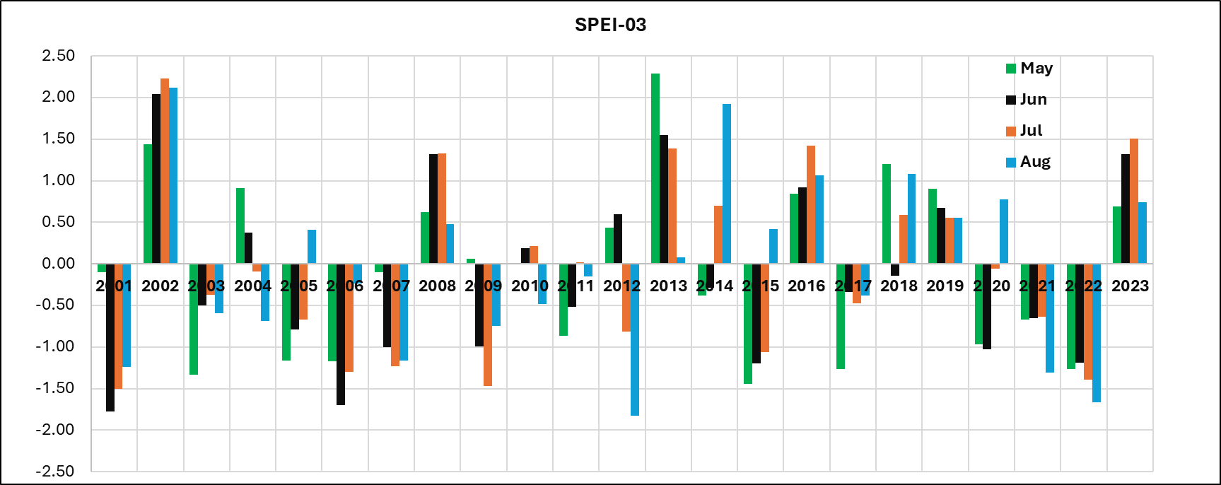
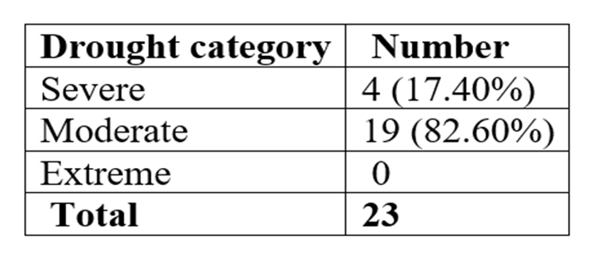
Characteristics of drought events (2001-2023)
Wetter
Drier
NB: The driest year was 2022

Slide 19
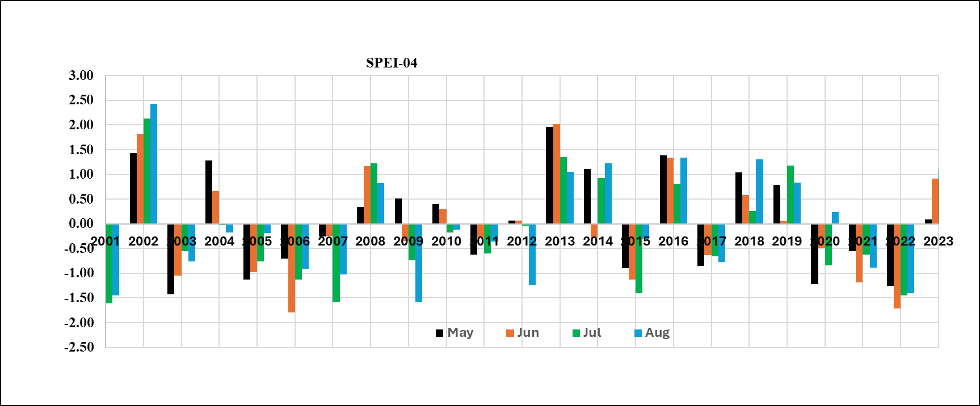
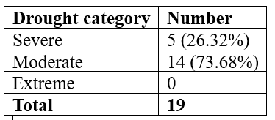
Wetter
Drier
NB: The driest year was 2022

Slide 20
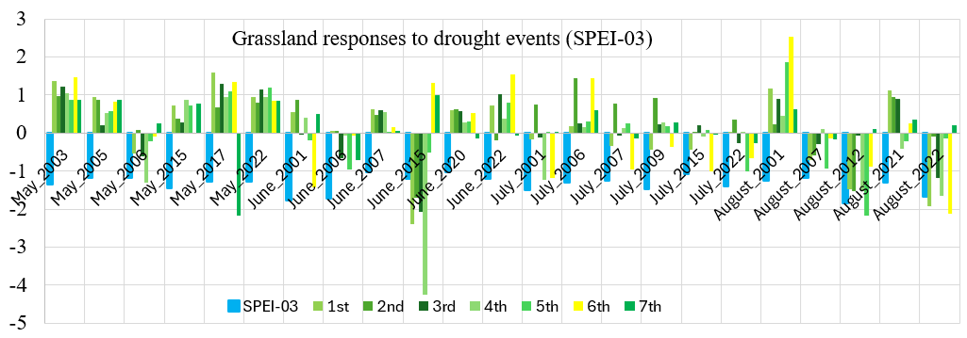
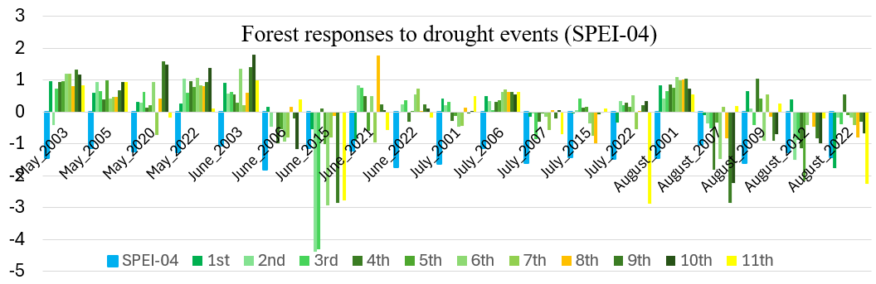
3.3 Correlations of Met Drought Events and Ecosystem Responses
Generally, they were found to be poorly correlated

Slide 21
Drought events vs Grassland responses (2001-2023)
Drought events | Stressed grass events | Response %
23 | 4 | 17.40
NB: Seasonal grazing might have distorted Grassland responses
Drought events vs Forest responses (2001-2023)
Drought events | Stressed forest events | Response %
19 | 5 | 26.3
Both ecosystems have remained largely resistant to drought events
High elevation (low PET) and snow cover might have contributed to such resistance

Slide 22
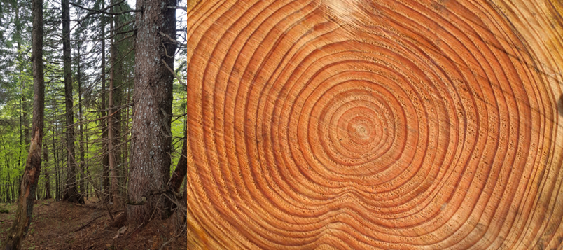
4. Next Work
Evaluating the response of forests and grasslands to drought events at other sites along the climatic gradient.
Confront the NDVI time series with other proxies of ecosystem’s sensitivity to drought: dendrochronological and herb-chronological study
Dolezal et al., 2021

Slide 23
5. Summary
So far, the forest and grassland ecosystems have shown low sensitivity to warming temperatures and recurrent drought events
However, if such climate anomaly trends persist in the future, they could have growing impacts on vegetation productivity and ecosystem functioning

Slide 24

Thank you!

