Slide 1
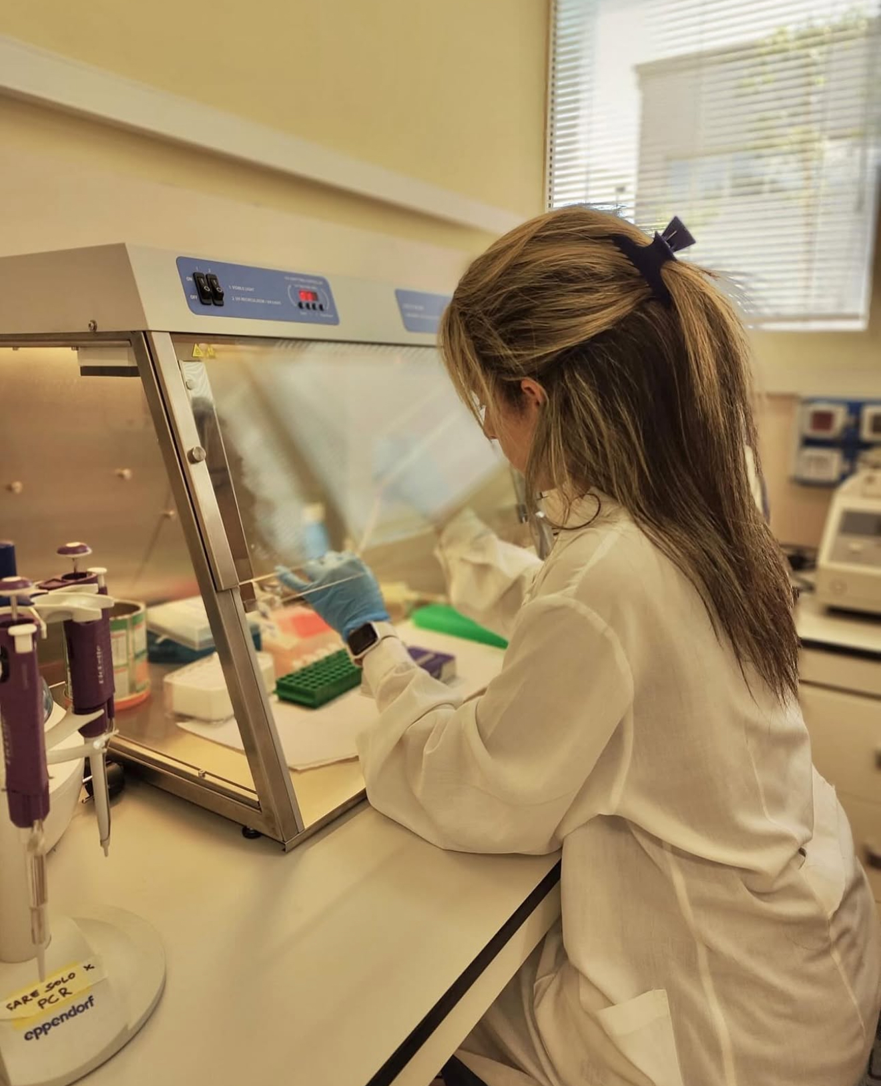
A non-invasive genetics insight into population structure and recolonization dynamics of the Eurasian otter (Lutra lutra) at the boundary of its Italian core range
Greta Agostini
CNR-IRET, 00015 Montelibretti, Rome

Slide 2
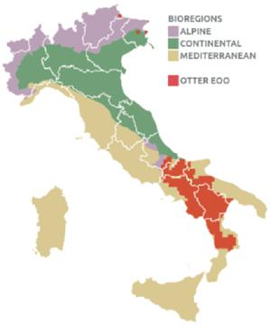
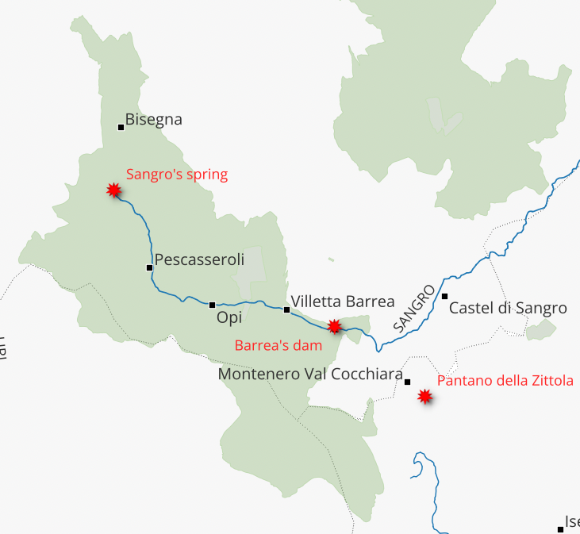
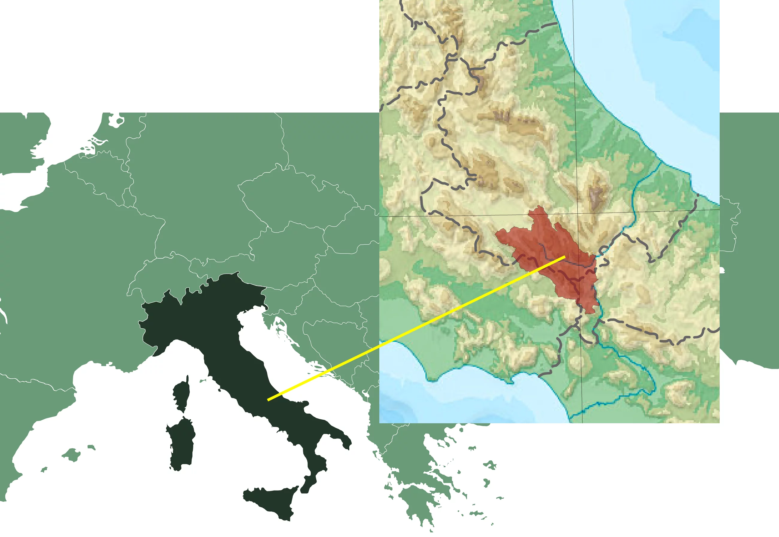

Distribution range of the Eurasian otter

Slide 3
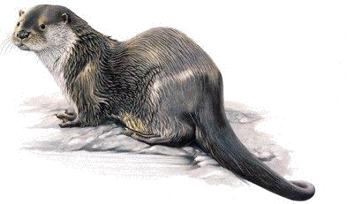
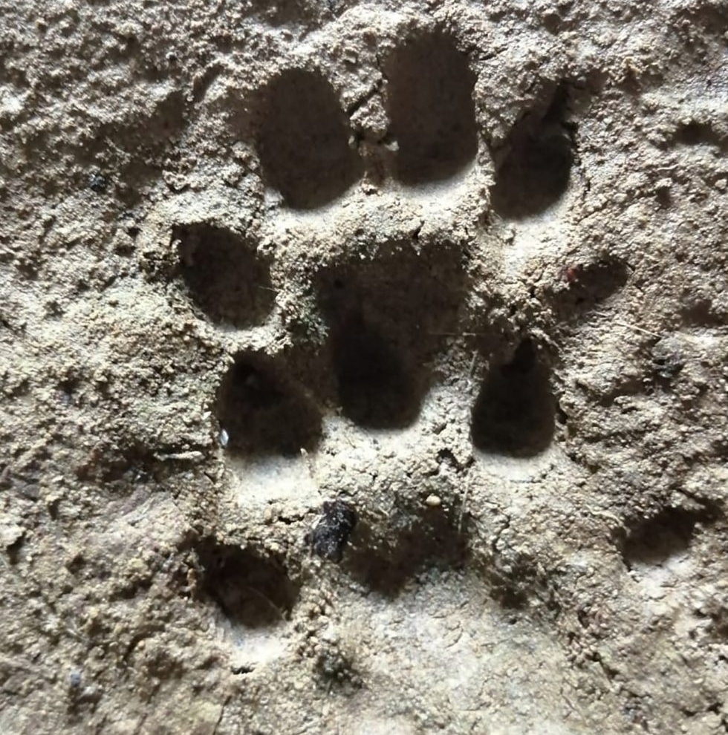
Objectives
How many otters are there in the PNALM?
Where do PNALM otter nucleus come from?
How much do they move in Central Italy?
What can limit gene flow?

Slide 4
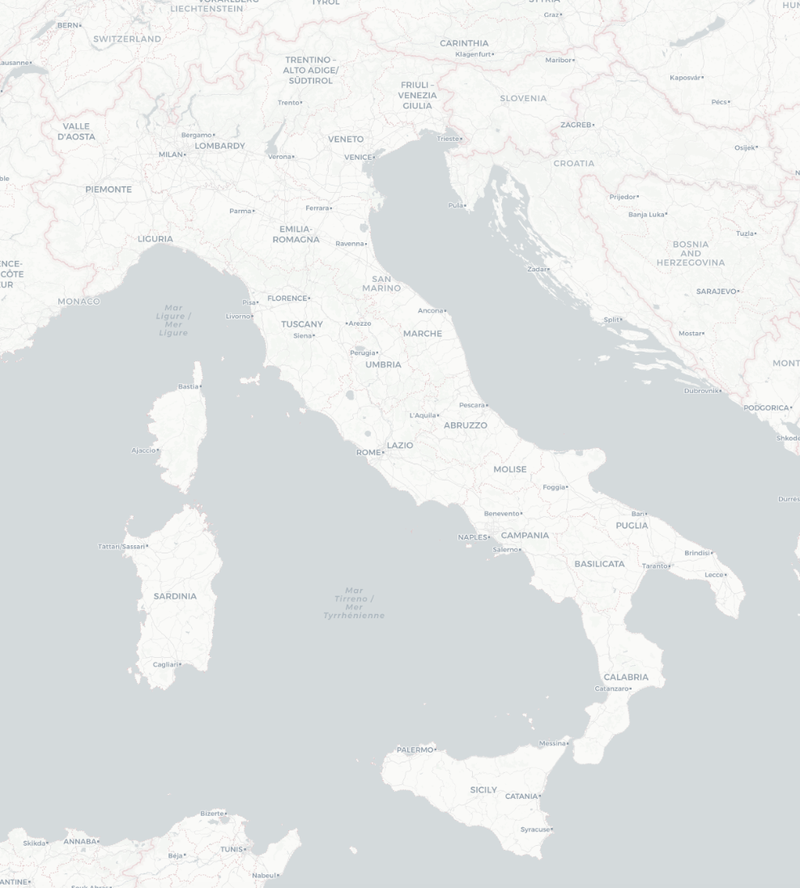
Sampling sites
Spraints
Anal jellies
Tissues

Slide 5
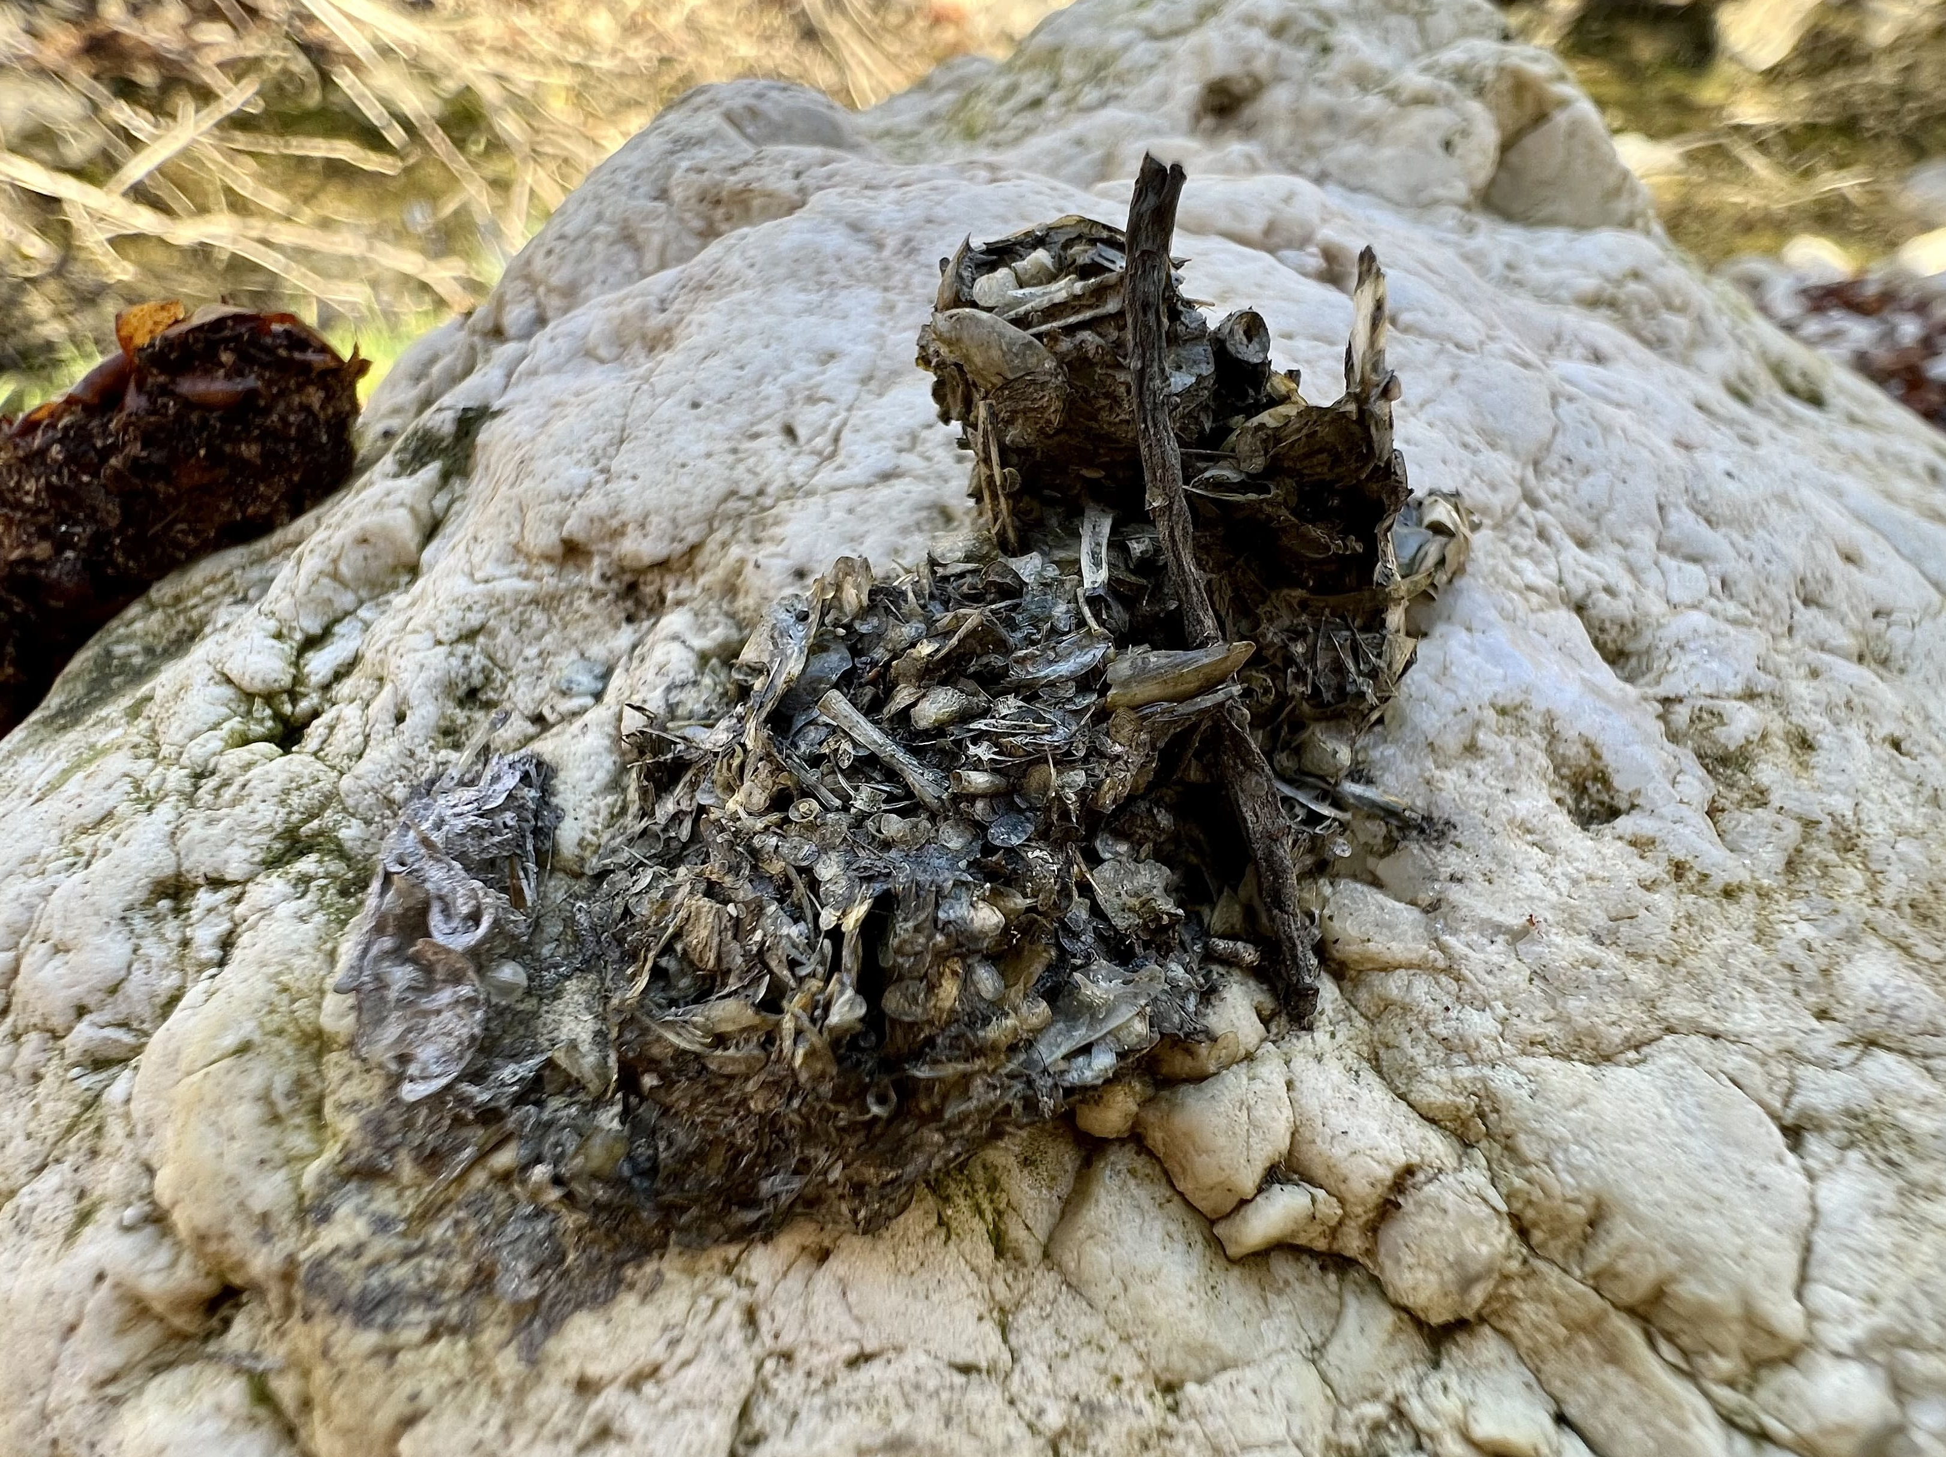
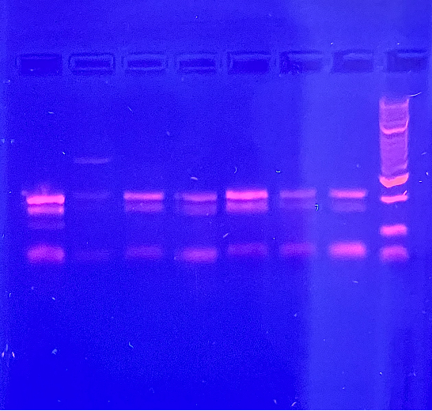
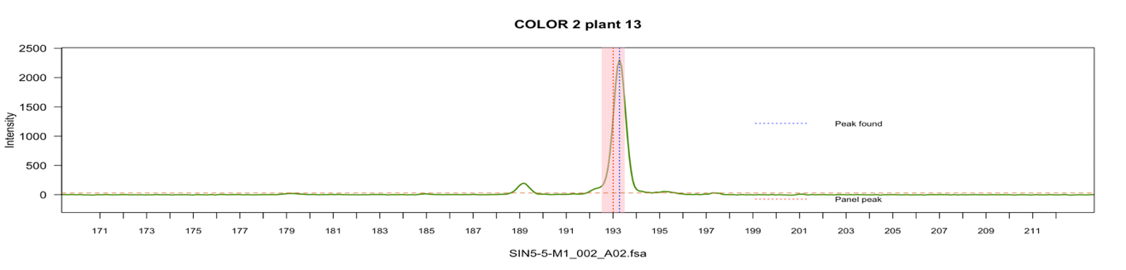
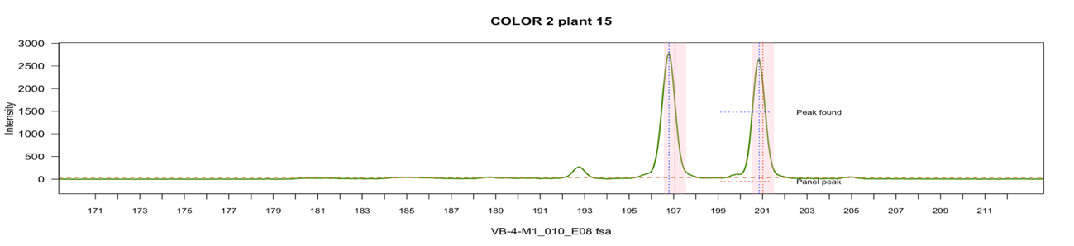
Non-invasive genetics
300 bp
100 bp

Slide 6
Objectives
How many otters are there in the PNALM?

Slide 7
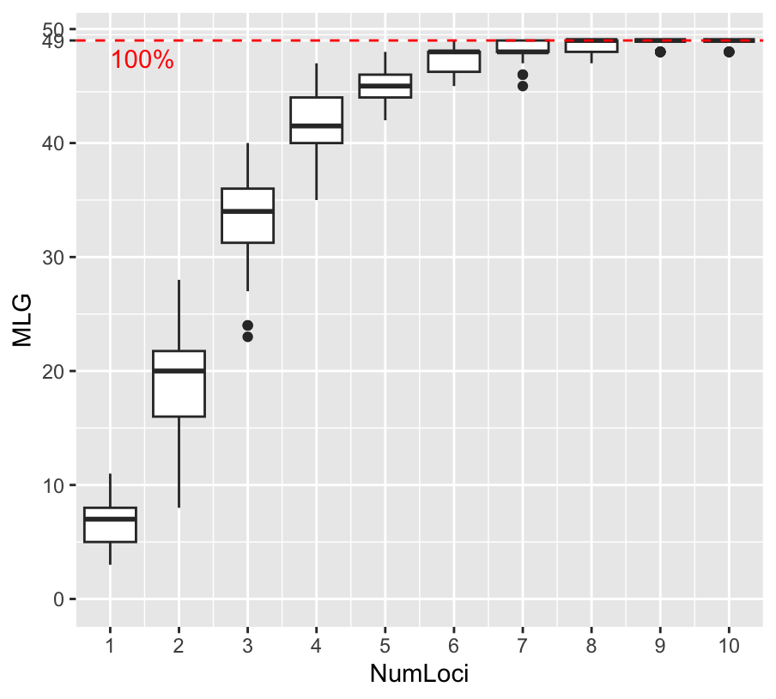


How many otters correspond to 50 faecal samples?
50 genotyped specimens
34 unique genotypes
S-V
F-A-P
15
10
4
3
1
1

Slide 8
How many otters are there in the PNALM?
Census population size
N_{c} = 50 (CI95% 31-75)
 | N_{c} | Reference
Sangro basin | 11(CI95%=12-14) | Lerone et al. 2014
FullSibIndex | Prob (Inc.) | Prob (Exc.) | Member 1 | Member 2 | Member 3 | Member 4 | Member 5
2 | 0.6460 | 0.6460 | Bar_12 | Bis_1 | Bis_3 | Opi3_3 | Opi3_4
5 | 0.9599 | 0.4683 | Bargel_1 | Bargel_2

Slide 9
Inbreeding level

Slide 10
Objectives
How many otters are there in the PNALM?
Where do PNALM otter nucleus come from?

Slide 11
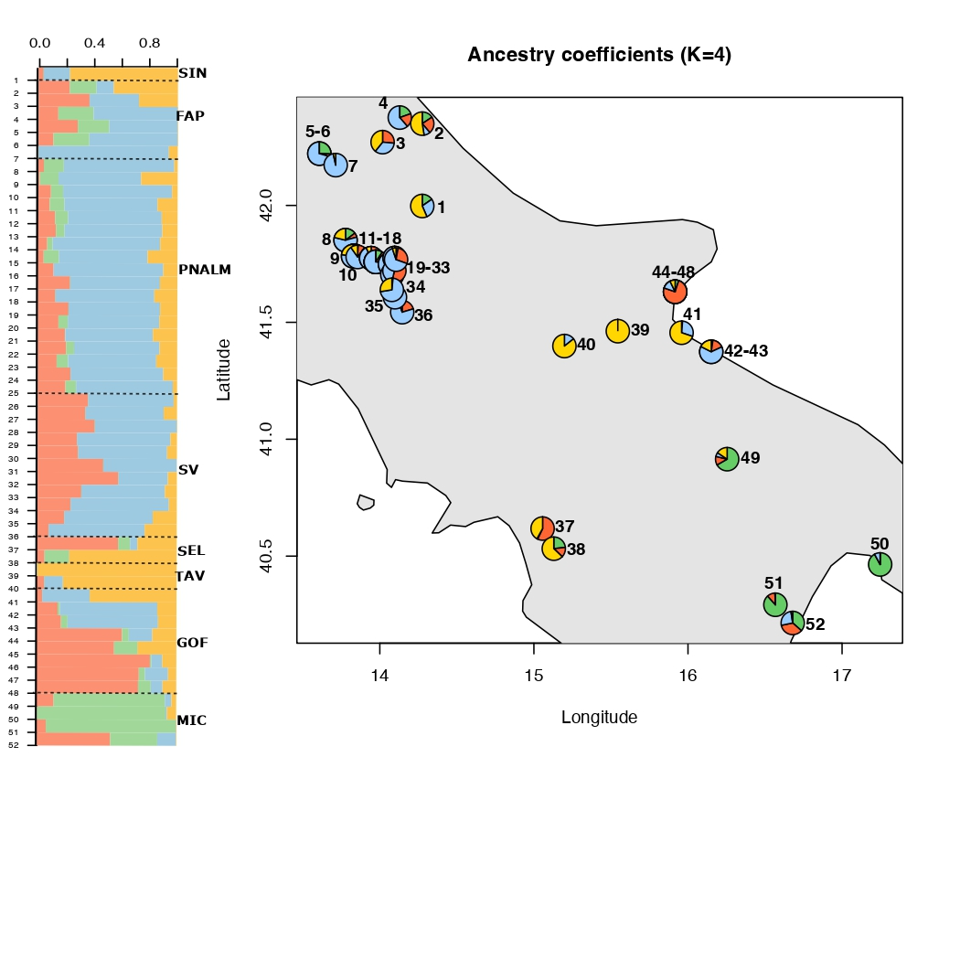
Where do PNALM otters come from?
FAP
Adriatic Sea
SIN
PNALM
TAV
GOF
SV
MIC
SEL
Tyrrhenian Sea

Slide 12
Objectives
How many otters are there in the PNALM?
Where do PNALM otter nucleus come from?
How much do they move in Central Italy?

Slide 13
How much do they move in Central Italy?

Slide 14
Objectives
How many otters are there in the PNALM?
Where do PNALM otter nucleus come from?
How much do they move in Central Italy?
What can limit gene flow?

Slide 15
What can limit gene flow?
FAP
Adriatic Sea
SIN
PNALM
TAV
GOF
SV
MIC
SEL
Tyrrhenian Sea

Slide 16
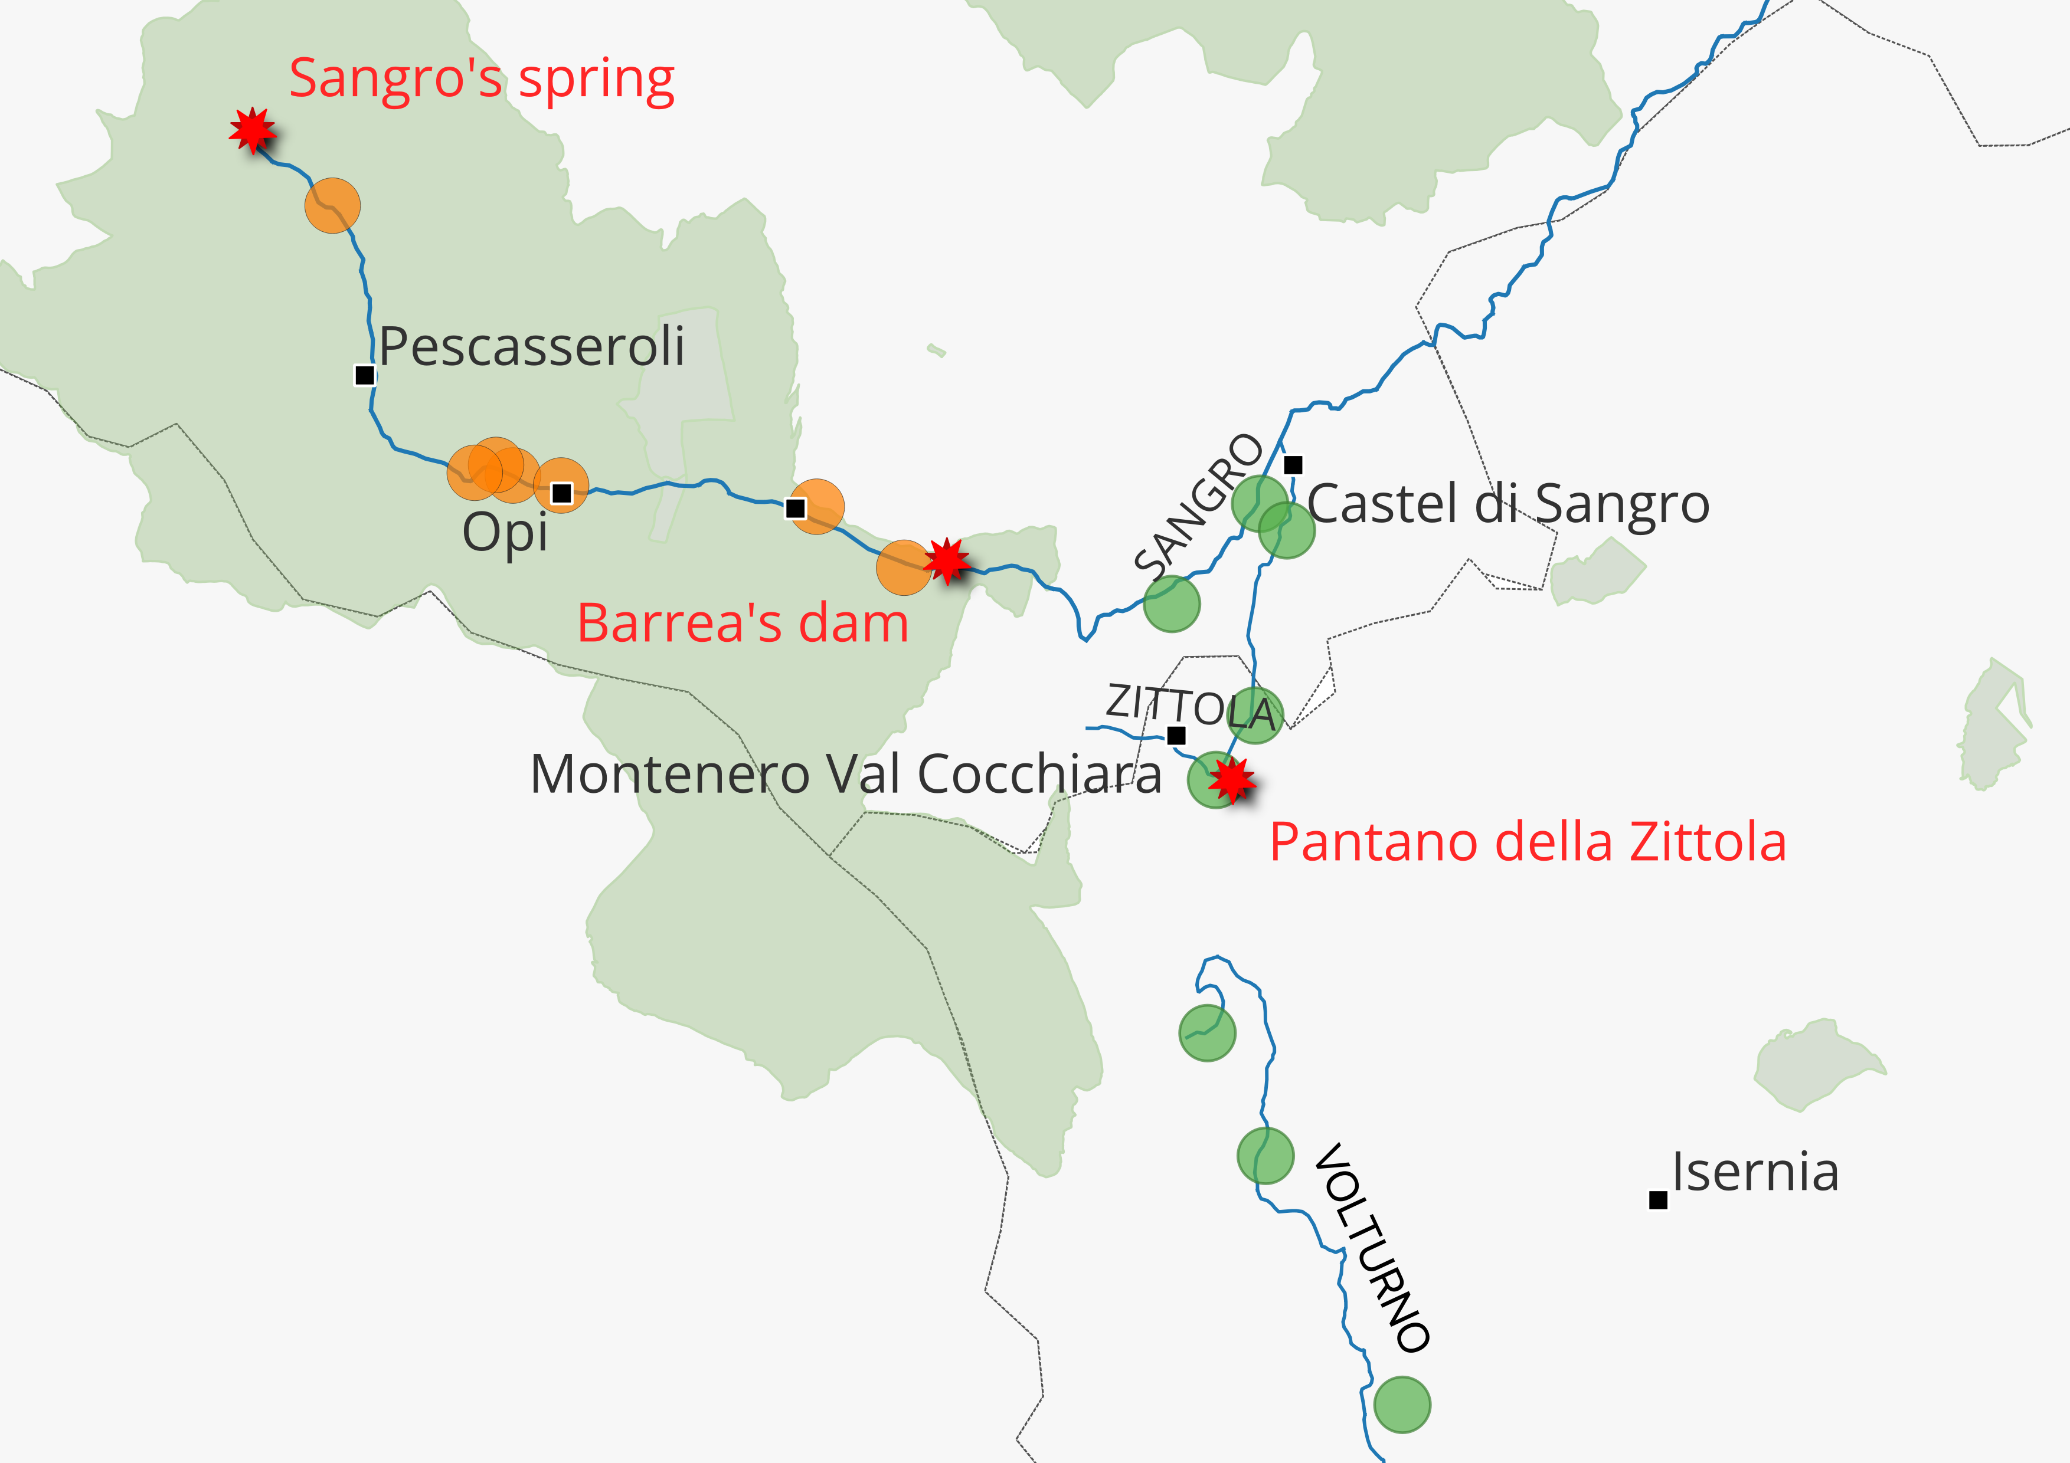
What can limit gene flow?

Slide 17

Conclusions
Favorable conservation status of PNALM otter nucleus
Monitoring and reducing man-made obstacles to facilitate otters’ expansion
Future genomic research to understand and support population stability

Slide 18

Thank you!

