Slide 1
Terahertz Imaging for Agriculture and Non-Invasive Food Inspection
Mario Pagano
CNR-IRET (Florence, Italy)

Slide 2
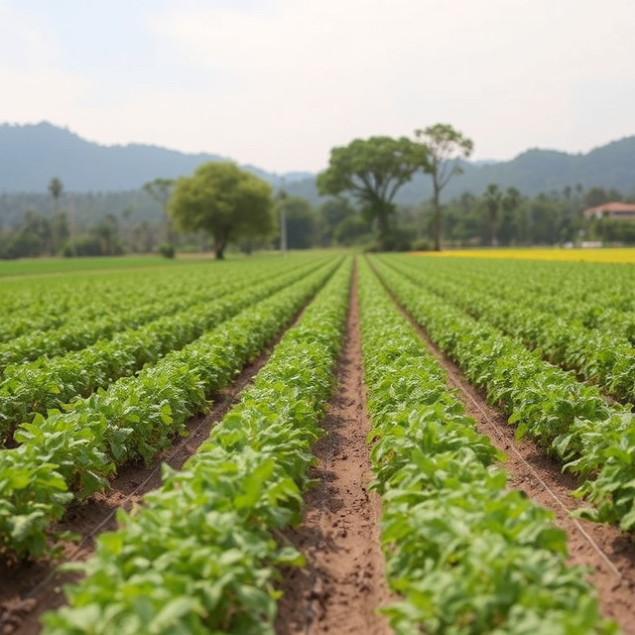
GLOBAL CHALLENGES IN AGRICULTURE
→ Biodiversity preservation
→ Environmental sustainability
→ Expansion in cultivated areas
→ Efficient resource management
→ Food security

Slide 3
Terahertz (THz) radiation
THz radiation shows great potential as a tool to overcome at least the last two challenges mentioned earlier.

Slide 4
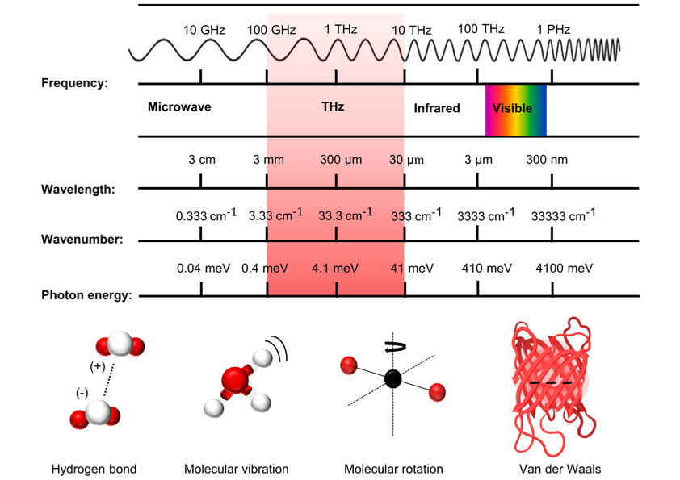
INTRODUCTION TO TERAHERTZ (THz) RADIATION

Slide 5
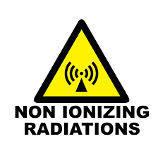
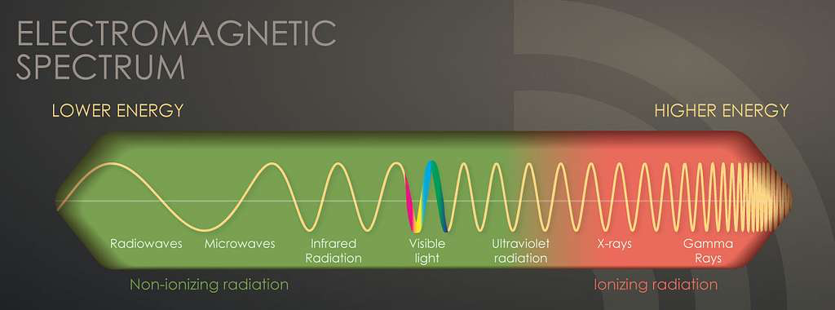
ADVANTAGES OF THz RADIATION:
→ Non-ionizing radiation
→ Evaluate packaging materials
→ Crop monitoring
→ Safe for biological analysis

Slide 6
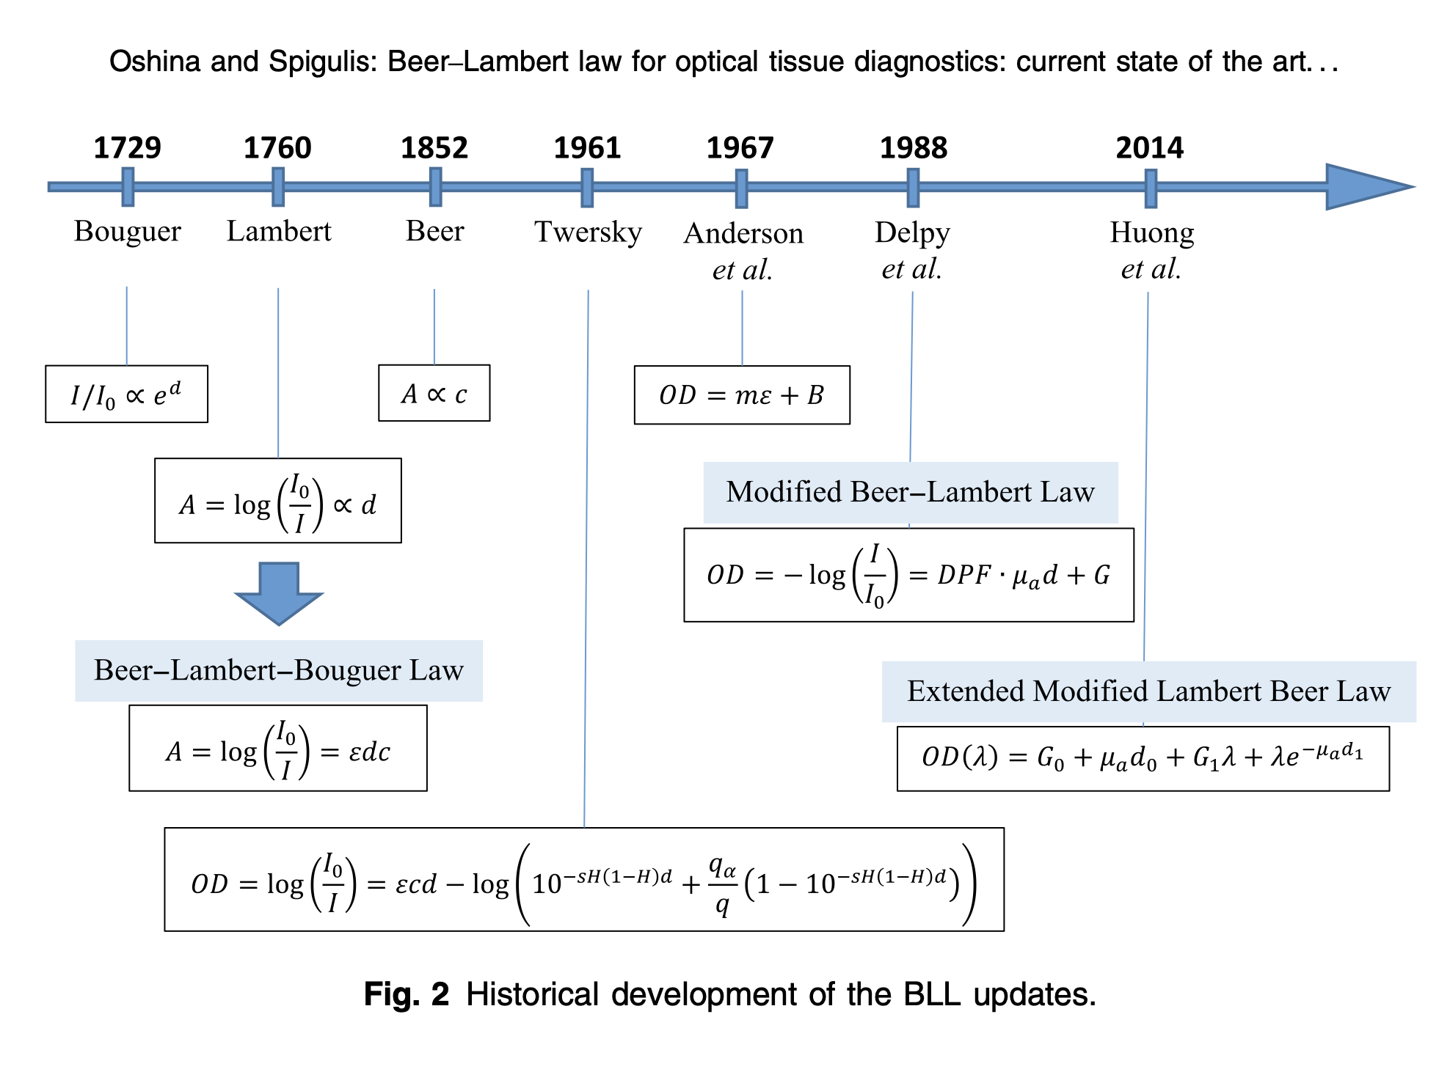
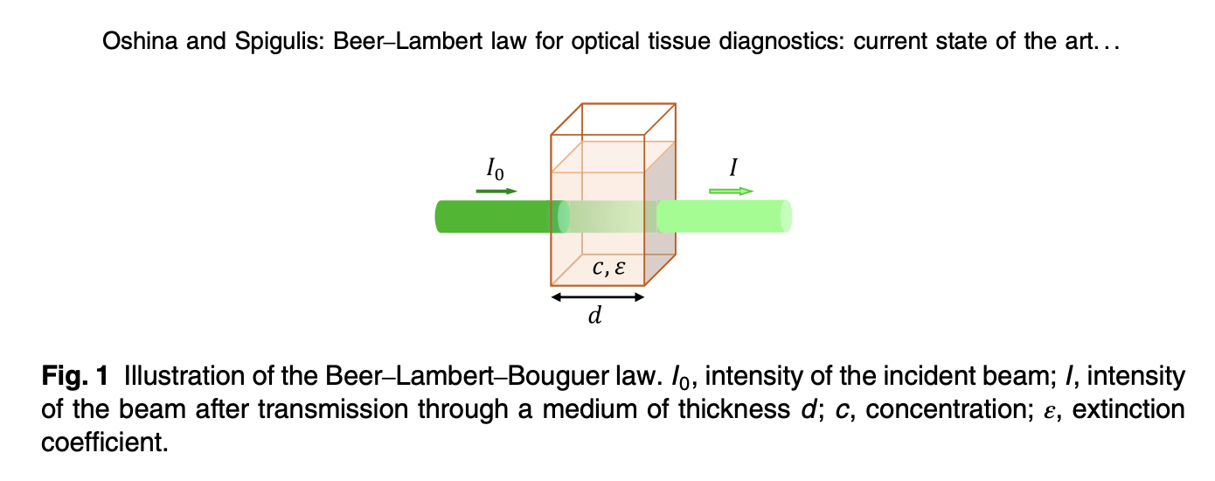
BEER–LAMBERT LAW
DOI: 10.1117/1.JBO.26.10.100901

Slide 7
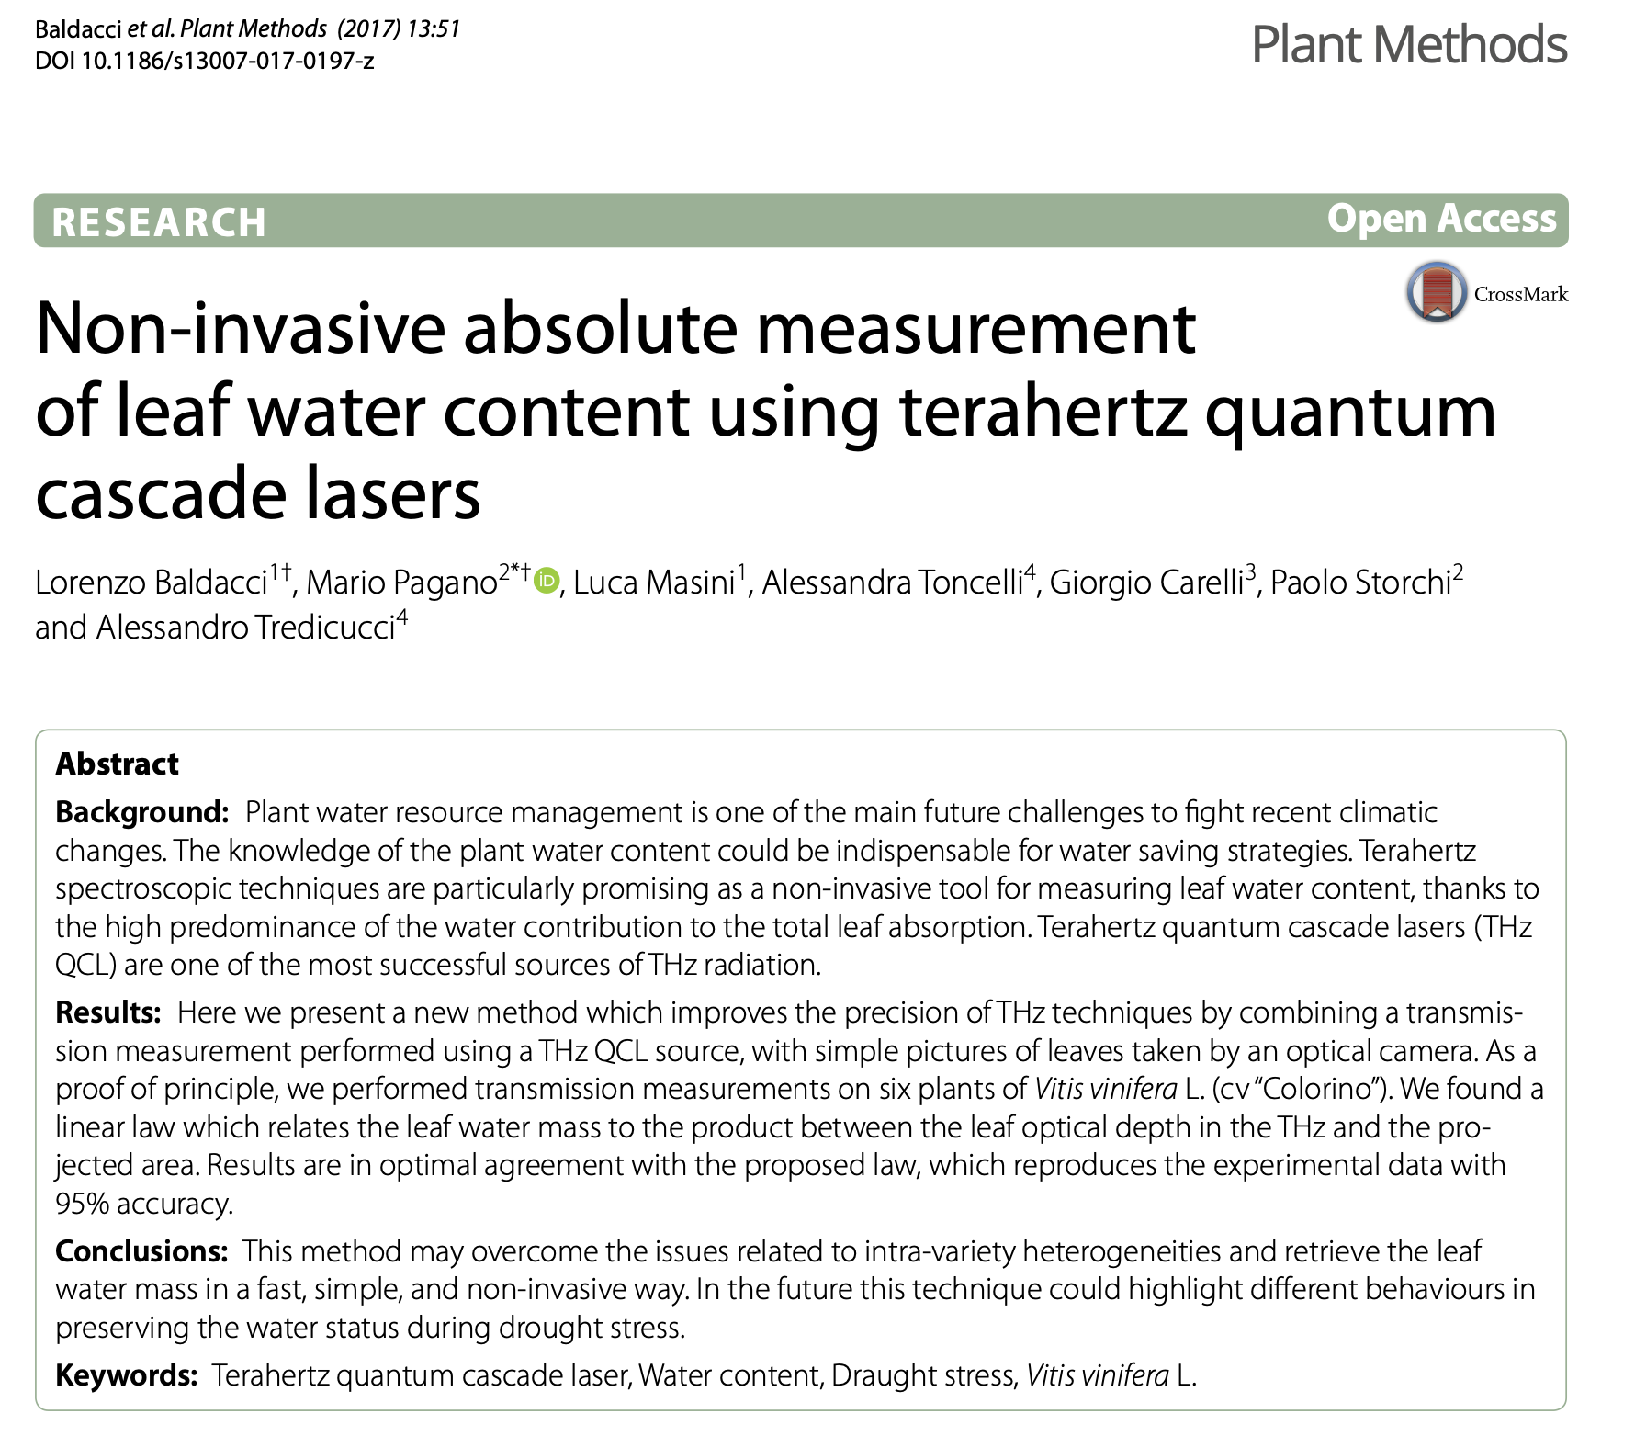
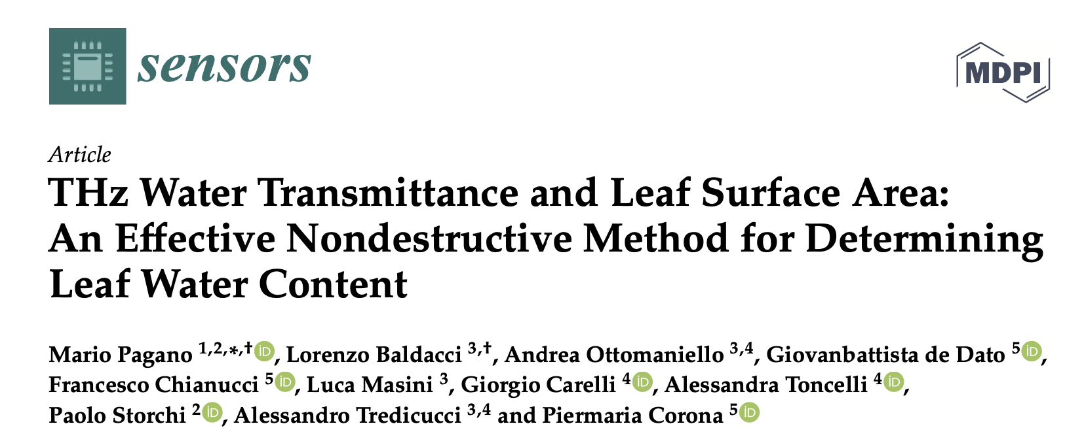
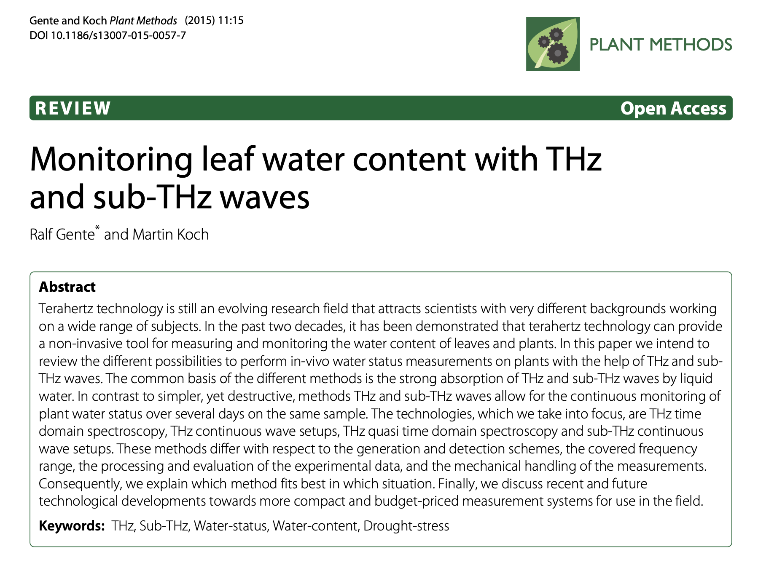
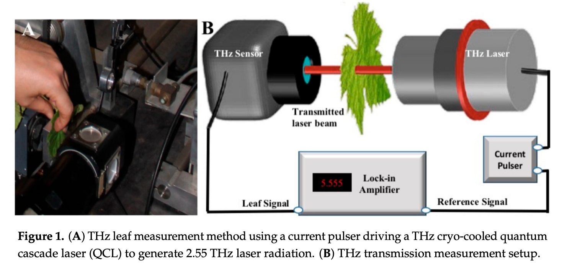
TERAHERTZ RADIATION IN AGRICULTURE AND IN PLANT SCIENCES

Slide 8
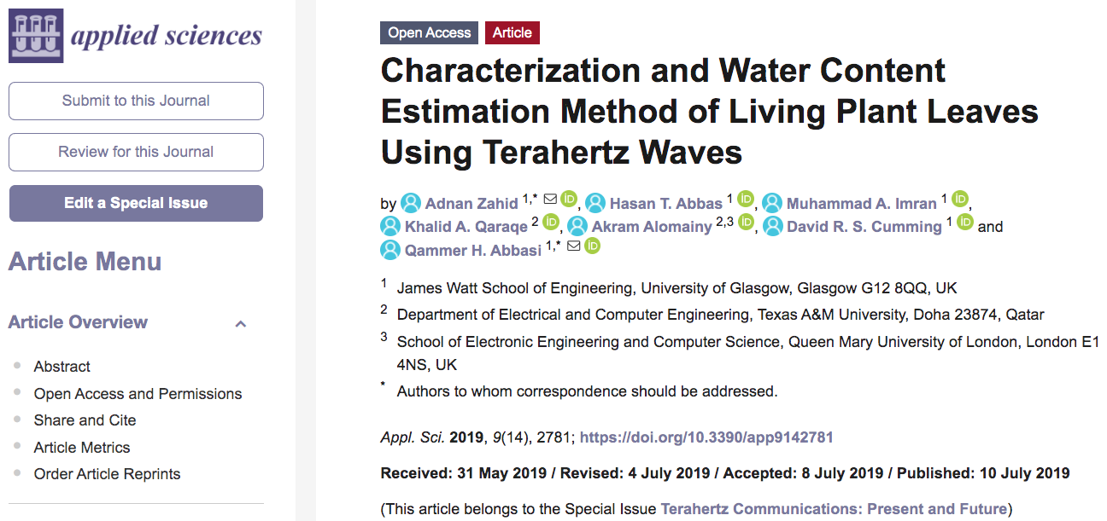
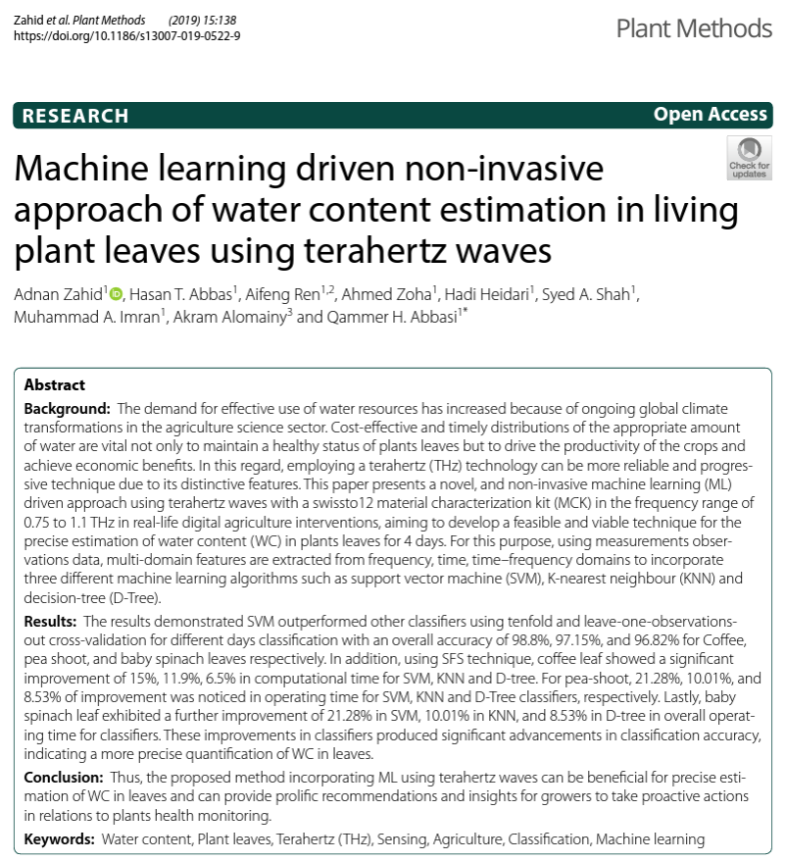
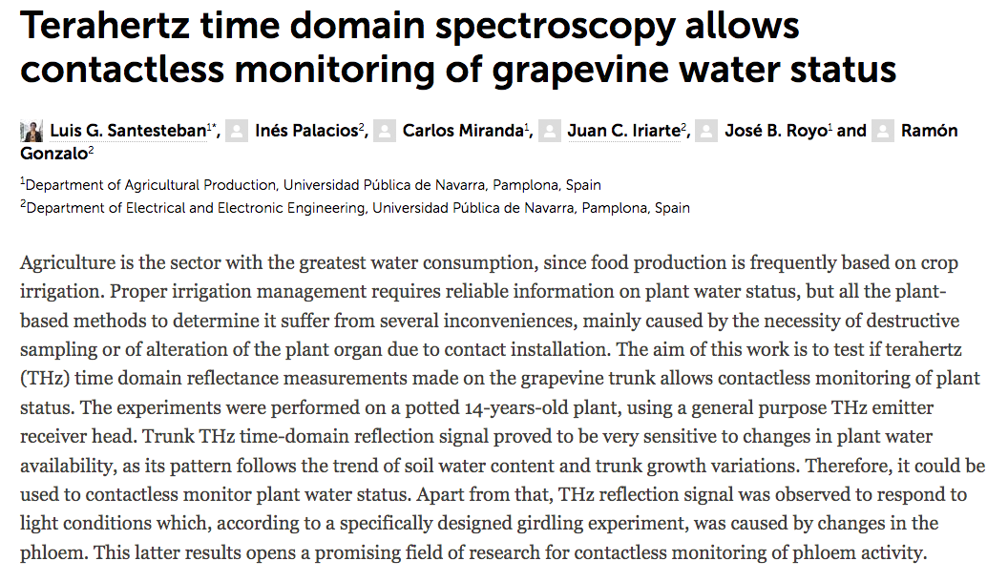
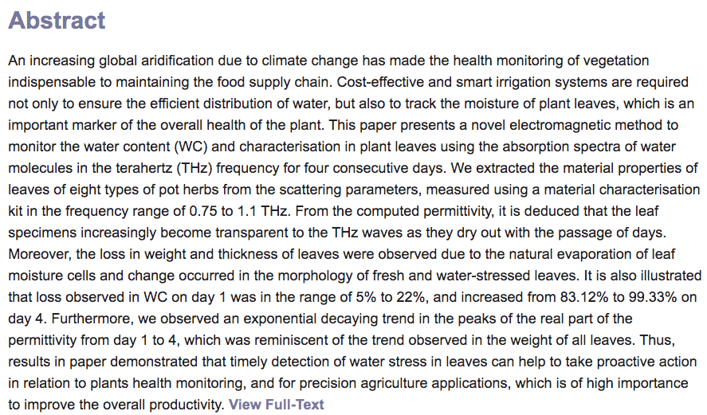
TERAHERTZ RADIATION IN AGRICULTURE AND IN PLANT SCIENCES

Slide 9
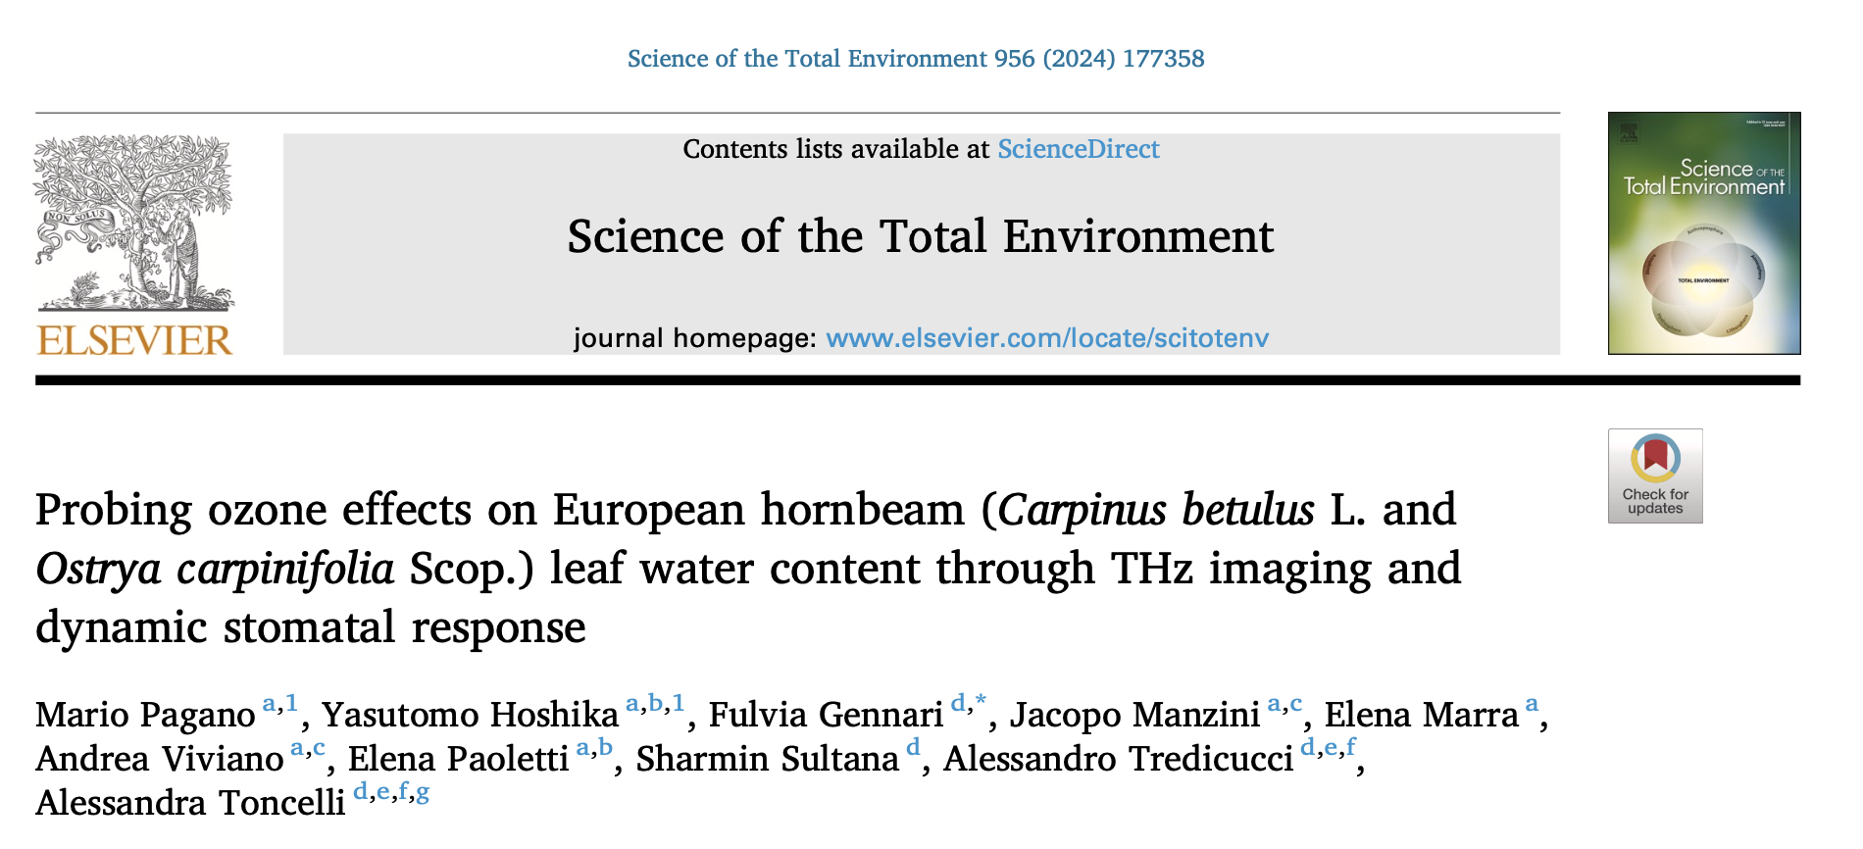
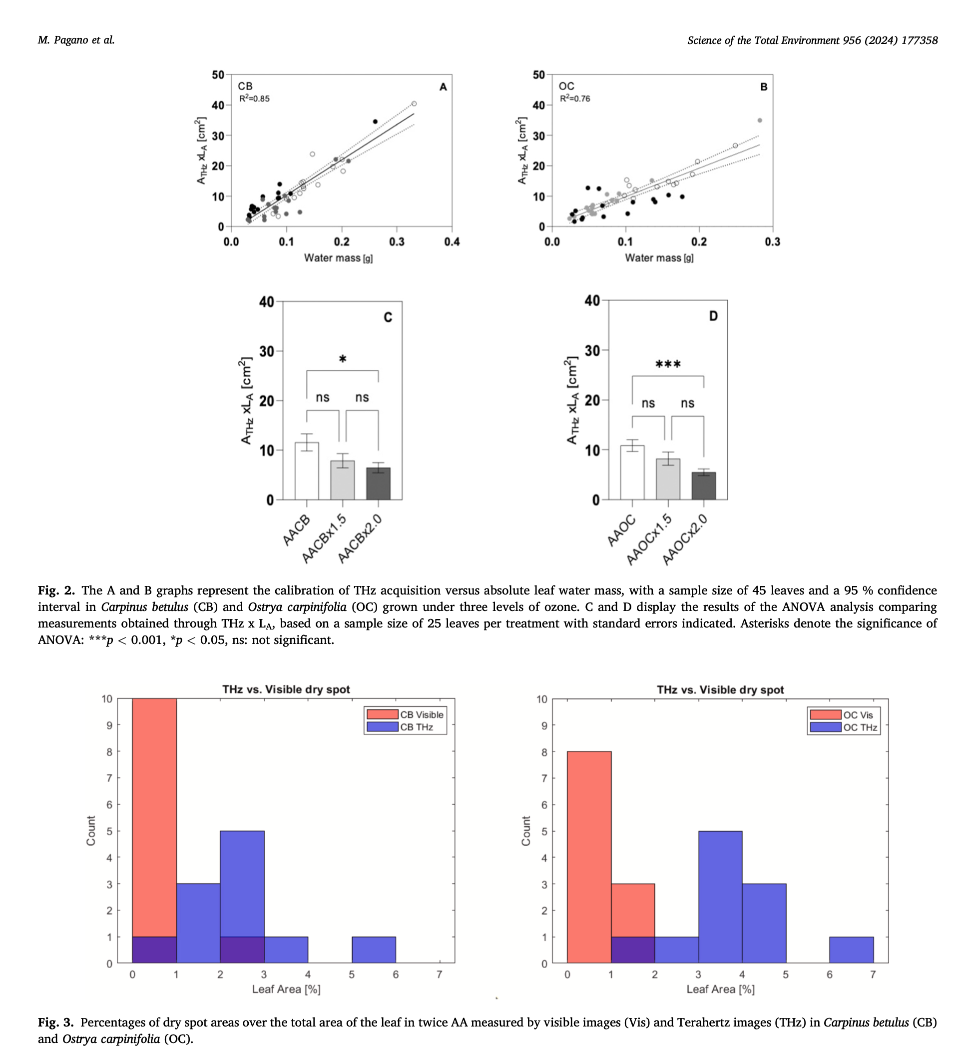
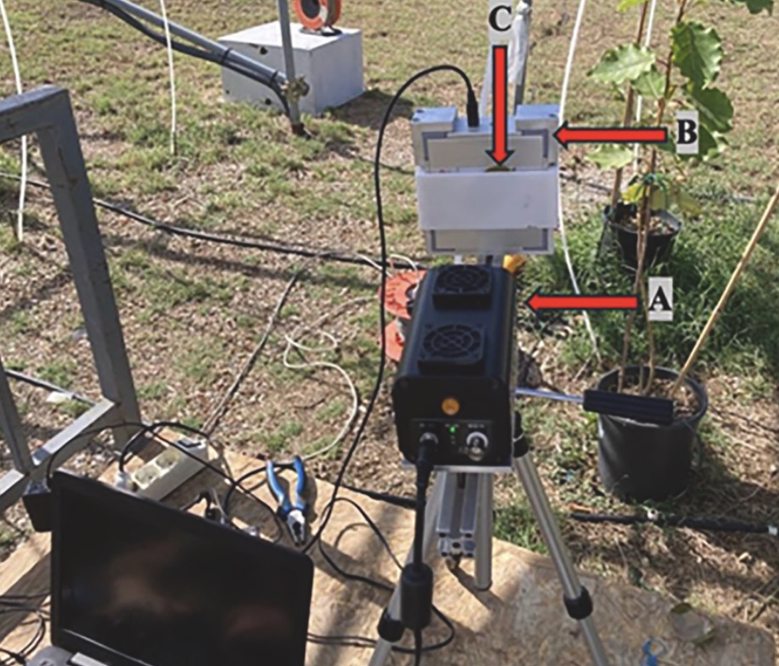
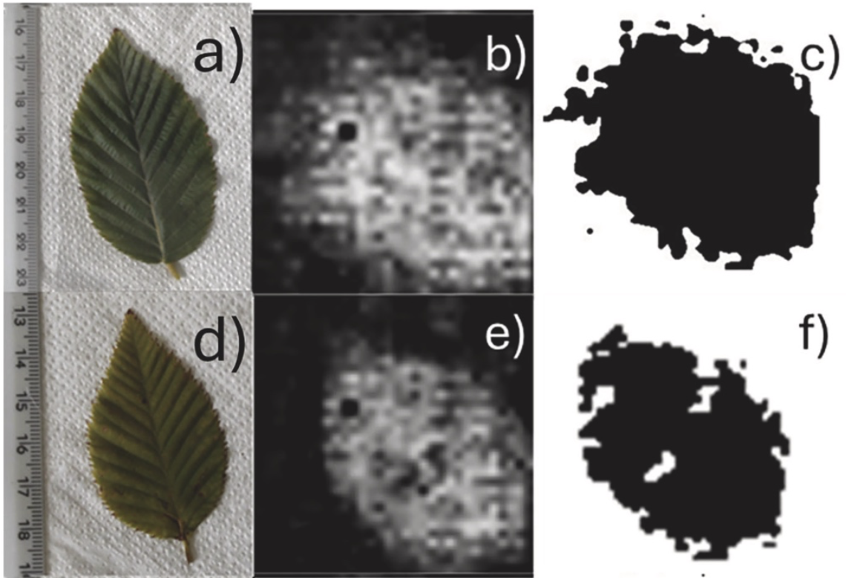
TERAHERTZ RADIATION IN AGRICULTURE AND IN PLANT SCIENCES

Slide 10
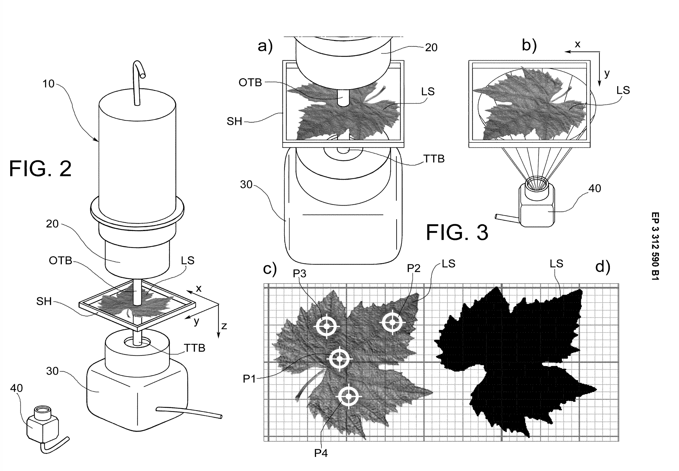
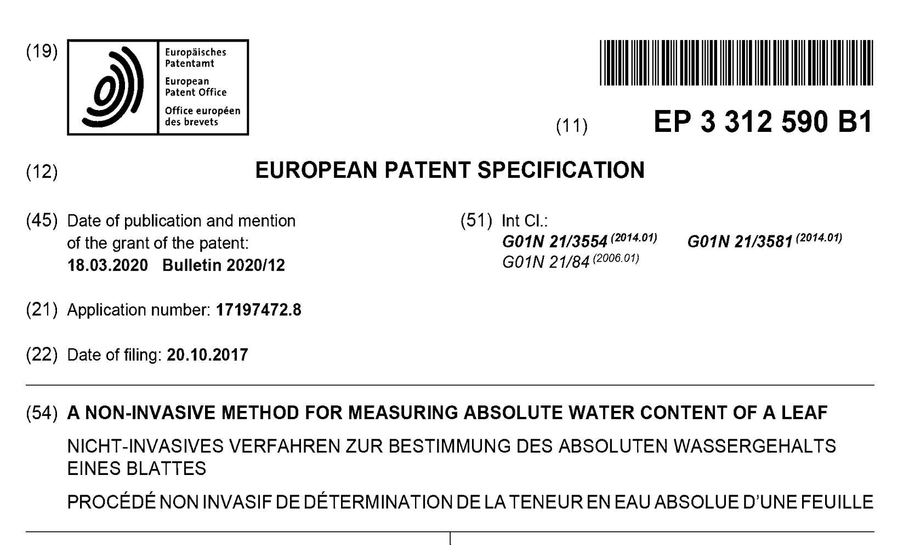
TERAHERTZ RADIATION IN AGRICULTURE AND IN PLANT SCIENCES

Slide 11
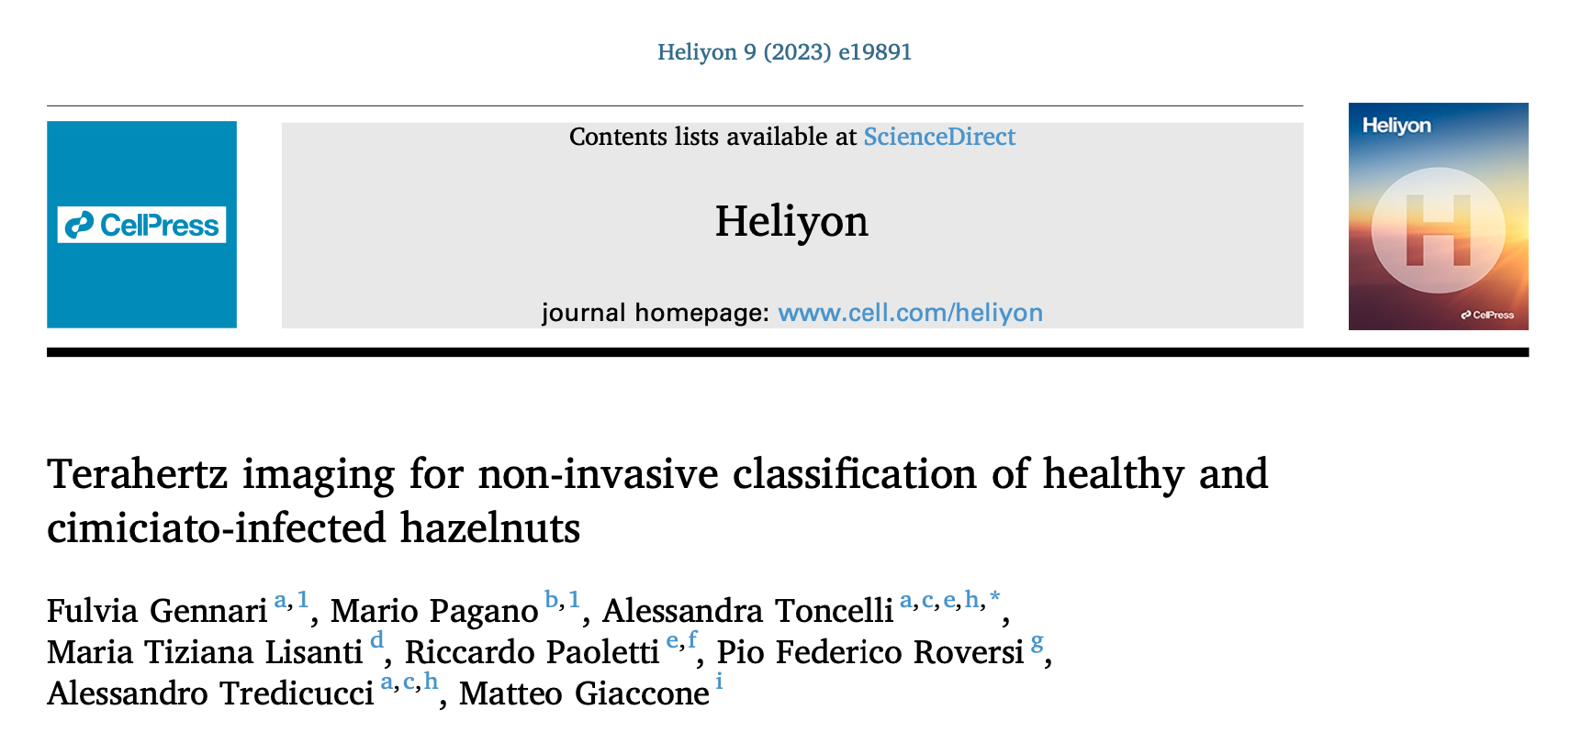
A Pilot Study on Food Security:
Terahertz Imaging for Hazelnut Classification

Slide 12
CHALLENGES IN HAZELNUT QUALITY AND CROP
Increasing Importance of Hazelnut Cultivation
Hazelnut (Corylus avellana) cultivation is expanding rapidly in terms of cultivated areas and expected crop yields.
Confectionery Industry Requirements
Raw hazelnuts must be free from defects and alterations to ensure products with acceptable organoleptic quality throughout their shelf-life.
Halyomorpha halys (Brown Marmorated Stink Bug)
A pest belonging to the family Pentatomidae, commonly referred to as the brown marmorated stink bug.
Impact of Infestation on Hazelnuts
Damage during kernel expansion or ripening results in shriveled kernels or high incidences of off-flavor described as "cimiciato" or “corked.”
Cimiciato Defect and Its Consequences
Affected hazelnuts develop a bitter, astringent taste due to the presence of diarylheptanoids, including asadanin, giffonin P, and related compounds.

Slide 13
METHODOLOGY AND SAMPLE DESIGN
Plant species
Trials were conducted on hazelnut kernels (Corylus avellana L.), cultivar Tonda di Giffoni.
Calibration Sample
Trial comprised of 150 hazelnuts used to develop the classification model.
Hazelnuts were manually shelled and visually inspected prior to THz analysis.
Two sub-samples:
110 Healthy Hazelnuts (HH): Free from defects.
40 Cimiciato Hazelnuts (CH): Damaged by stink bugs.
Validation Sample
Trial Consisted of 50 hazelnuts used for blind evaluation of the classification model.
Each hazelnut was:
Manually shelled.
Analyzed with a THz device for classification.
Visually inspected to confirm or reject the THz classification results.

Slide 14
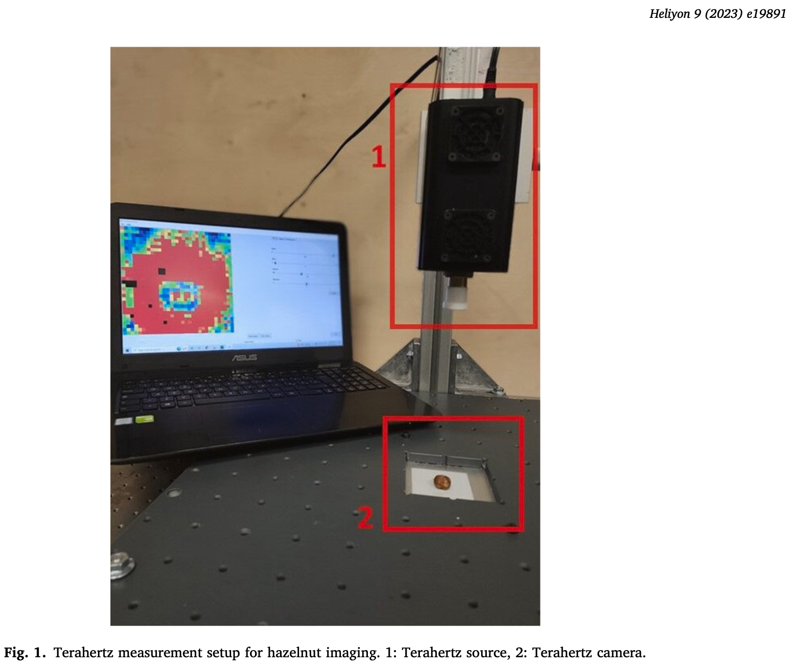
THE THz IMAGING SYSTEM
Source:
Type: Impact Avalanche Transit Time Diode Source (IMPATT-100-H/F)
Manufacturer: TeraSense, San Jose, USA
Nominal Output Power: 30 mW
Output Frequency: 140 GHz
THz Camera:
Model: T15/32/32
Manufacturer: TeraSense, San Jose, USA
Sensor Matrix: Square matrix with 32 x 32 pixels

Slide 15
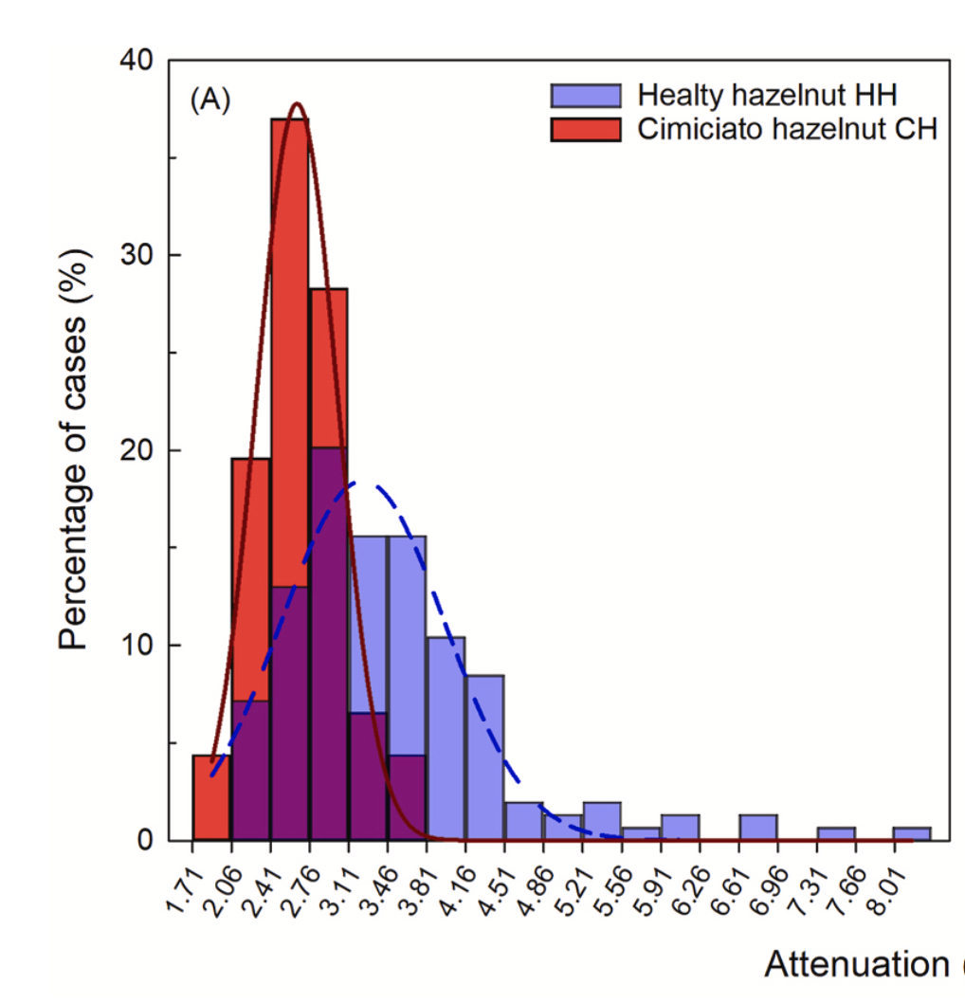
THE HISTOGRAMS OF THE DISTRIBUTION
OF THE ATTENUATION VALUES
Lower Attenuation Levels in CH Sample:
The CH sample generally exhibits lower attenuation levels compared to the non-CH sample. However, a complete separation between the two histograms is not observed.
Potential Causes for Lower Absorption in Damaged Hazelnuts (CH):
Structural alterations in tissue due to stink bug stings may contribute to reduced absorption. Stink bug injuries are reported to cause dry, necrotic tissue in infected hazelnuts.
Role of Stink Bug Saliva:
Stink bugs inject watery saliva containing hydrolyzing enzymes (protease, amylase, esterase, lipase) into hazelnuts. These enzymes may trigger biochemical reactions that alter THz absorption properties of the nuts.

Slide 16
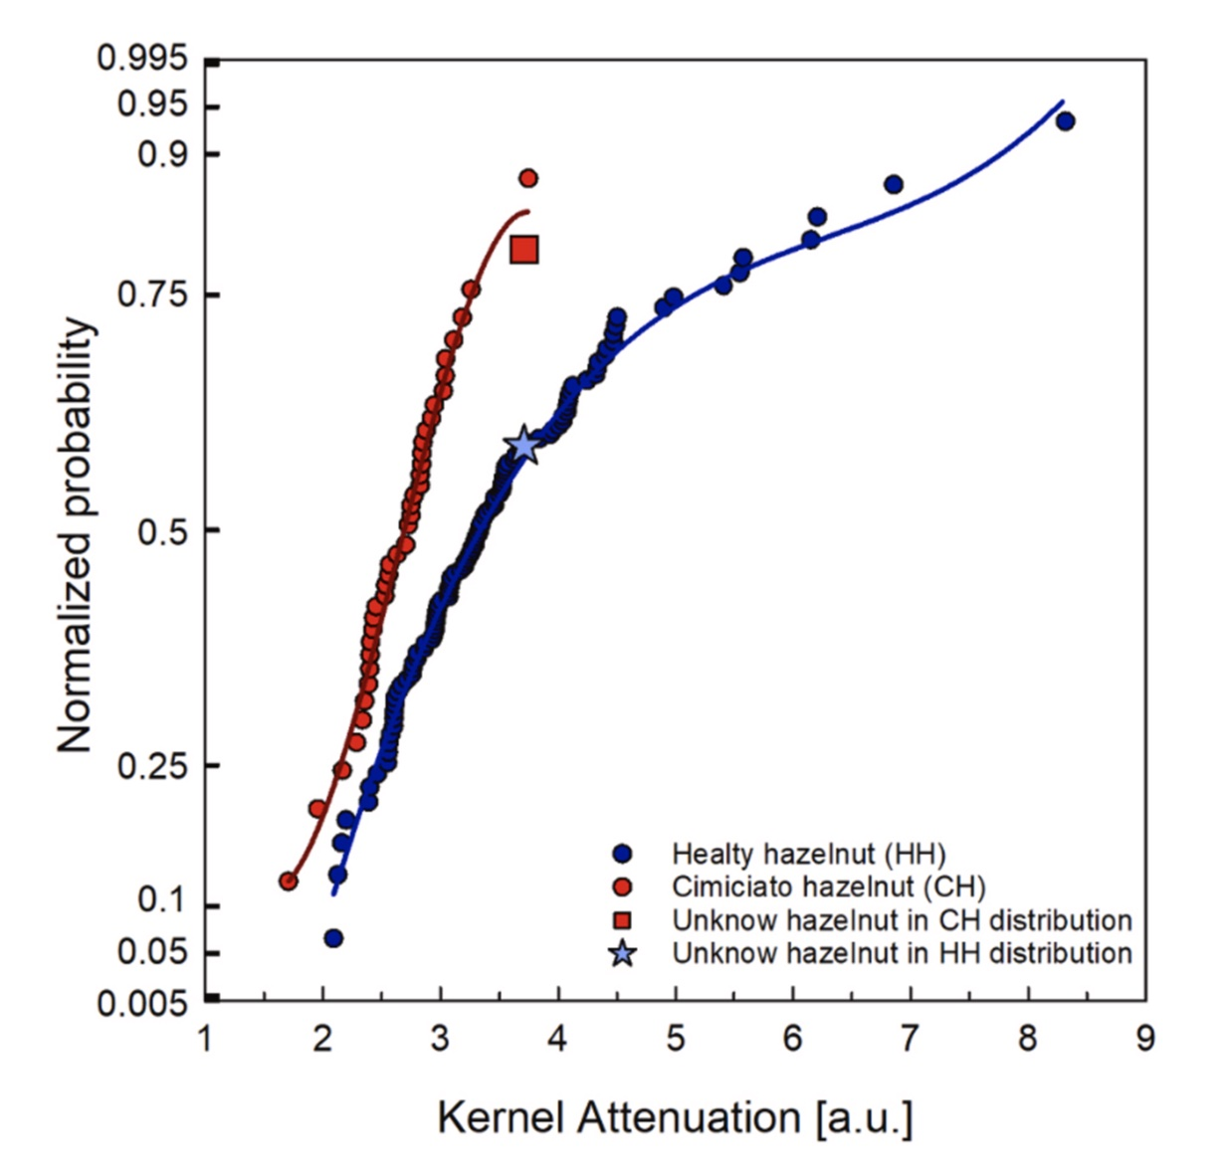
Classification Model Development
Plotted distributions for healthy and damaged hazelnuts.
Fitted both distributions with third-degree polynomial curves.
Model Evaluation Process
Introduced data from an unknown hazelnut sample as a new data point in both distributions.
Calculated the minimum distance between the new point and each fitted curve.
Assigned the sample to the distribution with the smaller distance.

Slide 17
Model Performance Highlights
True Negative Rate (TNR): 100% (all unhealthy hazelnuts correctly identified).
False Positive Rate (FPR): 0%.
Sensitivity Results
True Positive Rate (TPR): 75%.
False Negative Rate (FNR): 25% (lower sensitivity for healthy hazelnuts).

Slide 18
Fruit recognition using terahertz imaging for swift contamination assessment and non-invasive inspection
(FRUITSCAN)
Eurobioimaging Node - Terahertz Plant Imaging, THzI @ Italy - Molecular Imaging Italian Node

Slide 19
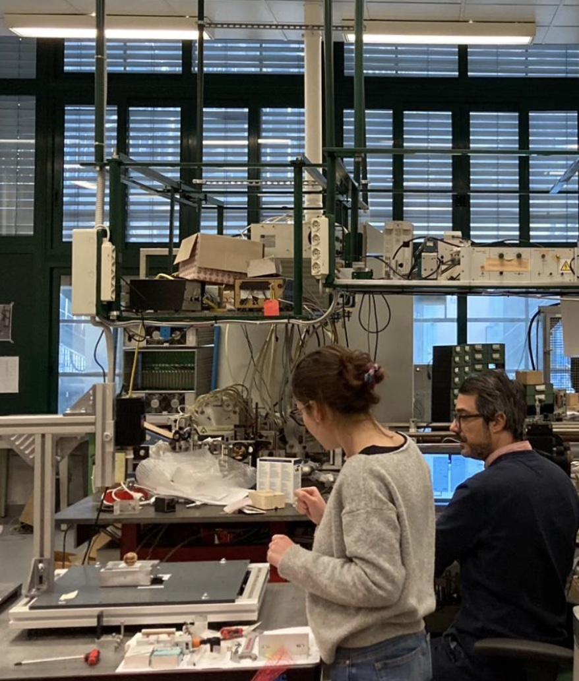
Project Objective
Leverages the synergy between terahertz (THz) imaging and artificial intelligence to classify hazelnuts and other fruits as healthy or unhealthy in a non-invasive manner.
Benefits of Terahertz Imaging
Facilitates early pest detection.
Aims to reduce chemical interventions.
Promotes a positive environmental impact.

Slide 20
CONCLUSIONS
Strong potential of continuous-wave terahertz (THz) transmission imaging as a reliable, non-invasive method for agricultural applications, particularly in identifying unhealthy samples.
The integration of THz imaging with artificial intelligence further expands its potential for agricultural quality control, driving innovation in food security and promoting resource-efficient practices.

Slide 21
A SPECIAL THANKS TO:
Fulvia Gennari, Riccardo Paoletti, Pio Federico Roversi,
Maria Tiziana Lisanti, Matteo Giaccone,
Alessandro Tredicucci and Alessandra Toncelli

Slide 22
Mario Pagano
CNR-IRET (FI)
mario.pagano@cnr.it

