Slide 1
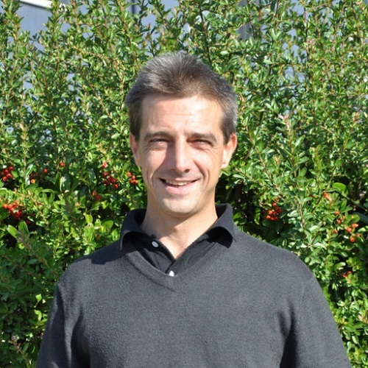
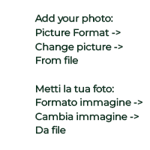
Biological valorisation of a vermicompost as biostimulant for horticulture
Davide Manzi
CNR IRET Pisa

Slide 2
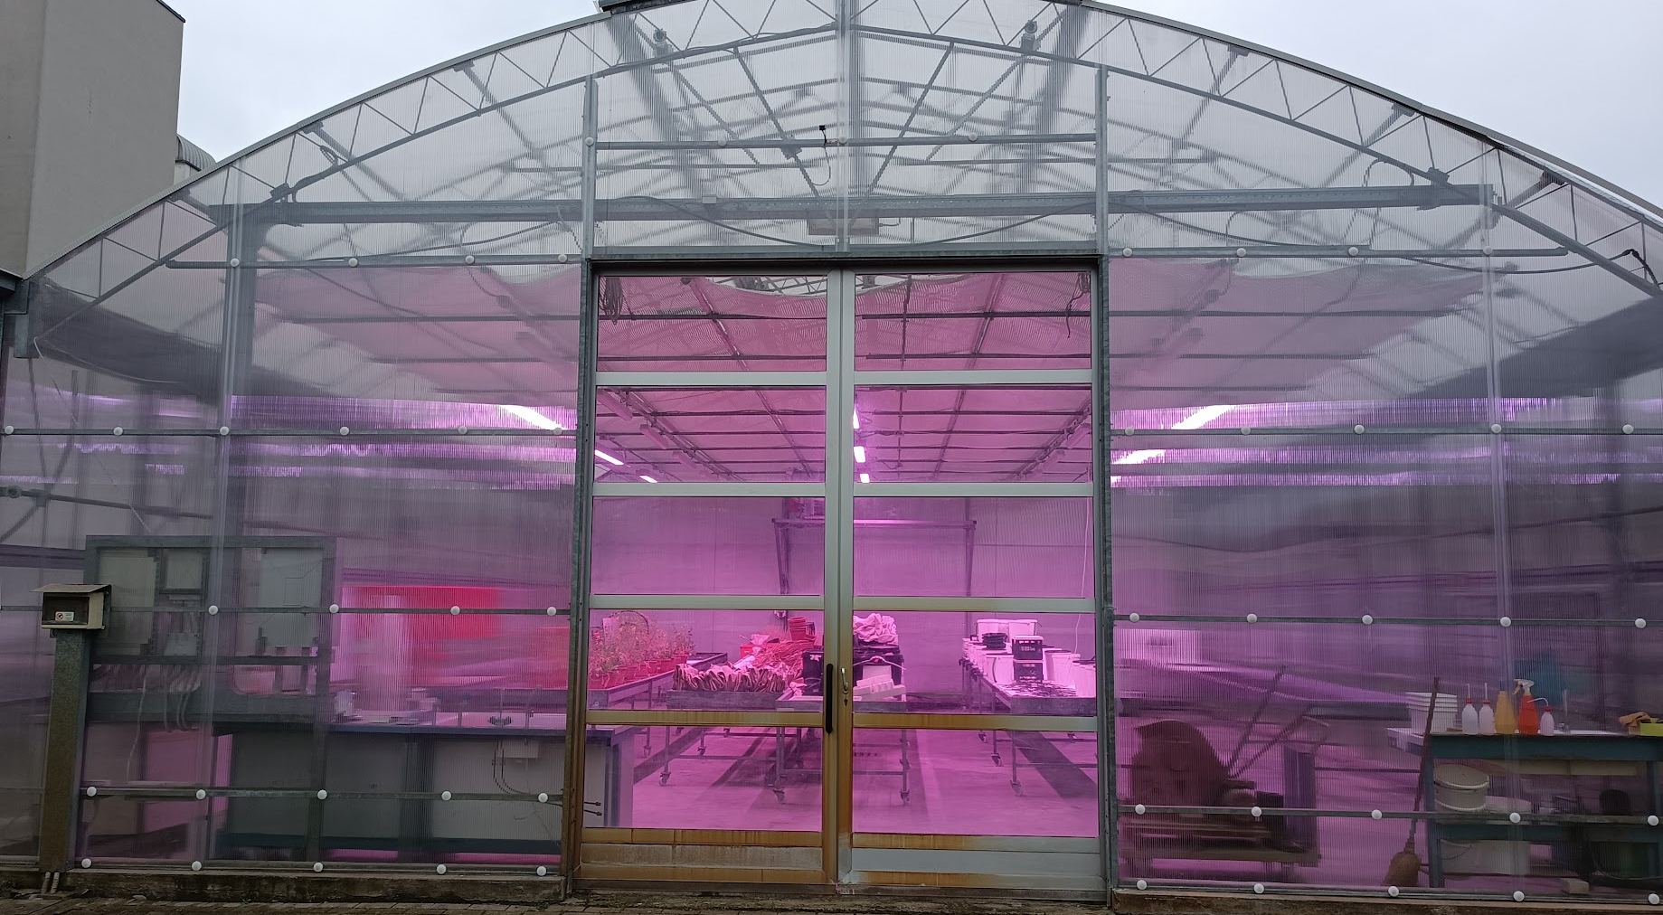
Aim of the experiment
Phase 1 : Biological enrichment of a vermicompost for the preparation of a biostimulant
Phase 2: Verify biostimulant properties on a plant species of agro-food interest, Lactuca sativa capitata (iceberg lettuce).
Economic valorisation of the product

Slide 3

Definition of biostimulant
nutrient use efficiency
Plant biostimulant must improve:
tolerance to abiotic stress
enhancement of qualitative plant traits
Microbial biostimulants
The Regulation (EU) 2019/1009 classifies biostimulants into two main categories:
Non Microbial biostimulants

Slide 4
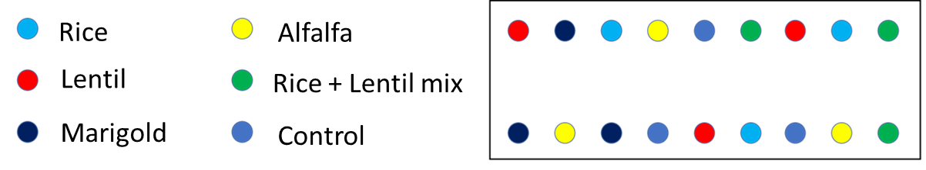
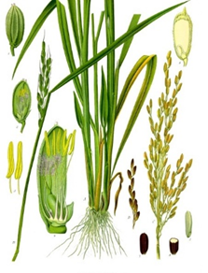
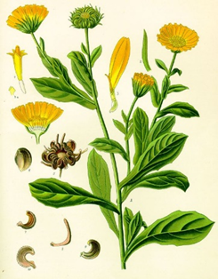
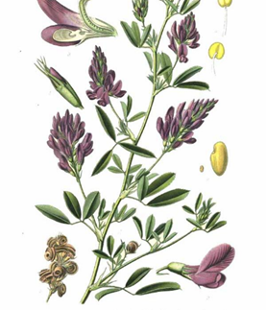
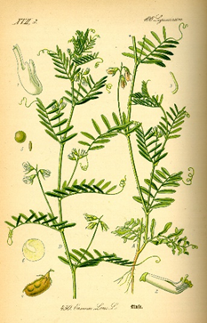
Phase 1
Biological enrichment of the vermicompost by selected plants
Rice
Marigold
Legumes: hosts of symbiotic nitrogen fixers
Alfalfa
Lentil
Rice + Lentil mix
+
Gramine: hosts of free nitrogen fixers
Asteraceae: may interact with associative nitrogen fixing bacteria

Slide 5
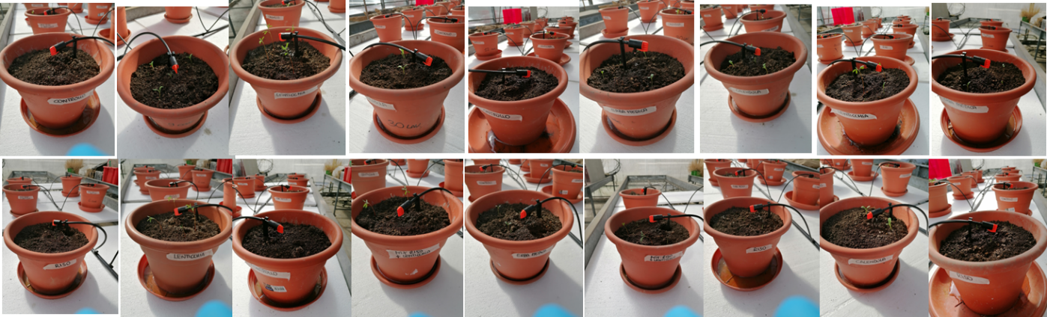
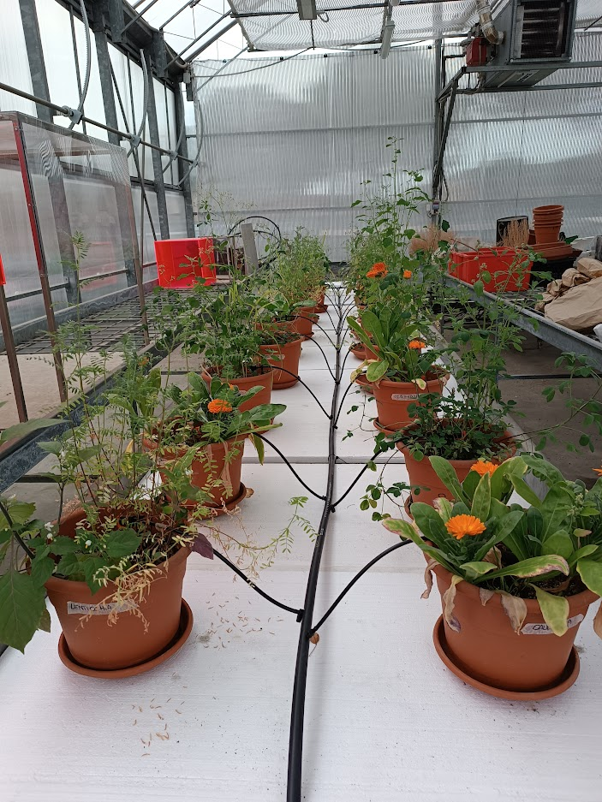
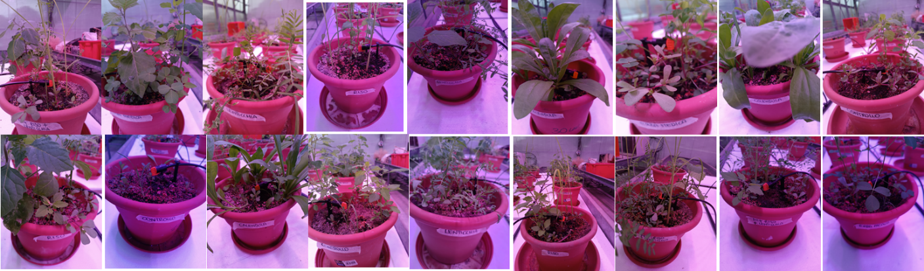
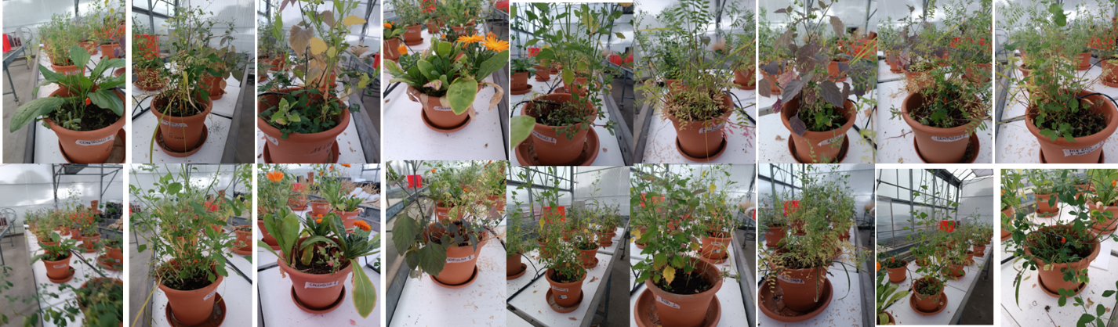
Phase 1
18 10 2022
28 11 2022
19 01 2023

Slide 6
Phase 1
Chemical Characterization of Substrates
Biological Characterization of Substrates
EC
TOC
β-glucosedase
Butyrate Esterase (BE)
pH
TP
Phosphatase
Aryl sulfatase
N-NO₃
TN
N-acetyl-β-glucosaminidase (NAG)
Ca, Fe, K, Mg, Mn, Pb, Ni, Zn, Cu
Alfalfa and Marigold are the plants that promote greater biological development of the substrate

Slide 7
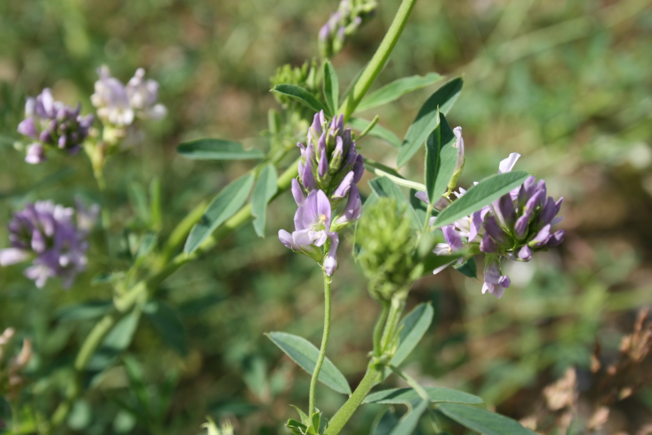
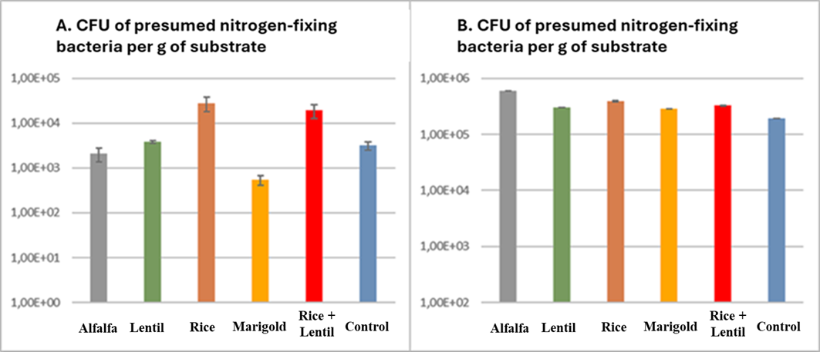
Phase 1
Microbiological Characterization of Substrates
End of Phase 1
Selection of the most performant plant species:
Alfalfa
Grinded roots added to the vermicompost to obtain biostimulant

Slide 8
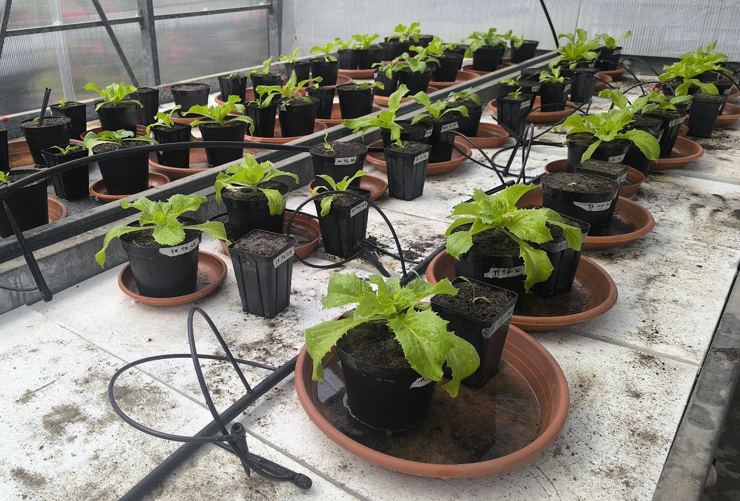
Phase 2
Effects of biostimulant on Lactuca sativa capitata (iceberg lettuce)
Evaluate the effect of biostimolant on plant growth and physiolocical characteristics

Slide 9
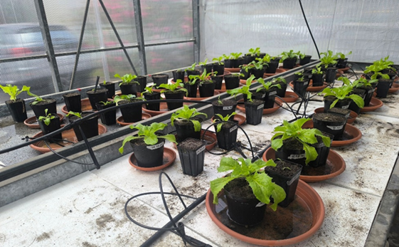
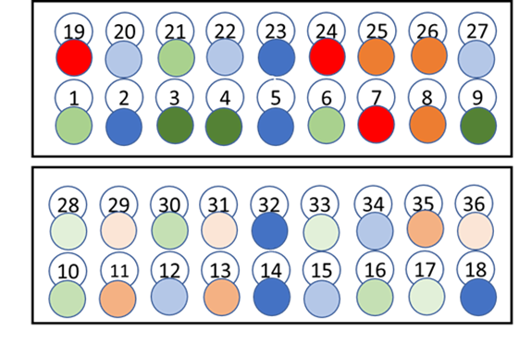
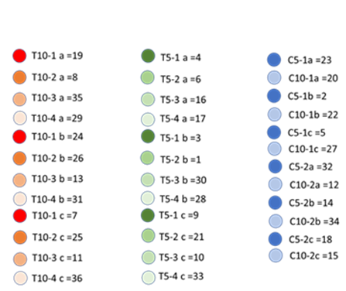
Phase 2:
Clinoptilolite zeolites were integrated into the biostimulant (3% w/w)
The control substrate was a sandy substrate based on neutral peat (pH 7.49)
2 different biostimulant application dosages were tested:
5% w/w
10% w/w

Slide 10
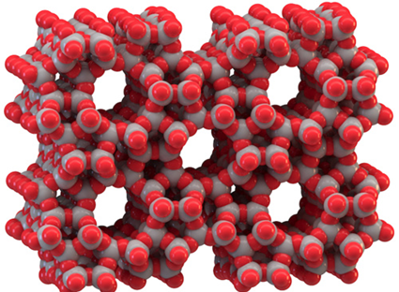
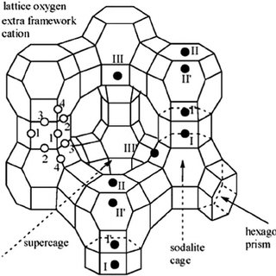
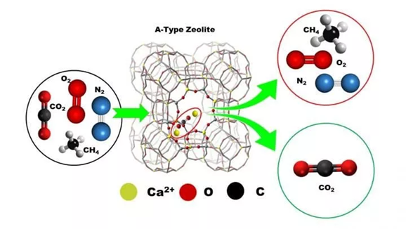
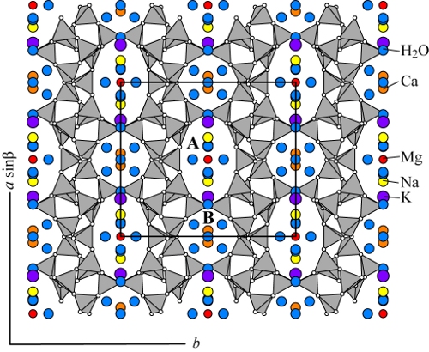
Phase 2
Zeolite clinoptilolite are hydrated aluminosilicate with multiple characteristics.
Adsorption and slow release of chemicals (CEC)
Three-dimensional structure
Water Adsorption / release

Slide 11
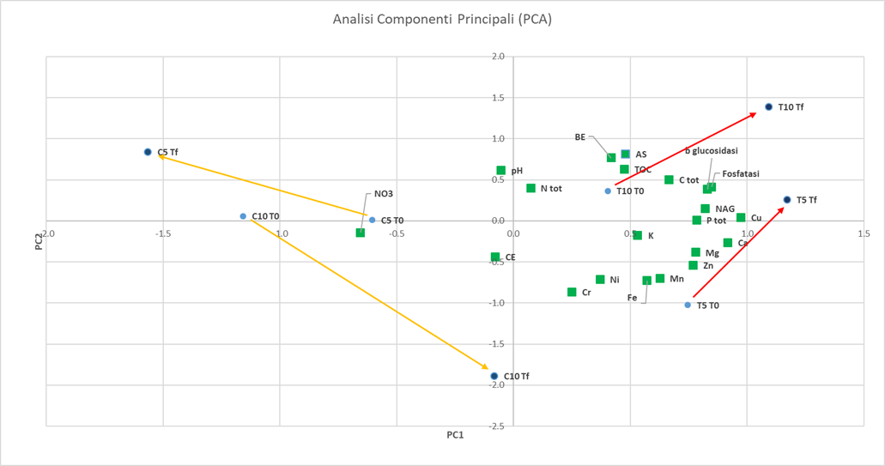
Phase 2
Chemical Characterization of Substrates
Biological Characterization of Substrates
Principal Components Analysis
EC
TOC
β-glucosedase
Butyrate Esterase (BE)
pH
TP
Phosphatase
Aryl sulfatase
N-NO₃
TN
N-acetyl-β-glucosaminidase (NAG)
Ca, Fe, K, Mg, Mn, Pb, Ni, Zn, Cu
The biostimulant increases the chemical and biological quality of the substrates
The 5% integration has led to excellent results

Slide 12
Phase 2
Chemical Characterization of Substrates
Biological Characterization of Substrates
Principal Components Analysis
EC
TOC
β-glucosedase
Butyrate Esterase (BE)
pH
TP
Phosphatase
Aryl sulfatase
N-NO₃
TN
N-acetyl-β-glucosaminidase (NAG)
Ca, Fe, K, Mg, Mn, Pb, Ni, Zn, Cu
The biostimulant increases the chemical and biological quality of the substrates
The 5% integration has led to excellent results

Slide 13
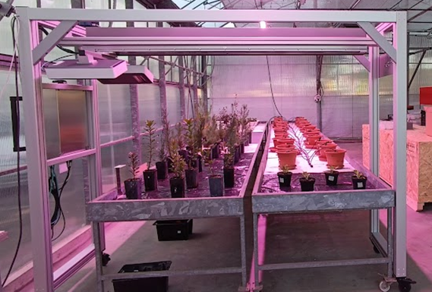
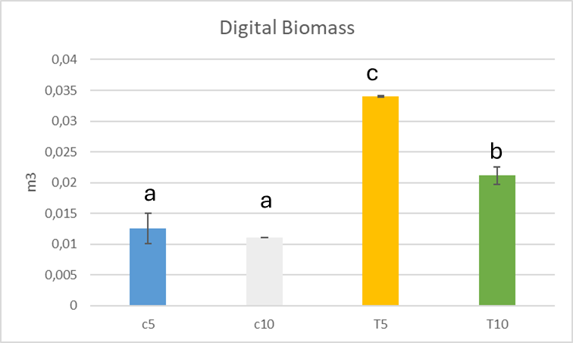
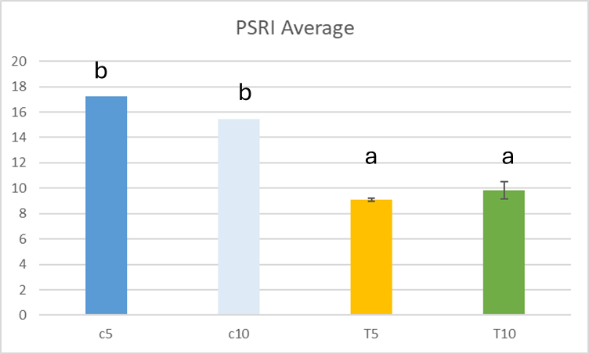
Phase 2
Analysis of vegetation indices conducted using the TraitFinder F600 phenotypist:
Biomass
Hue
NDVI
PSRI
The 5% integration showed the best effects on the plant

Slide 14
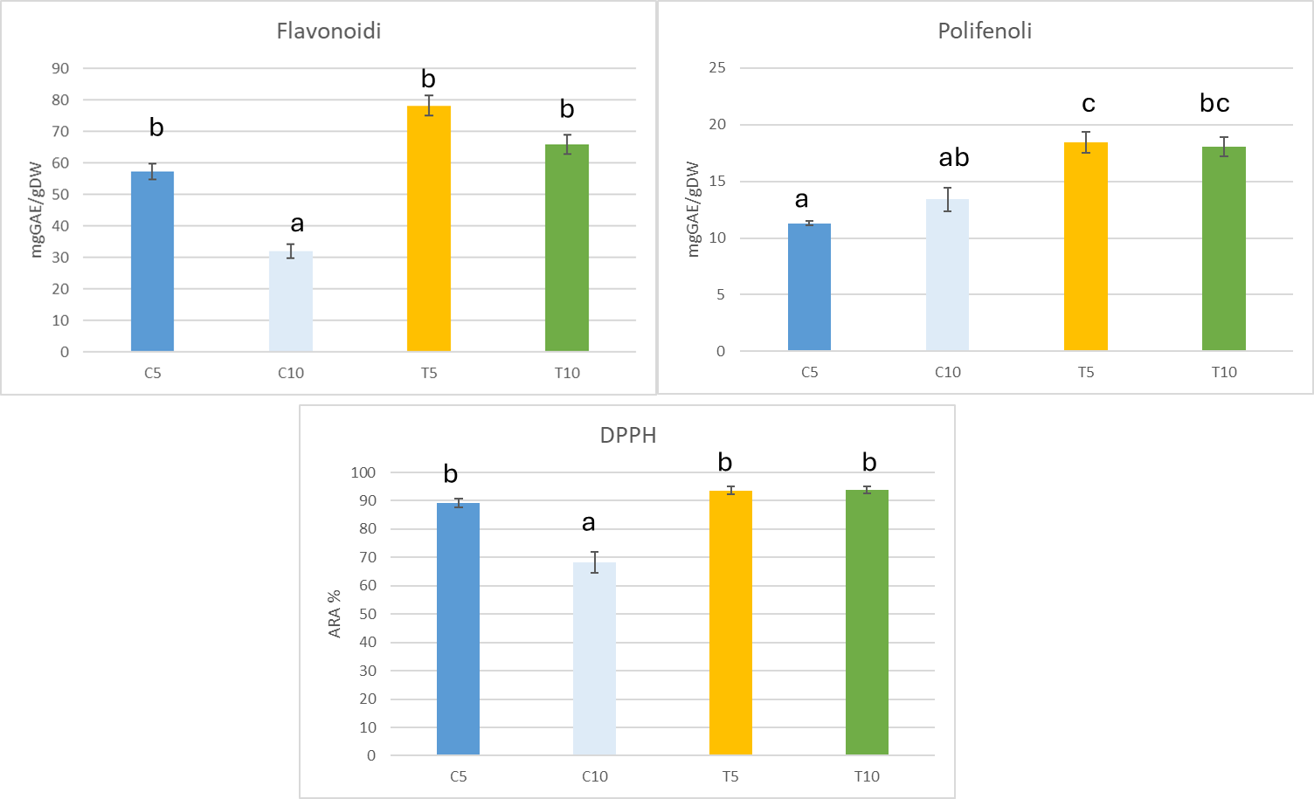
Phase 2
Parameters related to oxidative stress in plants
Flavonoids, polyphenols and DPPH (1,1-diphenyl-2-picryl-hydrazyl)
Flavonoids
Polyphenols
Treated plants show a higher content of polyphenols, flavonoids and a high total antioxidant capacity
DPPH
The 5% treatment showed less oxidative stress

Slide 15
Conclusions:
Phase 1
Phase 2
The 5% treatment showed a biostimulant activity comparable to 10%.
The application of the 5% biostimulant determined:
Increase in plant biomass
Greater plant resistance to oxidative stress
More efficient use of nutrients
Alfalfa showed the greatest enrichment capacity in N substrate bacteria
The developed product can be classified as biostimulant with a significant increase in economic value compared to the starting vermicompost
Vermicompost = 1 €/kg Biostimulant= 40-120 €/kg

Slide 16

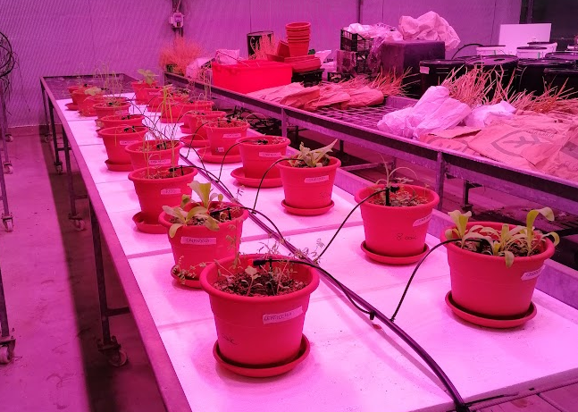
Thank you!

