Slide 1
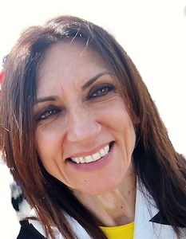
National programs of Classical Biological Control of the invasive alien pests Halyomorpha halys and Drosophila suzukii in Sardinia (Italy)
Laura Loru
National Research Council
Research Institute on Terrestrial Ecosystems

Slide 2



Alien species are animals, plants or other organisms that are introduced by humans, either intentionally
or accidentally, into areas
outside of their natural range.
Invasive alien species impact native biodiversity, ecosystems services or human economy and well-being
Biological invasions are a global consequence of an increasingly interconnected world and the rise in human population.
Icon made from Prosymbols Premium www.flaticon.com
Global warming exacerbates current invasions and facilitate new ones, amplifying their ecological, economic, and human-health impacts.
Icon made from fatihicon www.flaticon.com
Icon made from freepik www.flaticon.com

Slide 3
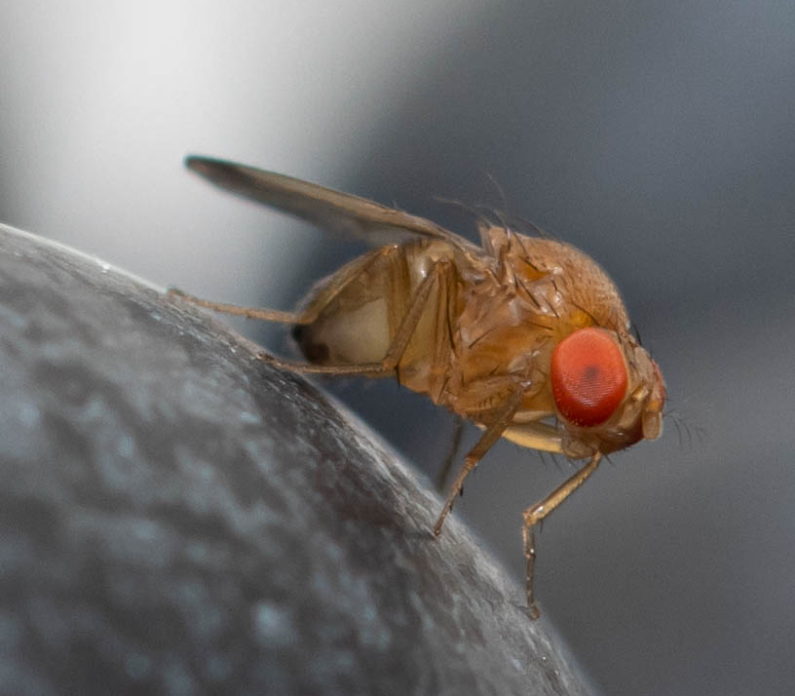
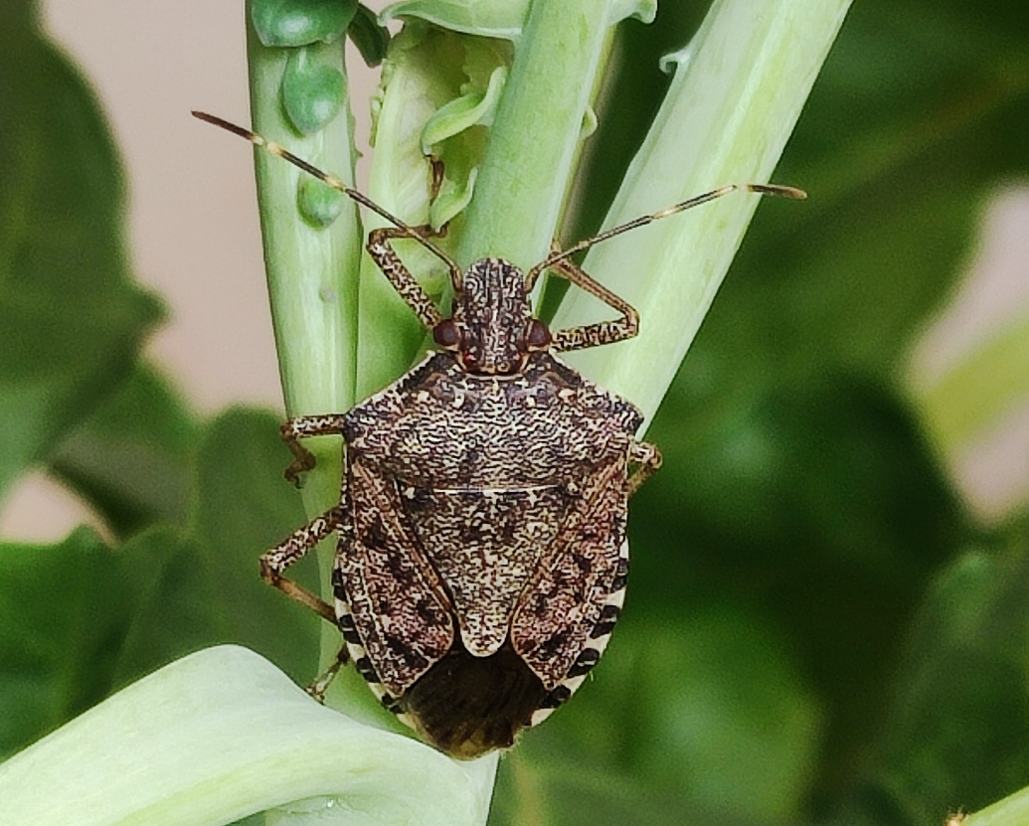
Insects are one of the taxa with the highest frequency of introduction due to their high diversity, biological properties, and close association with human activities.
Drosophila suzukii Matsumura, 1931 (Diptera Drosophilidae)
Both species native from east Asia
D. suzukii first detection in Italy: 2009
H. halys first detection in Italy: 2012
Halyomorpha halys (Stål) (Hemiptera Pentatomidae)

Slide 4
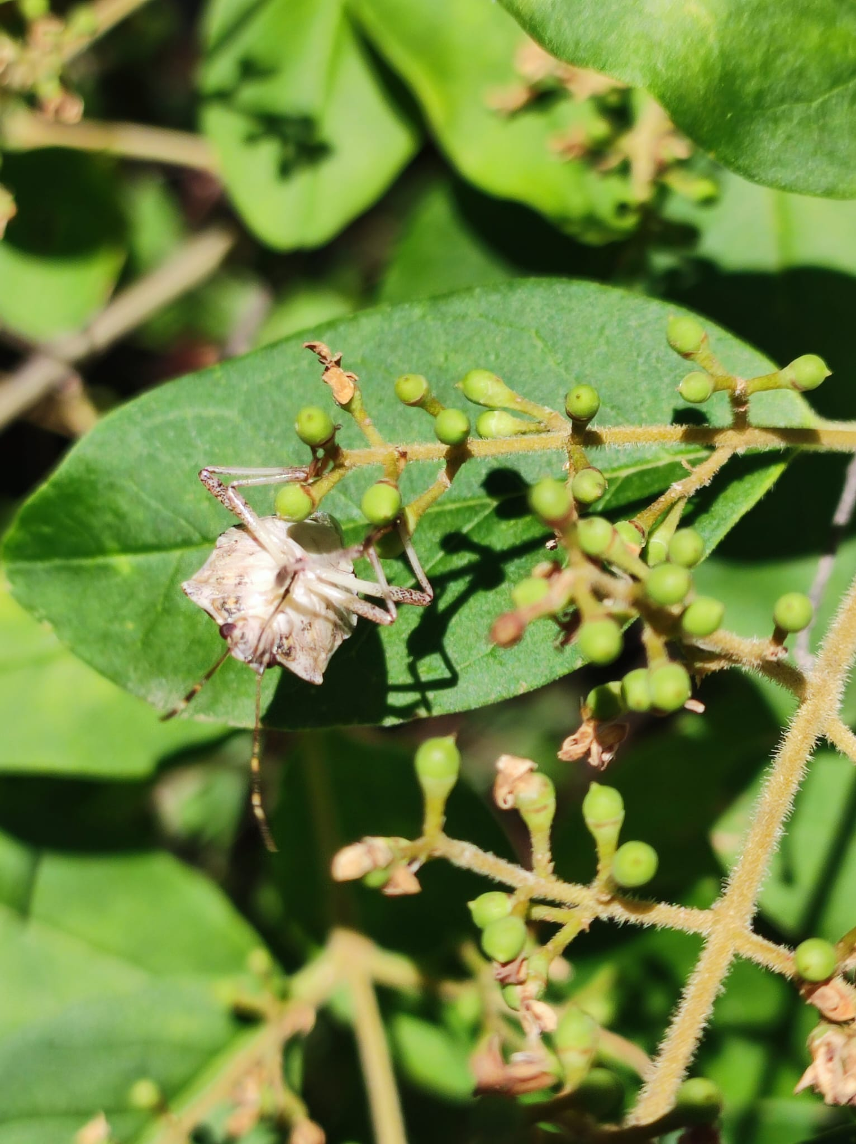
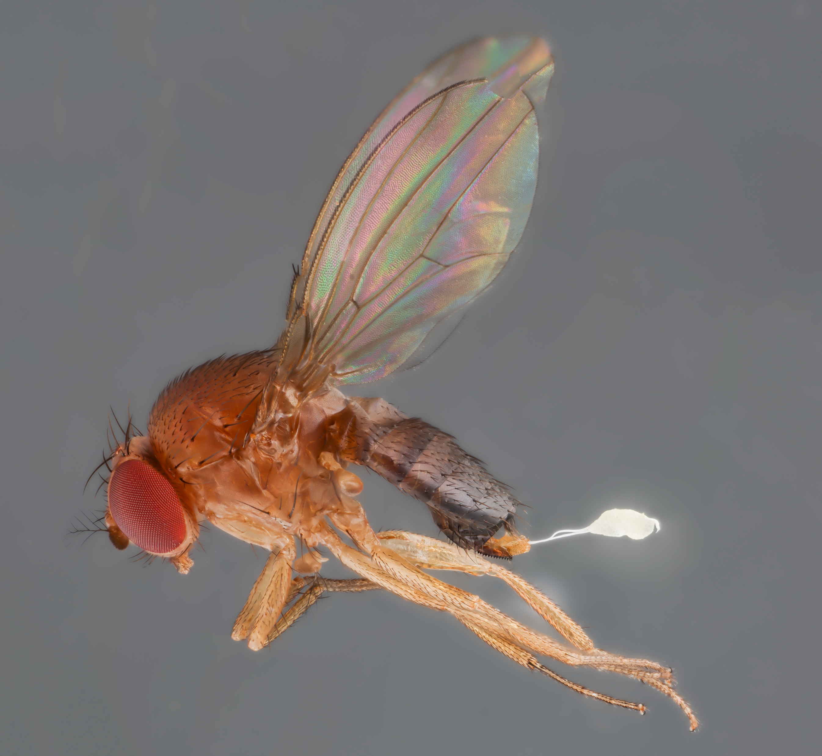
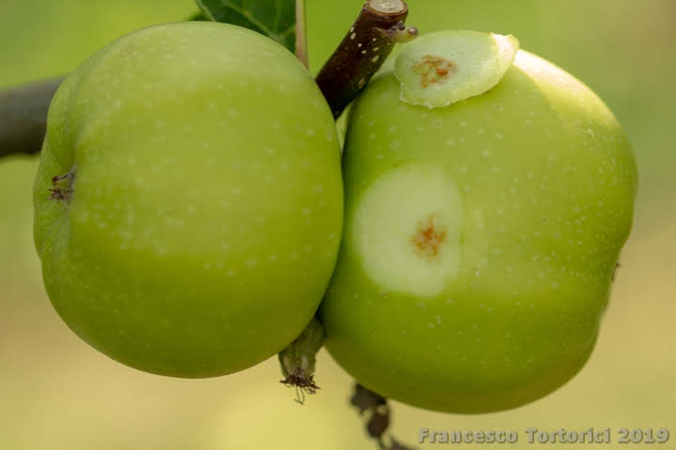
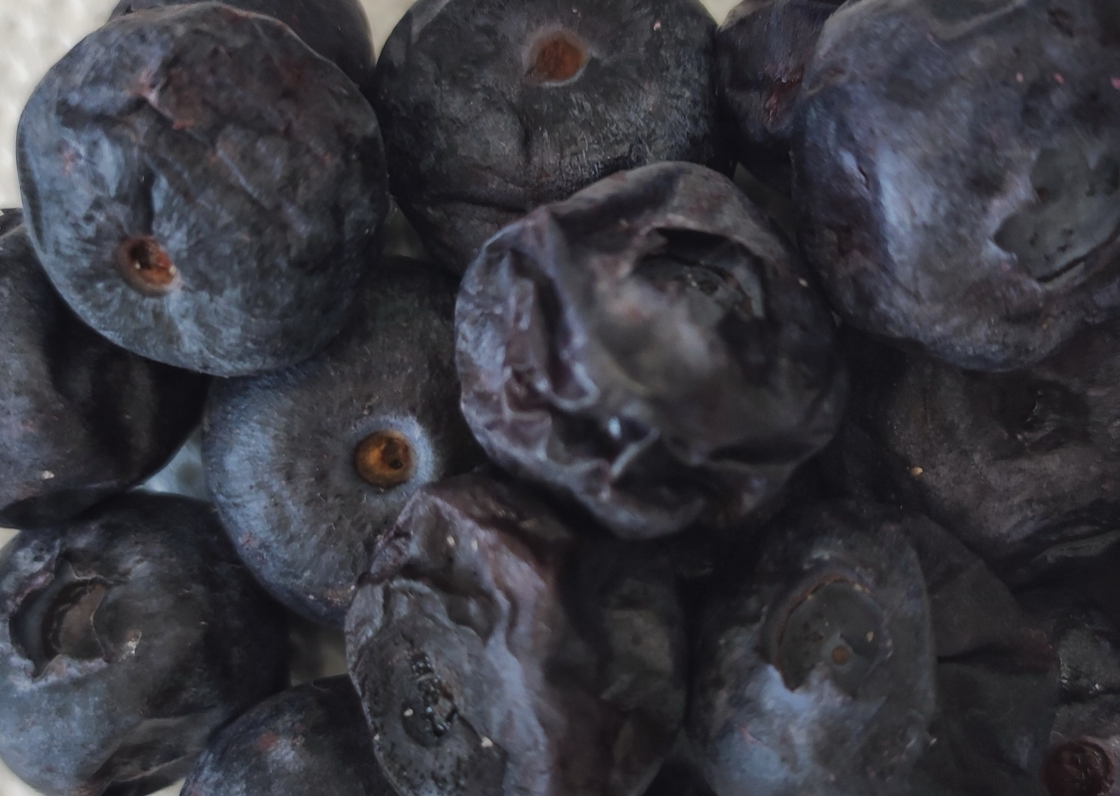
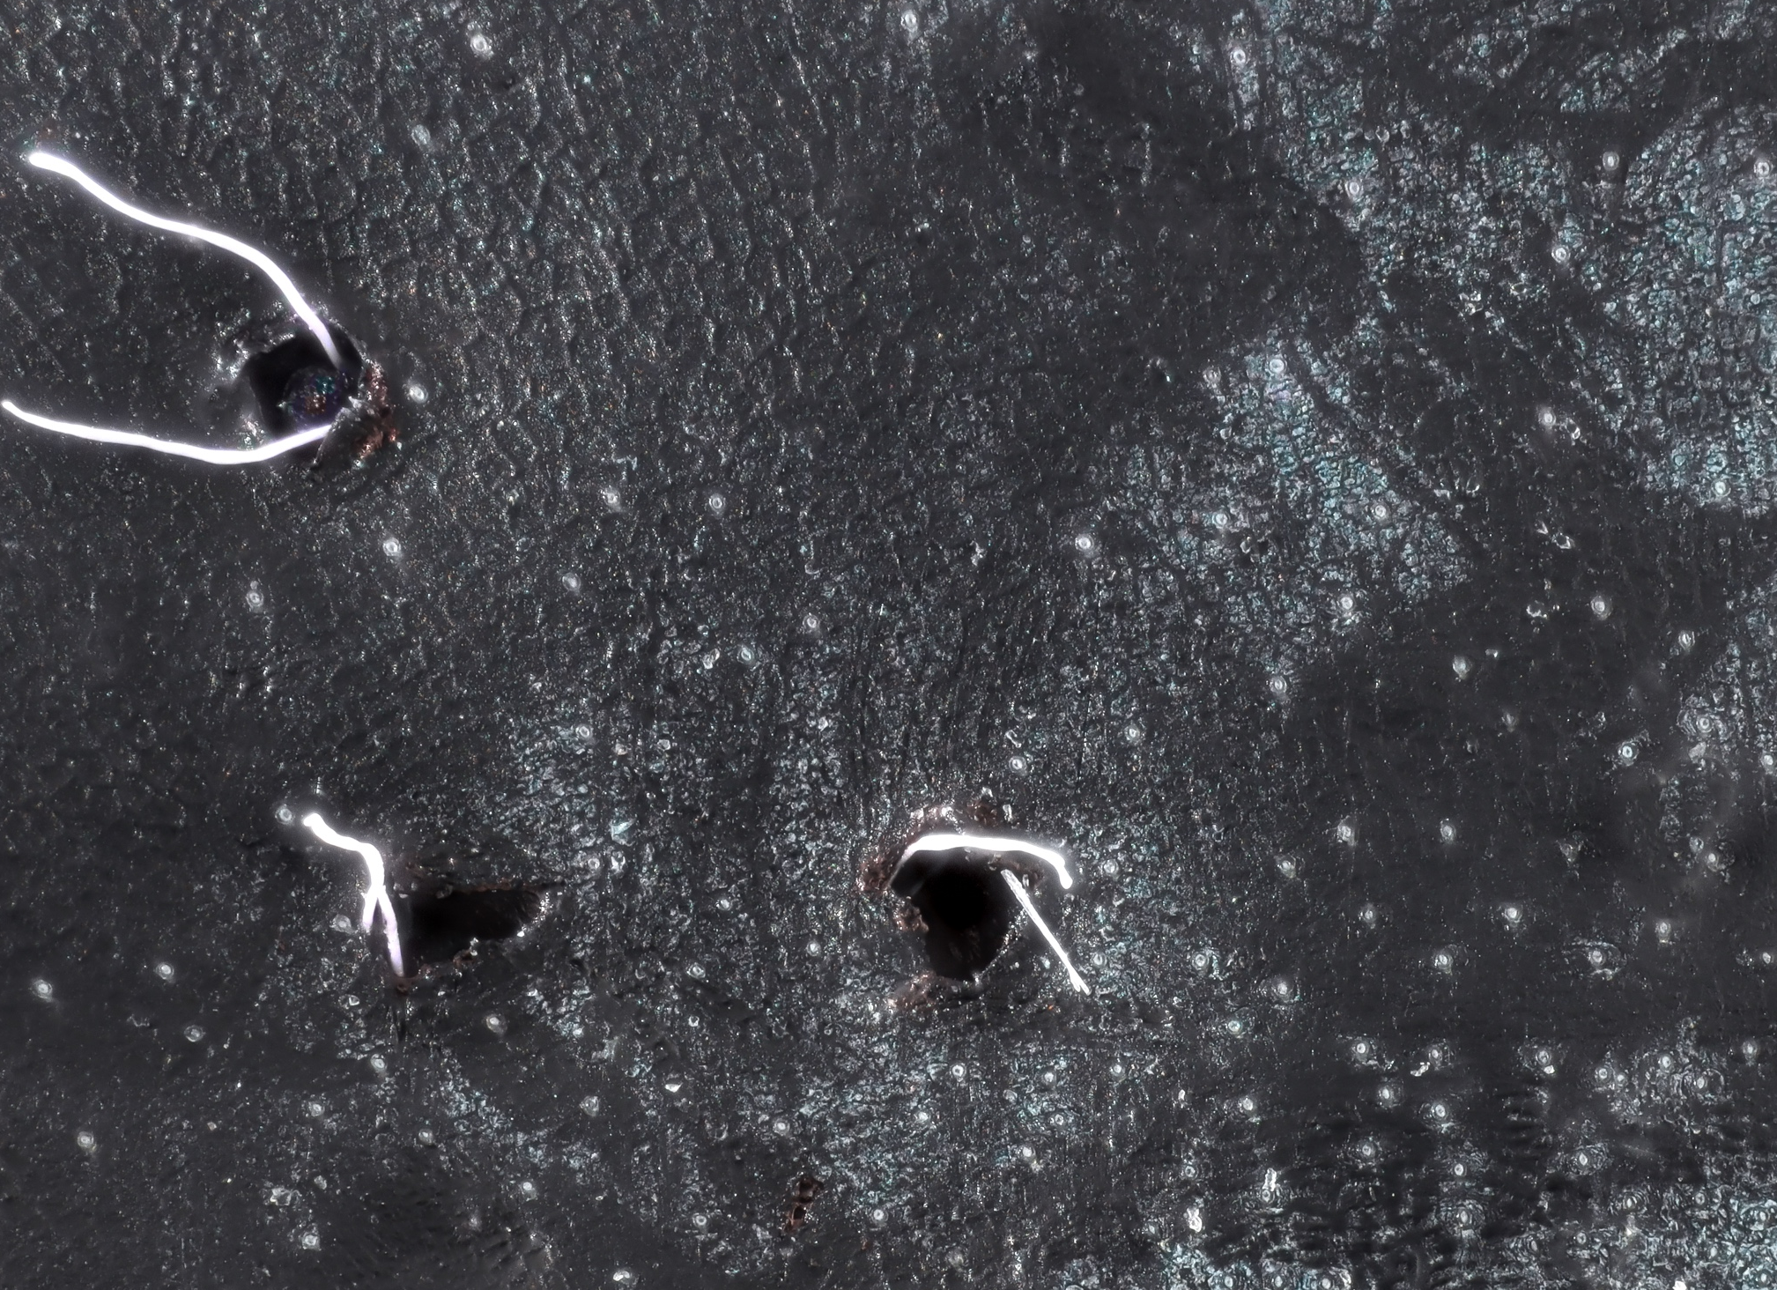
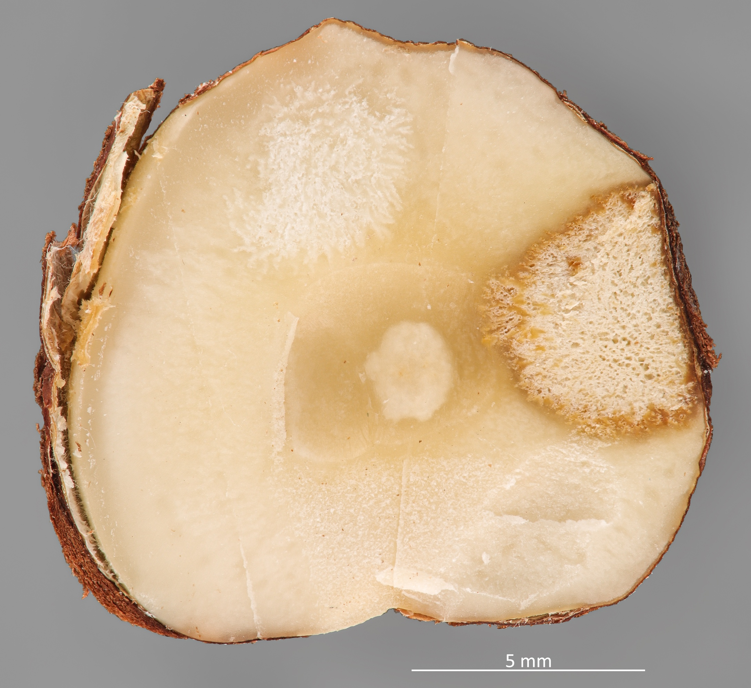
H. halys attacks a wide range of fruits, horticultural and ornamentals crops
D. suzukii is a pest of soft-fruits and cherries
Integrated pest management tools often fail to effectively reduce invasive pest infestations. Current pest management techniques rely on non-selective insecticides, which negatively affect the biocoenosis while increasing the production costs.

Slide 5


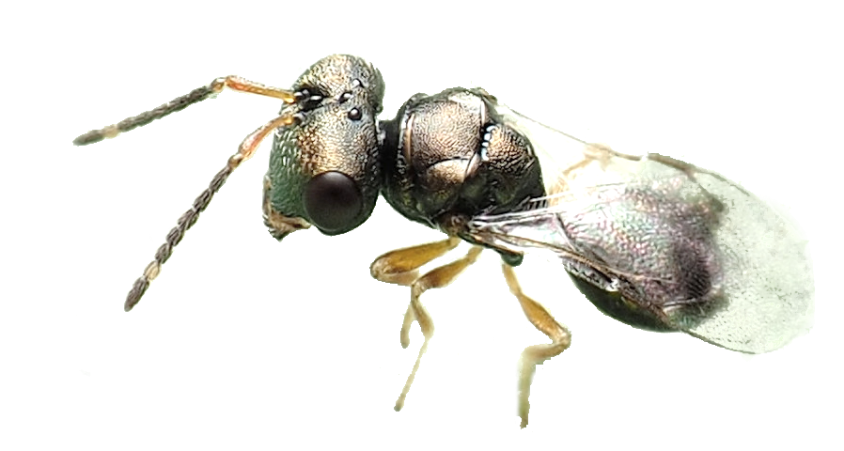




Icon made from freepik www.flaticon.com
<a href="https://www.flaticon.com/free-icons/lens" title="lens icons">Lens icons created by logisstudio - Flaticon</a>
Classical biological control refers to the intentional introduction of an exotic host-specific co-evolved natural enemy, for permanent establishment and long-term and sustainable control of the invasive insect pest populations across wide areas, often reducing them to less harmful levels.

Slide 6
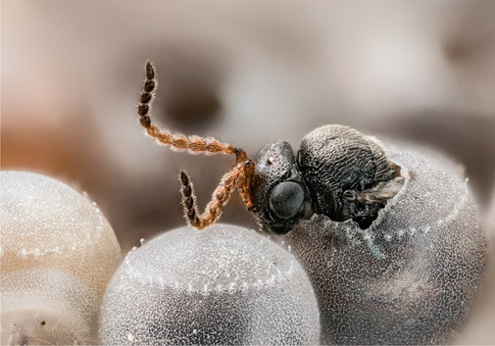
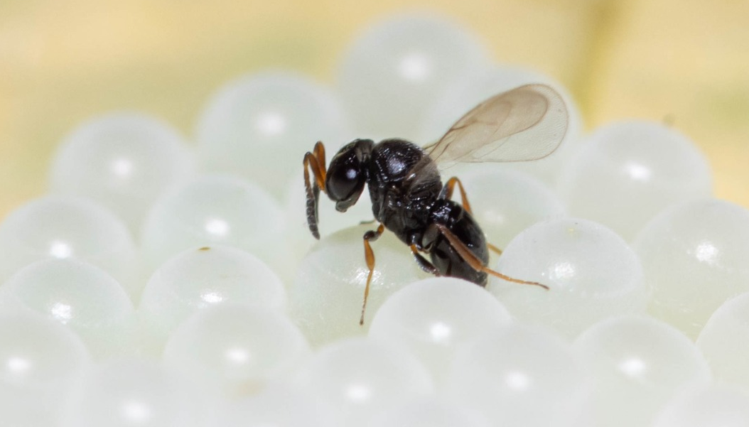
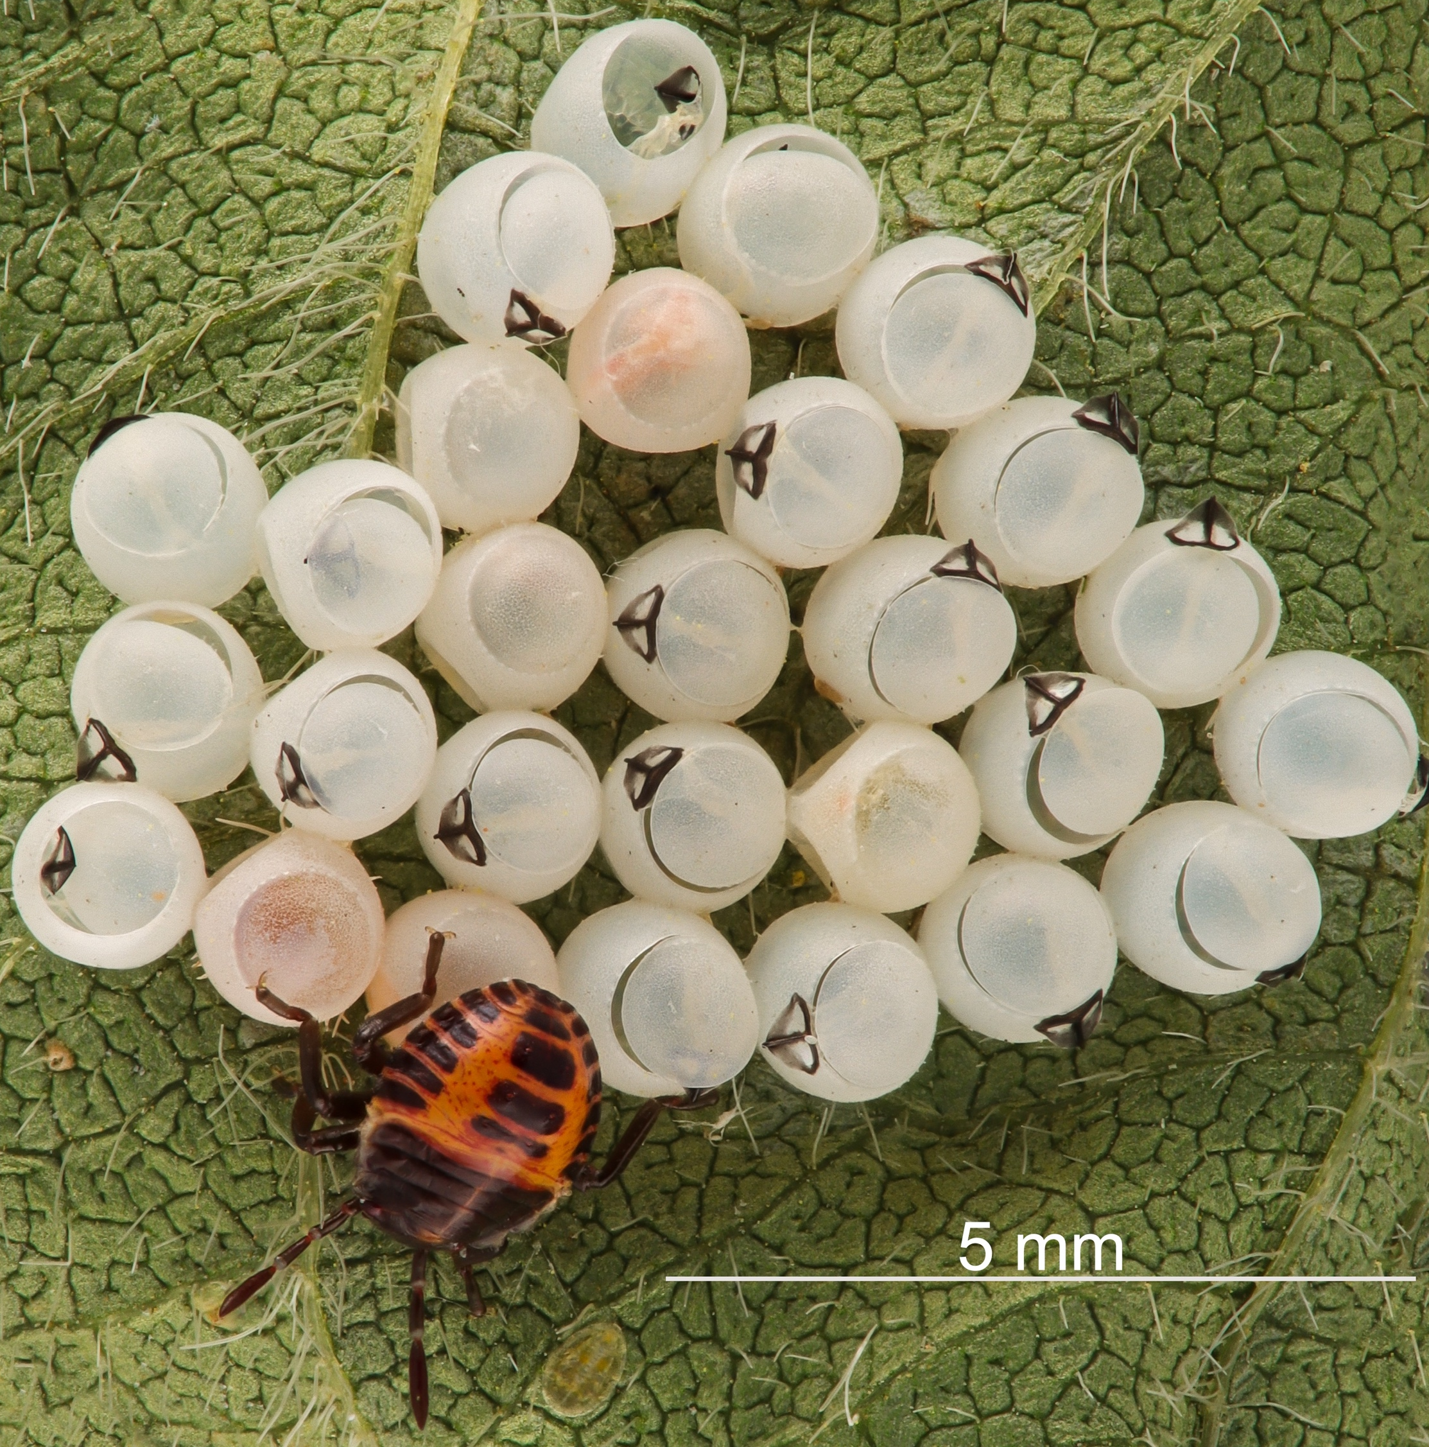
Egg parasitoid of H. halys
Trissolcus japonicus (Ashmead 1904)
Hymenoptera Scelionidae
Egg masses of H. halys

Slide 7
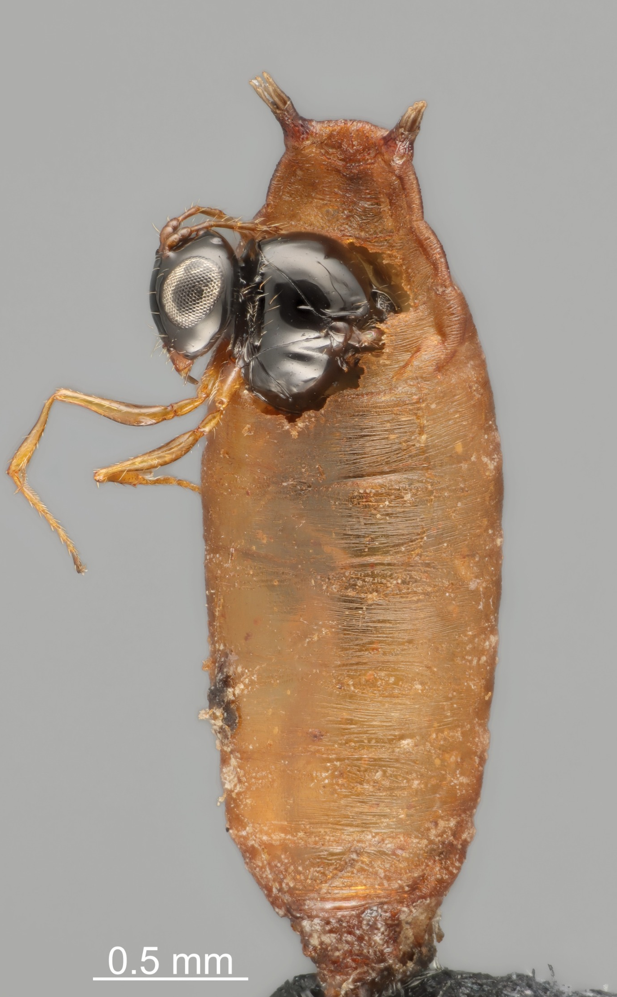
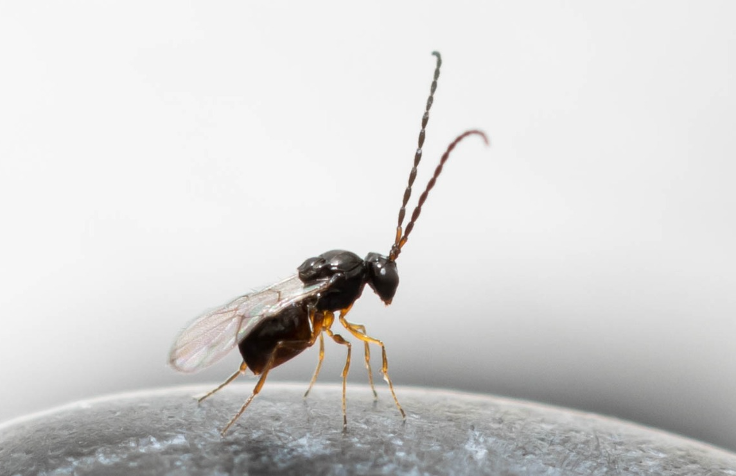
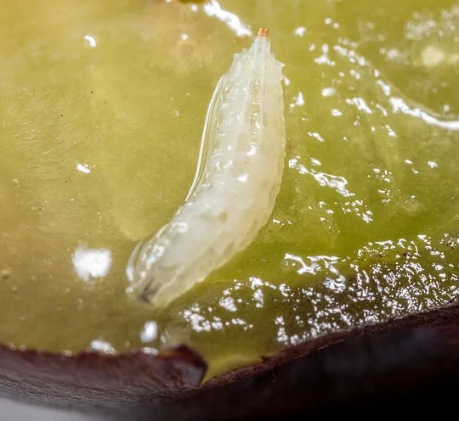
Larval parasitoid of D. suzukii
Ganaspis brasiliensis Ihering
(Hymenoptera Figitidae)
Larvae of D. suzukii

Slide 8
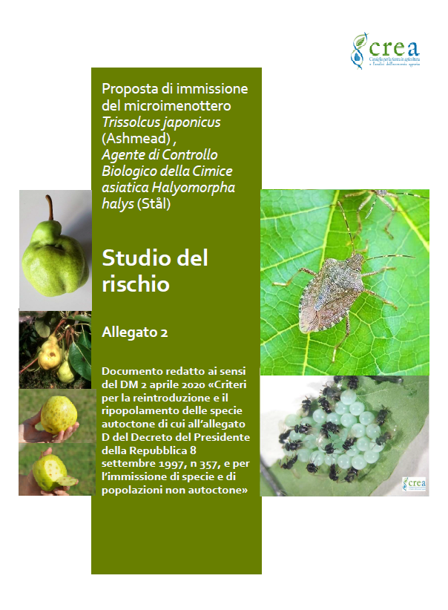
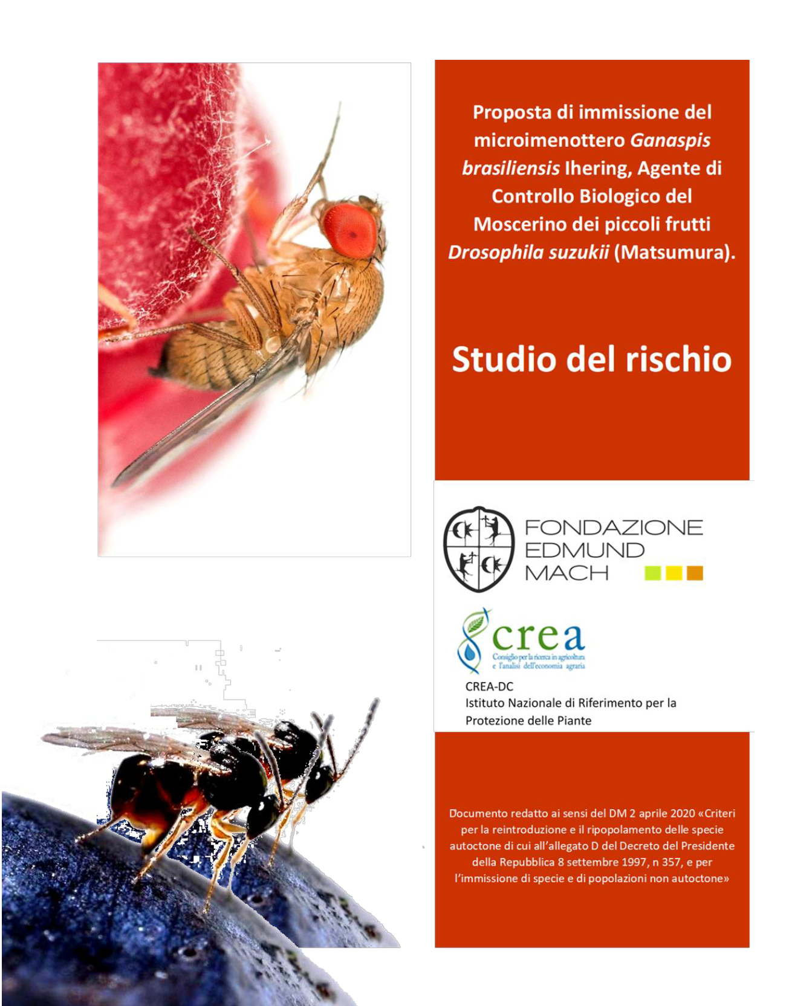
“Criteria for the reintroduction and repopulation of native species referred to in Annex D of the Decree of the President of the Republic of 8 September 1997, n 357,
and for the introduction
of non-native species
and population”.
Dossier contents:
i) information on the biology and ecology of the target pest and the selected antagonist;
ii) data about host-specificity testing and data already available in literature;
iii) environmental and economic impacts of the proposed release;
iv) probability of the parasitoid establishment and spread in the proposed release sites;
v) release schedule and post-release monitoring program;
vi) contingency plan to mitigate potential undesired environmental impacts;
vii) map and vegetation of release sites;
Risk assessment
dossier

Slide 9

Technical – Scientific Committee
Two Technical –Scientific Comittees were established within the frame of the action of the Ministry of Agriculture, Food Sovereignty and Forest.
The Committees are coordinated by Consiglio per la Ricerca in Agricoltura e l'analisi dell'economia agraria (CREA) and comprise:
scientific experts (from University, CNR, Edmund Mach Foundation, Laimburg Research Center, Enea etc.).
representatives of the regional Plant protection Services.
D. suzukii Committee
2021
OBJECTIVES:
securing annual permissions for the release of the exotic parasitoids from the Ministry of the Environment (but also Ministry of Health and Ministry of Agriculture, Food Sovereignty and Forests);
developing rearing and distribution systems for parasitoids to support field releases;
coordinating release and monitoring activities across participating regions.
H. halys Committee
2020

Slide 10
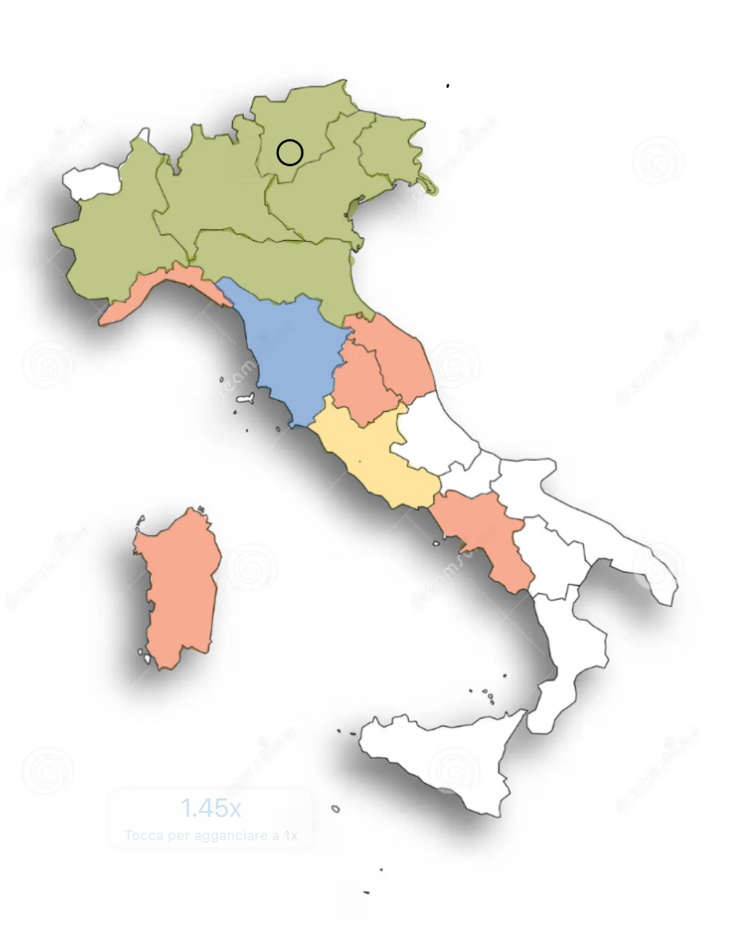
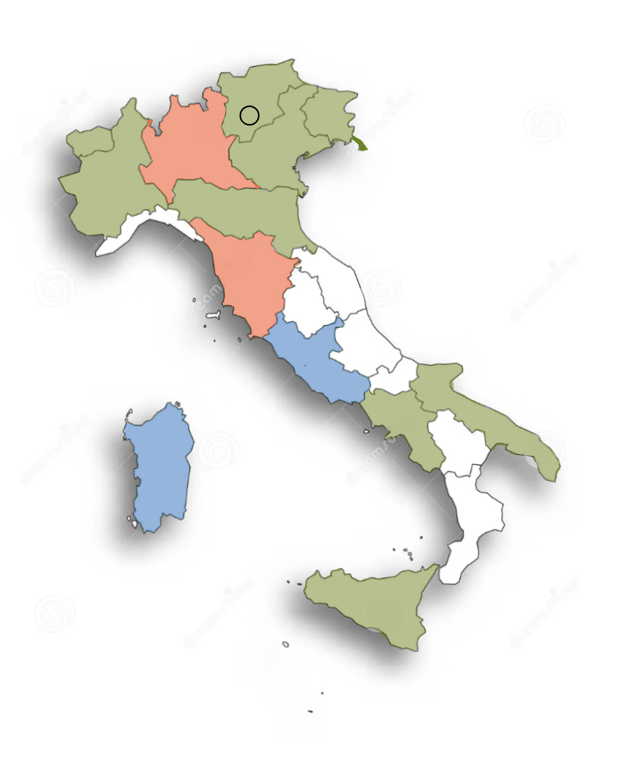

National programs of Classical biological control of H. halys and D. suzukii
2009
2012
Group 1 (2020)
Group 2 (2021)
Group 3 (2022)
Group 4 (2024)
Group 1 (2021)
Group 2 (2023)
Group 3 (2024)
2016
2012
H. halys
D. suzukii
Since 2020 and 2024 respectively, IRET is the scientific responsible of the T. japonicus and G. brasiliensis G1 mass rearing lab and the scientific partner of Sardinia Region for the H. halys and D. suzukii biological control programs in the island.

Slide 11
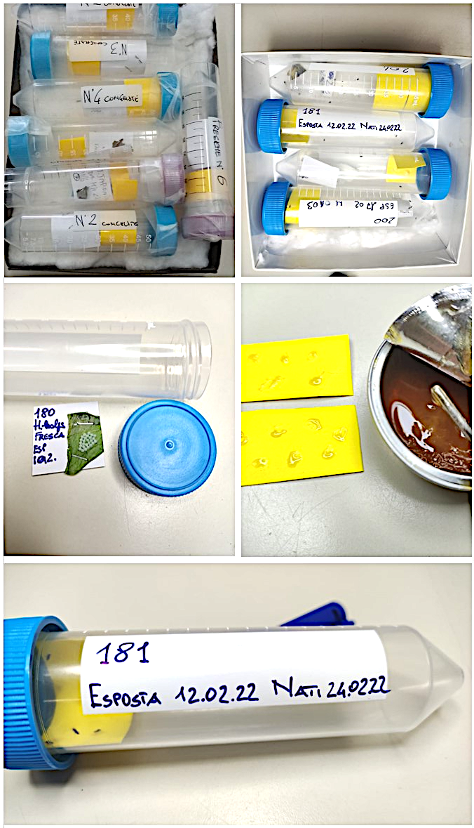
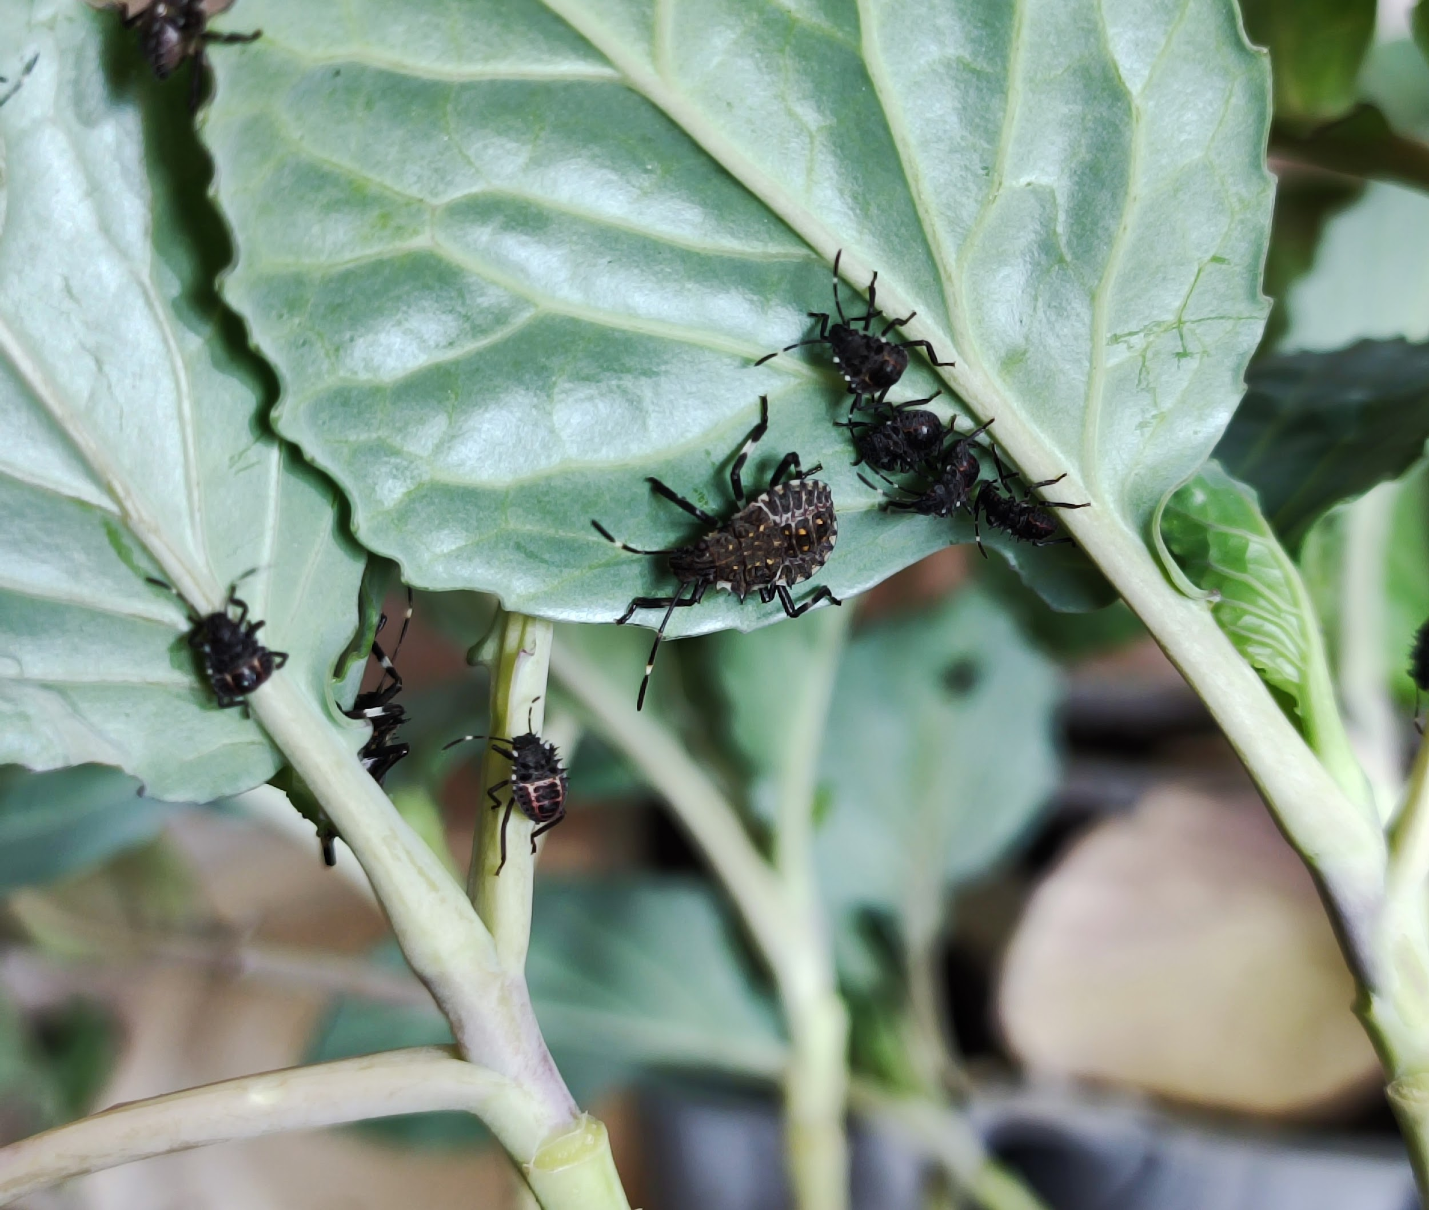
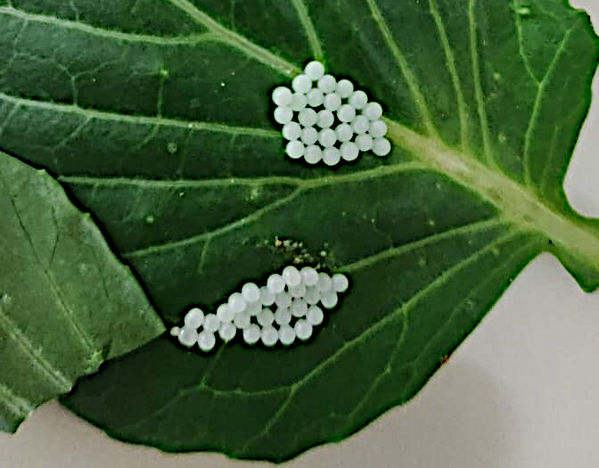
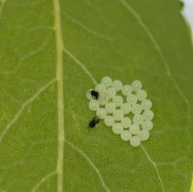
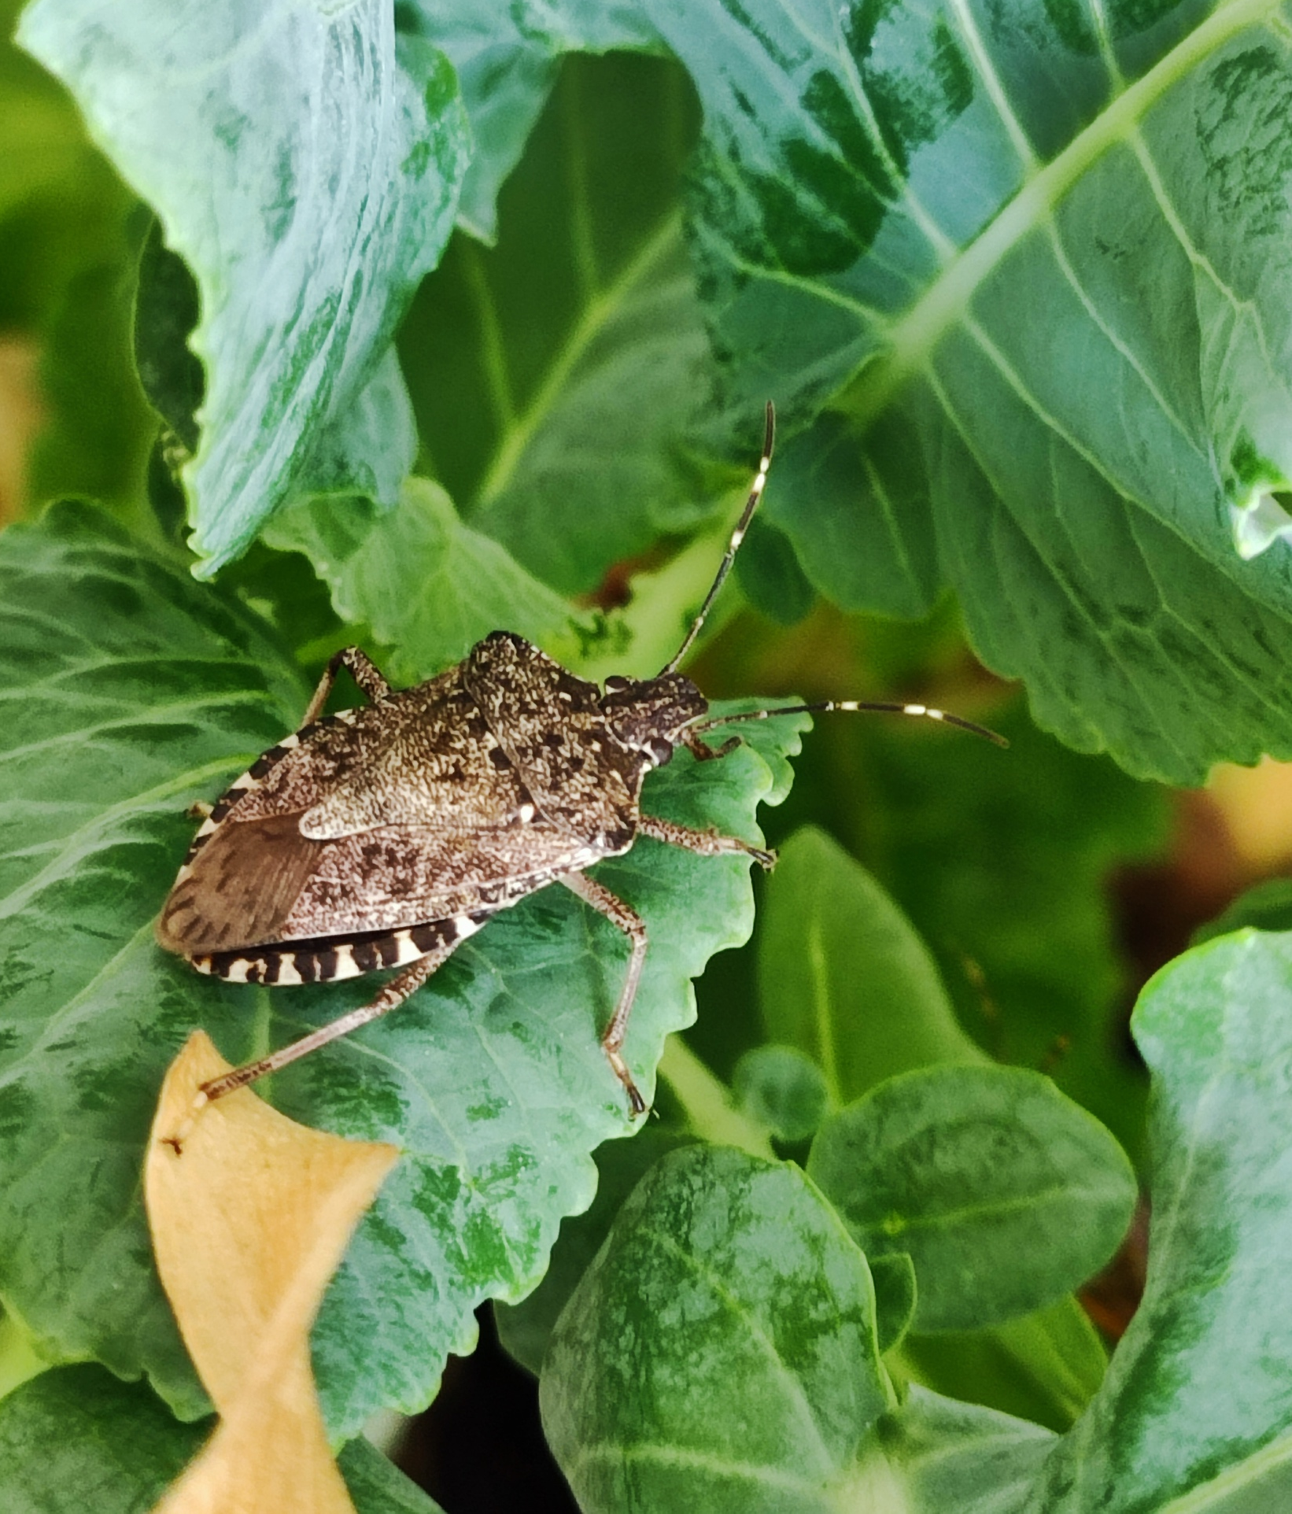
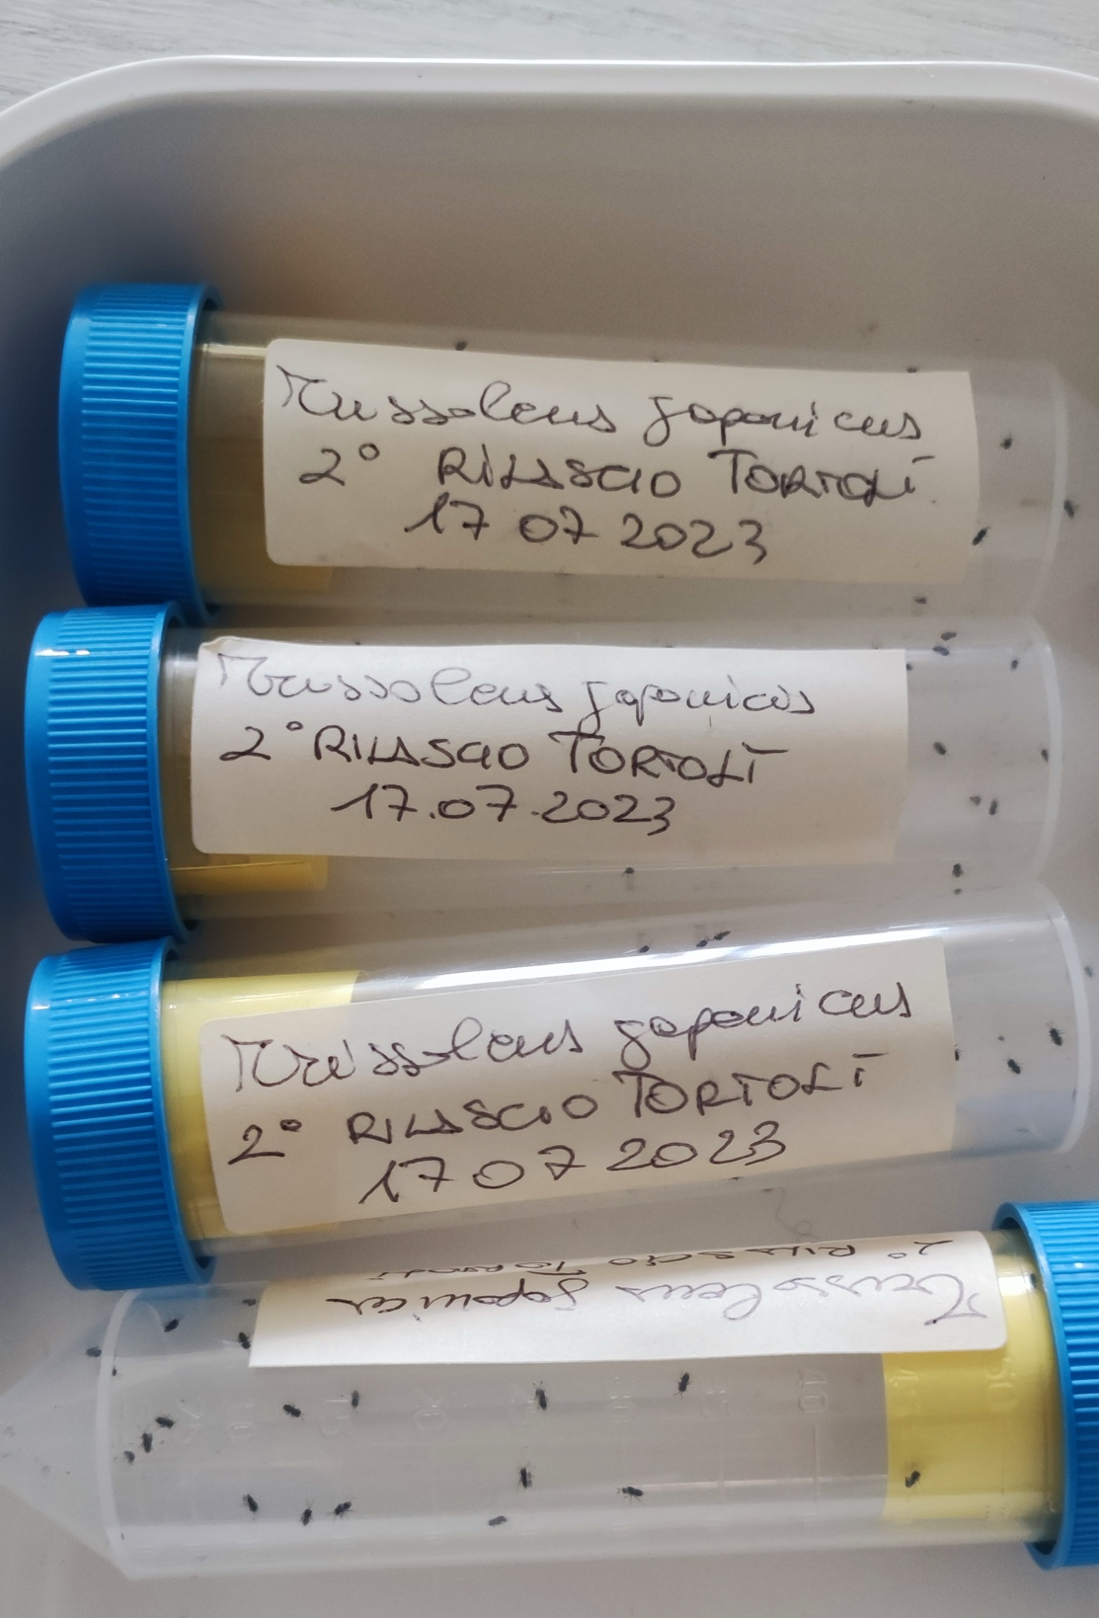
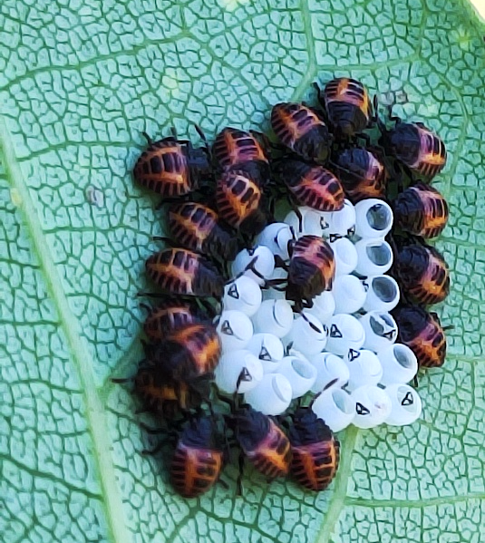
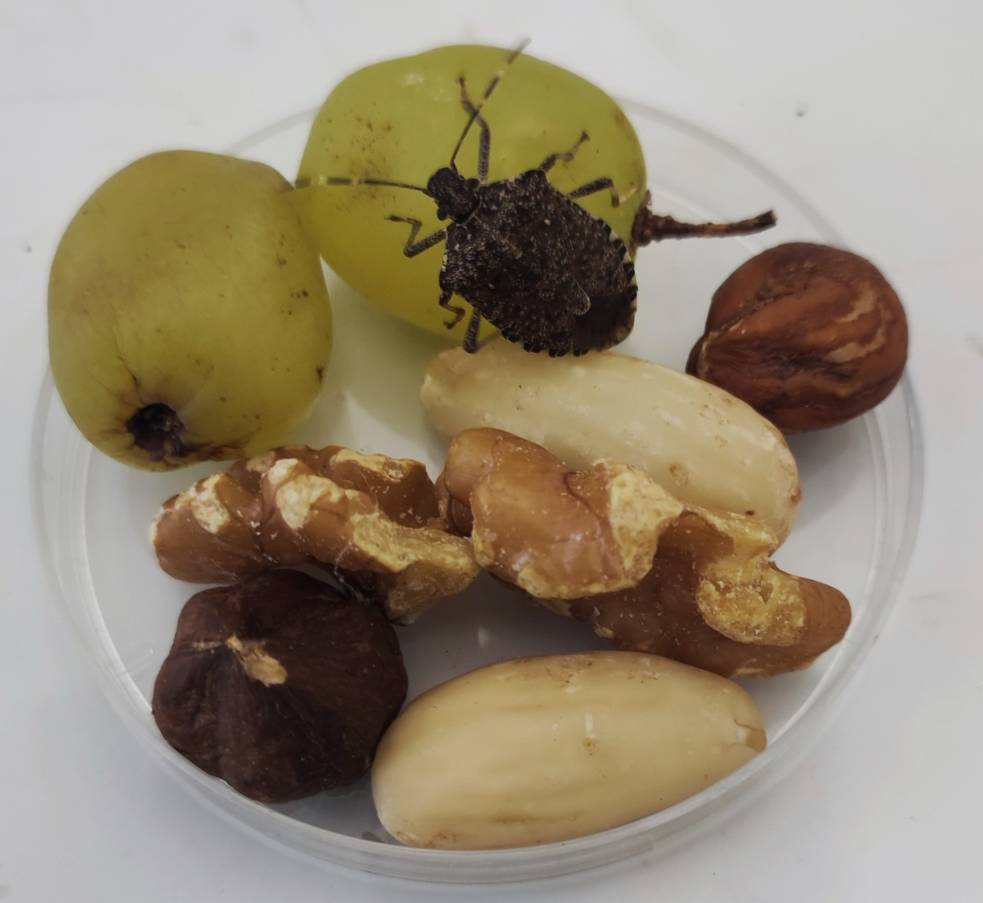
H. halys and T. japonicus rearings
Inoculum from
CREA DC Florence

Slide 12
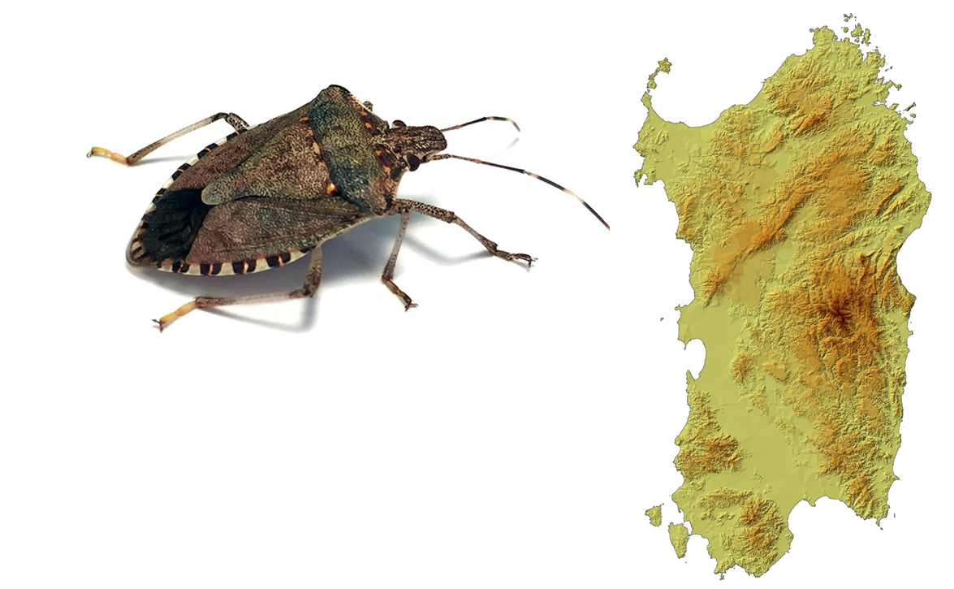
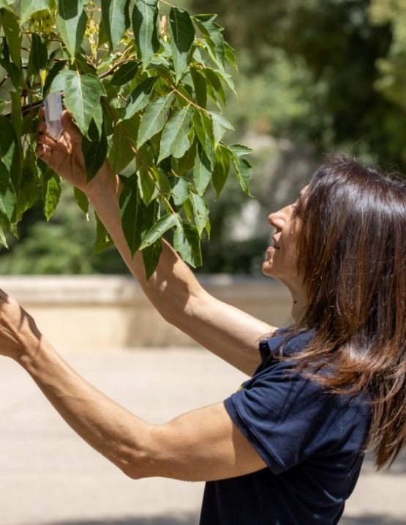
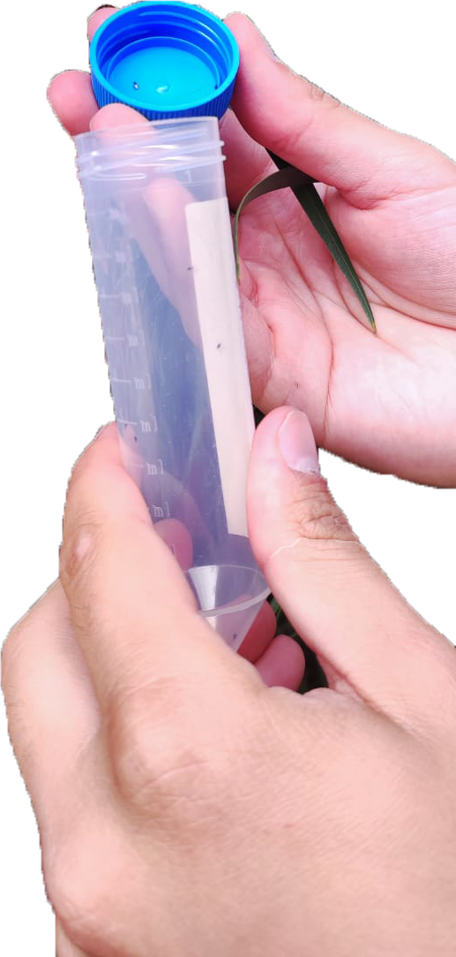
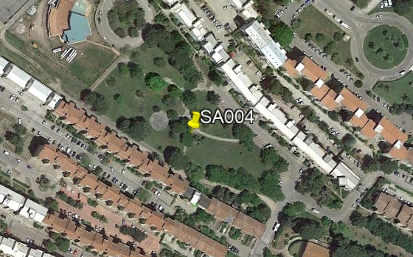
Classical biological control
of H. halys in Sardinia
5 release sites
2 release per site per year
100 T. japonicus fecunded females
per release
1
2
4
4
5
3
2021
2023
2022
2024

Slide 13
National programs of Classical biological control of H. halys and D. suzukii
Group 1 (2020)
Group 2 (2021)
Group 3 (2022)
Group 4 (2024)
Group 1 (2021)
Group 2 (2023)
Group 3 (2024)
H. halys
D. suzukii
Regions that joined the National programs in 2024 have been granted
release authorization for a three-year period

Slide 14
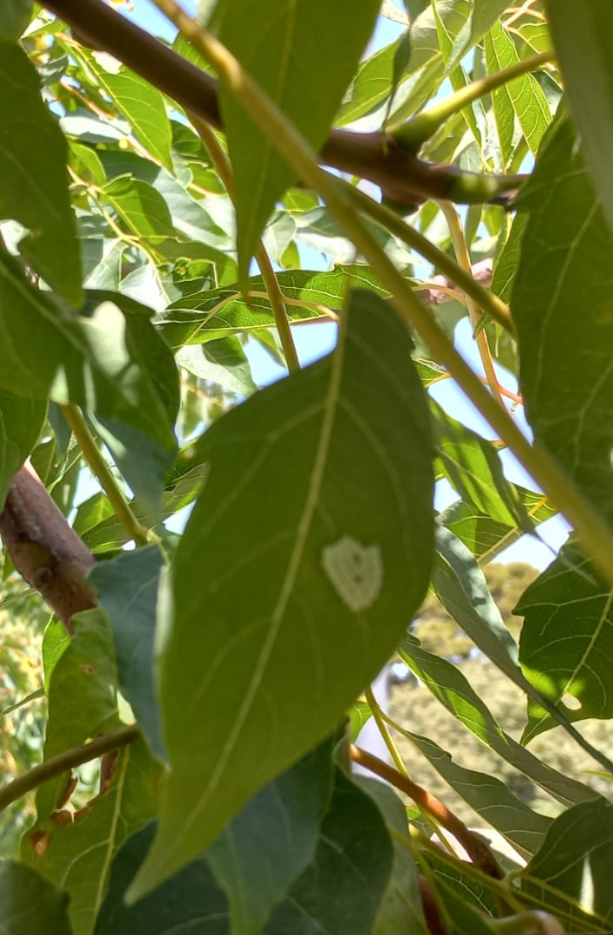
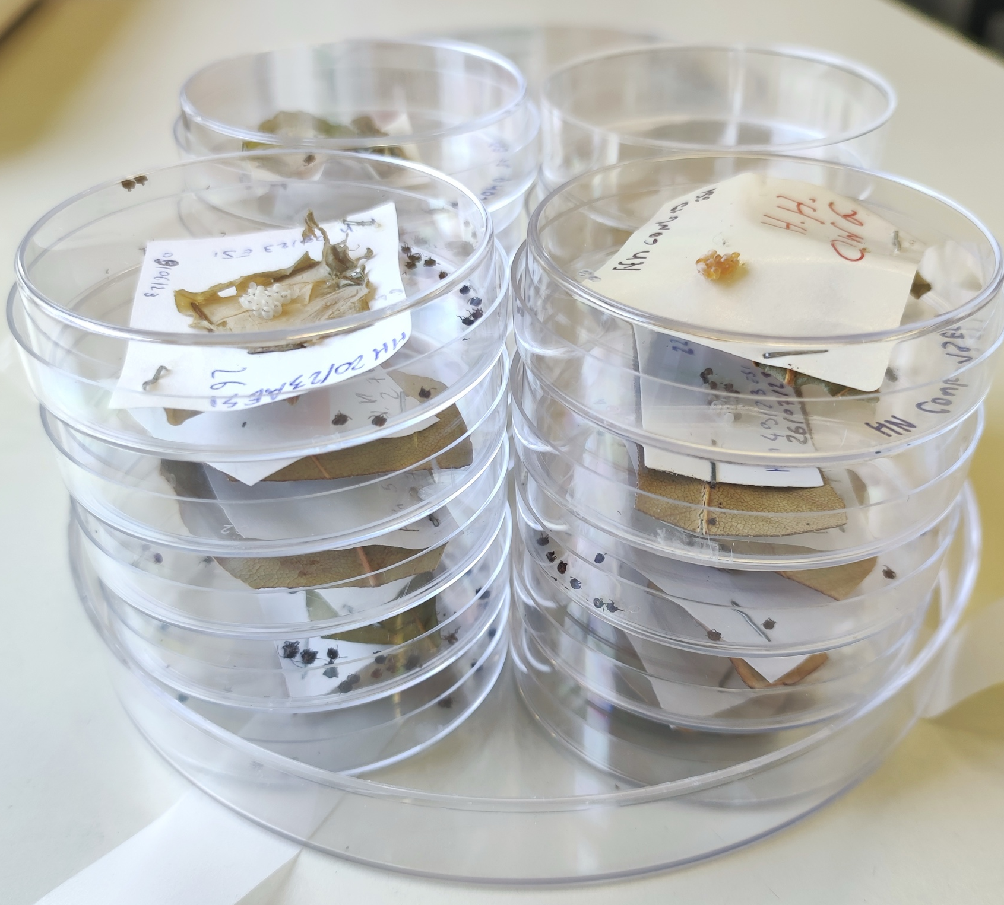
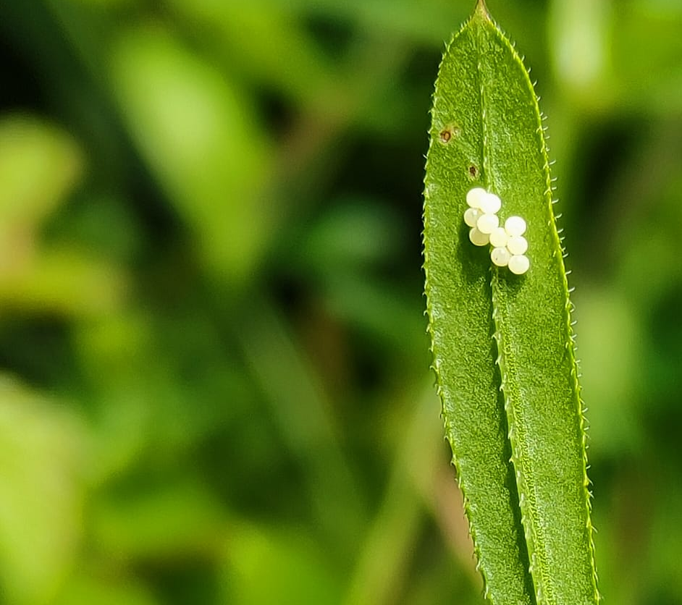
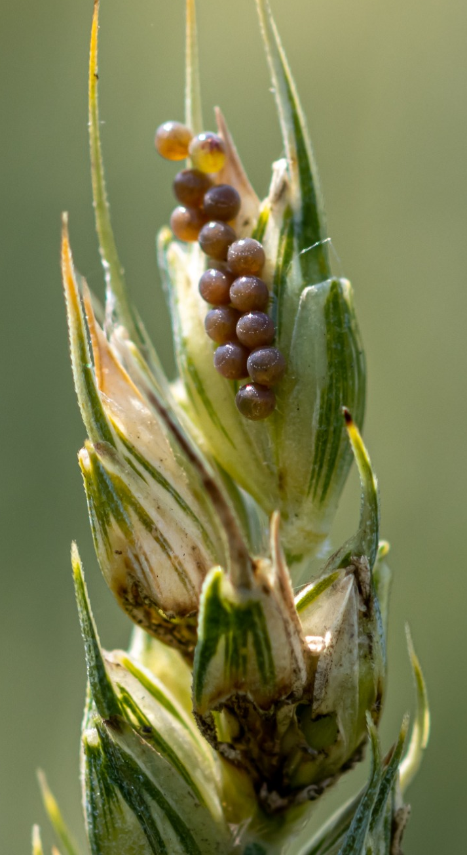
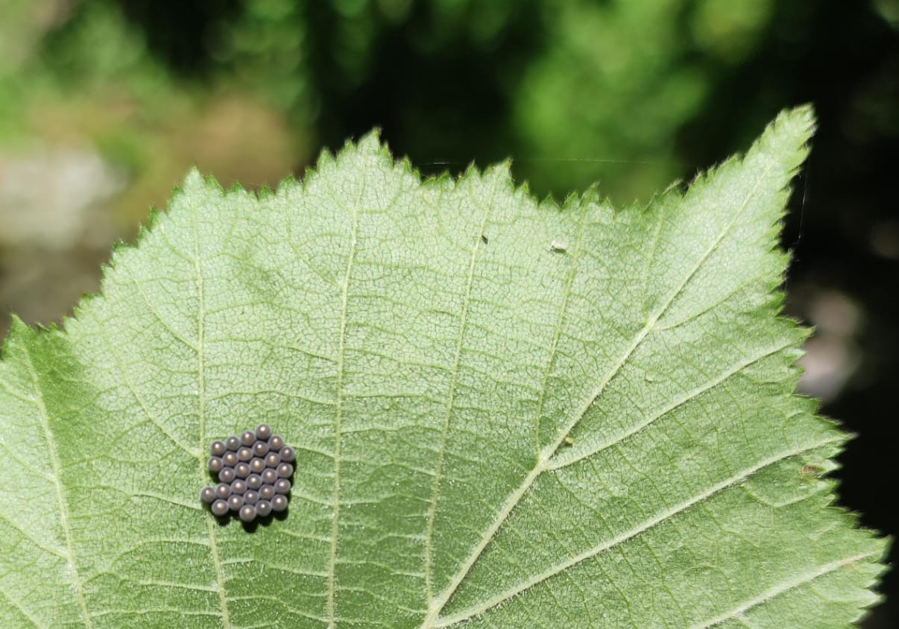
Pre and post-release
samplings
Pre- and post-release samplings of egg masses of H. halys and native pentatomids species are performed according to the national protocol. Egg masses are reared in laboratory until bug or parasitoid emergence.

Slide 15
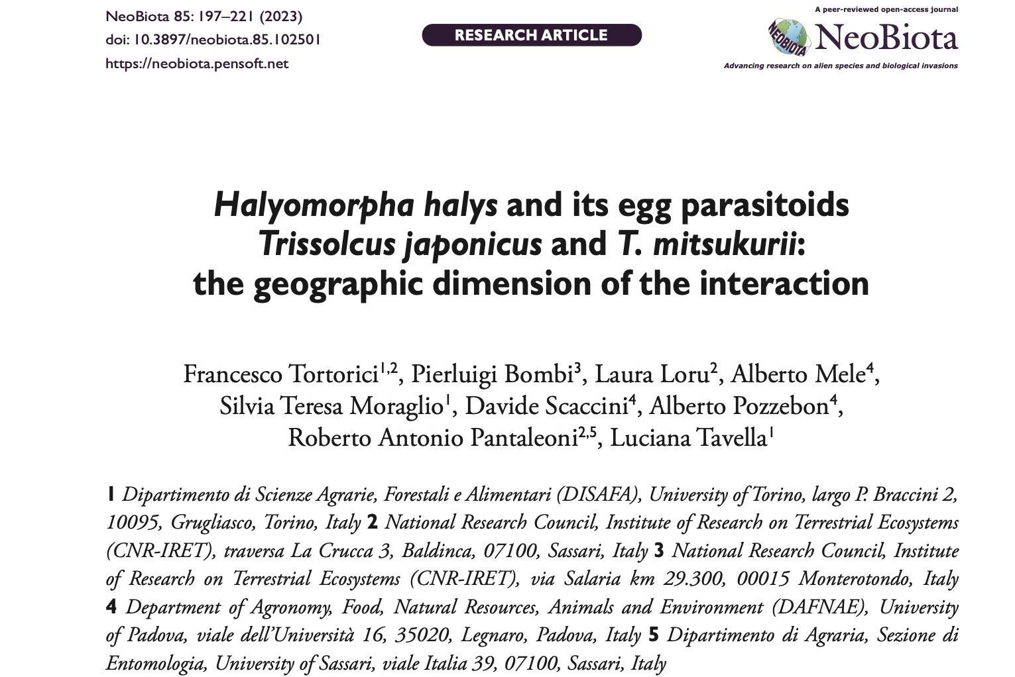
109 H. halys egg masses (2857 eggs) were collected in pre and post release samplings;
Two egg masses collected in site n°2 in post release sampling in 2022 resulted parasitised from T. japonicus (46 eggs);
1 egg mass collected in site n°3 in post release sampling in 2022 showed T. japonicus emergence holes;
T. japonicus emerged from one sentinel egg mass exposed after the releases, in site 1 in 2023;
No emergence was observed from non-target pentatomid egg masses
1
4
2
5
T. japonicus has not yet established in Sardinia
To be continued….
3
2021
2023
2022
2024

Slide 16
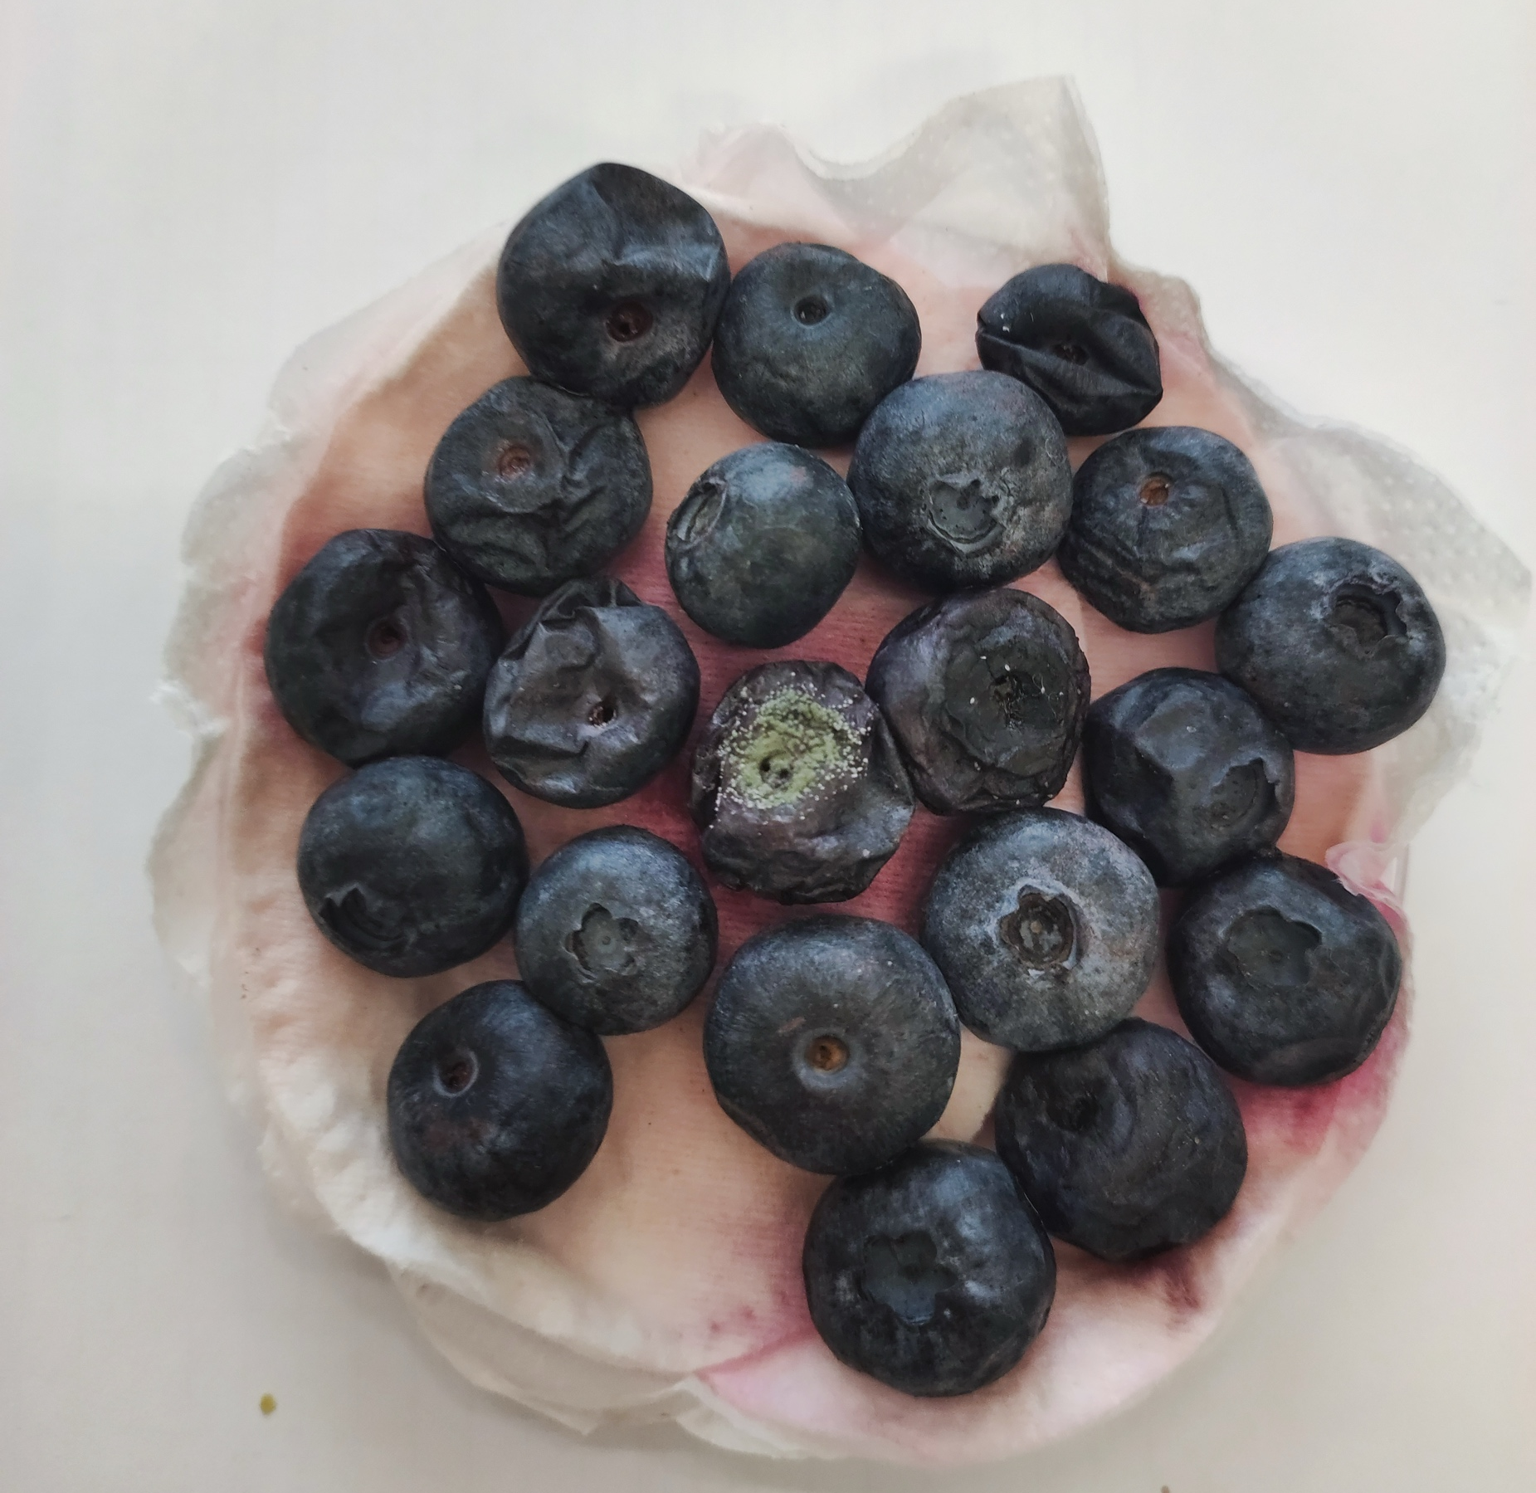
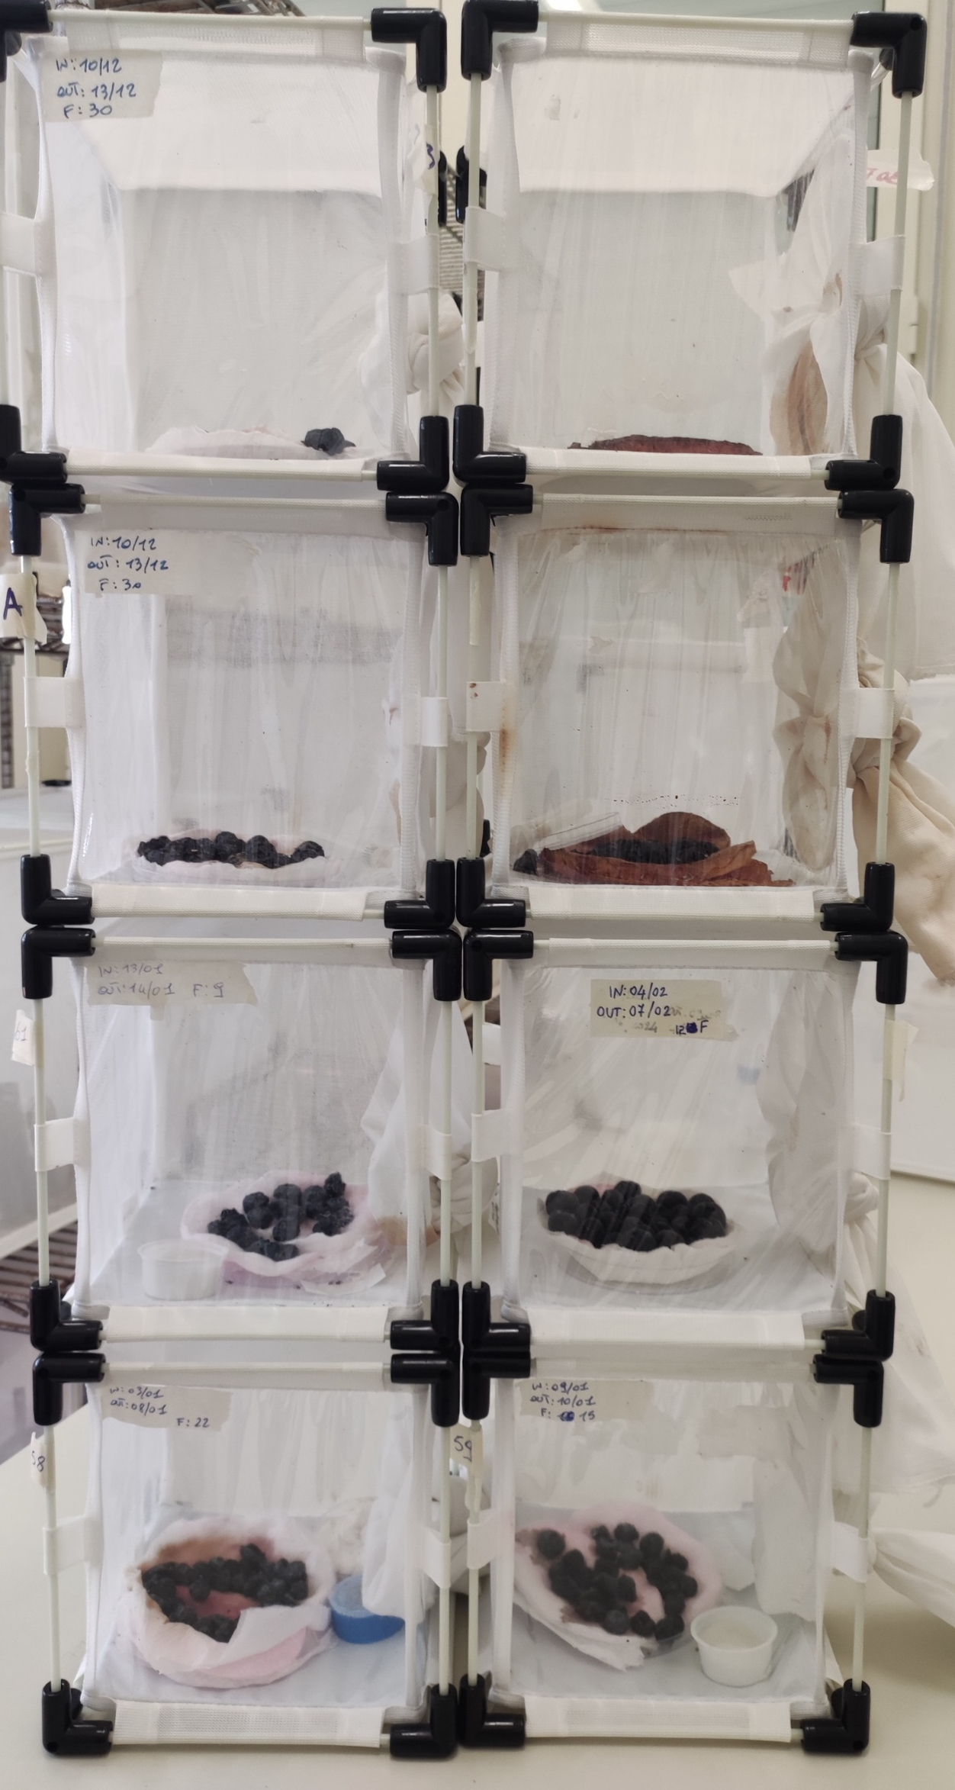
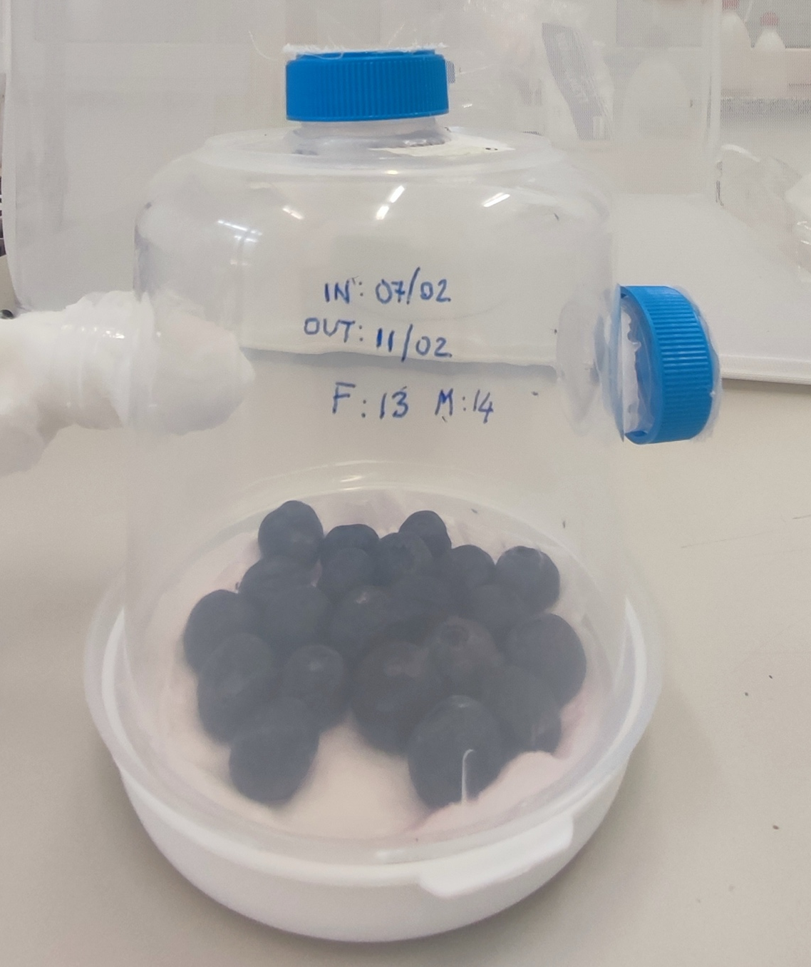
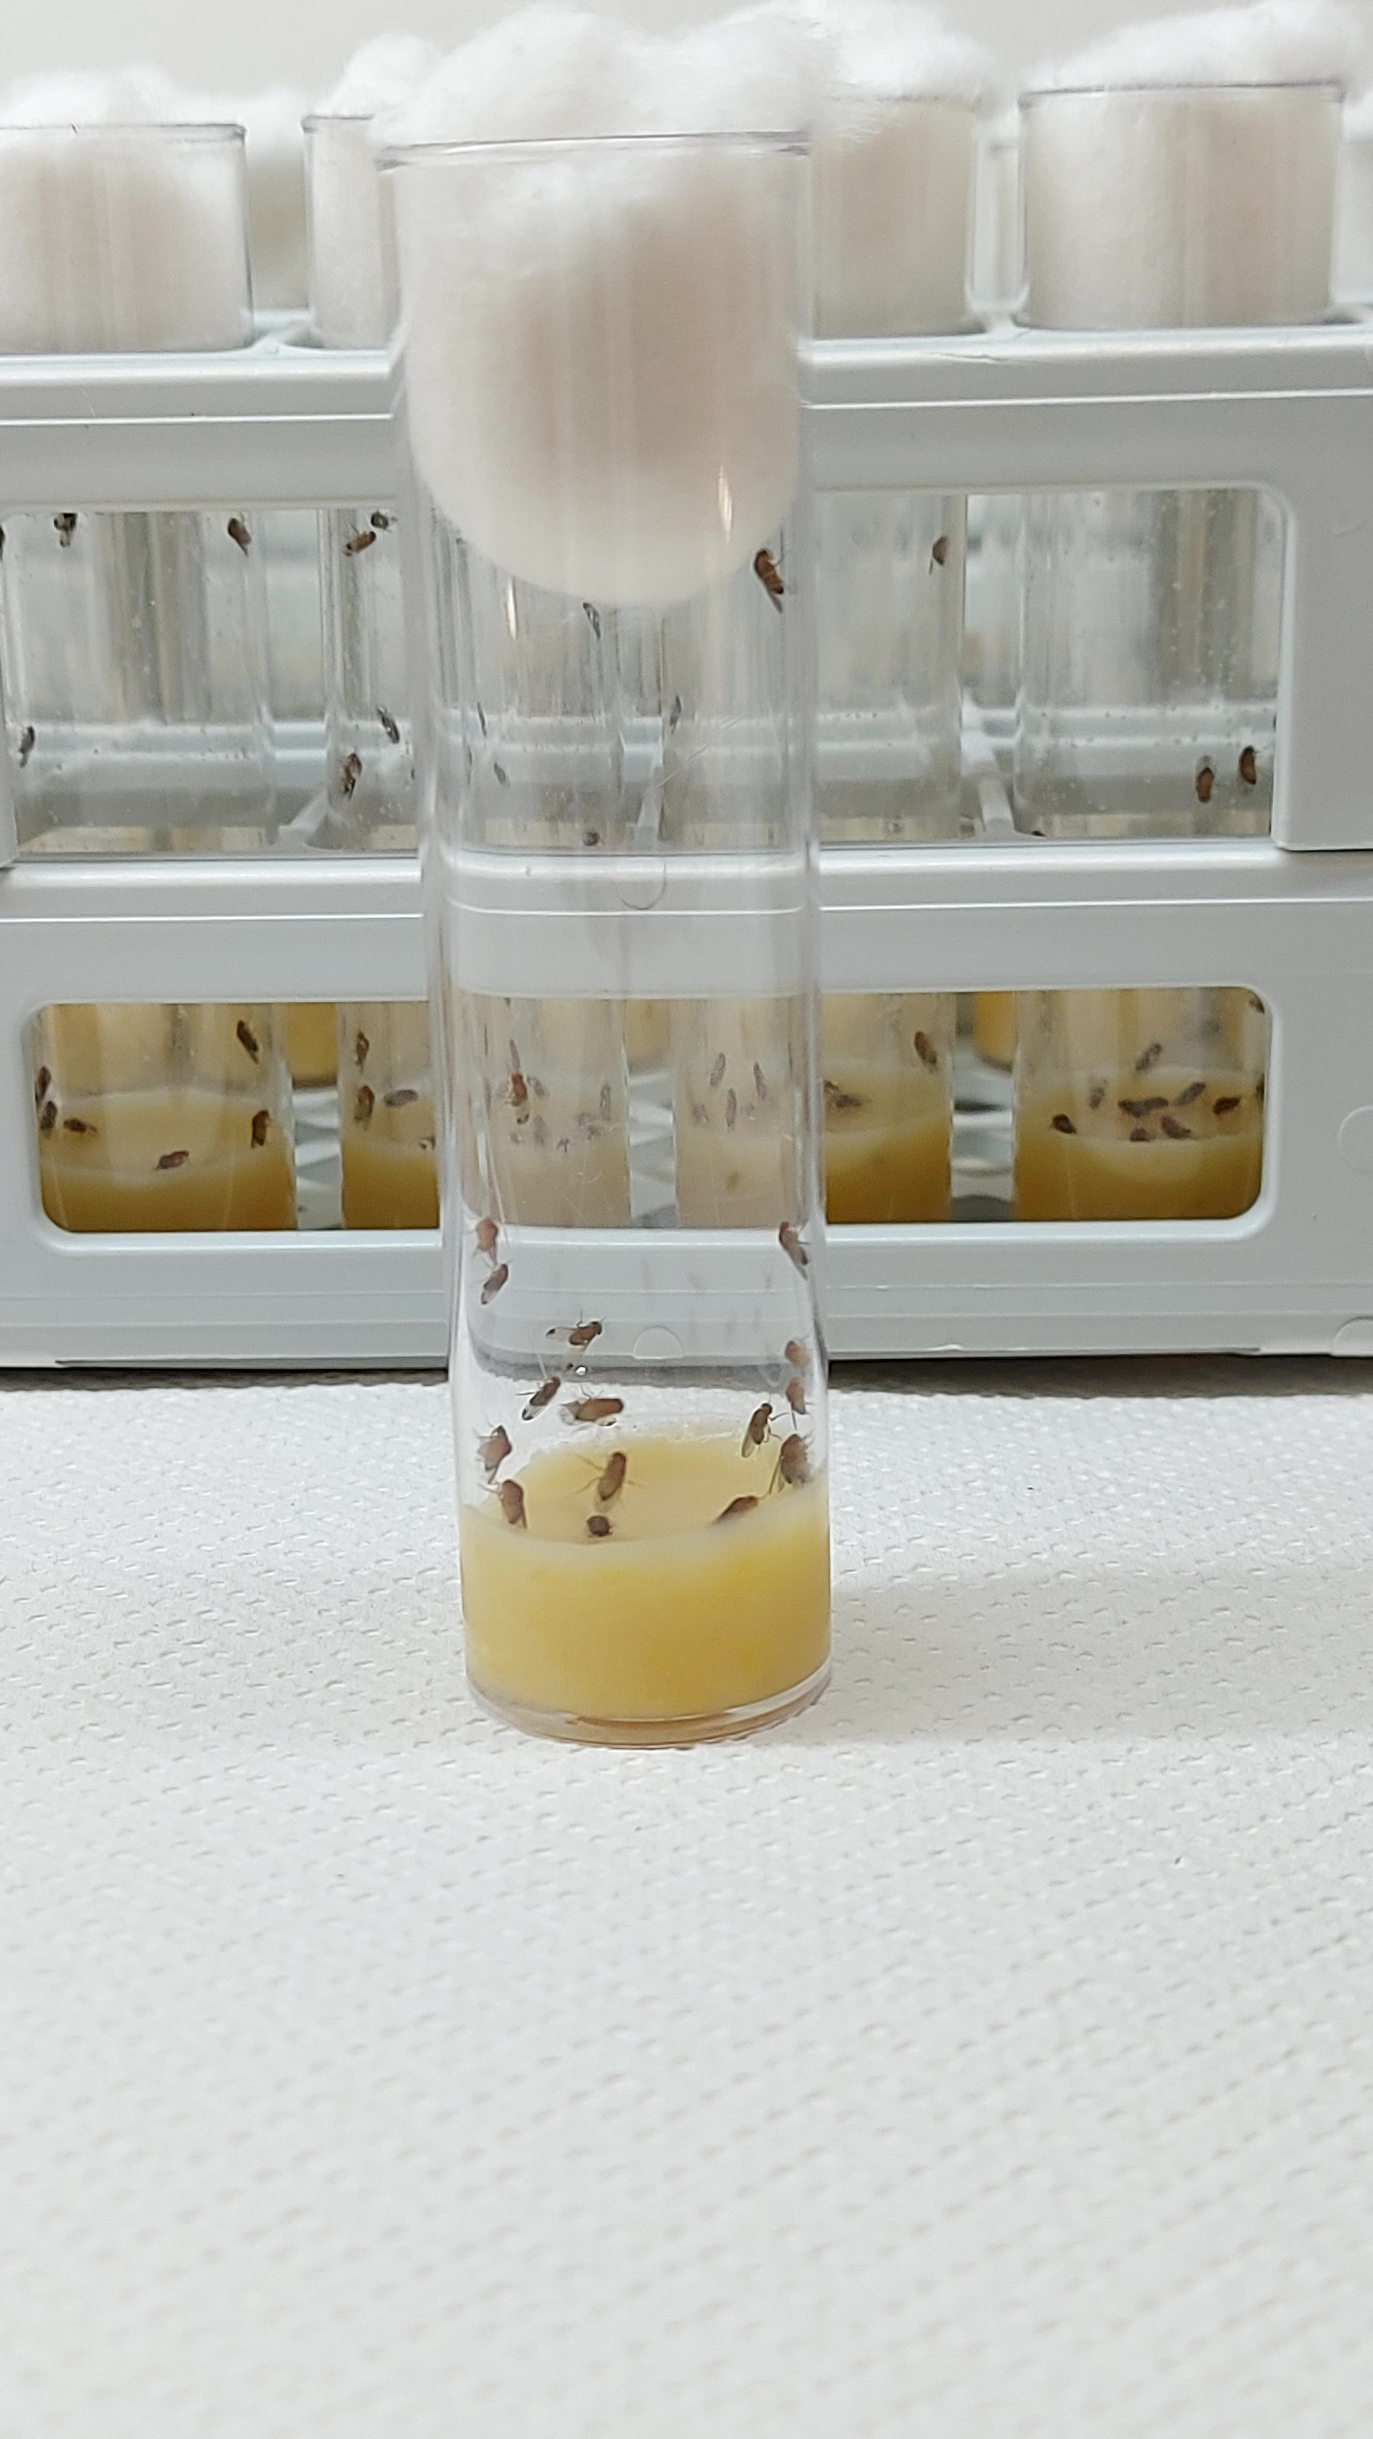
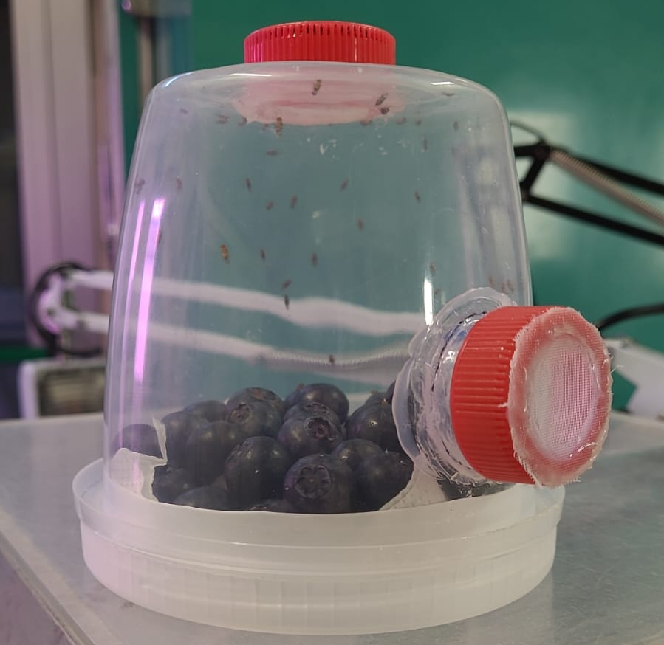
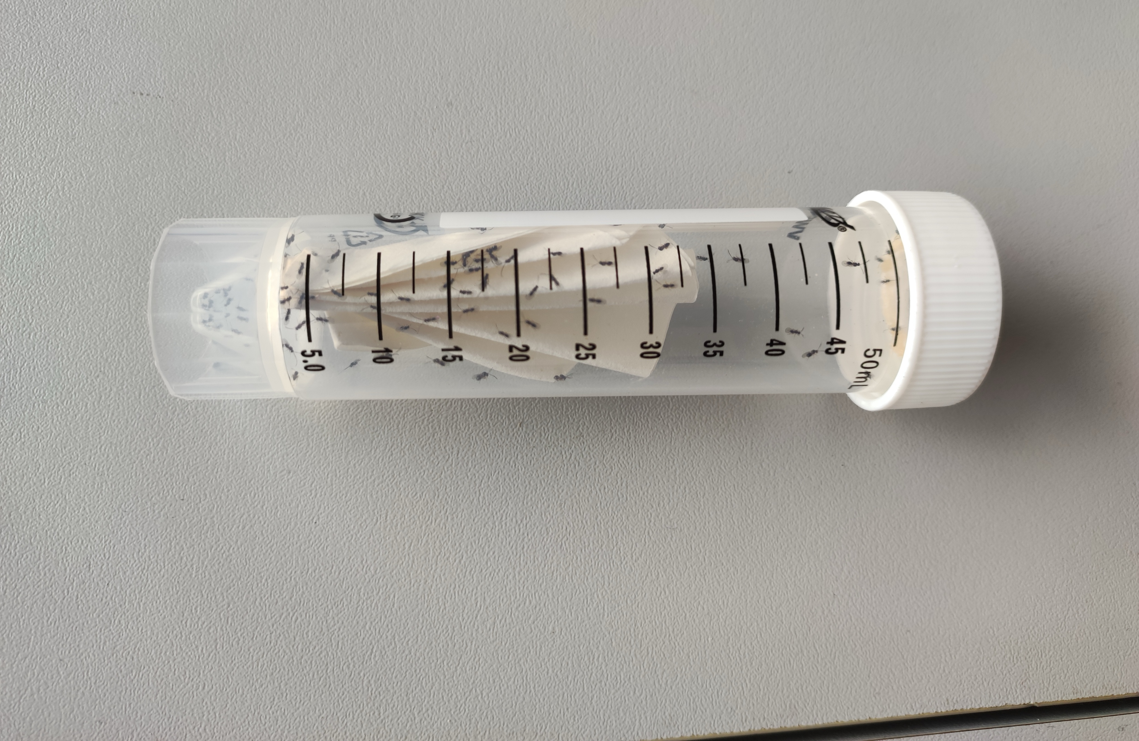
Inoculo from Laimburg Researc Center Bolzano
D.suzukii rearing
G. brasiliensis rearing
Inoculum from
Laimburg Research Centre

Slide 17
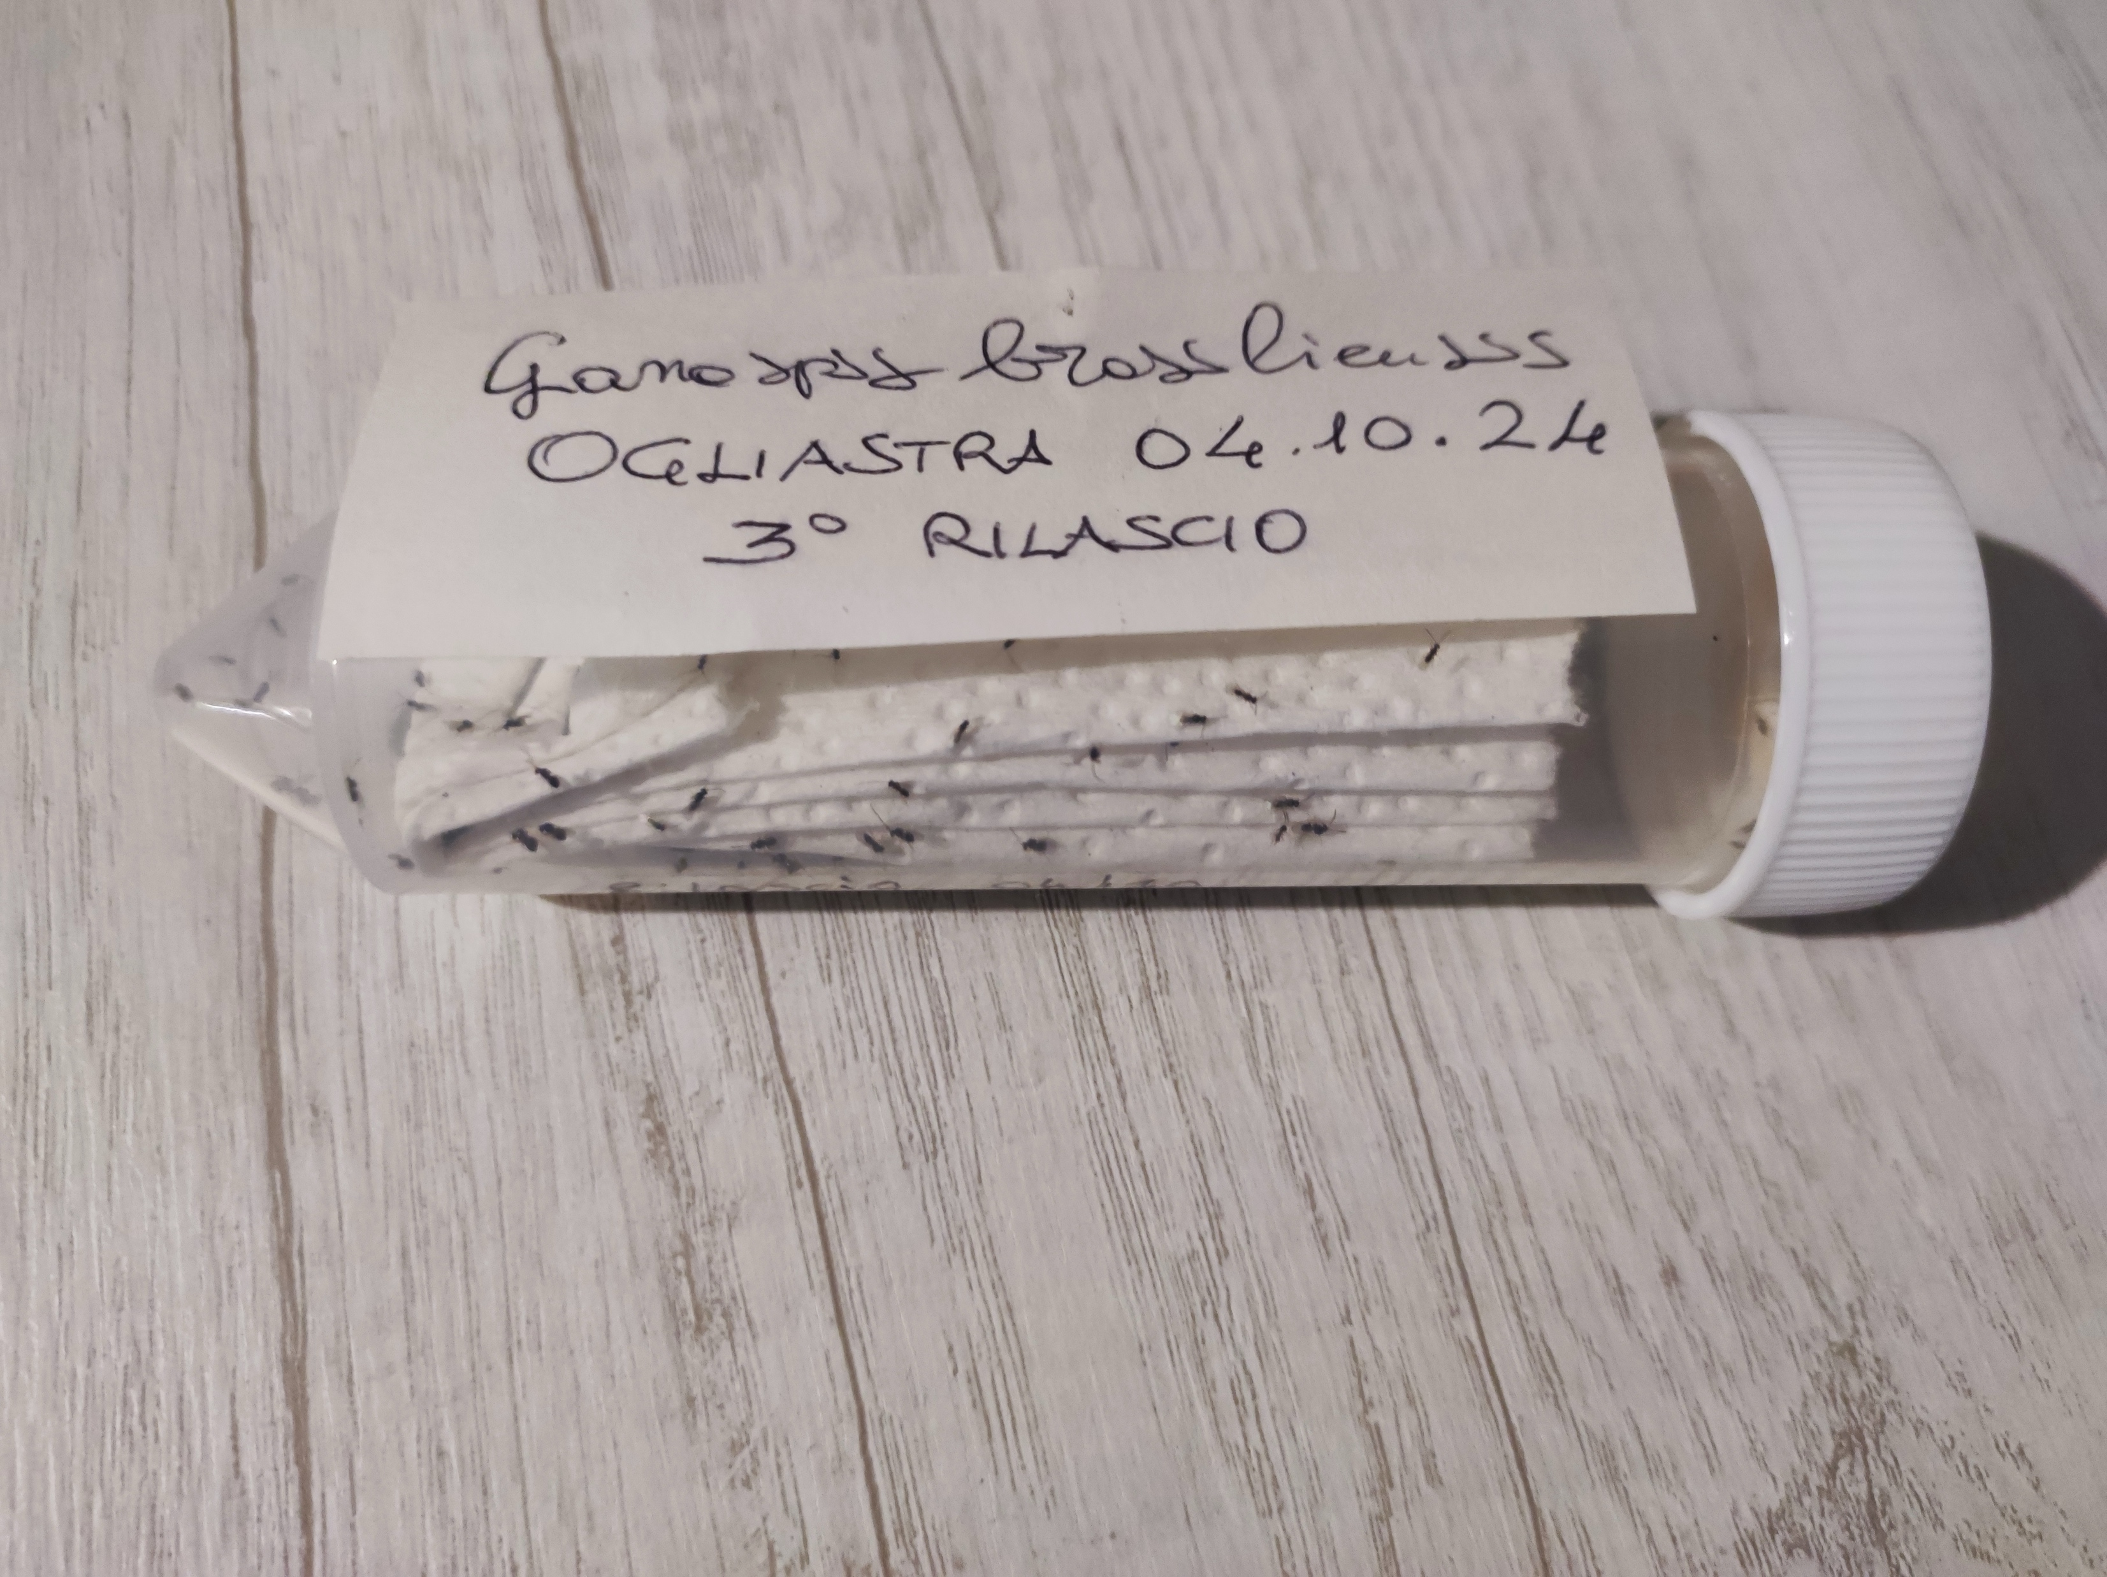
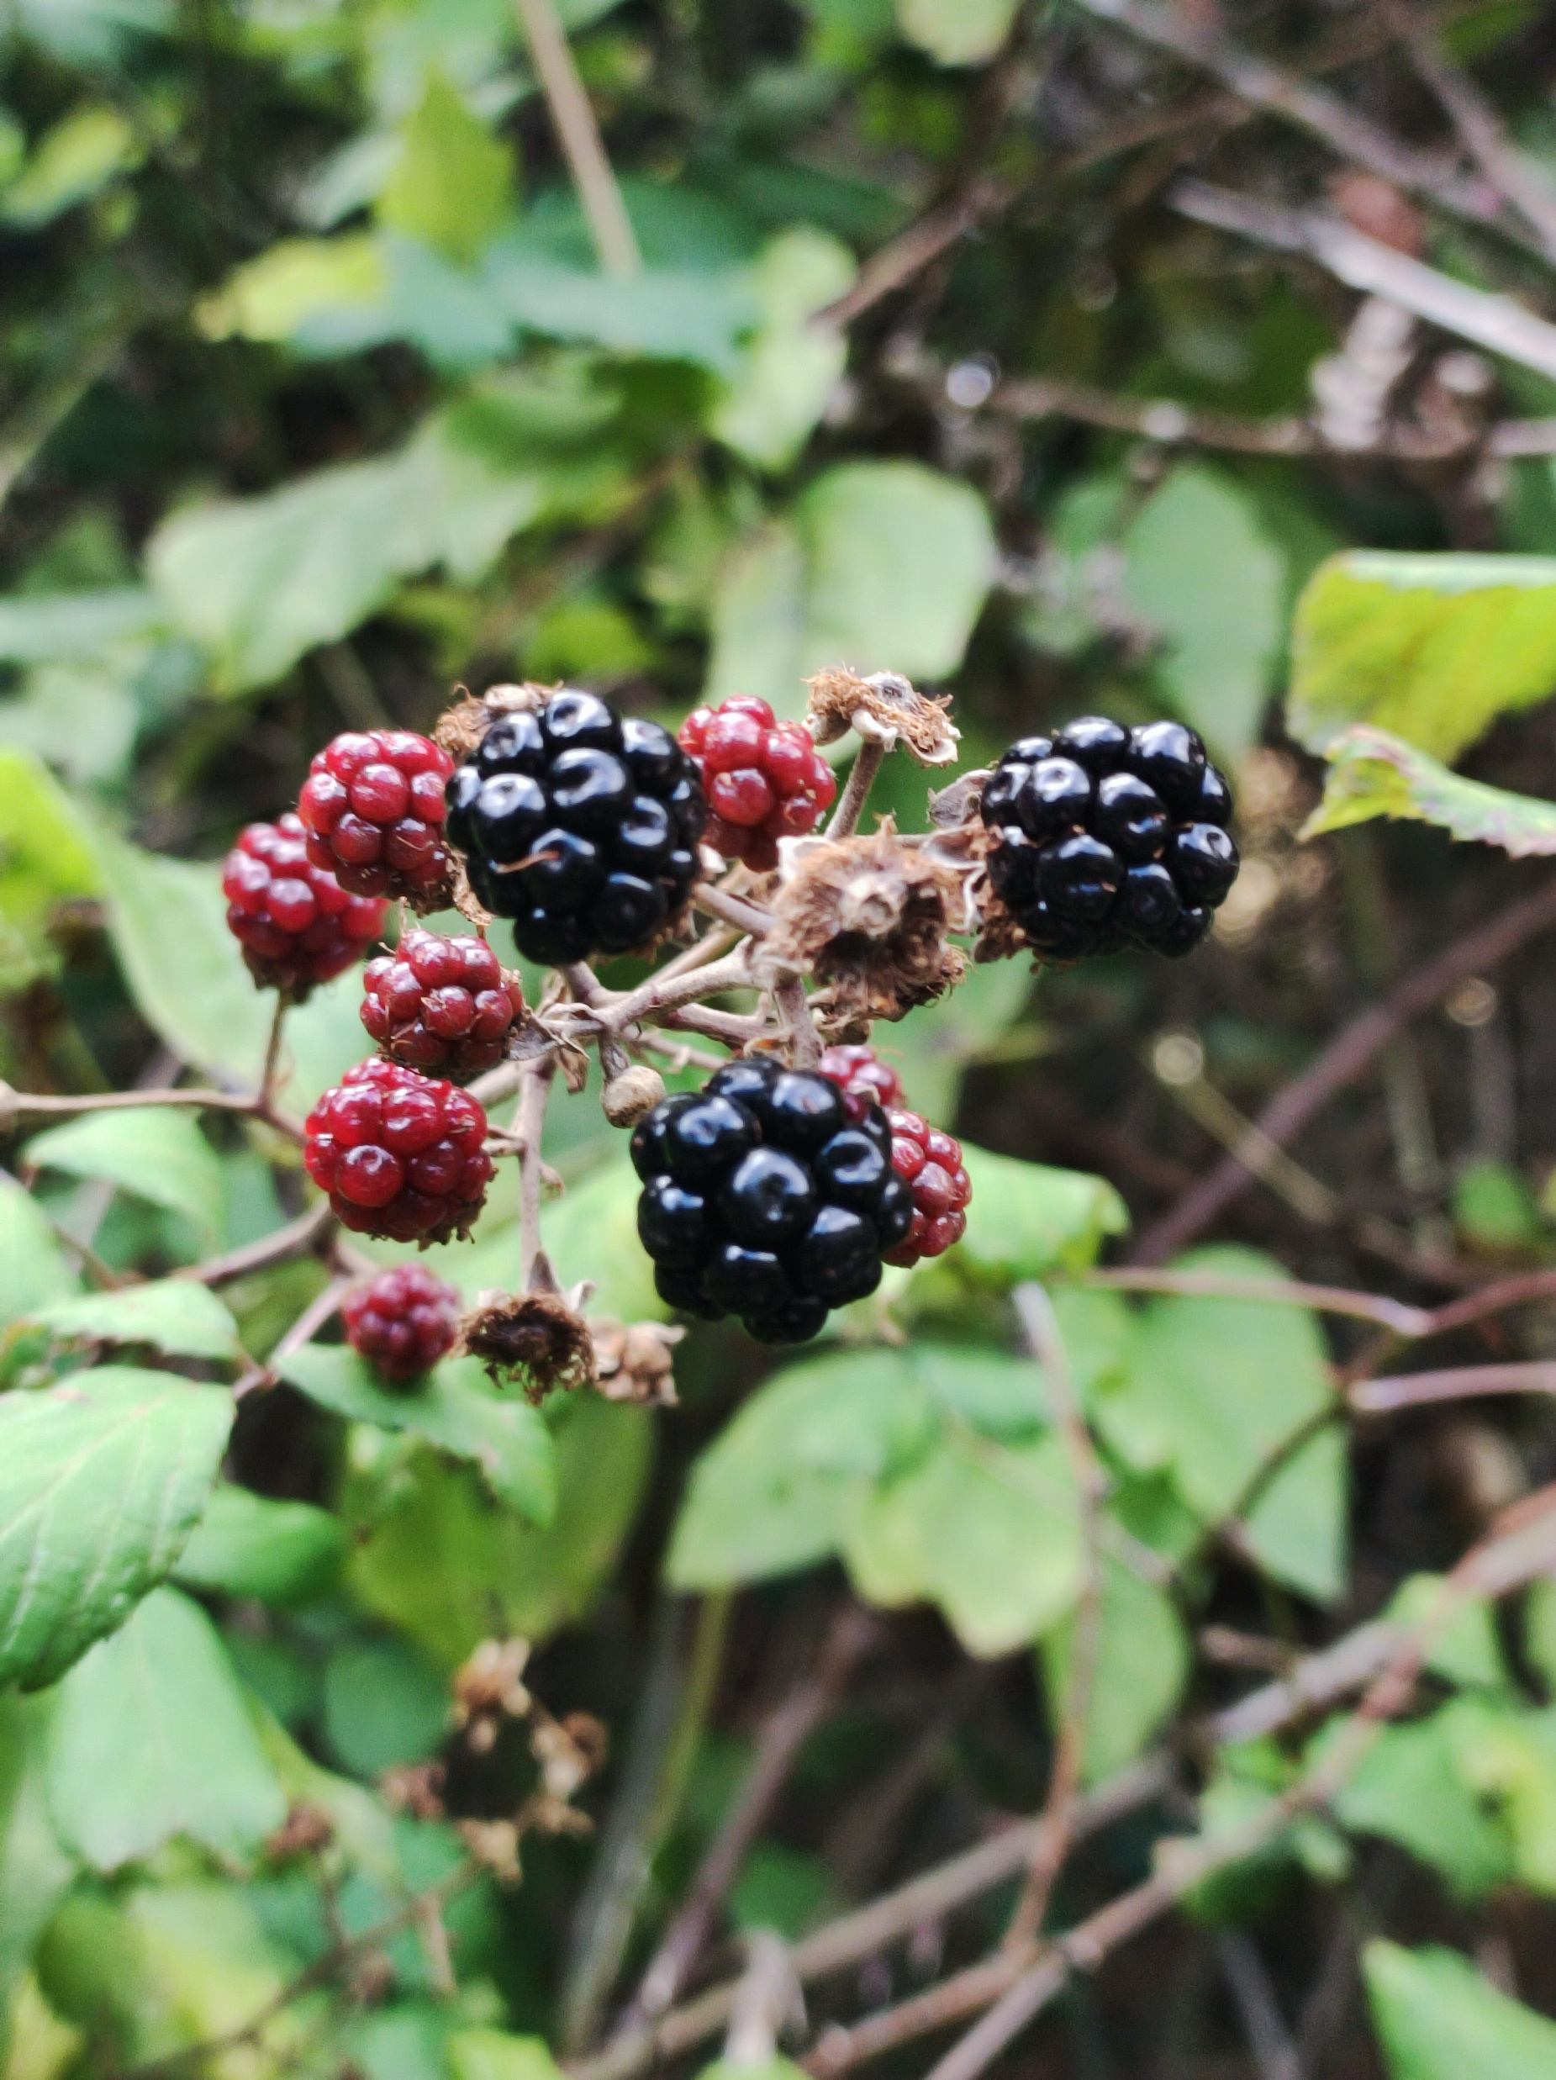
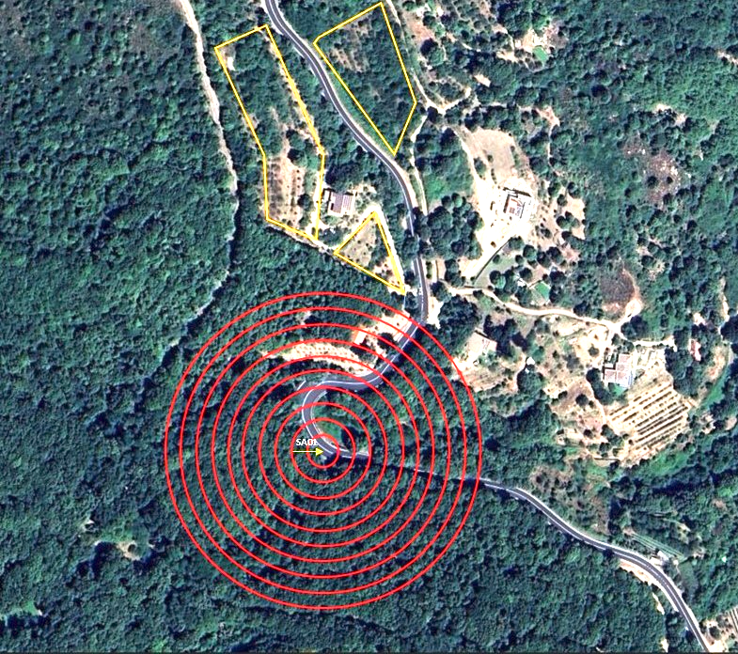
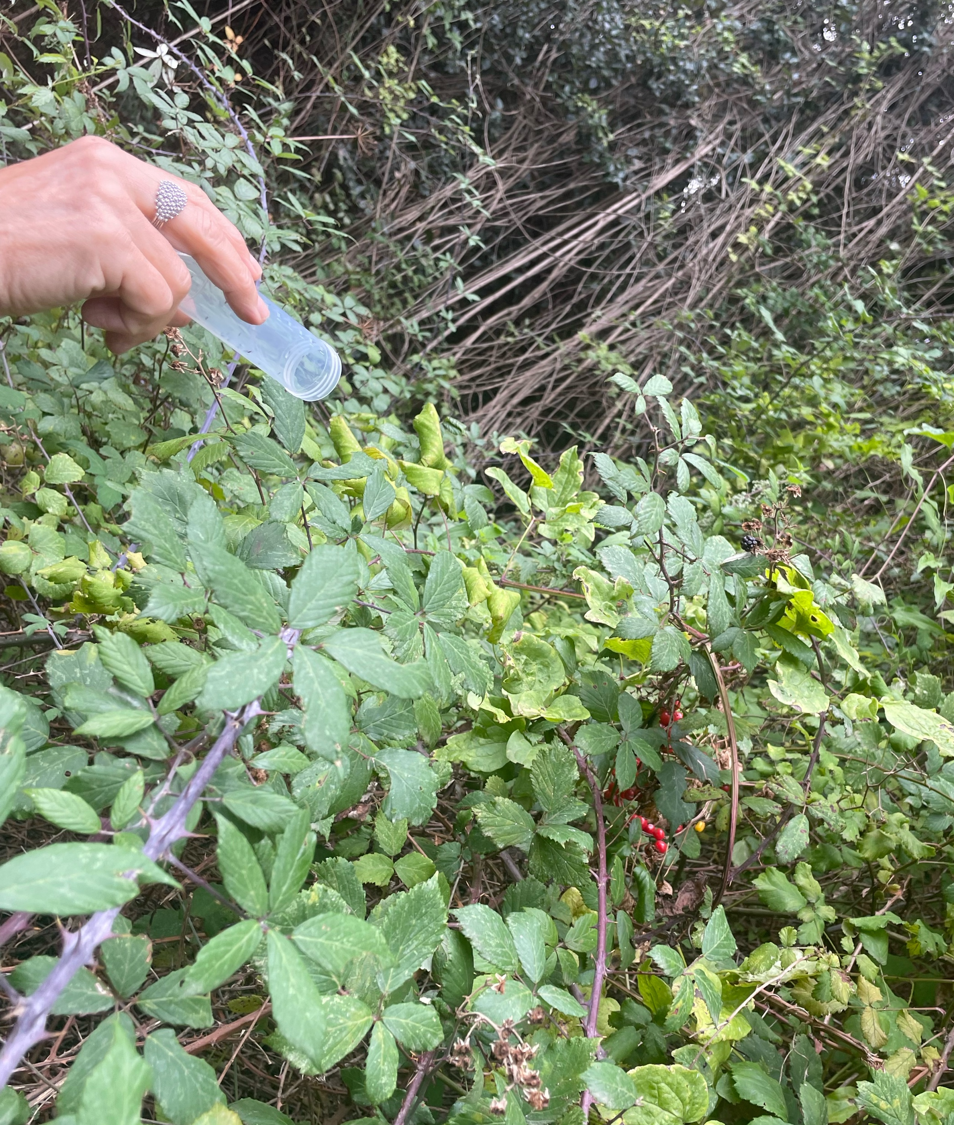
Classical biological control of D. suzukii in Sardinia
1 release site;
3 releases per year
100 G. brasiliensis fecunded females/release
1
2
1
3
4
2024
2025

Slide 18
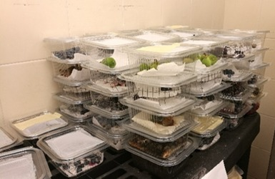
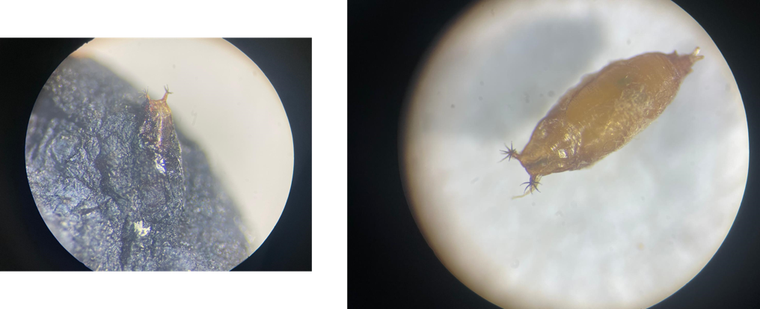
Pre- and post-release fruit samplings are performed according to the national protocol.
In laboratory, fruits were incubated for at least 35 days at 22°C and drosophilid pupae were regularly collected and isolated in plastic tubes for emerging fly or parasitoids.
G. brasiliensis did not emerge from either D. suzukii or non-target drosophilid pupae.
G. brasiliensis has not yet established in Sardinia
Work in progress….

Slide 19




Perspectives of management of future ecosystems
Non-native invasive arthropod species threaten biodiversity and food security worldwide, resulting in substantial economic, environmental, social and cultural costs;
Classical Biological Control (CBC) is regarded as a cost-effective component of integrated pest management programs to manage invasive arthropod pests sustainably;
CBC programs constitute a reactive management response to an invasive pest after it has become well-established, widespread, and problematic
Proactive Biological Control researches identify prior to their establishment pest species that have high invasion potential and are likely to cause economic or environmental damage once established.
Risk assessment and approval of the biological control agent to release are carried out in advance of the arrival of the pest improving CBC effectiveness.

Slide 20









Thank you!
Francesco Tortorici
Roberto Antonio Pantaleoni
Piera Maria Marras
Giovanni Marongiu
Mauro Nannini
Davide Serra
Chiara Lai
Anna Vittoria Taras
Sandro Flore
Laura Loru

