Slide 1

The project CAROLINA (ClimAte Resilience Over Landuse change In semi-Natural grAsslands, PRIN 2022 PNRR)
V. Lazzeri¹, F. Bretzel^{1,2}, F. D’Alò³, S. Doni¹, L. Latilla⁴, M. Mattioni³, E. Peruzzi^{1,2}, M. Sarti³, A. Scartazza^{1,2}, B. G. Tesfamariam³, C. Volterrani³, A. Coppi⁵, E. Siccardi⁵, V. A. Volanti⁵, L. Lazzaro⁵, O. Gavrichkova^{2,3}
1: IRET Pisa; 2: National Biodiversity Future Center; 3: IRET Porano; 4: IRET Montelibretti; 5: Department of Biology, University of Florence, Firenze, Italy

Slide 2
Grasslands, either not man-affected or only slightly managed, usually harbour a rich plant biodiversity that cannot be observed in closed habitats dominated by woody species such as shrublands, maquises and woodlands. Many grasslands can be attributed to habitats of the NATURA 2000 network.
The project CAROLINA: why

Slide 3
Grasslands, either not man-affected or only slightly managed, usually harbour a rich plant biodiversity that cannot be observed in closed habitats dominated by woody species such as shrublands, maquises and woodlands. Many grasslands can be attributed to habitats of the NATURA 2000 network.
In certain cases a moderate management can support the establishment and the persistence of a rich plant biodiversity avoiding that more competitive species would overcome the others with the result of a decline in species richness.
The project CAROLINA: why

Slide 4
A series of important ecosystem services are acknowledged to grasslands:
Zhao & al. Landscape Ecol 35, 793–814.
dc
PROVISIONING - Forage producion/above-ground biomass
- Raw materials
- Water yield/supply
- Livestock/ivestock production
- Habitat for wildlife species
- Biofuel supply
- Genetic library/Seed bank
- Milk/dairy productivity
Meat from cattle/sheep/goat
- Agronomic services
- Nectar/honey produciton
- Fiber production
- Wool production
- Sources of natural medicines
grasslands

Slide 5
A series of important ecosystem services are acknowledged to grasslands:
Zhao & al. Landscape Ecol 35, 793–814.
dc
PROVISIONING - Forage producion/above-ground biomass
- Raw materials
- Water yield/supply
- Livestock/ivestock production
- Habitat for wildlife species
- Biofuel supply
- Genetic library/Seed bank
- Milk/dairy productivity
Meat from cattle/sheep/goat
- Agronomic services
- Nectar/honey produciton
- Fiber production
- Wool production
- Sources of natural medicines
dc
Regulating
- Erosion regulation (water erosion)
- Water flow regulation
- Nutrients delivery/retention
- Climate regulation
- Pollination service
- Soil accumulation
- Erosion regulation (wind erosion)
- Water purification
- Air quality regulation
- Pest control
- Wildfire control
- Waste treatment
grasslands

Slide 6
A series of important ecosystem services are acknowledged to grasslands:
dc
Zhao & al. Landscape Ecol 35, 793–814.
Cultural
- Prevention and control of endoparasitic
- Recreational space/Recreation/Tourism
- Aesthetic appreciation/experience
- Spiritual and religious services
- Horticulture/cultural identity
- Ecological knowledge/Educational
dc
PROVISIONING - Forage producion/above-ground biomass
- Raw materials
- Water yield/supply
- Livestock/ivestock production
- Habitat for wildlife species
- Biofuel supply
- Genetic library/Seed bank
- Milk/dairy productivity
Meat from cattle/sheep/goat
- Agronomic services
- Nectar/honey produciton
- Fiber production
- Wool production
- Sources of natural medicines
dc
Regulating
- Erosion regulation (water erosion)
- Water flow regulation
- Nutrients delivery/retention
- Climate regulation
- Pollination service
- Soil accumulation
- Erosion regulation (wind erosion)
- Water purification
- Air quality regulation
- Pest control
- Wildfire control
- Waste treatment
grasslands

Slide 7
Grasslands abandonment can result in the advancement of more competitive species at the expense of other less competitive taxa.
The project CAROLINA: why

Slide 8
Grasslands abandonment can result in the advancement of more competitive species at the expense of other less competitive taxa.
This can lead to the overall reduction in plant biodiversity.
The project CAROLINA: why

Slide 9
Grasslands abandonment can result in the advancement of more competitive species at the expense of other less competitive taxa.
This can lead to the overall reduction in plant biodiversity.
In certain cases, it can also entail the partial or total replacement of the grassland at the advantage of other habitats characterized by a dominance of woody species.
The project CAROLINA: why

Slide 10
Grasslands abandonment can result in the advancement of more competitive species at the expense of other less competitive taxa.
This can lead to the overall reduction in plant biodiversity.
In certain cases, it can also entail the partial or total replacement of the grassland at the advantage of other habitats characterized by a dominance of woody species.
As a result, both a variation in plant biodiversity with a net decrease of species richness and a change in the ecosystem services provided can occur.
The project CAROLINA: why

Slide 11
Grasslands abandonment can result in the advancement of more competitive species at the expense of other less competitive taxa.
This can lead to the overall reduction in plant biodiversity.
In certain cases, it can also entail the partial or total replacement of the grassland at the advantage of other habitats characterized by a dominance of woody species.
As a result, both a variation in plant biodiversity with a net decrease of species richness and a change in the ecosystem services provided can occur.
Both grasslands and woodlands are fundamental habitats and we should aim at maintaining a balance between them.
The project CAROLINA: why

Slide 12
19 NATURA 2000 habitats are grasslands sensu lato: 1320, 1410, 1510*, 2120, 2130*, 2230, 2240, 2330, 6150, 6170, 6210*, 6220*, 6230*, 6240*, 62A0*, 6410, 6420, 6510, 6520
The project CAROLINA: why

Slide 13
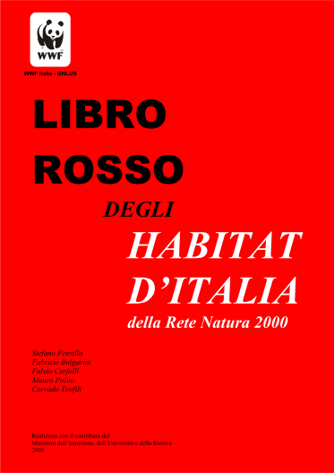
19 NATURA 2000 habitats are grasslands sensu lato: 1320, 1410, 1510*, 2120, 2130*, 2230, 2240, 2330, 6150, 6170, 6210*, 6220*, 6230*, 6240*, 62A0*, 6410, 6420, 6510, 6520
High menace: 2120, 2130*, 2230, 2240, 2330, 6410, 6420
Low menace: 1320, 1410, 1510*, 6150, 6170, 6210*, 6220*, 6230*, 6520
The project CAROLINA: why

Slide 14
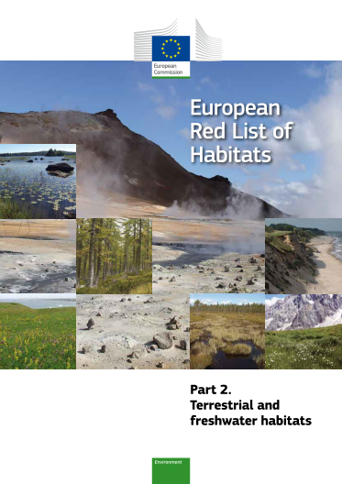
At the European level grasslands have turned out to be among the most threatened habitats
The project CAROLINA: why

Slide 15
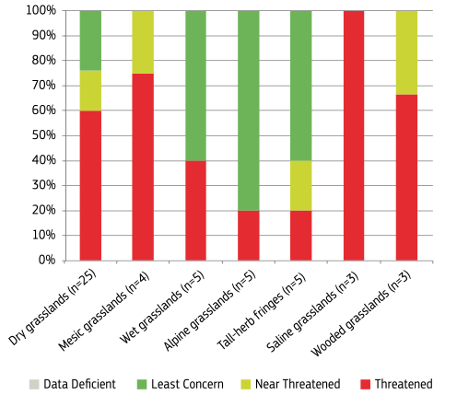
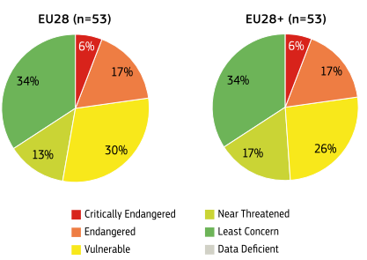
The project CAROLINA: why

Slide 16
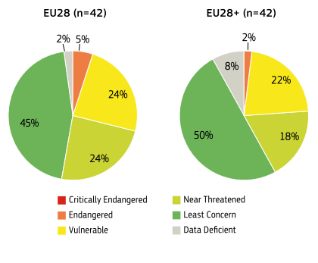
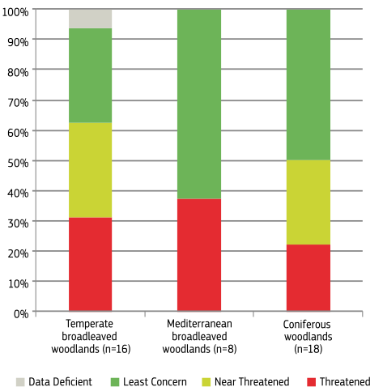
In particular if compared to forests (below):
The project CAROLINA: why

Slide 17
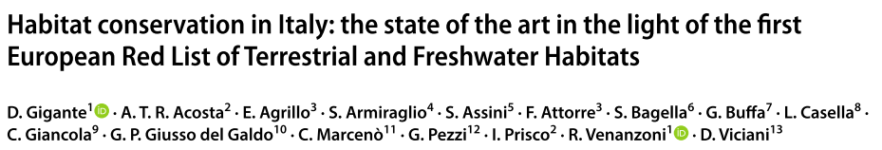
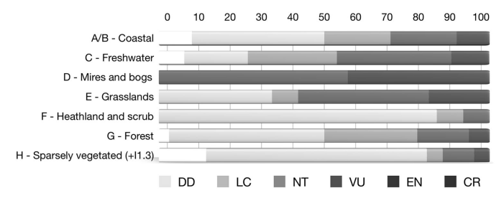
Rendiconti Lincei. Scienze Fisiche e Naturali (2018) 29:251–265
The project CAROLINA: why

Slide 18


Institute of Research on Terrestrial Ecosystems of the National Research Council
(Pisa and Porano)
Department of Biology of the University of Florence
The project CAROLINA: who we are

Slide 19
The project aims to study grasslands with two different approaches:
The project CAROLINA: what we do

Slide 20
The project aims to study grasslands with two different approaches:
The evaluation of the effects of moderate extensive grazing and rainfall reduction in three "manipulation sites"
The project CAROLINA: what we do

Slide 21
The project aims to study grasslands with two different approaches:
The evaluation of the effects of moderate extensive grazing and rainfall reduction in three "manipulation sites"
The evaluation of the transition from grasslands to mature woodlands through the analysis of five chronosequences
The project CAROLINA: what we do

Slide 22
Three main focuses:
Soil (three primary sites)
Plants (three primary sites)
Remote sensing (three primary sites + two secondary sites)
The project CAROLINA: what we do

Slide 23
Soil functional diversity
- ecoenzymes
- total organic C and N, physical fractionation and respective isotope composition
- Particulate Organic Matter - Mineral-Associated Organic Matter
- main physical and chemical properties
CAROLINA

Slide 24
Soil functional diversity
- ecoenzymes
- total organic C and N, physical fractionation and respective isotope composition
- Particulate Organic Matter - Mineral-Associated Organic Matter
- main physical and chemical properties
Plant functional diversity
- classical metrics of functional diversity
- physiological functional diversity
- carbon isotope composition (δ¹³C)
- leaf N content and δ¹⁵N composition
CAROLINA

Slide 25
Soil functional diversity
- ecoenzymes
- total organic C and N, physical fractionation and respective isotope composition
- Particulate Organic Matter - Mineral-Associated Organic Matter
- main physical and chemical properties
Plant functional diversity
- classical metrics of functional diversity
- physiological functional diversity
- carbon isotope composition (δ¹³C)
- leaf N content and δ¹⁵N composition
Spectral diversity
- spatial variability of the reflectance
- linking spectral diversity to climate variation and plant diversity
CAROLINA

Slide 26
potentiality of the grasslands in terms of biodiversity conservation and C sequestration
Plant functional diversity
Soil functional diversity
Spectral diversity
CAROLINA

Slide 27
potentiality of the grasslands in terms of biodiversity conservation and C sequestration
ecosystem resilience to climate change with land-use variation
Plant functional diversity
Soil functional diversity
Spectral diversity
CAROLINA

Slide 28
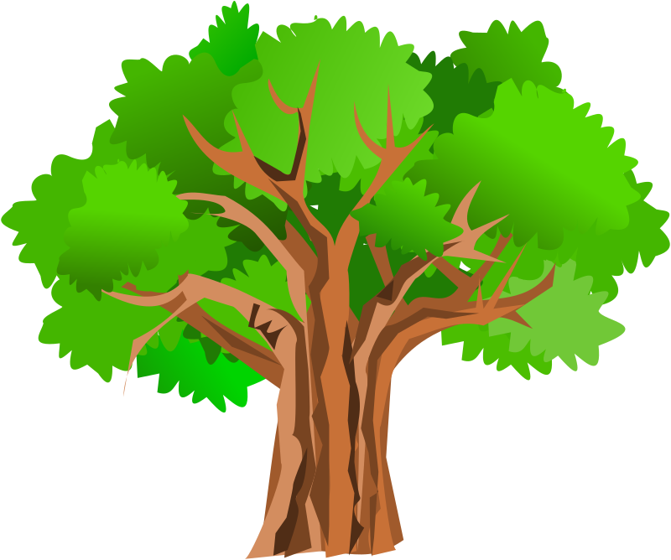
The soil samplings:
Halfway between tree trunk and the limit of its crown: T (tree)
The project CAROLINA: what we do

Slide 29
The soil samplings:
Halfway between tree trunk and the limit of its crown: T (tree)
5 meters from the crown: M (meadow)
The project CAROLINA: what we do

Slide 30
The soil samplings:
Halfway between tree trunk and the limit of its crown
5 meters from the crown: M (meadow)
Two depths:
0-10 cm
10-20 cm
The project CAROLINA: what we do

Slide 31
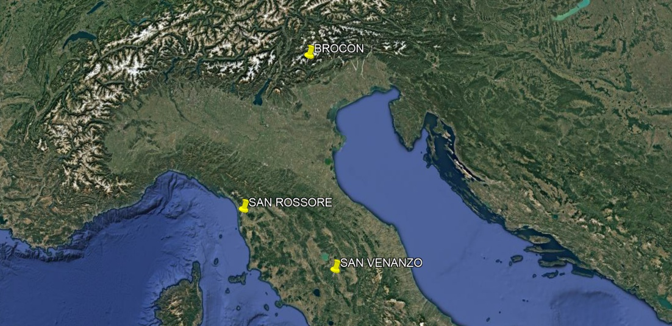
The three main sites: passo del Brocon, the park of San Rossore, San Venanzo
The project CAROLINA: what we do

Slide 32
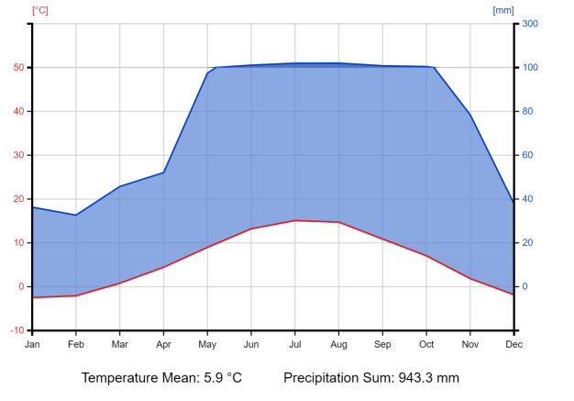
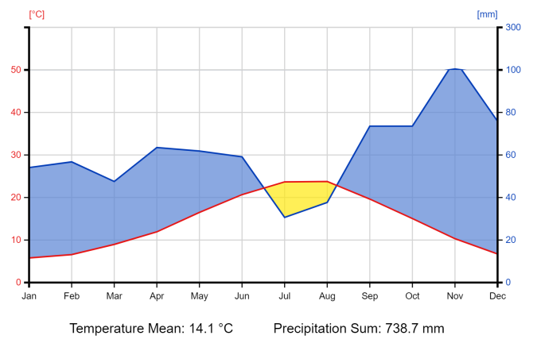
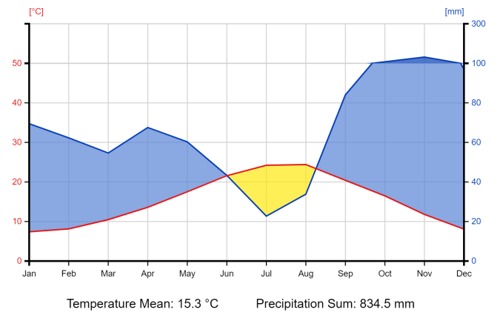
BROCON
1400-1750 m a.s.l.
SAN VENANZO
400-550 m a.s.l.
SAN ROSSORE
ca. 0 m a.s.l.
Macrobioclimate: Temperate
Bioclimate: Oceanic
Thermotype: Upper orotemperate-Lower cryorotemperate
Ombrotype: Lower/Upper hyperhumid
Macrobioclimate: Temperate (Strong submediterranean)
Bioclimate: Oceanic (submediterranean)
Thermotype: Upper mesotemperate
Ombrotype: Upper subhumid
Macrobioclimate: Mediterranean
Bioclimate: Pluviseasonal oceanic
Thermotype: lower Mesomediterranean
Ombrotype: Upper subhumid
The project CAROLINA: what we do

Slide 33
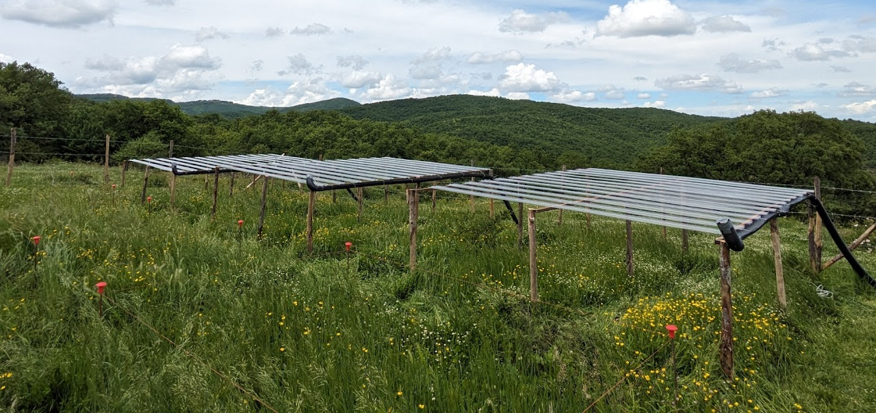
1) The "manipulation sites"
Two factors studied:
moderate extensive pasture
From 35% to 55% rainfall reduction
The San Venanzo manipulation site with the rain shelters installed
The project CAROLINA: what we do

Slide 34
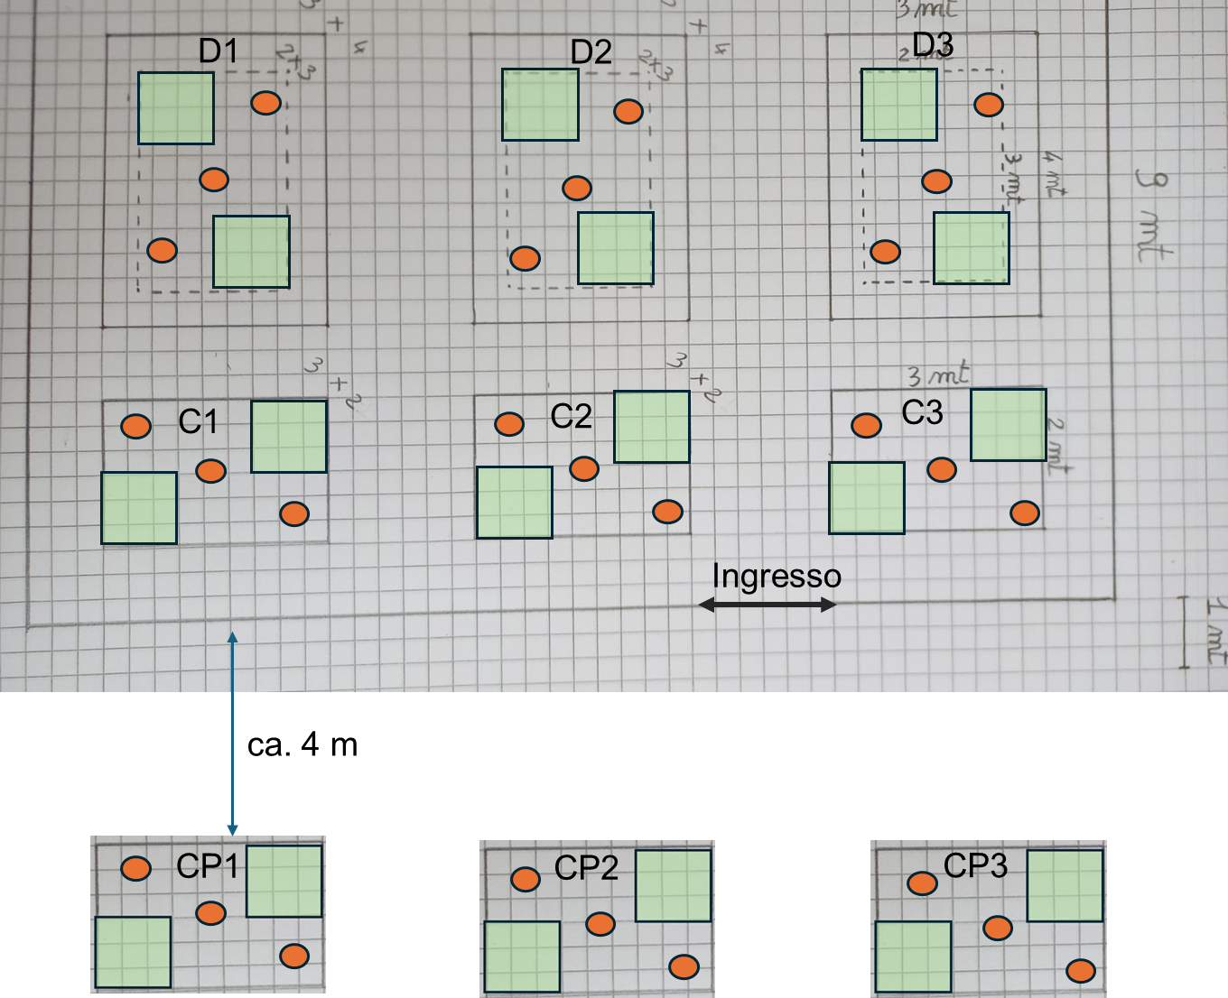
The "manipulation sites"
NO GRAZING
The project CAROLINA: what we do

Slide 35
The "manipulation sites"
NO GRAZING +
50% RAINFALL REDUCTION
NO GRAZING
The project CAROLINA: what we do

Slide 36
The "manipulation sites"
NO GRAZING +
50% RAINFALL REDUCTION
NO GRAZING
MODERATE EXTENSIVE GRAZING
The project CAROLINA: what we do

Slide 37
2) The transition from grasslands to woodlands.
For each of the primary sites we have identified a chronosequence made up of five stages
The project CAROLINA: what we do

Slide 38
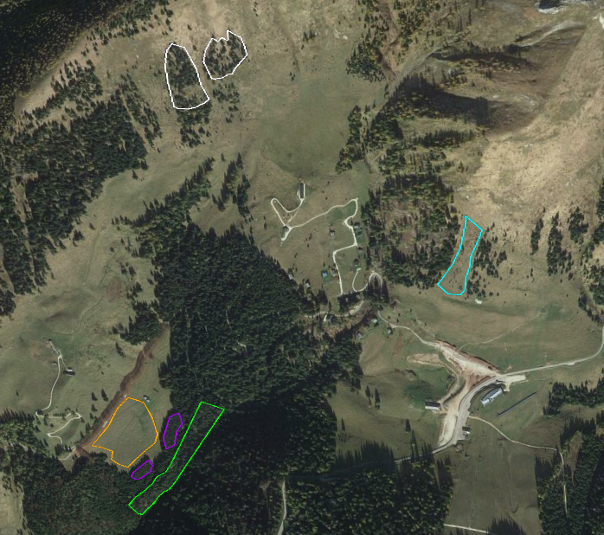
2) The Brocon site:
T0: grassland with extensive grazing
T0
The project CAROLINA: what we do

Slide 39
2) The Brocon site:
T0: grassland with extensive grazing
T1: grasslands with some young established trees (no grazing)
T1
T0
The project CAROLINA: what we do

Slide 40
2) The Brocon site:
T0: grassland with extensive grazing
T1: grasslands with some young established trees (no grazing)
T2: space occupied by ca. 50% grasslands and 50% adult trees
T1
T2
T0
The project CAROLINA: what we do

Slide 41
2) The Brocon site:
T0: grassland with extensive grazing
T1: grasslands with some young established trees (no grazing)
T2: space occupied by ca. 50% grasslands and 50% adult trees
T3: young woodland
T1
T2
T0
T3
The project CAROLINA: what we do

Slide 42
2) The Brocon site:
T0: grassland with extensive grazing
T1: grasslands with some young established trees (no grazing)
T2: space occupied by ca. 50% grasslands and 50% adult trees
T3: young woodland
T4: mature woodland
T1
T2
T0
T3
T4
The project CAROLINA: what we do

Slide 43
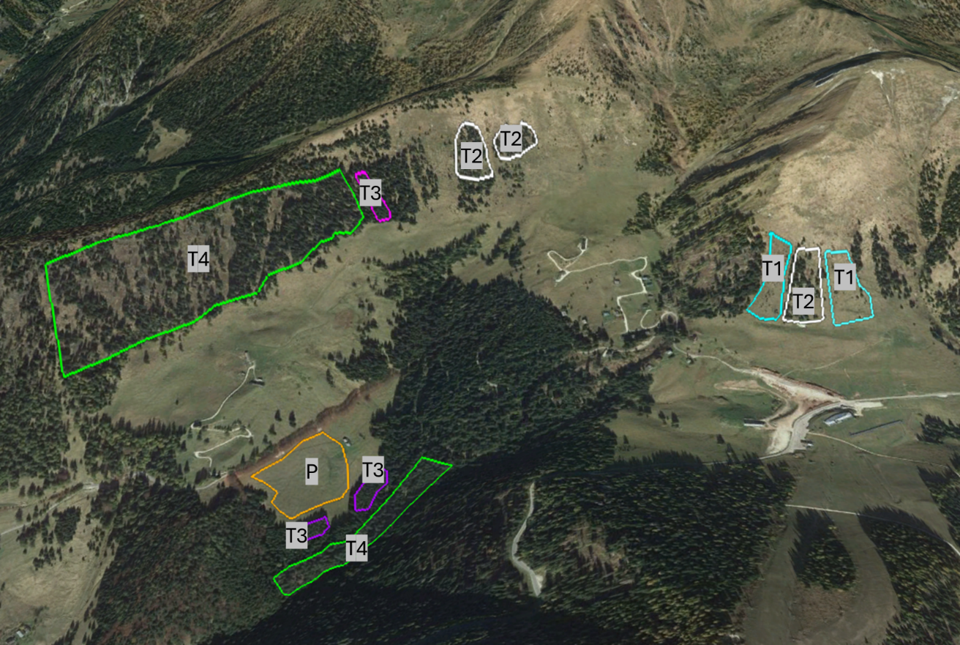
2) The Brocon site:
The project CAROLINA: what we do

Slide 44
SOME PRELIMINARY RESULTS

Slide 45
The project CAROLINA: soil laser granulometry

Slide 46
Decrease of the soil aggregate stability index
(ASI)
The project CAROLINA: soil laser granulometry

Slide 47
Decrease of loam
+
increase of sand
The project CAROLINA: soil laser granulometry

Slide 48
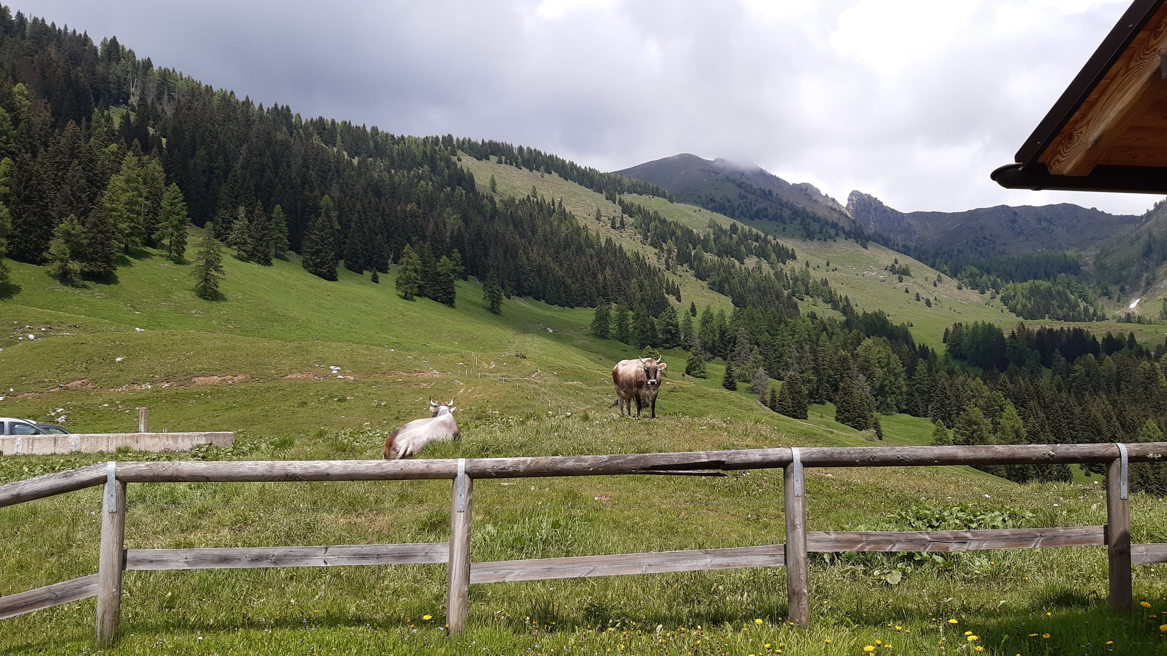

Slide 49
Soil aggregate stability is considered as a key indicator of soil quality.
Grasslands such as meadows and pastures managed with moderate extensive grazing seem to maintain a better quality in comparison with wooded areas.

Slide 50
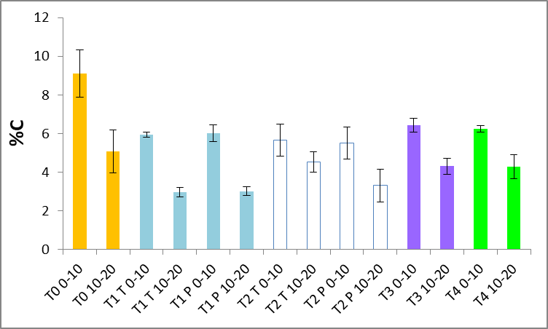
The project CAROLINA: soil total carbon and δ¹³C

Slide 51
Moderate grazing increased C content in both layers
The project CAROLINA: soil total carbon and δ¹³C

Slide 52
Higher C content in the lower layer of the wooded chronosequences (T3 and T4) may be related to massive litter deposition
The project CAROLINA: soil total carbon and δ¹³C

Slide 53
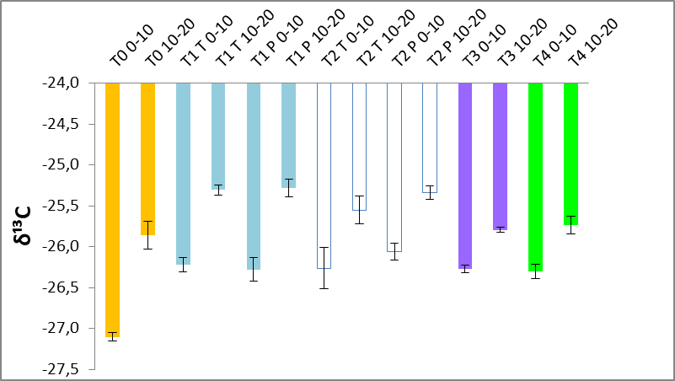
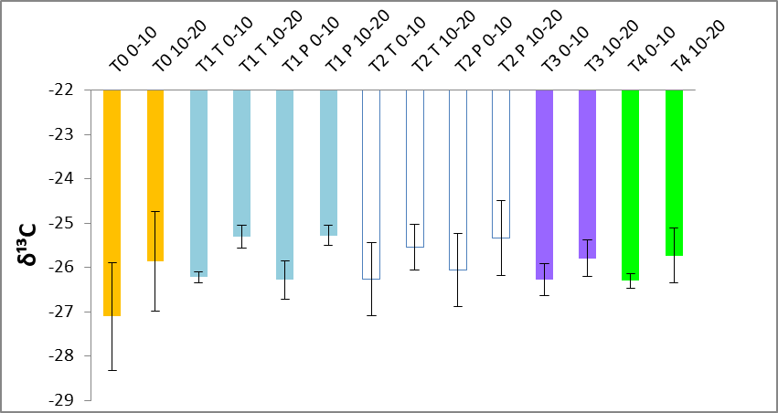
The project CAROLINA: soil total carbon and δ¹³C

Slide 54
Higher ¹³C enrichment between the two layers of the grazed grassland
The project CAROLINA: soil total carbon and δ¹³C

Slide 55
The absence of grazing and the predominance of conservative plant species could explain the similar results for δ¹³C in the other chronosequences
The project CAROLINA: soil total carbon and δ¹³C

Slide 56

The more pronounced ¹³C enrichment between the two layers of the grazed grassland suggest a higher decomposition rate of soil organic matter.

Slide 57
The more pronounced ¹³C enrichment between the two layers of the grazed grassland suggest a higher decomposition rate of soil organic matter.
This could be a clue of the higher quality of soil organic matter in the grazed site.

Slide 58
β-glucosidase (b-gluc): hydrolysis of cellobiose producing glucose
acid phosphatase (fosf): hydrolysis of esters and anhydrides of phosphoric acid
N-acetyl-β-D-glucosaminidase (NAG): N-acquiring enzyme from chitin and peptidoglycan
Arylsulfatase: sulphur acquisition from arylsulfate
They are considered a proxy for soil microbial activity related to soil quality
The project CAROLINA: ecoenzymes

Slide 59
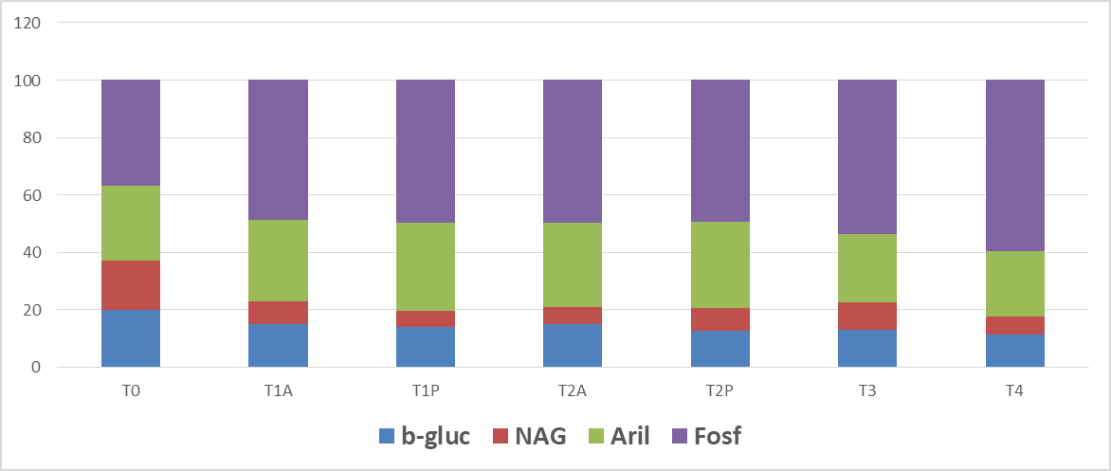
The project CAROLINA: ecoenzymes

Slide 60
More similar b-gluc, NAG and fosf in grazed grassland could be related to the high C content and to a likely ever higher N content
The project CAROLINA: ecoenzymes

Slide 61
A higher imbalance between b-gluc, NAG and fosf in non-grazed sites suggests nutrient and energy limitation
The project CAROLINA: ecoenzymes

Slide 62
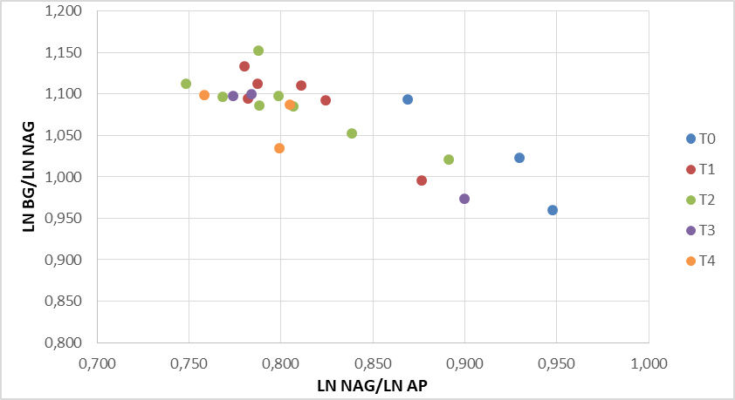
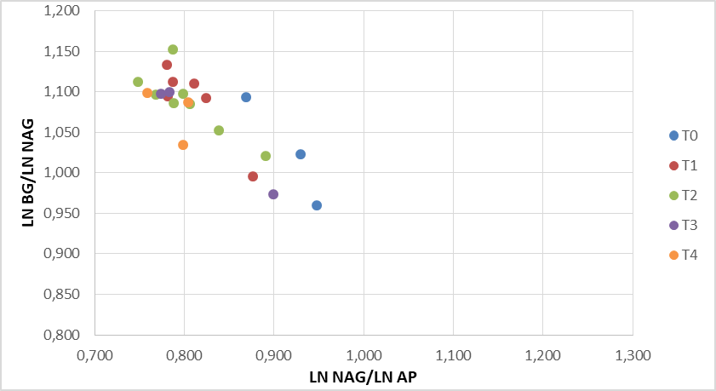
C + P limited
C + N limited
P limited
N limited
The project CAROLINA: ecoenzymes

Slide 63
C + P limited
C + N limited
P limited
N limited
These sites are characterized by a more pronounced C and P limitation
The project CAROLINA: ecoenzymes

Slide 64
The ecoenzymatic activies suggest that the grazed grasslands (T0) could be characterized by a higher nutrient availability for microbes.

Slide 65
ONGOING ACTIVITIES

Slide 66
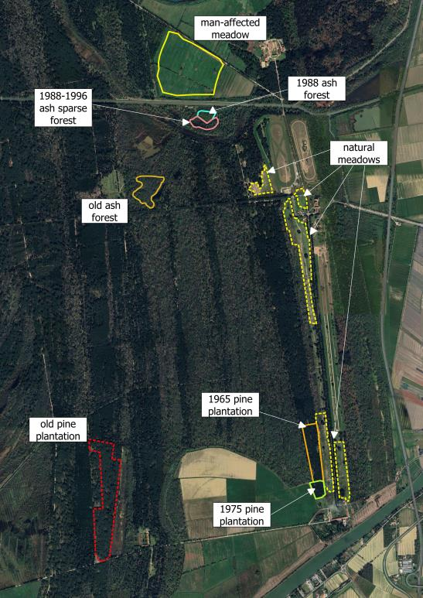
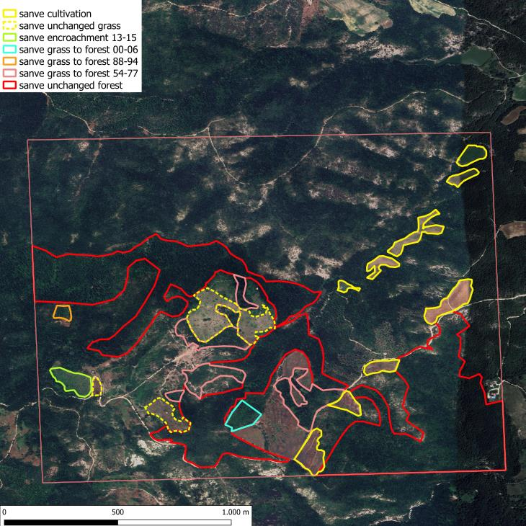
The chronosequences in the two other primary sites:
San Rossore
San Venanzo

Slide 67

Thank you!

