Slide 1



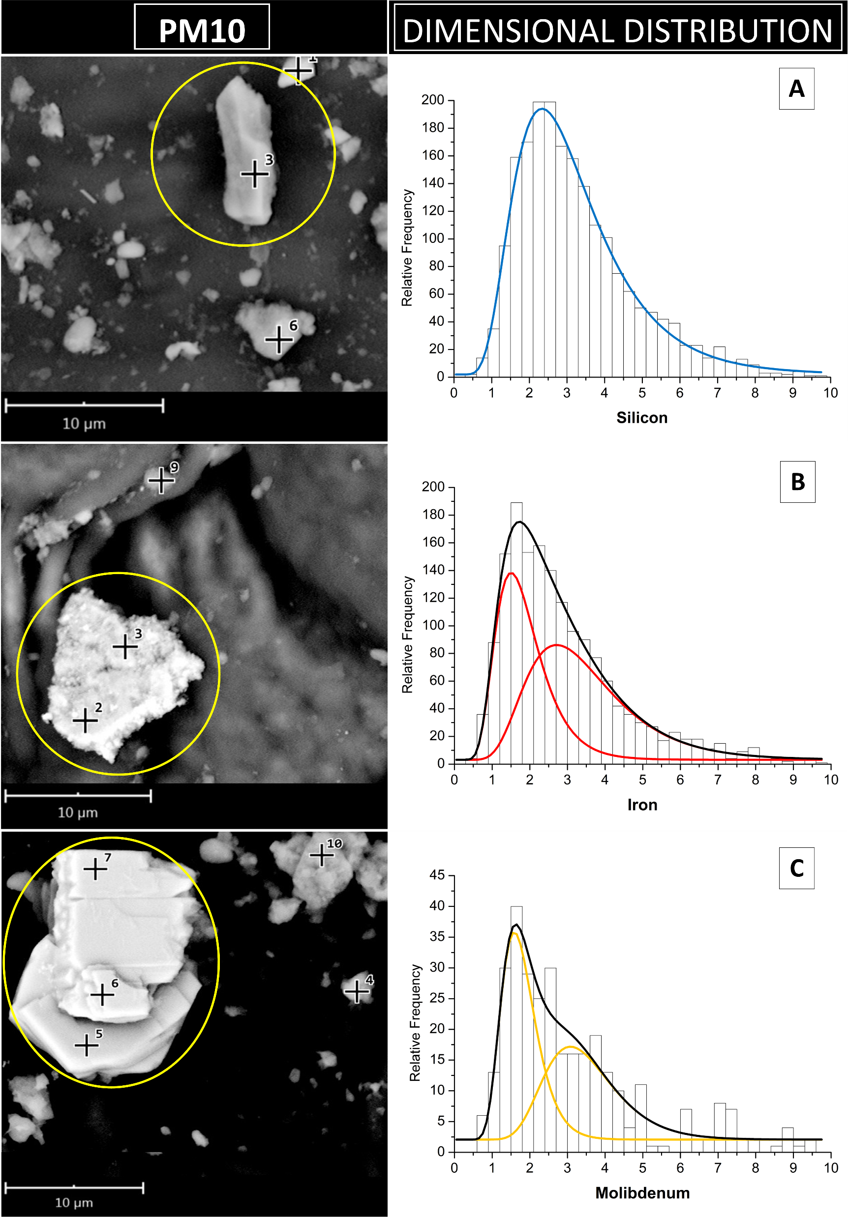

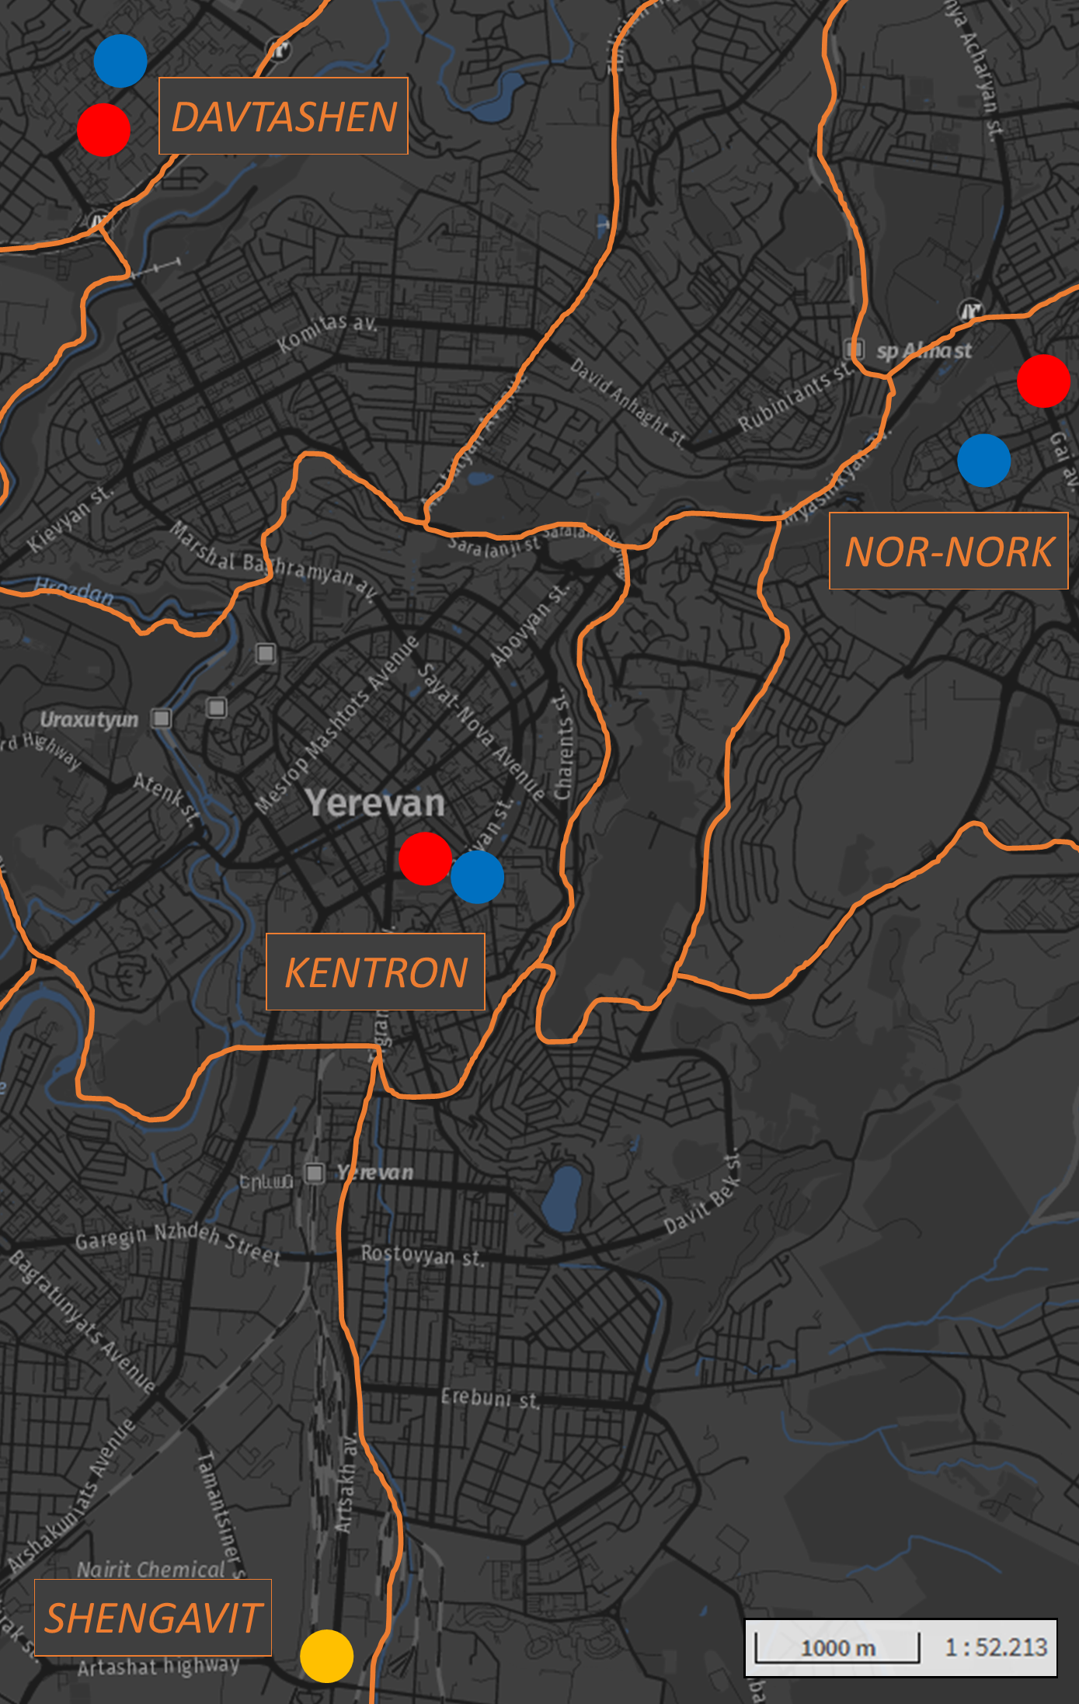
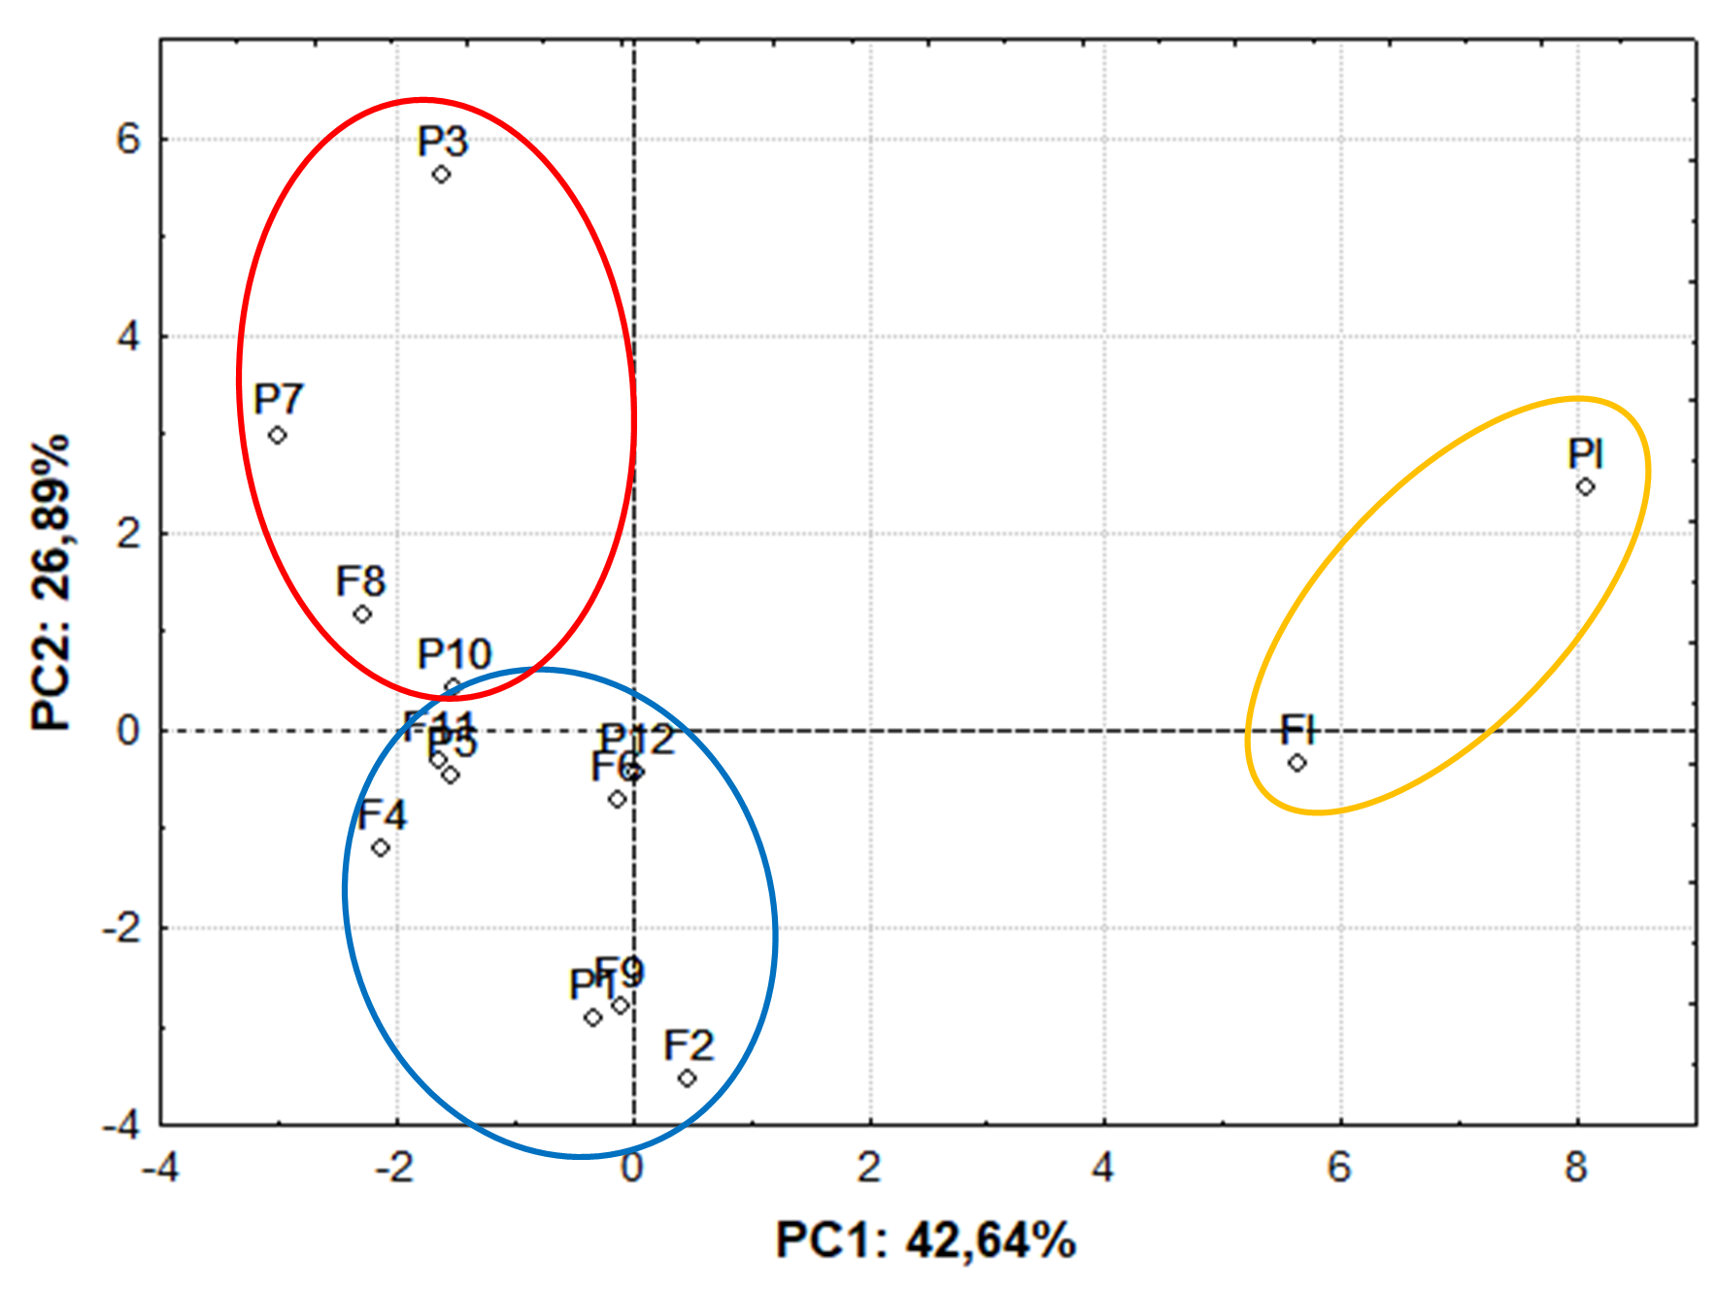
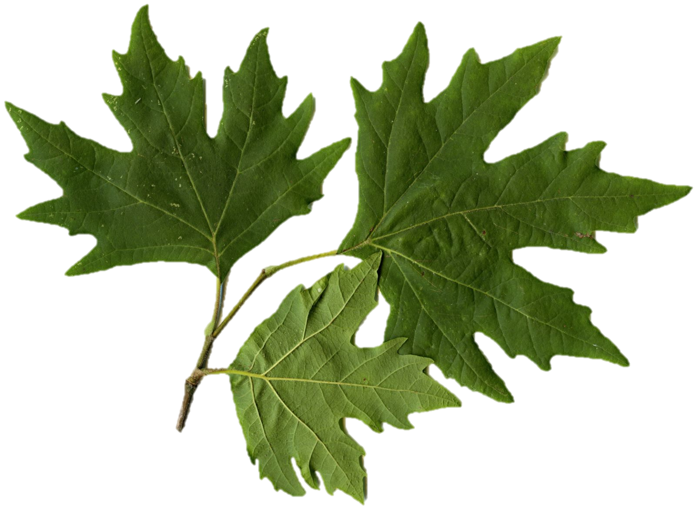
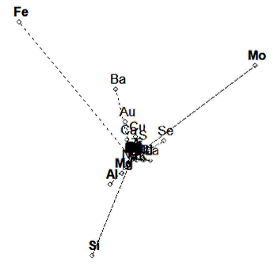




CNR IRET Conference
Rome, February 18th-19th 2025
Elemental profiling of PM10 in Yerevan: F. excelsior and P. orientalis leaves as bioindicators
- Fraxinus and Platanus leaves sampling
- 4 districts, 3 micro-environments
- Park / Street / Industrial
- PM characterization→SEM/EDX
- PM Density, Composition, Dimensions
RESULTS and EVIDENCES
- PM Density: not significant differences
- PM Composition: Significant differences
2.89
Ca
Fe
Mo
Si
Ba
Al
Cu
1.73
- PM Dimensions:
Significant relationship
Composition/Dimension,
Dimensional distribution and source: Mode Peaks
for Background,
Street and Industrial
3.21
1.71
3.35
G. Sgrigna, C. Calfapietra, L.Khachatryan

