Slide 1


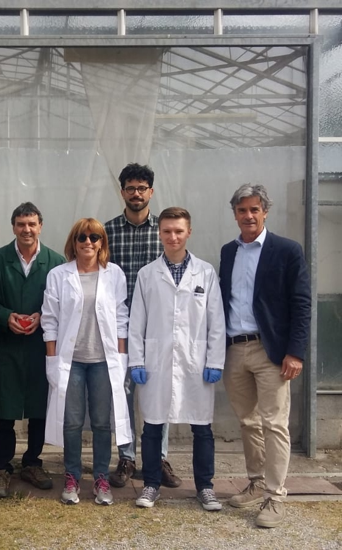

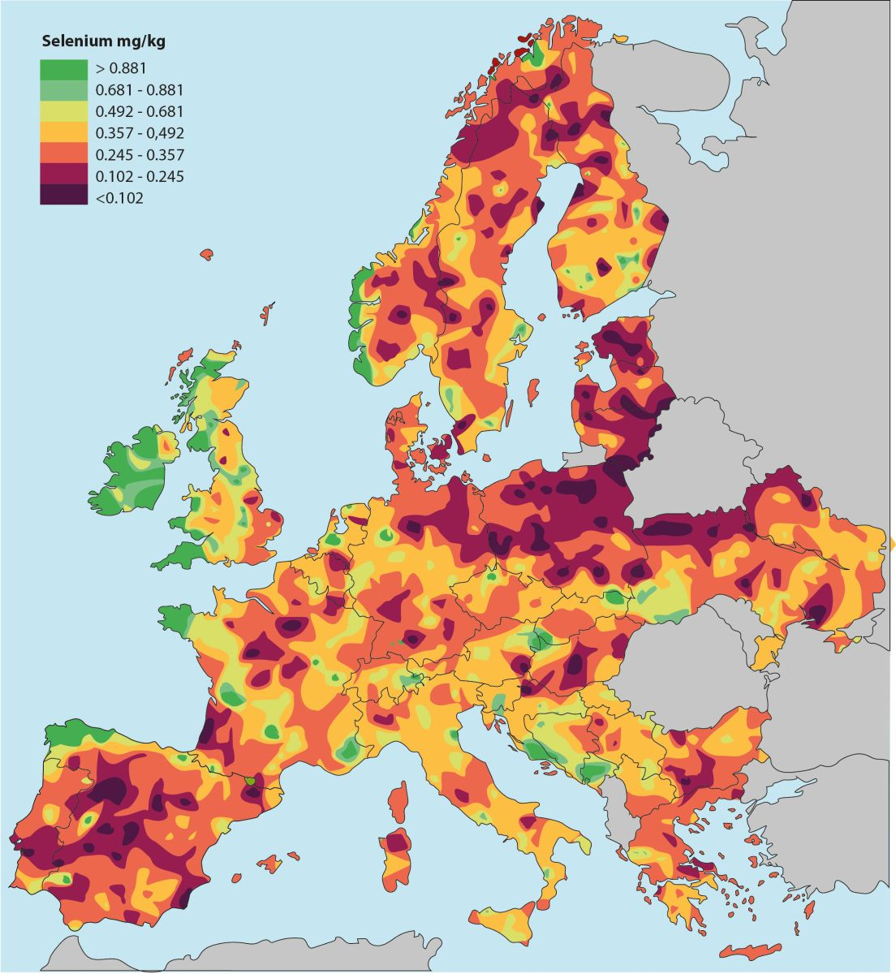
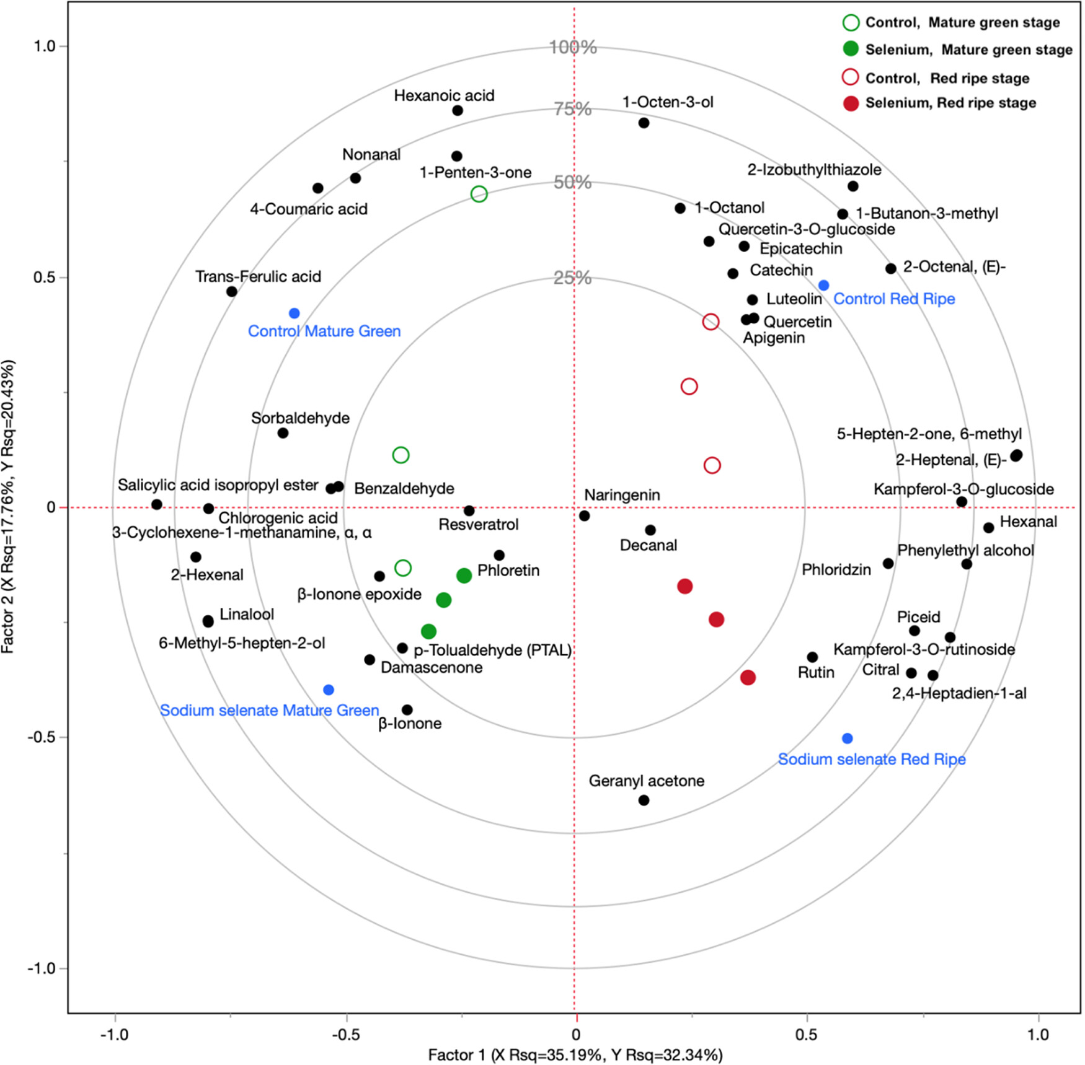
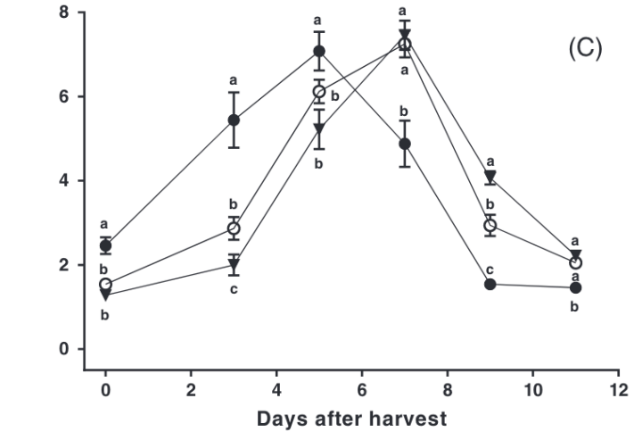
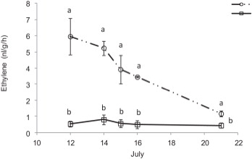



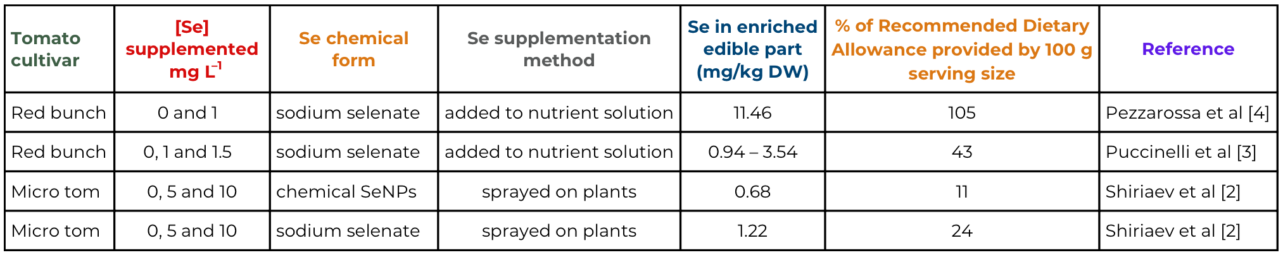

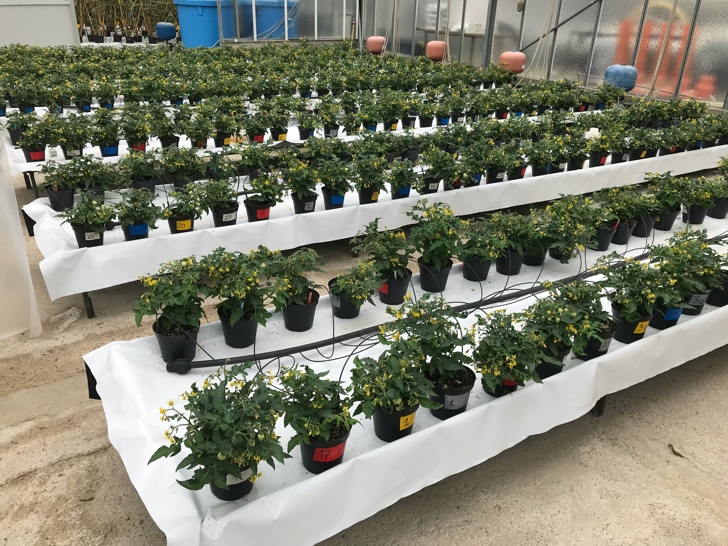
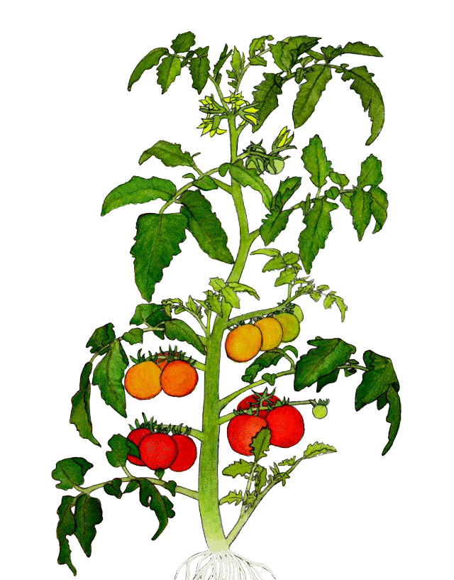

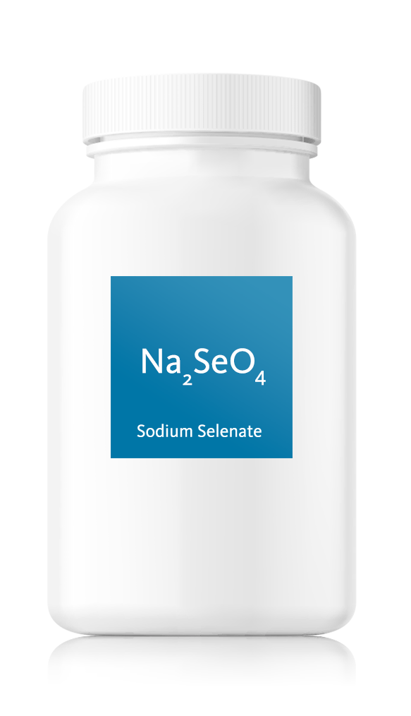
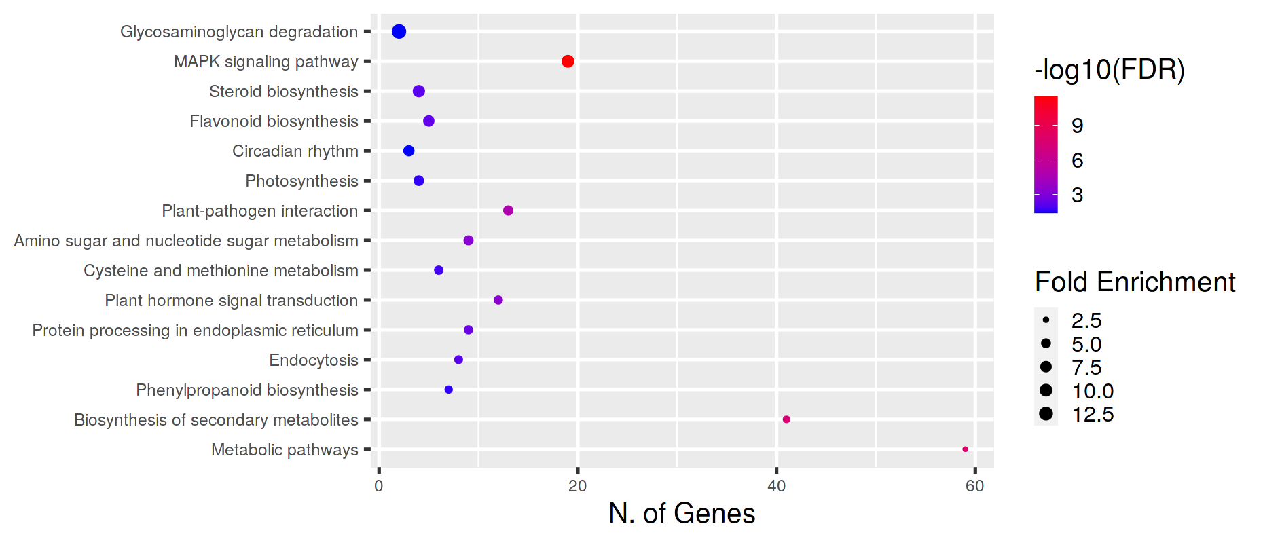

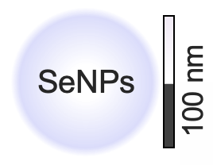
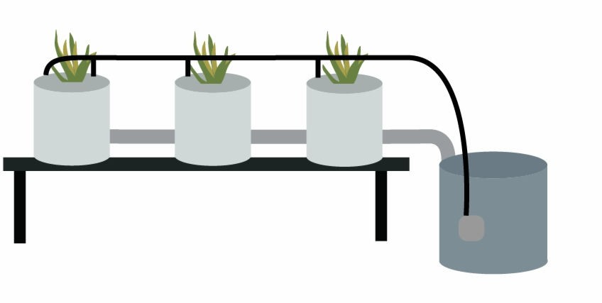
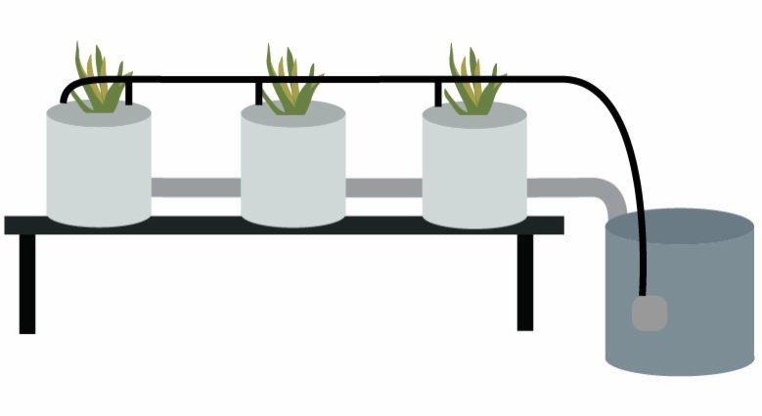
CNR IRET Conference
Rome, February 18th-19th 2025
Selenium Nanoparticles:
Improving Tomato Quality and Protecting Ecosystems
Background
Results
CV Micro tom [2]
RNA-seq showed that Se impacted expression of genes involved in hormonal signaling, secondary metabolism, flavonoid biosynthesis, glycosaminoglycan degradation (Fig. 6).
Se alternated biosynthesis of carotenoids and VOCs,
and increased antioxidant polyphenols (Fig. 7).
Selenium (Se) deficiency affects one billion people.
Se uptake depends on soil Se content, with plant-based food being the main source.
Italy and the EU have predominantly Se-deficient soils.
Biofortification of fruit crops with Se is a strategy to enhance human dietary intake.
Se intake less than 50 µg/day causes health problems. Se intake above 400 µg/day can be toxic.
In plants, Se enhances antioxidant capacity, delays senescence, and slows fruit ripening.
The poster summarise research from IRET on sustainable Se biofortification of tomato fruit.
Se accumulation [2]
Se was accumulated primarily by vegetative parts (Fig. 3), over the time it has been transported to fruit.
Figure 3. Se distribution in tomato organs.
CV Red bunch [3, 4]
Se postponed the ethylene climacteric peak for 2 days (Fig. 4), reduced respiration rate and weight loss.
Se delayed color change due to postponed lycopene and b-carotene synthesis and chlorophylls degradation.
Se reduced color change rate and ethylene rate in red ripe fruit throughout the postharvest (Fig. 5).
Figure 1. Soil selenium content in Europe (Huag et. al., 2007)
Materials and Methods
Figure 4. Ethylene production during post-harvest ripening in tomato fruit grown in nutrient solution with 0, 1 and 1.5 mg Se L^{–1}.
Figure 5. Ethylene evolution in tomato fruit treated with 1 mg Se L^{–1} detached at red stage and kept at 22 °C for 9 days.
Se level
A
B
C
Ripening
Figure 7. Partial least square discriminant analysis (PLS-DA). The model has been created using the identified VOCs and polyphenols as predictor variables, a factor combining ripening stage and Se concentration in tomato fruit as a response variable.
Conclusions
Se biofortification allowed to improve the nutritional value of tomato.
Application of NPs allowed to produce tomato fruit capable to safely fulfil or supplement RDA.
Se suppressed ethylene biosynthesis or postponed appearance of the climacteric peak, positively changed metabolome, which indicate an improvement of the shelf-life, consumer-liking and post-harvest quality.
Figure 2. Experimental set-up (A), Se biofortification strategies scheme: foliar spraying (B) and
substrate supplementation (C).
Figure 6. KEGG pathway enrichment analysis of DEGs in Se-enriched tomato fruit. Increasing the bubble size indicates an increasing enrichment score. Bubble colors from blue to red indicate an increasing false discovery rate (FDR).
References
Dr. Anton Shiriaev, PhD
Co-Authors: Irene Rosellini, Beatrice Pezzarossa
1. Haug A, Graham R, Christophersen O, Lyons. 2008. How to use the world's scarce selenium resources efficiently to increase the selenium concentration in food. Microb. Ecol. Health Dis. 19. 209-228.
2. Shiriaev A, Brizzolara S, Sorce C, Meoni G, Vergata C, Martinelli F, Maza E, Djari A, Pirrello J, Pezzarossa B, Malorgio F, Tonutti F. 2023. Selenium biofortification impacts tomato fruit metabolome and transcriptional profile at ripening. J. Agric. Food Chem. 71, 13554−13565.
3. Puccinelli M, Malorgio F, Terry LA, Tosetti R, Rosellini I, Pezzarossa B. 2019. Effect of selenium enrichment on metabolism of tomato (Solanum lycopersicum) fruit during post-harvest ripening. J. Sci. Food Agric. 99 (5): 2463–2472.
4. Pezzarossa B, Rosellini I, Borghesi E, Tonutti P, Malorgio F. 2014. Effects of Se-enrichment on yield, fruit composition and ripening of tomato (Solanum lycopersicum) plants grown in hydroponics. Sci. Hortic. 165, 106–110.

