Slide 1


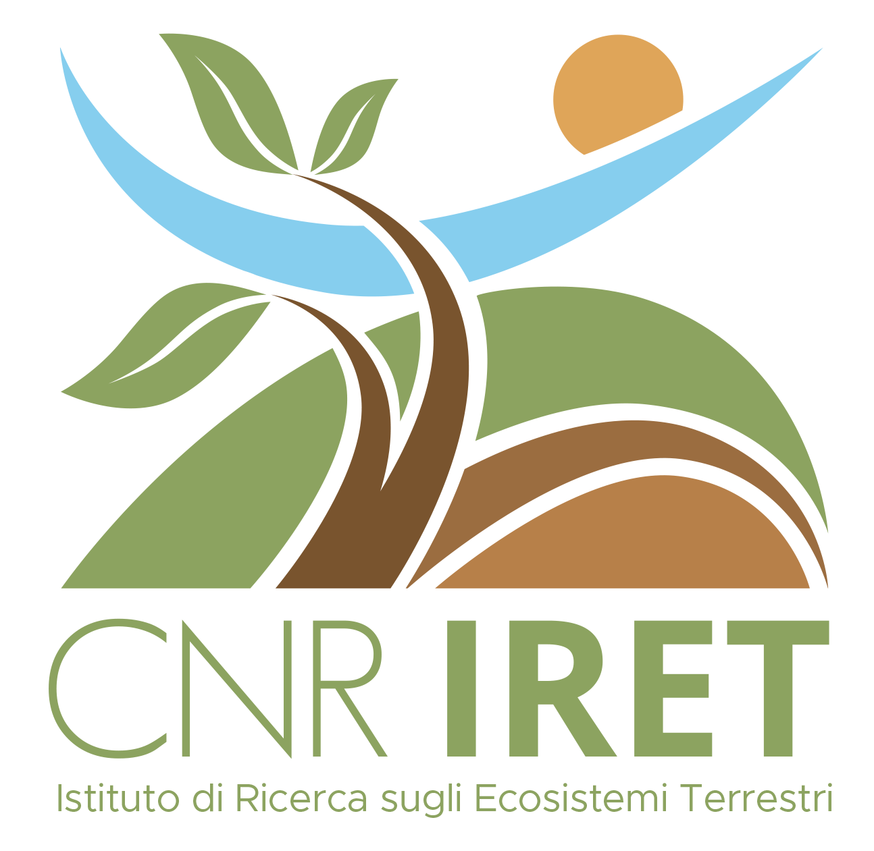

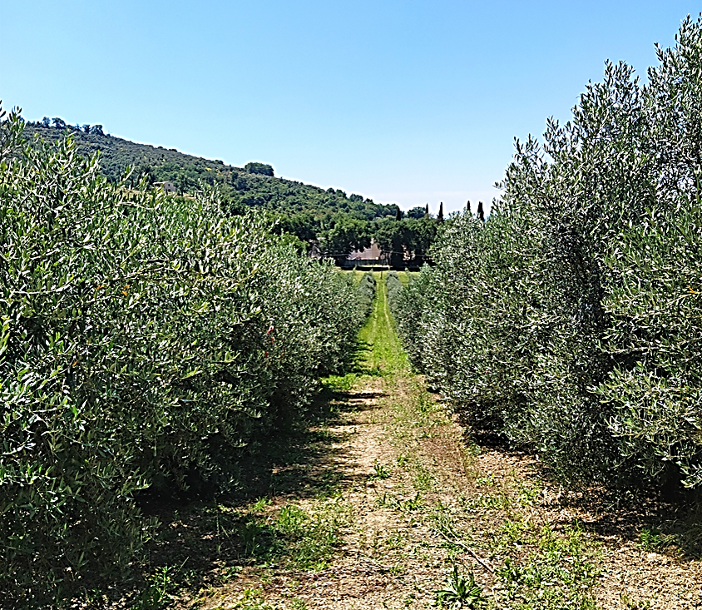

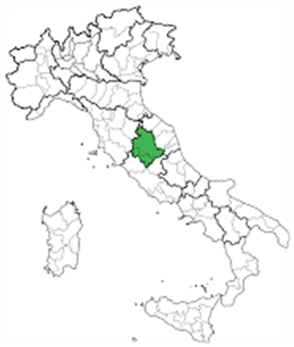

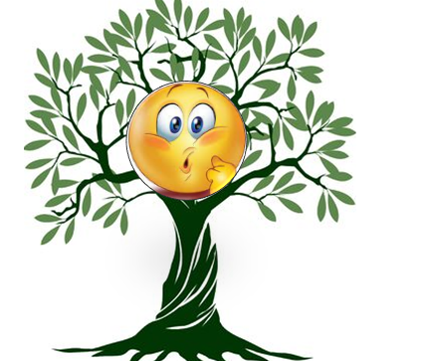
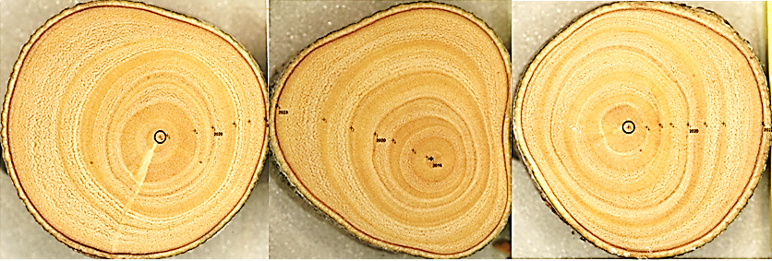
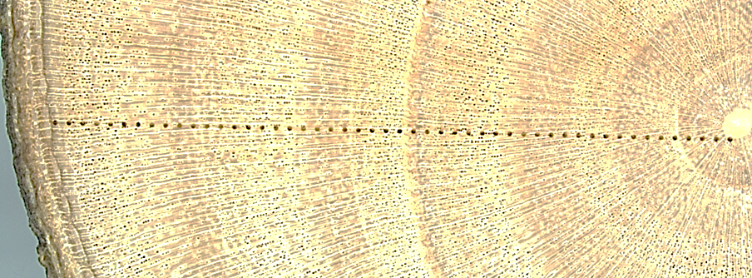
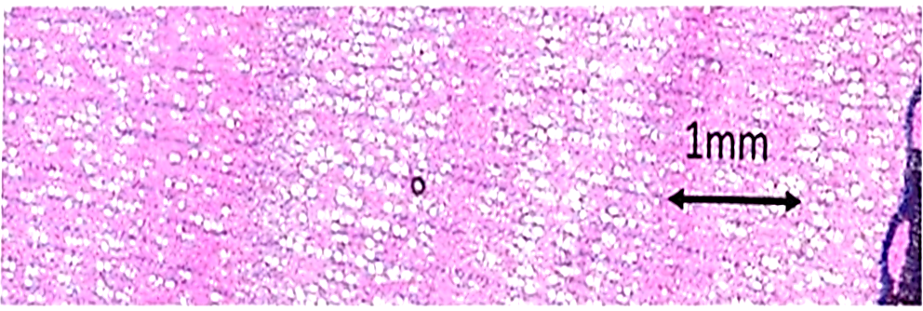
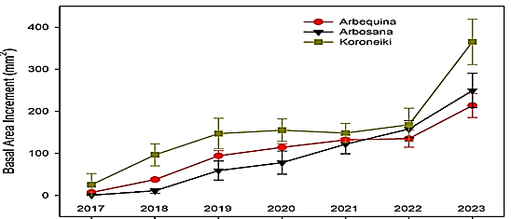
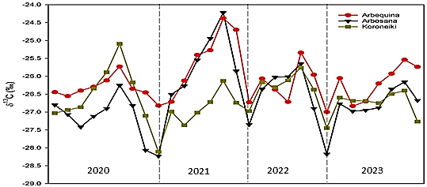
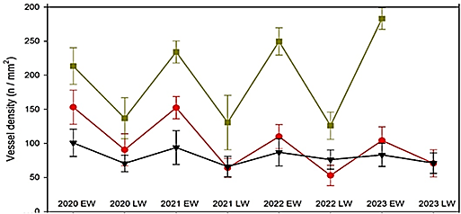
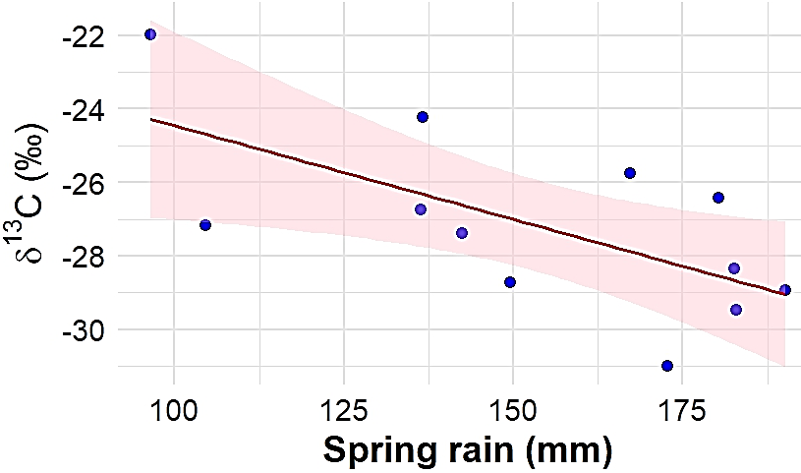
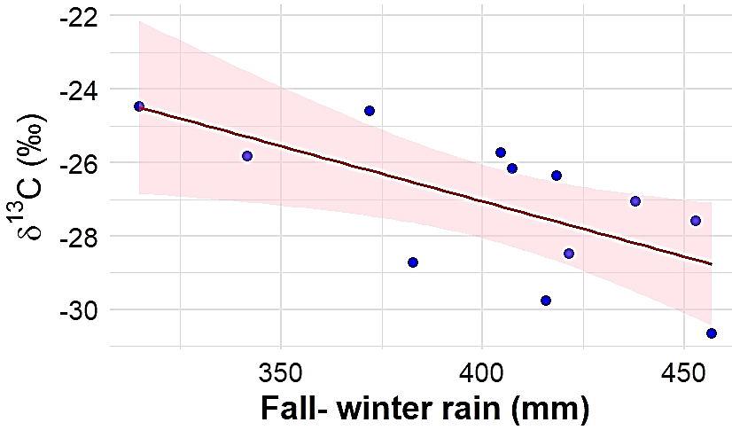

CNR IRET Conference
Rome, February 18th-19th 2025
Low δ¹³C variability and high vessel density reveal anisohydric olive cultivar as most drought-resilient
Silvia Portarena^{1,2}, Matthias Saurer³, Enrico Brugnoli¹, Daniela Farinelli⁴, Paolo Cherubini³
¹ Institute of Research on Terrestrial Ecosystems, National Research Council, Porano, Italy; ² National Biodiversity Future Center, Palermo, Italy, ³ WSL Swiss Federal Research Institute, Birmensdorf, Switzerland, ⁴ Department of Agricultural, Food and Environmental Sciences, University of Perugia, Perugia, Italy
Climate change
Olive orchard
Research question
Spello (Umbria)
Rainfed
High density
Arbequina, Arbosana, Koroneiki cultivars
How do three distinct olive cultivars differ in their physiological and anatomical responses to environmental variation
Challenges in agriculture:
impacts and adaptation
Ring width measurements
High-resolution δ¹³C analyses
Wood anatomical analyses
Arbequina & Arbosana
Koroneiki
Conclusion
Stomatal behavior: Arbequina & Arbosana: isohydric behavior, conserving water by closing stomata during summer stress; Koroneiki: more anisohydric behavior, using carbon reserves for xylem formation.
Hydraulic efficiency: Koroneiki: higher vessel densities enhance hydraulic capacity, supporting efficient water transport and productivity.
Silvia Portarena

