Slide 1


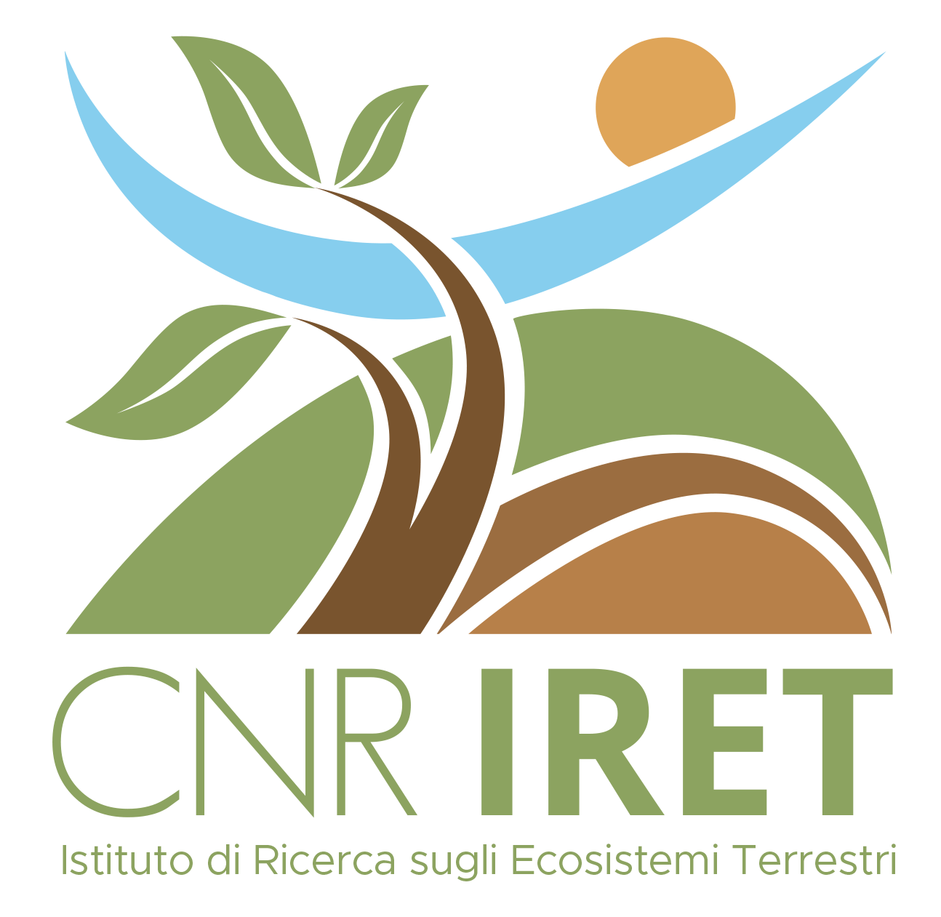


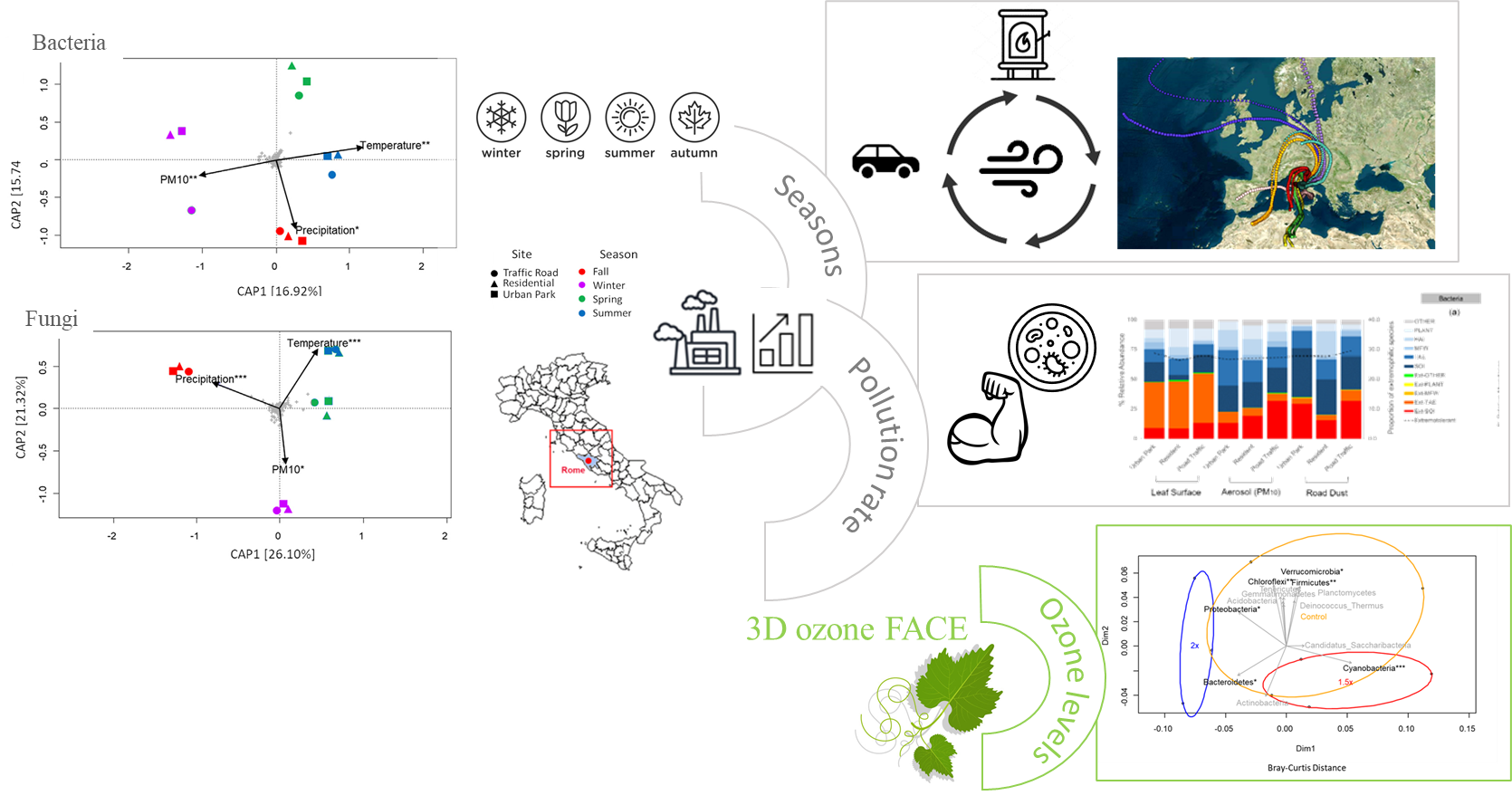


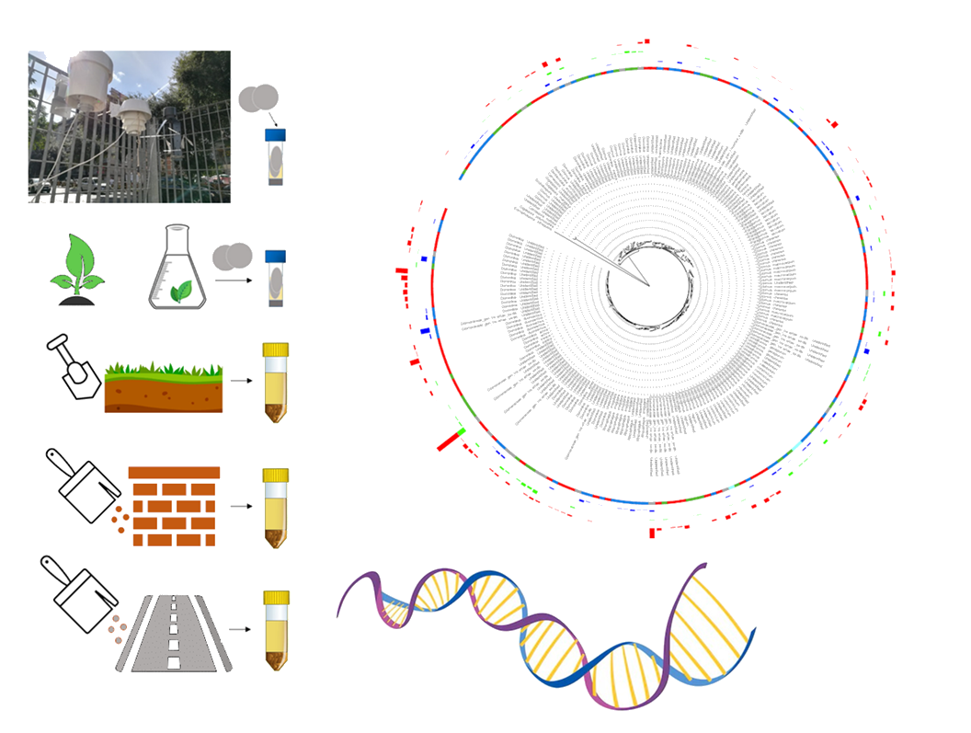


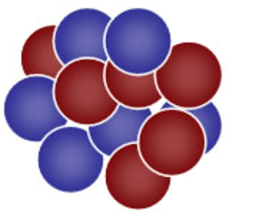
CNR IRET Conference
Rome, February 18th-19th 2025
Meta-Genomics: Exploring Every Surface
P. Pollegioni^{1,2}, C. Mattioni^{1,2}, S. Cardoni³, Federica d’Alò¹, Marco Ciolfi¹, Chiara Anselmi¹, Marco Lauteri¹, Olga Gavrichkova^{1,2}
¹Research Institute on Terrestrial Ecosystems, National Research Council, Porano (TR), ²National Biodiversity Future Center, Palermo ³, Istituto di Ricerca Sulle Acque, National Research Council, Taranto
Over the last four years, the CNR-Research Institute on Terrestrial Ecosystems (IRET, Porano, Terni) has focused its attention on biodiversity of microbial communities.
>> Assessing the biodiversity of microbial communities in relation to pollution levels in urban environments.
>> Shedding light on the role of soil-associated microbial communities in the plant invasion process (Ailanthus altissima, Mill.)
High-throughput amplicon sequencing of the bacterial 16S rRNA gene and the fungal internal transcribed spacer (ITS) regions. This approach has been applied to environmental DNA extracted from various substrates:
PM10 filters (Project MicroAir, PRIN2022-BIOMASTER)
Leaf surfaces (Project MicroAir, 3D ozone FACE)
Soil samples (Project CNR@ UseIt)
Wall surfaces of ancient palaces (Collaboration with Accademia Nazionale dei Lincei)
Paved road surfaces (Project MicroAir)
In Rome, the absence of precipitation, combined with the resuspension of dust caused by vehicular traffic, contributes to the peak abundance of soil-associated microbes during winter and summer. Elevated PM10 concentrations, influenced by climatic conditions, domestic heating, and dust advection events from the African desert, further shaped microbial communities in winter. Over the seasons, extremotolerant microbes and opportunistic pathogenic fungi showed a progressive increase in response to rising pollution levels similarly to the ozone-associated effects on the phyllosphere communities of common grape vine.
In the framework of UseIt, we combined a high-throughput amplicon sequencing of ITS
regions, with stable isotopes analysis of soil samples to investigate the community compositions and structures of soil-associated fungi across Ailanthus altissima density gradient (Absence, Front and Infested) in three pilot experimental sites (Urban Park, Rural and Natural) of central Italy. The tree of heaven is in fact one of the worst invasive plant species in Europe and North America. We are currently investigating the putative role of symbiotic relationships between A. altissima and associated Arbuscular Mycorrhizae Fungi (AMF) in its Evolution of Increased Competitive Capacity (EICA).
Stable isotopes
Paola Pollegioni

