Slide 1



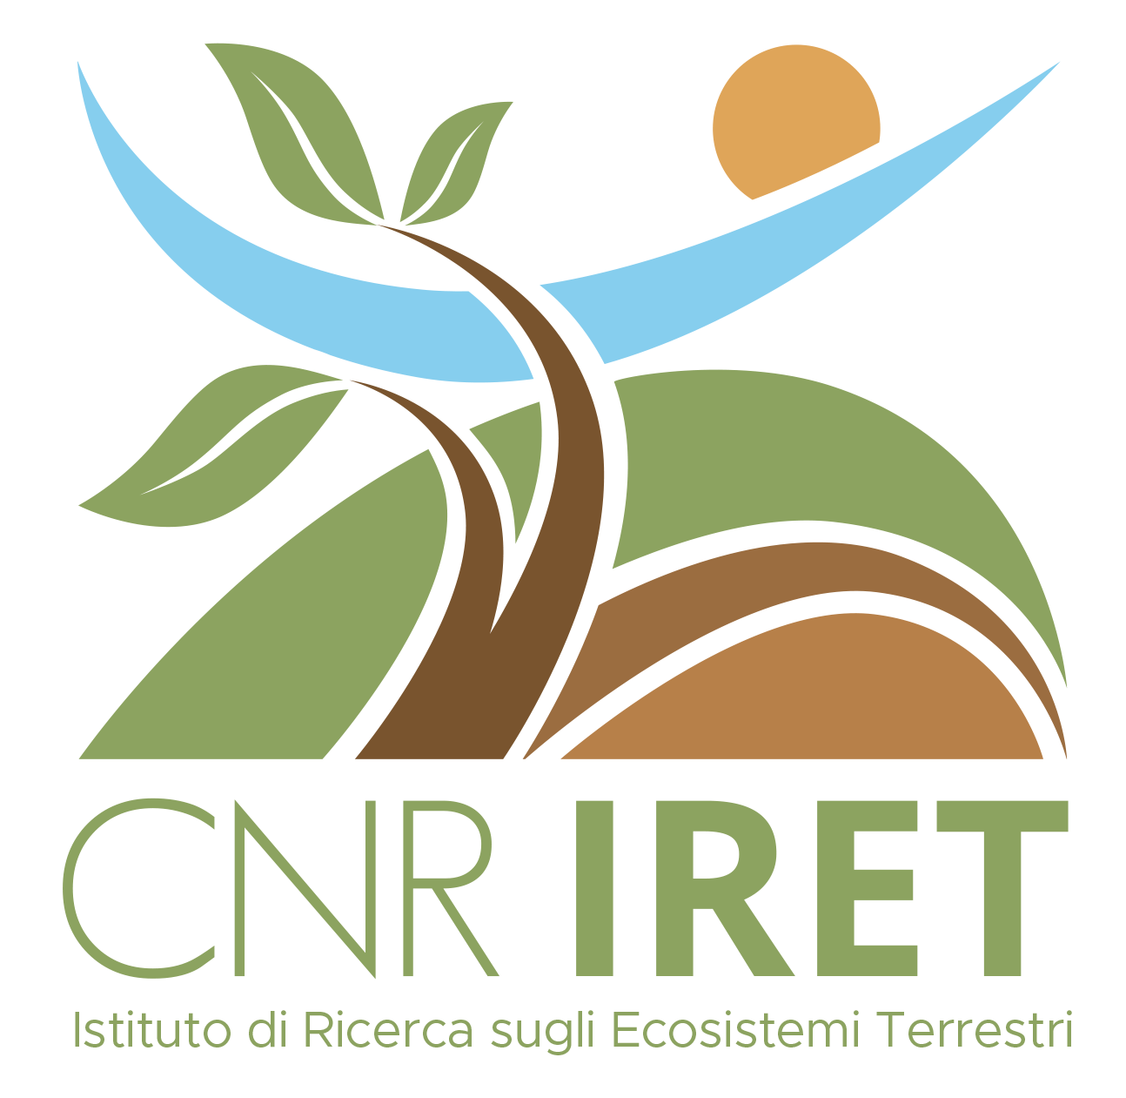




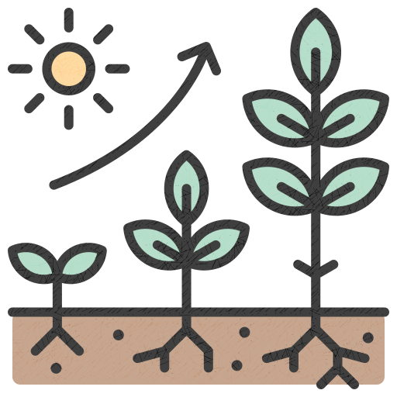

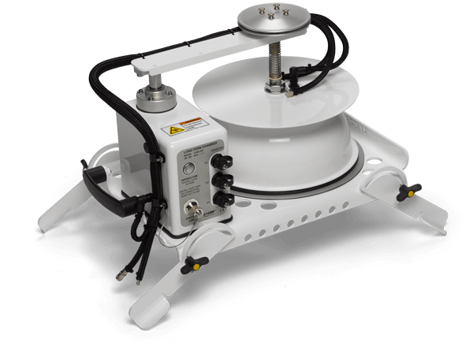
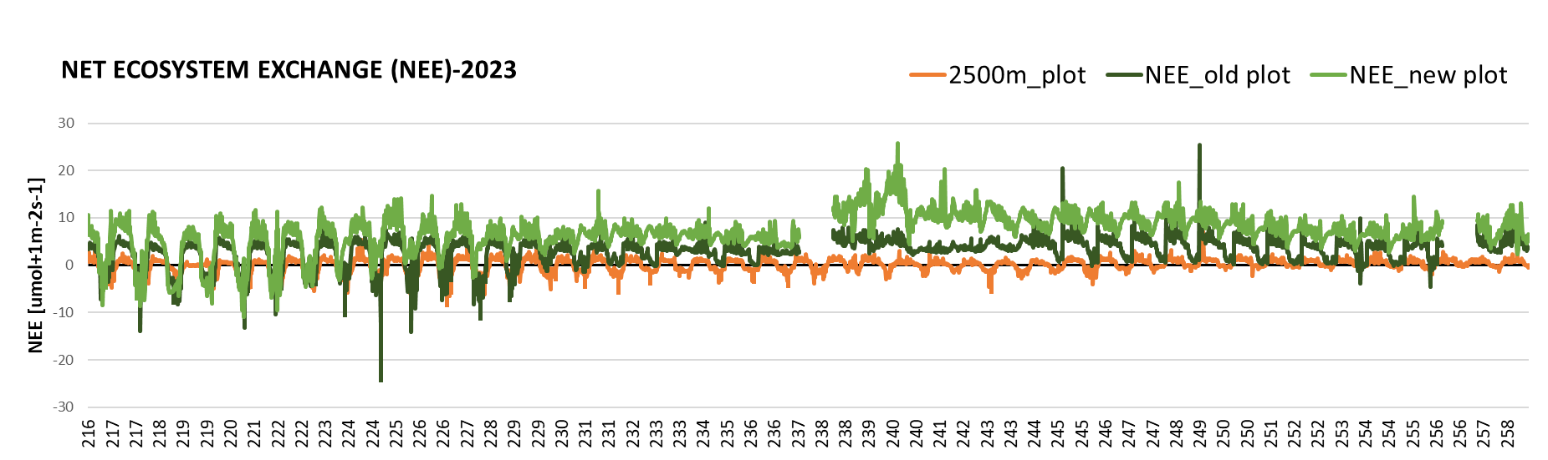
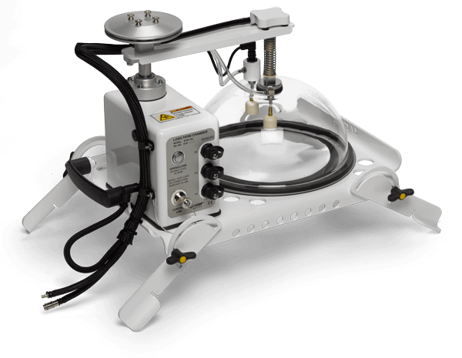

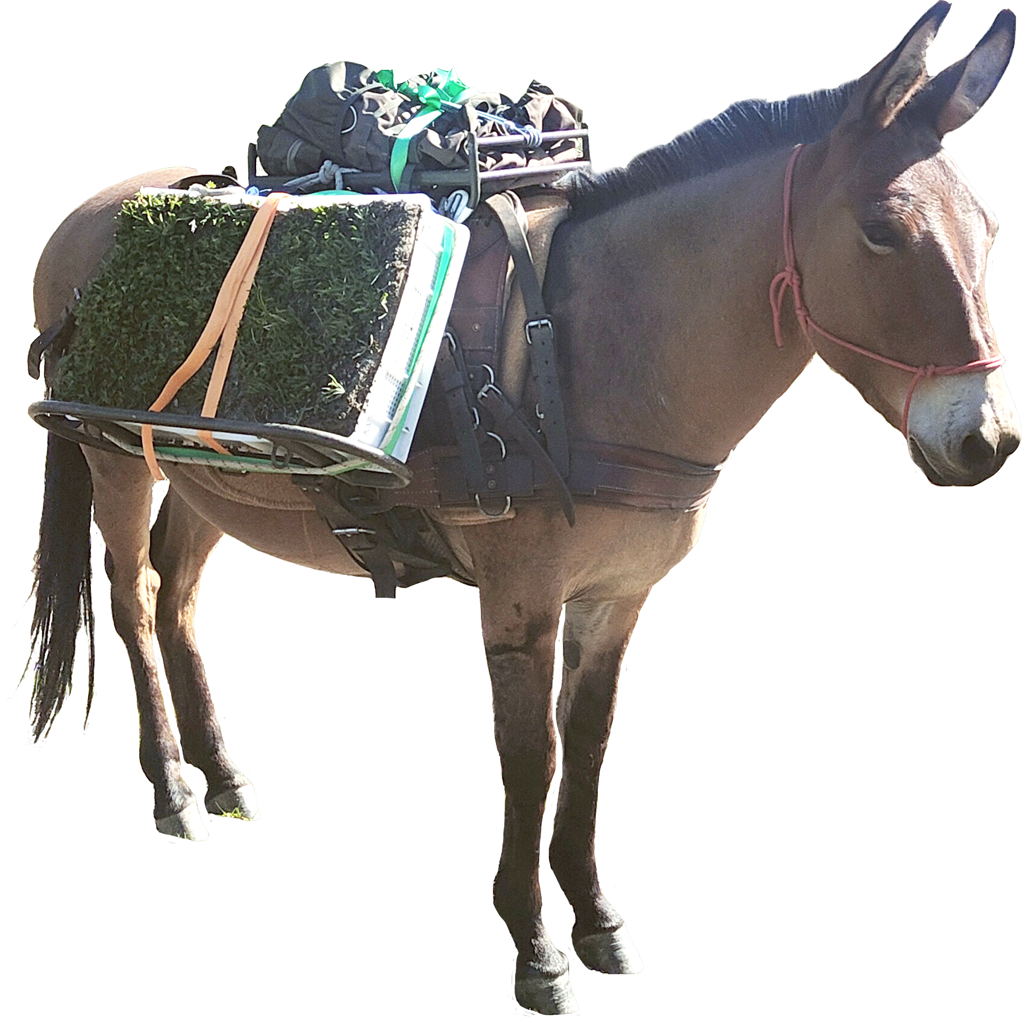
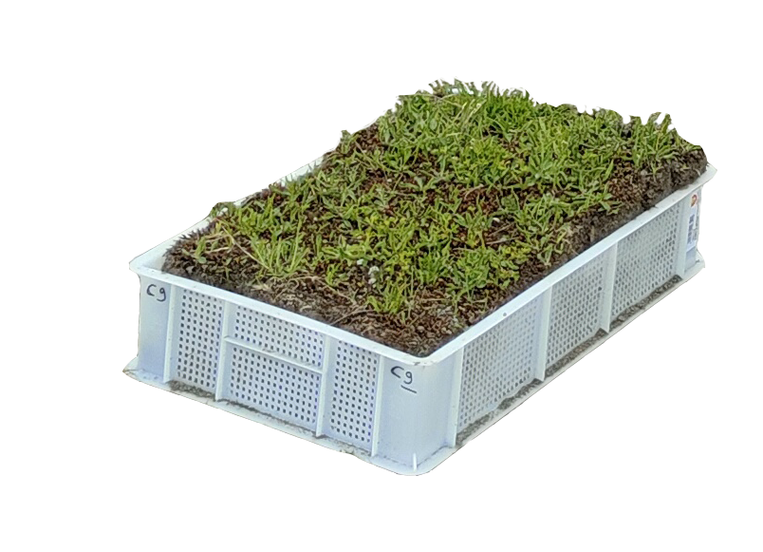


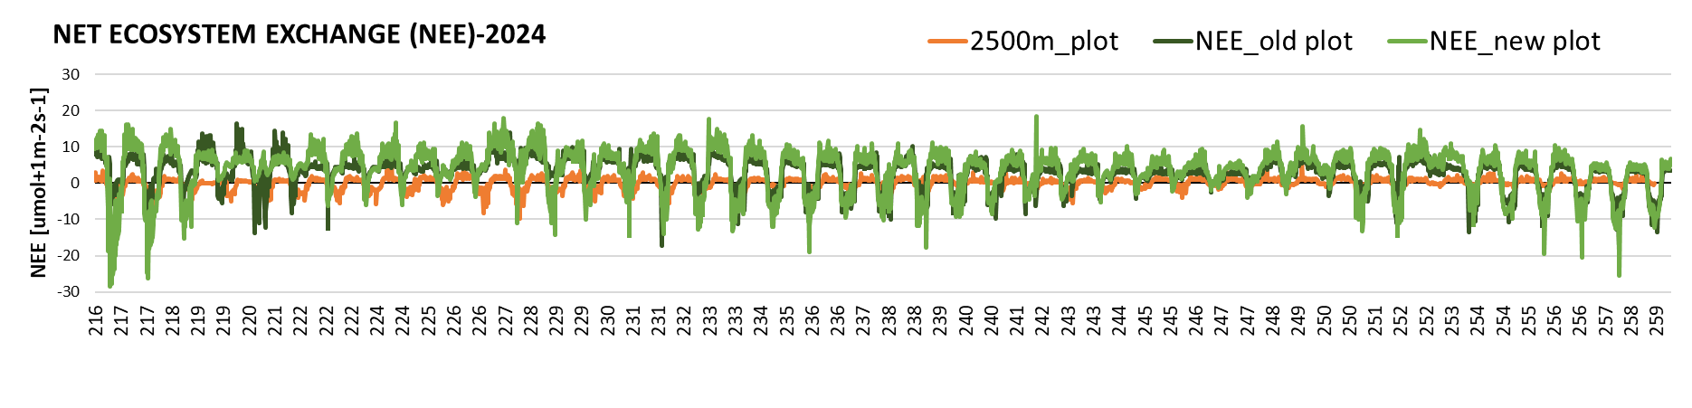

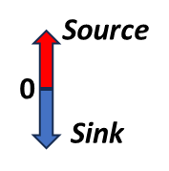

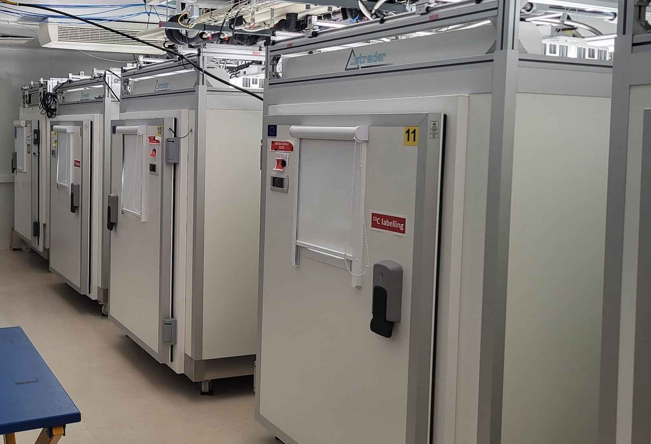
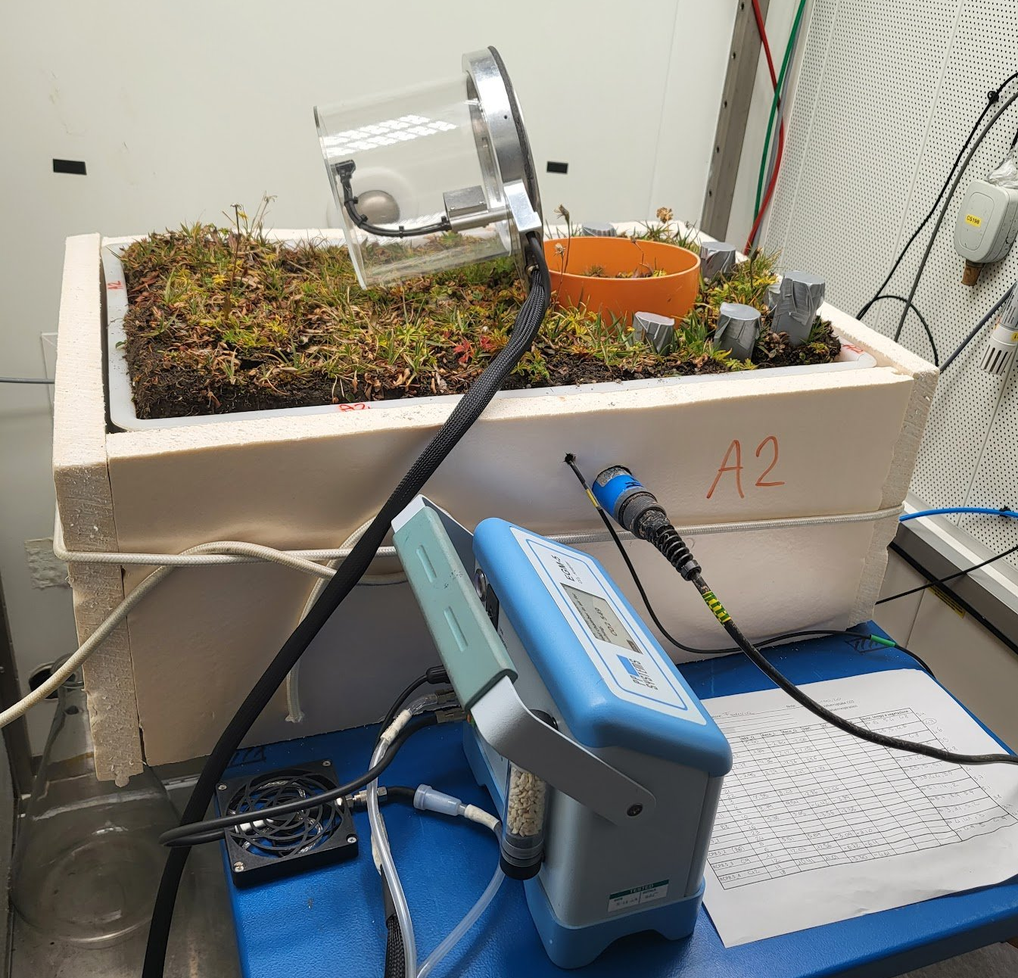



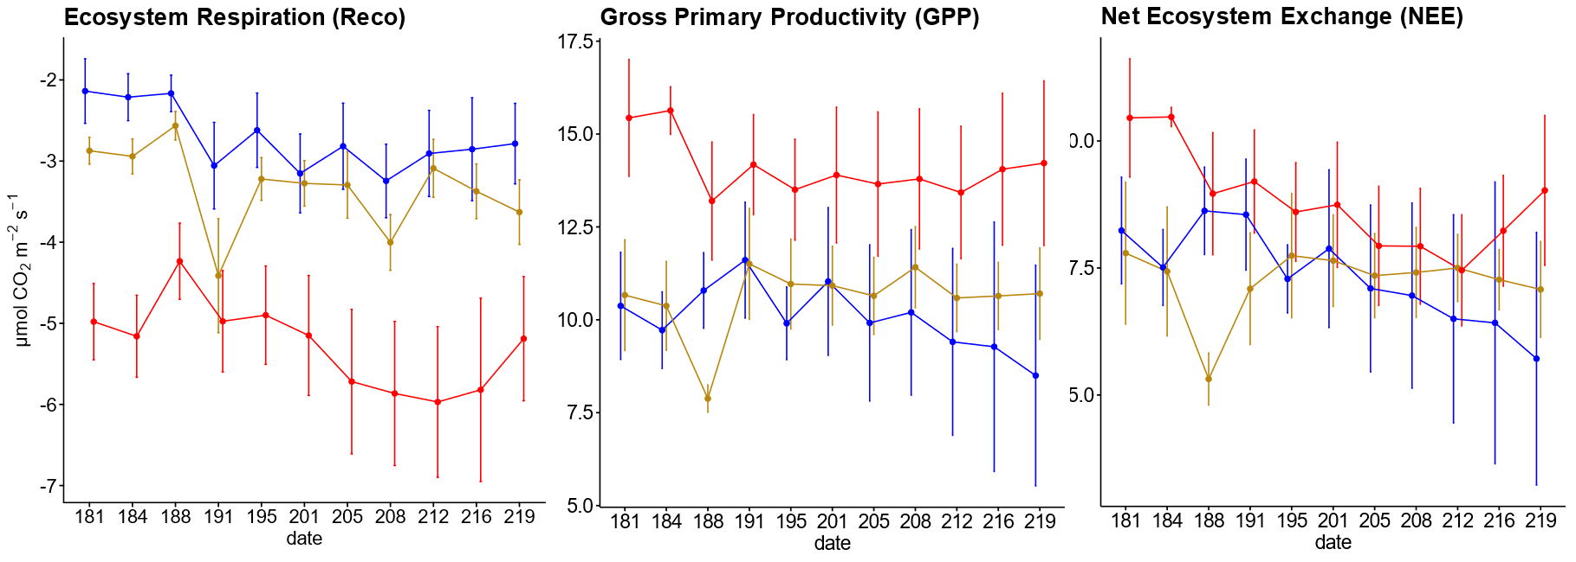




CNR IRET Conference Rome February 18th-19th 2025
Manipulation experiments in Alpine ecosystems: Exploring climate change impacts and carbon dynamics
F. D’Alò, O. Gavrichkova, C. Volterrani, L. Latilla, M. Sarti, A. Milcu, S. Devidal, E. Brugnoli, L.M. Borruso, L. Montagnani, A. Augusti
MICROCOSM EXPERIMENT
TRANSPLANTATION EXPERIMENT
MICROPLANTALP
MICROorganism-PLANT Interactions in the Forefield of Glaciers: a Hotspot for Studying the Impact of Climate Change in ALPine Habitats
Site: Courmayeur, Val Veny-Italy
1° transplantation
OLD PLOT
2° transplantation
NEW PLOT
2500 m
2022
2023
2024
1500 m
Installation continuous C-fluxes chambers
LI 8100
BACKGROUND
Unraveling changes in the carbon balance (NEE) and its components (R_{eco}, GPP) in an alpine grassland subjected to climate manipulation.
Assessment of the responses of carbon fluxes under different acclimation stages.
In 2023 both transplanted plots acted as carbon sources, with the new plots emitting more C. By 2024, the differences diminished, and the emissions declined, likely due to increased photosynthetic rates and reduced carbon loss through respiration, characteristic of the recovery phase following disturbance.
Alpine areas are warming faster than the global average, making them highly sensitive to climate change and potentially significant CO₂ sources. Climate change is expected to disrupt the balance between carbon assimilation, storage in vegetation and soils, and release through respiration.
NEE
Warming reduced carbon uptake immediately after disturbance, with partial recovery after one year, but not to pre-disturbance levels
MICROCOSM EXPERIMENT
Analyze the projected dynamics of soil-plant carbon fluxes under future climate conditions for the year 2070.
Three climate scenarios
projected for 2070
in the IPCC 2022:
Control (420 ppm CO₂)
RCP 4.5 (550 ppm CO₂)
RCP 8.5 (800 ppm CO₂)
Temperature
Precipitation
Relative Humidity
Radiation
[CO₂ ]
OBJECTIVES
Analyze the state of alpine ecosystem under future climate conditions, by integrating the study of carbon fluxes, plants, and soil microorganisms with climate manipulation experiments.
CO₂ flux measurement (IRGA - EGM5, PP-System)
Vegetation cover assessment
Microbiological sampling
¹³C pulse labeling-chasing experiment
Montpellier European Ecotron
(CNRS, France)
Under RCP 8.5, elevated CO₂, and temperatures stimulated canopy growth, preserving carbon sink functions despite higher respiration
Alpine ecosystems demonstrate short-term adaptability to warming conditions, but their long-term ability to sequester carbon is uncertain, highlighting the need for both field and experimental studies to understand future climate impacts.
Federica D’Alò

