Slide 1
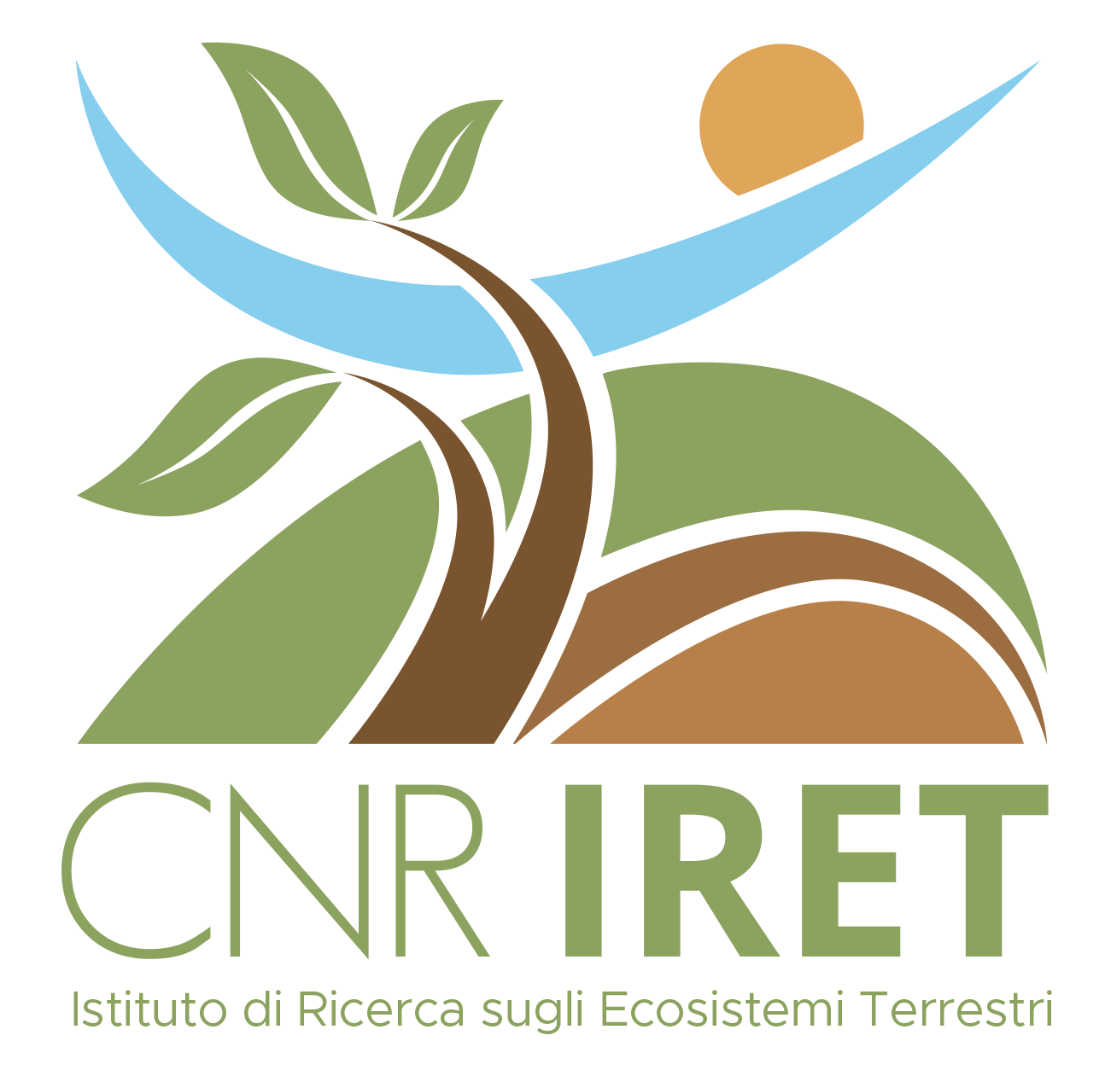
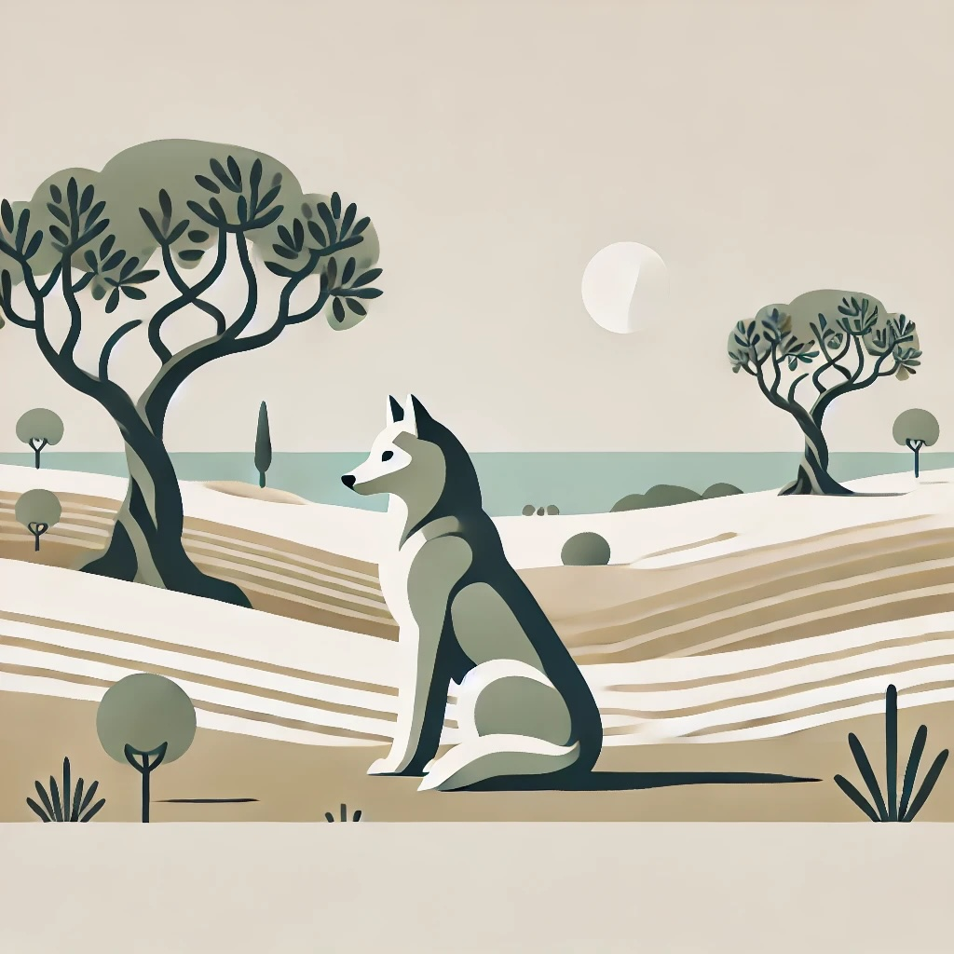
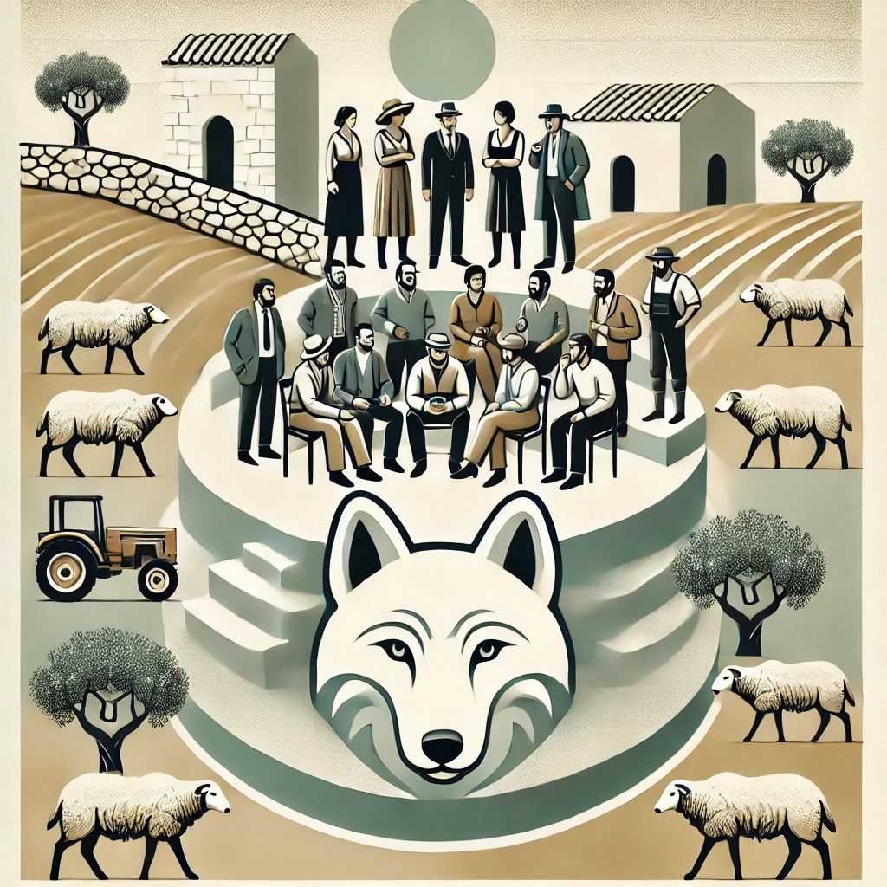
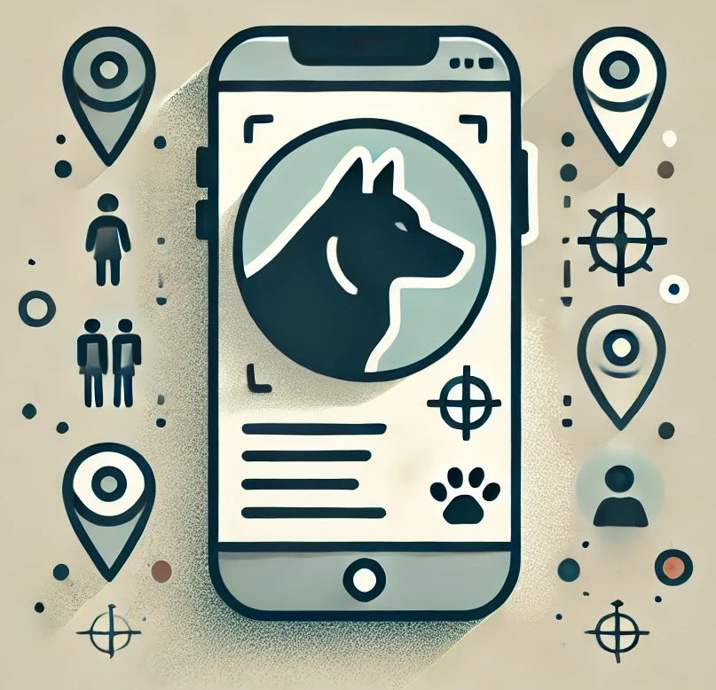
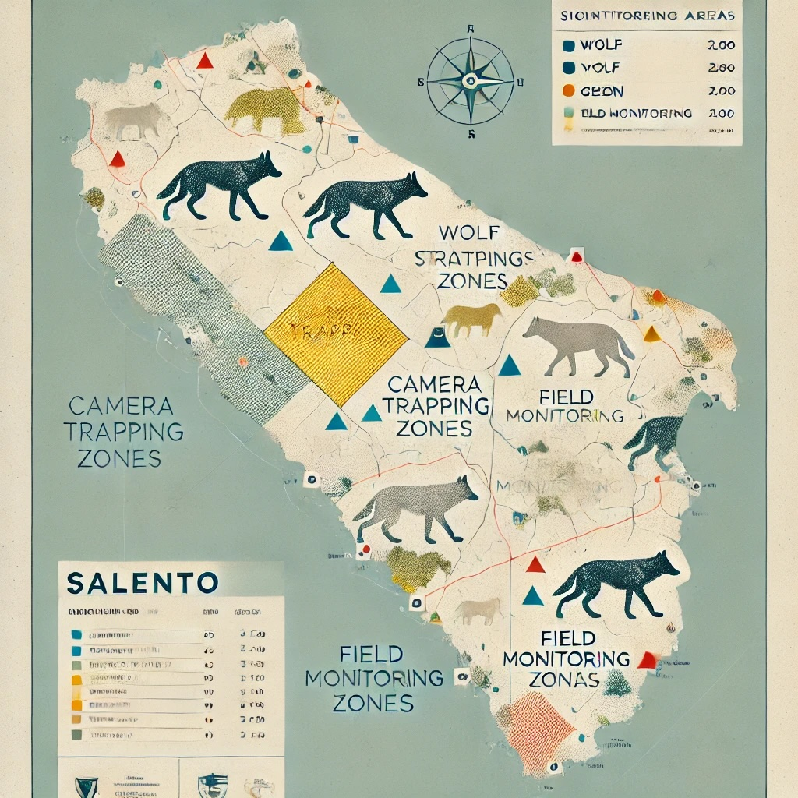
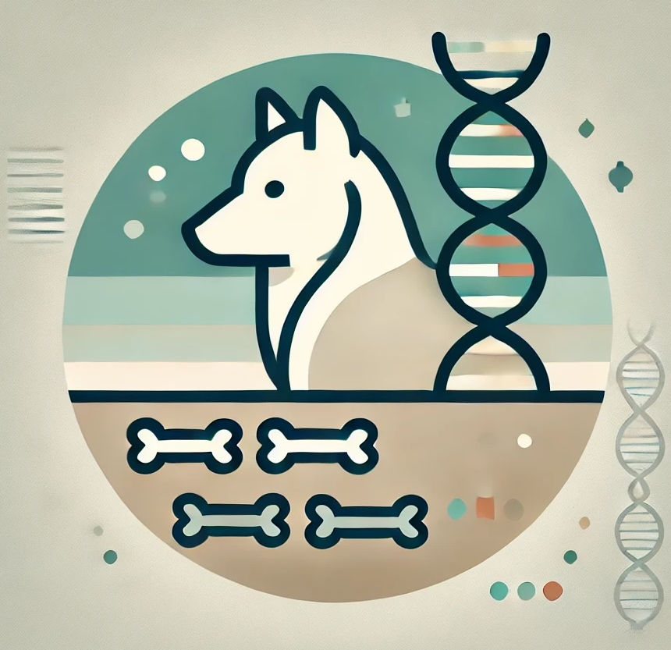
CNR IRET Conference
Rome, February 18th-19th 2025
Stakeholder Engagement & Awareness
28 meetings and 4 workshops to foster dialogue among stakeholders for
wolf coexistence.
Smart tools for conservation
Our citizen science and field support apps ensure transparent and FAIR data management with eScience tools.
.
Monitoring and Management of Wolves in Salento
Field Monitoring & Camera Trapping
Over 120 hectares surveyed, 55 camera traps deployed, and 97 videos recorded providing valuable insights into wolf presence, behaviour, and habitat use.
The HIC SUNT LUPI project applies rigorous scientific methods to monitor wolf populations and study their diet, ensuring informed conservation strategies
Insights from Camera Traps
6 wolf packs identified and 4 reproductive events documented.
Diet Analysis for Conservation
86 samples collected to reveal predator-prey dynamics, aiding ecosystem balance and livestock protection.
F. De Leo , P. Ciucci, P. Colangelo, E. Mori, I. Rosati, D. Raho, E. Solano, F. Cozzoli
Francesco De Leo

