Slide 1


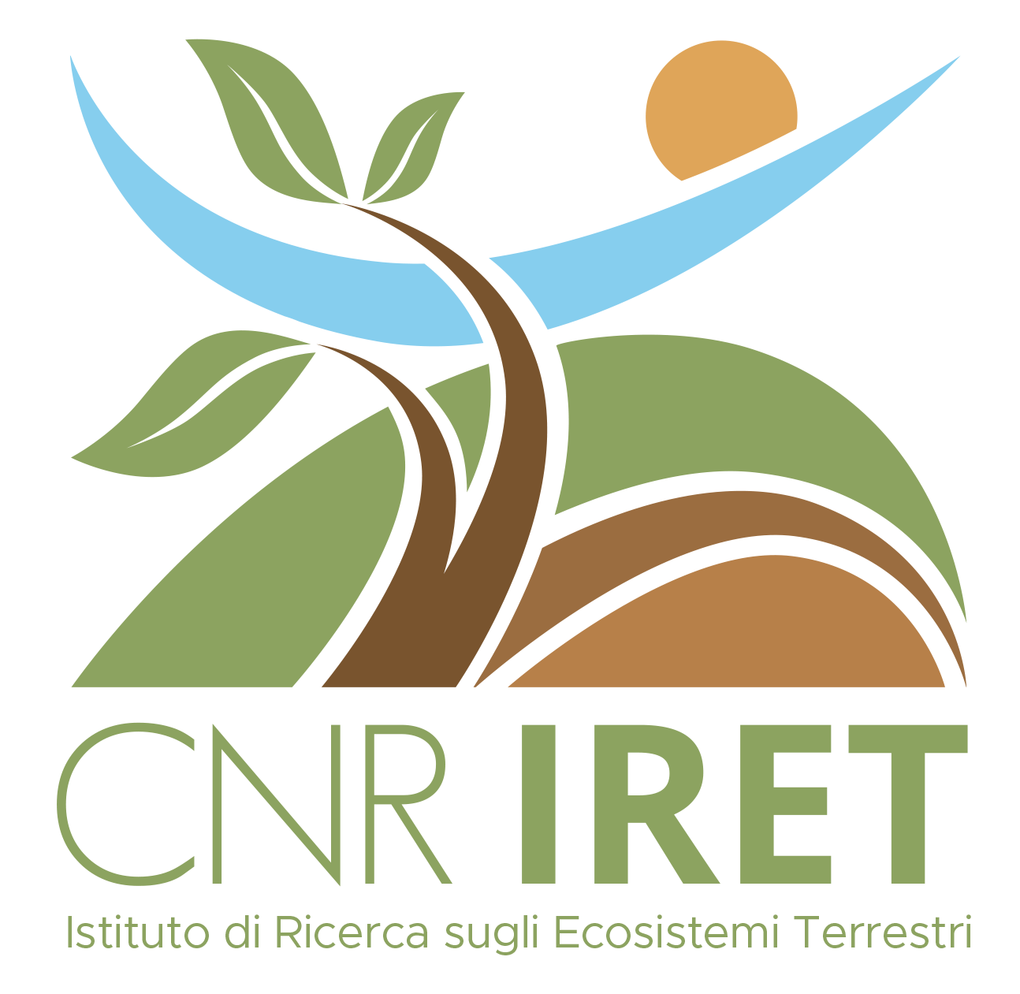
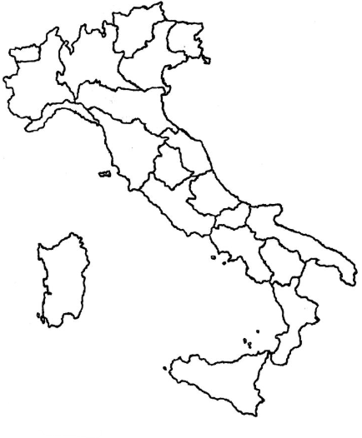
CNR IRET Conference
Rome, February 18th-19th 2025
Certified sustainable forest and life cycle management to support the implementation of an ecosystem service-based crediting mechanism
Research context
Case study results and interpretation
International certification schemes already exist to ensure that sustainable practices are implemented in forest restoration and conservation interventions
Most popular examples of those schemes are the Programme for Endorsement of Forest Certification (PEFC) and the Forest Stewardship Council (FSC)
Both PEFC and FSC allow the quantification and monitoring of Ecosystem Services (ES), but with different perspectives, creating market uncertainty and biases
Environmental crediting based on ES is a promising solution to ensure a compromise between the need to protect and conserve natural capital, and the market demand to make business and earning out of (forest) ecosystems
We illustrate and test here the implementation of a new crediting system to support the recovery and sustainable management of thousands of hectares in Italy owned by Catholic Church; developed credits are called “Laudato Si’” (CLSi’)
CLSi’ are quantified for three pilot areas of the Institute for the Support of the Clergy (I.D.S.C.) of Asti, in the Region of Piedmont, Italy
The environmental cost-benefit balance in Box 1 represents the credits calculation model, based on combination between life cycle benefits and costs of forest interventions and future management
Possible model improvements concern the biophysical assessment of the ES as a basis for a more representative and non-market influenced valuation model
The I.D.S.C. is currently investigating strategies to sell credits according to principles of sustainable forest management and intervention (focus on biodiversity and recreational/social services, rather than ‘just’ carbon uptake)
CLSi’ calculation framework: parameters and rationale
Forest property under active management (a), in ha
Non-owned but actively managed forest (b), in ha
Income associated with the sale of timber extracted through improvement operations (P), in €
Costs for certification of ecosystem services (C5), in €
Costs for implementing the farm forestry plan and its management (C5), in €
Costs of forestry companies for interventions deducting the value of timber (C5), in €
Costs for administration and taxes (C5), in €
Costs for producing the paper and digital certificate (C5), in €
% increase in earnings to be sent to the Central Institute S.C. (∆%), cross-ref. to n.15
Total duration of the active management and time span of intervention (T_{n}), in years (n = 5)
Annual maintenance cost of new trails and other generated infrastructure (A1), in €
Annual cost of auditing for certification (A2), in €
Annual cost of administrative and technical management, marketing and communication (assumed = 2% of implementation costs) (A3), in €
Rental or other management cost per b (B), in €
Profit to be sent to the Central Institute S.C. for clergy sustenance, health insurance for priests and energy efficiency of I.D.S.C. properties (U), assumed to be = 10% of total costs, in €
Further info: https://oxygenmap.green/
Total project implementation costs Profits for the I.D.S.C. (variable parameter, 10% of the costs)
Y = Σ C5_{i} + [(A1 + A2 + A3 + B) x T_{n}] U = Y x ∆%
Number of generated credits per unit of area N_{CLSi’} = (Y + U – P) / 50, where 50 (euro) is assumed as hypothetic environmental credit cost parameter set by the I.D.S.C. on the basis of a market price analysis of carbon credits.
Benedetto RUGANI^{1*}, Marco ALLOCCO², Cinzia SAPONERI², Luca SALVAI², Ettore D’ANDREA¹, Gabriele GUIDOLOTTI¹, Marco MICALI¹, Carlo CALFAPIETRA¹
¹ Consiglio Nazionale delle Ricerche (CNR), Istituto di Ricerca sugli Ecosistemi Terrestri (IRET), Porano (TR), Italy
² SEAcoop STP, Torino, Italy *corresponding author and presenter: benedetto.rugani@cnr.it
Box 1

