Slide 1



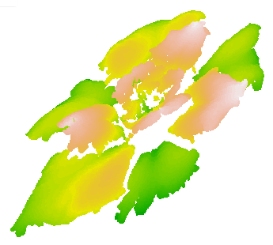
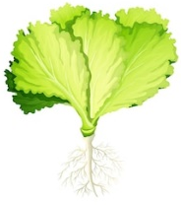
CNR IRET Conference
Rome, February 18th-19th 2025
New indicators for the selection of plants adapted to saline environments:
combining High-Throughput digital Plant Phenotyping with morpho-physiological and biochemical analyses in sustainable water management
D. Di Baccio, M. Barbafieri, I. Rosellini, M. Mascherpa, E. Tassi
Results and Conclusions
Research Institute on Terrestrial Ecosystems – Pisa unit
Real time monitoring
daniela.dibaccio@cnr.it
Measurements
Phenotyping
Morphological parameters:
3D Leaf Area, Digital Biomass, Light Penetration Depth, Plant Height
Multispectral parameters:
NDVI, PSRI, NPCI, GLI
Technical parameters:
Hue, convex hull area, voxel volume, lightness
3D leaf area
Experimental set-up
model plant: Lactuga sativa L.
saline Irrigation Waters (IWs)
cm²
MicroScan-PlantEye F600 (Phenospex)
Validation-prediction
Zn (apical leaves) vrs. NDVI
Control
Plant trait measurements
Physiological traits:
Growth analysis, chlorophyll fluorescence
Biochemical:
Pigments, minerals content
Specific relationships-new combined indices
NaCl (g L⁻¹) | 0.04 | 12.0 | 12.0 | 12.0
CaCl₂ (mg L⁻¹) | 39.5 | 39.5 | 443.1 | 443.1
ZnCl₂ (mg L⁻¹) | < ql | < ql | 20.0 | 20.0
CuSO₄ (mg L⁻¹) | < ql | < ql | < ql | 51.6
EC (mS cm⁻¹) | 0.7 | 17.4 | 17.5 | 18.0
pH | 8.2 | 7.9 | 7.4 | 7.5
shoot FW
Leaf Zn
**
**
Shoot FW vrs. Digital Biomass
a
***
a
bc
ab
b
b
b
c
g.
mg kg⁻¹ DW
a
b
b
c
Daniela Di Baccio

