Slide 1



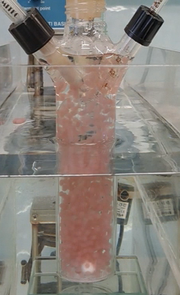
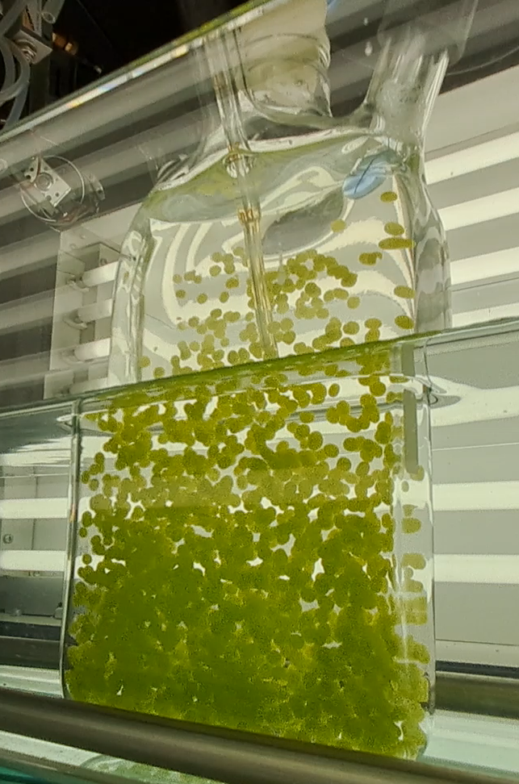


CNR IRET Conference
Rome, February 18th-19th 2025
Biohydrogen production by immobilized
FOSSIL FUELS
Cells immobilized in 2% w/v calcium alginate
Finite in supply, cause land degradation and release of greenhouse gases and pollutants.
Rhodopseudomonas palustris
– Purple non sulfur bacterium –
Cylindrical 220 mL photobioreactor
Chlorella vulgaris
– Microalgae –
Flat 600 mL photobioreactor
H₂
BIOLOGICAL
produced by photosynthetic microorganisms:
Environmentally friendly properties
Achievement of carbon neutrality
Extremely combustible
Its combustion yields only water as byproduct
Among the strategies that could be explored to improve biological H₂ production efficiency, the immobilization of cells could be particularly effective.
H₂ produced 868 mL
H₂ produced 214 mL
Average productivity 2.68 mL(H₂)/h
Average productivity 1.53 mL(H₂)/h
GC analysis of the gas produced by the culture (PerkinElmer Clarus 500)
Immobilization process
Increase:
Product recovery, cell harvesting, medium replacement
Volumetric cell density
Homogeneous distribution of cells
Light conversion efficiency
Cells’ resistance to various environmental stresses
The ability of the immobilized cells to produce H₂ in two photobioreactors was tested
Further research is necessary to improve the industrial and commercial feasibility of H₂ production by photosynthetic microorganisms
Acknowledgements:
European Union’s Horizon research and Innovation program No 101093150
Raffaella Zampieri

