Slide 1


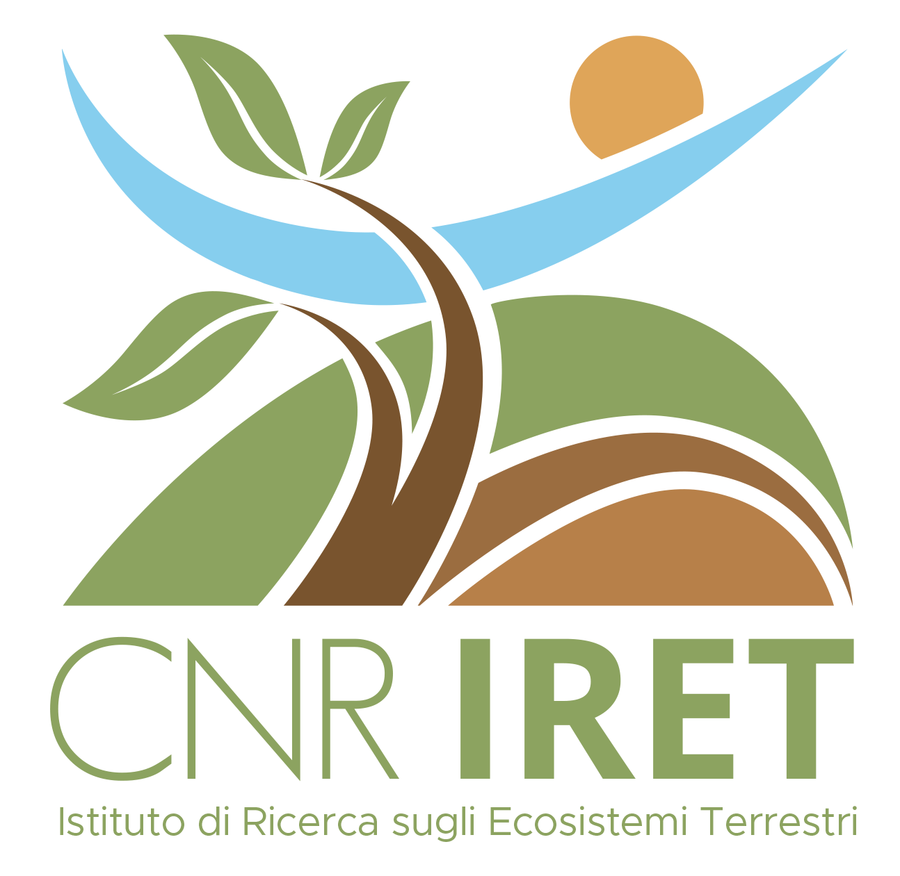


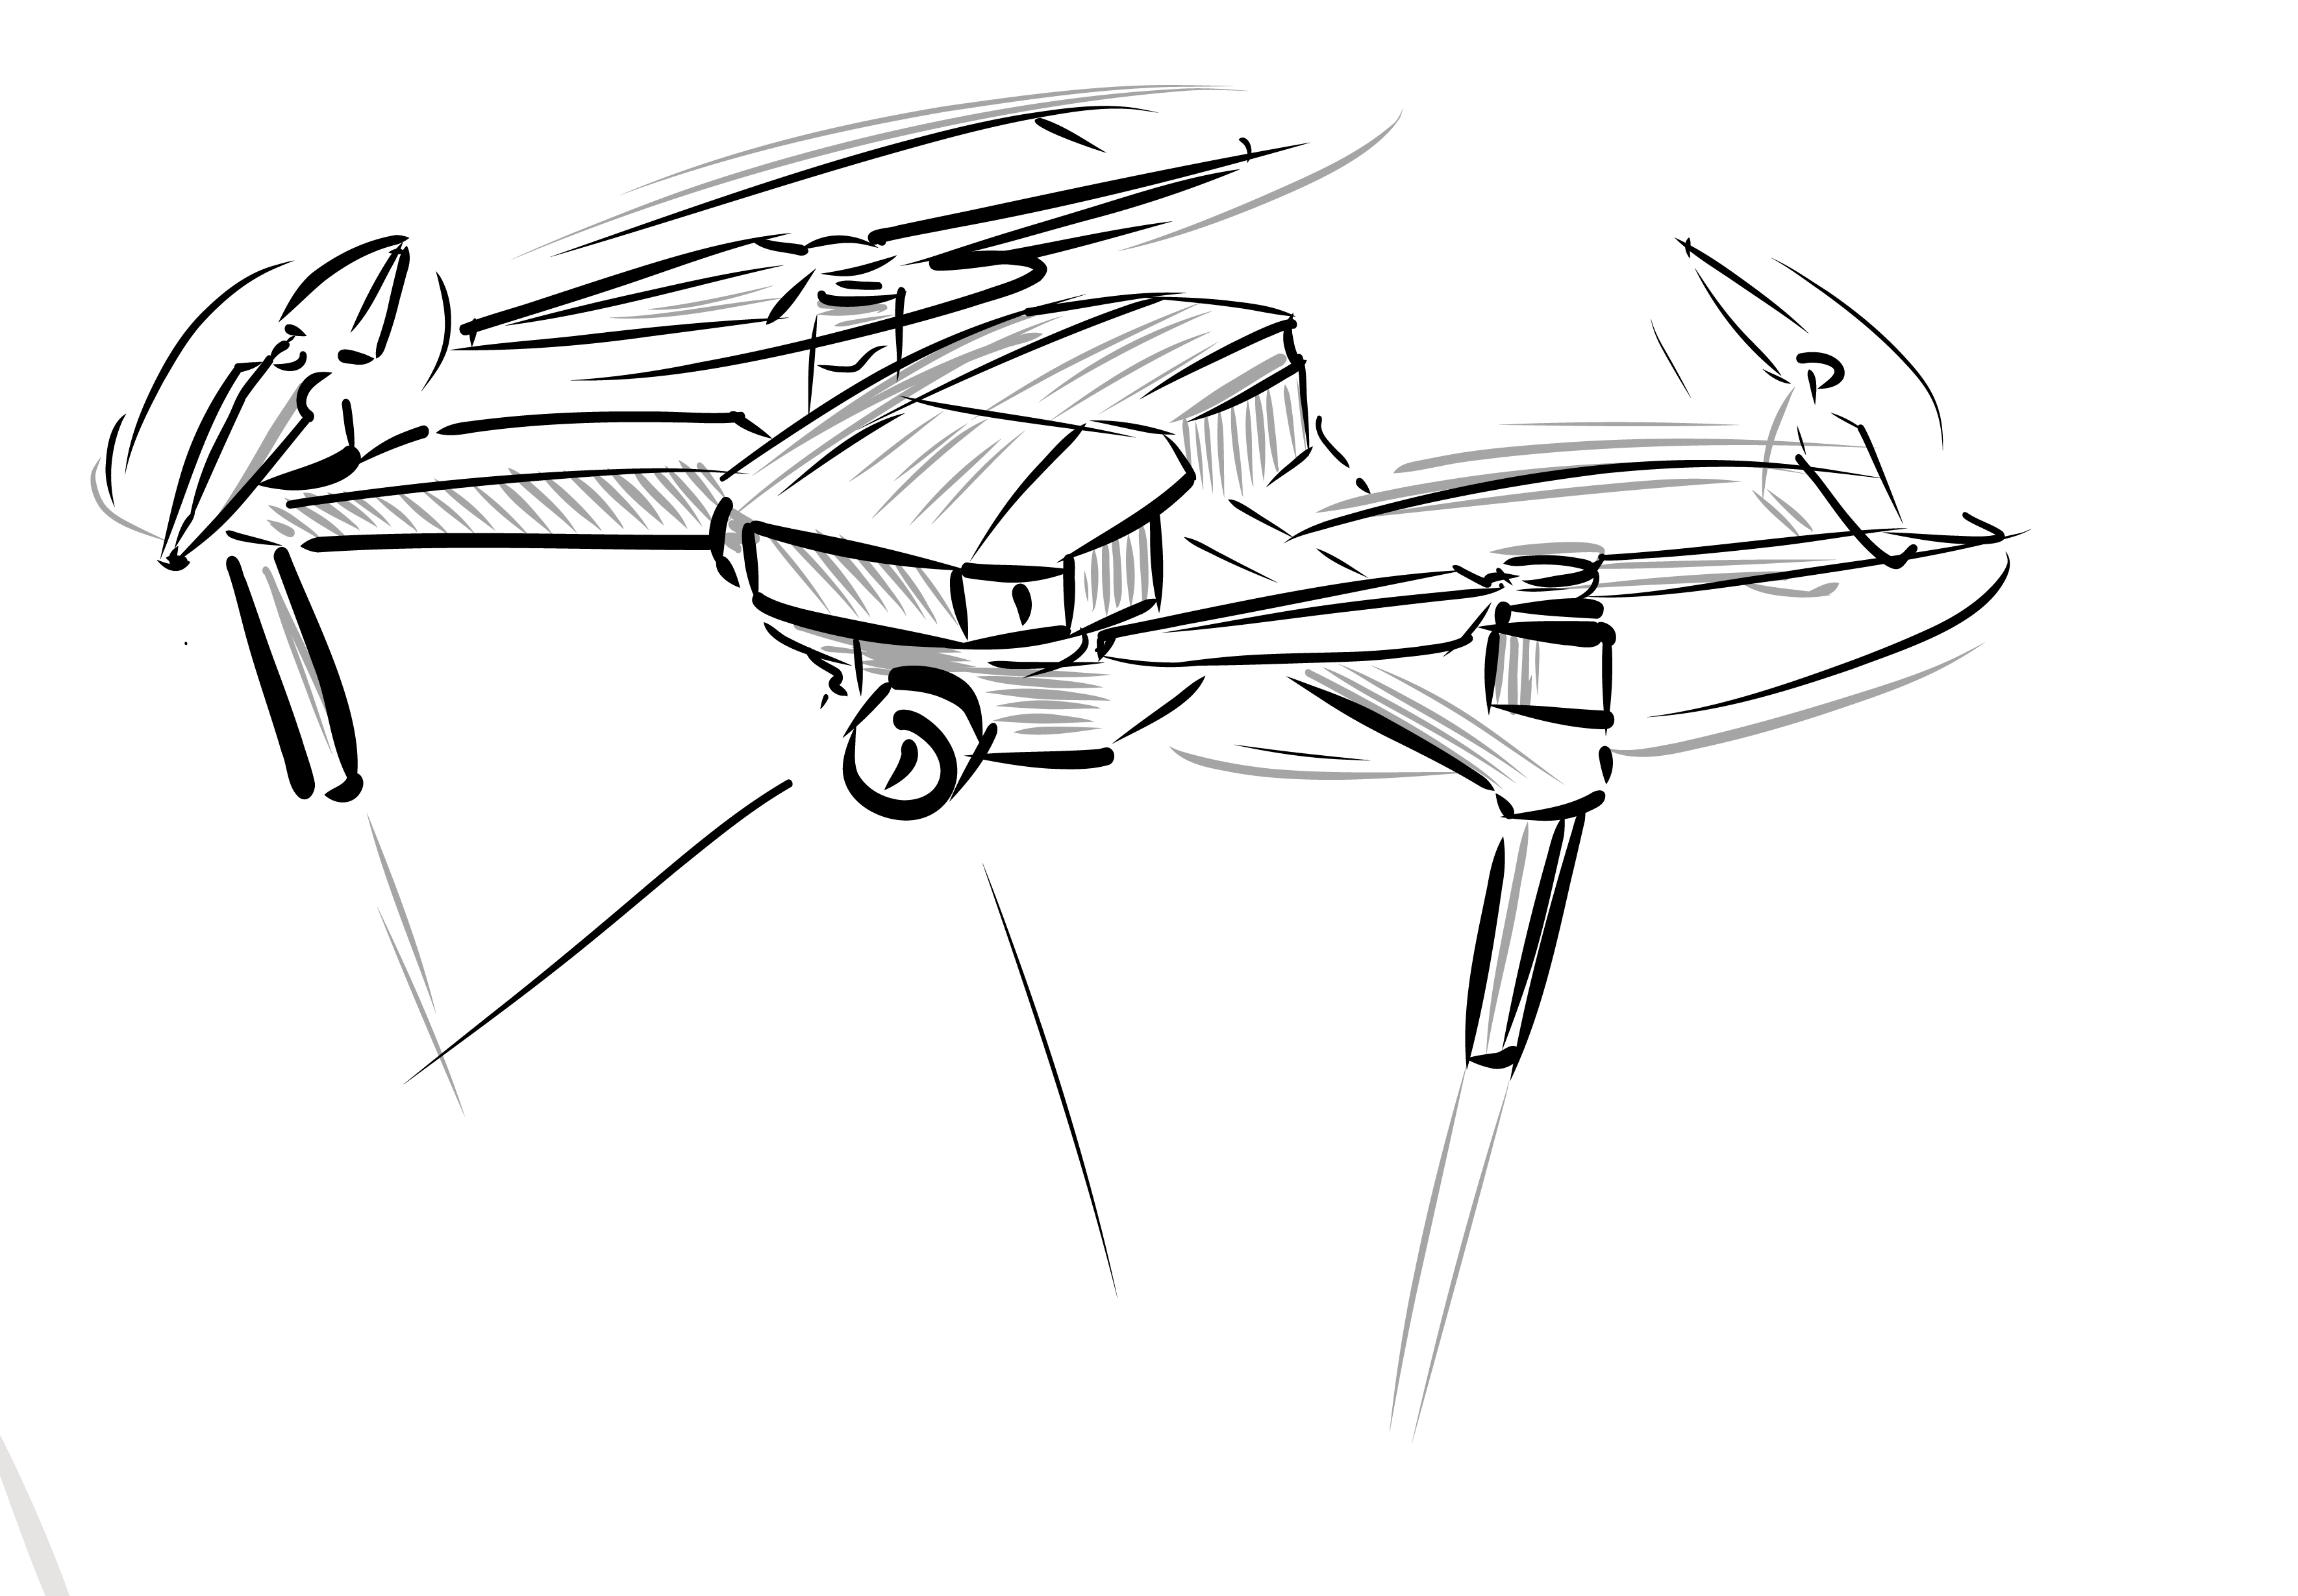
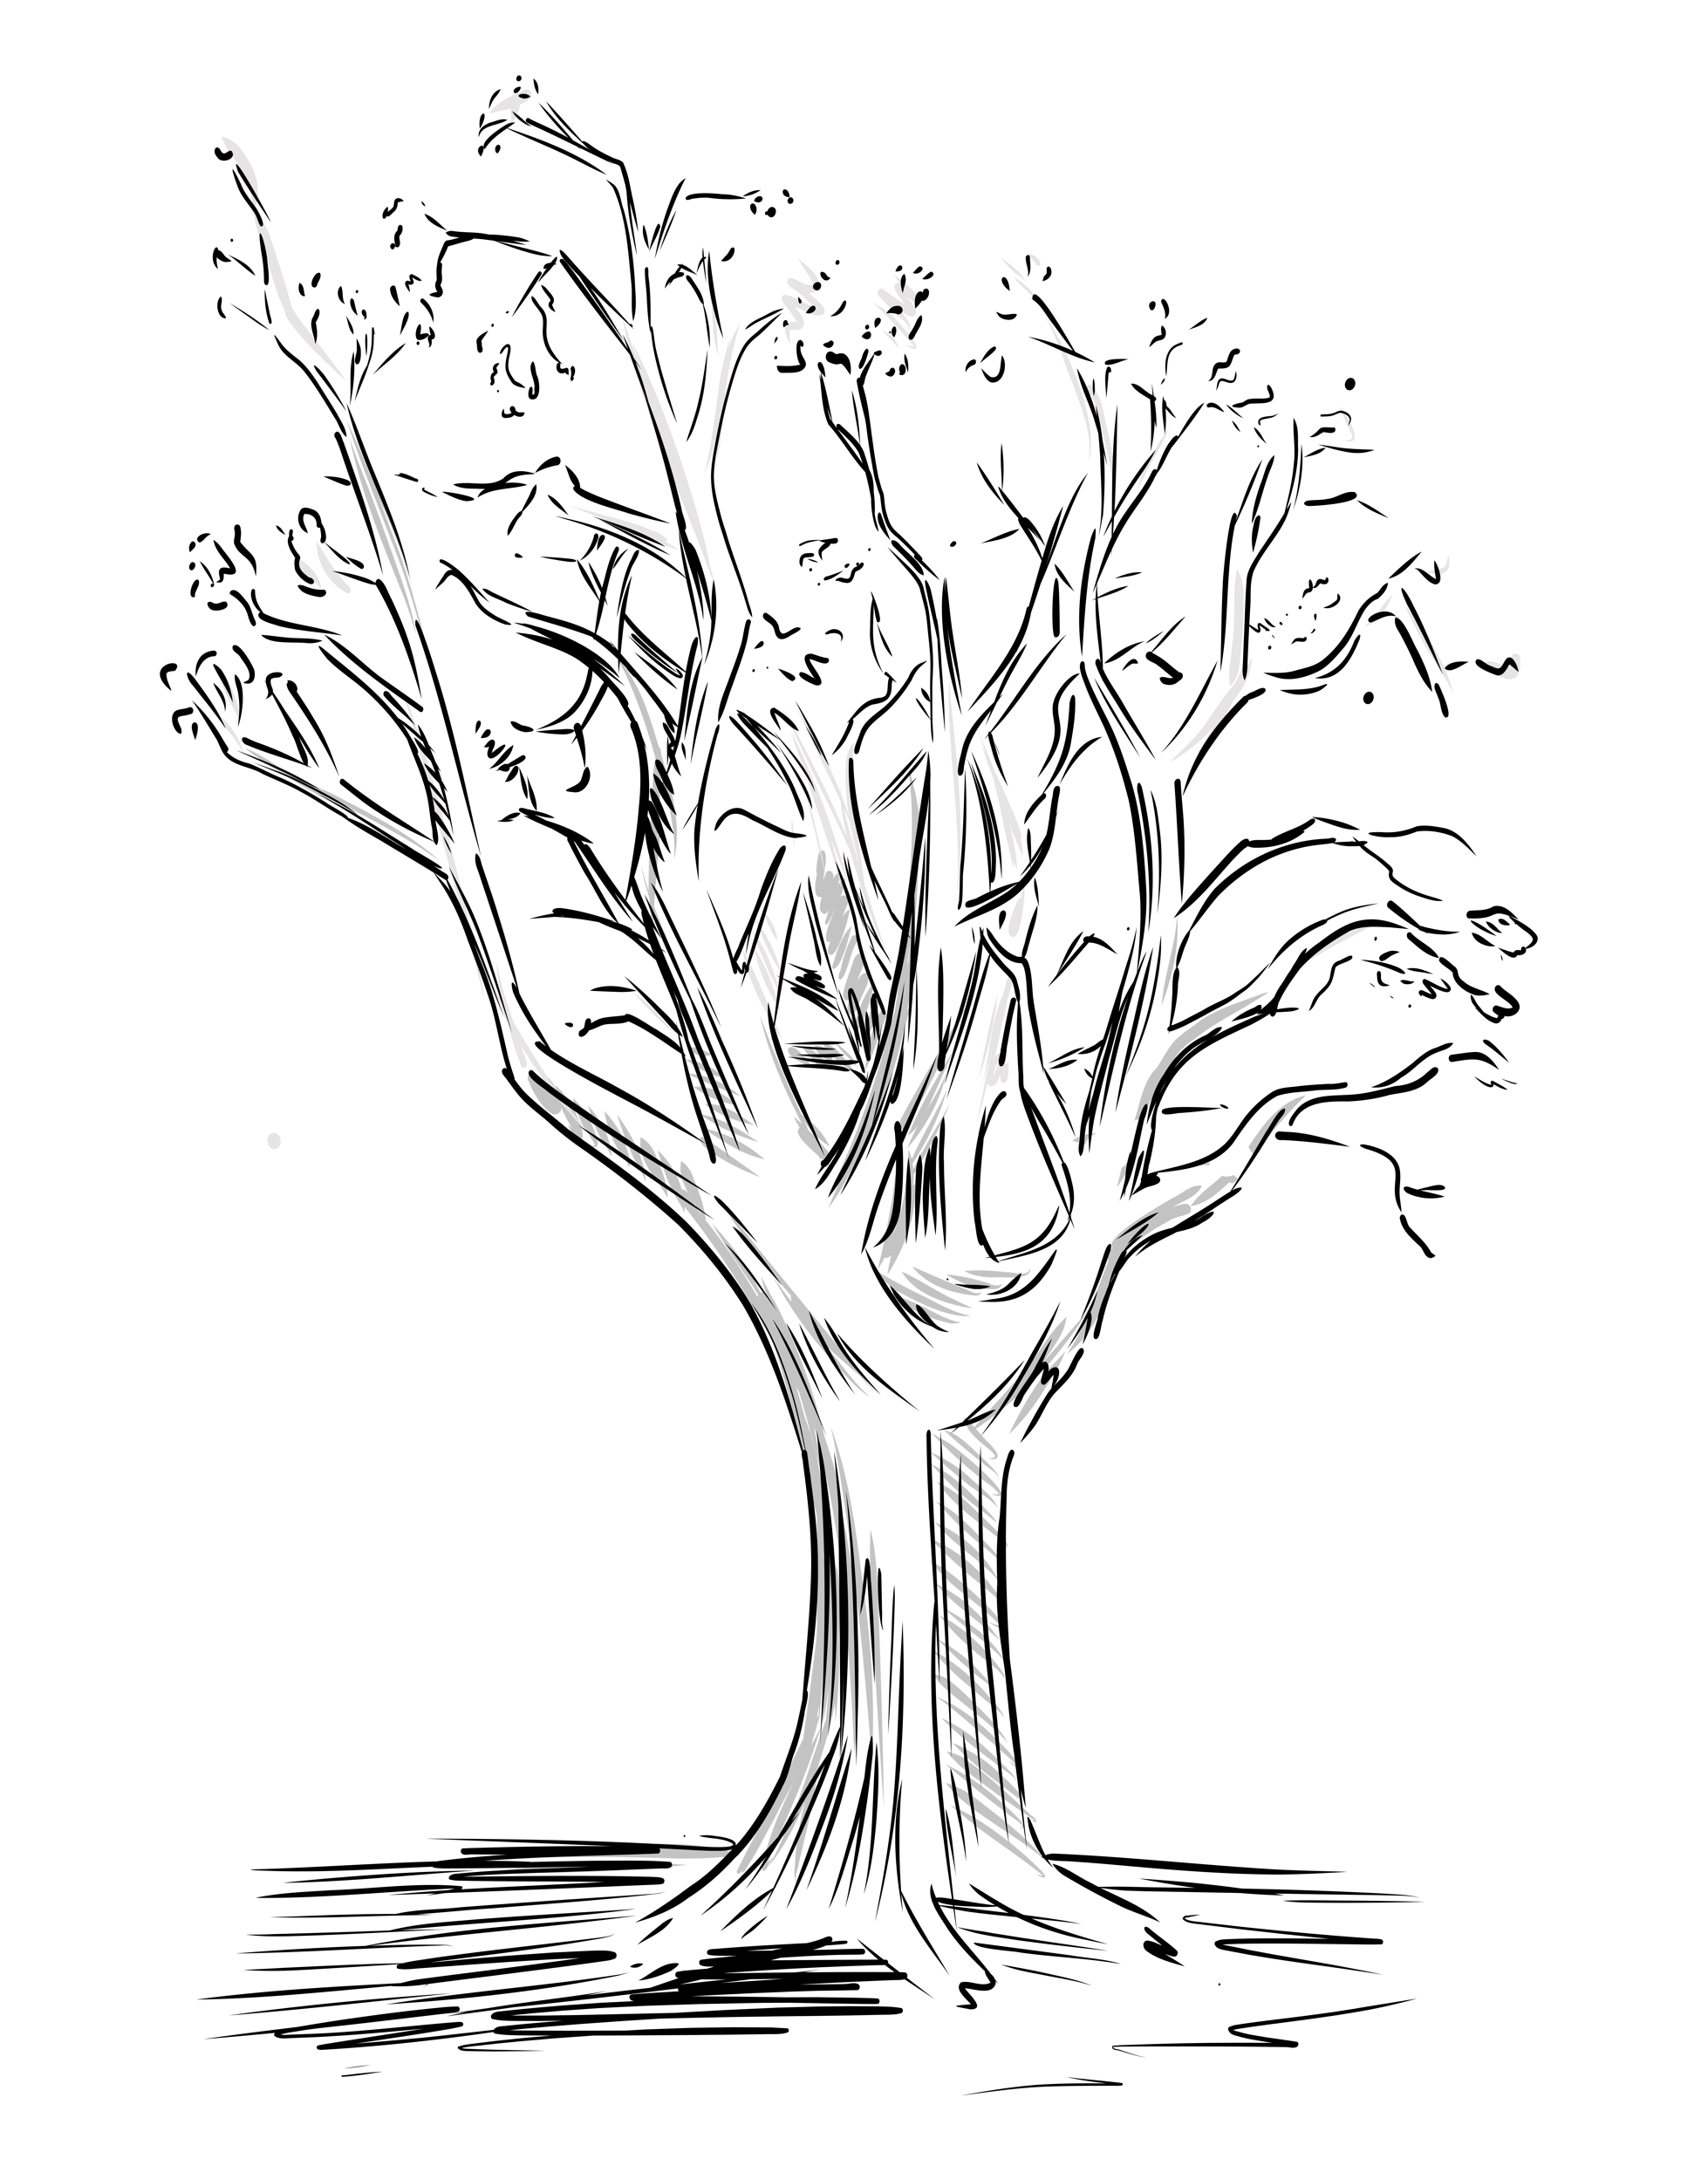

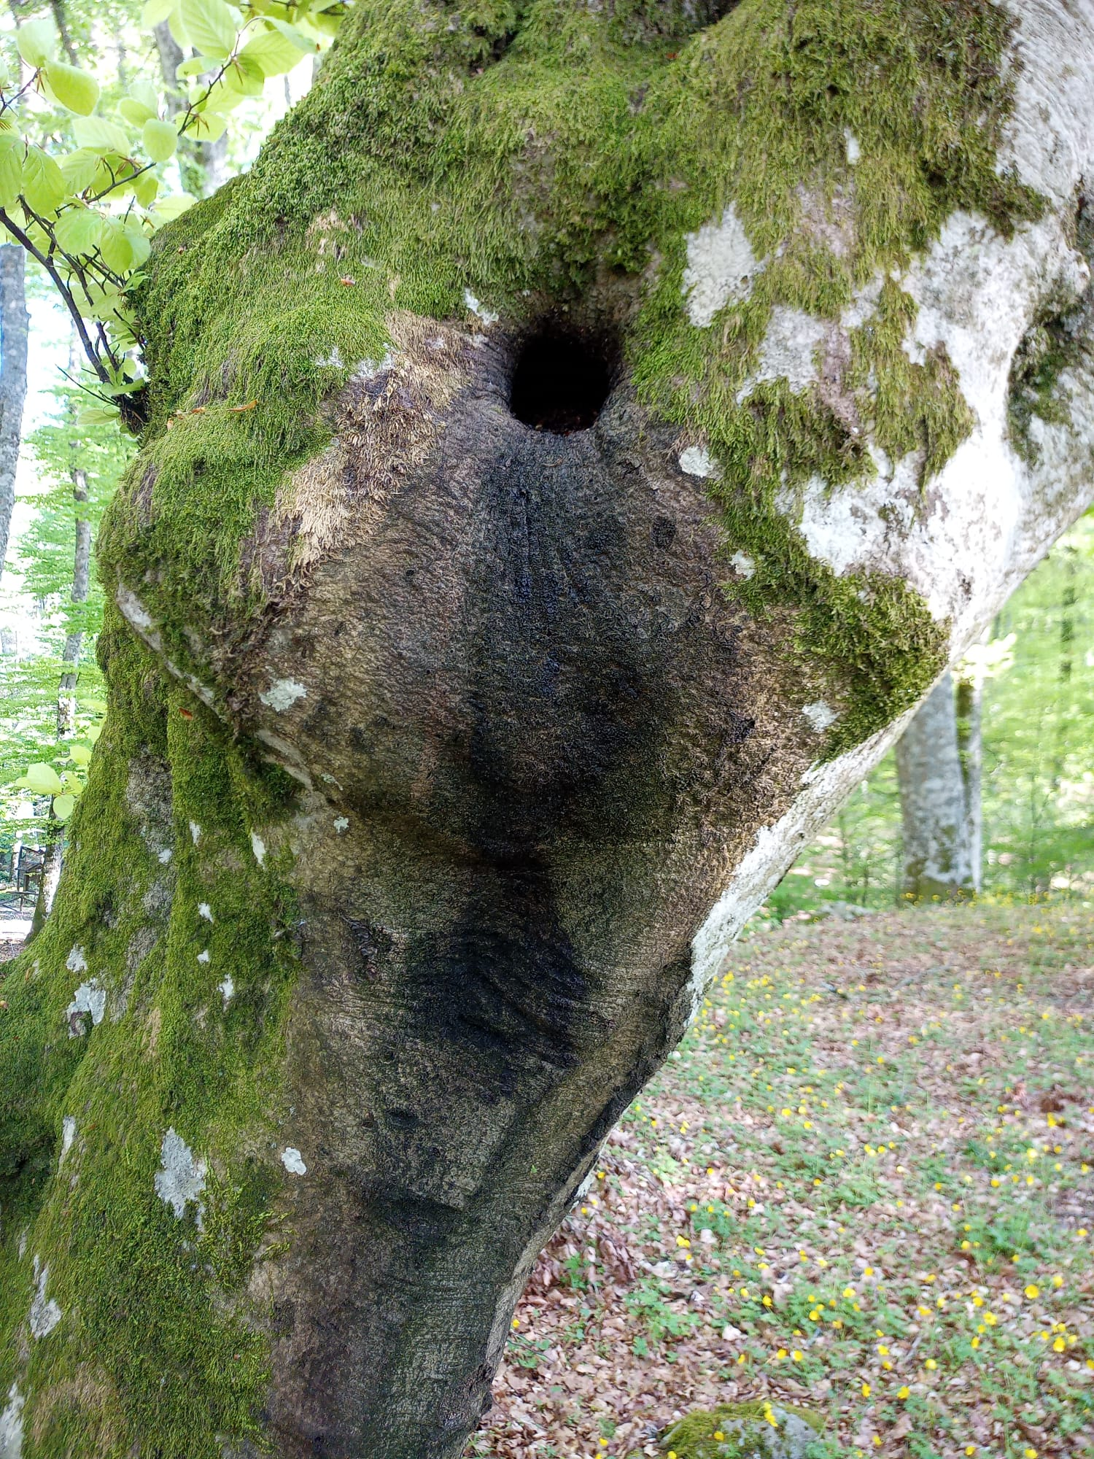
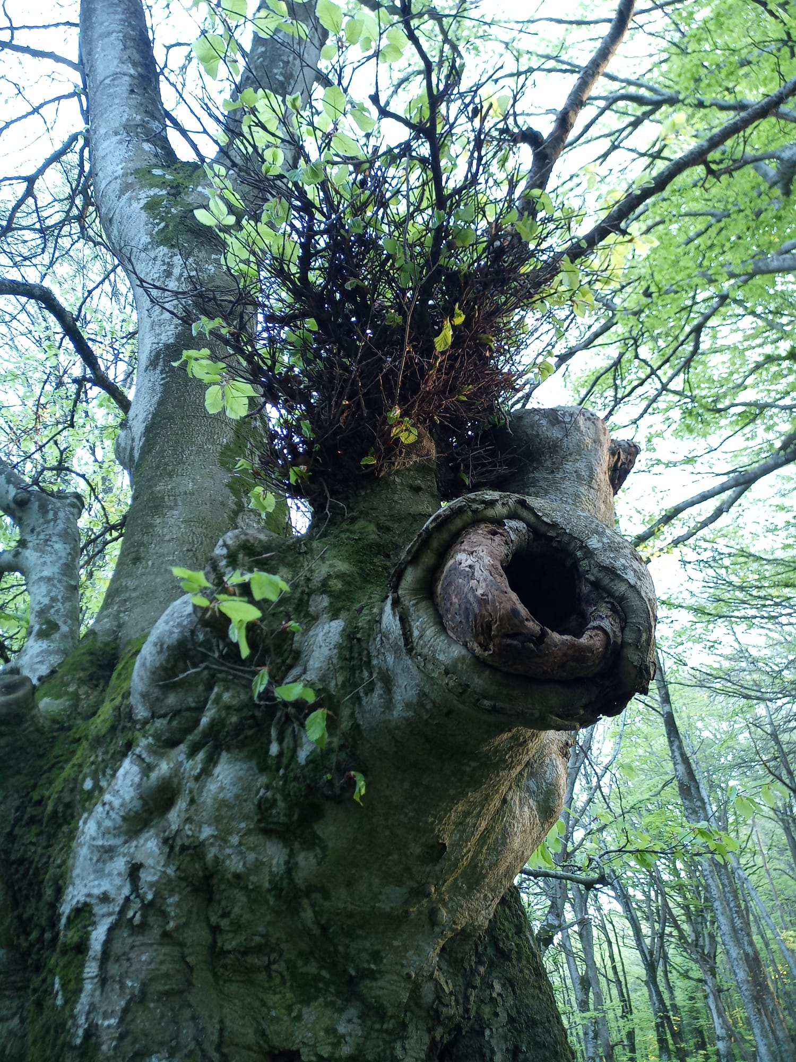
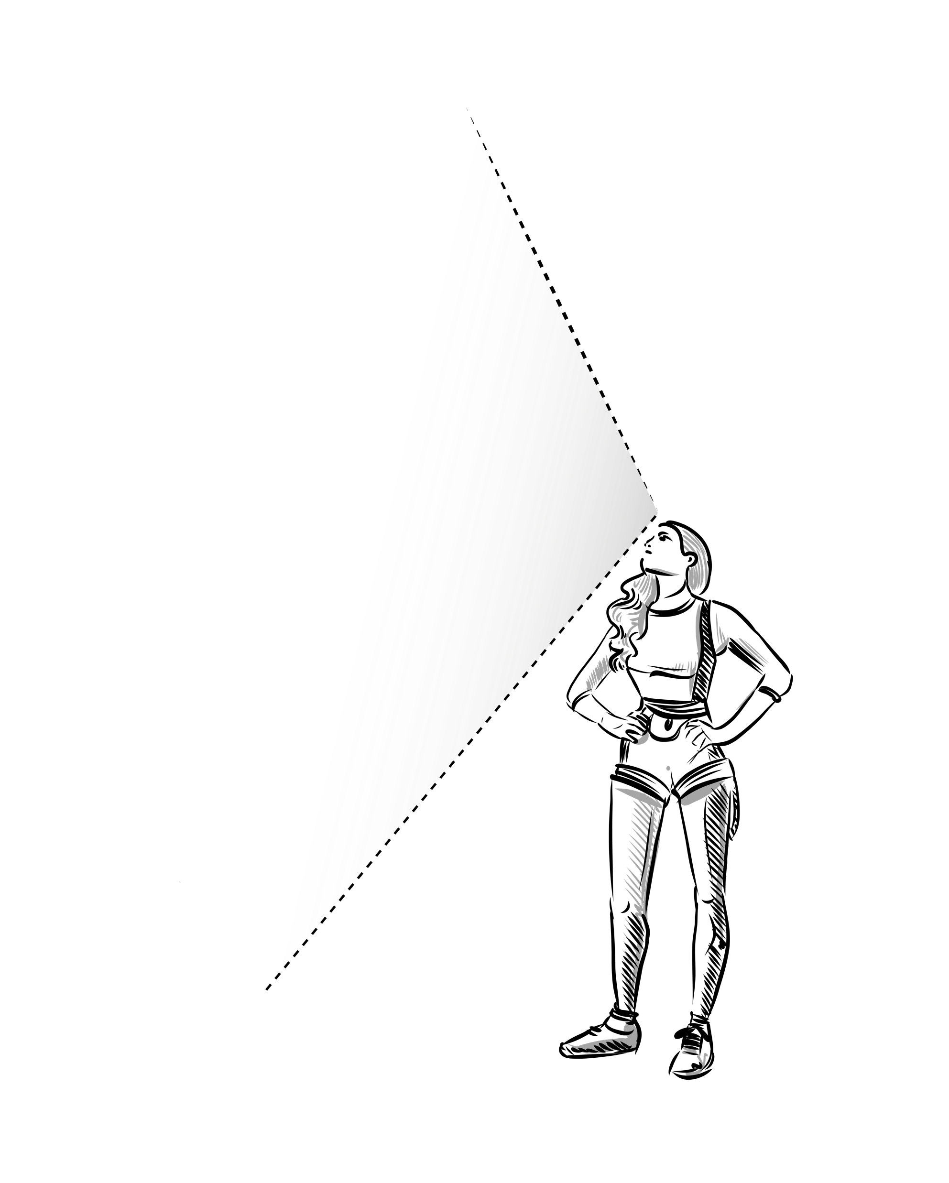
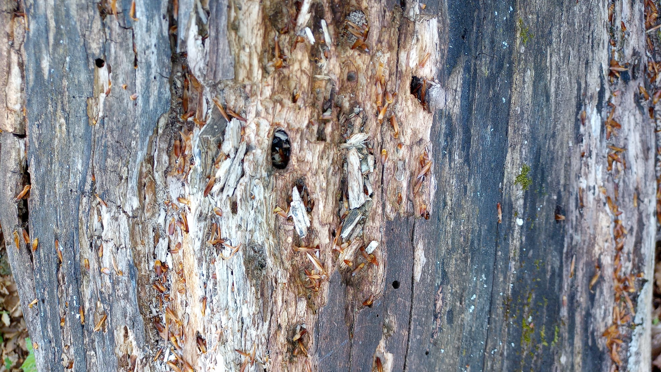
CNR IRET Conference
Rome, February 18th-19th 2025
Vertical biodiversity: a study of tree crown microhabitats through tree climbing and drones
L. Latilla, P. Bertolotto, S. Carloni, F. Sicuriello, B. De Cinti
IRET-CNR, Montelibretti
Examples of vertical biodiversity: microhabitats
Introduction
Tall trees host numerous microhabitats essential for forest biodiversity. However, ground-based observations provide a limited view of vertical biodiversity.
Objectives and Methodology
This study examines the relationship between vertical biodiversity observed from the ground and that detected through direct canopy access via tree climbing techniques, aiming to develop predictive models.
Results
Preliminary data obtained in Cansiglio forest reveal a high concentration of cavities, deadwood, and bird nests in the upper canopy. Tree climbing provides detailed observations but is limited to a small sample of trees. To overcome this limitation, the study will test the use of drones.
Conclusions
Integrating ground observations and drone technology will enable a more comprehensive analysis of vertical biodiversity, supporting forest conservation and management.
Leonardo Latilla

