Slide 1


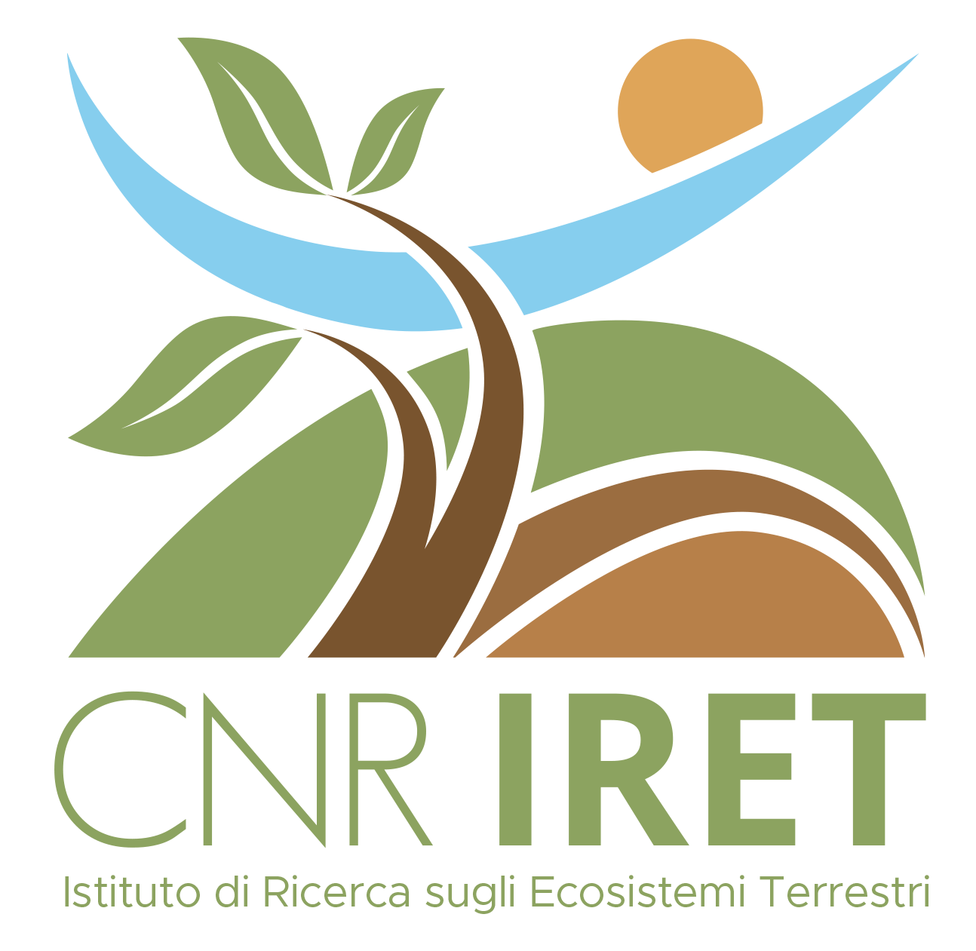
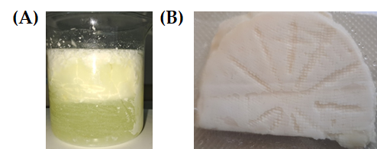
CNR IRET Conference
Rome, February 18th-19th 2025
New vegetables rennet development for vegetarian cheeses production
Emilia Caputo¹, Luigi Mandrich²
¹Institute of Genetics and Biophysics, (IGB)-CNR, Via Pietro Castellino 111, 80131 Naples, Italy; ²IRET-CNR, Via Pietro Castellino 111, 80131 Naples, Italy;
Cheese making is an ancient practice to preserve perishable food such as milk for a long time. The first phase of cheese making involves the addition of animal-derived rennet, containing the enzymes necessary for the hydrolysis and coagulation of milk caseins, and for cheese ripening (mainly lipase/esterase).
The proposed technology concerns the production of cheeses, by using rennet from vegetables sources, i.e. replacing the enzymes involved in milk caseins coagulation and cheeses ripening, with enzymes of vegetable origin. In this way, vegetarian cheeses are obtained. Various vegetables have been selected and tested for this purpose, in particular: cardoon (Cynara cardunculus), artichoke (Cynara cardunculus var. scolymus), papaya (Carica papaya L.), pineapple (Ananas comosus (L.) Merr.), mushrooms (Pleurotus ostreatus (Jacq. ex Fr.) P. Kumm.) and fig milky sap (Ficus carica L.).
Mini-curd making. A) Milk clotting; B) Final product. Mini-curd analysis. Main characteristics of the vegetable and fruit rennet.
MCA=Milk Clotting Activity; *c.p.= cheese curd; § the incubation time was 10 min; ◊SU=Standard Unit
In all cases, cheeses were obtained, and as observed by the analysis of some profiles of volatile substances released, they exhibited interesting features. The artichoke, cardoon, and thistle mushroom extracts showed high proteolytic activity compared to calf rennet, while the level of esterase activity appeared to be similar for all the extracts. The papaya extract showed the lowest proteolytic and esterase activity. Although the pH, moisture, fat, and protein contents were very similar to those of cheese made with calf rennet, the medium- and long-chain FFAs broadly differed among produced cheeses, with variations in the lipid quality indices.
This technology has been selected for future promotions by the CNR PROMO-TT Instrument Office, Record Card:294 (https://promott.cnr.it/en/technology/294/new-vegetables-rennet-development-for-vegetarian-and-vegan-cheeses-production).
 | calf rennet | internal bracts artichoke | cardoon | pineapple | papaya | fig milky sap | oyster mushroom
pH | 5.5 | 5.8 | 5.5 | 6.2 | 5.3 | 5.0 | 5.5
esterase activity (U/mL) | 0.017±0.001 | 0.010±0.001 | 0.008±0.001 | 0.013±0.002 | 0.004±0.001 | 0.012±0.001 | 0.016±0.002
protease activity§ (% BSA digested) | 46±4 | >99 | >99 | 28±5 | 18±4 | 51±4 | 98±2
MCA (SU◊) | 8000 | 800 | 667 | 1067 | 593 | 8000 | 640
c.p.* yield from 500 mL milk (g) | 72±5 | 68±3 | 70±4 | 57±3 | 67±4 | 69±3 | 51±4
Poster Presenter Luigi Mandrich

