Slide 1


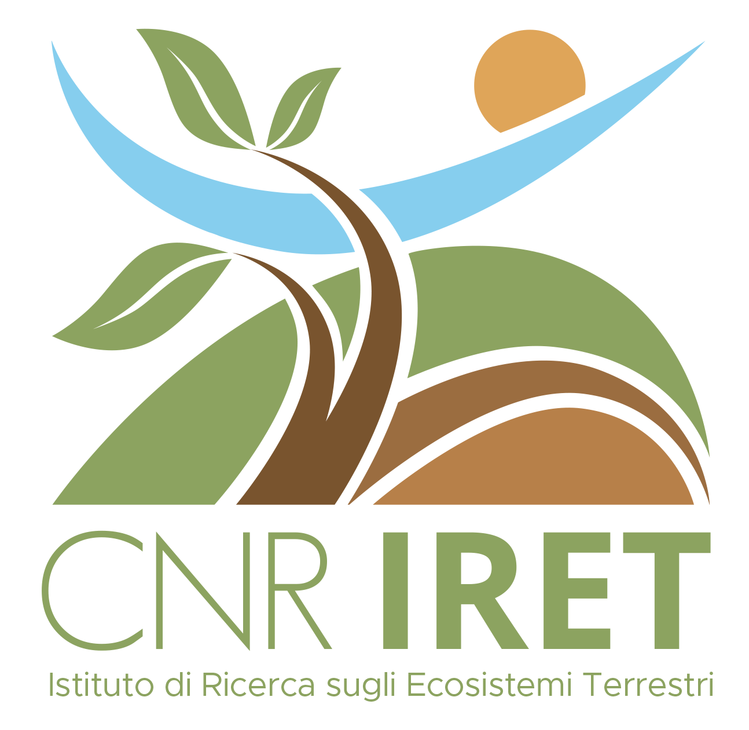
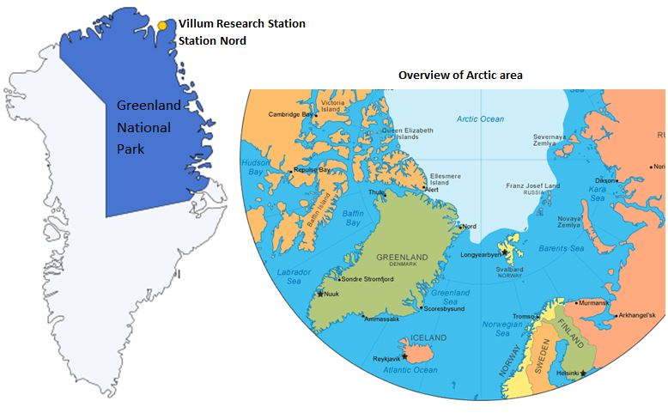
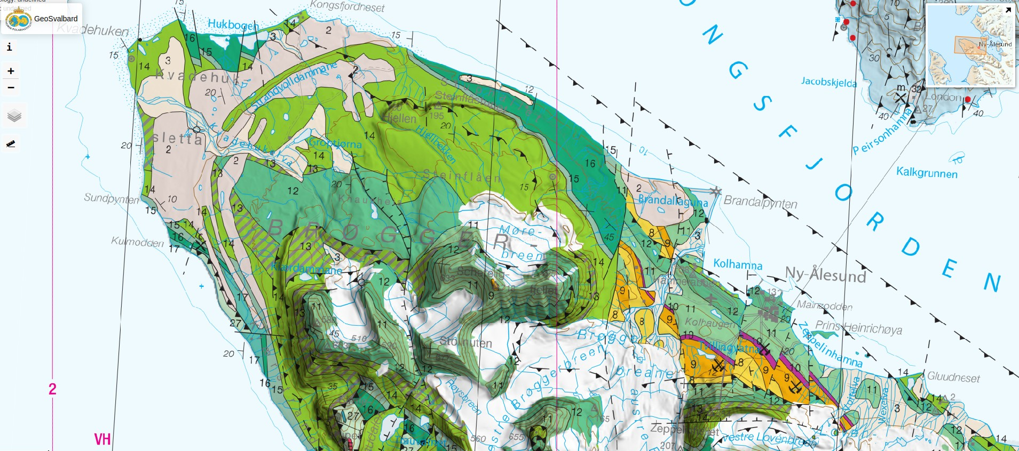
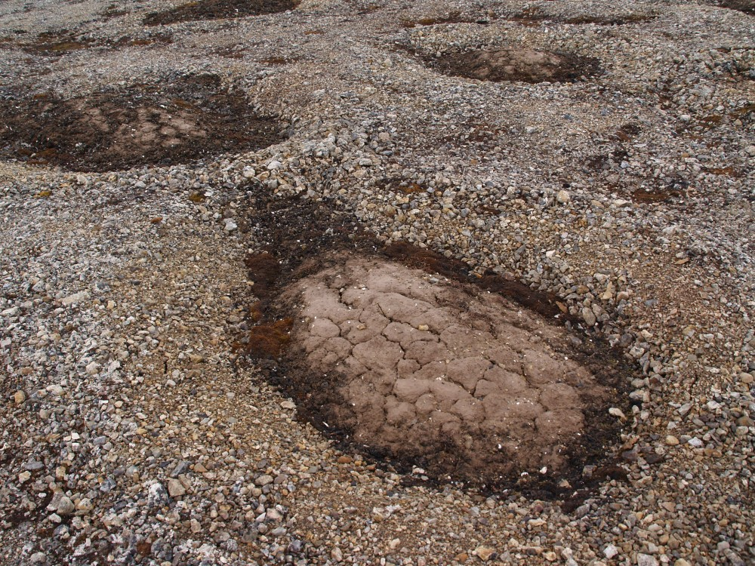
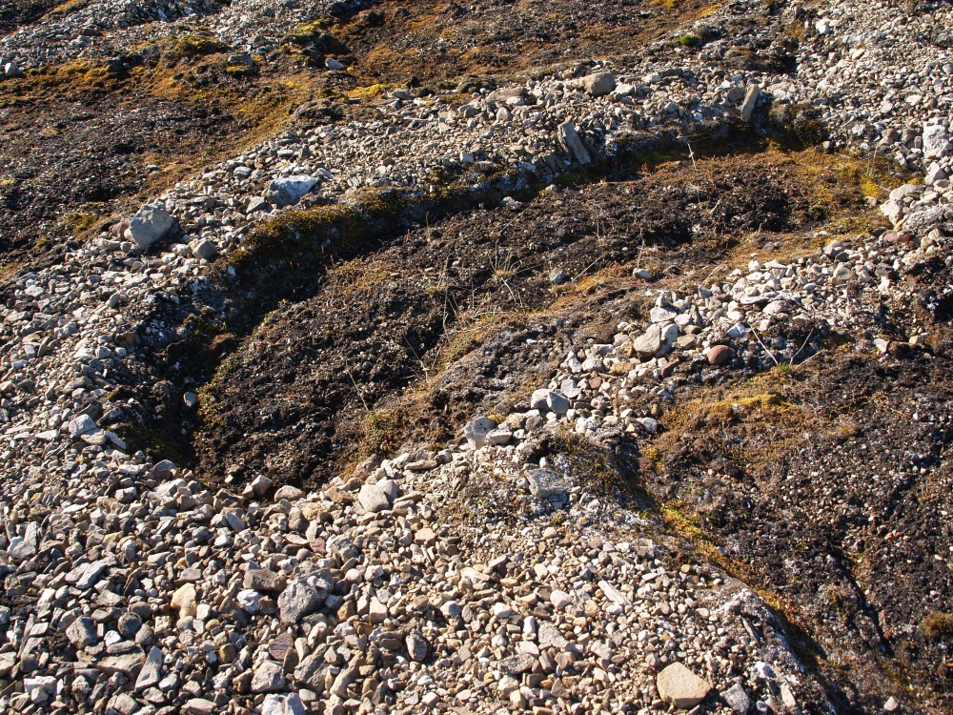
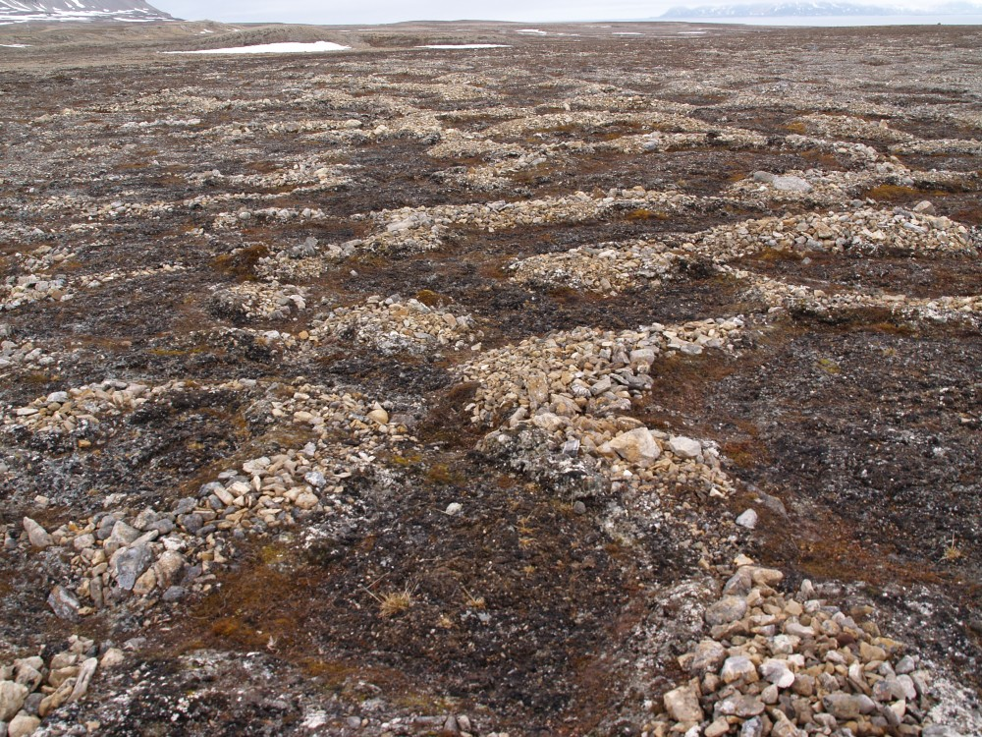
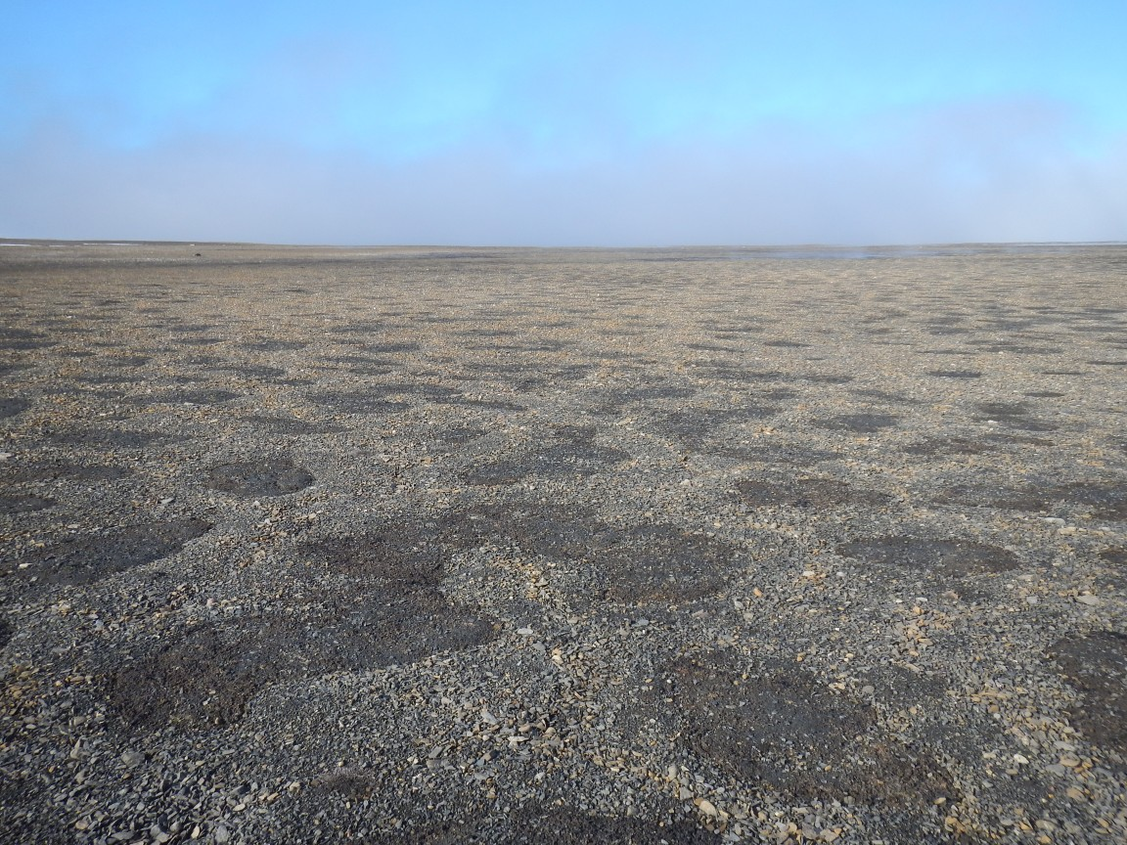
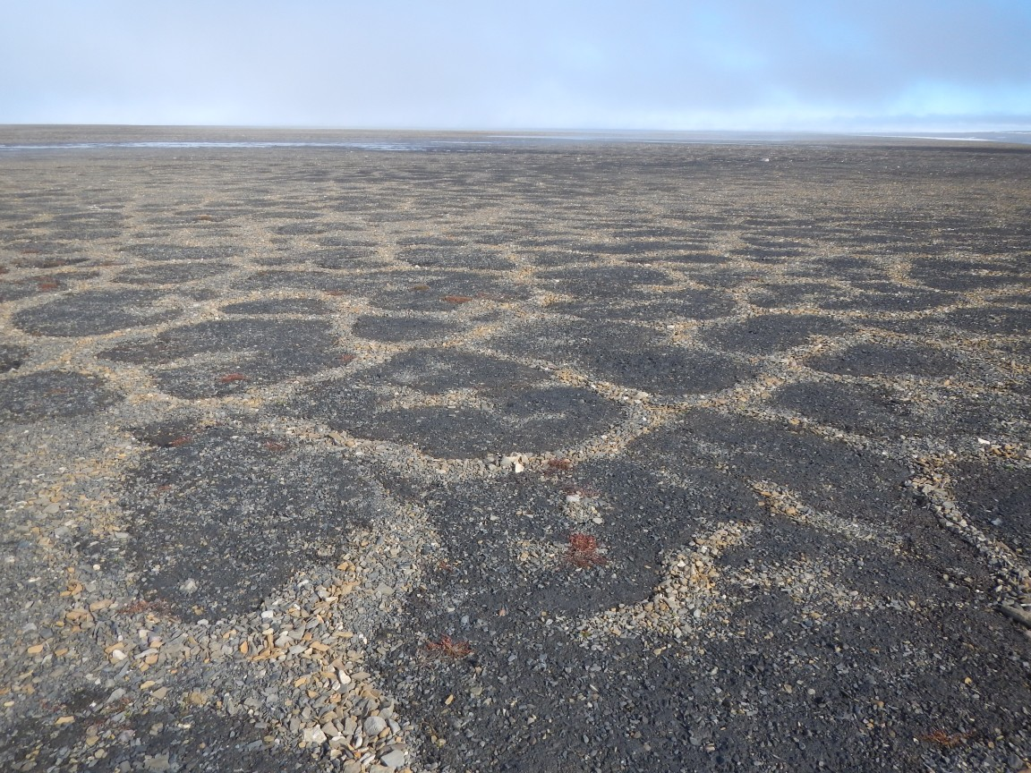

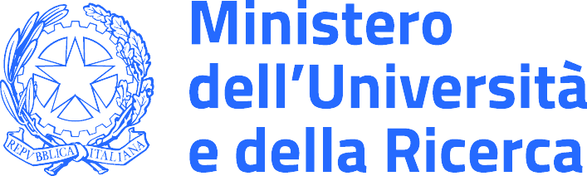
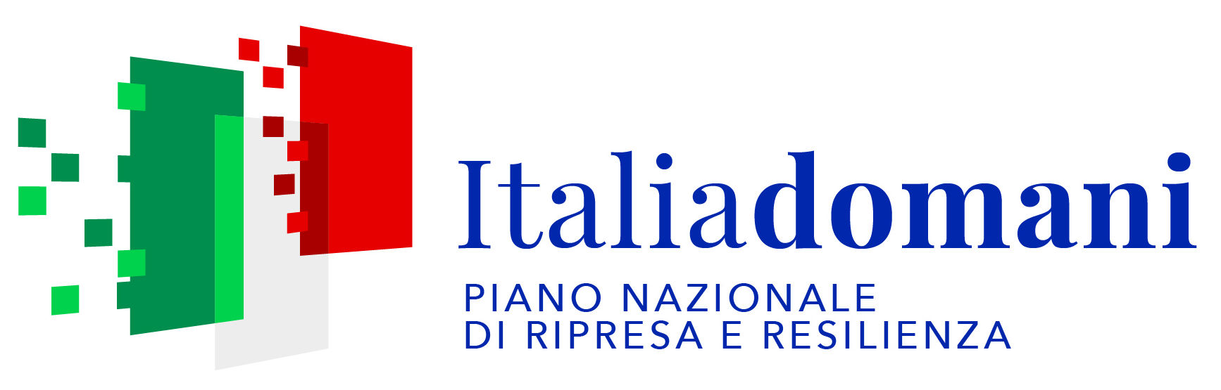

CNR IRET Conference
Rome, February 18th-19th 2025
The BRISMIC project: Interactions among landform, soil, vegetation, and microbiome during initial colonization stages in High Arctic patterned grounds
S. Ventura^{1,2}, L.P. D’Acqui^{1,2}, S. Di Lonardo¹
¹IRET-CNR, Research Institute on Terrestrial Ecosystems, National Research Council, via Madonna del Piano 10, 50019 Sesto Fiorentino, ²NBFC, National Biodiversity Future Center, Palermo
Brøggerhalvøya
Patterned grounds like sorted circles, frost boils and polygons are widely diffused in the High Arctic, where they are connected to the presence of permafrost. Their structure, development, and pedology have been thoroughly studied, while associated colonizing plants and microbiota are far less characterized, and their distribution in relationship to the developmental stages of the landforms not well known.
The BRISMIC project addresses these research needs by evaluating how plants and soil microbiota affect the properties of patterned ground soil and the development of permafrost-driven morphologies in two High Arctic ecosystems along a N-S gradient using latitude and exposure to the North-Atlantic Current as a proxy for climate/temperature change.
To reach this goal, the sites at Brøggerhalvøya in Svalbard (78° 58’ N, 11° 30’ E) and Villum in Greenland (81º 36’ N, 16º 39’ W), have been selected.
Villum
We will replicate the study at Villum, where the patterned system is less diverse. Then, we will complete the large surveying and sampling at Brøggerhalvøya.
At Brøggerhalvøya, on the southern coast of Kongsfjorden, we characterized patterned ground systems with different degrees of plant and biocrust colonization: slightly, moderately and highly colonized. We went along the coastal plan of the Brøggerhalvøya and up to the Kongsfjordneset and to the westernmost point of the peninsula, the Kvadehuken to target 1) plant species; 2) soil morphology; 3) soil physical properties (bulk density and structure); 4) soil organic matter content and its pools; 5) microbial community structure and activity in bulk and rhizosphere soil.
After completing field activities, linking soil physical, chemical and biochemical properties and functioning to the presence and activities of microbiota and plants in the two targeted sites will allow to identify the potential drivers of the early stages of colonization and soil development of patterned grounds in the High Arctic, where cyclic burial and exhumation of material is believed to play an important role in the soil carbon cycle.
Stefano Ventura

