Slide 1


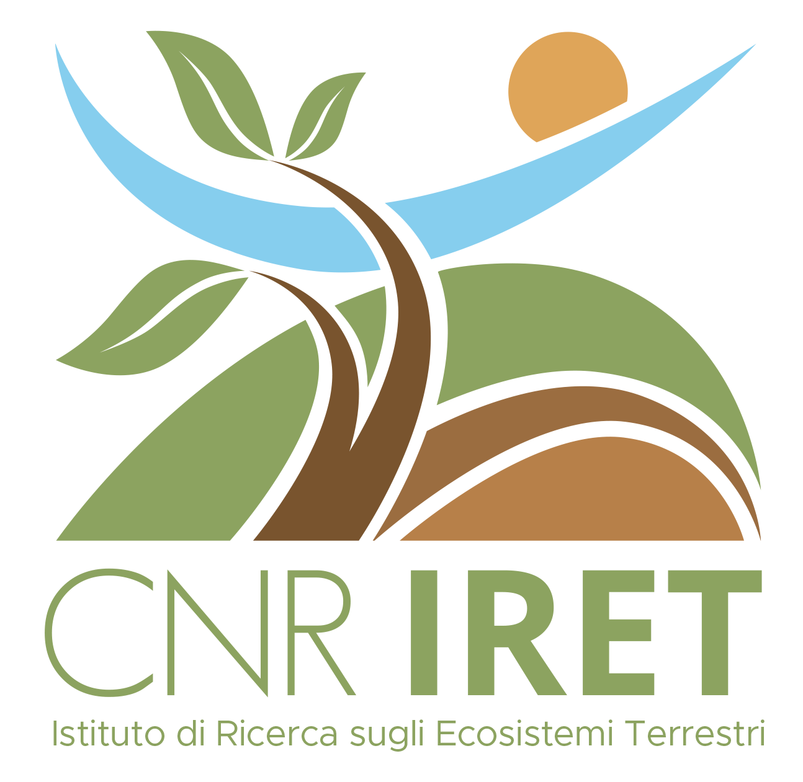
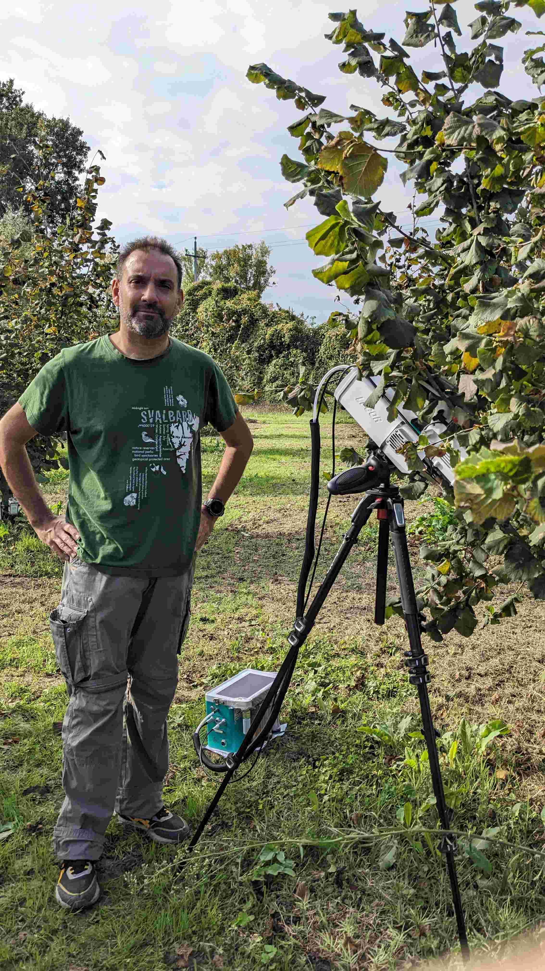
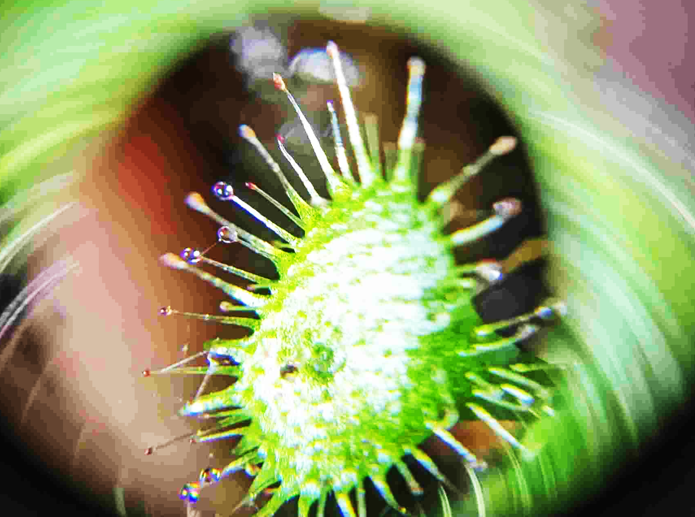
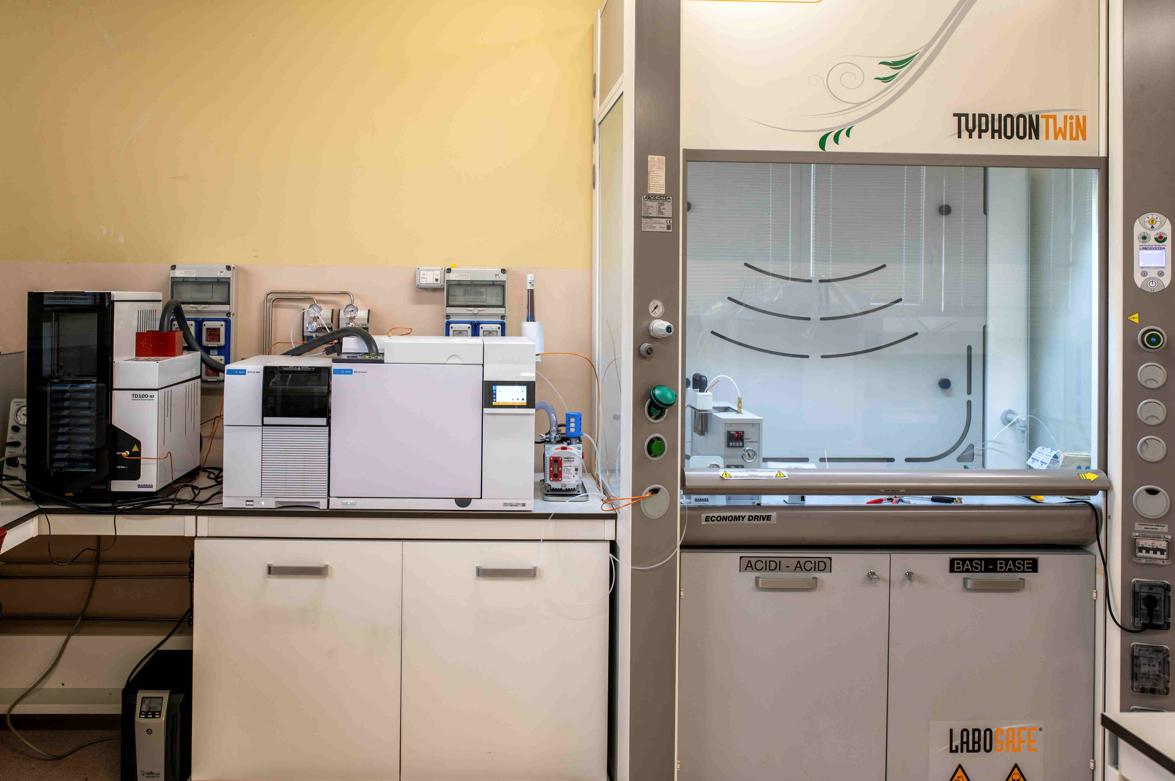
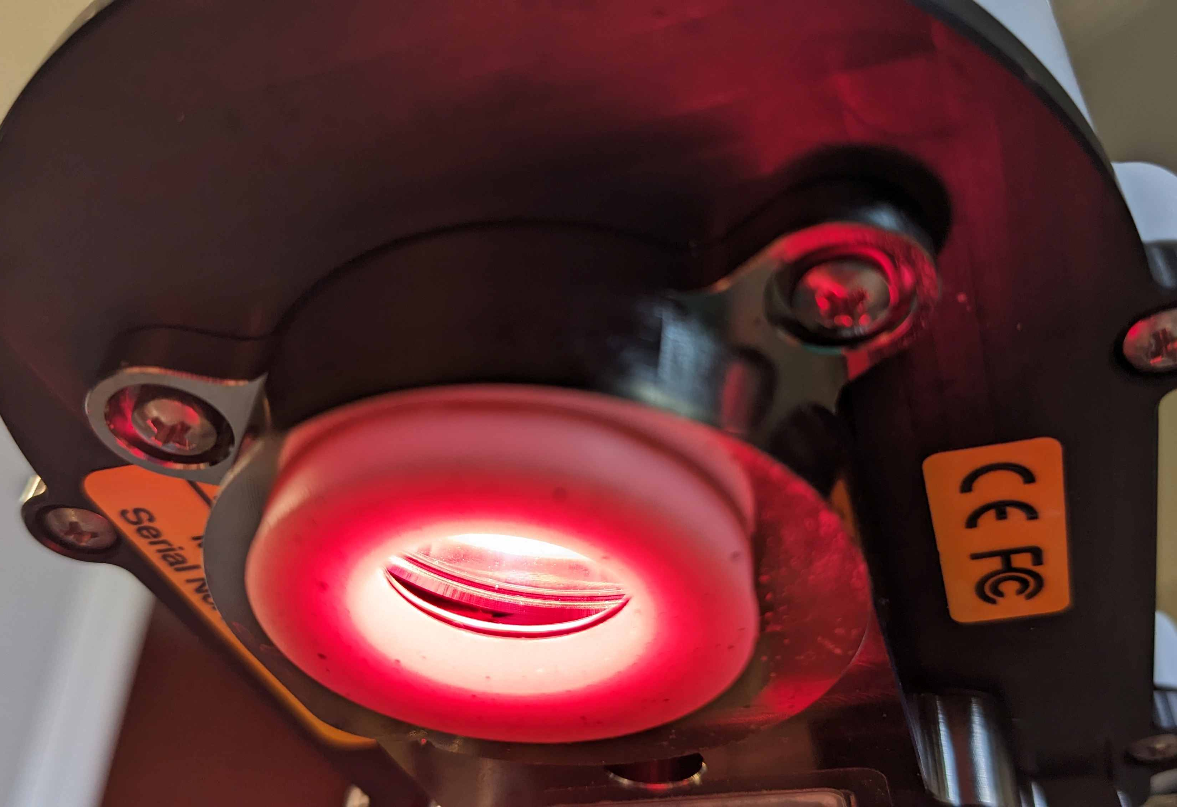
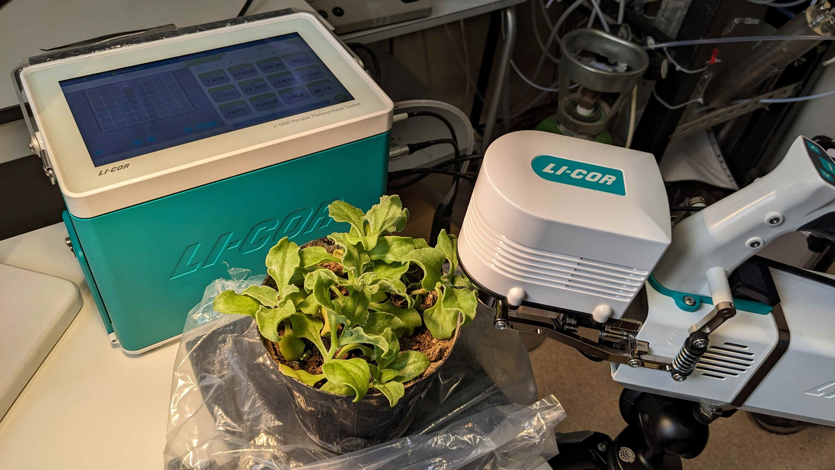
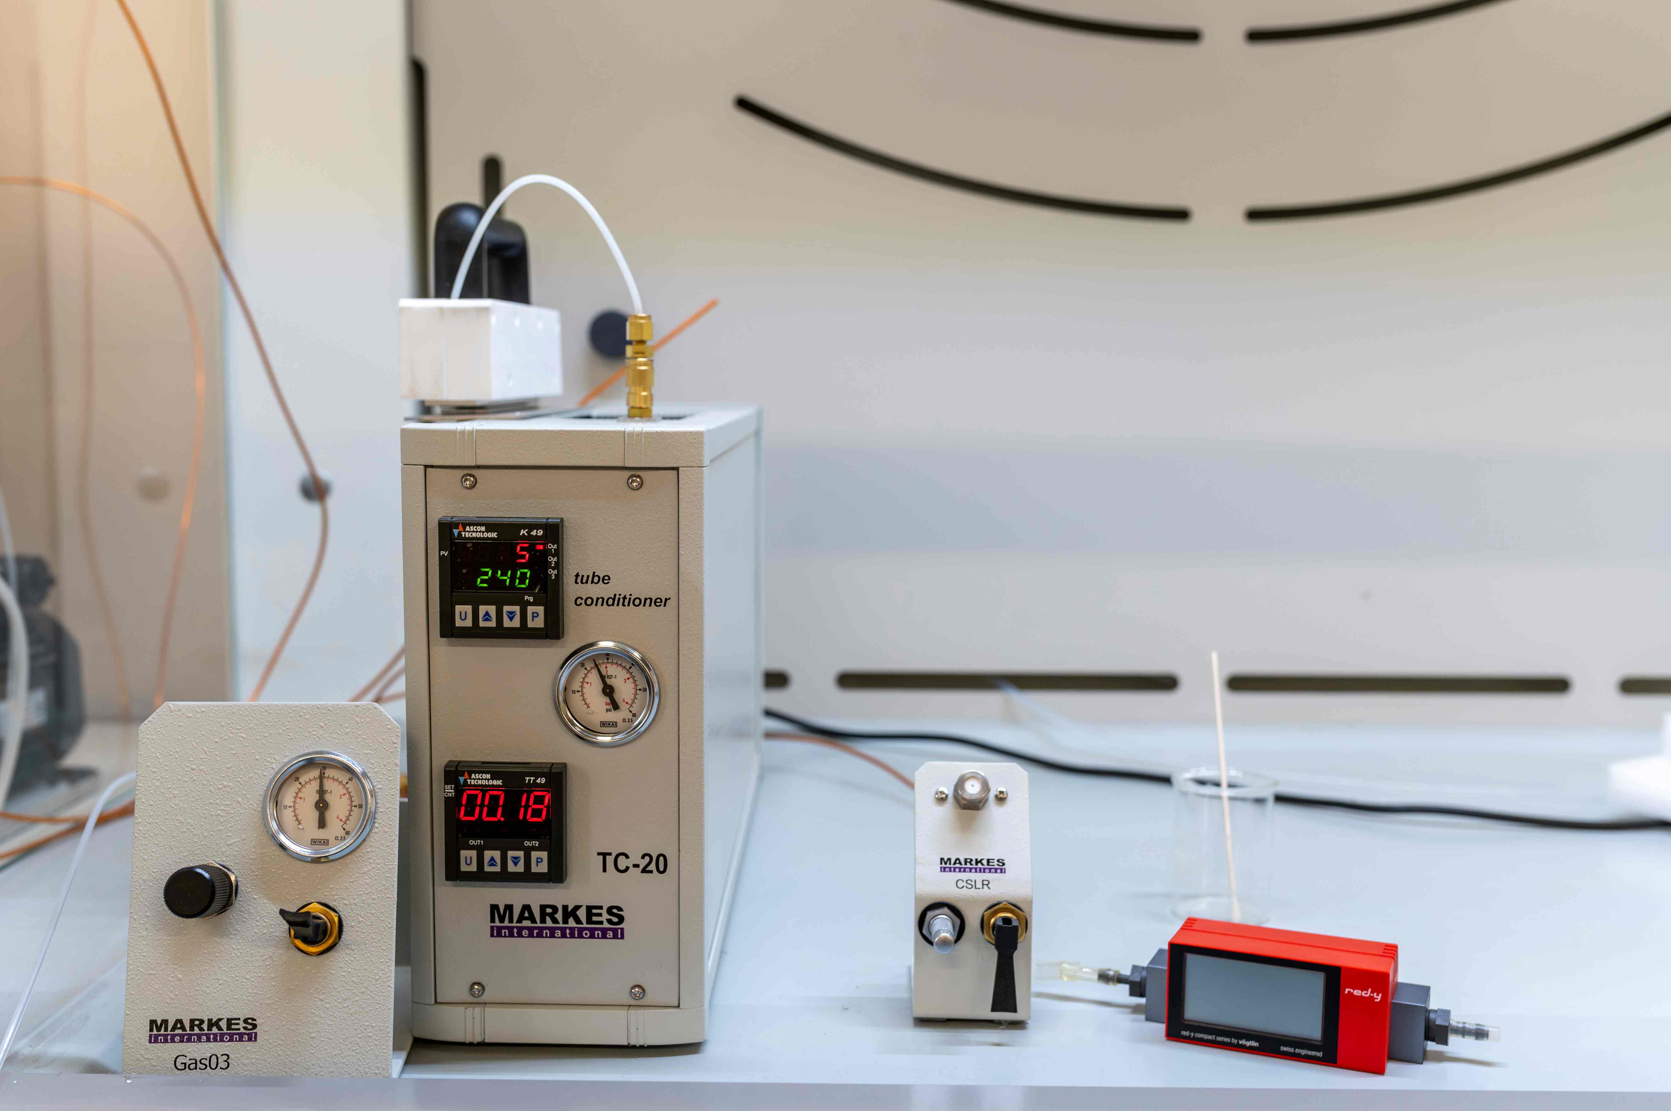
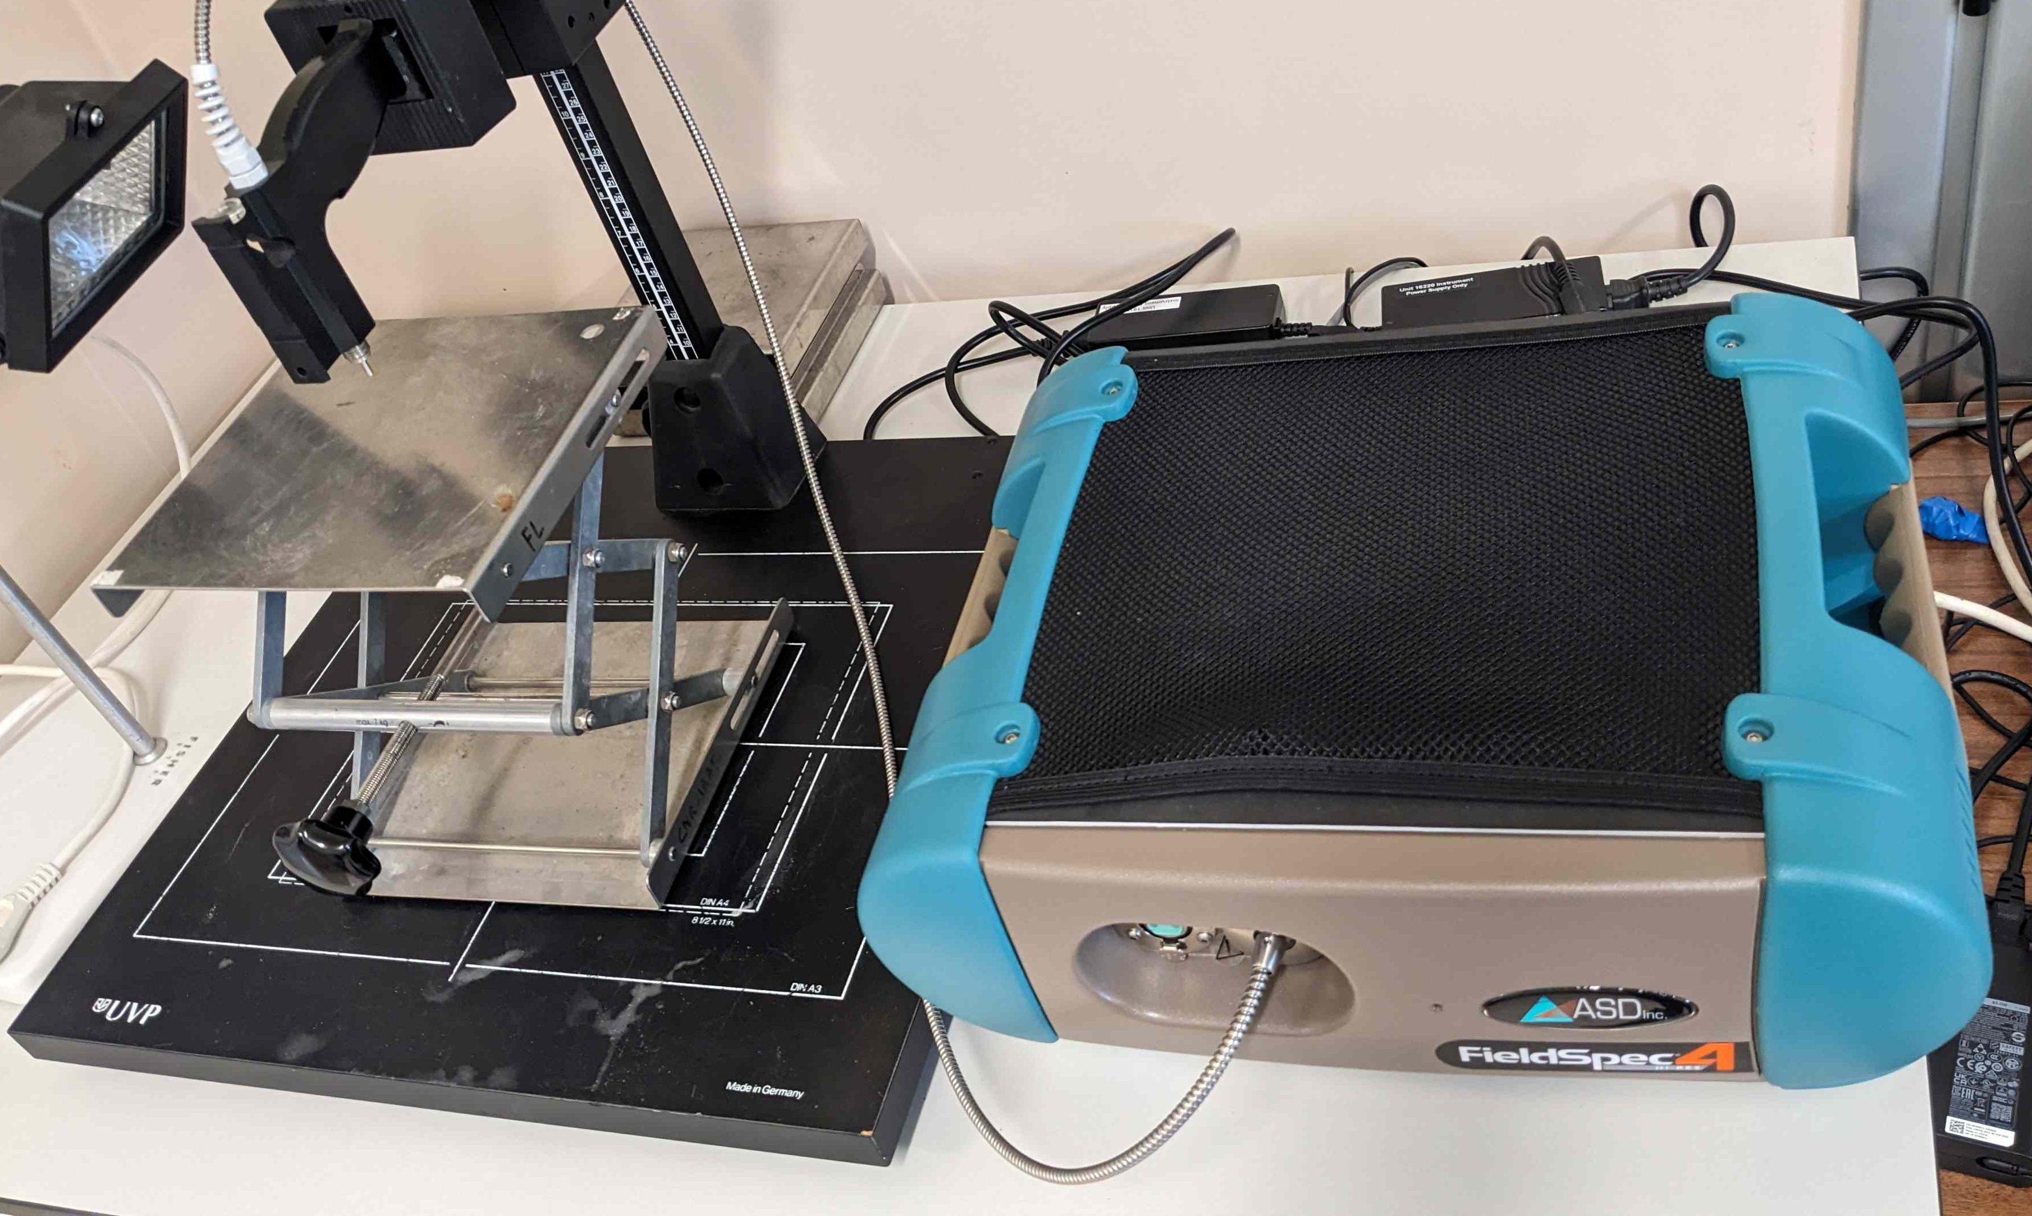
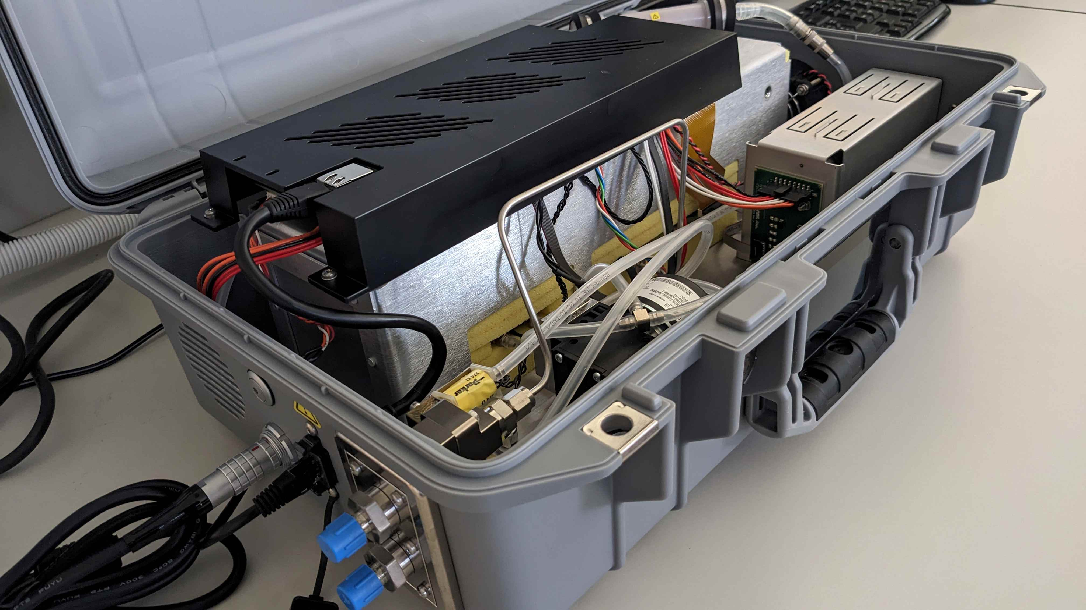
CNR IRET Conference
Rome, February 18th-19th 2025
Infrastructure improvement at CNR-IRET Institute of Montelibretti financed by ITINERIS project
W. Stefanoni, E. Pallozzi, C. Calfapietra
The PNRR funding opportunities have enabled IRET to make significant investments in local infrastructure, enhancing both the quality and impact of ongoing scientific research. The acquisition of state-of-the-art instruments will facilitate deeper investigations into plant responses to biogenic and anthropogenic disturbances, critical factors in our current era of climate change.
The LiCOR LI-6800 replaces the older LI-6400XT model, offering faster data acquisition, improved portability, and extended configuration options. Its accessories enable monitoring of soil respiration, respiration rates of small organisms (e.g., insects), and photosynthetic rates of both evergreen and broadleaf species, as well as algae and mosses in aqueous solutions.
Agilent Gas Chromatography/Mass Spectrometry (GC/MS) system equipped with a H₂ gas generator for in-situ carrier gas production to analyze Volatile Organic Compounds (VOCs) emissions. The instrument features a Markes autosampler that handles up to 100 tubes for continuous analysis. This setup enables the analysis of numerous samples within hours, with overnight programming capability, significantly accelerating the process. Unlike the previous GC/MS system, it eliminates the need for helium, offering both cost and environmental benefits. The system also supports liquid-phase injections for analyzing laboratory-derived extracts.
High-Res Spectroradiometer
ASD FieldSpec 4
covers the full solar irradiance spectrum (350–2500 nm), enabling the measurement of vegetation indices including NDVI, PRI, WI, NDWI, ARI, and CRI. These indices provide insights into plant functional traits related to photosynthetic pigments (chlorophyll, carotenoids, and anthocyanins), leaf structure, and water content.
The LI-7810 (CO₂, CH₄, and H₂O analyzer) enables high-precision, long-term monitoring of greenhouse gas emissions and can be mounted on a backpack for real-time field data acquisition in both static and dynamic configurations. The instrument supports soil experiment measurements, and up to 16 units can be interconnected to continuously monitor CO₂, CH₄, and H₂O emission rates across larger areas.
Projects in which the instruments have worked in the last year:
M.i.T.e.: P. Brunetti, D. Marzi, M.L. Antenozio, C. Caisutti
PRIN 2022 – Assisted Phytoremediation: P. Brunetti, D. Marzi, M.L. Antenozio, C. Caisutti
MCIN_Spanish Ministry of Universities: NEOCOMP - M. I. Nogues Gonzalez, C.A. Alonso
STUDY VISIT ABROAD of Polish Academy of Sciences: M. I. Nogues Gonzalez, Z. Miszalski, M. Gieniec
MiPAAF - Sviluppo del vivaismo e della piattaforma varietale corilicola: VI.VA.CO“ S. Portarena e Prof.ssa D. Fanelli (UniPG)
NBFC –Spoke4.5.2-Monitoring functional characterization and traceability of resilient basic propagation material for ecosystem restoration and nature-based solutions, E D’Andrea, N. Rezaei Sangsaraki, P. De Angelis, D. Liberati, G. D’Onofrio, S. Pagliarani
ARSIAL - identificazione di specie arboree idonee agli attuali scenari di cambiamenti climatici nella Regione Lazio: L. Fusaro (CNR_IBE), L. Passatore, G. Giorgetti
Dr. Walter Stefanoni

