Slide 1


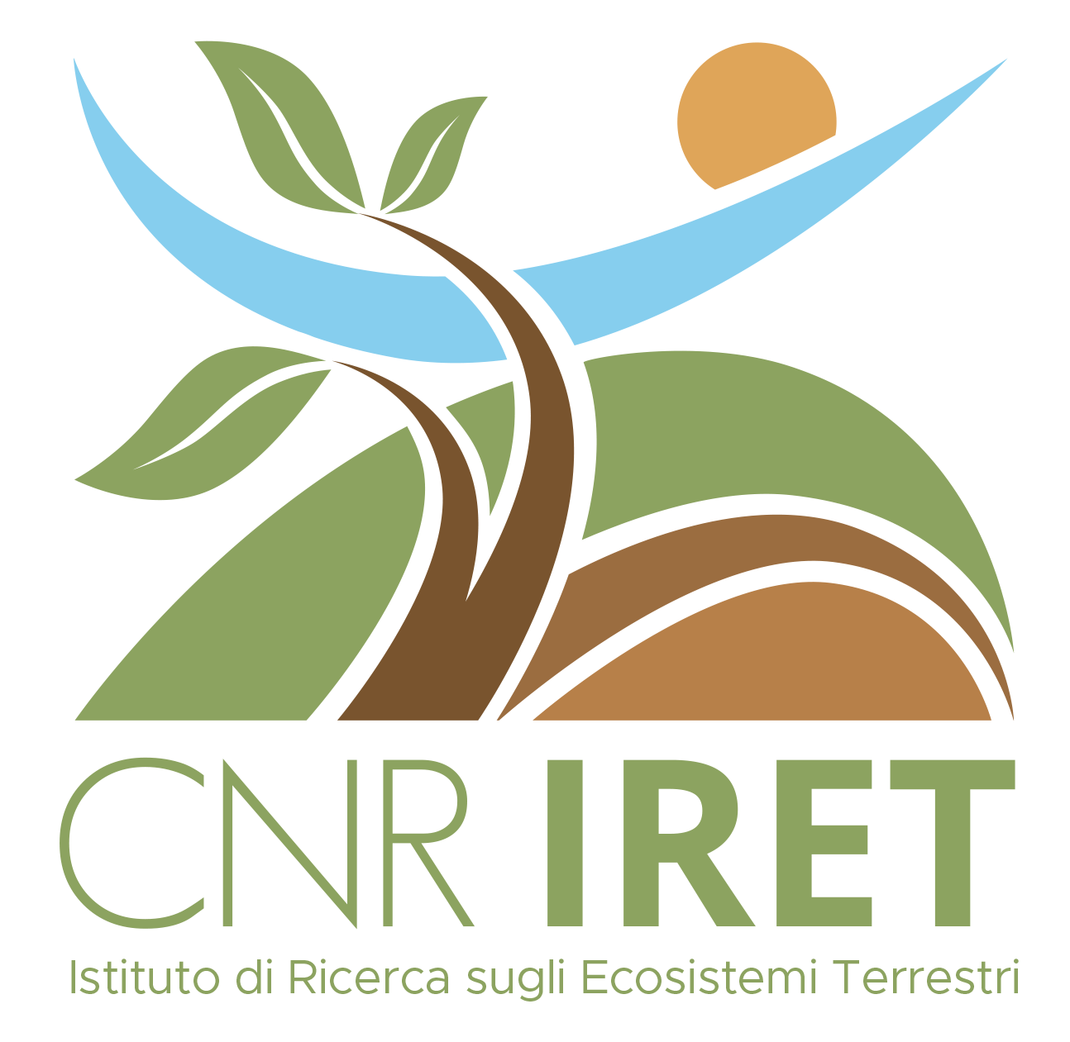
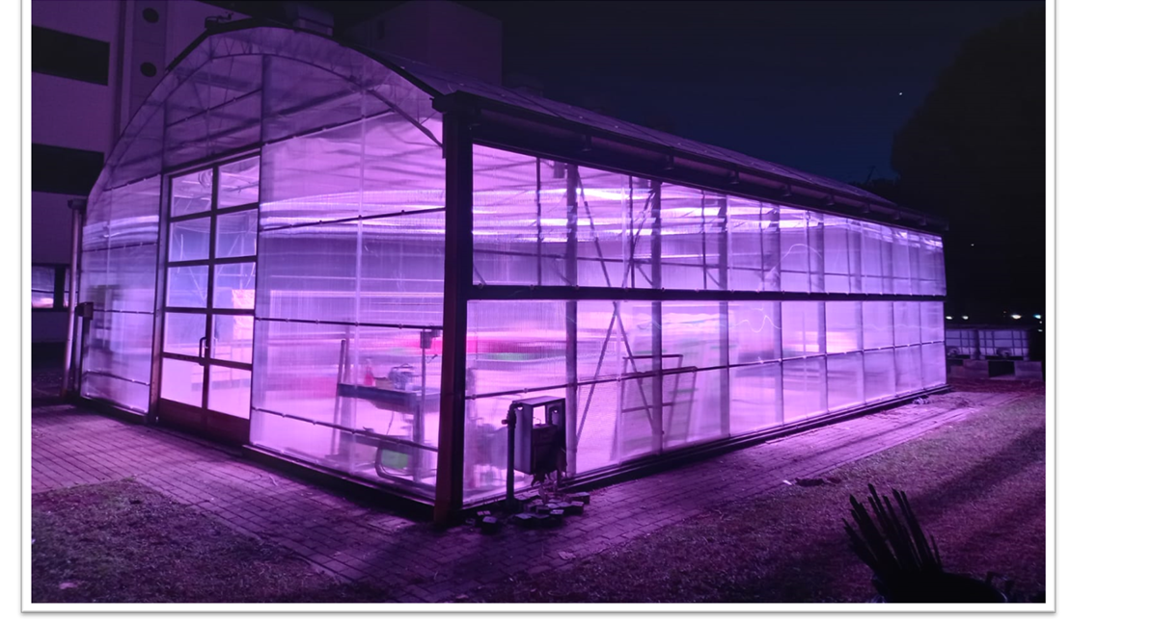
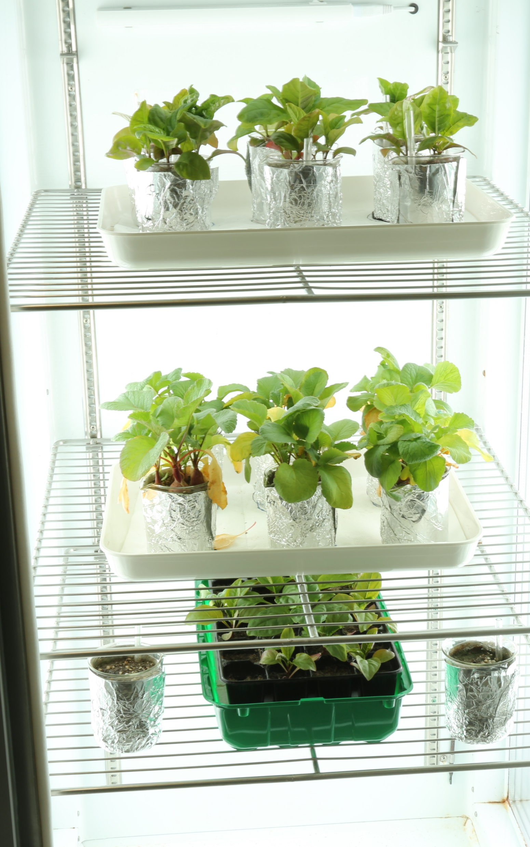
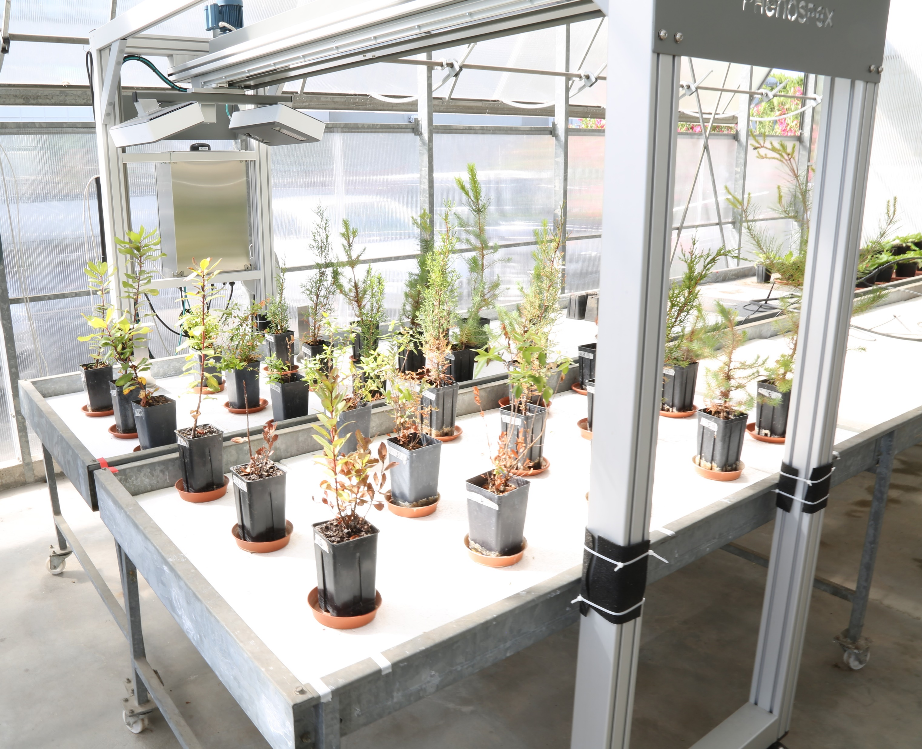
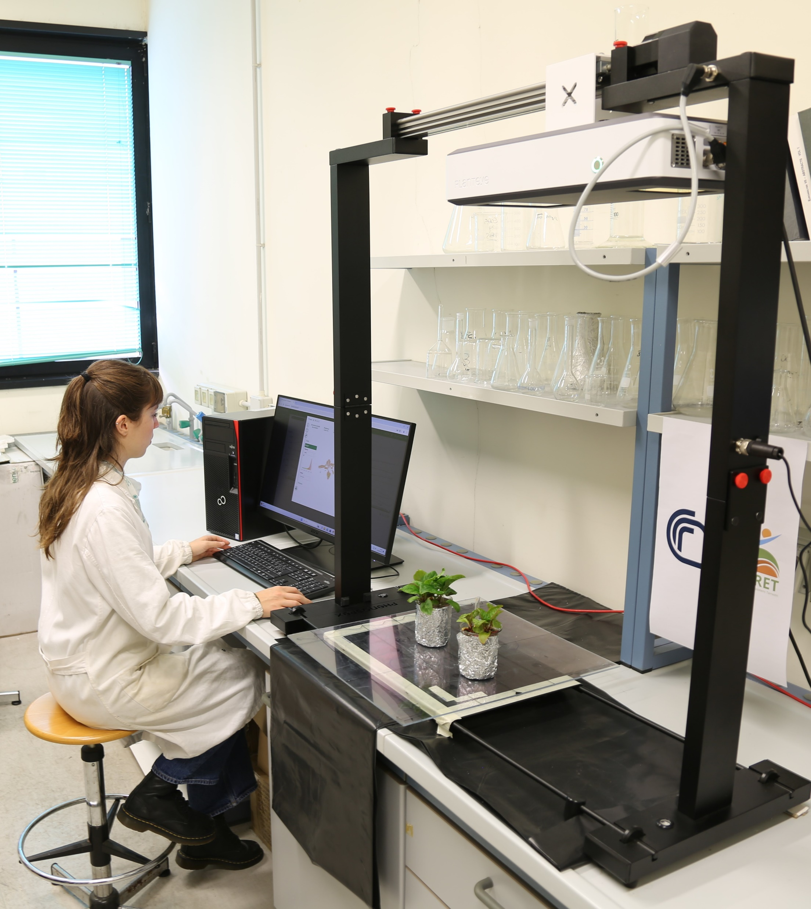
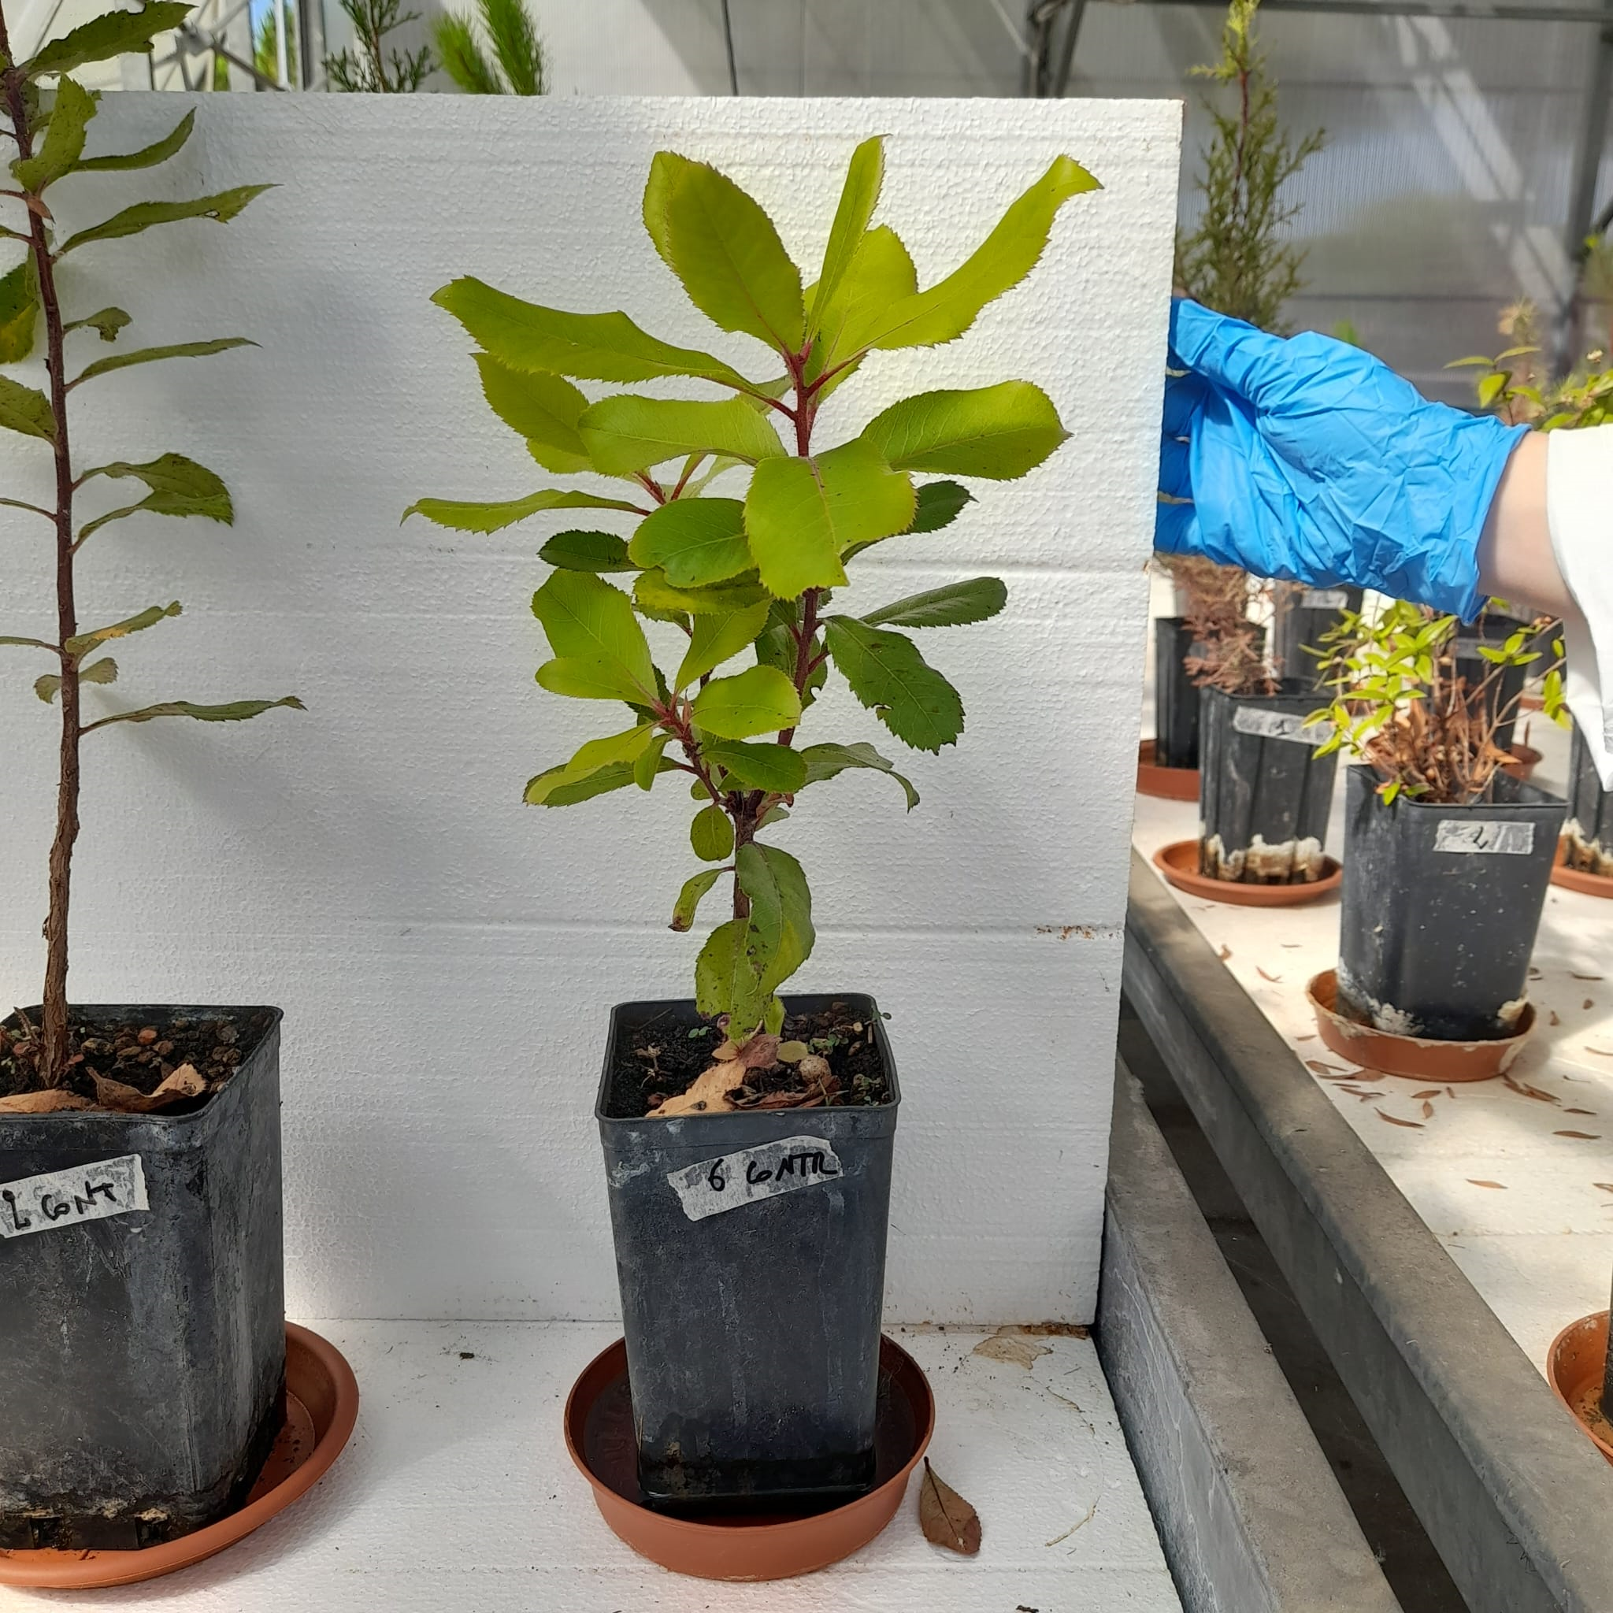
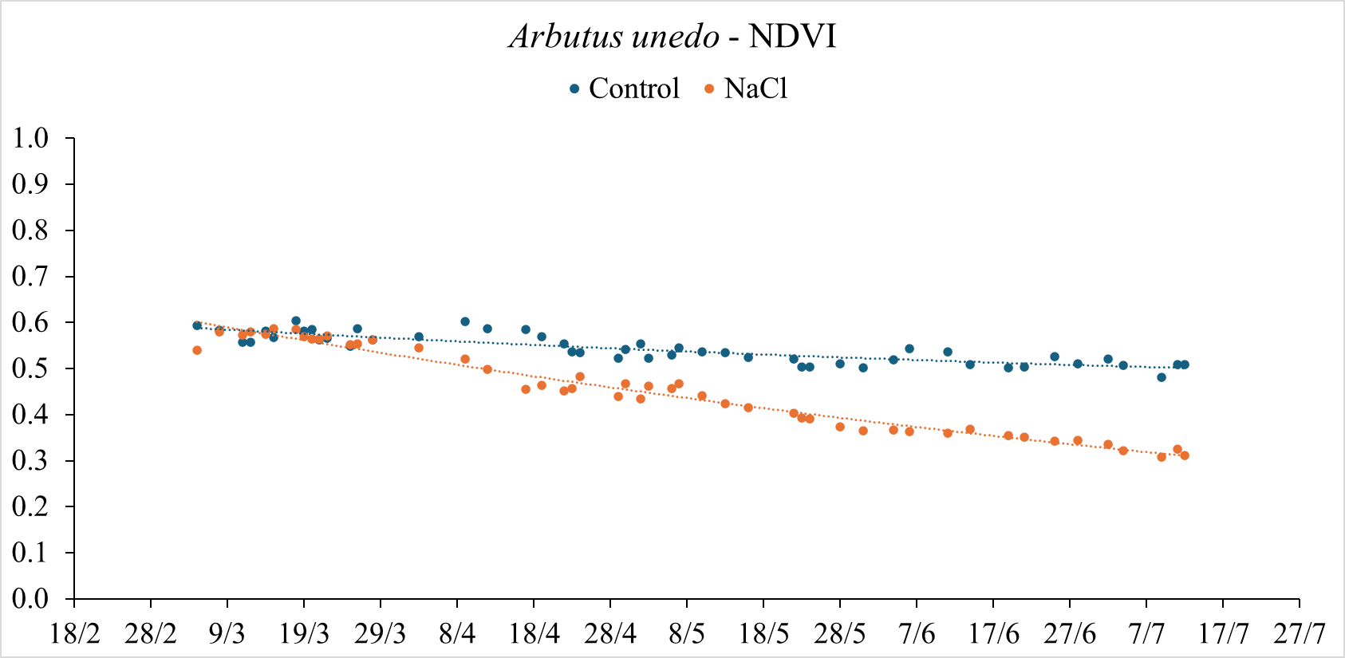
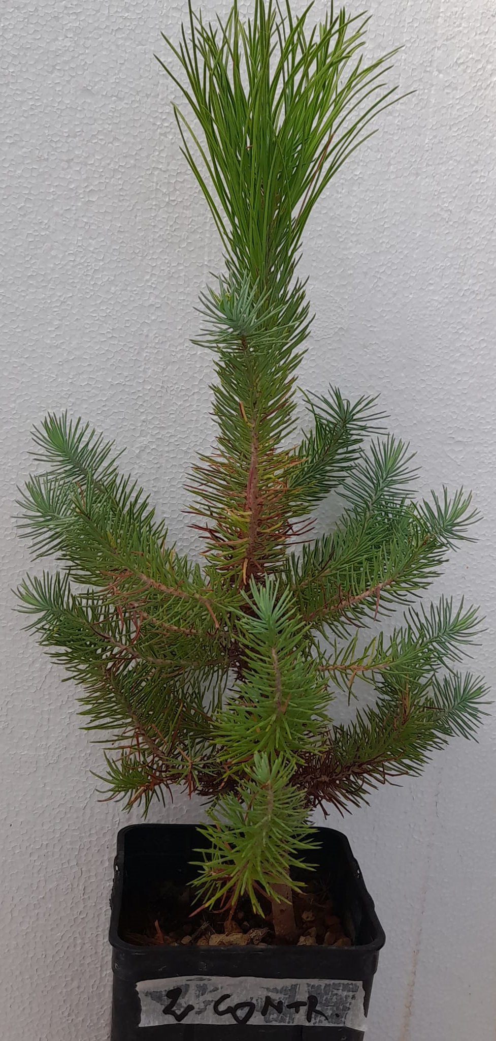
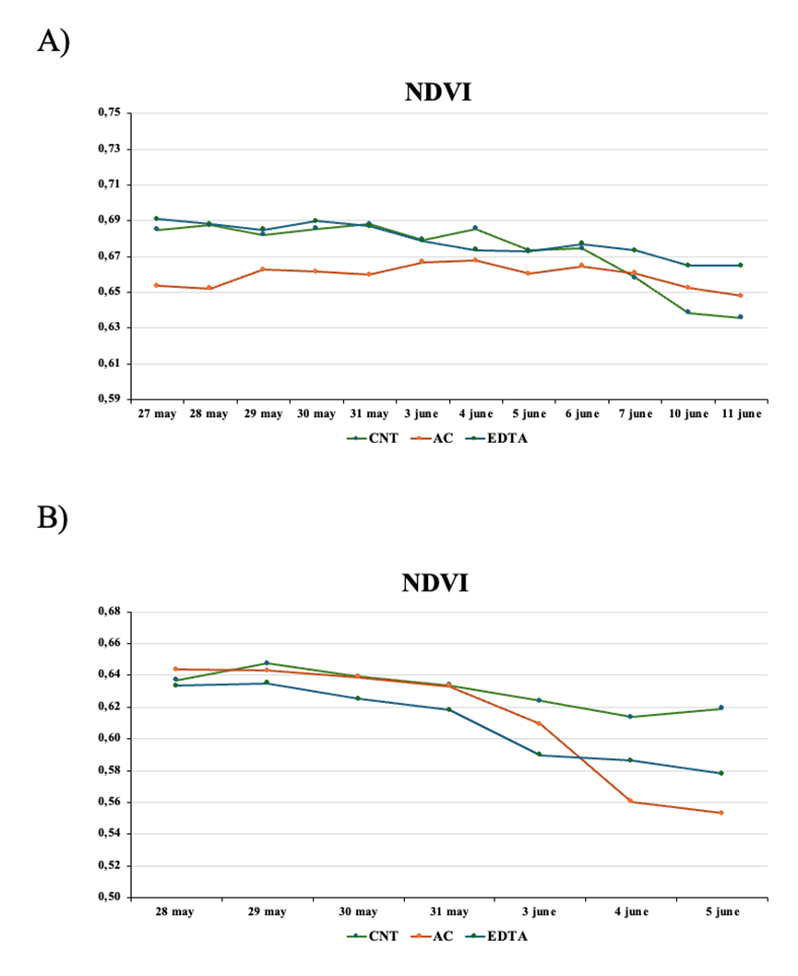
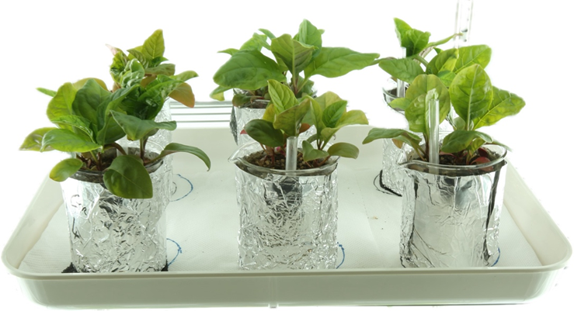
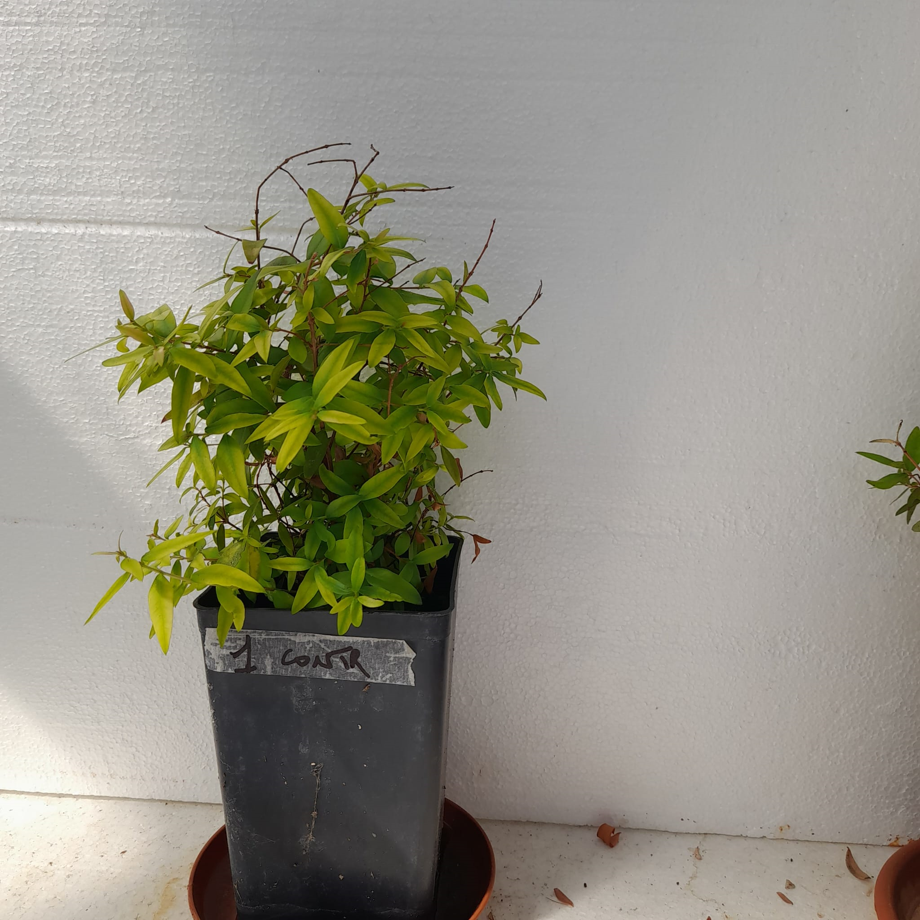
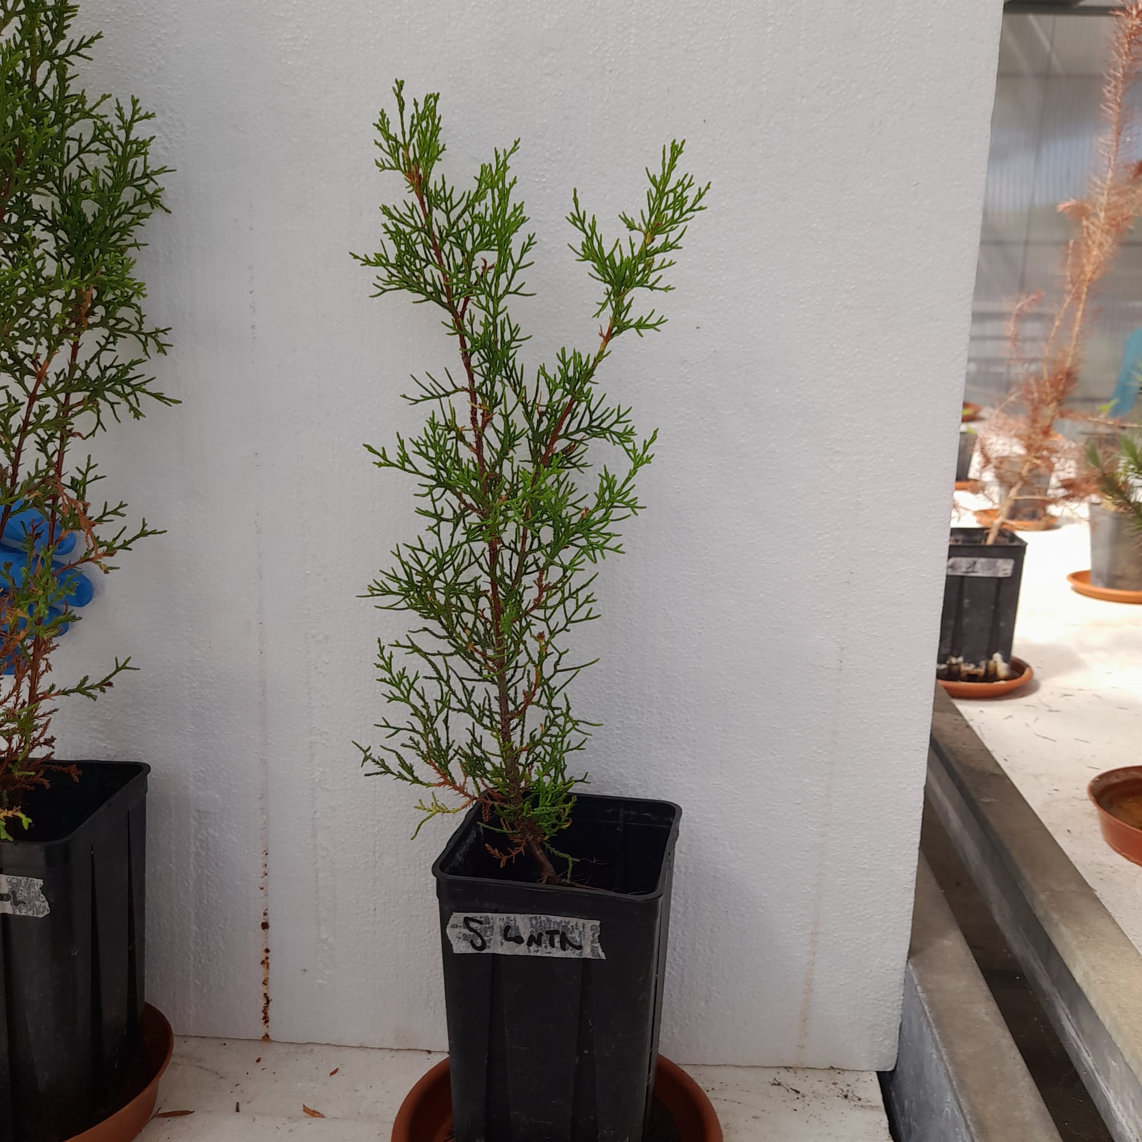
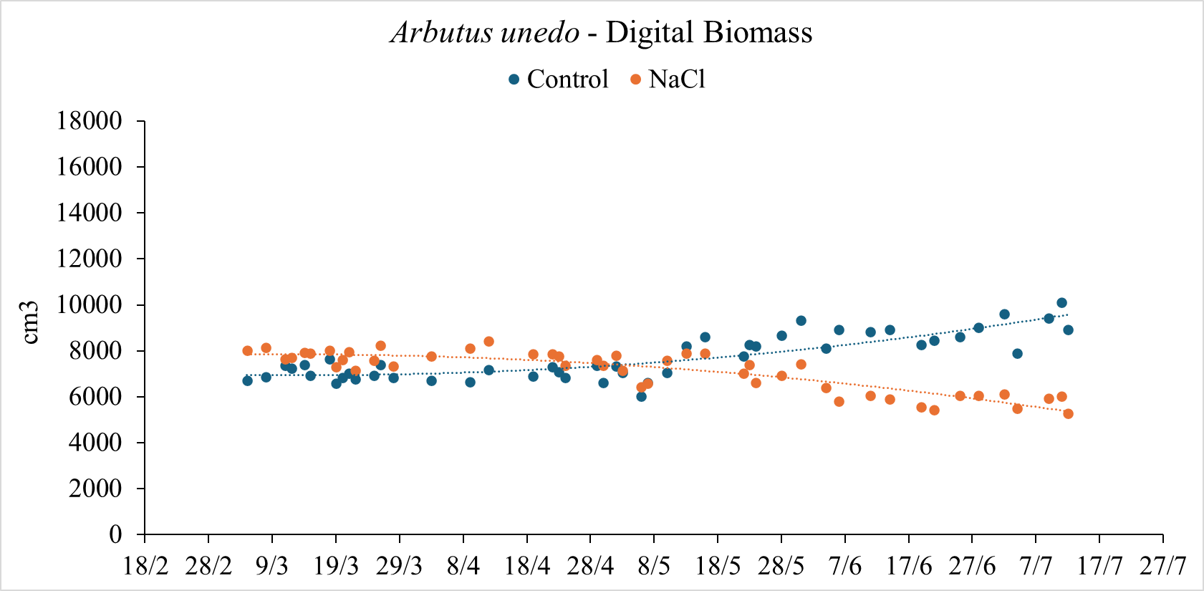
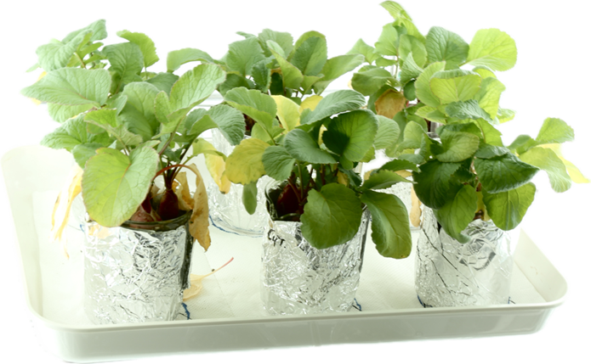
CNR IRET Conference
Rome, February 18th-19th 2025
Enhancing Ecosystem Recovery: The Role of Digital Plant Phenotyping (DPP) in supporting
Nature-based (NbS) Solutions
M. Barbafieri , D. Di Baccio, A. Scartazza, E. Tassi, I. Guidoni, A. Vezzosi, I. Rosellini
DPP: advanced monitoring technology
Multispectal sensors - Non destructive - Real time
Analisys and selection of species for NbS
Adapted to degraded environments
Optimization of treatments for resilient growth
NbS application
Phytoremediation - Environmental Recovery - Biodiversity conservation
The Digital Plant Phenotyping Lab at IRET in Pisa
Green house
Climatic chamber
Microscan
Trait Finder
The STUDY within Spoke 4 - NBFC:
Evaluating salinity stress on Mediterranean maquis plants
The STUDY within PRIN - EUREECA:
Evaluating effects of treatments on plant growth and Rare Earth uptake
Visualization of NDVI A) and Digital Biomass B)
of Arbutus unedo
during the experimental trial
By TRAIT FINDER
Visualization of NDVI of
Phytolacca americana A)
and of Rafanus sativus B)
during the experimental trial
By MICROSCAN
Meri Barbafieri
IRET - PISA

