Slide 1




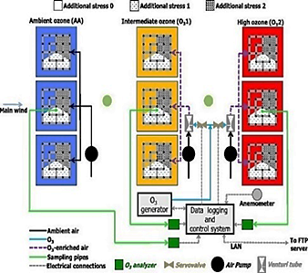
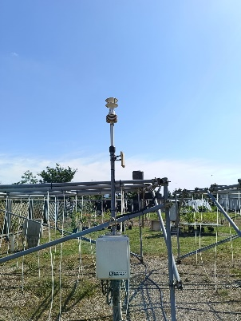

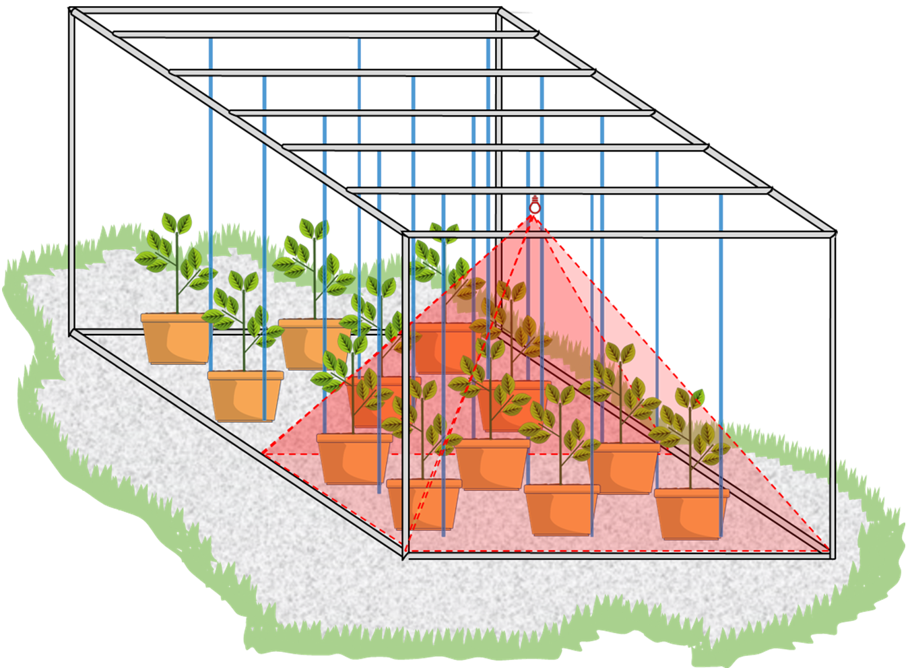
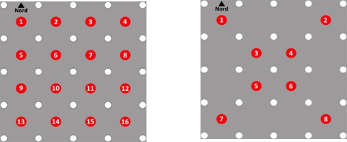
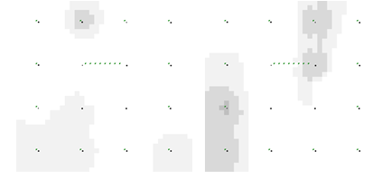
CNR IRET Conference
Rome, February 18th-19th 2025
TECHNOLOGIES FOR ECOSYSTEM RESEARCH: FO₃X – FREE – AIR O₃ EXPOSURE
Lazzara L.¹*, Marra E.¹, Hoshika Y.¹, Moura B.B.¹, Manzini J.¹, Garosi C.¹, Viviano A.¹, Materassi A.², Fasano G.², Paoletti E.¹
¹Research Institute on Terrestrial Ecosystems, National Research Council, Sesto Fiorentino, Italy
²Bioeconomy Research Institute, National Research Council, Sesto Fiorentino, Italy
* Corresponding author
FACE FACILITY
FO3X is an advanced FACE system designed to study the effects of ozone pollution on vegetation under ambient conditions. It is crucial for the study of plant O₃ uptake.
FACILITY SPECIFICATIONS
HEAT FACE
9 plots 5x5x2 m (L x W x H)
Split-plot experiment design: Each O₃ treatment is replicated three times.
Teflon-made vertical pipes network.
Climatic variables: meteorological station (3 m height) with multisensory instruments.
DIFFUSIVE SAMPLERS
The sensors are used for long-term measurements of O₃ concentration within the plots
Temperature Free Air Controlled Enhancement technology to assess the combined effects of (O₃ + high Temperature)
Up: 1.5 m
O₃ dispersion was below 20%.
Botton: 0.5 m
Up: 1.5 m
Botton: 0.5 m

