Slide 1


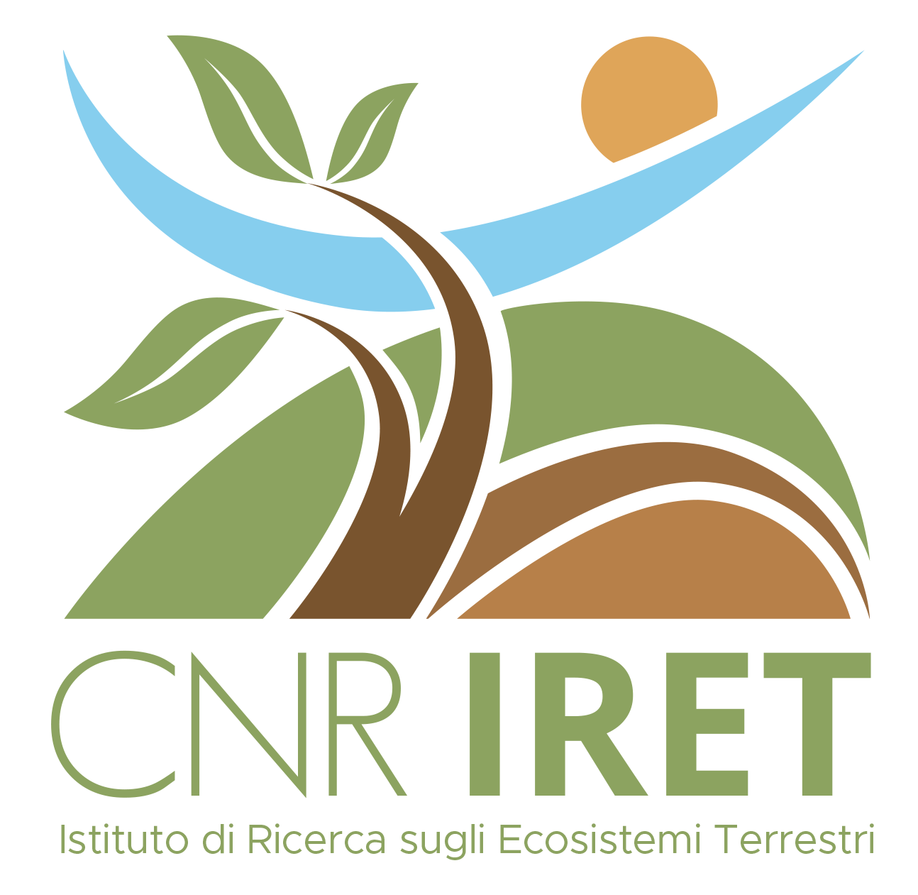
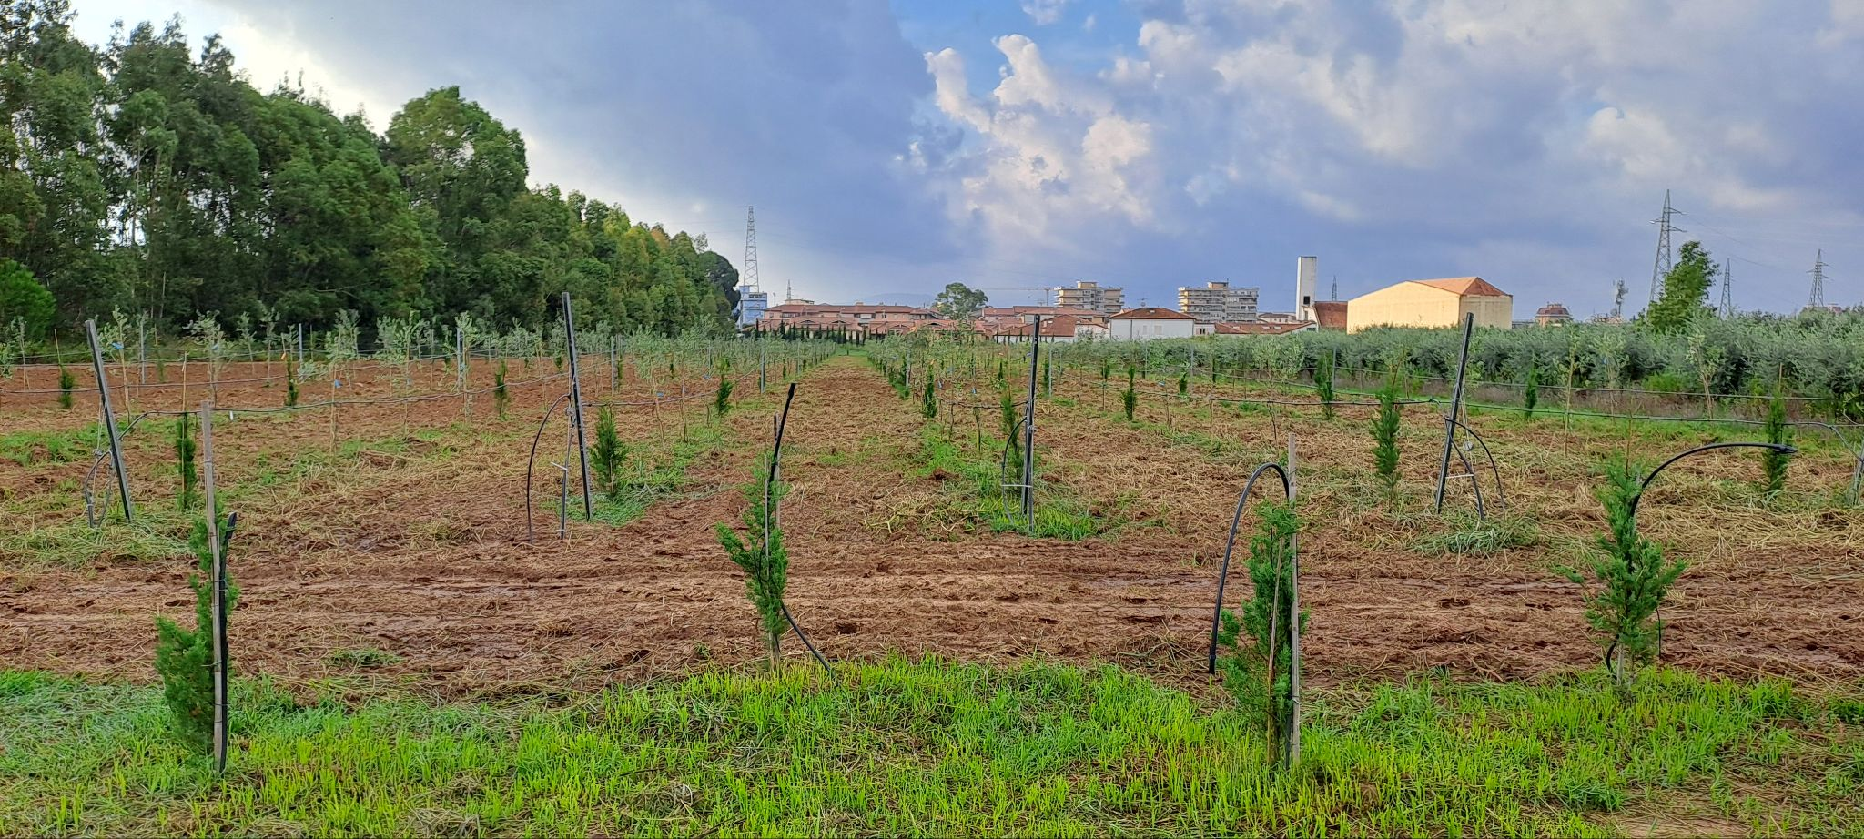
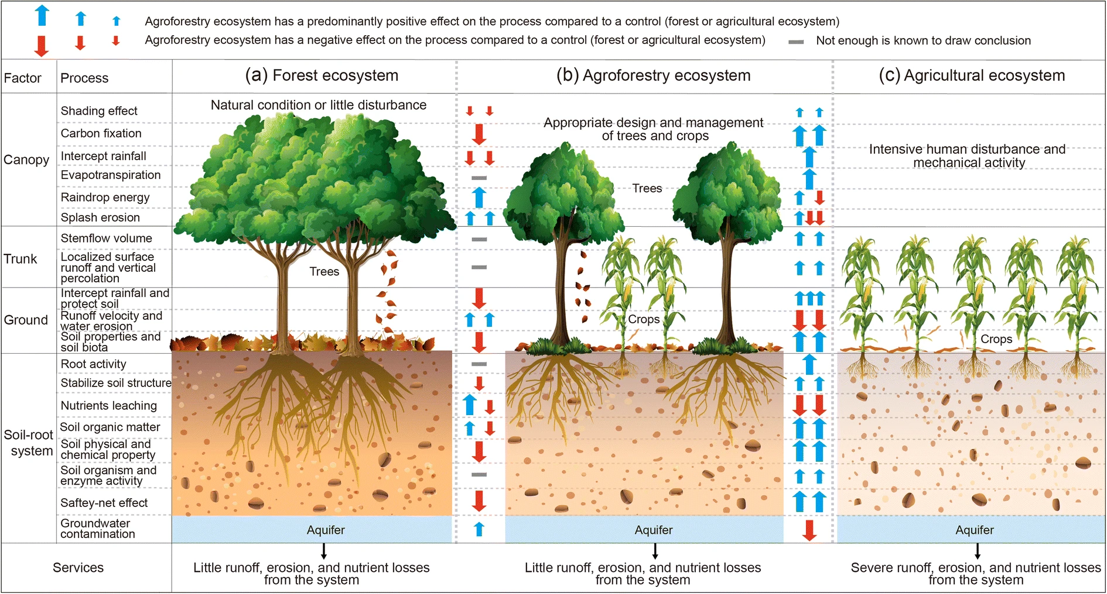
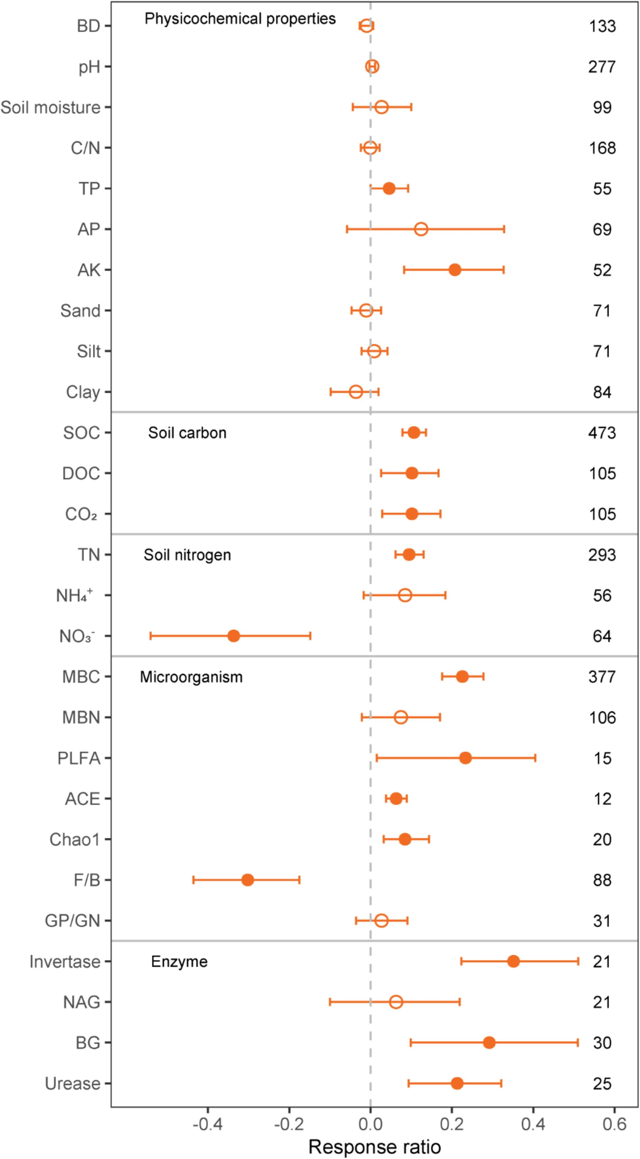

CNR IRET Conference
Rome, February 18th-19th 2025
Eco-physiological and growth characters of woody plant species in determining the potential of traditional agroforestry practices as nature-based carbon sinks in Mediterranean area
Garosi C., Marra E., Conti N., Della Rocca G., Paris P., Nigrone E., Palanti S., Hoshika Y., Paoletti E.
Agroforestry system as a nature-based carbon sink: how the growth and eco-physological characteristics of forest species influence the potential of agroforestry systems as carbon sinks?
Living Hub – Case study
Agroforestry system consisting of Olea europaea L. (cv. leccino and canino) and Cupressus sempervirens L. (var. stricta and horizontalis), with Vicia faba L., at the S. Paolina experimental farm - Follonica (GR). This agroforestry system, will be subjected to water and salt stress.
Study hypothesis
The amount of C sequestered will depend on site biological, climatic, soil, management and specie-specific factors.
Abiotic stress response represent a key factor in C-sequestration potential.
Cesare Garosi
Pan, J., Chen, S., He, D., Zhou, H., Ning, K., Ma, N., ... & Dong, Z. (2025). Agroforestry increases soil carbon sequestration, especially in arid areas: A global meta-analysis. Catena, 249, 108667.

