Slide 1
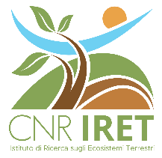
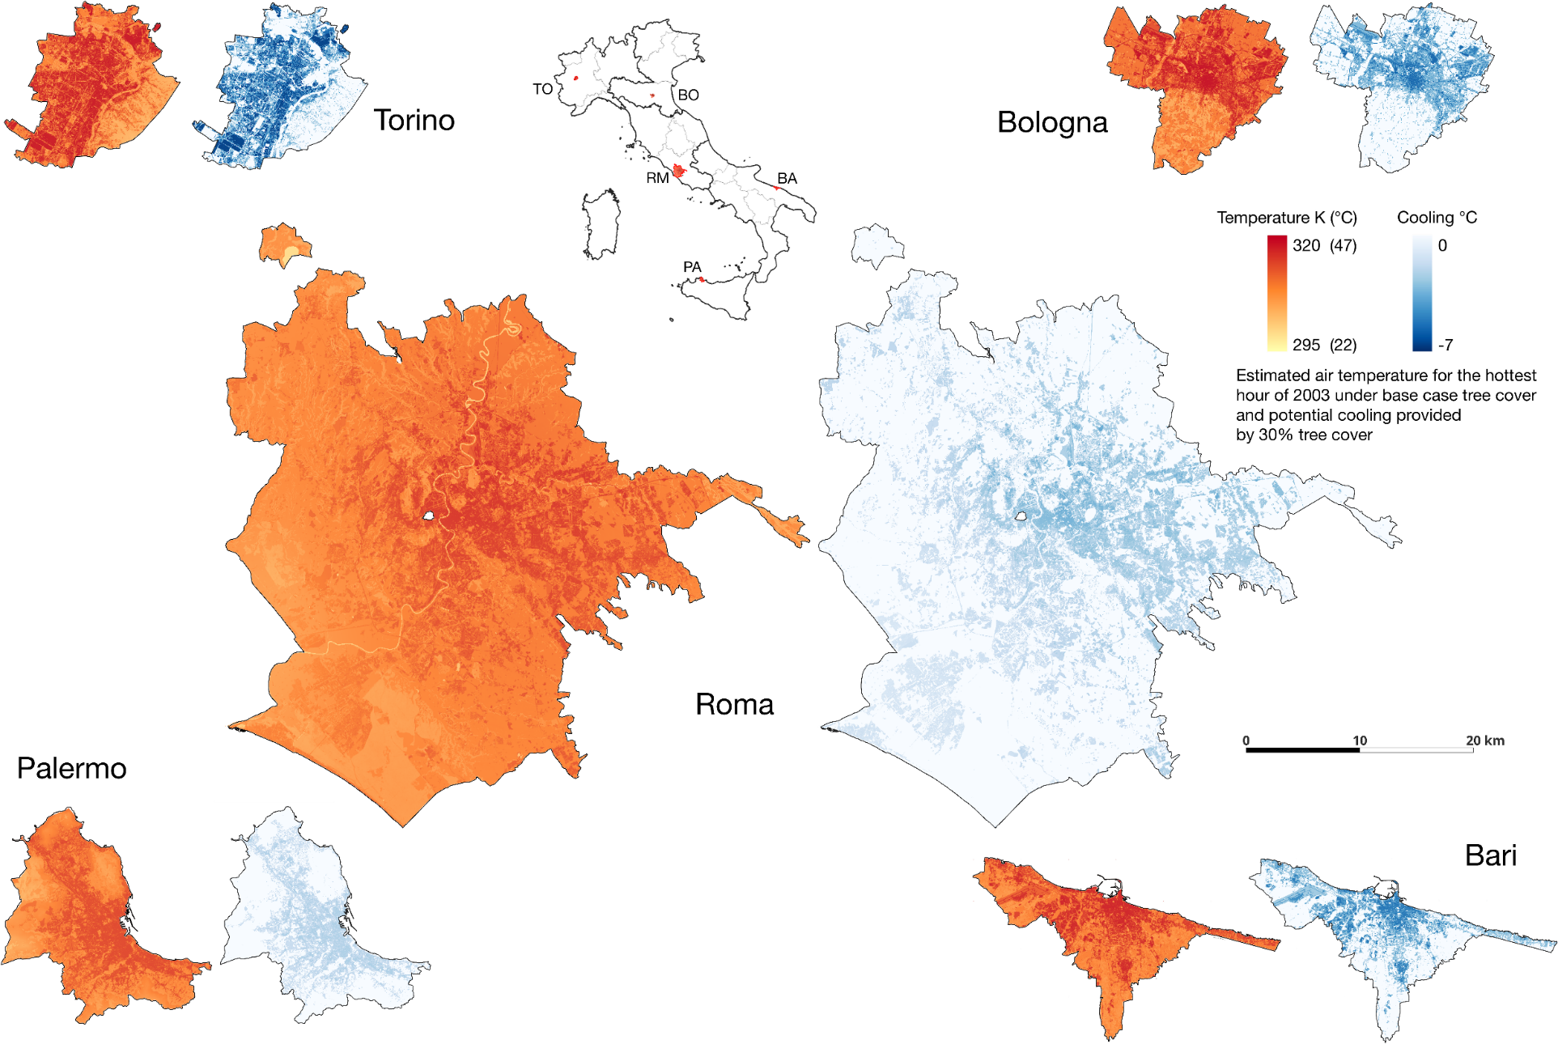
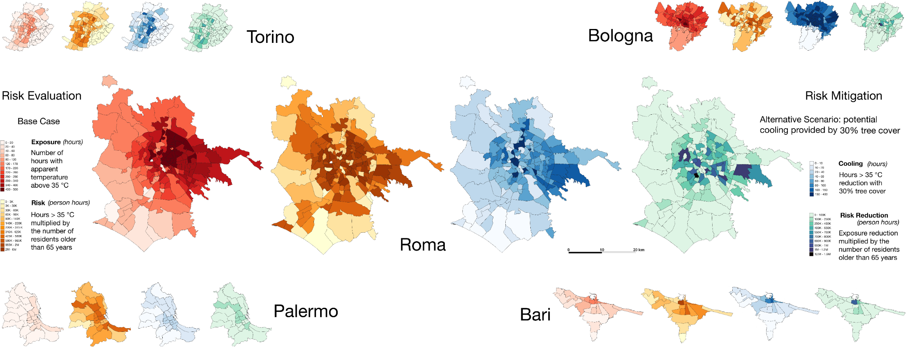
CNR IRET Conference
Rome, February 18th-19th 2025
Leveraging Urban Tree Cover to Combat Heatwaves: Modeling Intensity, Duration, and Mortality in Italian Cities
T.A. Endreny, F. Chiocchini, A. Endreny, C. Calfapietra, M. Ciolfi
Cities are increasingly adopting nature-based solutions (NbS) to reduce the impacts of heatwaves, and there is a growing need for tools to support the strategic design and management of these solutions. This study used the i-Tree Cool Air soil-vegetation-atmosphere transfer model to assess how increasing urban tree cover enhances evaporative cooling, thus reducing exposure to heatwaves and associated mortality. This study simulated heatwave events and heatwave degree days (a measure of intensity and duration) for 10 Italian cities (Bari, Bologna, Bolzano, Cagliari, Firenze, Genova, Palermo, Roma, Torino, and Verona) during the entire summer of 2003, with hourly time steps.
Two scenarios were modeled: a base case and an alternative scenario in which tree cover was increased to meet a minimum target of 30%, aligning with European goals. In the base case, heatwave events and excess mortality among individuals aged 65 and older were estimated for each city, with data distributed across neighbourhoods based on heatwave degree days and the size of the elderly population.
The alternative 30% tree cover scenario resulted in an average reduction of 40% in both heatwave degree days and excess mortality, with cooling benefits derived from evapotranspiration of water that would have otherwise been runoff in the base case. This modeling approach can help to prioritise where to implement NbS for maximum impact.
Francesca Chiocchini
This study received funding support from the National Biodiversity Future Centre and was supported by a sabbatical leave for TE from SUNY ESF to CNR IRET.

