Slide 1


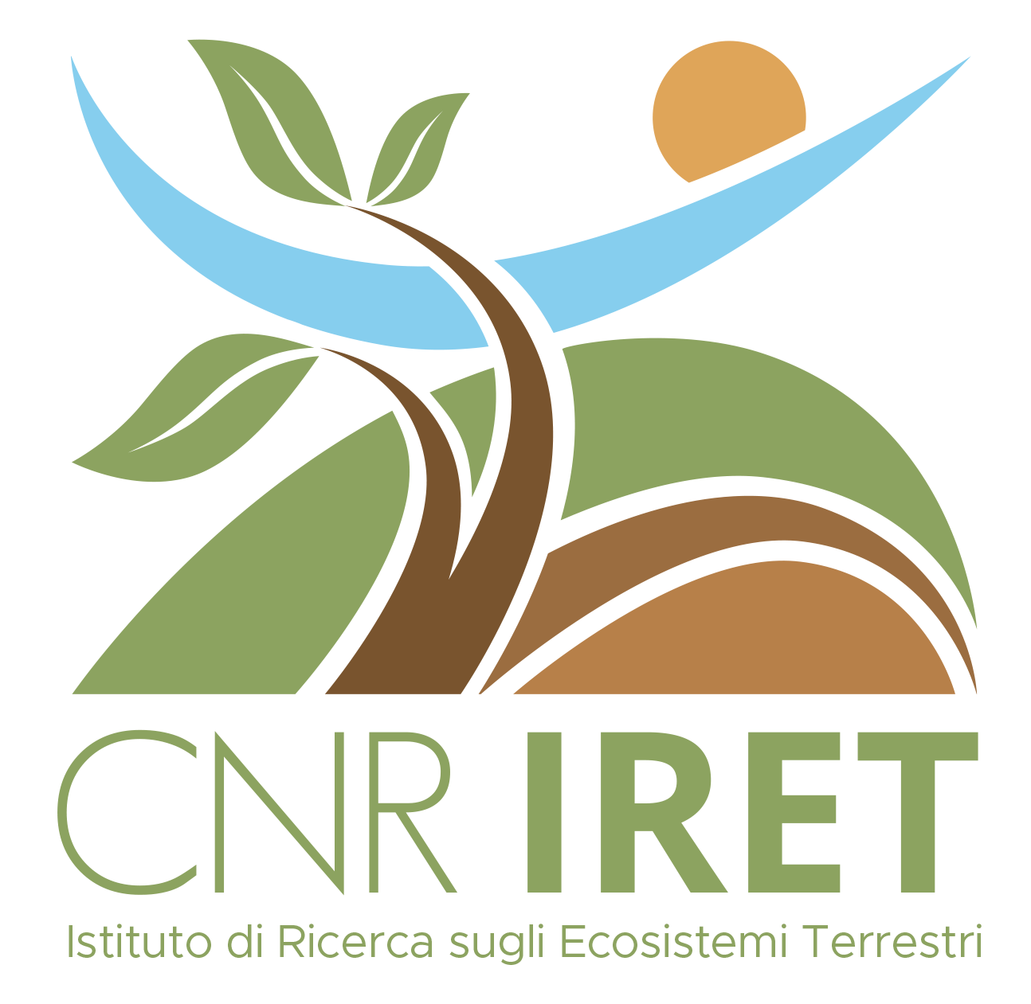
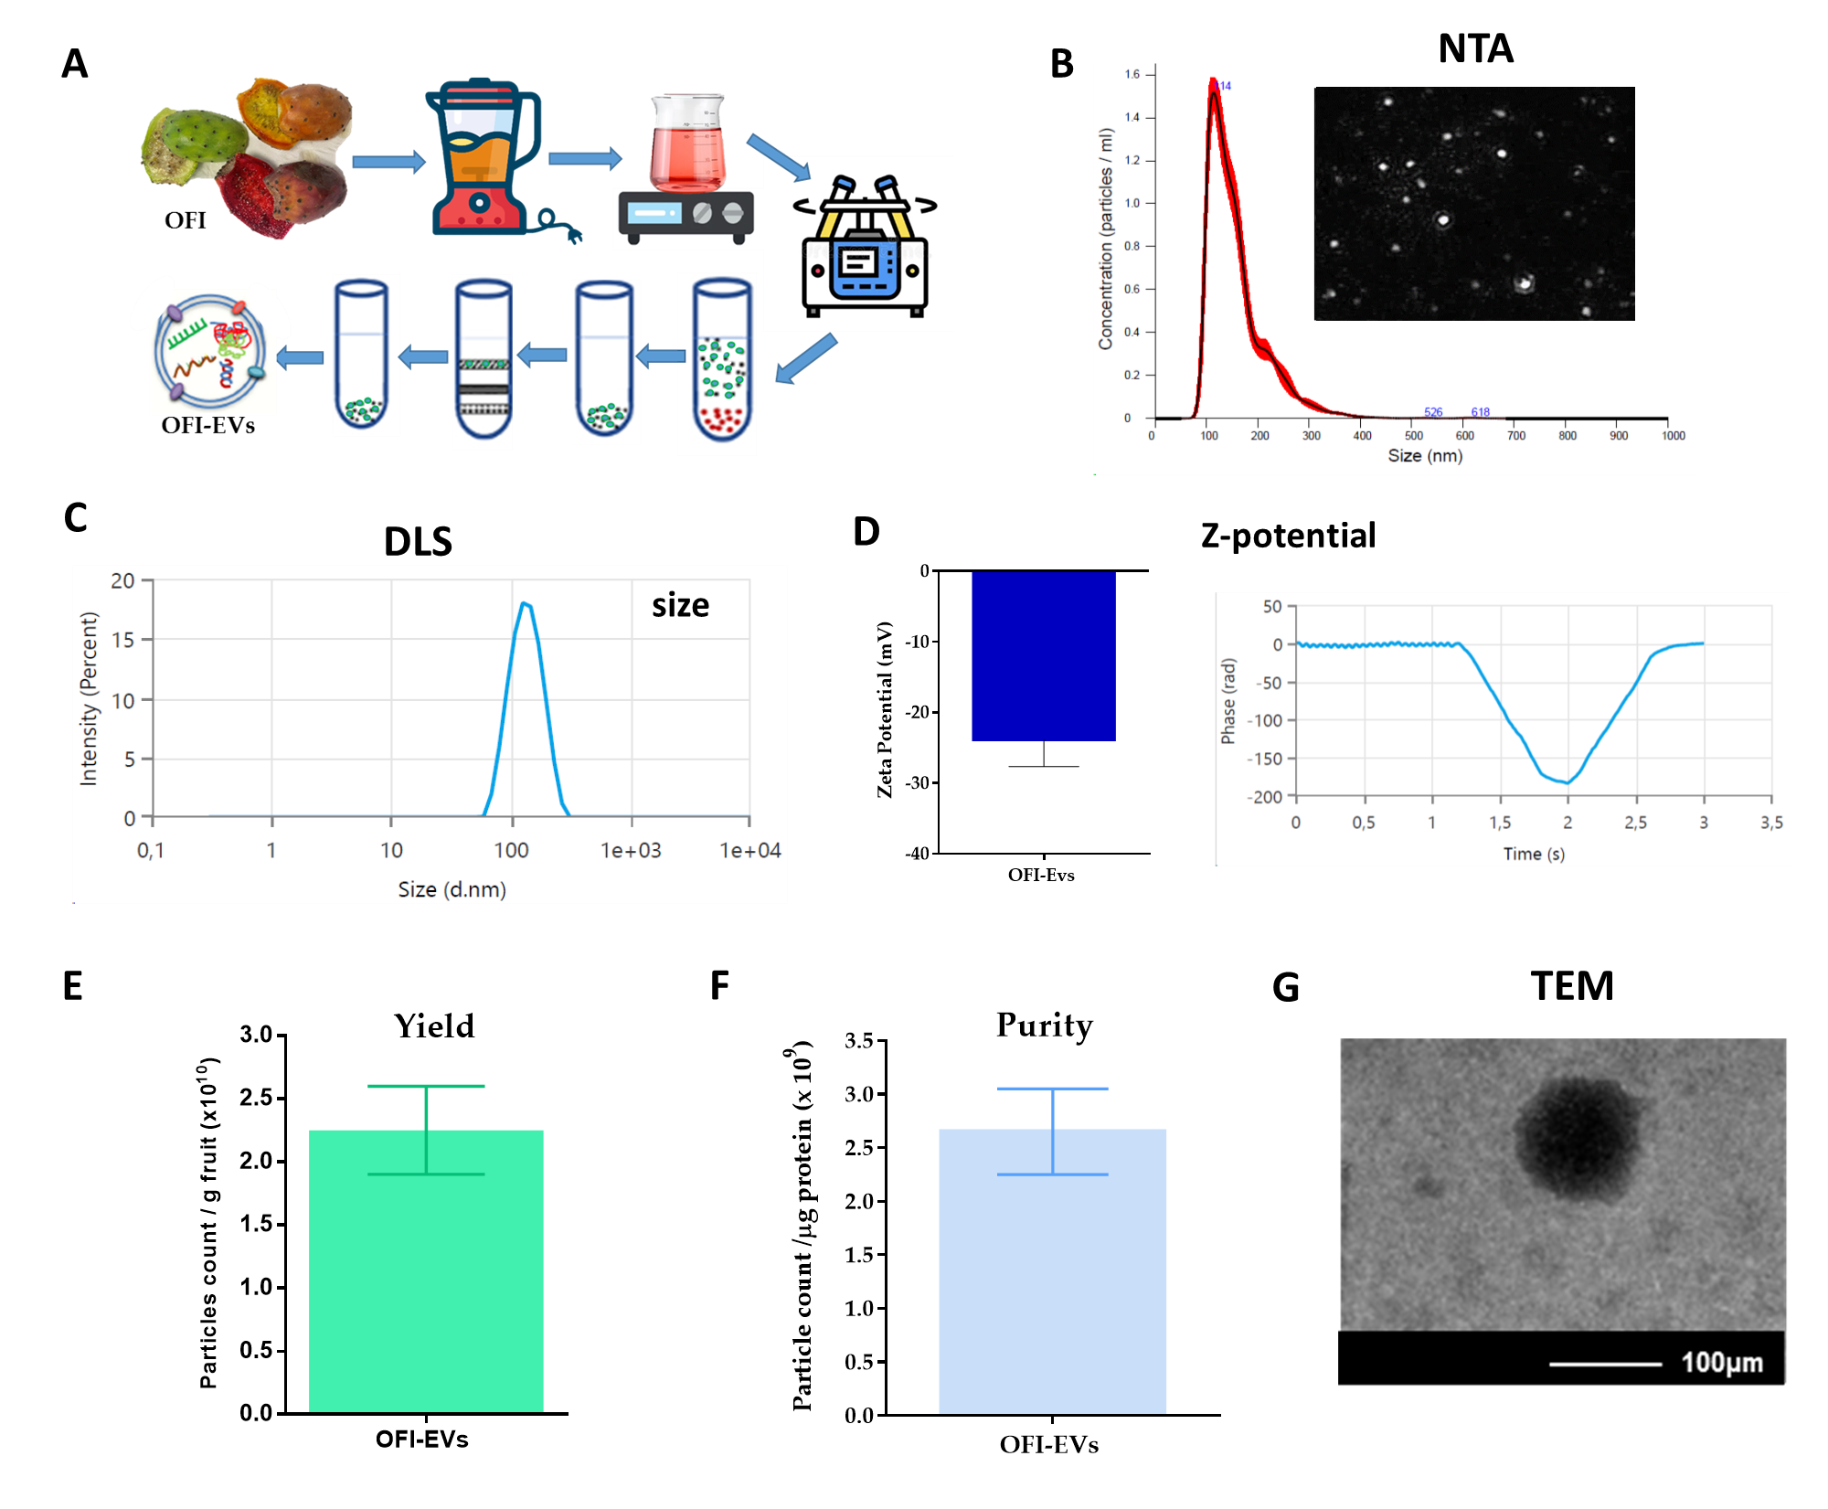
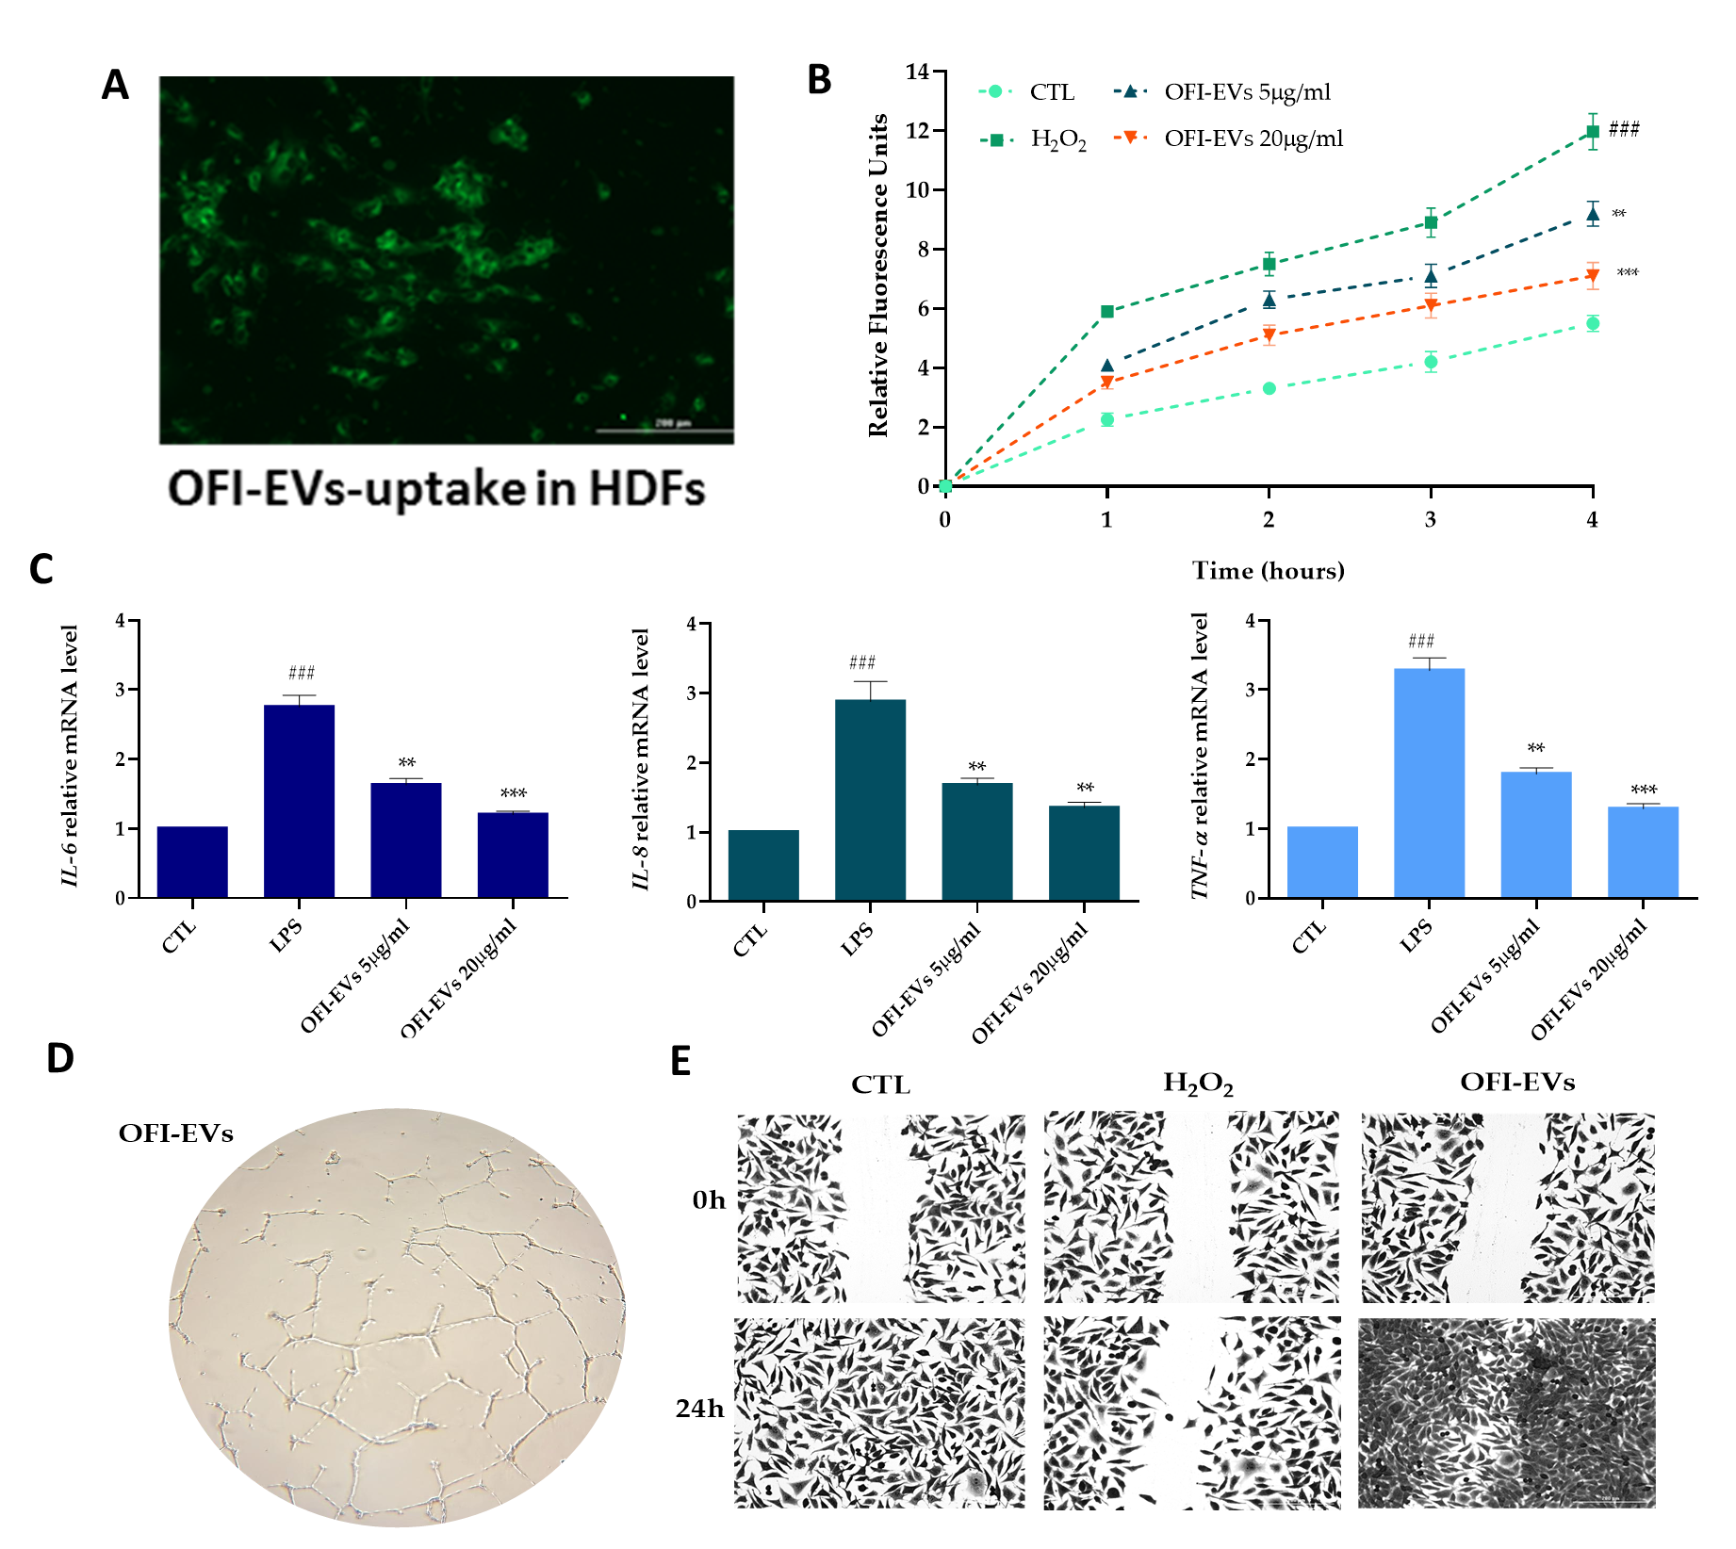
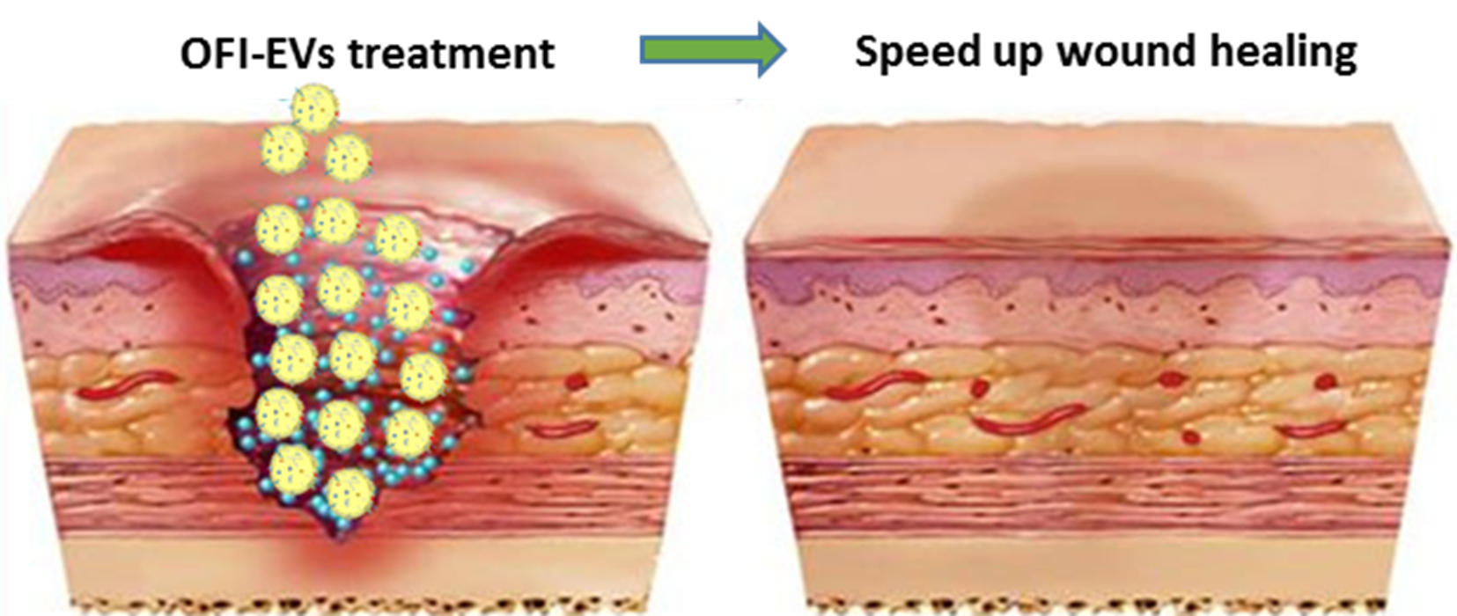
CNR IRET Conference
Rome, February 18th-19th 2025
Plant-derived extracellular vesicles: an innovative delivery system and a source of natural bioactive compounds
Sorur Yazdanpanah^{1,2}, Umberto Galderisi¹, Anna Valentino², Gianfranco Peluso^{2,3}, Mauro Finicelli²
¹Department of Experimental Medicine, University of Campania "Luigi Vanvitelli", Via Santa Maria di Costantinopoli 16, 80138 Naples, Italy.
²Research Institute on Terrestrial Ecosystems (IRET), National Research Council of Italy (CNR), Via Pietro Castellino 111, 80131 Naples, Italy.
³Faculty of Medicine and Surgery, Saint Camillus International University of Health Sciences, Via di Sant'Alessandro 8, 00131 Rome, Italy.
Introduction
Results
Plant-derived extracellular vesicles (P-EVs) are emerging as promising agents for delivering bioactive compounds, playing a key role in intercellular communication. They can effectively deliver a wide range of cargoes, including proteins, lipids, nucleic acids (noncoding RNAs, DNA, mRNA), and other bioactive compounds. P-EVs exhibit a remarkable range of biological activities, showing both preventive and therapeutic potential in alleviating various pathological conditions. Their ability to efficiently deliver both exogenous and endogenous bioactive molecules to mammalian cells, combined with their low cytotoxicity, makes them promising candidates for developing novel therapeutic strategies across multiple diseases.
In this study, EVs were extracted from Opuntia ficus-indica fruit (OFI-EVs) and analyzed for their particle size distribution, concentration, and bioactive molecule composition to evaluate their potential role in chronic wound healing.
Pro-inflammatory cytokine OFI-EVs exhibited biocompatibility and protective effects in an in vitro chronic wound model by reducing inflammation and oxidative stress. They downregulated (IL-6, IL-8, TNF-α) in LPS-stimulated human leukemia monocytic cell line (THP-1) and enhanced cellular antioxidant defenses. Additionally, they promoted wound healing by stimulating the migration and new angiogenesis of human dermal fibroblast (HDFs) and of Human Umbilical Vein Endothelial cells (HUVEC). These findings suggest that OFI-EVs could serve as a natural candidate for healing chronic wound.
Isolation and Characterization
Biological activity
Conclusion
OFI exhibits health-promoting and wound-healing properties. Despite their desirable biological properties, many natural products face limitations in crossing the stratum corneum to reach wounds. However, modern delivery techniques improve the effectiveness of natural bioactive products by enhancing their permeability and bioavailability, overcoming challenges in penetrating the stratum corneum for wound healing. This study emphasizes the therapeutic potential of OFI-EVs, which facilitate intercellular communication and effectively deliver bioactive molecules to target cells. OFI-EVs reduce inflammation and oxidative stress, accelerating the healing of chronic skin wounds.
(A) Schematic illustration of OFI-EVs isolation procedure. (B) Size distribution using nanoparticle tracking analysis. (C,D) Size distribution, Zeta potential using dynamic light scattering. (E,F) Production yield and purity of OFI-Evs (G) Transmission electron microscopy image of isolated OFI-EVs.
(A) Semi-quantitative analysis of PKH67-EVs fluorescence intensity (B) ROS release using cellular ROS assay kit (H2DCFDA). (C) IL6, IL8, and TNFα analyzed by qRT-PCR in THP-1 cells. (D) Optical images of HUVECs tubes. (E) Representative images of wound closure.
Sorur Yazdanpanah

