Slide 1




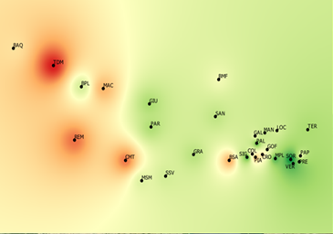
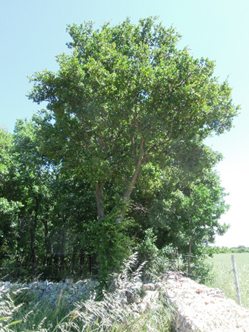
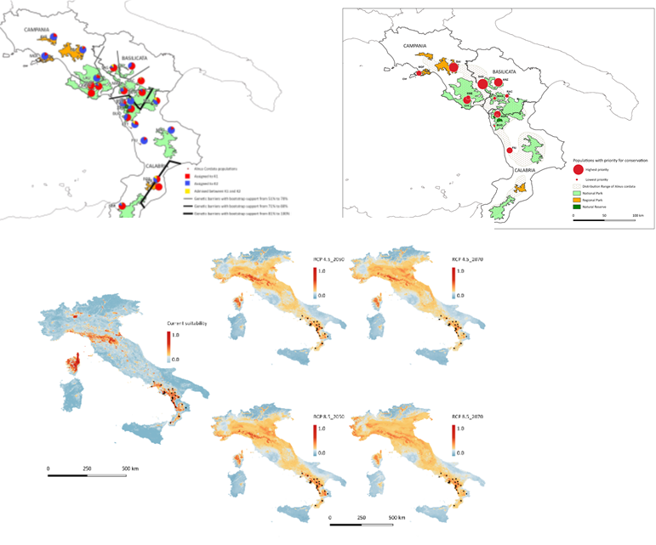
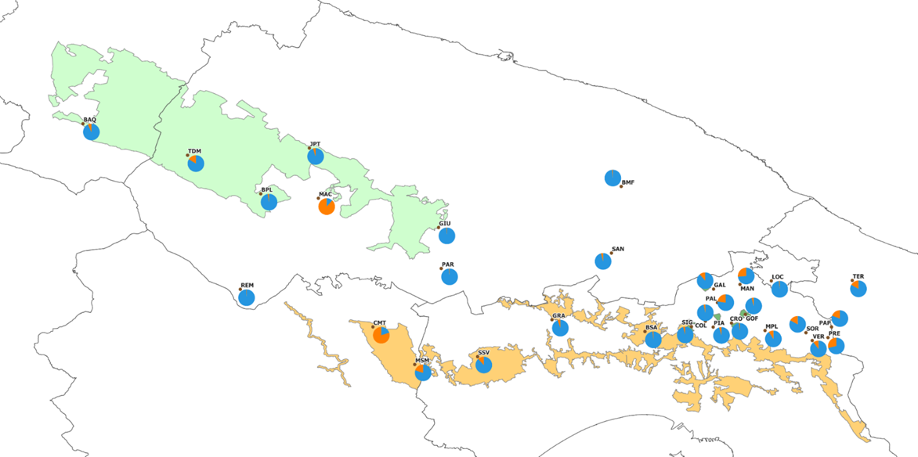
CNR IRET Conference
Rome, February 18th-19th 2025
Genetic diversity and structure of Alnus cordata and Quercus trojana populations in the native range of southern Italy: an essential step towards the definition of management and conservation strategies
C. Mattioni, A. Marchesini, M. Gaudet, F. Chiocchini, L. Leonardi , M. Cherubini, P. Pollegioni P.
Microsatellite genotyping for:
-Understanding demography and genetic structure of natural populations
-Identify hot spots of neutral diversity and conservation units
-Reconstruct evolutionary history
- integrate the genetic/genomic data with climatic and topographic data
Priority conservation areas
Management strategies
Quercus trojana
STRUCTURE identified two genetic clusters weakly correlated with the elevation
Alnus cordata
30 populations,
552 samples,
12 SSRs markers
23 populations,
517 samples,
10 SSRs markers
Indication of priority conservation areas
STRUCTURE analysis revealed the presence of two main gene pools, genetic divergence between two populations in the core of distribution
Predicted current (A) and future potential geographic distribution of Alnus cordata by 2050 (range 2041-2060)and 2070 (range-2061-2080) according to the climate CMIP6 model under RCP4.5 and RCP 8.5 scenarios
Claudia Mattioni

