Slide 1


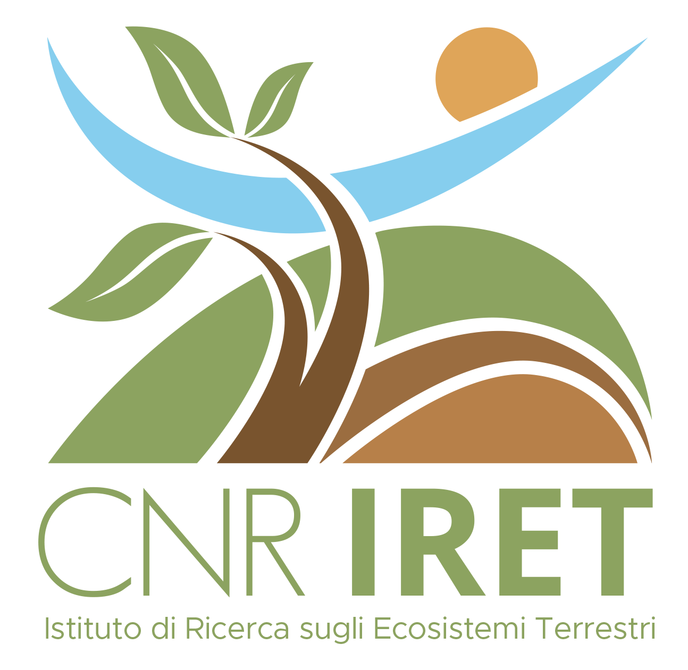
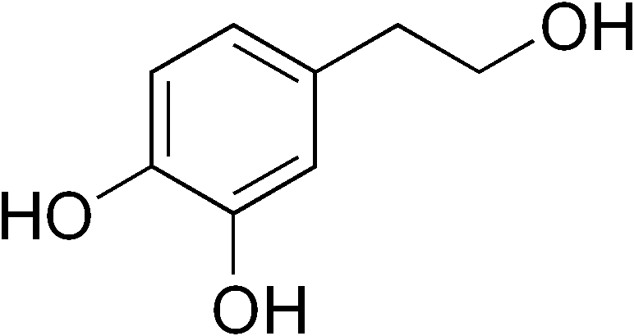
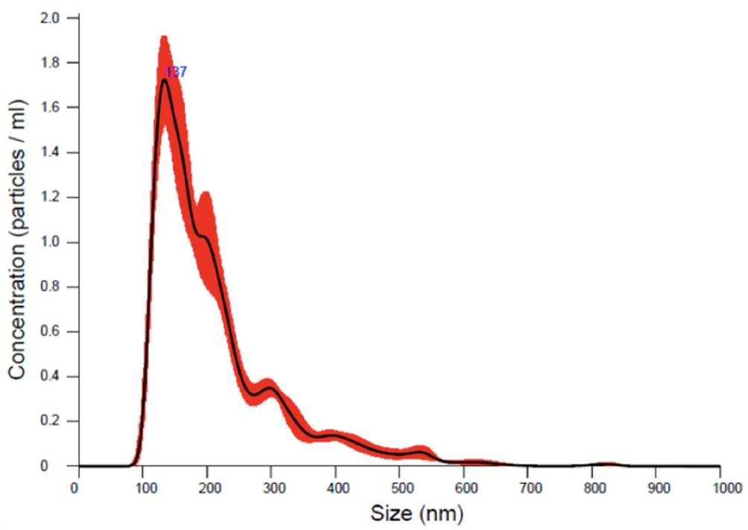
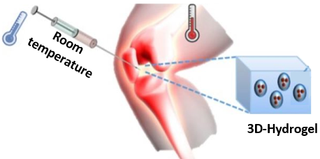
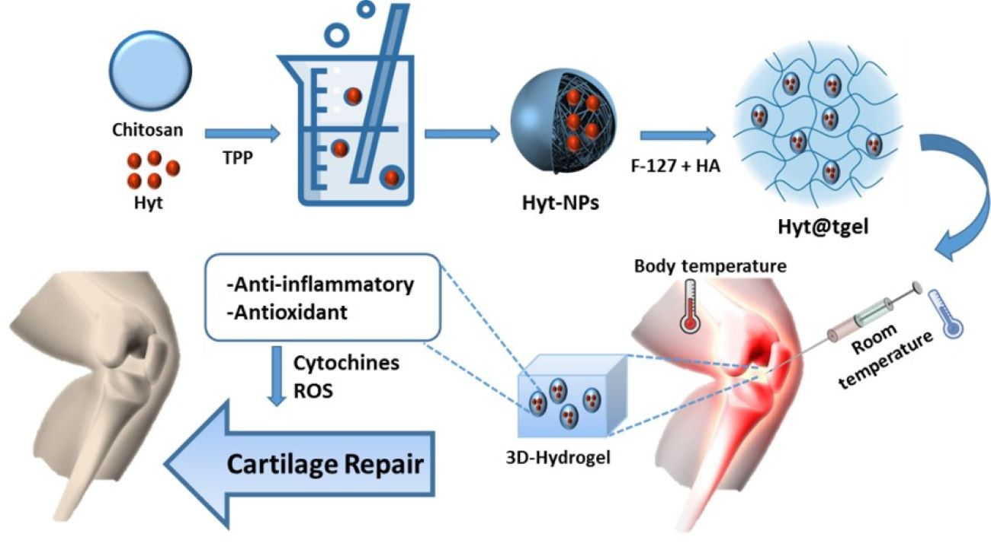

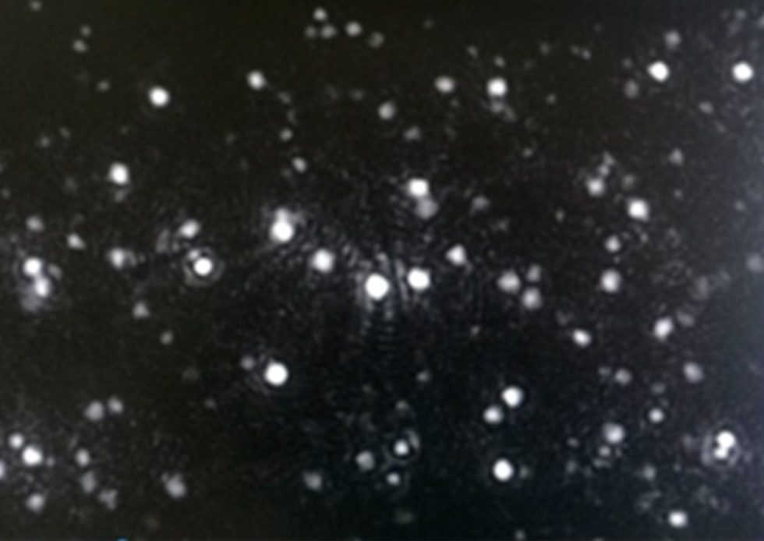

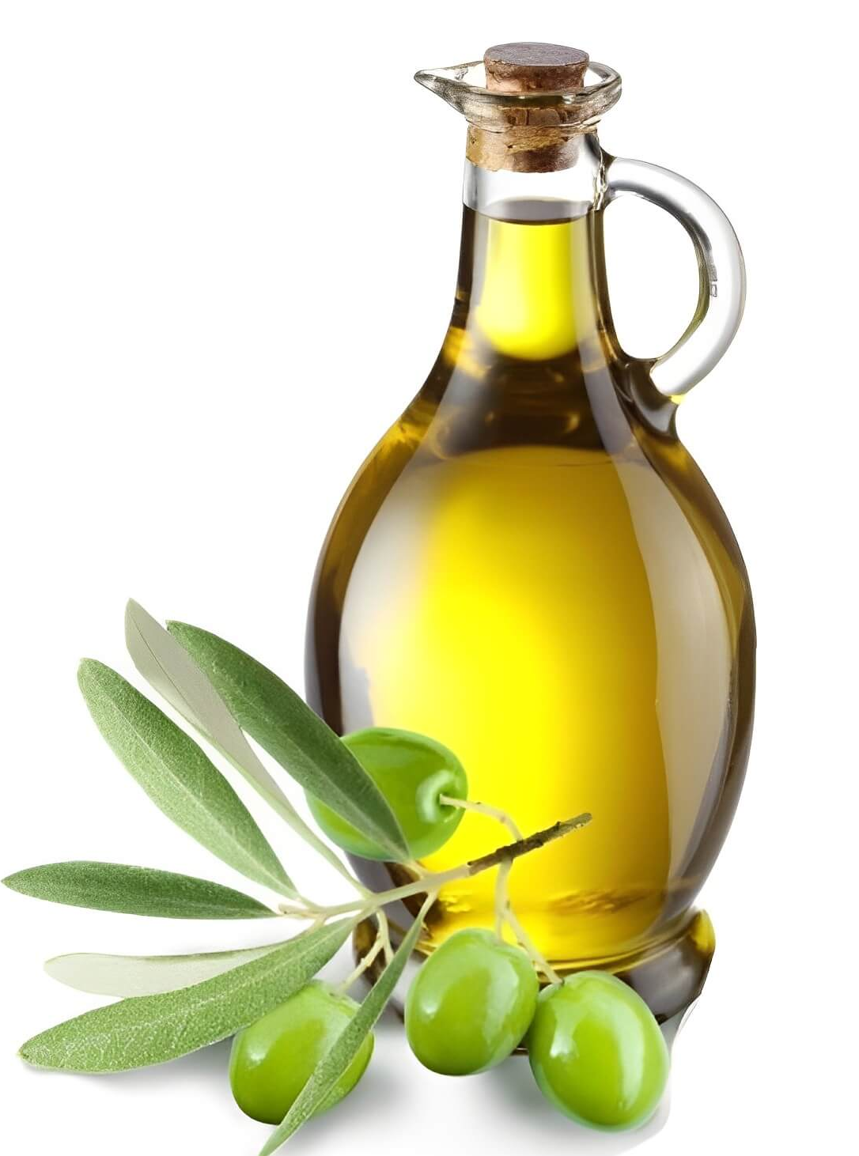
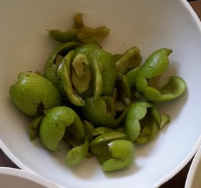
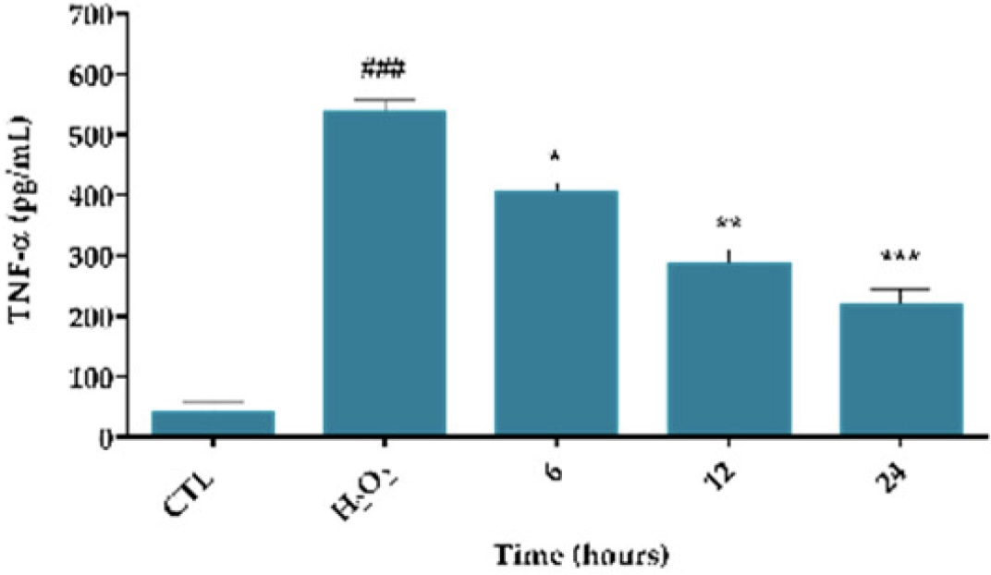
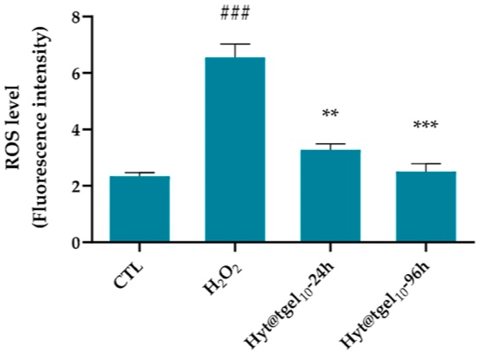
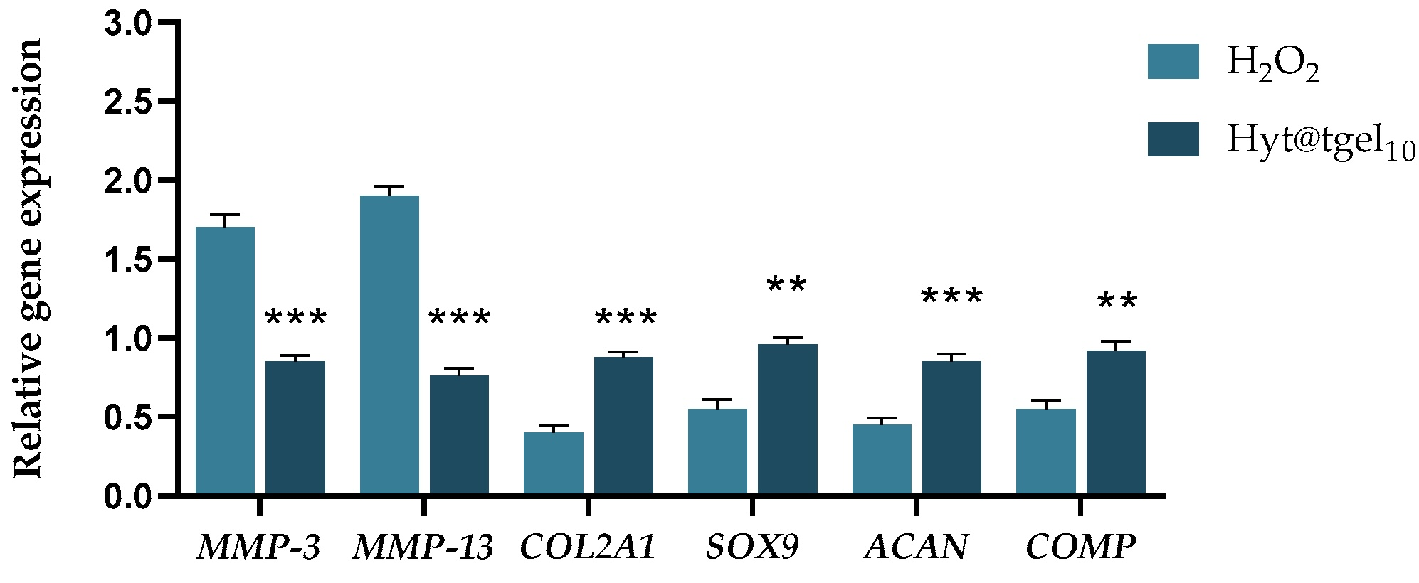
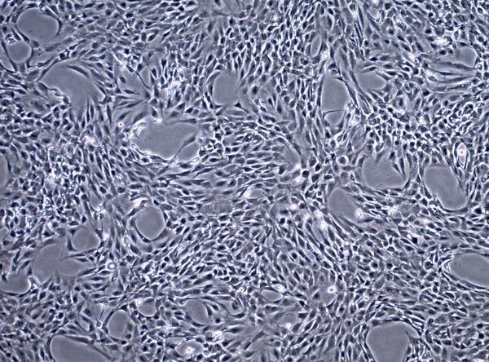
CNR IRET Conference
Rome, February 18th-19th 2025
Food Waste Valorization from Olive Oil Production Chains: New Applications in Regenerative Medicine
Silvia Romano^{1,2}, Umberto Galderisi¹, Raffaele Conte², Gianfranco Peluso^{2,3}, Anna Di Salle²
1. Department of Experimental Medicine, University of Campania "Luigi Vanvitelli", Via Santa Maria di Costantinopoli 16, 80138 Naples, Italy.
2. Research Institute on Terrestrial Ecosystems (IRET), National Research Council of Italy (CNR), Via Pietro Castellino 111, 80131 Naples, Italy.
3. Faculty of Medicine and Surgery, Saint Camillus International University of Health Sciences, Via di Sant'Alessandro 8, 00131 Rome, Italy.
INTRODUCTION
Olive oil by-products are often discarded as waste, despite being rich in bioactive compounds. Reusing them for medical applications supports regenerative medicine, especially osteoarthritis treatment. One key compound, hydroxytyrosol, is a powerful antioxidant and anti-inflammatory that supports cartilage regeneration but has poor stability and bioavailability. To overcome these limitations, Hyt@tgel has been developed. It is an innovative drug delivery system, consisting of chitosan nanoparticles embedded in a thermosensitive hydrogel, which changes from liquid to gel at body temperature, allowing the targeted and prolonged release of Hyt into damaged joints.
Sources of Bioactive Molecule
Drug Delivery System: Synthesis and Characterization
Biological Activity
Body Temperature
Anti-inflammatory and Antioxidant
↓ Cytochines - ROS
Hydroxytyrosol (Hyt)
Hyt
TPP
Chitosan
Room Temperature
F-127 + HA
Cartilage Repair
Hyt@tgel
Hyt-NPs
3D-Hydrogel
RESULTS
Anti-inflammatory Effects
Antioxidant Effects
Regulation of Osteoarthritis-related Gene Expression with Inhibition of Degenerative Processes
↑ Chondrocyte viability
↓ Senescence
CONCLUSION
Hyt@tgel offers an innovative and eco-friendly osteoarthritis treatment, integrating agriculture, biotechnology, and healthcare to enhance patient benefits and reduce environmental impact. Repurposing agri-food by-products represents a crucial step toward a more sustainable future. By promoting a more efficient circular economy, this approach minimizes waste and maximizes the use of natural resources, paving the way for a healthier planet and a more sustainable healthcare system.
Silvia Romano

