Slide 1



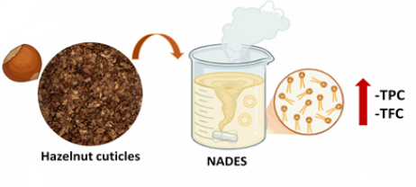
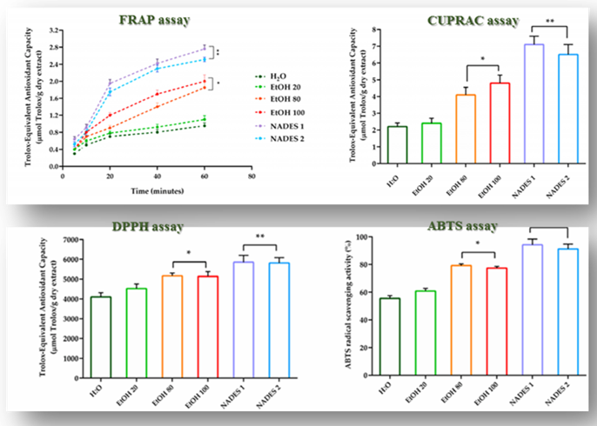
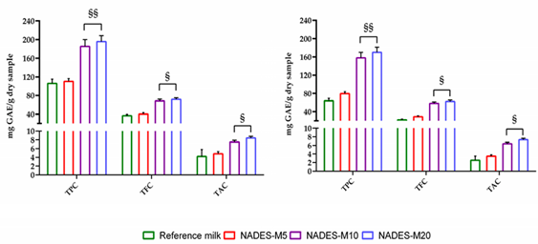


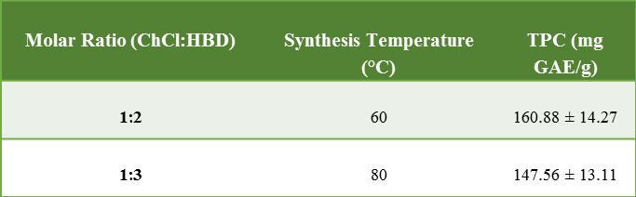
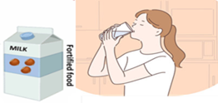
CNR IRET Conference
Rome, February 18th-19th 2025
Functional Plant-Based Beverage Fortified with Hazelnut Cuticle Polyphenols: Antioxidant and Phenolic Content Characterization
Fabrizia Sepe, Raffaele Conte, Sabrina Margarucci, Ezia Costanzo, Orsolina Petillo, Gianfranco Peluso, Loredana Marcolongo, and Anna Calarco
Research Institute on Terrestrial Ecosystems (IRET), CNR, Via Pietro Castellino 111, 80131 Naples, Italy; fabriziasepe@cnr.it
INTRODUCTION
Roasted hazelnut cuticles, a by-product of nut processing, are an underutilized yet exceptionally rich source of dietary fibers as well as of natural antioxidants owing to the presence of phenolic compounds. The aim of this study was to assess the feasibility of using the polyphenol-enriched extract as an aqueous phase in the production of vegetable milk for enhancing its nutritional value and antioxidant properties.
RESULTS
1) Synthesis and characterization
2) Antioxidant activity
3) Fortified beverage
.
4) Organoleptic Property
CONCLUSION
In conclusion, this study demonstrates the potential for sustainable valorization of hazelnut cuticles, through their incorporation as NADES extracts in plant-based milk, providing an innovative solution to reduce food waste while catering to consumer demand for nutritionally enriched and eco-friendly products.
Fabrizia Sepe

