Slide 1


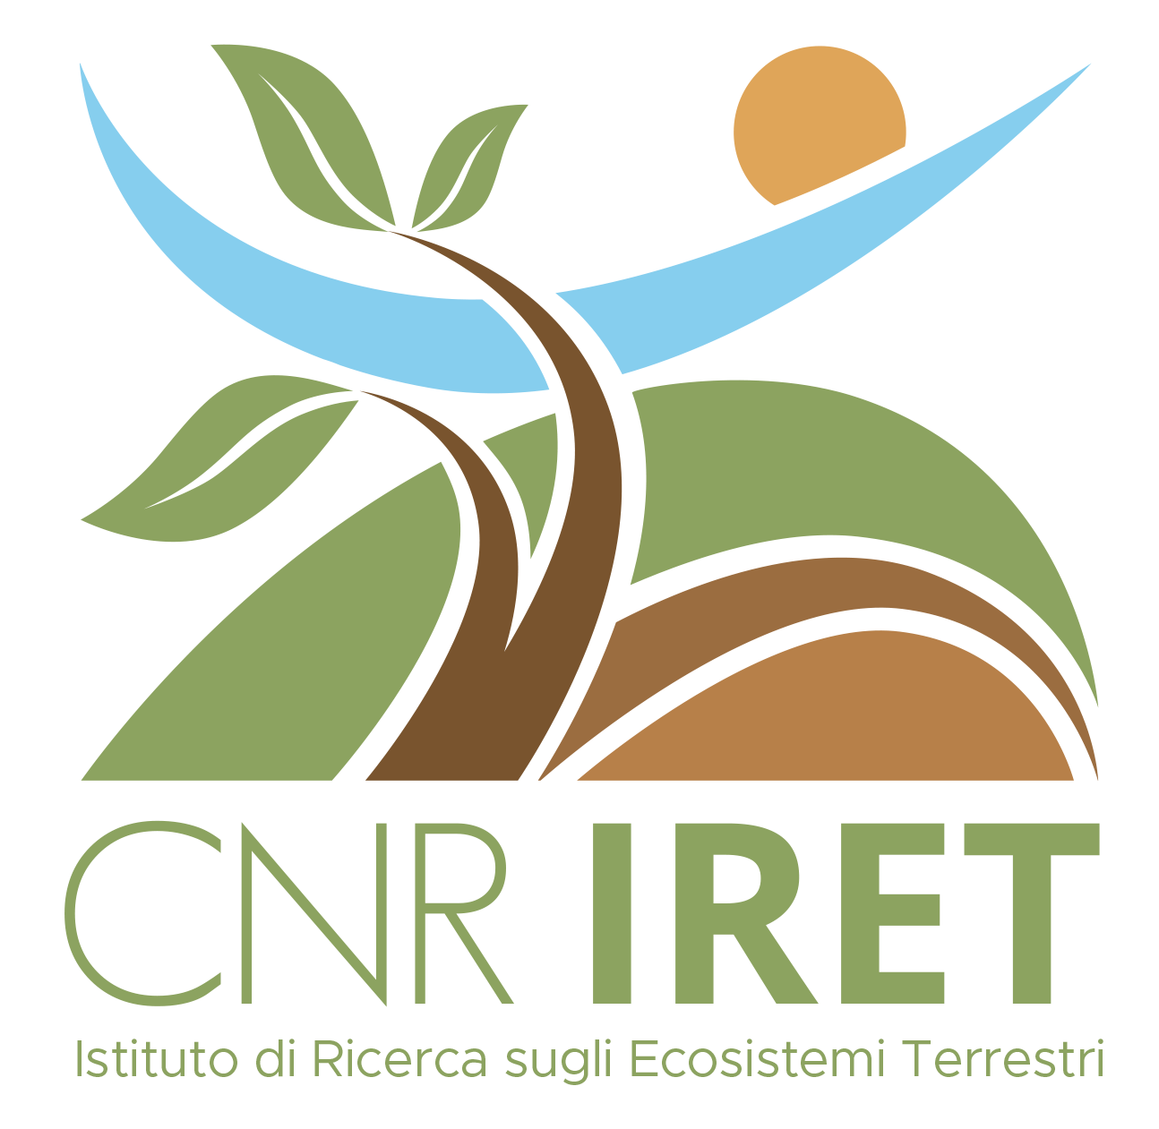
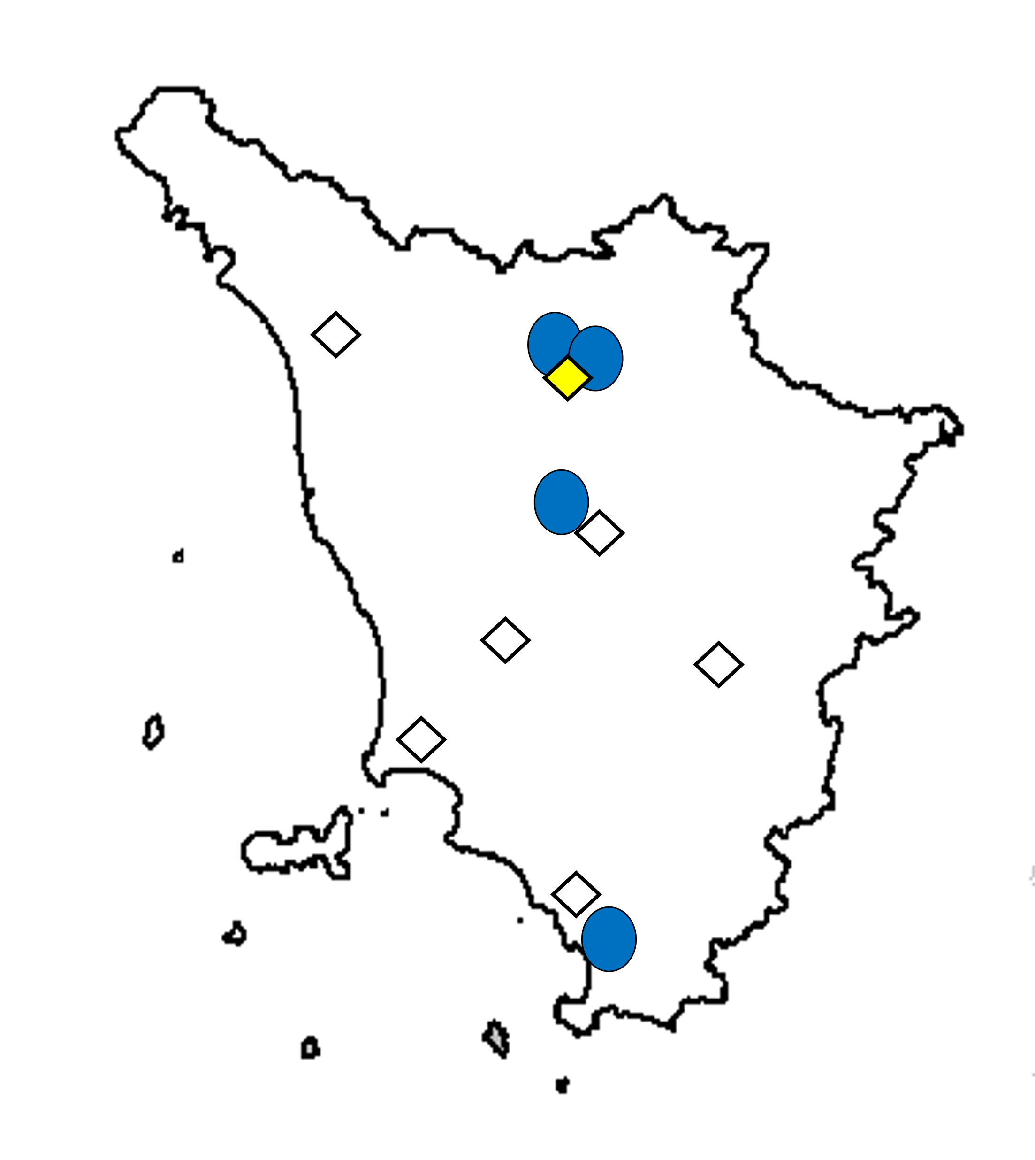
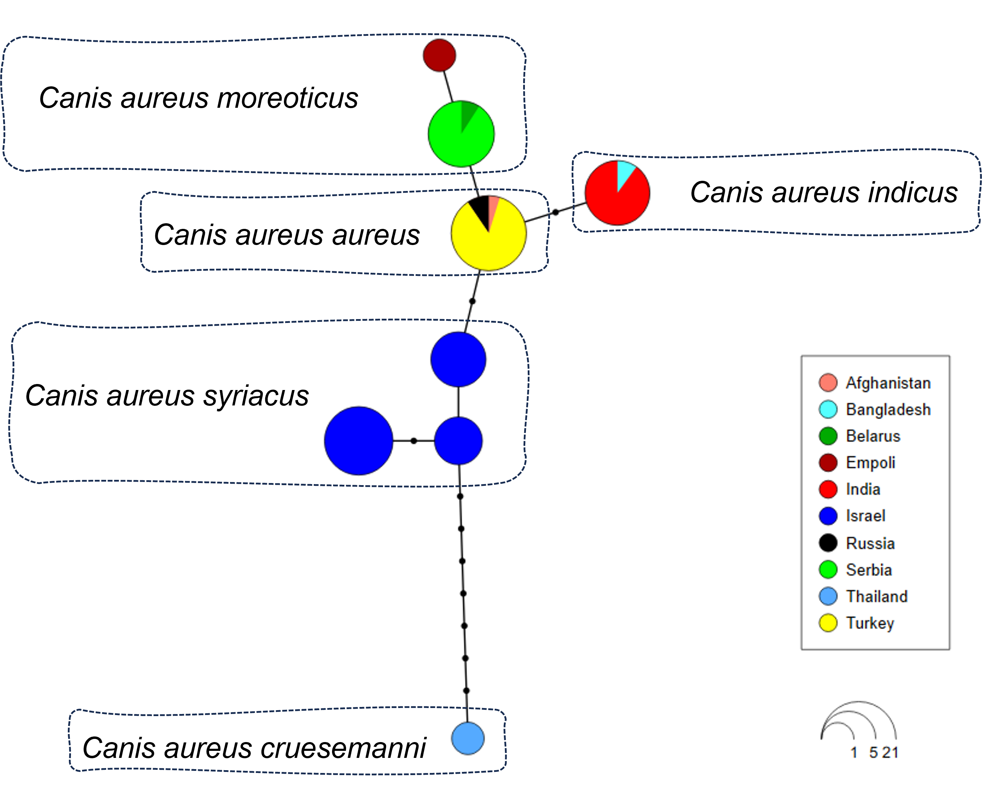
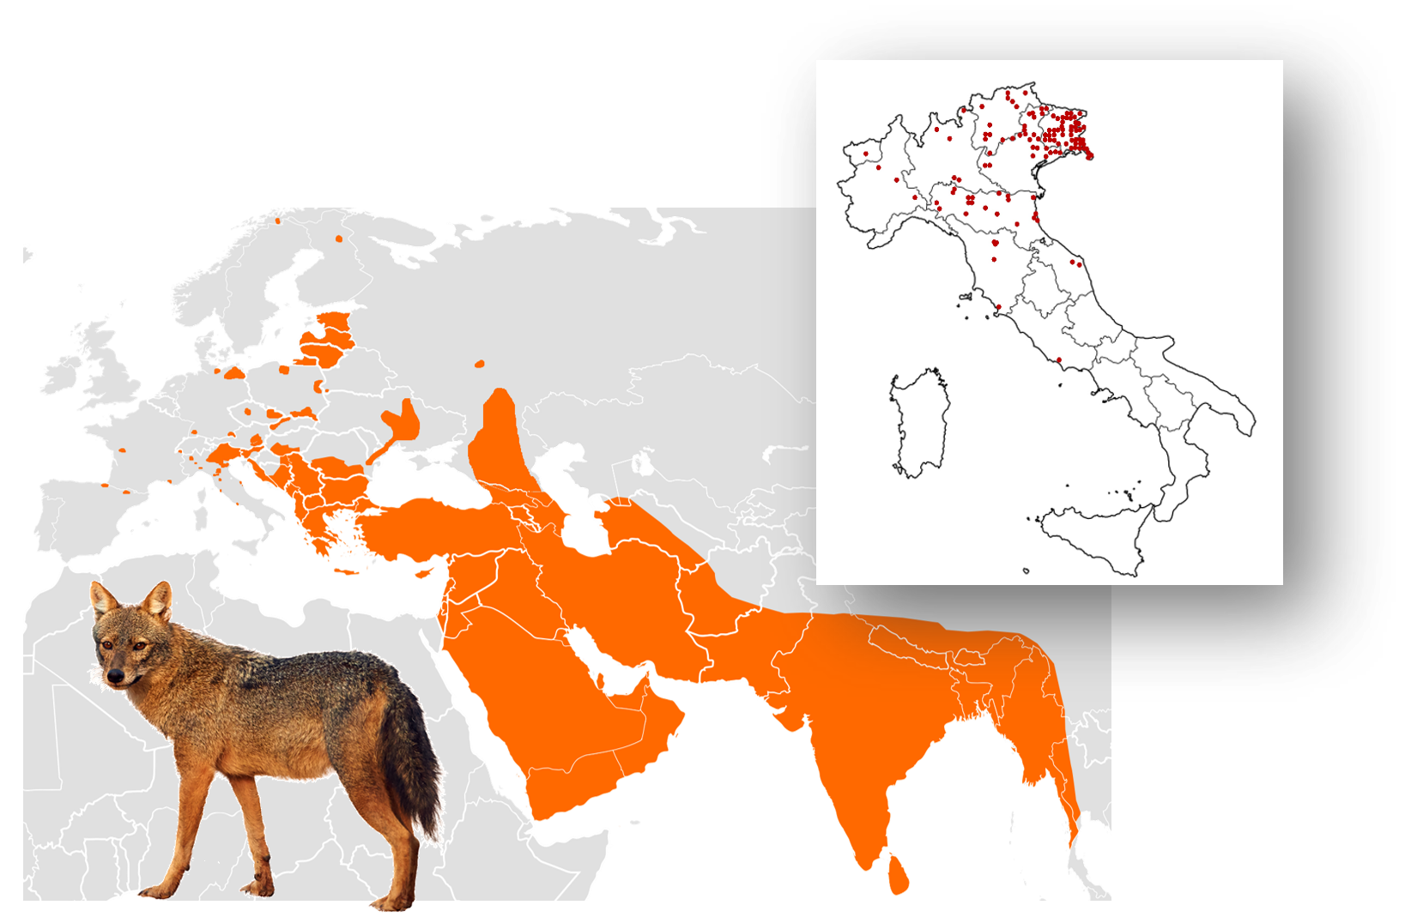
CNR IRET Conference
Rome, February 18th-19th 2025
Jackal-howling in urban and rural areas: status of a protected species in Tuscany
Emiliano Mori^{1,2}, Andrea Viviano¹, Olivia Dondina^{2,3}, Stefano Pecorella⁴ & Leonardo Ancillotto^{1,2}
1. Istituto di Ricerca sugli Ecosistemi Terrestri IRET, Consiglio Nazionale delle Ricerche, Via Madonna del Piano 10, 50019 Sesto Fiorentino (Firenze), Italy.
2. National Biodiversity Future Center, 90133 Palermo, Italy.
3. Dipartimento di Biologia, Università degli Studi di Firenze, Via Madonna del Piano 8, 50019 Sesto Fiorentino (Firenze), Italy.
4. Therion Research Group, Castel San Mauro, 34170, Gorizia, Italy
INTRODUCTION
The golden jackal Canis aureus is a wild canid species of Asian origin, which is naturally fast-expanding its range in Europe (Figure 1). First occurrences on North-Eastern Italy date back to late 1980s.
MATERIALS AND METHODS
1. Literature/online newspaper review on golden jackal in Tuscany
= occurrences from literature review
The first record in Tuscany dates back to 2021 at the north-western outskirts of Firenze metropolitan area, with a pair of individuals [1].
2. Molecular analyses on road kills by means of mitochondrial markers (480 bp fragment of cyt-b).
= jackal howling emission sites
3. Bioacoustic survey (jackal howling) through standard methods in seven sites to assess the occurrence of reproductive groups [3].
= positive answer to jackal howling
In 2022, a juvenile individual was road-killed in central Tuscany (Empoli, province of Firenze).
Then, a further individual has been camera-trapped in the Maremma Regional Park, in southern Tuscany (province of Grosseto) [2].
RESULTS
Aims
Assessing the distribution of the golden jackal in Tuscany by combining different approaches: bioacoustics, molecular analysis and literature/newspaper review
Literature review confirmed three sites of occurrence of golden jackal in Tuscany (Figure 2).
Molecular analyses on the road-kill from Empoli confirmed it as belonging to the C. a. moreoticus clade, with a new haplotype (Figure 3).
Figure 2. Distribution of the golden jackal in Tuscany combining literature data, jackal howling and molecular data.
DISCUSSION
The limited but expanding presence of golden jackals in Tuscany highlights the need for further research to understand their ecological role and potential impact on the existing ecosystem, particularly in relation to the established grey wolf population. Conservation efforts should focus on mitigating potential human-wildlife conflicts, as the golden jackal has been mostly recorded within urban and suburban areas, as well as on ensuring the long-term viability of this newly arrived species.
REFERENCES
[1] Bacci, F., & Lunghi, E. (2022). Natural History Sciences, 9(2), 59-62.
[2] Pacini, G., Lazzeri, L., & Ferretti, F. (2022). Habitat Online. https://www.habitatonline.eu/2022/05/prima-documentazione-di-sciacallo-dorato-canis-aureus-nel-parco-regionale-della-maremma/
[3] Giannatos, G., Marinos, Y., Maragou, P., & Catsadorakis, G. (2005). Belgian Journal of Zoology, 135, 145–149.
Figure 3. Haplotype network of mitochondrial cytochrome-b sequences (480 bp) of golden jackal from throughout its range. Italian samples were confirmed to belong to C. a. moreoticus clade. Circles represent different haplotypes. Circle sizes are proportional to the number of specimens examined for each haplotype, whereas dots indicate mutational steps.
EMILIANO MORI
Figure 1. Worldwide and Italian distribution of the golden jackal Canis aureus.

