Slide 1




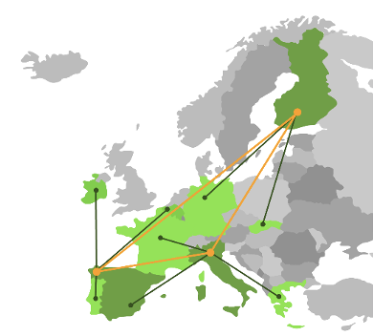
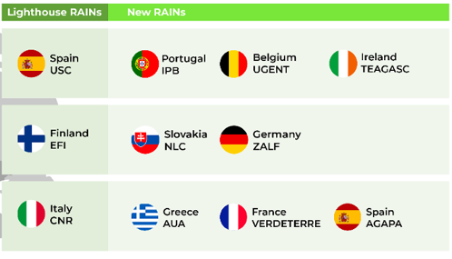
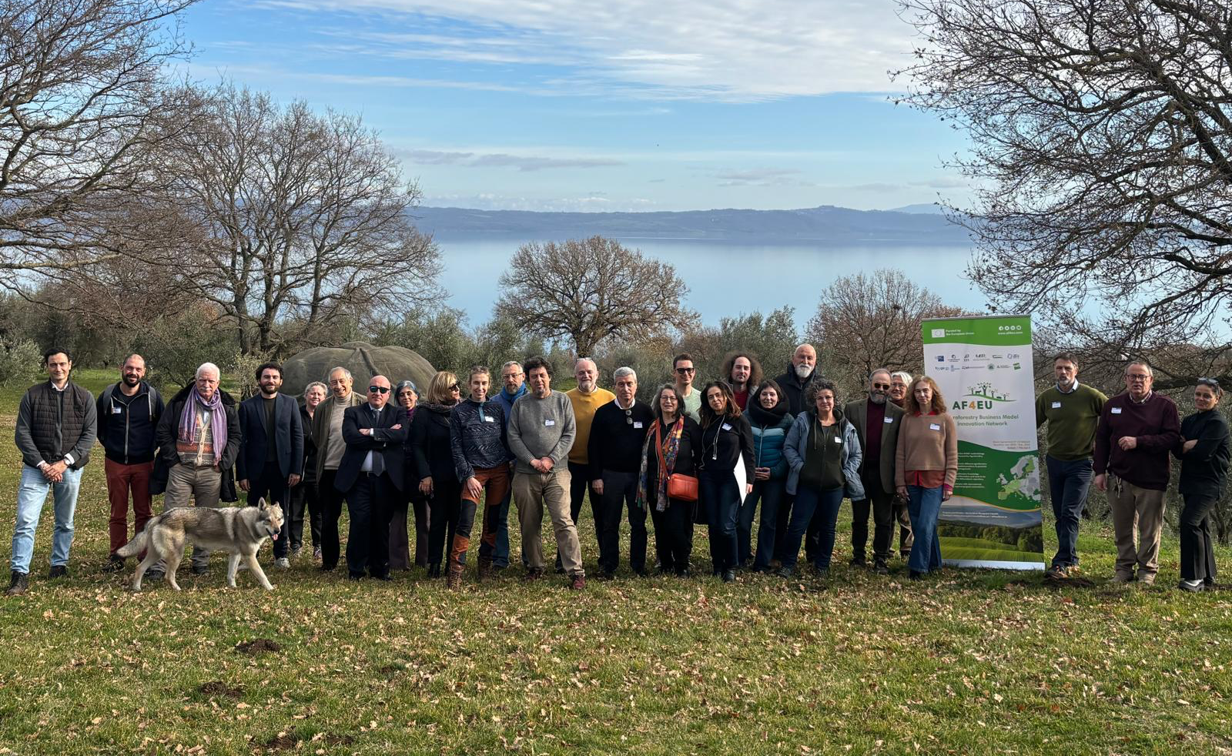
CNR IRET Conference
Rome, February 18th-19th 2025
Advancing Agroforestry Innovation in Europe: the role of IRET in the AF4EU project
Enrico Petrangeli, Cinzia Pellegrini, Francesca Chiocchini, Marco Ciolfi, Marco Lauteri, Pierluigi Paris
Agroforestry Business Model Innovation Network (AF4EU) is an EU-funded project that promotes agroforestry in Europe through the development of a multi-actor approach linked to interactive and innovation-driven expanded agroforestry networks: the Regional Agroforestry Innovation Networks (RAINs).
Three “Lighthouse RAINs”, reflects the agroforestry in countries of the Continental – Boreal, Mediterranean and Atlantic regions. IRET is acting to establish a methodological framework for construction of the new RAINs
The AF4EU consortium: 12 partners and five national associations from 10 different European countries.
Within this framework. IRET elaborates the guidelines to identify (1) the RAIN management procedures; (2) the RAINs governance structure, (3) the role and activities of the Innovation Broker, (4) the involvement of actors/stakeholders in each RAIN, (5) the composition, objective and timing for each RAIN workshop and (6) the thematic issues to be addressed by validating and extending the most promising land management innovations collected in AFINET towards the development of business models
The Italian RAIN bases on the stakeholder community
(farmers, extenders, multipliers, researchers and policy makers)
acting within the Bolsena Lake Biodistrict
Poster Presenter Enrico Petrangeli

