Slide 1







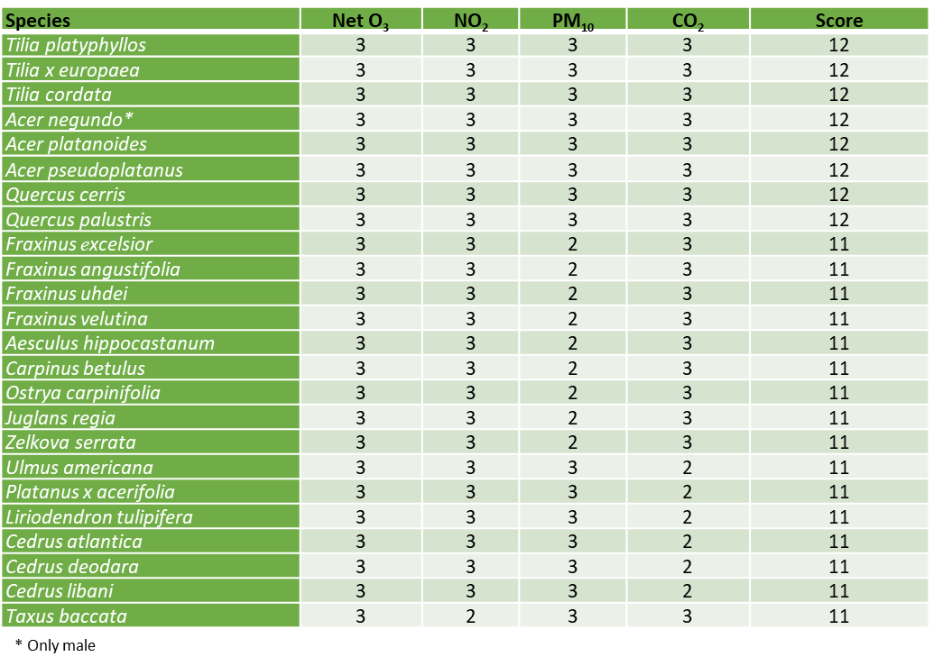
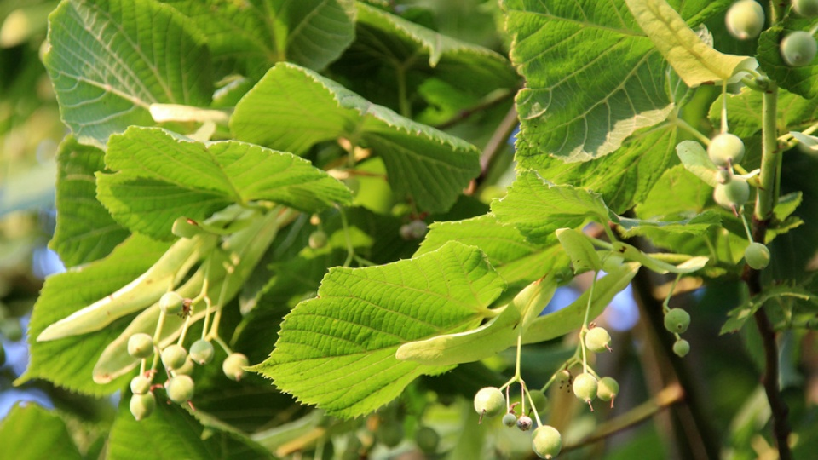
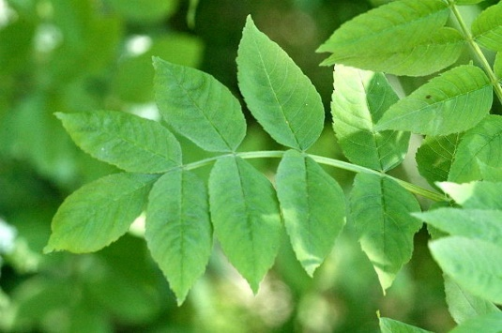

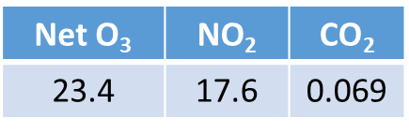
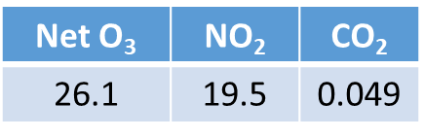
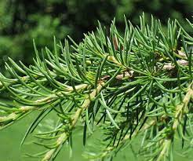

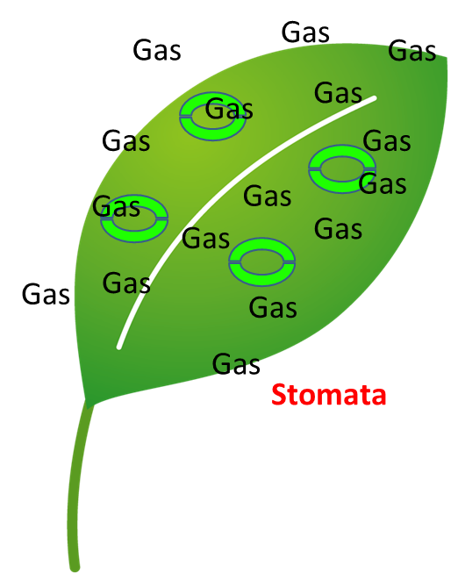
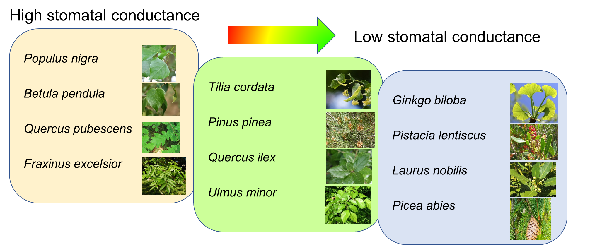
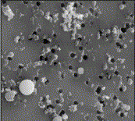
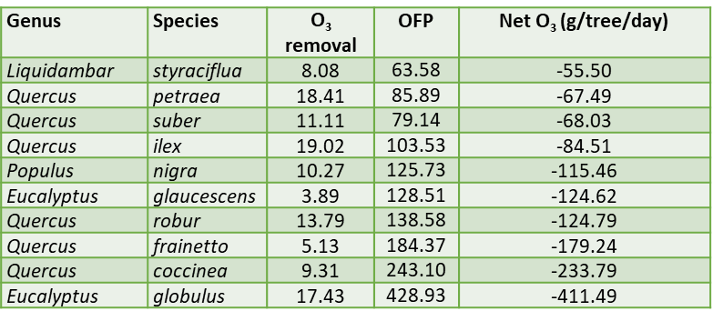
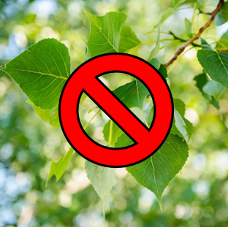
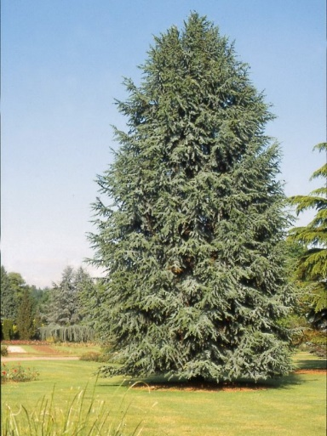
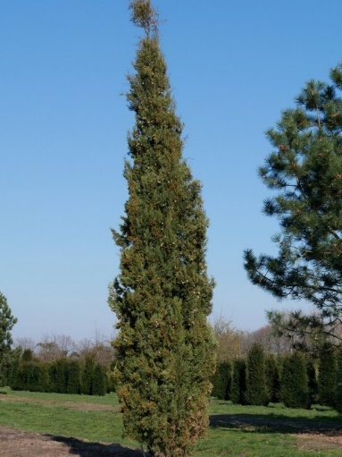
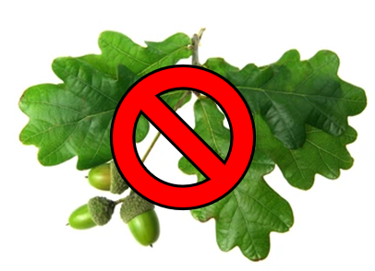
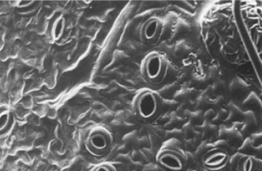
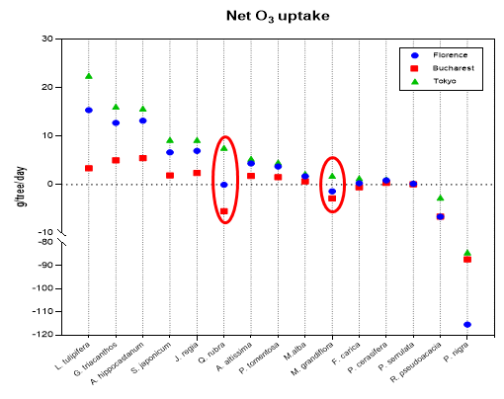
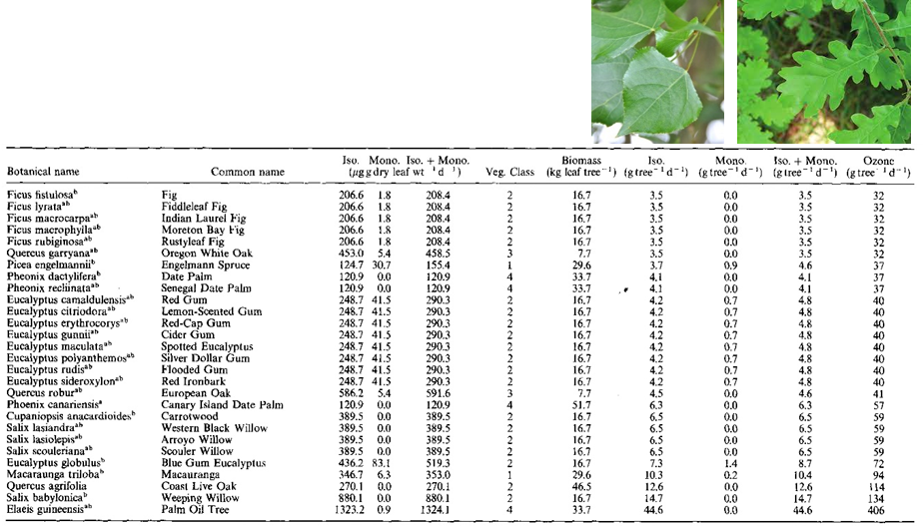
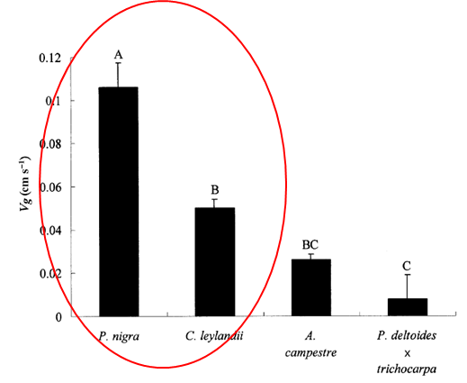
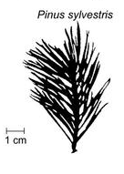
FlorTree model: optimal tree species selection considering air pollution removal capacity in urban ecosystems
CNR IRET Conference
Rome, February 18th-19th 2025
Hoshika Y.^{1,2}, Manzini J.^{1,3}, Moura B.B.^{1,2}, Paoletti E.^{1,2}
¹IRET-CNR Firenze, Italy; ²NBFC, Palermo, Italy; ³ DAGRI, ³University of Florence, Italy
FlorTree model
New empirical model for tree species selection
for urban greening considering air quality
- Best species for air quality for Florence
Tilia platyphyllos
Fraxinus excelsior
Tree selection is a crucial step for proper urban planning:
For 220 species (trees and shrubs) commonly used in Tuscany region
Development of a species-specific model
for the removal of the main air pollutants
Parameters were obtained by the survey with more than 300 literatures
g/tree/day
g/tree/day
Cedrus libani
Species with high g_{s} and low VOC emission are recommended for gas pollution removal. Large conifers have shown a good performance for PM removal.
- Gas pollutant removal
- Particulate matter (PM10)
Stomatal conductance (index for stomatal aperture) is an essential parameter to calculate gas pollution uptake to tree leaves.
Conifers are more efficient to catch PM
compared to broadleaf trees thanks to the greater leaf surface and crown
structural complexity.
On the other hand…
g/tree/day
BVOC emitted plants (Quercus, Populus sp.) are not suitable due to the potential formation of O₃.
- Is species-specific removal performance affected by different climate and air pollution conditions?
- BVOC emissions for O₃ formation
Cedrus libani
Cupressus
sempervirens
· Different climate and pollution conditions led to a partial change in the air pollutants removal by trees.
· Quercus rubra and Magnolia grandiflora showed negative net O₃ uptake in the European cities but the O₃ balance was positive in Tokyo.
BVOC emission (isoprene & Monoterpene) may contribute to the formation of O₃.
Species-specific parameter POF (potential ozone formation) was used to assess the negative impacts on air quality.
According to the literature data, we developed an emipirical equation using STAR (Shoot silhouette to total leaf area ratio) and PT (Phyllotaxis) to estimate the species-specific PM removal capacity.
Beckett et al. (2000, GCB)
Benjamin & Winer (1998, Atmos Environ)
Yasutomo Hoshika (IRET-CNR Firenze)

