Slide 1

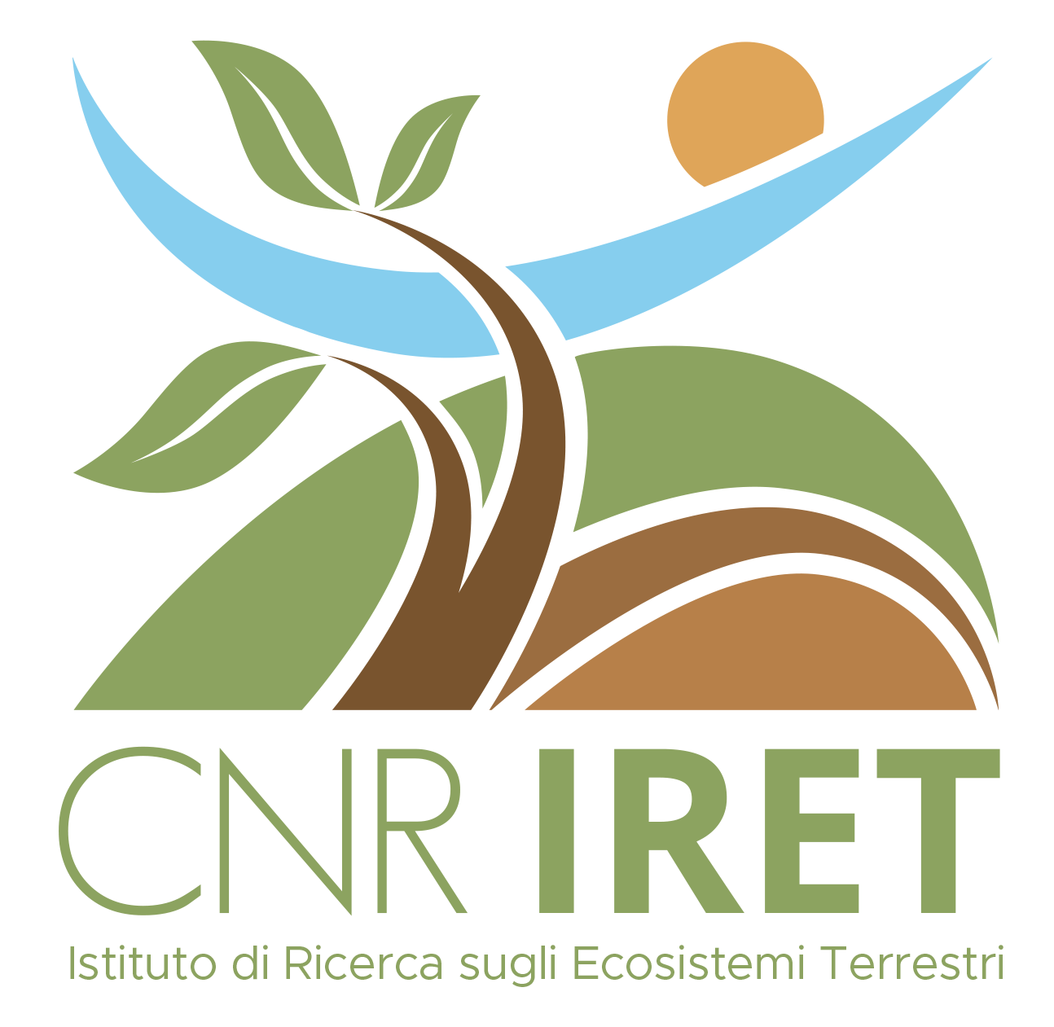
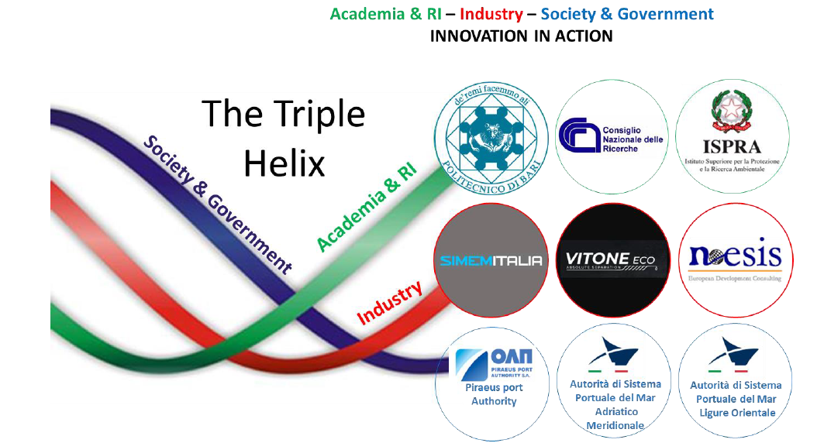
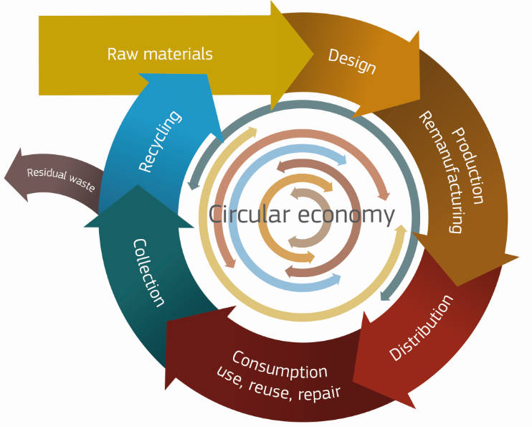
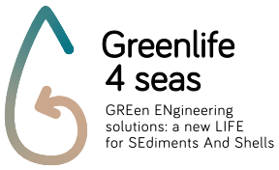
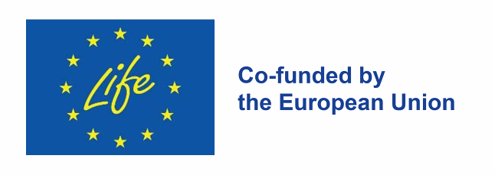
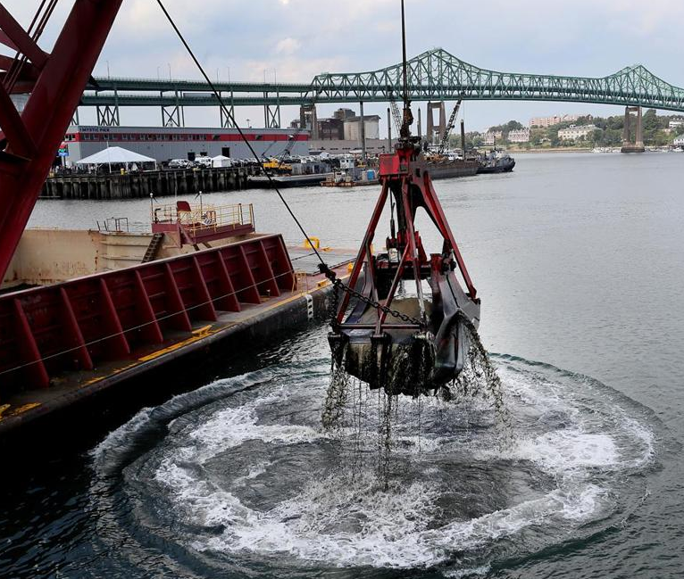
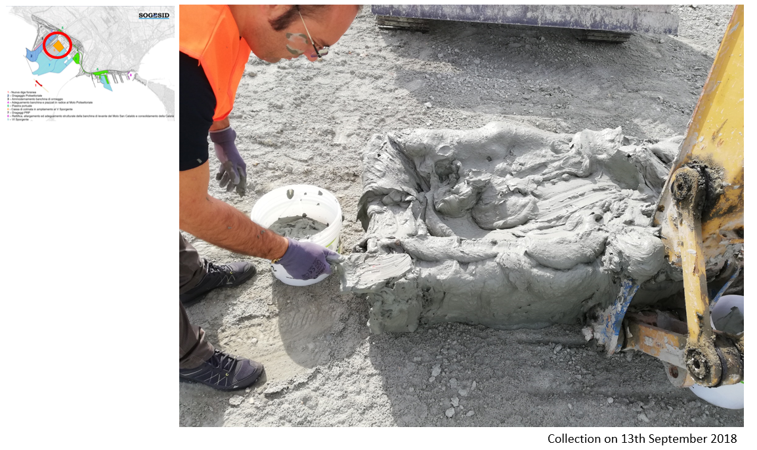
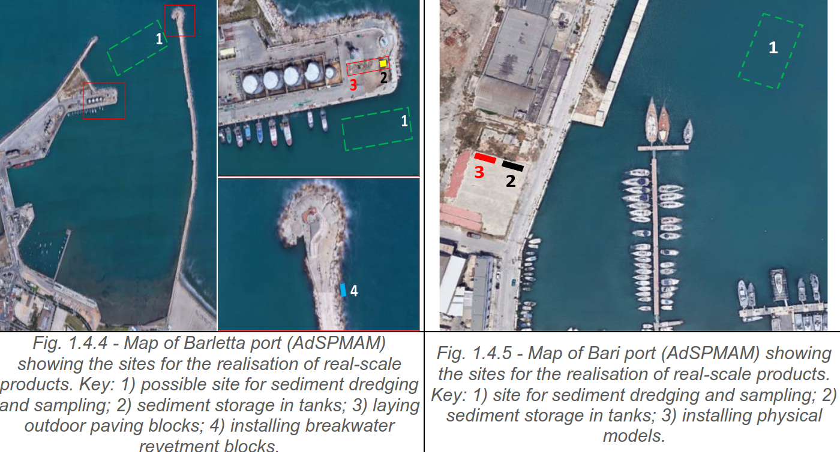

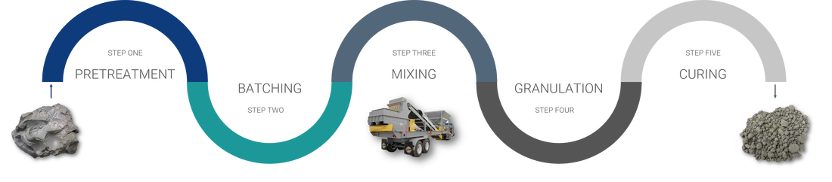
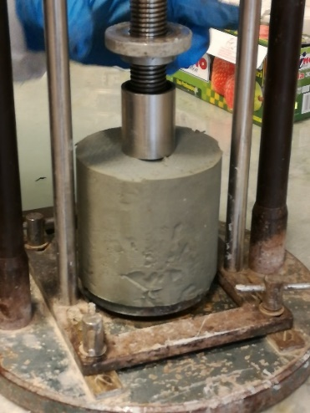
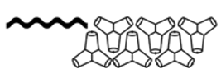
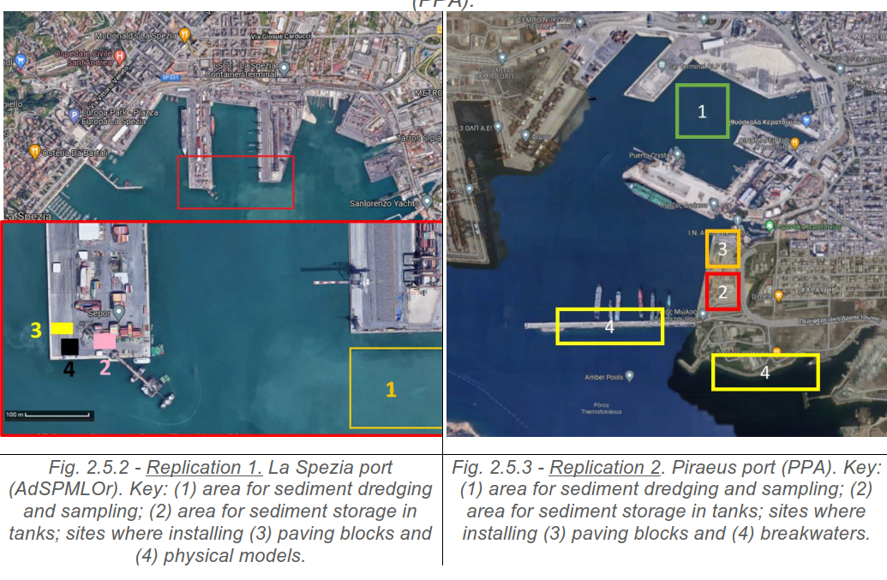
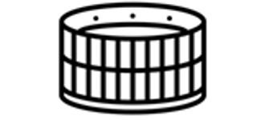
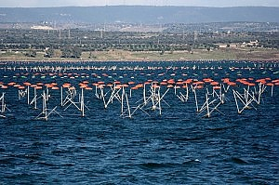
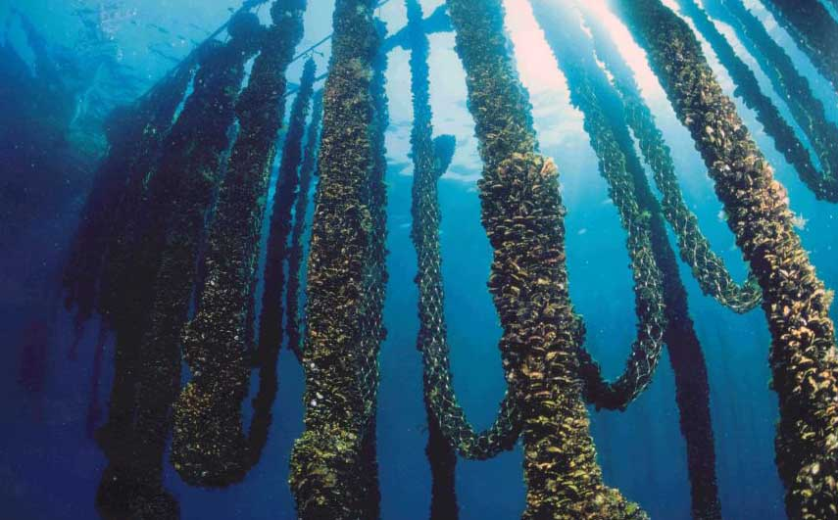
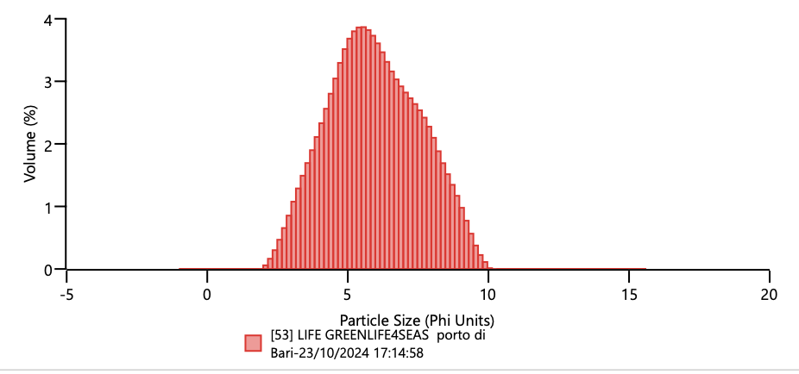
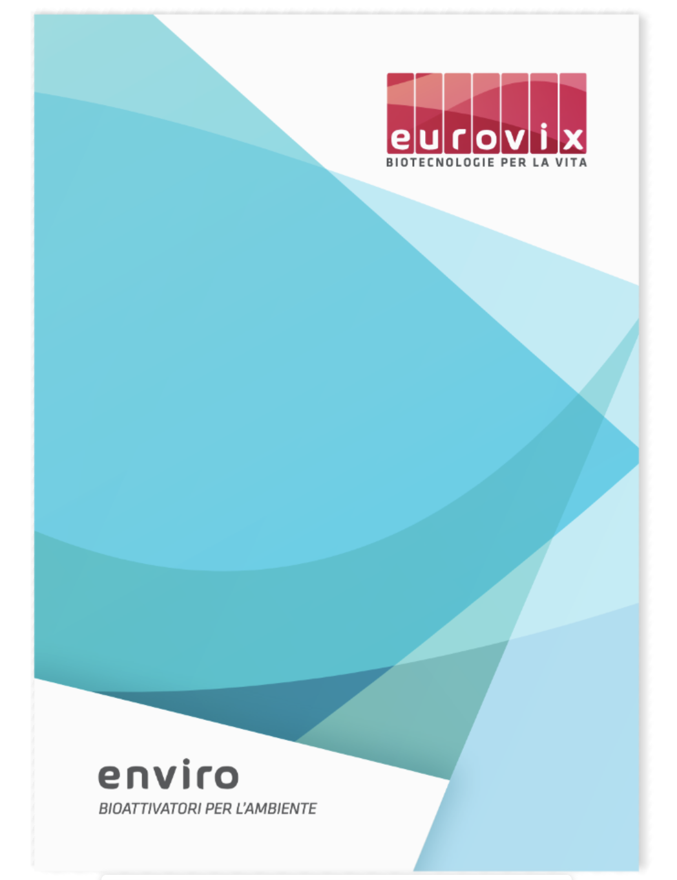
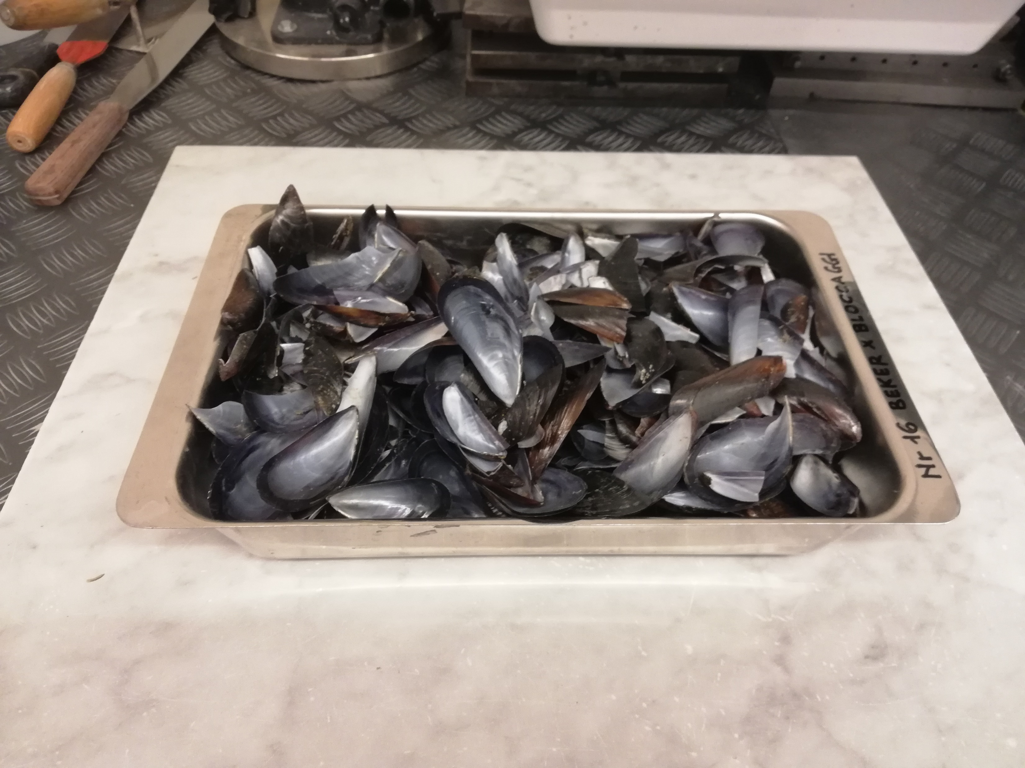
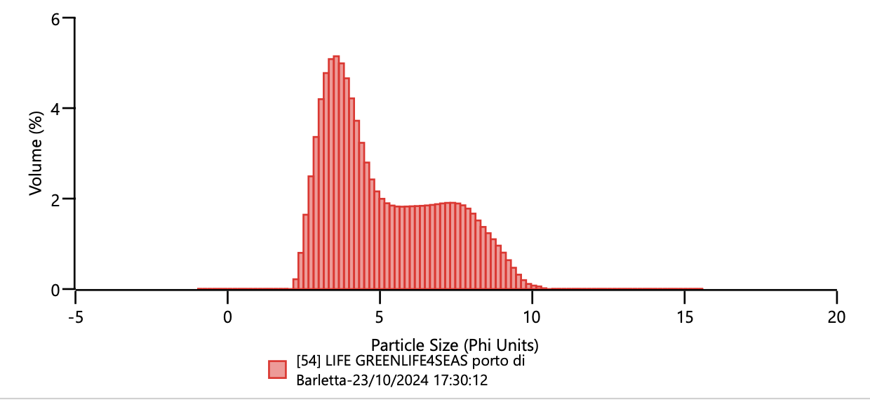
CNR IRET Conference
Rome, February 18th-19th 2025
«GReen ENgineering solutions: a new LIFE for SEdiments And Shells»
S. Doni, E. Peruzzi, C. Macci, I. Rosellini, M. Di Leo, C. Vitone, M. Mali, R. Petti, G. Masciandaro
Background
GREENLIFE4SEAS project
DREDGED SEDIMENTS
CER (EWC) 170505
WASTES FROM DREDGING
ACTIVITY – SLUDGES
Start: 01/10/23 - End: 01/10/28
OBJECTIVE
In-situ recovery and reuse of
dredged sediments and shells, as secondary raw materials for the realisation of sustainable and innovative by-products for building sector, through an optimised mixing technology
Total amount: € 3.930.225
PROJECT LOCATION
paving
blocks
In Europe the volume of potentially contaminated dredged sediments is estimated at 200 million cubic meters per year
Barletta Port Bari Port
breakwater
blocks
SHELLS
CER (EWC) 020103
WASTES FROM AGRICULTURE, HORTICULTURE, AQUACULTURE, FORESTRY, HUNTING AND FISHING
Dredging sediment
Shell powder
Stabilized
sediment
mass stabilization
La Spezia Port Piraeus Port
Sediment characterization
Remediation of contaminated sediments
 | Bari | Barletta
pH | 8,61 | 8,89
Electrical Conductivity (dS m⁻¹) | 55,0 | 34,9
Total Nitrogen (%) | 0,14 | 0,20
Total Organic Carbon (%) | 1,12 | 3,27
C/N ratio | 8 | 16
Total Phosphorus (mg kg⁻¹) | 662 | 657
Cation Exchange Capacity (meq 100g⁻¹) | 22,5 | 13,7
Petroleum hydrocarbons (C>12) (mg kg⁻¹) | 1242 | 362
Bari
Landfarming process
with bioactivators
Soil Texture: silty loam
selected microorganisms
organic nutrients
mineral salts
catalytic oligoelements
enzymatic components
natural growth factors
Pilot-plant
Lab-scale
The global production of marine bivalves is approximatively 15 million tons per year. Many of the shells are disposed of illegally
Barletta
Monitoring of sediment decontamination
Serena Doni

